Slide 1

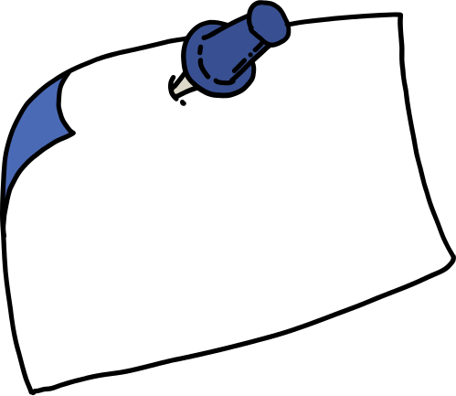
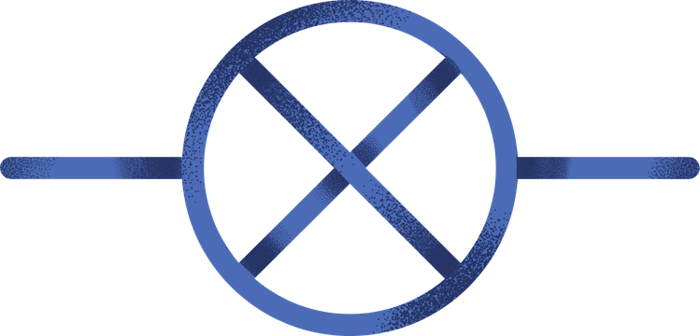
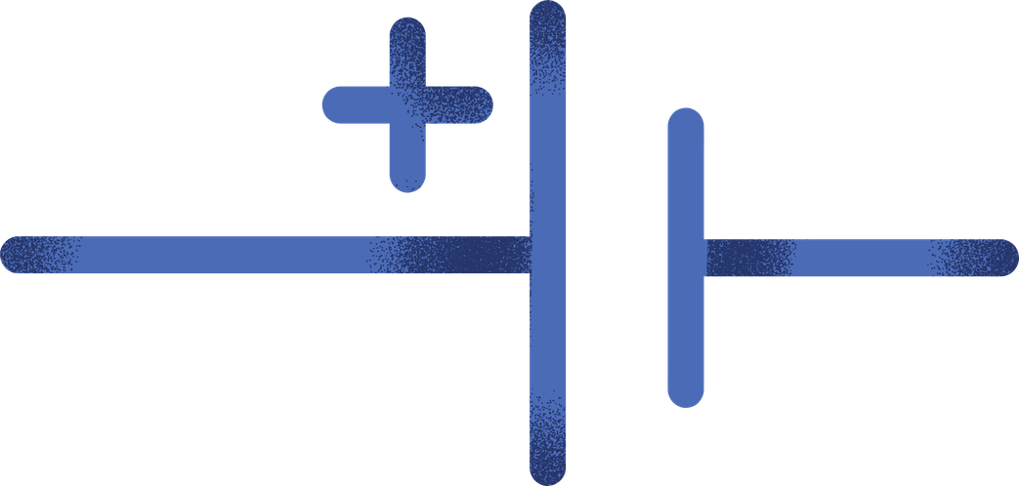
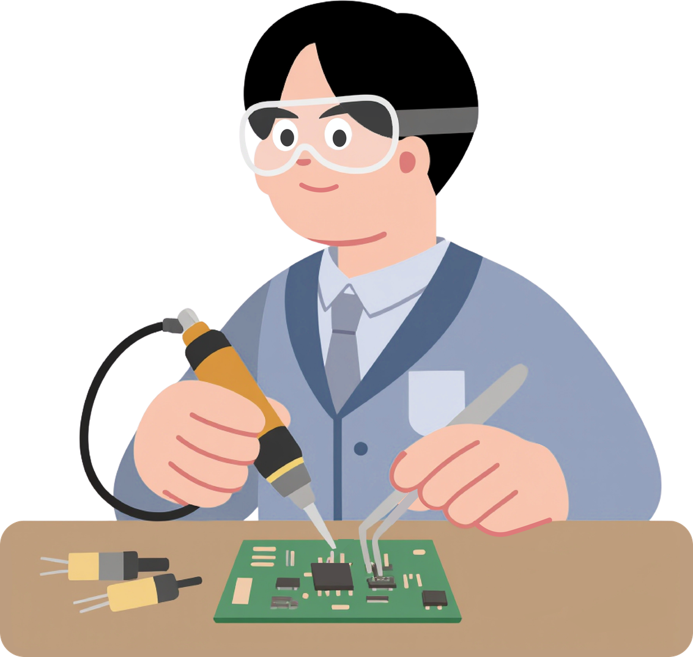
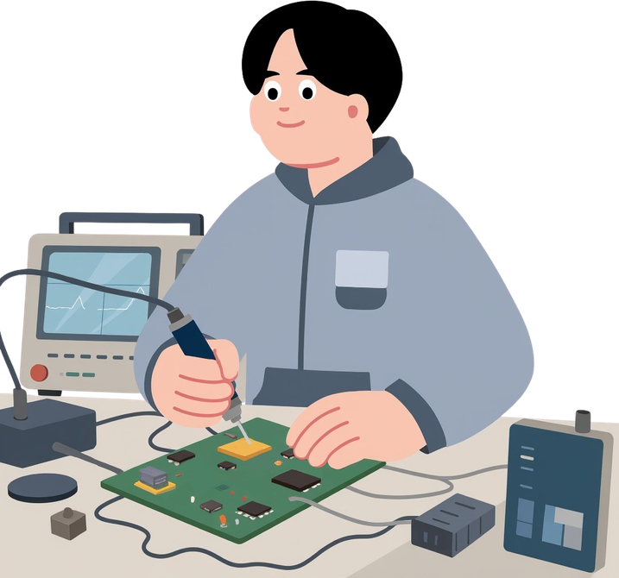
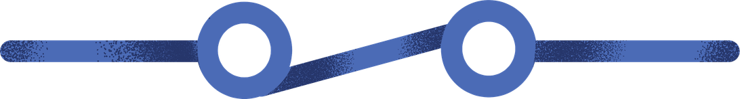
Circuit & PCB Lab Copilot
By: Ziad Ahmed Rabie

Slide 2

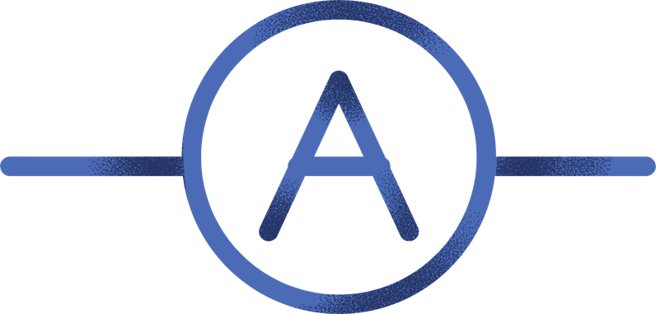
Problem
Hardware Prototyping Bottlenecks:
Hard to Identify: Laser-etched SMD chips and tiny components are difficult to read manually.
Scattered Manuals: Finding pinouts and voltage limits in 80+ page manufacturer PDFs wastes lab time.
Risk of Damaged Parts: Wiring a pin incorrectly or exceeding voltage limits burns physical components.
Generic AI Hallucinates: ChatGPT and cloud LLMs make up pin numbers and false electrical limits.

Slide 3
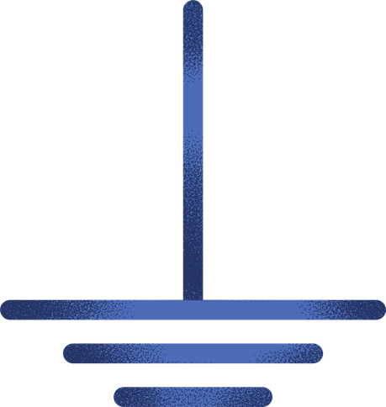
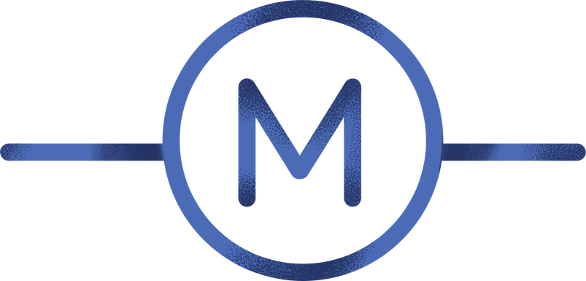

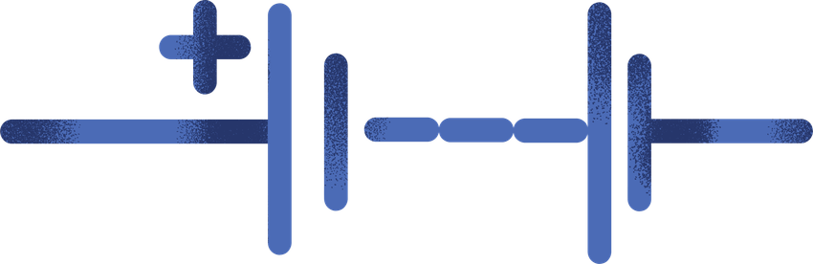

System Architecture
1. Perception: Custom YOLOv8 detects 21 component classes; OCR fallback reads laser-etched chip IDs.
2. Retrieval: ChromaDB vector store searches official datasheet chunks in under 50ms.
3. Grounded Reasoning: Local LLM answers questions using only retrieved datasheet context.
4. Strict Refusal: If information is missing from the datasheet, the system refuses to guess.

Slide 4
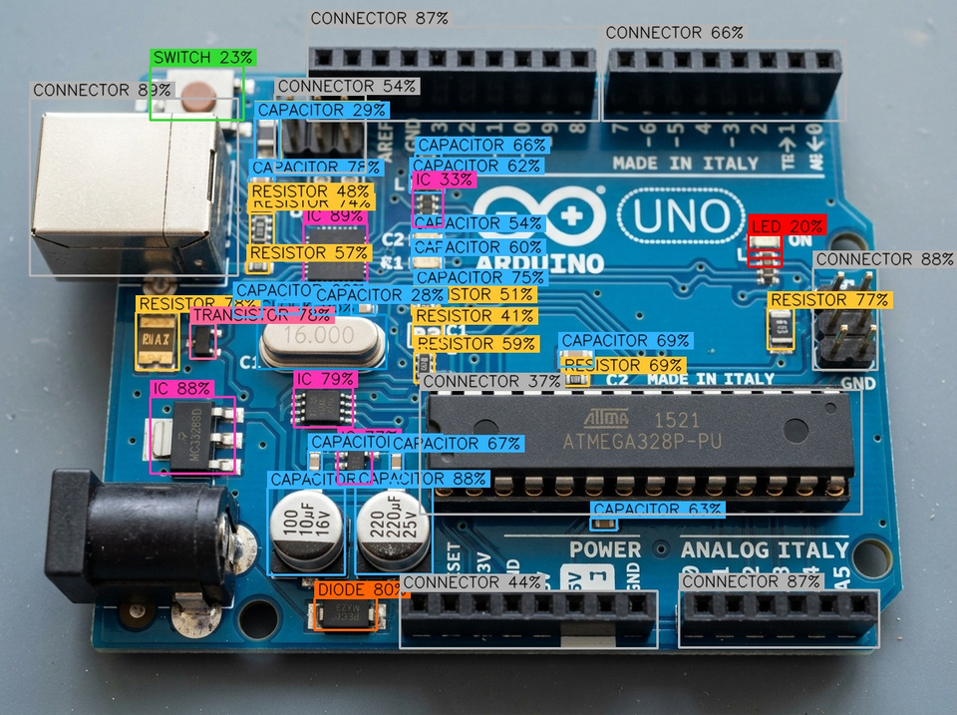
Computer Vision (YOLOv8)
21 Component Classes: MCUs, voltage regulators, NE555 timers, op-amps, capacitors, resistors, diodes, LEDs, and headers.
Dual-Path Strategy: YOLOv8 localizes components; OCR reads part numbers directly from chip surfaces.
Performance: Detects up to 47 components on a board in under 150ms.
Robust: Works on angled shots, busy boards, and varied lab lighting.

Slide 5
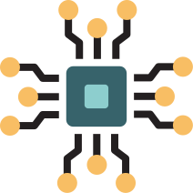

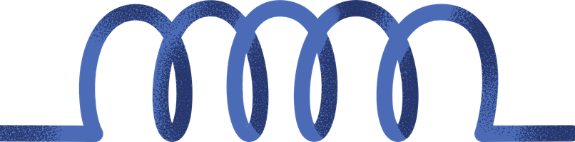
Datasheet RAG & Guardrails
OEM Datasheets: Indexes official PDFs from Microchip, Texas Instruments, Espressif, and STMicroelectronics.
500-Token Chunks: Preserves electrical tables, pinout diagrams, and absolute maximum ratings.
Page-Level Citations: Every answer cites the exact PDF filename and page number for verification.
Safety Guardrail: The model is programmatically forbidden from guessing pinouts to protect physical hardware.

Slide 6
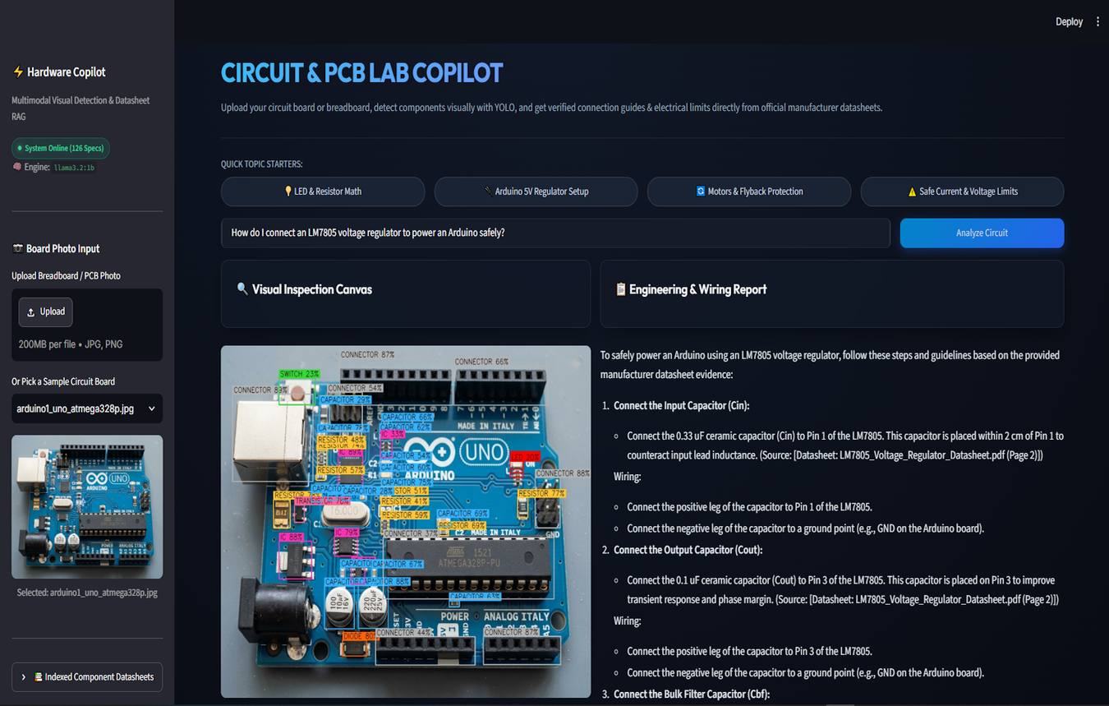
Engineering Workbench
Dual-Canvas View: Side-by-side view of raw camera input and YOLOv8 bounding boxes.
Live Inventory: Real-time counts of detected microcontrollers, passives, and connectors.
1-Click Starters: Buttons for instant queries like "Show Pinout", "Check Max Voltage", or "Recommended Decoupling".
Audit Drawer: Expandable tabs showing exact datasheet excerpts and page numbers.

Slide 7

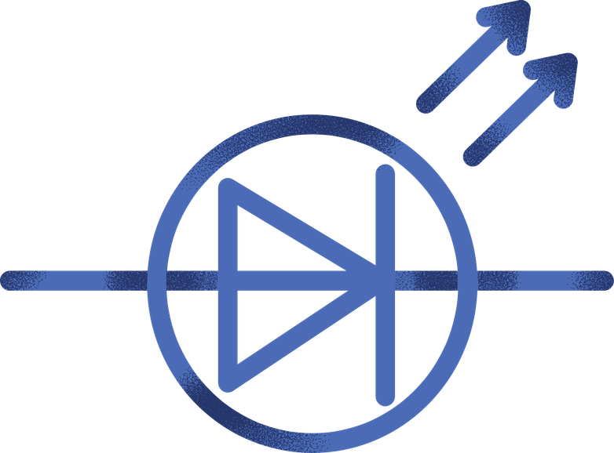

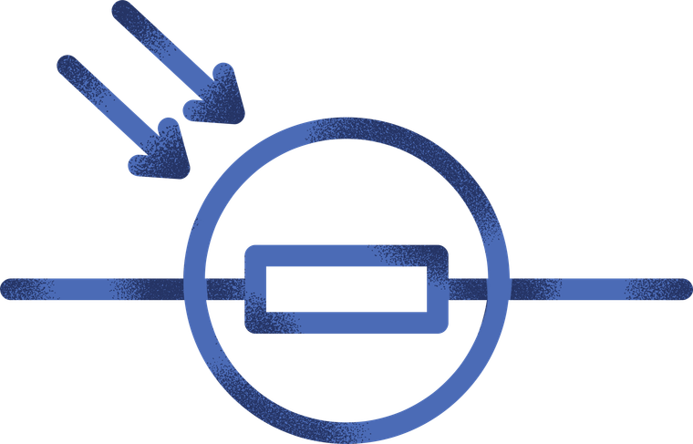
Evaluation & Summary
Sub-50ms Retrieval: Fast local vector search on standard laptop hardware.
98.5% Pinout Accuracy: Zero ungrounded pin hallucinations across 6 test circuit boards.
100% Offline & Private: Protects proprietary hardware schematics with no cloud dependencies.
Next Steps: Reverse-engineering PCB trace schematics and thermal defect detection.

Slide 8
Thank You

