Slide 1
Industrial Predictive
Maintenance System
Machine Learning Project Presentation
RUL • Failure • Failure Type • Repair Cost
Predict → Understand → Maintain

Slide 2
Project Goal
01
Move maintenance from reactive to predictive.
Detect risk early
Estimate remaining life
Support maintenance
Use machine sensor readings to identify machines approaching failure.
Predict Remaining Useful Life (RUL) in operating hours.
Identify likely failure type and estimate the expected repair cost.
Industrial Predictive Maintenance • Machine Learning Project

Slide 3
Choose the Problem
02
What problem are we solving?
Who has this problem?
Unexpected industrial machine failures can cause downtime, production losses, and maintenance costs.
Manufacturing plants, maintenance teams, production engineers, and equipment operators.
Why is it important?
Proposed ML solution
Early warning gives teams time to schedule maintenance before a critical breakdown.
Build multiple predictive models from sensor and machine-condition features.
Industrial Predictive Maintenance • Machine Learning Project

Slide 4
Define the ML Task
03
RUL Prediction
Failure Within 24h
Regression
Predict remaining operating hours.
Binary Classification
Predict whether failure risk exists in the next 24 hours.
Failure Type
Repair Cost
Multiclass Classification
Predict Bearing, Electrical, Hydraulic, Motor Overheat, or None.
Regression
Estimate expected repair / maintenance cost.
Industrial Predictive Maintenance • Machine Learning Project

Slide 5
Dataset
04
• Industrial machine condition and sensor dataset.
• Input features include machine ID, machine type, vibration, temperature, current, pressure, RPM, operating mode, maintenance history, and ambient temperature.
• Four target variables were modeled independently: RUL, failure within 24h, failure type, and estimated repair cost.
• The dataset supports both classification and regression tasks in one predictive-maintenance workflow.
machine_id
machine_type
vibration_rms
temperature_motor
current_phase_avg
pressure_level
rpm
operating_mode
hours_since_maintenance
ambient_temp
Industrial Predictive Maintenance • Machine Learning Project

Slide 6
EDA
05
Target distribution
Sensor behavior
Key observation
Repair cost is highly zero-inflated:
85.19% → zero cost
14.81% → non-zero cost
This explains why repair-cost regression is harder than the other targets.
The main signals describe machine operating condition:
• Vibration
• Motor temperature
• Current
• Pressure
• RPM
• Maintenance history
• Ambient temperature
Machine health is driven by combinations of operating conditions rather than a single sensor.
Tree-based models are therefore a strong fit for the problem.
Industrial Predictive Maintenance • Machine Learning Project

Slide 7
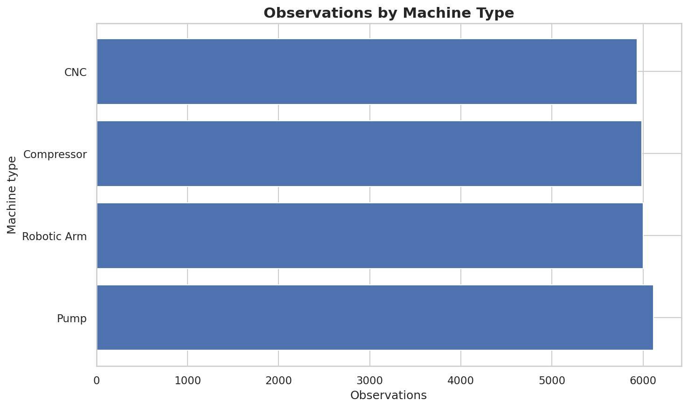

Slide 8
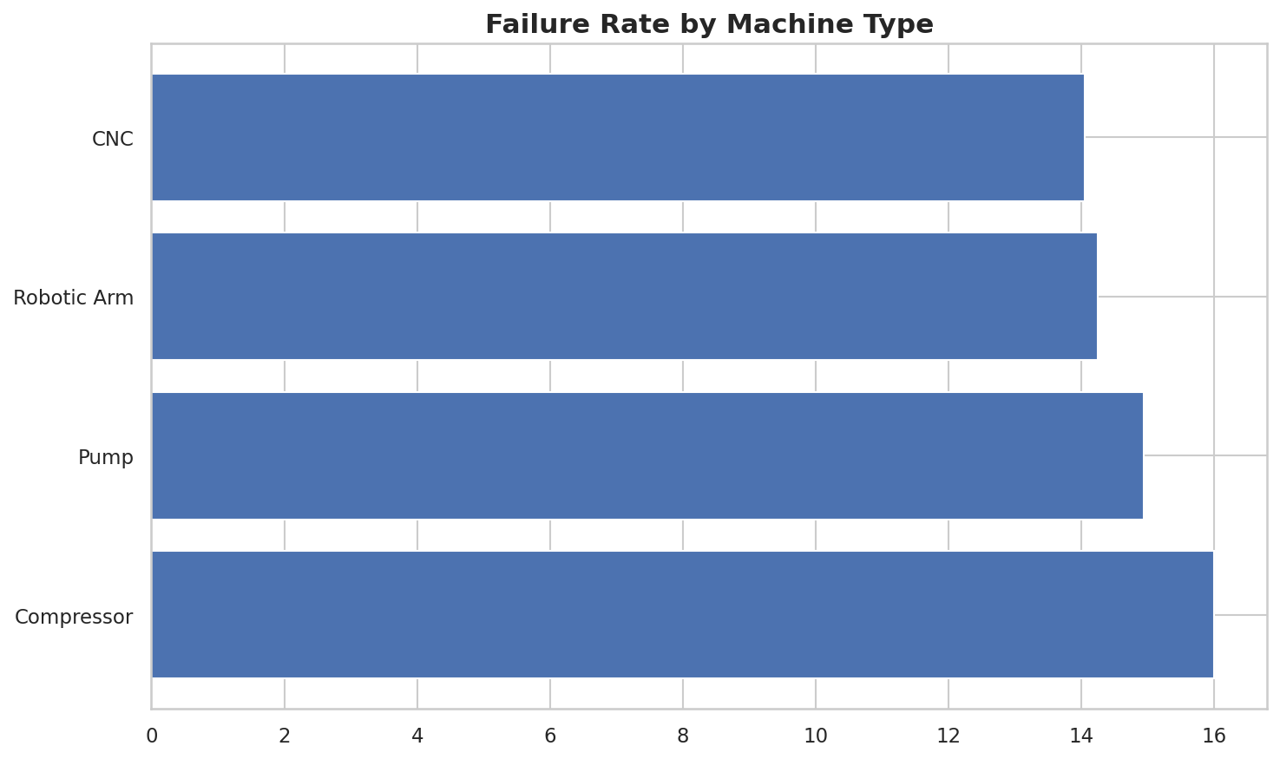

Slide 9
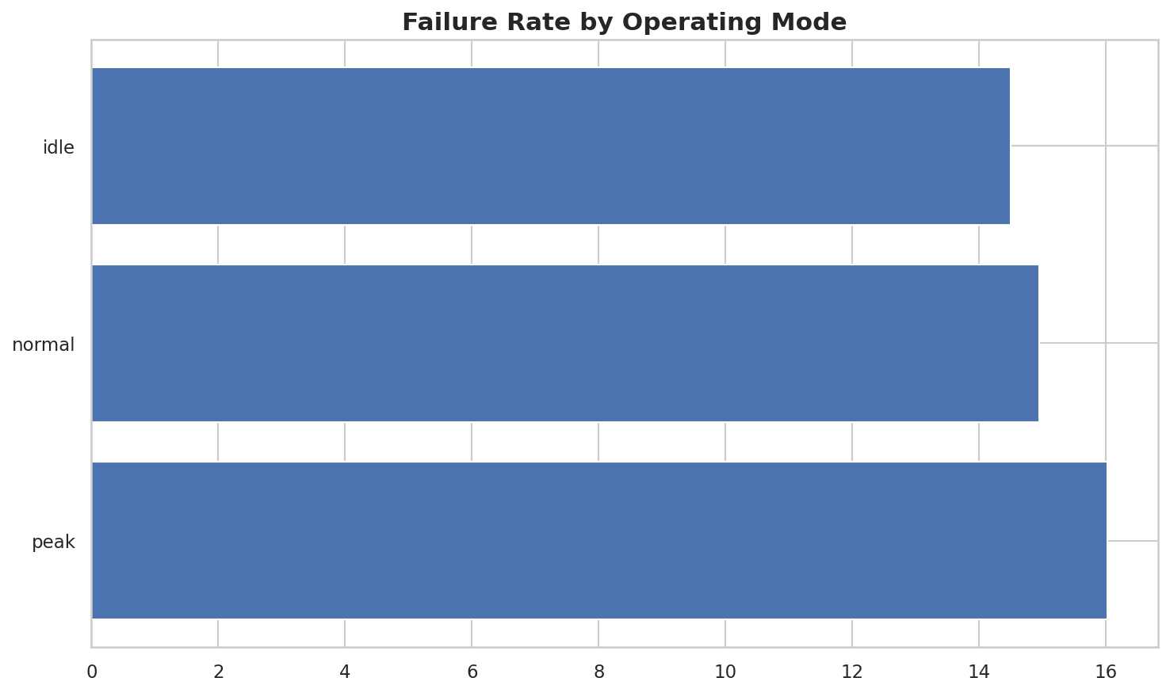

Slide 10
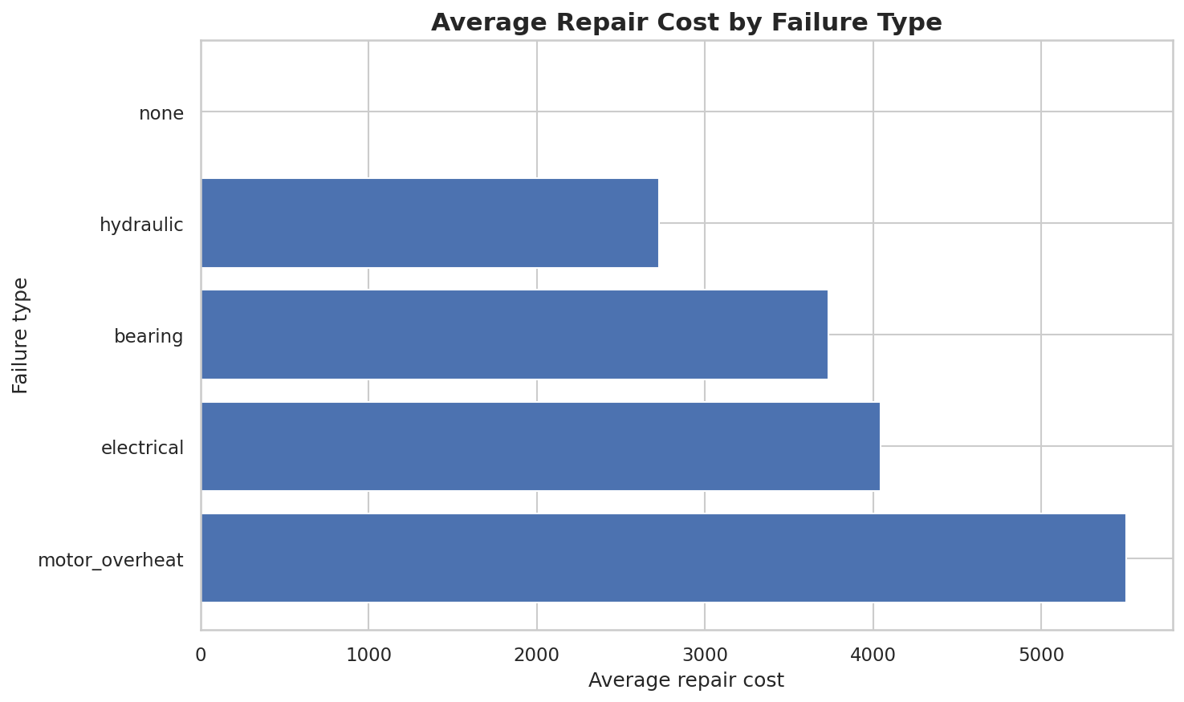

Slide 11
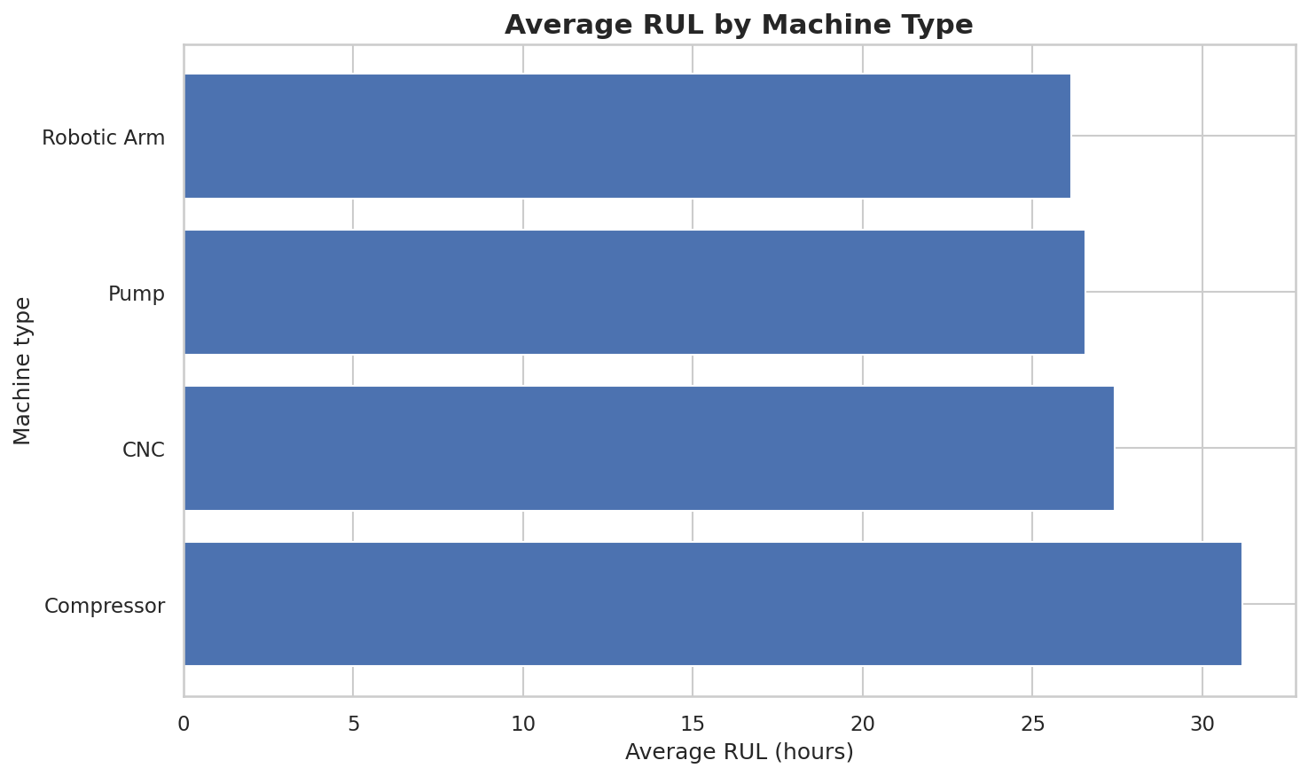

Slide 12
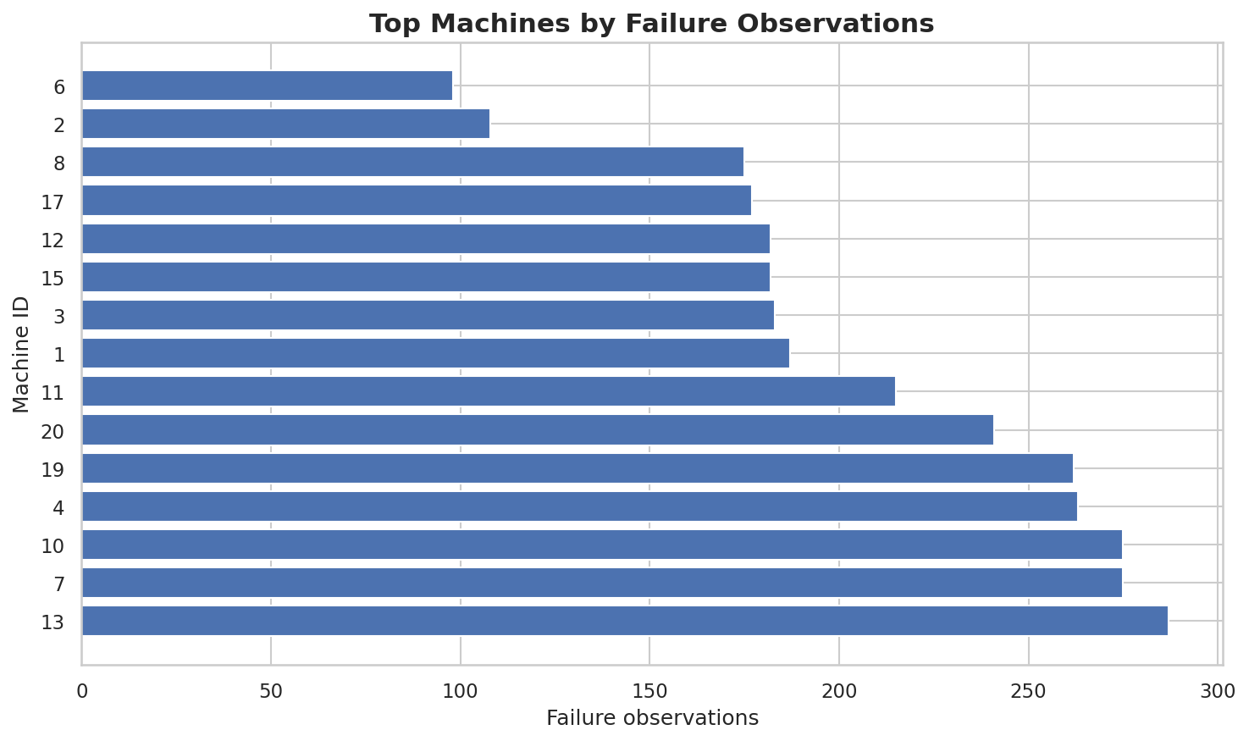

Slide 13
Data Cleaning
06
1
2
3
4
Separate targets
Handle missing values
Check data quality
Prevent leakage
Keep each prediction target separate from the input features.
Use pipeline-based imputation so training and inference follow the same process.
Inspect distributions, invalid values, missingness, and outliers.
Fit preprocessing only on training data through sklearn Pipelines.
Industrial Predictive Maintenance • Machine Learning Project

Slide 14
Preprocessing
07
Numerical features
Categorical features
Pipeline design
KNNImputer
RobustScaler
Used inside the ColumnTransformer so preprocessing is reproducible at inference time.
OneHotEncoder
Machine type and operating mode are converted into model-ready numerical features.
ColumnTransformer
+
Model
The saved pipeline contains preprocessing and the trained estimator together.
Industrial Predictive Maintenance • Machine Learning Project

Slide 15
Baseline Model
08
Start simple → establish a reference → then improve.
Classification baseline
Regression baseline
Why baseline matters
A simple classifier provides a reference point before using stronger ensemble methods.
Linear Regression gives a simple relationship between machine features and continuous targets.
A complex model is useful only if it clearly improves over a reasonable baseline.
Industrial Predictive Maintenance • Machine Learning Project

Slide 16
Try Multiple Models
09
Linear Regression
Decision Tree
Random Forest
Regression baseline
Interpretable nonlinear model
Strong ensemble baseline
Gradient Boosting
XGBoost
SVR
Sequential boosting
High-performance boosting
Kernel-based regression
Hyperparameter tuning was applied where appropriate using GridSearchCV.
Industrial Predictive Maintenance • Machine Learning Project

Slide 17
Model Evaluation
10
RUL
Failure Within 24h
Failure Type
Repair Cost
Random Forest Regressor
R² ≈ 0.925
XGBoost Classifier
F1 ≈ 0.94
XGBoost Multiclass
Macro F1 ≈ 0.96
Random Forest
R² ≈ 0.785
• Regression: evaluated using R², MAE, and RMSE.
• Classification: evaluated using accuracy, precision, recall, and F1-score.
• Repair-cost regression is the most difficult target because 85.19% of the target values are zero.
Industrial Predictive Maintenance • Machine Learning Project

Slide 18
Model Comparison
11
Target | Best Model | Task | Result
RUL | Random Forest | Regression | R² ≈ 0.925
Failure within 24h | XGBoost | Binary classification | F1 ≈ 0.94
Failure type | XGBoost | Multiclass classification | Macro F1 ≈ 0.96
Repair cost | Random Forest | Regression | R² ≈ 0.785
Best model is selected per target because the four tasks have different objectives.
Final deployment
Four trained pipelines are saved as .pkl files and consumed by the Streamlit application.
Industrial Predictive Maintenance • Machine Learning Project

Slide 19
Real-World Interpretation
12
Sensor Data
RUL
Failure Risk
Failure Type
Repair Cost
Healthy machine
Warning
Critical
RUL > 24h
Failure risk: NO
Failure type: None
Repair cost: $0
Continue monitoring.
RUL ≤ 24h
Failure analysis is activated.
Maintenance should be scheduled soon.
Very low RUL
Immediate maintenance is strongly recommended.
Failure type and cost support the decision.
The system turns raw sensor readings into an actionable maintenance decision.
Industrial Predictive Maintenance • Machine Learning Project

Slide 20
Thank You

