Slide 1
PRESENTATION TITLE
Improving Home Loan Approvals with Machine Learning
1/7/2025

Slide 2
TEXT LAYOUT 1
Agenda
Project Overview​
Data
Analysis
Modeling
Model Evaluation
Recommendations

Slide 3
TEXT LAYOUT 1
Project Overview
Business Problem: Manual loan processing is time-consuming, taking 2-3 days.
Business Objective: Use ML to predict loan approval instantly.
Hypothesis: With ML, we can automate loan processing, ensuring faster, accurate, and efficient decisions.

Slide 4
TEXT LAYOUT 1
Project Overview
Business Problem: Delayed loan approvals cause inefficiency.
Business Objective: Provide real-time decisions for applicants.
Hypothesis: ML can predict creditworthiness based on historical data, reducing decision time to seconds.

Slide 5
TEXT LAYOUT 1
Process Overview / Solution
1. Applicant submits information via the app.
2. Data is processed by the ML model.
3. Instant response is sent: Approved or Denied.

Slide 6
TEXT LAYOUT 1
Data
Dataset Overview:
- Records: 614 (Train), 367 (Test)
Features: 12 columns (Categorical and Numerical)
Data Challenges:
- Missing values addressed using mean (numerical) and mode (categorical).
- Scaled numerical features for consistent model input.

Slide 7
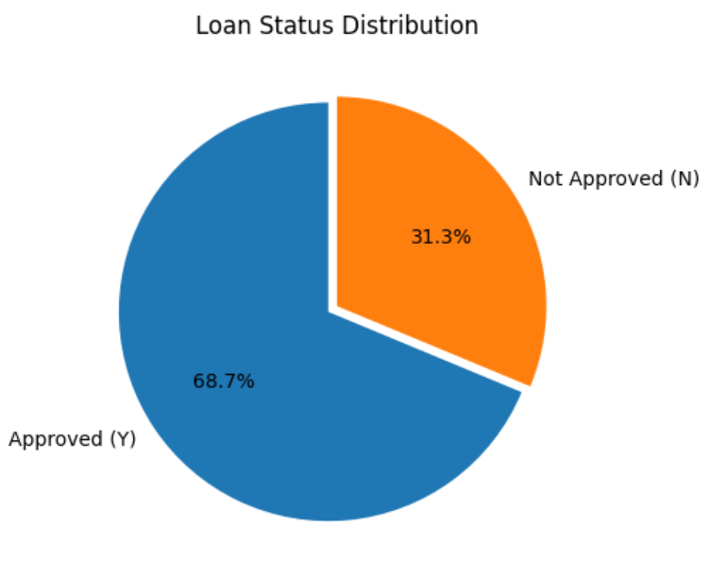
TEXT LAYOUT 1
Analysis
1. Loan Status Distribution: Majority are approved.

Slide 8
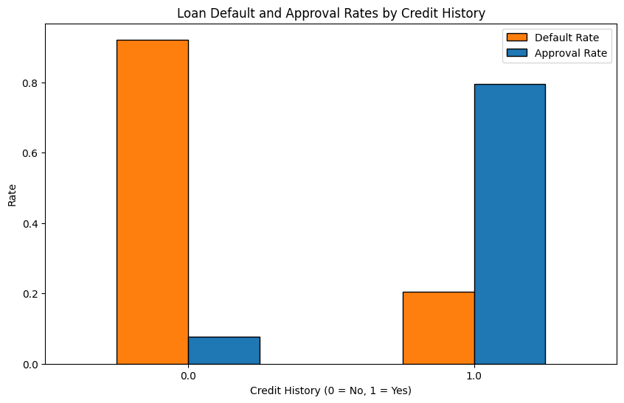
TEXT LAYOUT 1
Analysis
2. Applicants with credit history are more likely to get approved.

Slide 9
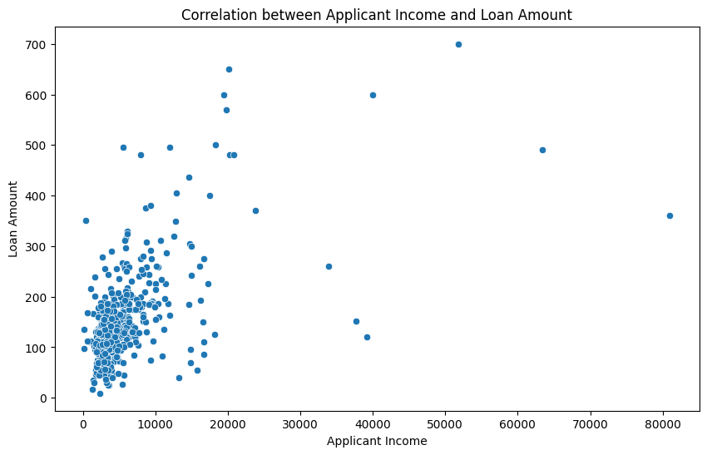
TEXT LAYOUT 1
Analysis
3. Moderate positive correlation (0.57) between income and loan amount.

Slide 10
TEXT LAYOUT 1
Modeling
Models Used:
- SVC (Support Vector Classifier)
- Random Forest
GaussianNB
- Decision Tree
- AutoML (Auto-sklearn)
Key Steps:
- AutoML automates feature engineering and hyperparameter tuning.
- BespokeML models allow for manual control and experimentation.

Slide 11
TEXT LAYOUT 1
Model Evaluation
Performance Comparison:
- AutoML: Accuracy 78.8%
- SVC : Accuracy 77.2%
- Random Forest : Accuracy 73.9%
- Gaussian Naive Baies : Accuracy 78%
- Decision Tree : Accuracy 73%
Trade-offs:
- AutoML for ease of use and speed.
- BespokeML for customization and control.

Slide 12
TEXT LAYOUT 1
Recommendations
1. Use AutoML for rapid deployment and efficiency.
2. Consider Bespoke ML for specialized cases requiring customization.
3. Integrate the solution with existing loan processing workflows.

Slide 13
Thank You

