Slide 3
Person 1: (3, 2)
Person 4: (2.34, 1.67)
Person 2: (1, 1.5)
Person 5: (0.21, 1.34)
Person 6: (3.49, 0.88)

Slide 4
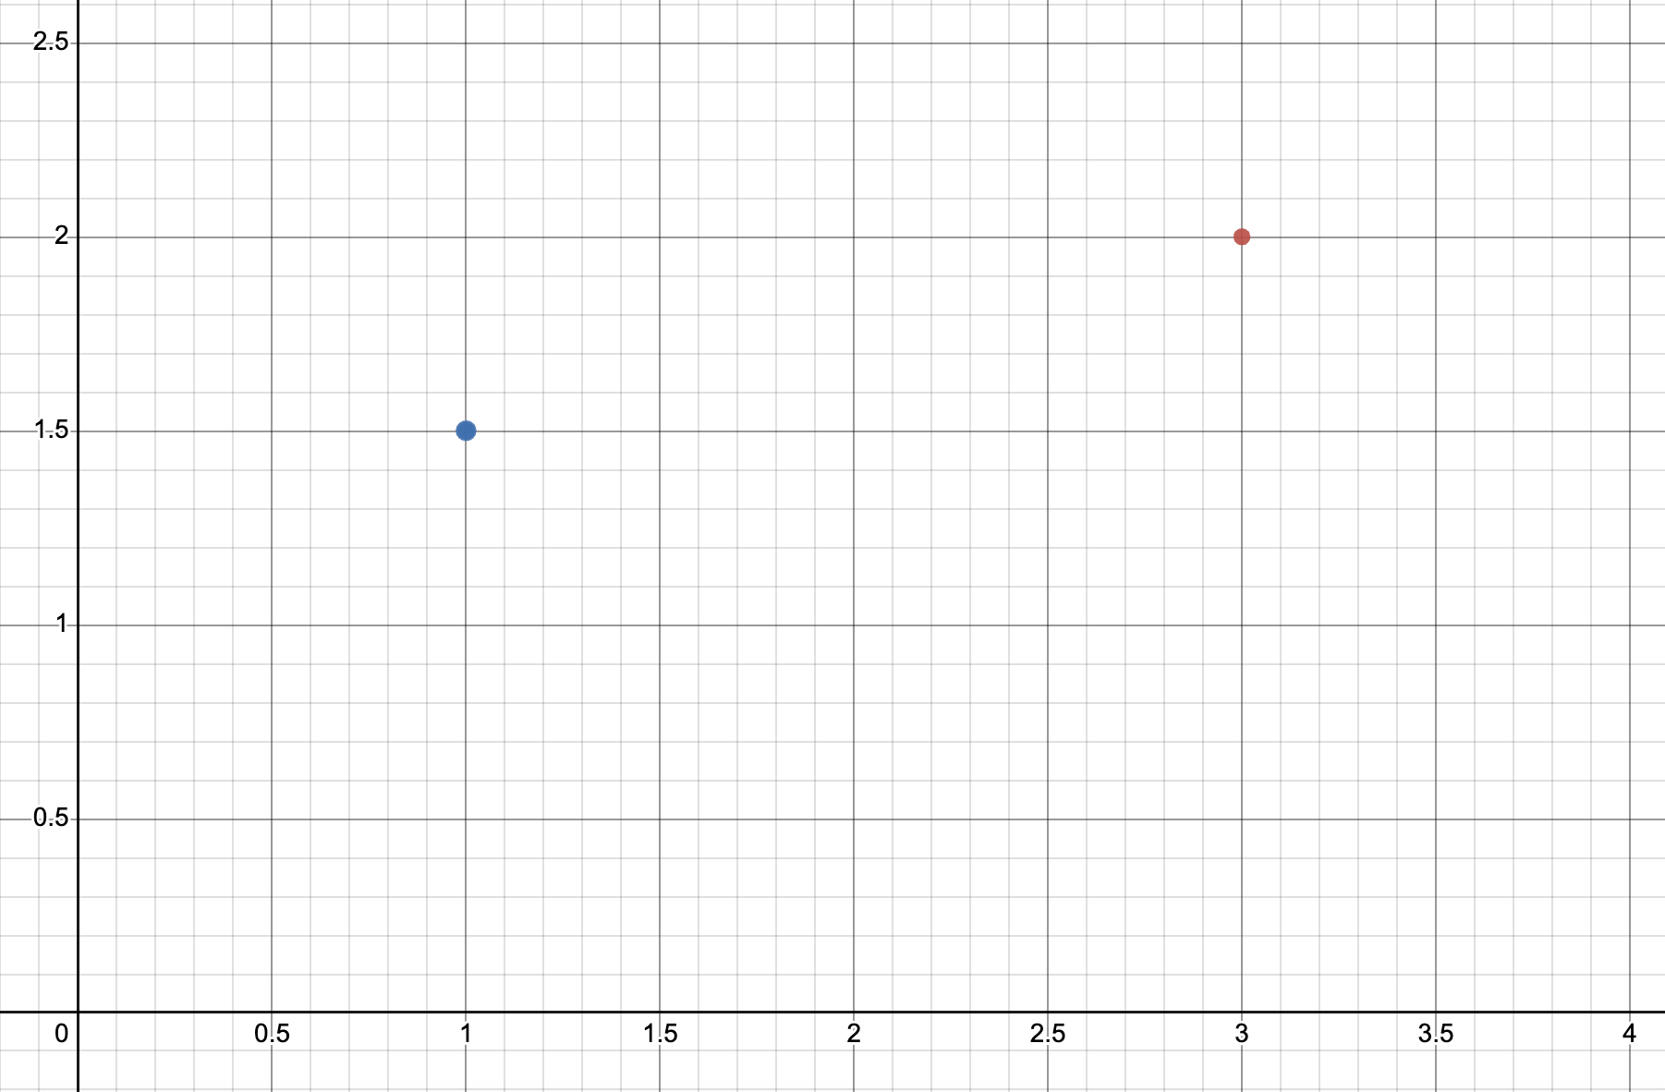
Person 1: (3, 2)
Person 2: (1, 1.5)

Slide 5
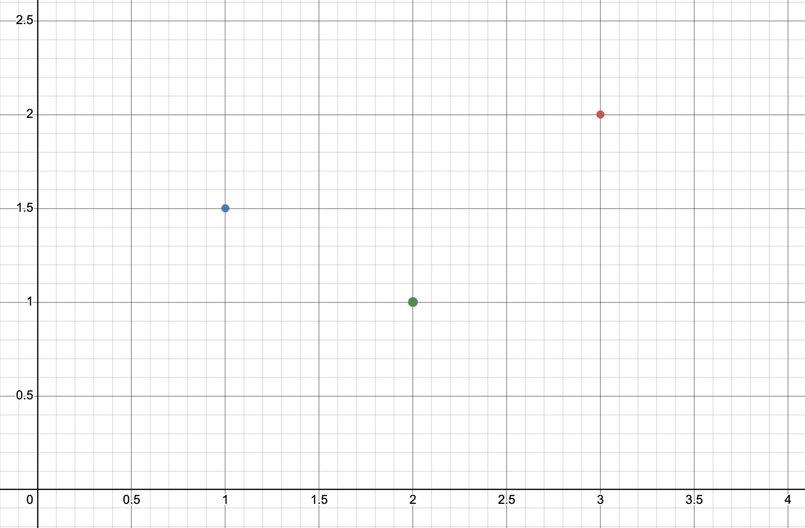
Person 1: (3, 2)
Person 2: (1, 1.5)
Person 3: (2, 1)

Slide 6
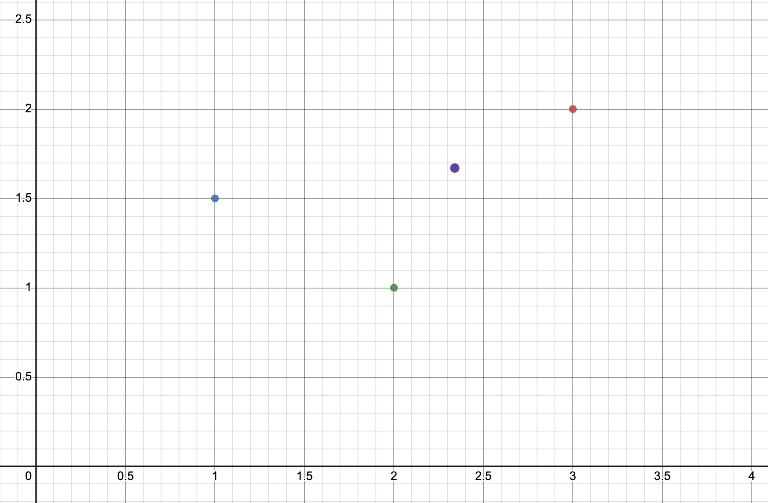
Person 1: (3, 2)
Person 4: (2.34, 1.67)
Person 2: (1, 1.5)
Person 3: (2, 1)

Slide 7
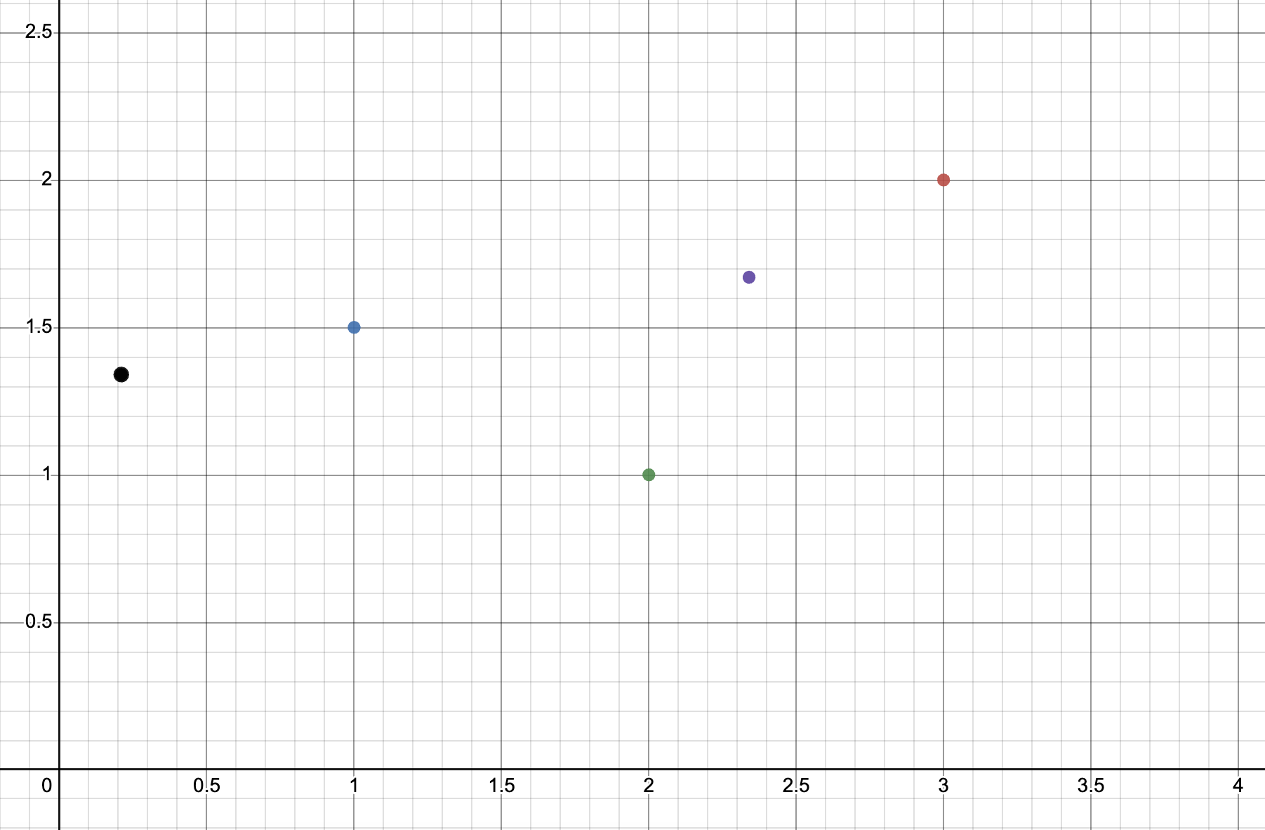
Person 1: (3, 2)
Person 4: (2.34, 1.67)
Person 2: (1, 1.5)
Person 5: (0.21, 1.34)
Person 3: (2, 1)

Slide 8
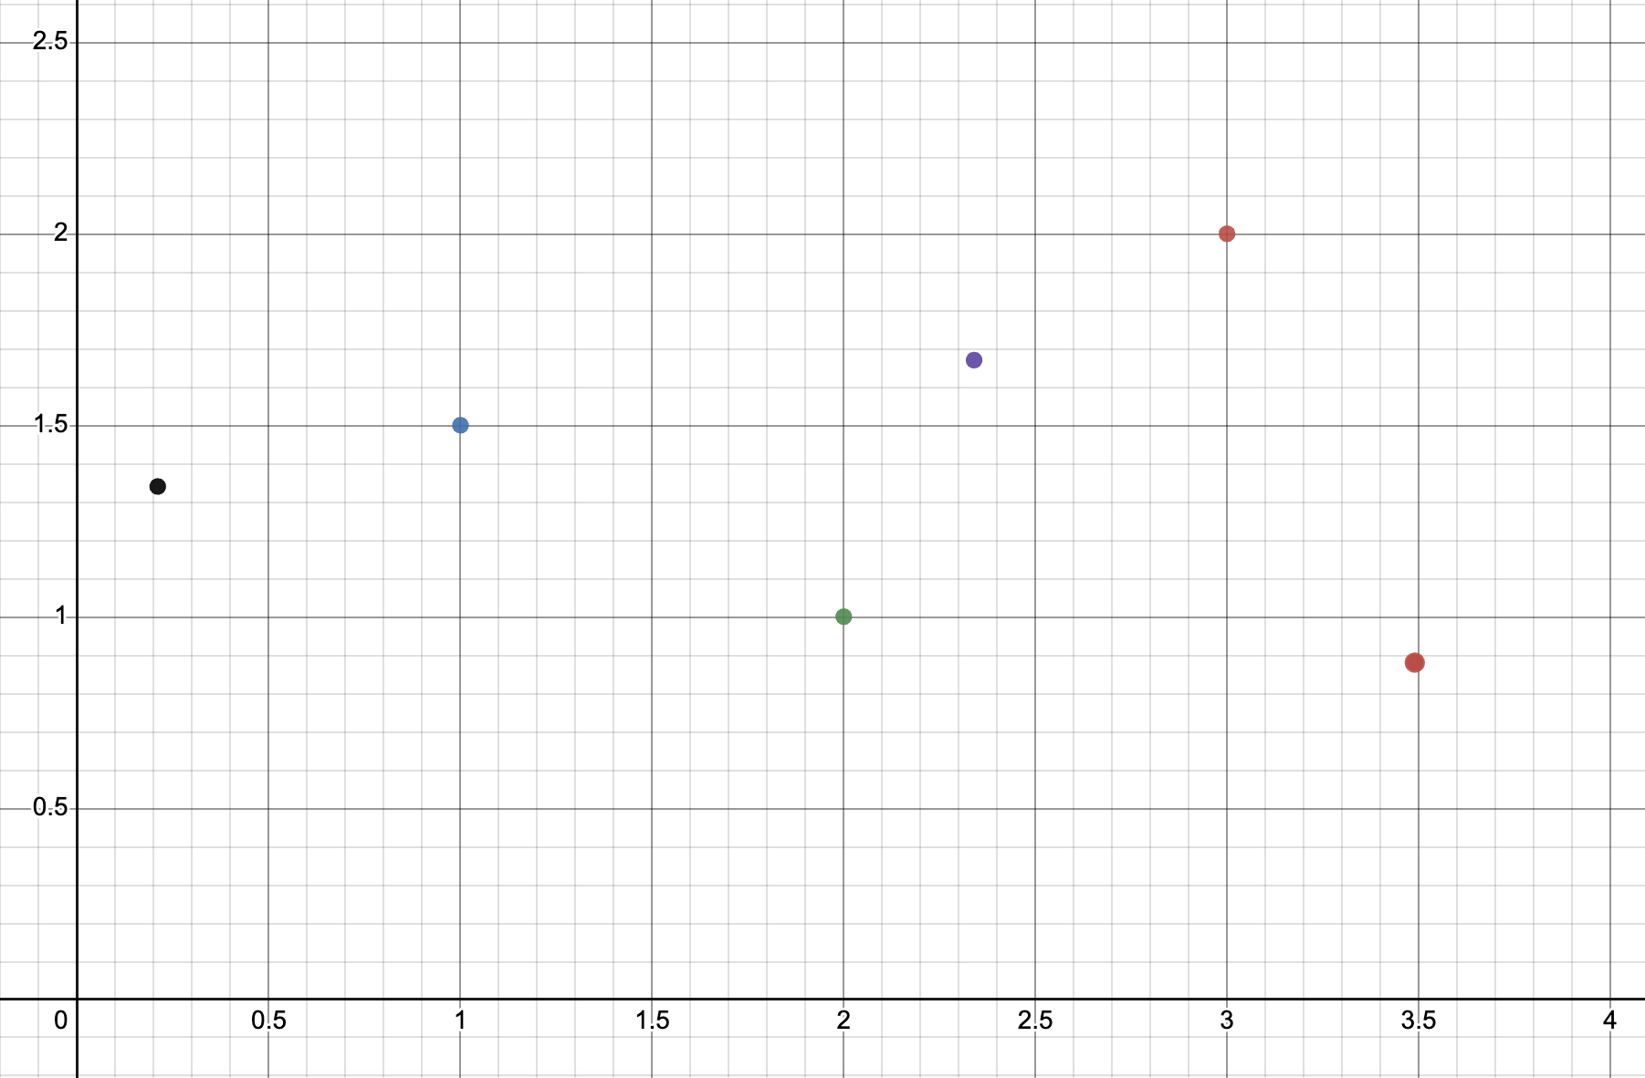
Person 1: (3, 2)
Person 4: (2.34, 1.67)
Person 2: (1, 1.5)
Person 5: (0.21, 1.34)
Person 3: (2, 1)
Person 6: (3.49, 0.88)

Slide 9
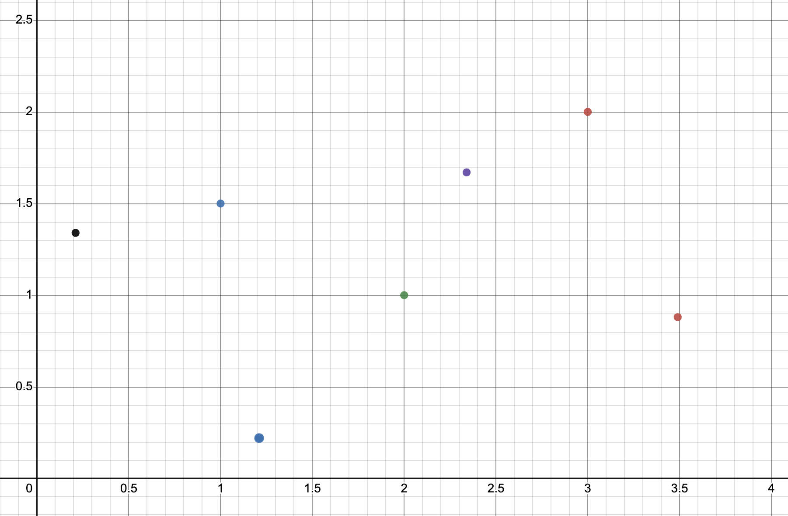
Person 1: (3, 2)
Person 4: (2.34, 1.67)
Person 2: (1, 1.5)
Person 5: (0.21, 1.34)
Person 3: (2, 1)
Person 6: (3.49, 0.88)
Person 7: (1.21, 0.22)

