Slide 2
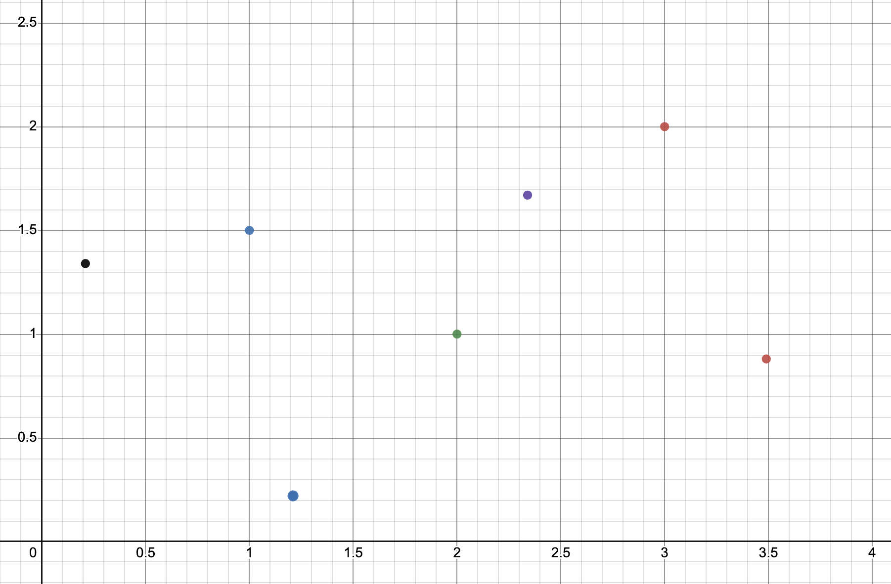
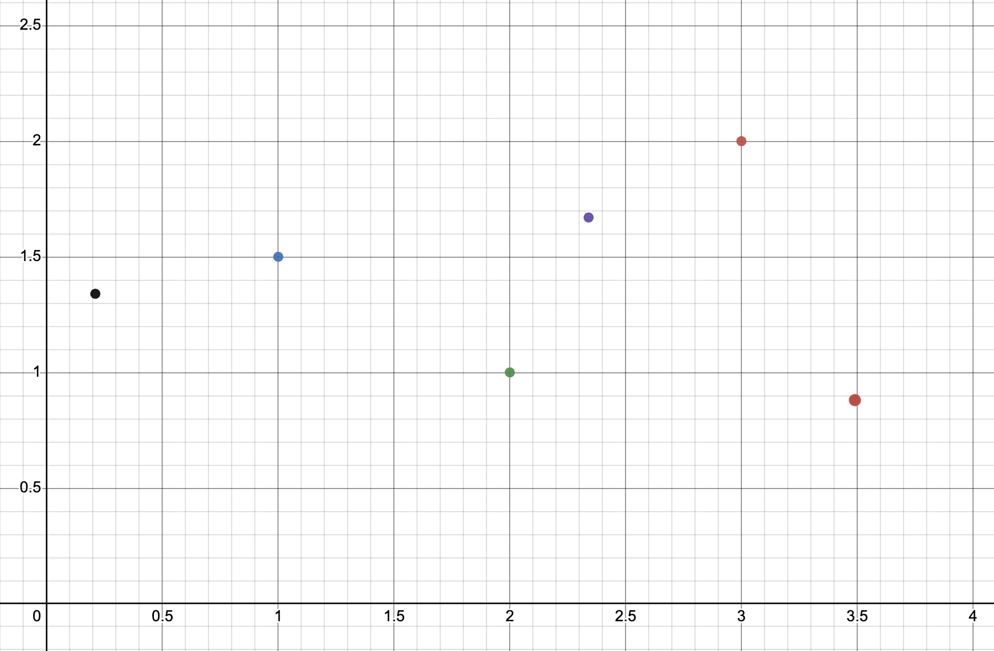

Slide 3
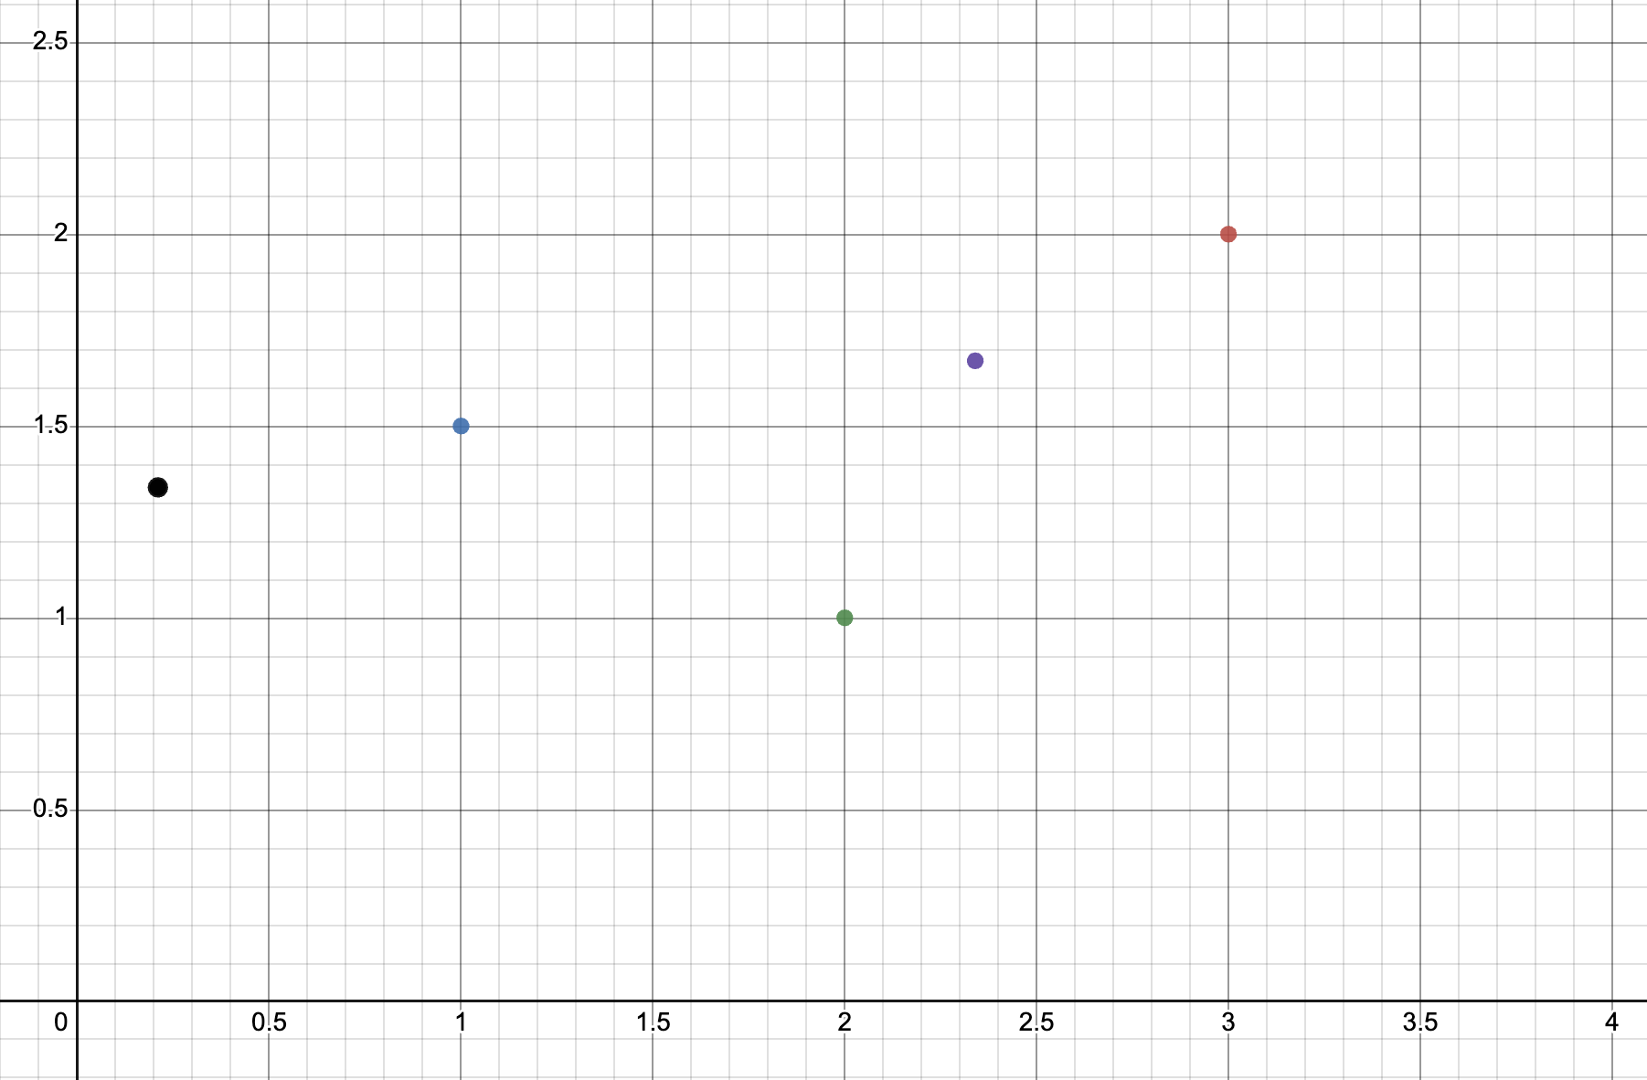
Person 1: (3, 2)
Person 4: (2.34, 1.67)
Person 2: (1, 1.5)
Person 5: (0.21, 1.34)
Person 3: (2, 1)

