Slide 1
STOMACHE Mobile Application

Slide 2
Team Members
Ziad Emadeldin 20194813
Omar Mansour 20195395
Mohamed Emad 20195198

Slide 3
Index
Introduction --------------------------------------------------------------------------------------------------------- 4
Home Page --------------------------------------------------------------------------------------------------------- 5
Login/Sign-up ----------------------------------------------------------------------------------------------------- 6
Users Database -------------------------------------------------------------------------------------------------- 7
Main Menu --------------------------------------------------------------------------------------------------------- 8
Categories --------------------------------------------------------------------------------------------------------- 9
Offers ---------------------------------------------------------------------------------------------------------------- 10
Details of Order ----------------------------------------------------------------------------------------------------11
Restaurant Location --------------------------------------------------------------------------------------------- 12
The Cart ------------------------------------------------------------------------------------------------------------ 13
Orders Database --------------------------------------------------------------------------------------------------14
My Account -------------------------------------------------------------------------------------------------------- 15
Settings ------------------------------------------------------------------------------------------------------------- 16
Change Password ----------------------------------------------------------------------------------------------- 17
About App ---------------------------------------------------------------------------------------------------------- 18
Advantages -------------------------------------------------------------------------------------------------------- 19

Slide 4
Introduction
Our application is an online ordering application for a restaurant that provides users an easy and simple interface to use.
And provides him multiple features to use :
Browsing through restaurant menu categories
Ordering items with no need to go to restaurant
The simplicity and ease of access of a menu are the main things that facilitate ordering food in a restaurant.

Slide 5
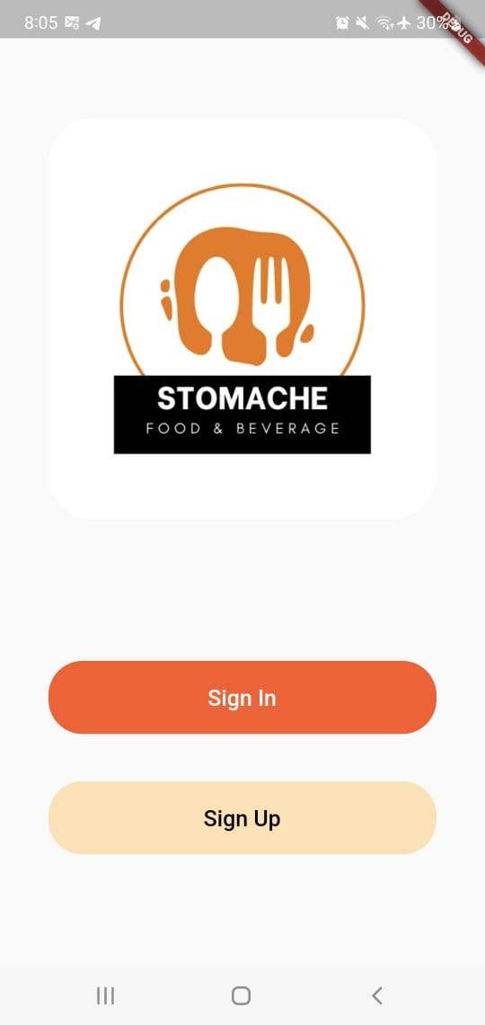
Home Page
Once the user clicks on the restaurant icon the home page appears.
User can sign in with his/her account or sign up
if the user doesn’t have an account.

Slide 6
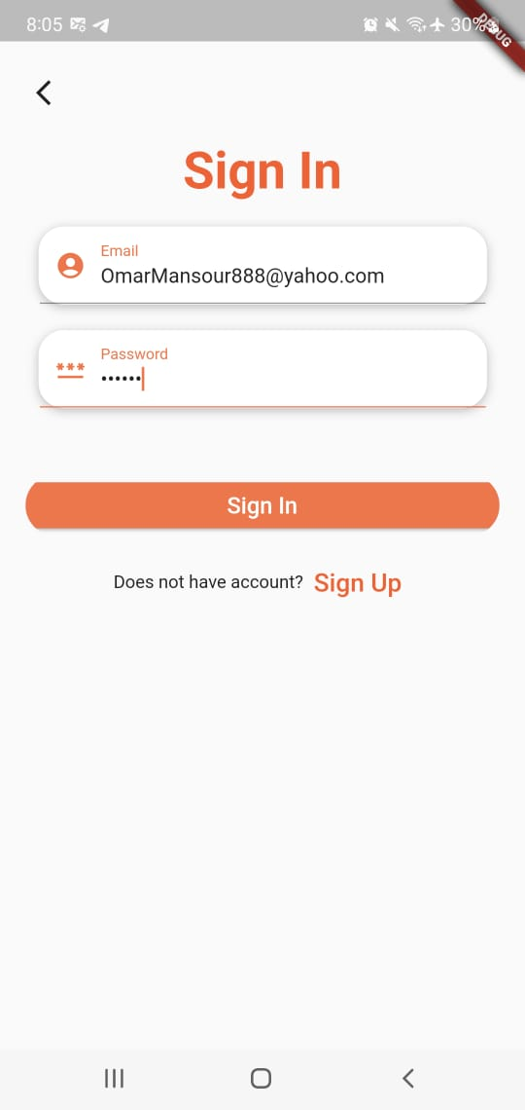
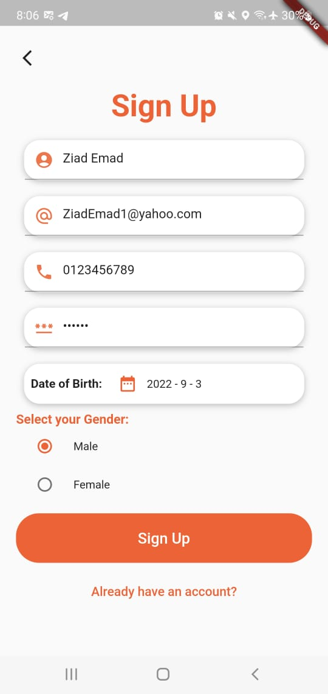
Login/Sign up
The user shall login with his/her specific email and password.
At the first time of joining the app the user must fill the form of the sign up page.

Slide 7
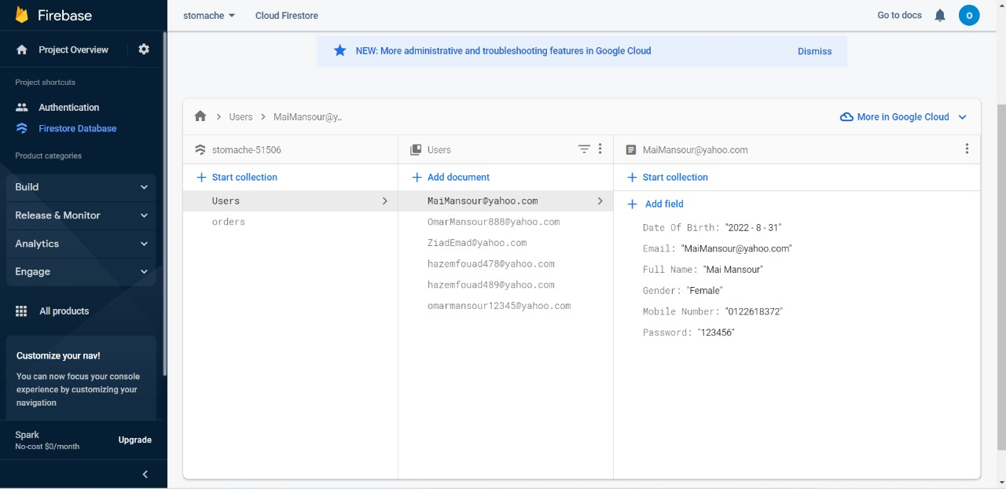
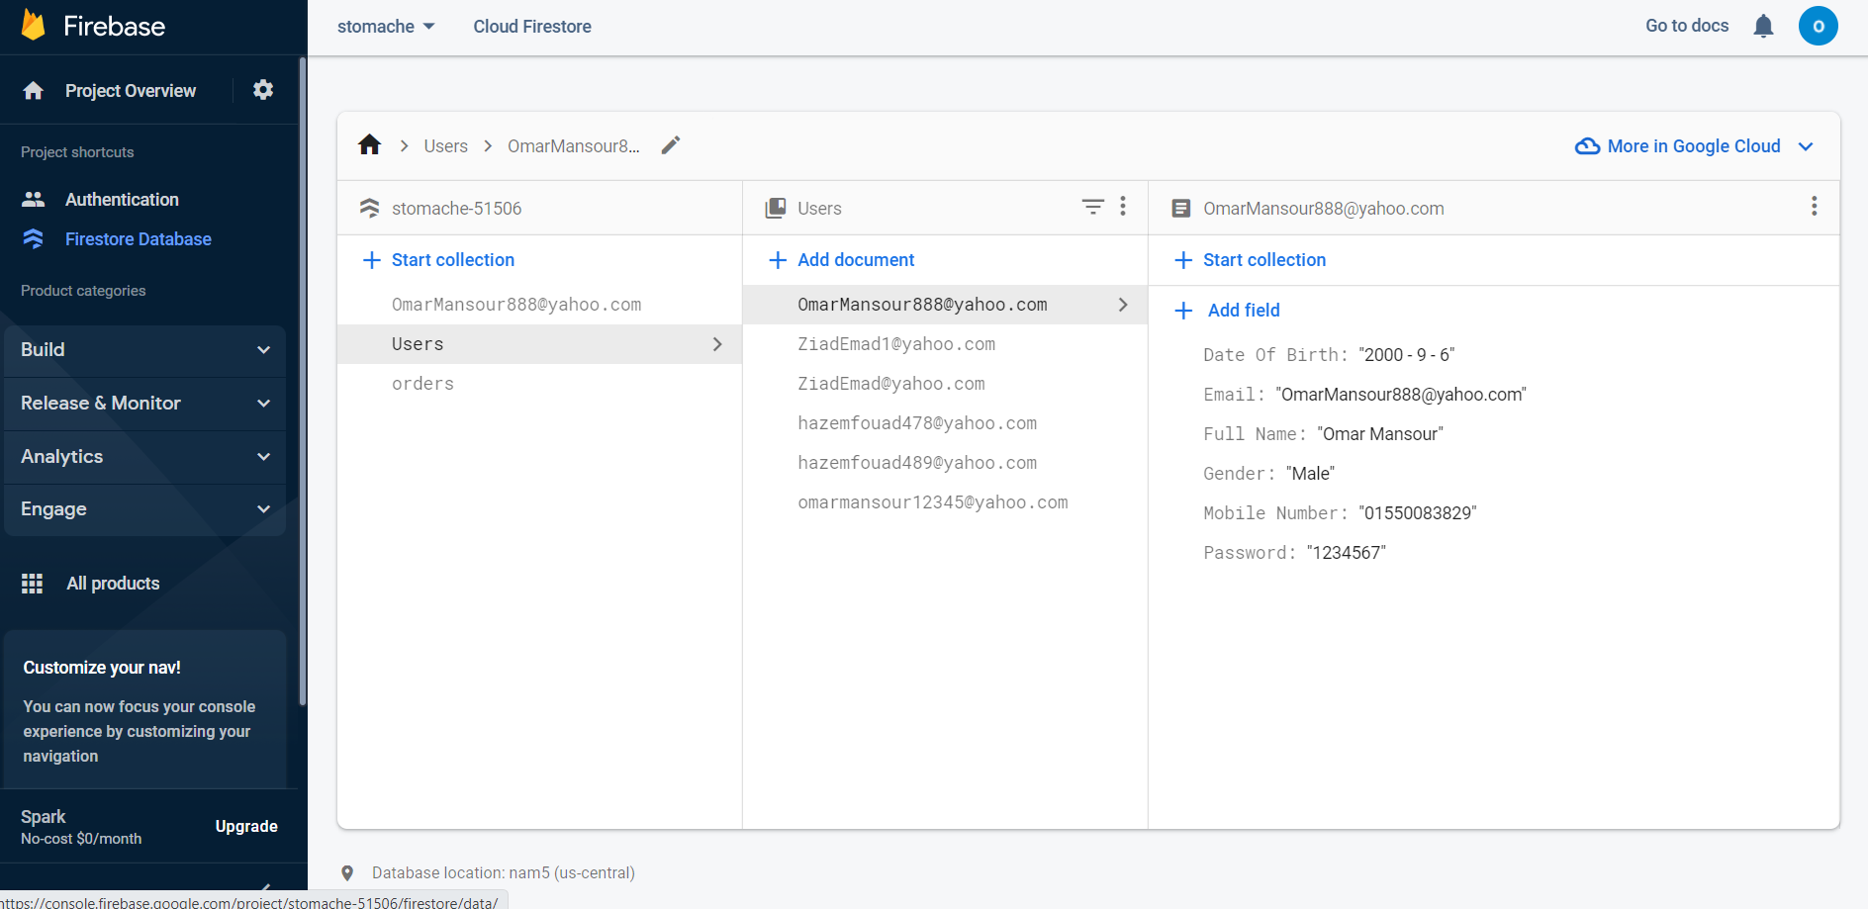
Users Database
The user’s data stored in firebase as follows:

Slide 8
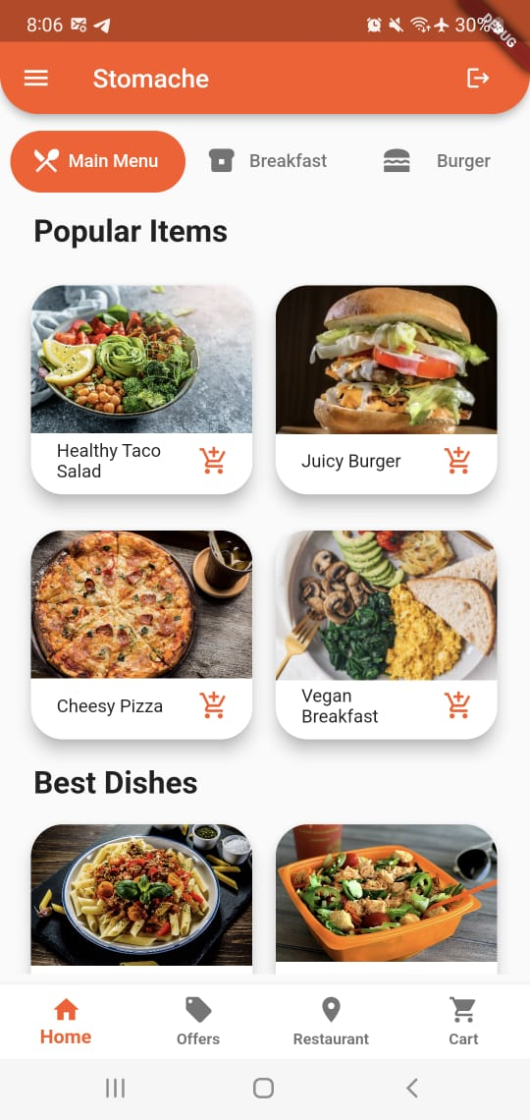
Main Menu
In the main menu a default tab controller used with length of 5 that take list of tabs in the tab bar. That make it easy to switch between categories.
The items shown created with card widget because it attracts the users and makes it easy to differentiate between the other items.
Once the user clicks on the card of any item, a details page will appear to choose the size and quantity of the item.

Slide 9
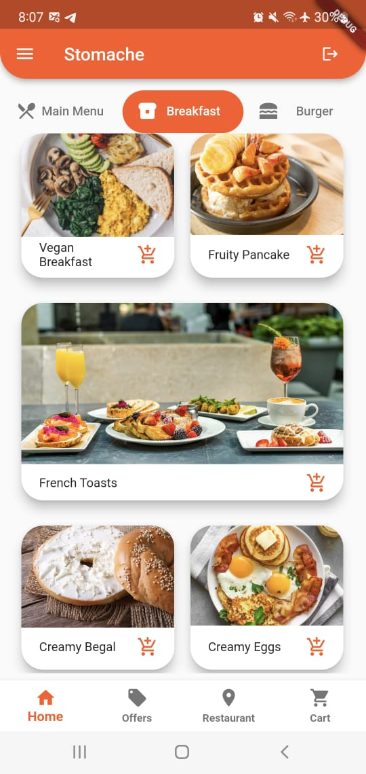
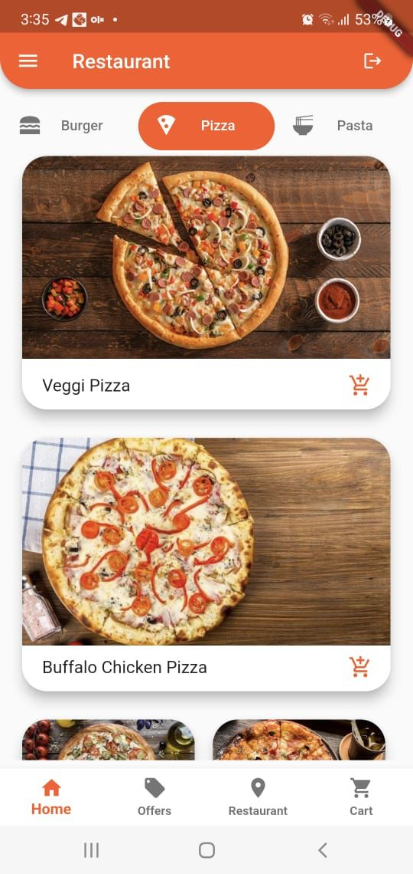
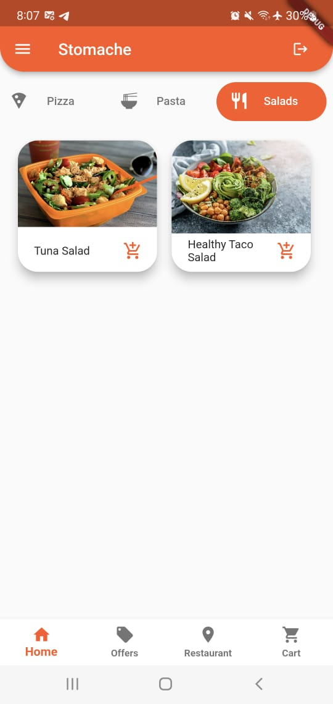
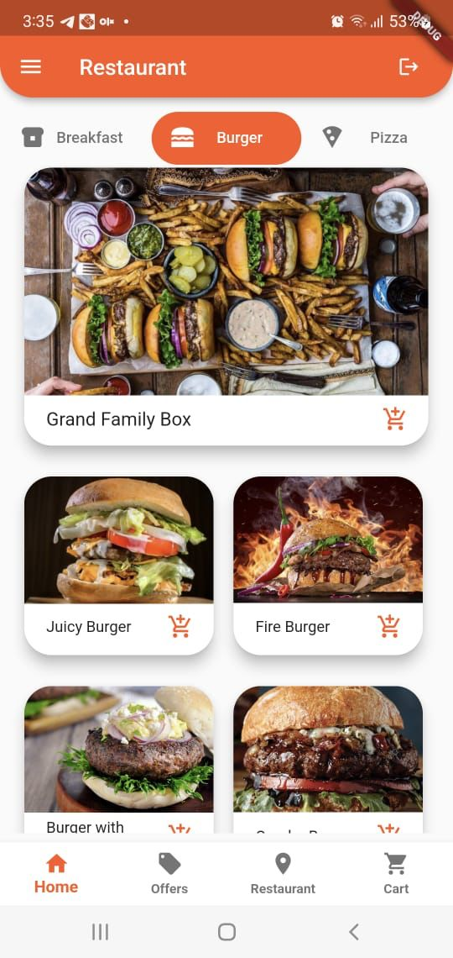
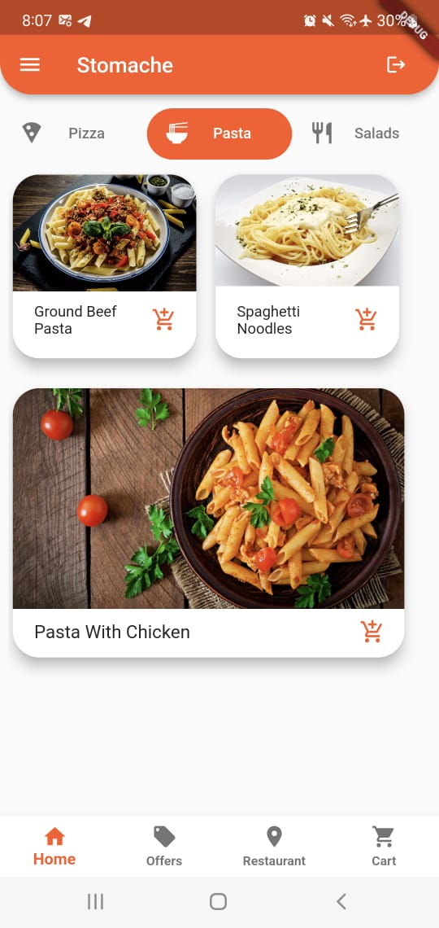
Categories

Slide 10
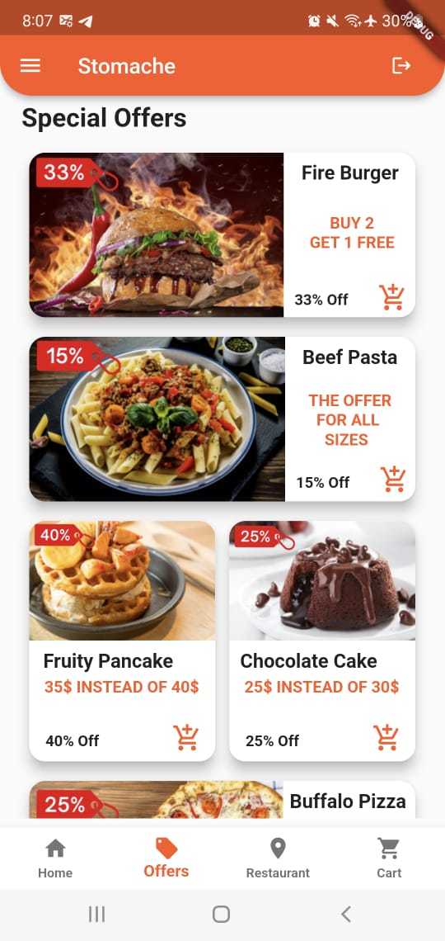
Offers
Some items are designed with card widget to be in the special offers page.
Each item has the discount percent that attract the user to buy.
The user can check the details of the item when he clicks on the card.

Slide 11
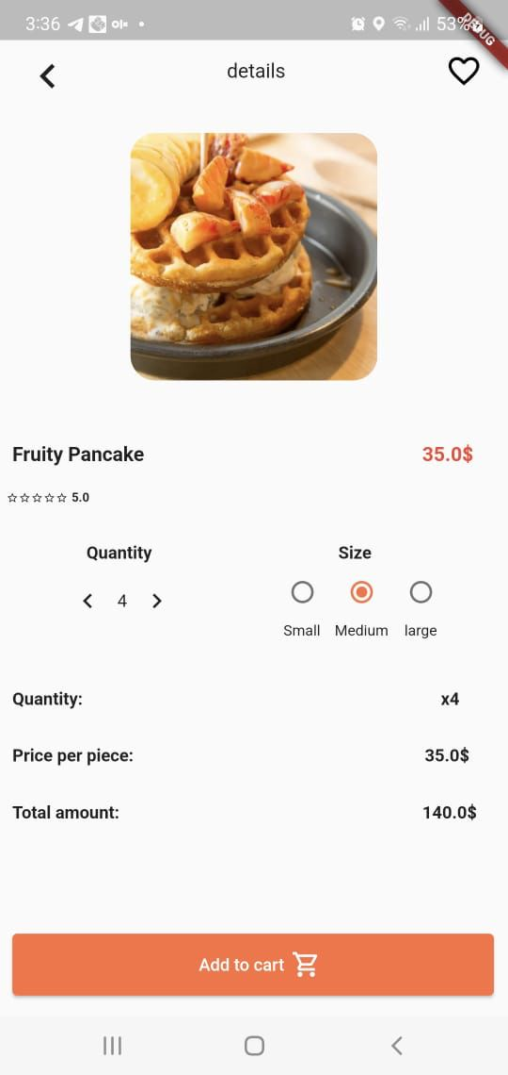
Details of Order
It shows information about the item such as price, rating about item, image for the item.
It allows the user to choose the preferable size and quantity for his order.
Based on the chosen price and quantity it displays the total price of the order.
And the last step is pressing the “Add to Cart” button in order to send it to the cart.

Slide 12
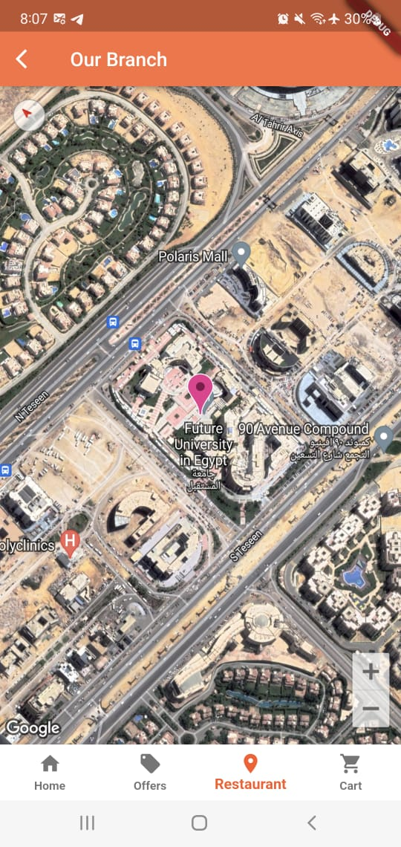
Restaurant Location
It shows the location of the restaurant in google maps

Slide 13
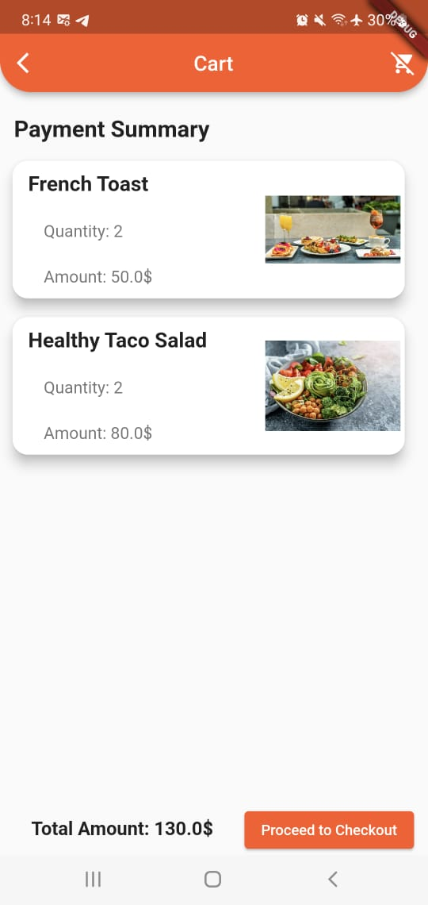
The Cart
It shows a detailed information about the user’s order like images for items, the quantity and amount of each item and the total price for all items.
A button in the top right of the screen to clear all the ordered items in the cart.
“Proceed to Checkout” button sent your order to the database with some information about user like email, full name, mobile number and total price.

Slide 14
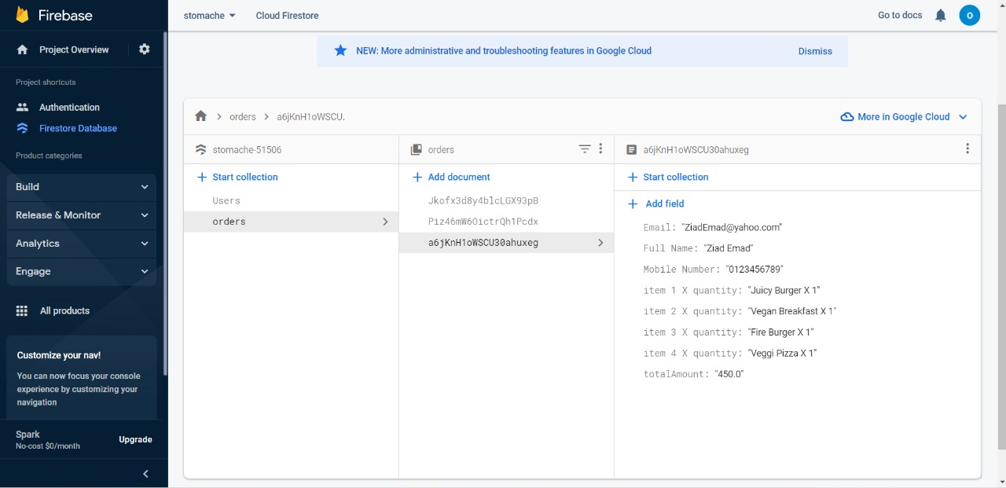
Orders Database
The orders in the cart stored in firebase as follows:

Slide 15
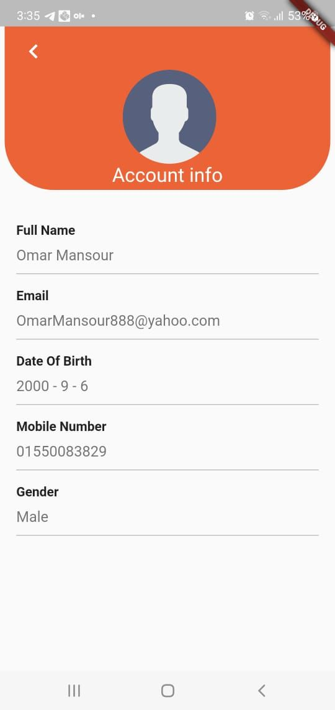
My Account
It shows various information about user like:
Full Name
Email
Date Of Birth
Mobile Number
Gender

Slide 16
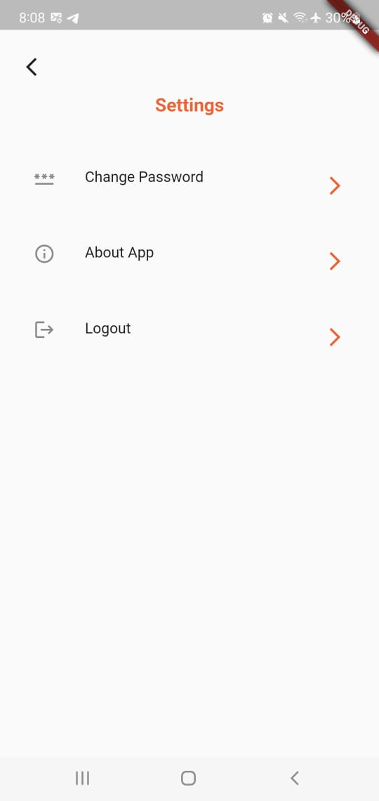
Settings
It provides different features to the user

Slide 17
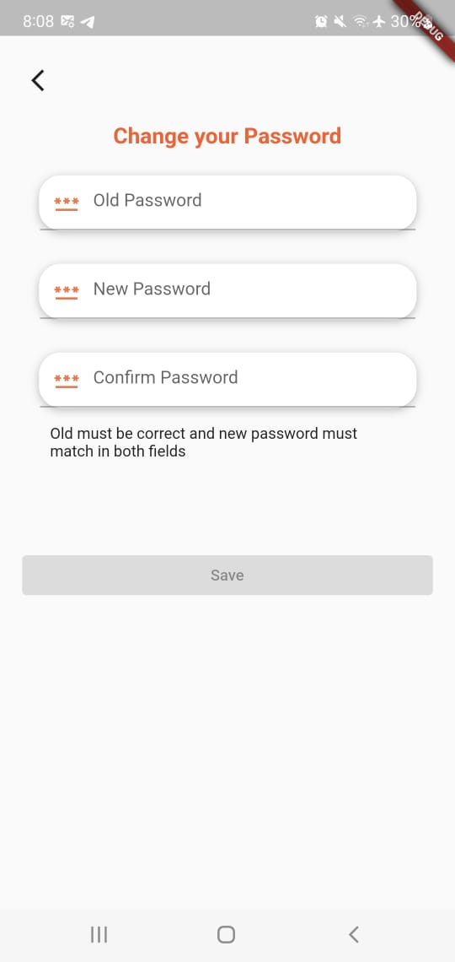
Change Password
When the user needs to change his password, he must enter the old password correctly.
The new password must match in 2nd and 3rd fields.
The last step is to press on the save button to change it immediately in the database.

Slide 18
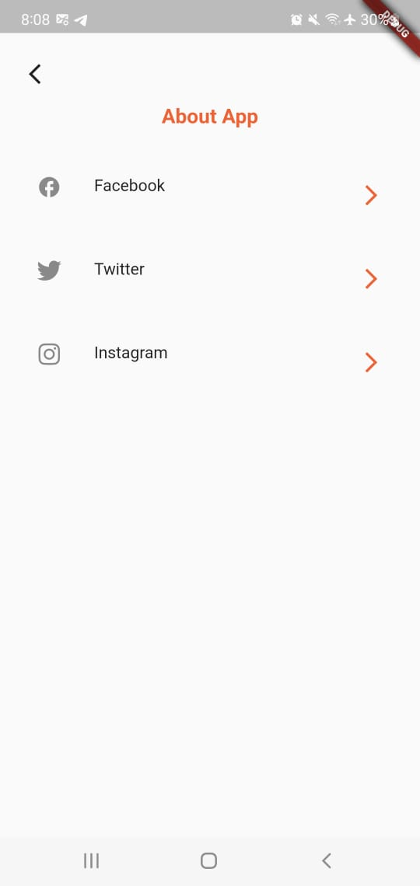
About App
It navigates user to Stomache page on Facebook, Instagram and Twitter

Slide 19
Advantages
Advantages of our Online App:
Easier to attract new customers.
Lesser mistakes and lesser problems.
No more waiting in long queues to place an order.
Our Restaurant can handle orders with more accuracy and increase their productivity.

Slide 20
Any Questions?

Slide 21
Thanks!

