Slide 1
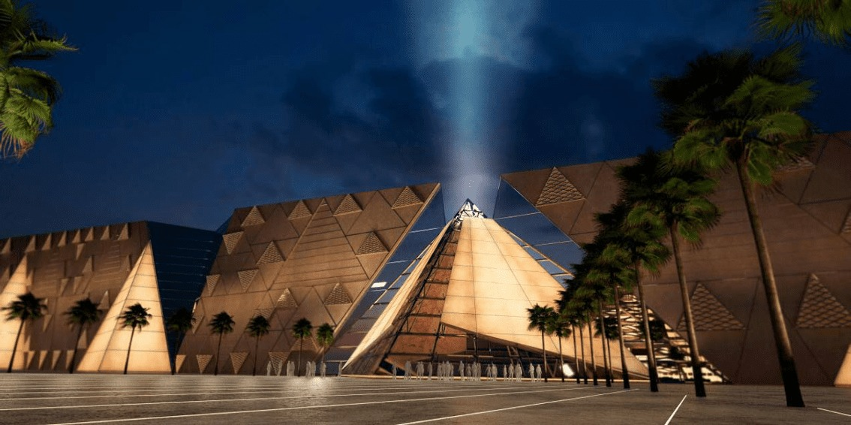
The Museum App
Course title: Software Engineering (1)
DR. Manal Ismail
TA: Eng. Ahmed Saied
Made by: Dina Salah Salem
Hosam Magdi Lotfy
Seif Mostafa Abdel Halim
Shrouk Ashraf El saied
Ziad Hesham Salah

Slide 2
Project Overview
The app mainly aims to provide an easy way to explore the museum from your home, know more about the artifacts in the museum, and book your ticket, pay online or just book a ticket and pay on your visit, in addition to a map to the museum to easily navigate through it.
In addition to being able to view all the events organized by the museum and register in them as well.

Slide 3
Steps:
First by determining the user requirements, a primary design of the application was set, then by analysing user requirements, determining what needs to be done what technology will be used and making all necessary diagrams we started preparing the WBS and assigning each team member with a task, which were monitored weekly by the team leader and assigned according to the Gantt chart to maintain the schedule, then developing process started and with each phase a feedback was taken and implemented in the next stage, until the final stage in which it was ensured that all requirements were fulfilled and system functionality was ensured.

Slide 4
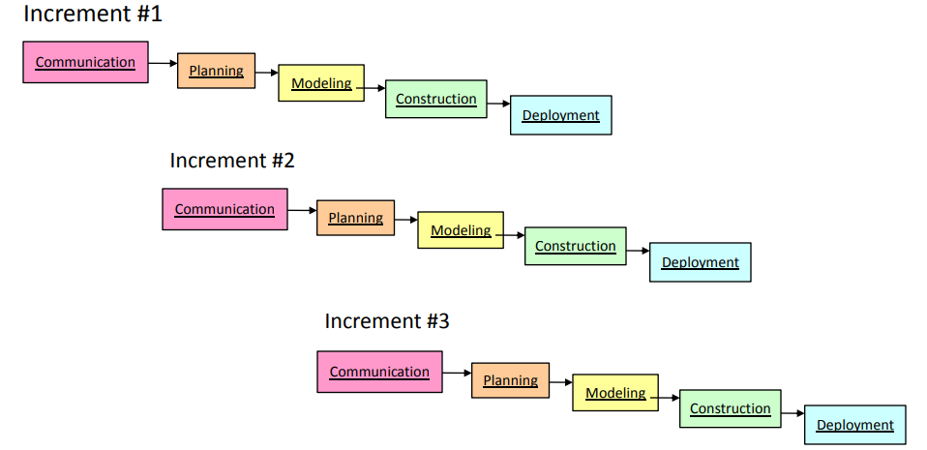
The used model
Incremental model was used to develop the project.

Slide 5
Diagrams:

Slide 6
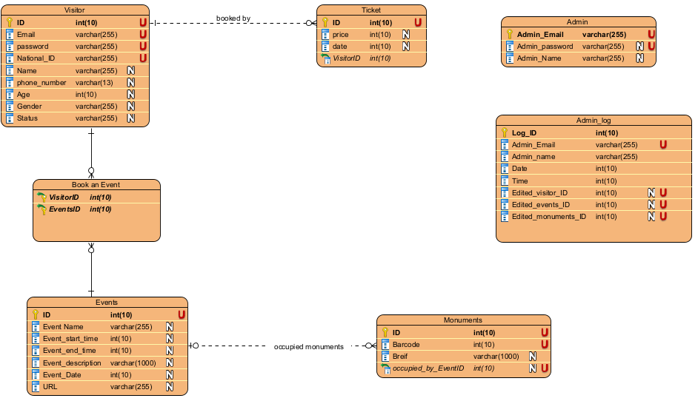
ERD
First an ERD was developed to know the main elements in the project and start developing the app according to them.

Slide 7
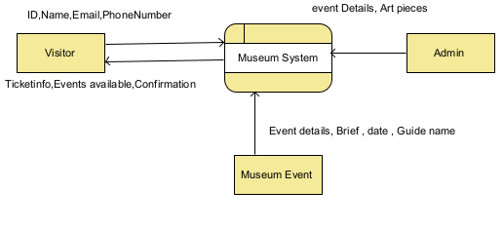
DFD
Then A DFD to identify the data stores for database development, the processes and their relationships with the entities in the app.
Level 0 DFD is an overview for the whole system as shown:

Slide 8
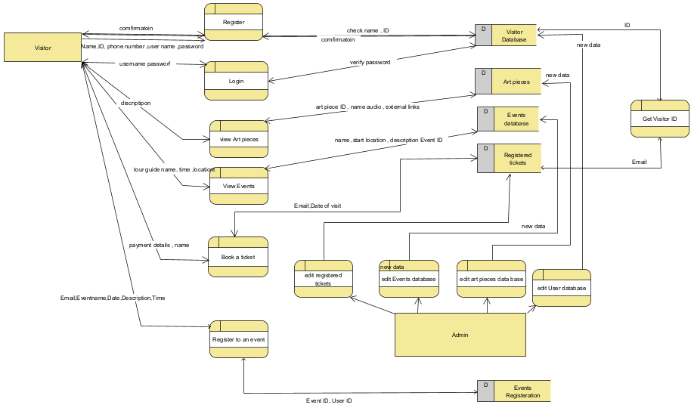
DFD
Then a level 1 DFD to give more details into the system.

Slide 9
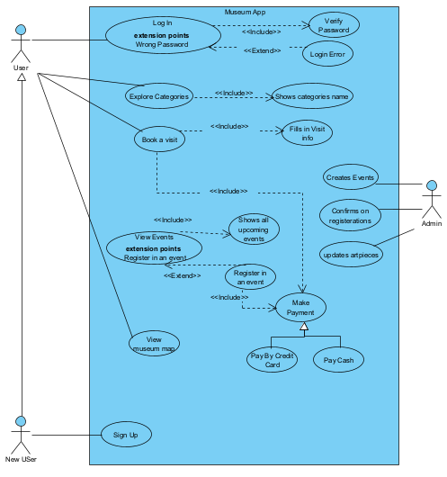
Use case diagram
Then developing the use case diagram in order to plan the implementation of the user requirements in the application

Slide 10
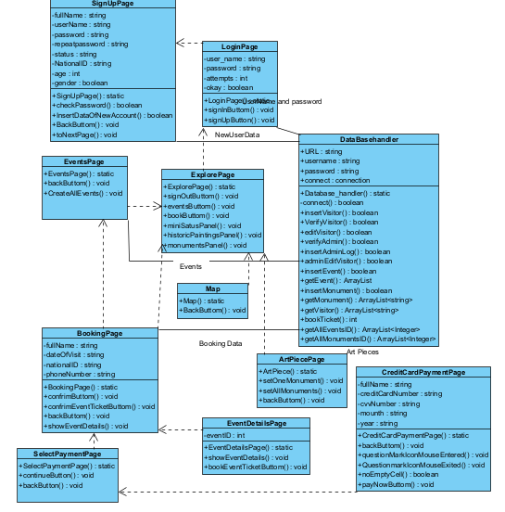
Class diagram
To identify the classes within the system, their relationships, attributes and functions.

Slide 11
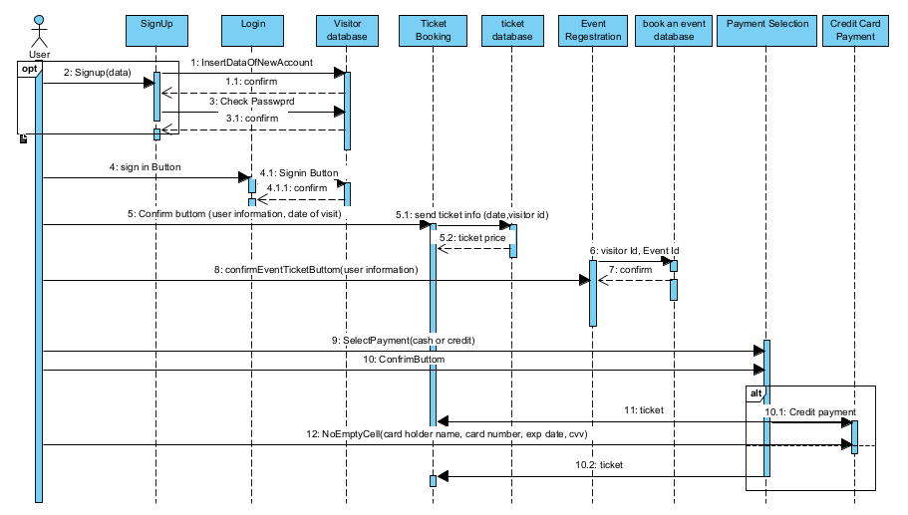
Sequence diagram:
Identifying the lifelines, outgoing messages, their sources and distention, and the expected feedback.

