Slide 1

Tutorial 2
Computer Engineering Department
Faculty of Engineering
Cairo University
Image Processing & Computer Vision - CMP(N)446
Convolution & Discrete Fourier Transform

Slide 2
Quiz Time!

Slide 3
Sheet 1
Convolution

Slide 4
Review of the Convolution Operation

Slide 5
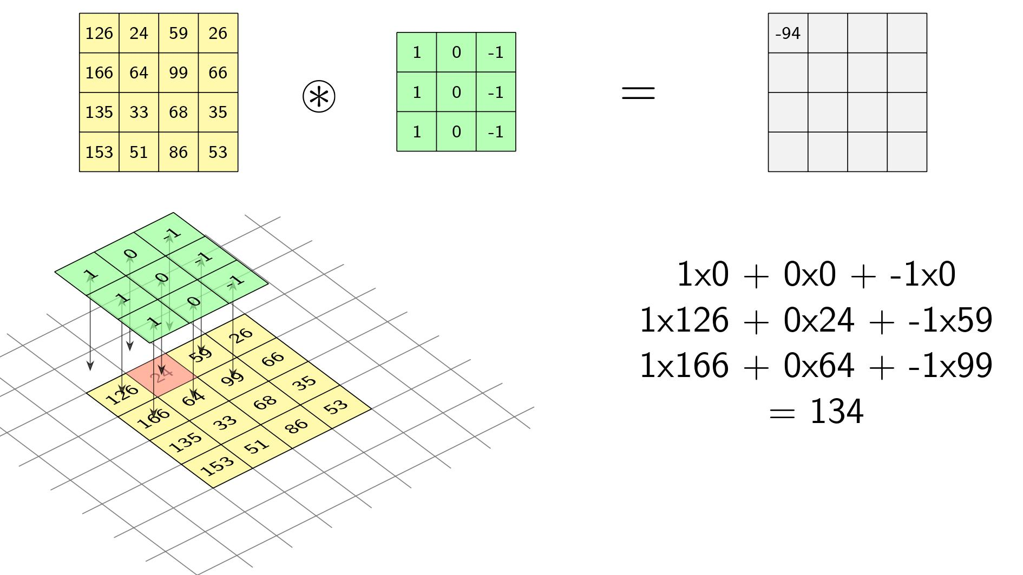
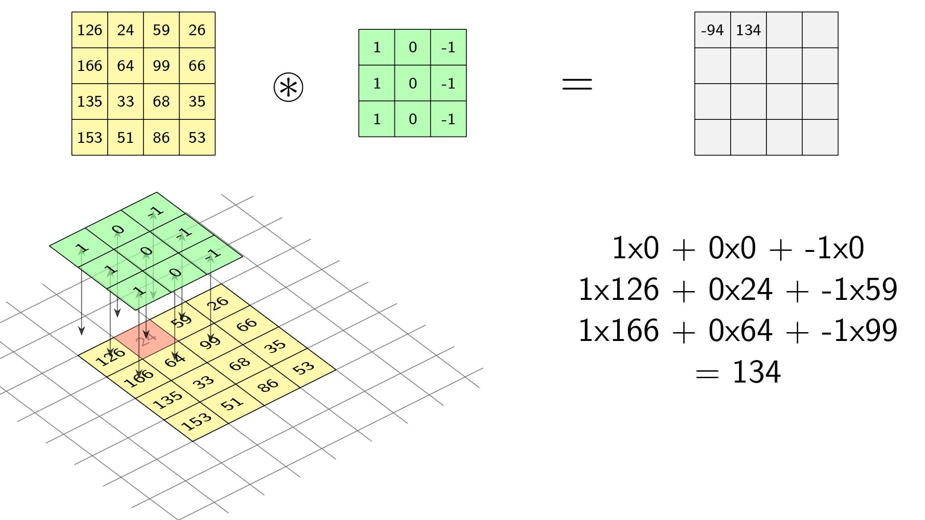
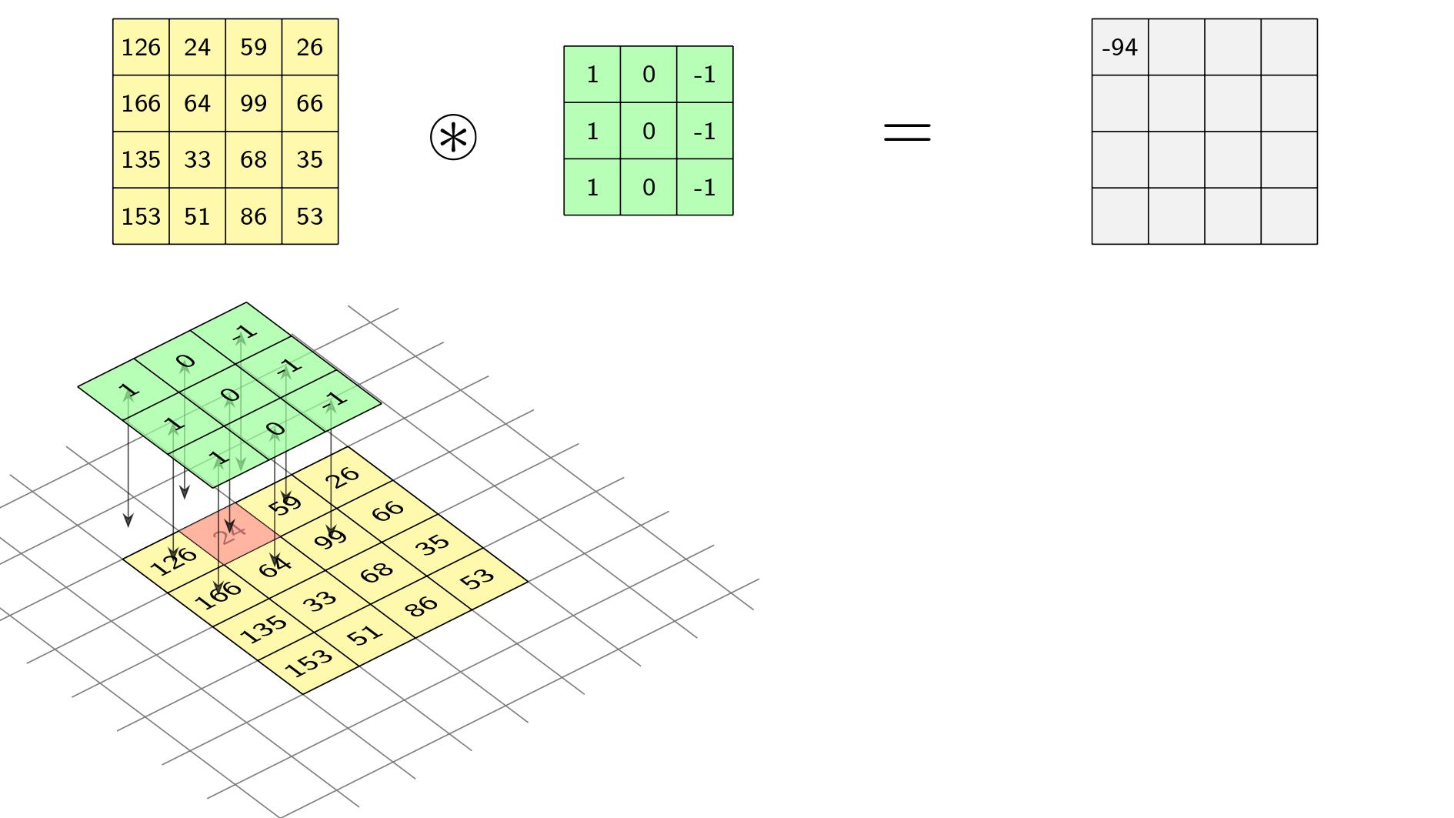
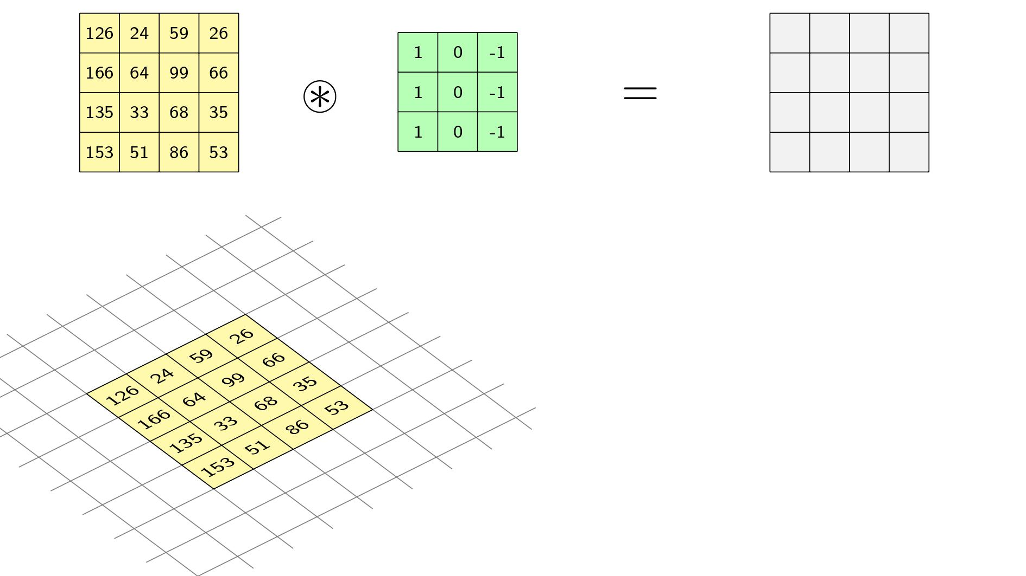
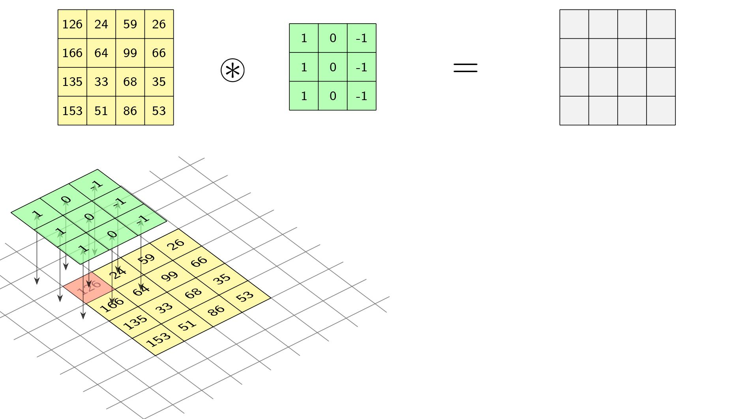
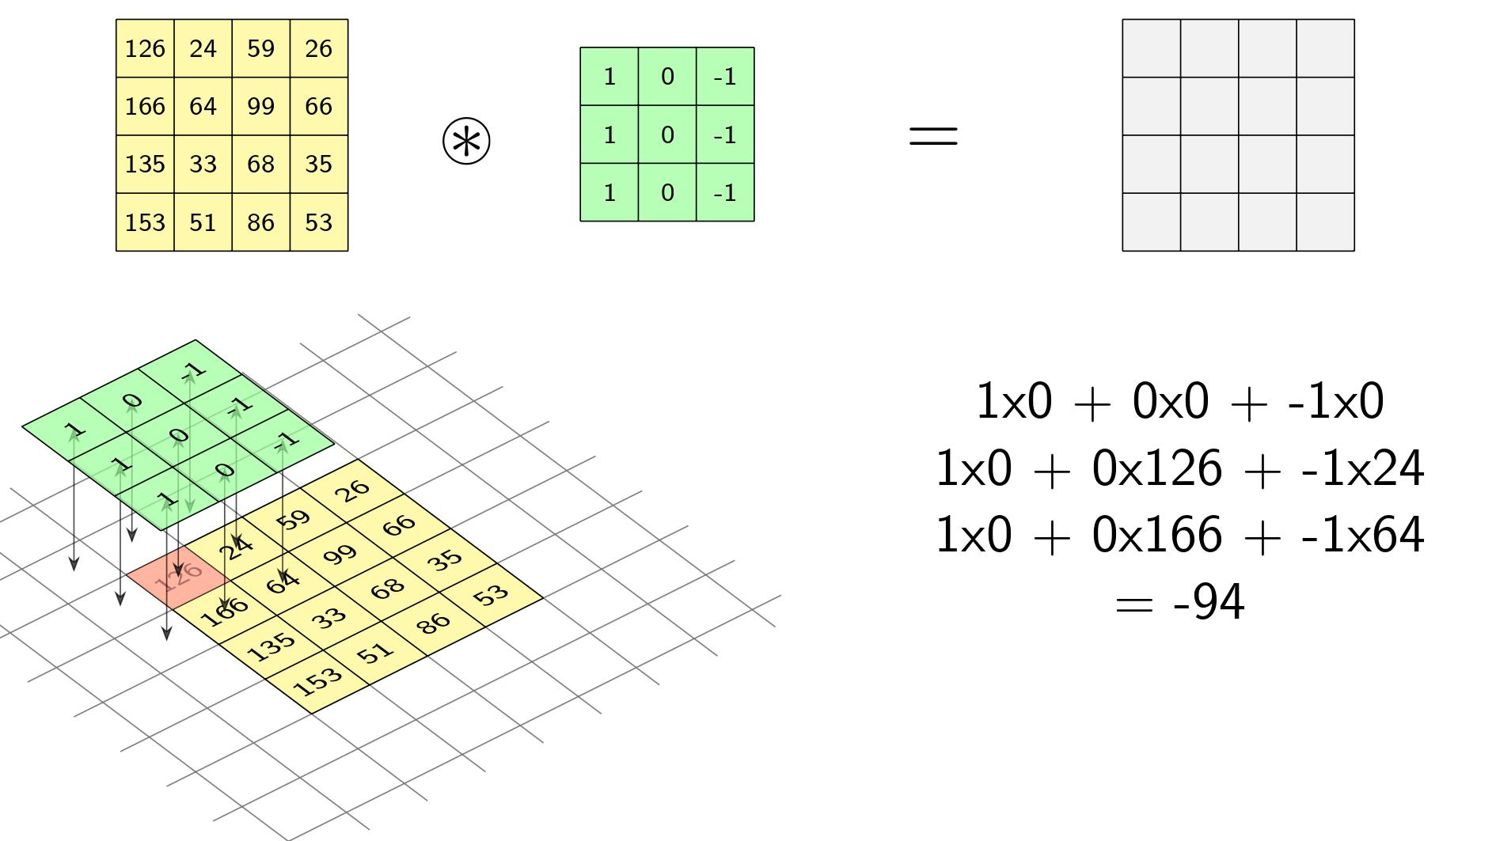

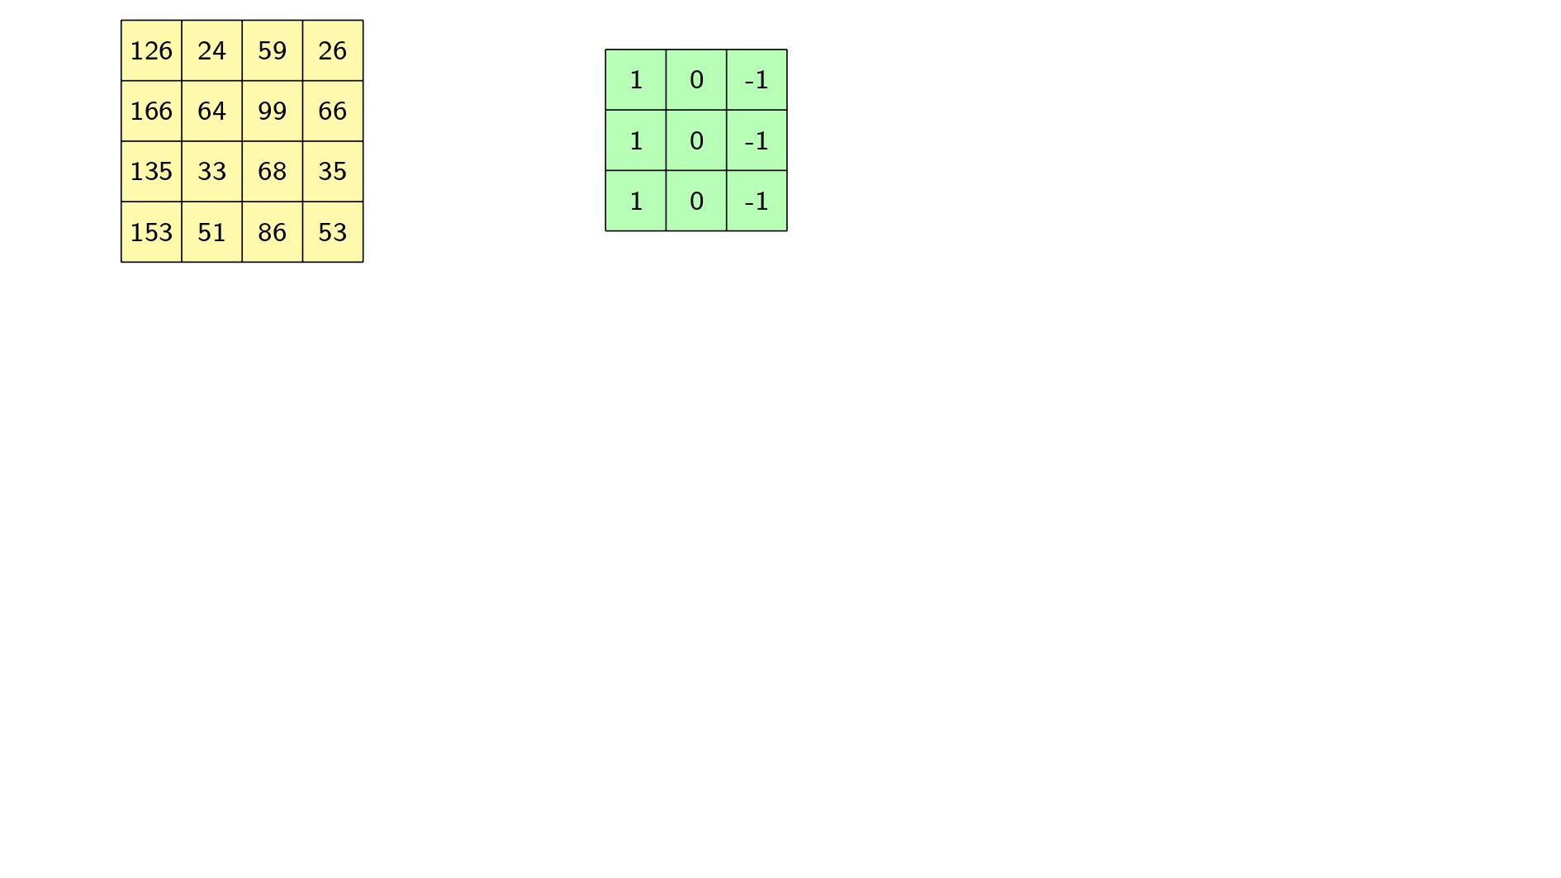

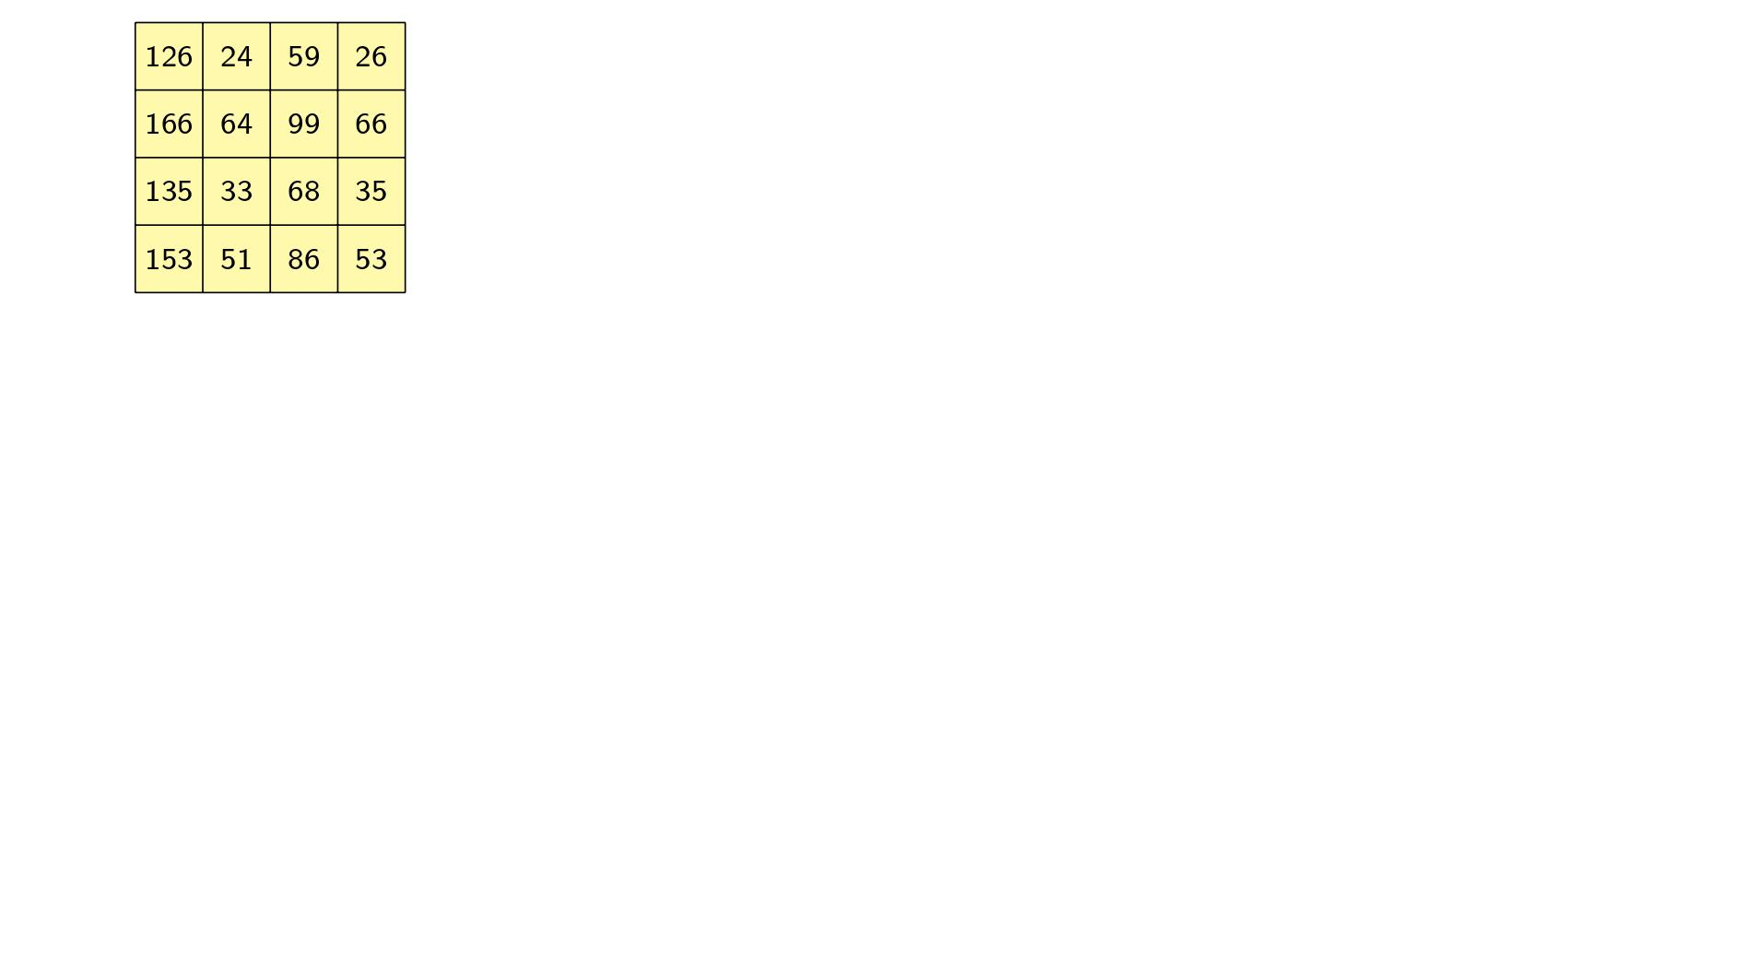
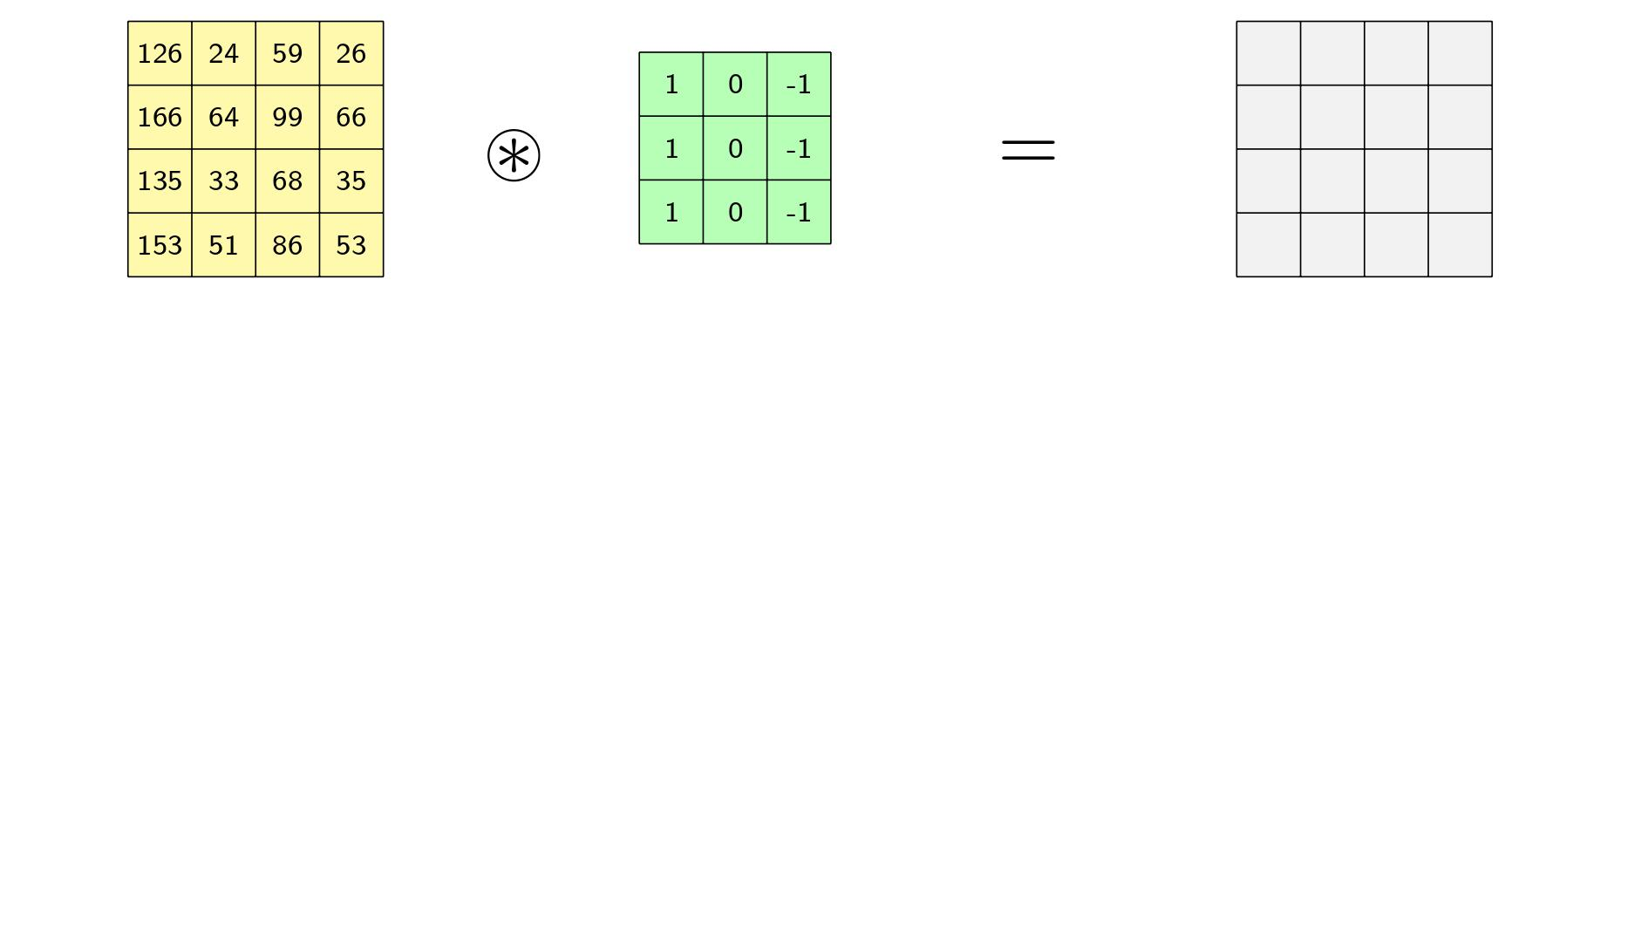
-88
Notes:
Strictly speaking, this is not convolution.

Slide 6
Review of the Convolution Operation

Slide 7
Sheet 1 – Exercise 1
Convolve these two matrices
-4 | 1 | -1 | -2 | 5
-7 | 3 | -2 | -6 | 9
-8 | 5 | -2 | -6 | 10
-5 | 4 | 0 | -8 | 5
-2 | 2 | 1 | -4 | 1
1 | 1 | 2 | 0 | 3
2 | 3 | 0 | 5 | 1
2 | 3 | 0 | 4 | 4
2 | 2 | 1 | 1 | 2
1 | 0 | 0 | 0 | 3
1 | 0 | -1
1 | 0 | -1
1 | 0 | -1
*
=
??
Notes:
Suggestion: Calculate on the whiteboard the result of some special cells, like the corner, and tell them the rest is repetitive and can be done at home.

Slide 8
Sheet 1 – Exercise 2
Convolve these two matrices
1/25 | 1/25 | 1/25 | 1/25 | 1/25
1/25 | 1/25 | 1/25 | 1/25 | 1/25
1/25 | 1/25 | 1/25 | 1/25 | 1/25
1/25 | 1/25 | 1/25 | 1/25 | 1/25
1/25 | 1/25 | 1/25 | 1/25 | 1/25
0 | 0 | 0 | 0 | 0
0 | 0 | 0 | 0 | 0
0 | 0 | 250 | 0 | 0
0 | 0 | 0 | 0 | 0
0 | 0 | 0 | 0 | 0
10 | 10 | 10 | 10 | 10
10 | 10 | 10 | 10 | 10
10 | 10 | 10 | 10 | 10
10 | 10 | 10 | 10 | 10
10 | 10 | 10 | 10 | 10
*
=
??

Slide 9
Lab 2
Convolution & Discrete Fourier Transform

Slide 10


Part 1
You are required to produce a horizontally propagating wave
Review of the Meaning of the Frequency Domain
Inverse DFT
??

Slide 11
Part 2 & Part 3
Part 2: You are required to understand the effect of applying some filters.
Part 3: You are required to convolve some filters with an image.

Slide 12
Remember
You are expected to understand EVERYTHING YOU WRITE
You will be asked at the end of the lab regarding your understanding to get the grade

