Slide 1
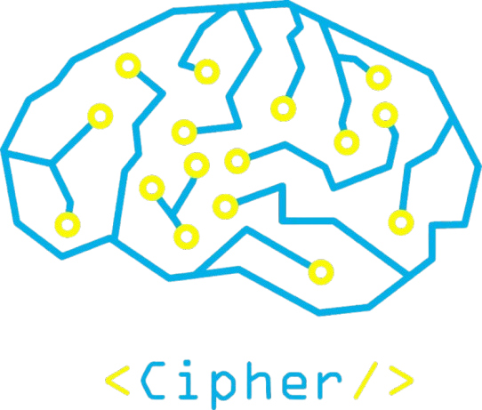

FLUTTER
Write once, run everywhere

Slide 2
Mobile Applications Overview
1- Native apps.
2- Cross-Platform apps.
Mobile apps can be categorized into :

Slide 3
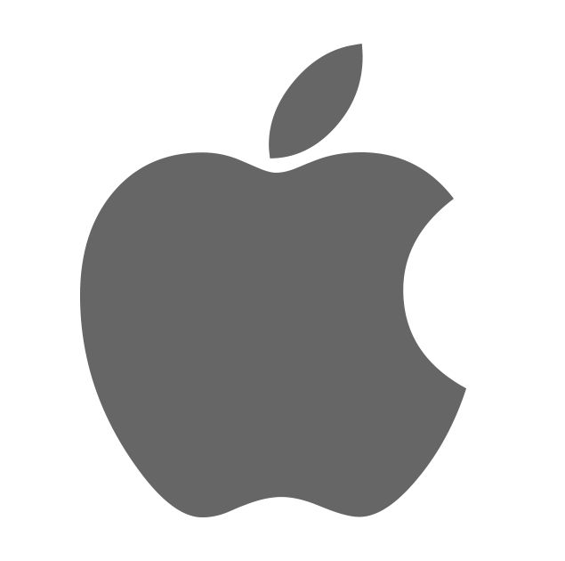
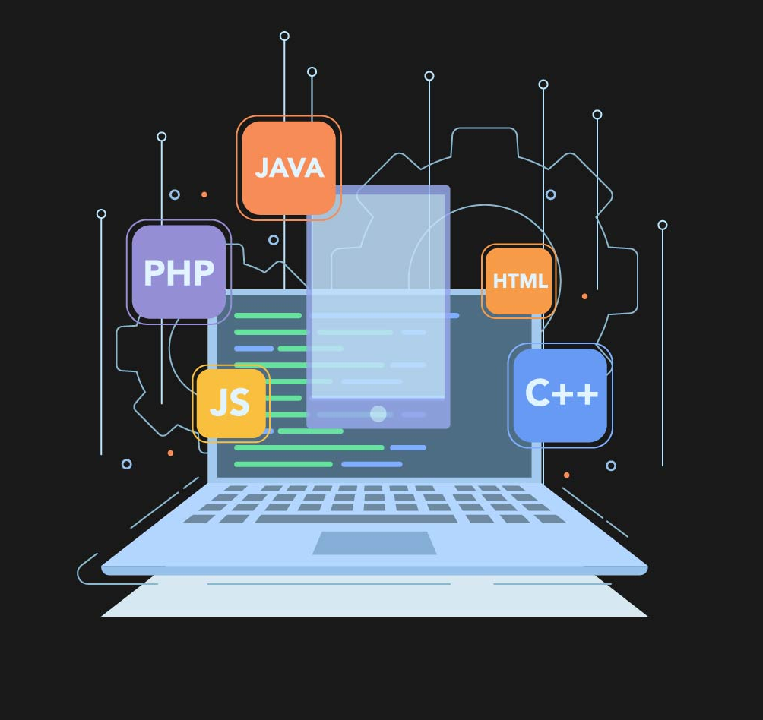
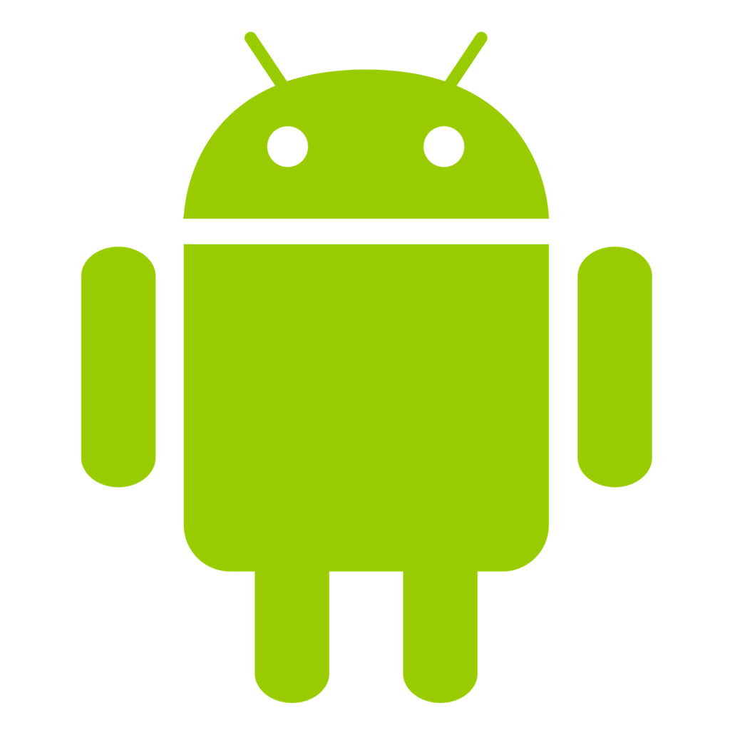
Native Mobile Apps

Slide 4
Cross-Platform Mobile Apps

Slide 5
What is Flutter ?
Flutter is an open-source UI software development kit created by Google. It is used to develop cross platform applications from a single codebase for any web browser, Android, iOS, Linux, macOS, and Windows.

Slide 6



Slide 7
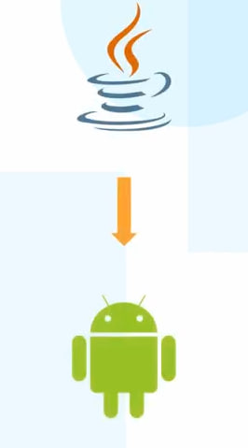
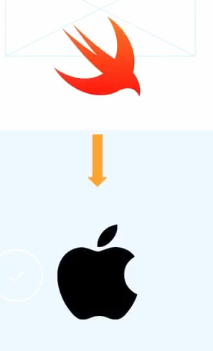
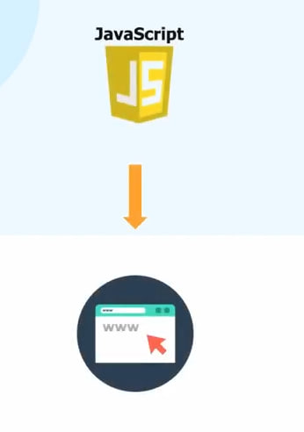

Slide 8
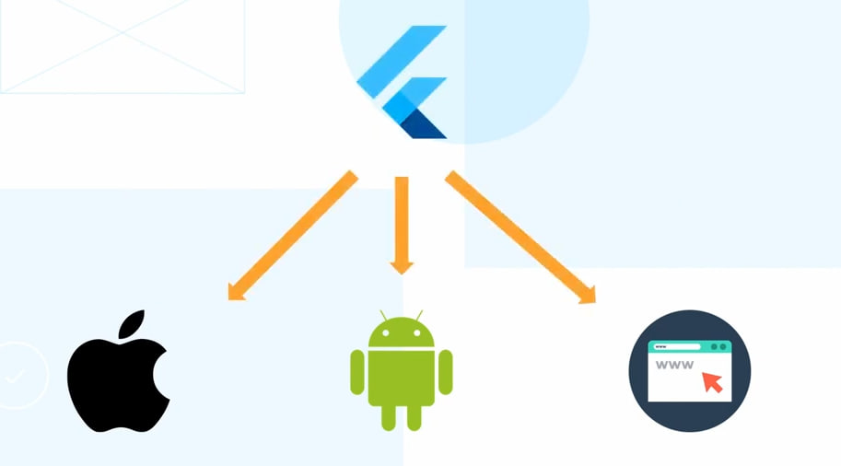
Write once, run everywhere

Slide 9
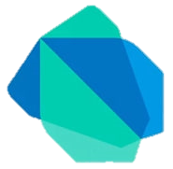
Flutter with DART

Slide 10

How can I become flutter developer ?

Slide 11


Slide 12


Slide 13

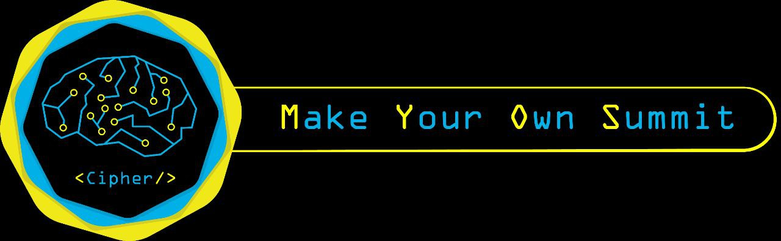
Eng. Ziad Salah
Flutter developer

