Slide 1

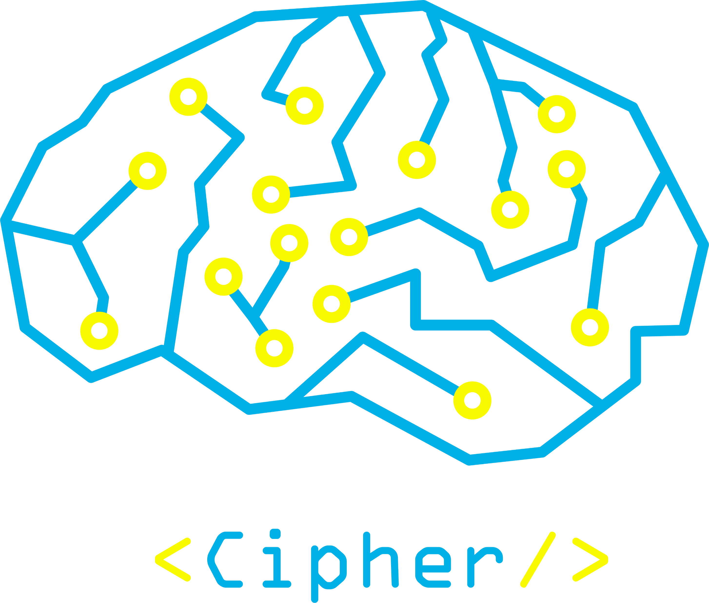


FLUTTER

Slide 2


What about mobile application?

Slide 3

Native
Applications​
Cross platform

Slide 4
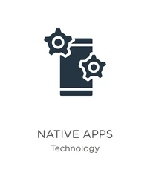

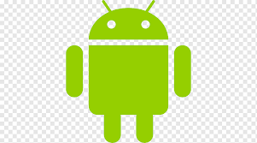
Native
Apps
IOS
Android

Slide 5
IOS Apps
Swift
Objective-C

Slide 6
IOS Apps
Java
Kotlin

Slide 7


Cross Platform apps
.write once run everywhere

Slide 8

What is Flutter ?
Flutter is an open-source UI software development kit created by Google. It is used to develop cross platform applications from a single codebase for any web browser, Android, iOS, Linux, macOS, and Windows

Slide 9

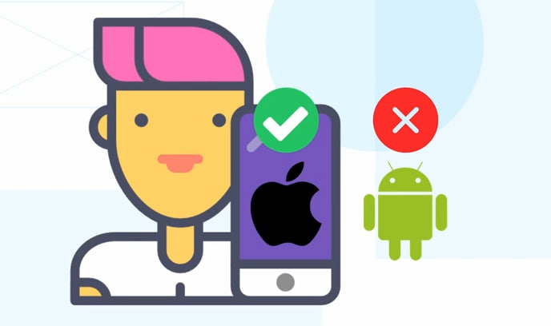
Why Flutter?

Slide 10
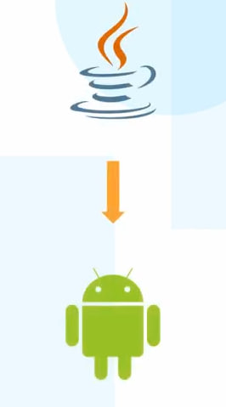
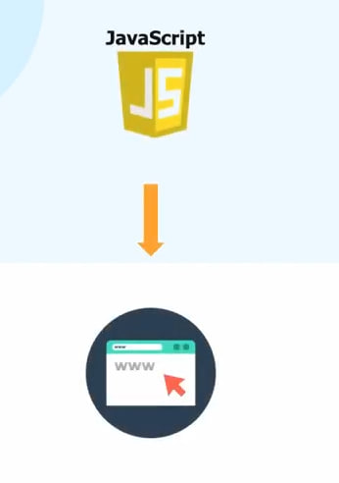
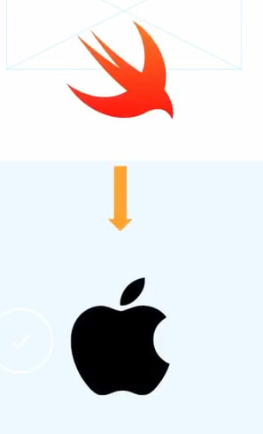

Slide 11
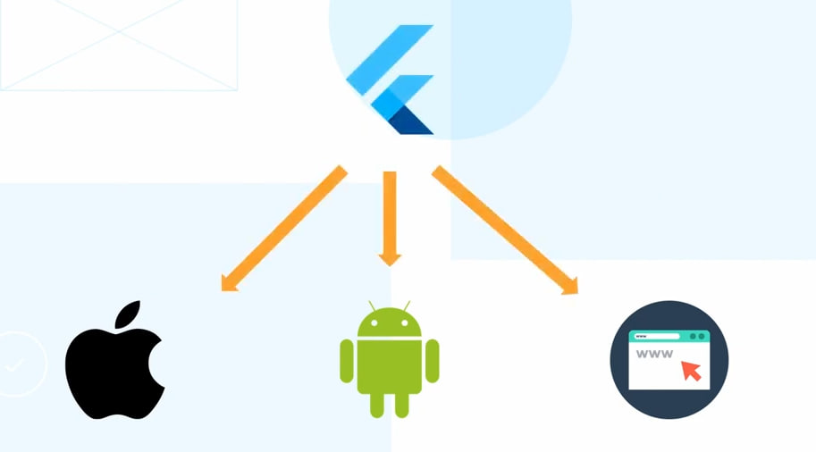

Slide 12

Flutter with DART

Slide 13
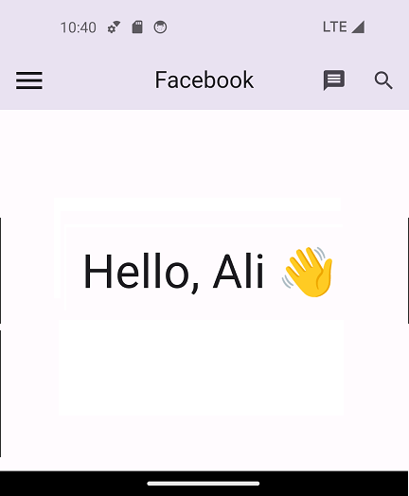
Scaffold
Appbar
Body

Slide 14
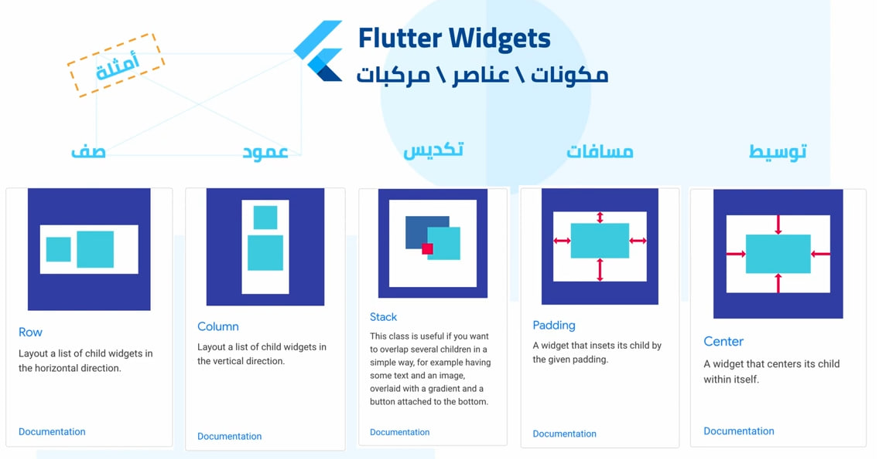

Slide 15

How can I become flutter developer ?

Slide 16

Thank you
Ziad salah
Flutter developer

