Slide 1
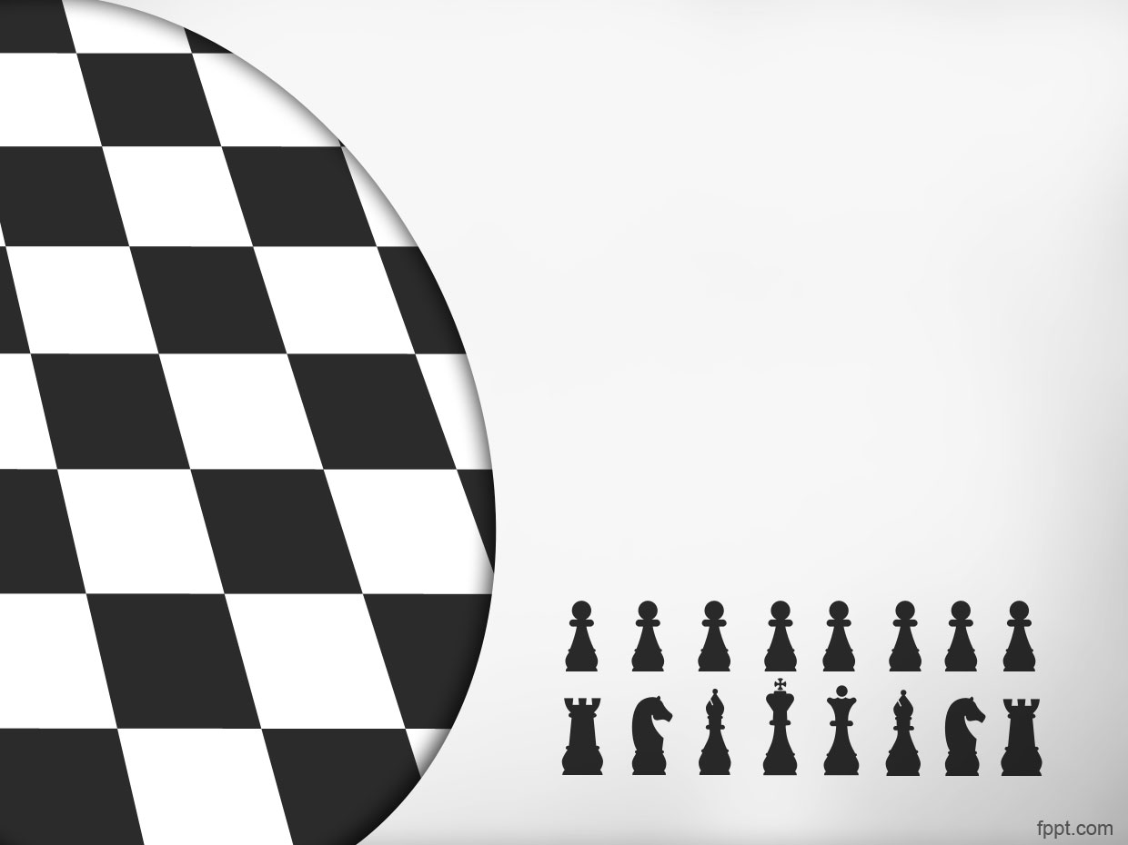
Intelligent Chess Player

Slide 2
Ziad Hany Wadea 20210380
Ahmed Harams Mustafa 20210125
Mohammad Mahmoud Hanafi 20210827
Omnia Ibrahim Sayed 20210180
Zineb Yasser Mohammed 20210389
Mariam Mahmoud Mustafa 20210927

Slide 3
Journey through Chess history #
Chess, a timeless and strategic game, has captivated minds for centuries. Originating in India, it has evolved into a global pursuit, challenging players to engage in a battle of wits on the 64 squares of the checkered board.

Slide 4
Journey through Chess history ##
It has evolved through diverse cultures and civilizations. Its roots can be traced to the ancient game of Tauranga, a precursor that symbolized the four divisions of the military – infantry, cavalry, elephants, and chariots.

Slide 5
General Rules: #
The ultimate goal of chess is to checkmate your opponent's king, placing it in a position where it cannot escape capture.

Slide 6
General Rules: ##
Each piece has specific moves. Pawns advance, bishops diagonal, knights jump, rooks traverse horizontally or vertically, queens combine these movements, and kings cautiously move one square at a time.
Chess can be a leisurely pastime or a race against the clock. Time controls, from classical to rapid, add an element of urgency and decision-making pressure.

Slide 7
Introducing our chess player: #
In a world where technology meets strategy, We've developed something cool
—The Intelligent Chess Player.
This AI-powered chess whiz goes beyond our expectations.
“We designed it in the context of our AI course”

Slide 8
Introducing our chess player: ##
There is lots of different platforms and games that provide online and intelligent chess game
We made a chess game using different algorithms:
. depth-first search
. alpha-beta pruning
. min-max

Slide 9
Let our chess player introduce itself
Here is the chess player let’s dive in~
I was implemented using two heuristics
-Intelligent Decision making
-Positioning Heuristic

Slide 10
“Intelligent Decision making”
Driven by a keen understanding of piece values. Each chess piece is assigned a score, creating a dynamic framework for strategic maneuvers.
Prioritizing high-value pieces gives the ability to capture formidable opponents, strategically enhancing its position.
Avoid exchanging a high-value piece for one that has less score without good positioning and weird moves if there were no good captures ahead and no need to defend itself.

Slide 11
“Positioning Heuristic”
we've introduced a sophisticated positioning heuristic.
Here, each piece is assigned a position array, optimizing its location for strategic advantage. For instance, knights favor the center, reflected in their lower scores towards the borders, preventing unnecessary cornering.

Slide 12
Chess Player:
I'll walk you through the general strategies and decision-making processes I employ, guided by heuristics.
I navigate the chessboard. Through a method known as depth-first exploration, I meticulously analyze potential moves, unraveling the consequences of several moves ahead. It's akin to peering down a labyrinth of possibilities, seeking the most advantageous route toward triumph.

Slide 13
“Impact of Depth-first”
Now let’s go through the Depth-first search:
Depth-first exploration allows me to analyze potential moves in exquisite detail, envisioning the consequences several moves ahead. This depth of analysis is the bedrock of my strategic approach, enabling me to traverse the complex branches of the game tree and uncover hidden tactics.

Slide 14
“cons of Depth-first”
Depth-first exploration comes with its considerations. While it excels in meticulous analysis, it may occasionally overlook promising moves in unexplored branches.
The risk lies in potentially missing out on unexpected opportunities, as the exploration is committed to thoroughly investigating a particular path before backtracking.

Slide 15
“pros of Depth-first”
Yet depth-first exploration remains an indispensable tool. Its advantages in thorough analysis often outweigh the drawbacks, shaping my decision-making and contributing to the overall finesse of my gameplay.
As we journey through the complexities of chess, keep in mind that every move is a calculated step, and depth-first exploration is my guide through the intricate dance of strategy and tactics.

Slide 16
Chess Player:
Then the Alpha-Beta algorithm. Imagine it as my refined and strategic tool, a calculated approach to decision-making that complements and elevates my depth-first exploration.
Together, where heuristics lay the foundation, depth-first exploration refines the details, and the Alpha-Beta algorithm orchestrates the symphony of strategic brilliance.

Slide 17
“Impact of alpha-beta”
Allow me to introduce a key player in my strategic ensemble: Alpha-Beta pruning. This ingenious algorithm transforms the way I traverse the possibilities on the chessboard.
Imagine a method that stops evaluating a move the moment it uncovers a possibility worse than a previously examined one—a game-changer in efficiency and precision.

Slide 18
NO. moves
After Before
- 9966 - 643
- 724 - 39
- 35572 - 6034

Slide 19
“Impact of alpha-beta”
Here's the brilliance: it significantly reduces the number of moves I need to evaluate. By intelligently pruning away unpromising branches, it streamlines the decision-making process. Think of it as a sculptor chiseling away the unnecessary, leaving behind a masterpiece of strategic brilliance.

Slide 20
“Cons of alpha-beta”
In certain situations, where move rankings are close, the impact of Alpha-Beta pruning might be less pronounced, revealing a nuanced challenge.
Implementing this requires a careful coding, as any misstep can affect the quality of its pruning performance.
The effectiveness of Alpha-Beta pruning play in harmony with move order; a subtle cadence that influences the quality of its pruning, demanding strategic acumen.

Slide 21
“Pros of alpha-beta”
Alpha-Beta pruning is my efficiency virtuoso, reducing the number of moves I scrutinize, and allowing me to focus on the most promising ones.
By intelligently pruning away less fruitful branches, I refine my strategic precision.
at resource conservation, optimizing computational prowess, and enabling me to delve deeper into the chess tapestry.

Slide 22
“Conclusion of alpha-beta”
Using this algorithm, allows me to peer into the future moves, adeptly assess positions, and strategically choose the path that promises success.
In essence, I navigate the chessboard with a blend of foresight, evaluation, and strategic decision-making.

Slide 23
Chess Player
Here my role as The Chess player is finished, the presentation will continue all the required topics to be discussed

Slide 24
Similar apps in market
Stockfish: An open-source chess engine that is widely regarded for its strength and analysis capabilities. Many chess platforms use Stockfish as their engine.
Komodo: Another powerful chess engine known for its deep analysis and strategic play. It's available for various platforms and is used in both standalone applications and online chess platforms

Slide 25
Similar apps in market
Chess.com: A popular online chess platform that offers a computer opponent for players of all levels. It also includes features like lessons, puzzles, and an interactive community.
Lichess: A free, open-source online chess platform that includes a computer opponent powered by Stockfish. It's known for its clean interface and strong community.

Slide 26
Main functionalities #1
Importing Modules:
import pygame: Imports the Pygame library for
building the game.
import engine: Imports a custom module (engine) that seems to handle the game logic.
import Ai: Imports a module for artificial intelligence, presumably for the chess opponent.

Slide 27
#2
Configurations:
WIDTH, HEIGHT: Defines the dimensions of the
game window.
SQUARES_NUMBER: Specifies the number of
squares in each axis.
SQUARE_SIZE: Calculates the size of each
square based on the board dimensions.
IMAGES: An empty dictionary to store
images of chess pieces.

Slide 28
#3
Loading Piece Images:
  get_images(): Loads images of chess
  pieces into the IMAGES dictionary using
  Pygame's transform.scale method.
Drawing Board:
  draw_board(background): Draws the
  chessboard with alternating colors for
  each square.

Slide 29
#4
Drawing Pieces:
  draw_pieces(screen, board_state): Draws
  chess pieces on the board based on
  the current game state.
Drawing Current State:
  draw_current_state(): Calls functions to
  draw the board and pieces based on the
  current game state.

Slide 30
#5
Initialization:
Initializes Pygame and sets up the
game window.
Creates a GameState object from the
engine module.
Retrieves valid moves for the initial state.

Slide 31
Game Loop: #6
Runs the main game loop.
Handles events such as mouse clicks and key presses.
Manages human and AI turns, allowing players to make moves.
Checks for game-over conditions (checkmate or stalemate).
Allows undoing moves with the backspace key.
Updates the display with the current game state.

Slide 32
#7
AI Moves:
  Calls the AI module to find and execute the best move for the AI player.
Display Update:
  Updates the display to reflect the current state of the game.

Slide 33
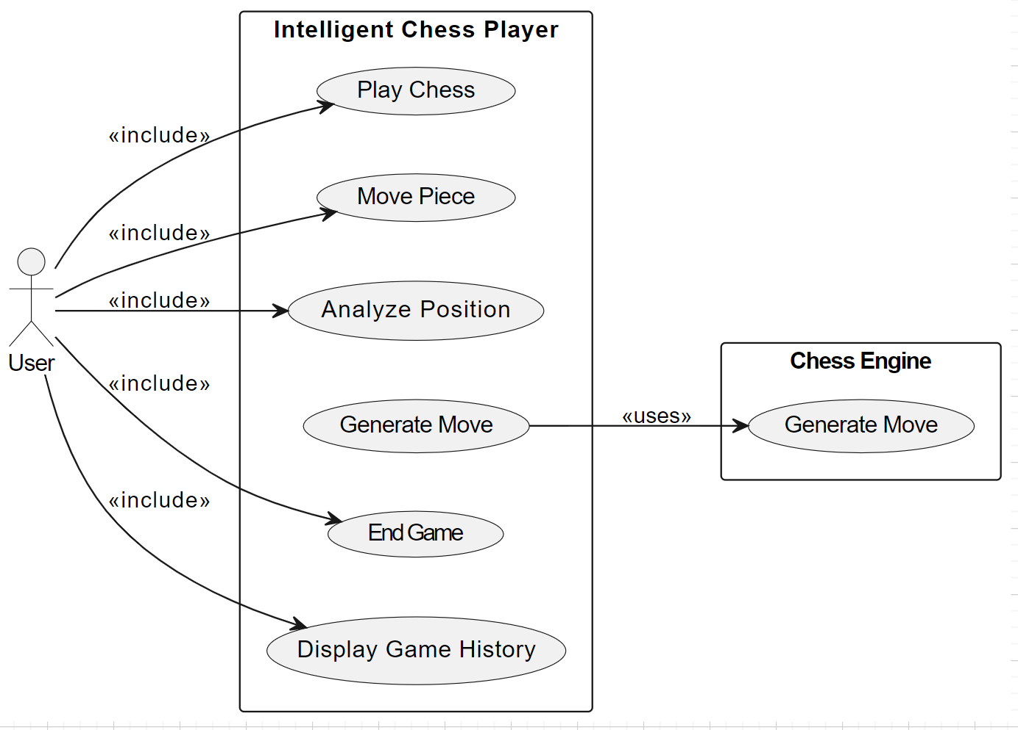

Slide 34
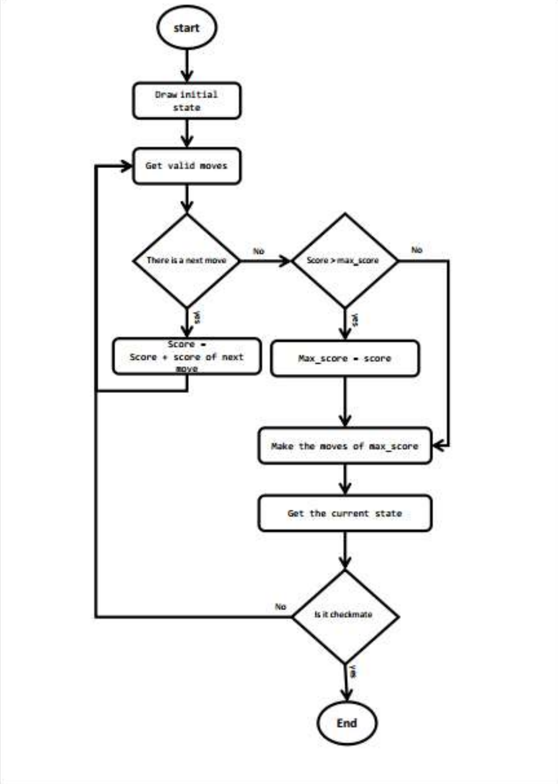

Slide 35
Search papers in this context #
https://www.researchgate.net/publication/49400711_Intelligence_and_chess
https://www.sciencedirect.com/science/article/abs/pii/S0160289606001139
https://www.geocities.ws/chess_camp/study_1.pdf

Slide 36
Search papers in this context ##
https://arxiv.org/pdf/1712.01815v1.pdf
https://www.chesspower.co.nz/chess-research.html

Slide 37
Platform and Dataset
Dataset link: https://www.kaggle.com/datasets/ziadhanywadea/chess-game/data
Development Platform: Visual studio

Slide 38
Thanks

