Slide 1



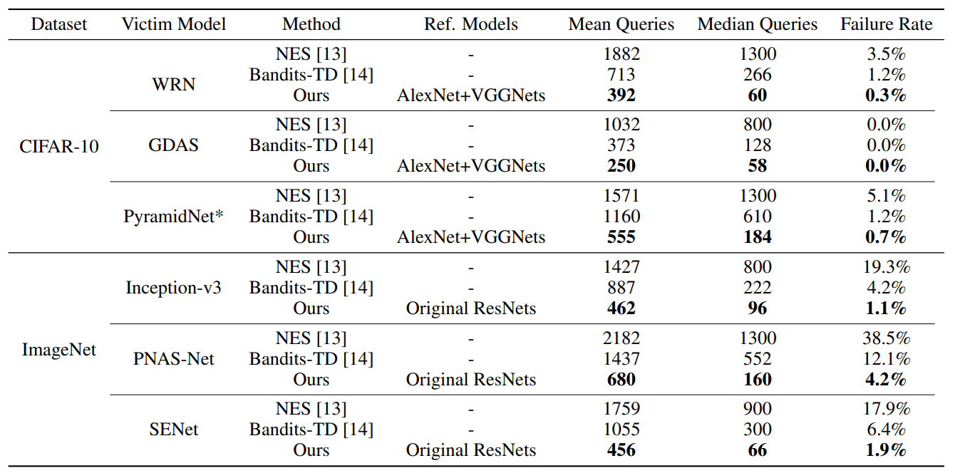
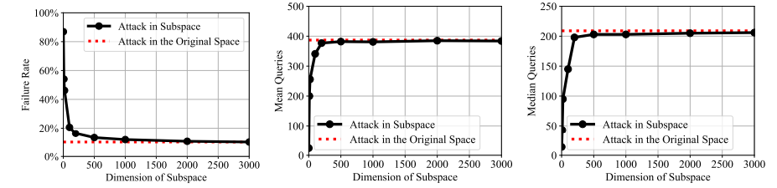
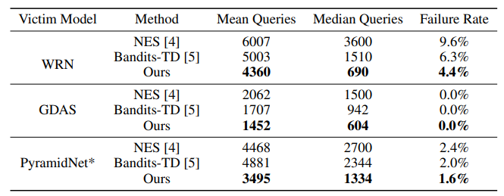
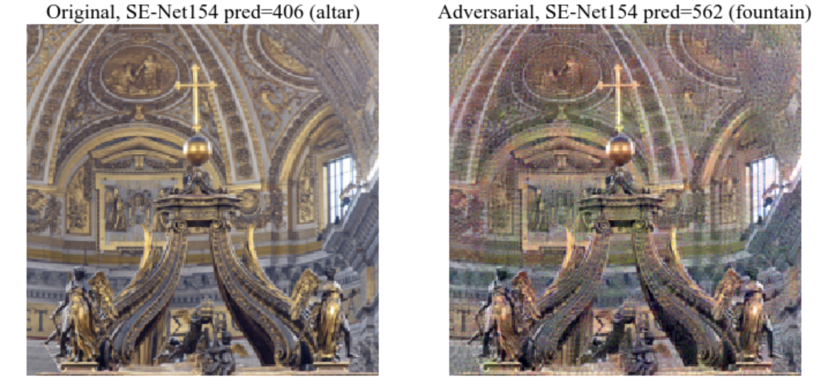
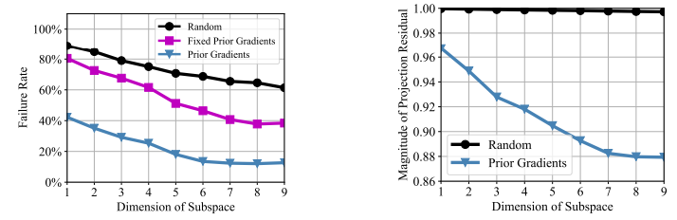

Subspace Attack: Exploiting Promising Subspaces for Query-Efficient Black-box Attacks
Ziang Yan^{1,3}* Yiwen Guo^{2,3}* Changshui Zhang¹
Tsinghua University¹ Bytedance AI Lab² Intel Labs China³
Introduction and Background
DNNs are vulnerable to adversarial attacks. Even without access to network parameters (i.e., black-box), attacks can still be performed.
Transfer-based black-box attacks utilize transferability of adversarial examples between models, and suffer from high failure rates.
Query-based black-box attacks are performed by zeroth-order optimizations, but high query complexity is inevitable, making the procedure costly and probably suspicious to the classification system.
Subspace Attack (to bridge the gap)
We first discover that gradient estimations and zeroth-order optimizations can be performed in random subspaces with much lower dimensions than one might suspect.
Promising subspaces can be spanned by utilizing gradients of a few reference models, trained using small auxiliary datasets.
Efficiency is improved by “coordinate descent” and exploration is encouraged by drop-out and drop-layer.
Results
Our subspace attack improves both query efficiency and attack success rate.
Attack in Random Subspaces
Untargeted Results
Source Code
Targeted Results
Generated Adversarial Examples on ImageNet
Attack in Subspaces Spanned by Prior Gradients

