Slide 1

SCE17-0153 Hierarchical Text Topic Detection From Text Data
By: Chen Ziao
Supervisor: Assoc. Prof Adams Wai Kin Kong

Slide 2

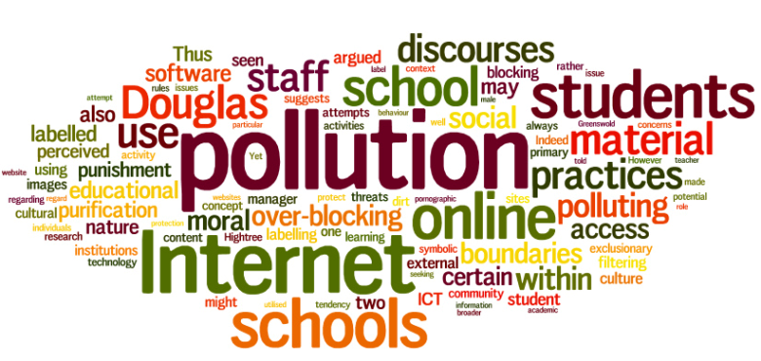
Text Topics
There are a lot of text documents and articles online
What are these topics talking about?

