Slide 1
Exchange-Rate Flexibility and External Adjustment
An Early Comparative Assessment of Bangladesh, Pakistan, and Vietnam
Research question How did Bangladesh's exchange-rate and reserve pressure dynamics evolve around its May 2025 move toward a more flexible exchange-rate arrangement, and what does a stylized external-shock stress test suggest about remaining vulnerabilities?
Why Bangladesh, why now
Comparators: Pakistan & Vietnam
Bangladesh Bank adjusted the exchange rate in May 2024, followed by the introduction of a crawling peg with band regime in mid-May 2025. A live, ongoing transition with limited existing empirical assessment.
Chosen to illustrate differences in exchange-rate management, external financing structure, reserve management, remittance dependence, and trade structure. They were not selected to imply structural similarity to Bangladesh.
Descriptive, non-causal assessment — an Exchange Market Pressure index plus a mechanical stress-test scenario

Slide 2
METHODOLOGY
Data & Empirical Framework
Coverage & sources
Countries: Bangladesh, Pakistan, Vietnam
Sample: 2018-M01 to 2026-M06 (monthly, common window); stress-test baseline 2025-Q2 to 2026-Q1
Core variables: reserves (excl. gold), nominal exchange rate, current account, goods exports/imports, remittances (BGD/PAK), global energy-price index
Exchange Market Pressure (EMP)
Kaminsky, Lizondo & Reinhart (1998), IMF Staff Papers — two-component index
EMPᵢ,ₜ = %Δeᵢ,ₜ − αᵢ × %Δrᵢ,ₜ
Primary sources
e = domestic currency per USD, end-of-period
r = IMF International Liquidity reserves excluding gold
αᵢ = σ(%Δe) / σ(%Δr), estimated per country over the full common sample
• IMF International Liquidity — reserves excluding gold
• IMF Exchange Rates (ER) — nominal exchange rate, end-of-period
• IMF Balance of Payments (BOP) — current account, goods trade
• IMF World Economic Outlook — GDP growth, CPI (context only, not used as reform-window evidence)
• IMF Primary Commodity Price System — global energy-price index
• Bangladesh Bank / State Bank of Pakistan — national remittances
No policy-rate data required. KLR's original crisis-dating threshold is not applied ; the continuous index is used descriptively only.
Analytical layers
Gate 2 — descriptive pre/post-reform event-window comparison Gate 3 — mechanical 4-quarter stress-test scenario
Source: RESEARCH_LEDGER.md, DATA_DICTIONARY.md — full provenance and verification record.
2

Slide 3
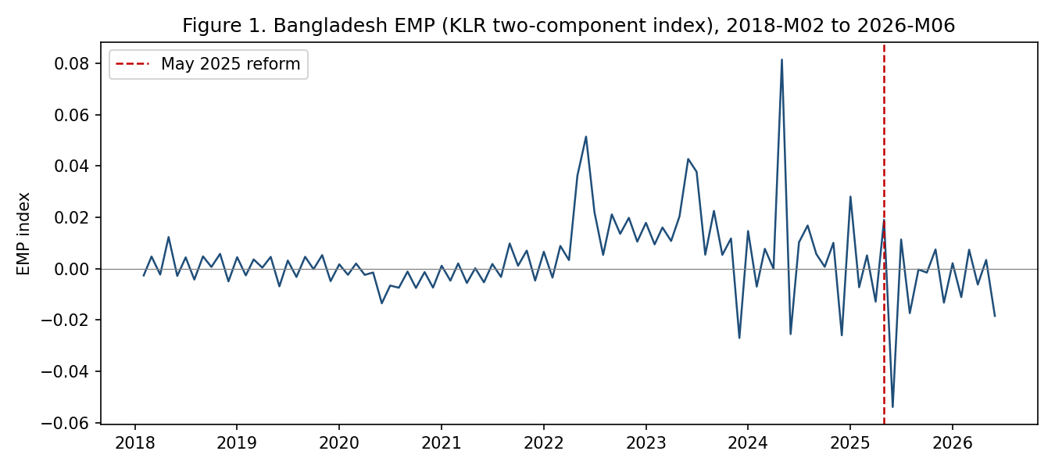
DESCRIPTIVE EVIDENCE
Exchange-Market Pressure Around the May 2025 Reform
Pre-reform mean (12mo)
0.0072
May 2025 (reform month)
0.0190
Post-reform mean (12mo)
−0.0060
Full historical mean
0.0037
May 2025 is not unusually large relative to the preceding 12-month empirical distribution.
Bangladesh EMP (KLR two-component index), 2018–2026; dashed line = May 2025 reform
Central interpretive constraint
Pakistan (−0.0023 → −0.0113) and Vietnam (0.0035 → 0.0000) show the same directional decline in mean EMP over the identical calendar window. Neither had a comparable reform. In this descriptive design, Bangladesh's pattern cannot be disentangled from common external conditions; the observed change is associated with, not attributed to, the May 2025 reform.
Source: emp_klr_two_component.csv, gate2_event_window_summary.csv, GATE2_ANALYSIS.md (locked). Descriptive only — not a causal estimate.
3

Slide 4
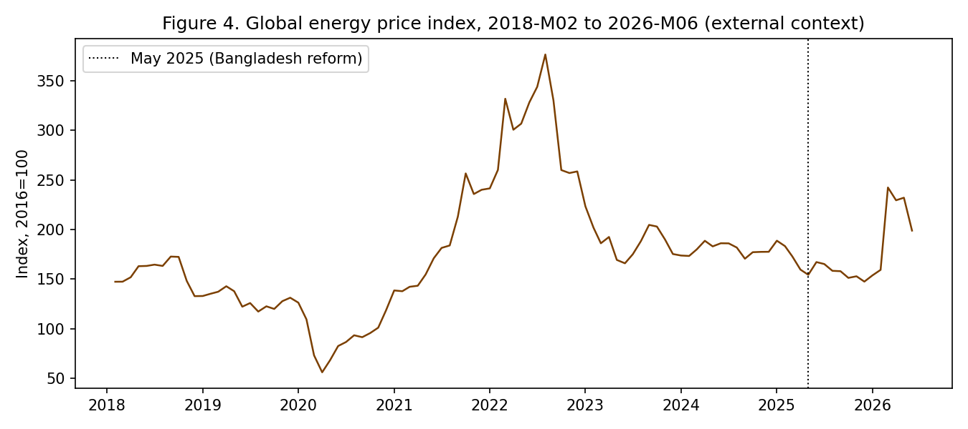
EXTERNAL POSITION
External Adjustment & Vulnerability Channels
Latest observed 4-quarter baseline (2025-Q2 to 2026-Q1, USD million)
 | Exports | Imports | Current acct. | Remittances (12mo)
Bangladesh | 42,477.2 | 66,594.0 | 161.0 | 34,748.9
Pakistan | 30,913.0 | 62,457.0 | 450.0 | 40,589.9
Vietnam | 494,755.0 | 458,784.0 | 31,023.0 | N/A
Vietnam remittances: N/A (no suitable nationwide monthly series available).
Bangladesh's near-zero current-account balance provides little offset to the scale of its trade flows in the stress-test baseline. (see Slide 5).
Why this matters
Vulnerability channels identified
The same energy-price series is used as the mechanical import-price shock proxy in the stress test. A global benchmark is applied identically to all three countries instead of being country-specific.
• Reserve accumulation observed since the reform (e.g. Bangladesh, June 2025) should not be read as confirmation of durably reduced pressure; the same directional pattern appears in Pakistan and Vietnam.
• Post-reform EMP movement is attributable mostly to the reserve component, not the exchange rate, which has moved in discrete, managed steps consistent with a crawling peg with band.
• A global energy-price spike (2026-M03) falls inside the post-reform window.
Source: gate3_stress_test.csv, master_analytical_dataset.csv (locked). Descriptive only.
4

Slide 5
STYLIZED SCENARIO — NOT A FORECAST
Four-Quarter External-Shock Stress Test
Shocks: remittances −10% (BGD/PAK only) · exports −5% (all three) · import value +10% (stylized, global energy-price shock, real quantities held constant) · baseline 2025-Q2 to 2026-Q1
Bangladesh
Pakistan
Vietnam
Combined external-account deterioration
Combined external-account deterioration
Combined external-account deterioration
−$12,258.1m
−$11,850.3m
−$70,616.2m
Mechanically shocked current account
Mechanically shocked current account
Mechanically shocked current account
−$12,097.1m
−$11,400.4m
−$39,593.2m
Remittance + export + import-price shocks
Remittance + export + import-price shocks
Export + import-price shocks only — no remittance shock
Policy-relevant implications (descriptive, not causal; countries not ranked)
• Given their small baseline current-account surpluses relative to trade flows, the imposed combined shocks mechanically produce large external-account gaps in Bangladesh and Pakistan.
• These figures show implied cumulative deterioration over 4 quarters — not predicted reserve losses. Actual outcomes depend on financing, exchange-rate adjustment, capital flows, and policy response, none of which are modeled here.
• Vietnam's remittance shock is marked N/A, not zero — no suitable nationwide monthly remittance series was available; its combined figure reflects two shocks, not three, and is not directly comparable to the other two countries'.
Limitations: descriptive, fixed-window design with no causal identification; shock magnitudes and the import-price transmission assumption are imposed, illustrative choices, not estimated parameters; external debt, REER, and policy rate are out of scope.
Source: gate3_stress_test.csv, STRESS_TEST.md, FINAL_RESULTS_LOCKED.md R-005 (locked). Mechanical scenario — not a forecast.
5

