Slide 1

CCI CANTEEN SYSTEM
Onwabe Zibeke, Call Center Agent | BSc in ICT ( Software Developer)

Slide 2

About Project
Executive Summary
At CCI Durban, a significant operational inefficiency has been observed: agents frequently exceed their allocated 30-minute breaks due to long queues at the canteen. This delay disrupts workflow, reduces productivity, and contributes to unnecessary stress among staff. Furthermore, financial hardship is a recurring issue for some agents, particularly towards the month-end, leading to skipped meals and reduced morale.
To address these challenges, I propose the implementation of the CCI Canteen System—a digital platform that enables advance food ordering, real-time meal status tracking, and a controlled allowance system for agents in need. The solution is integrated with CCI’s existing employee verification systems to ensure security, ease of use, and scalability.
The CCI Canteen System is a practical, secure, and employee-centric solution that aligns with both operational goals and the welfare of agents. It is built on the foundational understanding of internal systems and employee needs.

Slide 3
Problem Statement
This section identifies the key issues affecting agent productivity and satisfaction. Operationally, extended canteen wait times disrupt break adherence, impacting team performance. Financially, agents face challenges affording meals during work hours, with no existing support system in place to bridge short-term food access gaps.
Operational Challenges
Financial Constraints
CCI agents have two 30-minute breaks, one of which is typically lunch.
Long queues at the canteen regularly lead to agents exceeding their break times.
Supervisors and team leaders often struggle to maintain adherence metrics due to inconsistent break durations.
Many agents face short-term financial challenges, especially between pay periods.
There is currently no internal credit system or support mechanism tailored to food access during work hours
ZIBEKE

Slide 4

Proposed Solution
The CCI Canteen System is a web-based platform, optimized for both desktop and mobile use, that offers the following
ZIBEKE

Slide 5
System Overview
The CCI Canteen System is a web-based platform, optimized for both desktop and mobile use, that offers the following:
1. Online Pre-Ordering
Agents can place meal orders in advance.
Orders can be scheduled based on designated break times to ensure availability without queuing.
2. Live Meal Status Tracking
Orders will move through status phases:
Ordered
Preparing
Ready
Collected
Admins (kitchen staff) can update these statuses in real time.
Agents will be notified of status changes and can pick up meals accordingly.
3. Canteen Credit Allowance
Every agent is eligible for up to R500 canteen credit per month.
Funds are only deducted from salary if used.
The credit becomes available 3 working days into the new month, ensuring CCI has sufficient funds from the new salary cycle to back any used credit.
This system is tied to real-time employee data from CCI Connect to prevent abuse.
4. Cancellation Policy
Agents may cancel orders under these conditions:
Before preparation starts (Ordered): No charge.
During preparation (Preparing): 25% cancellation fee.
Once marked as ready (Ready): 50% cancellation fee.
After collection (Collected): Cancellation is disabled.
Example: For a R10 item:
R0 fee if cancelled at “Ordered”
R2.50 fee at “Preparing”
R5.00 fee at “Ready”
5. Payment Options
Agents can choose from:
Card
Cash
Allowance (if available)

Slide 6
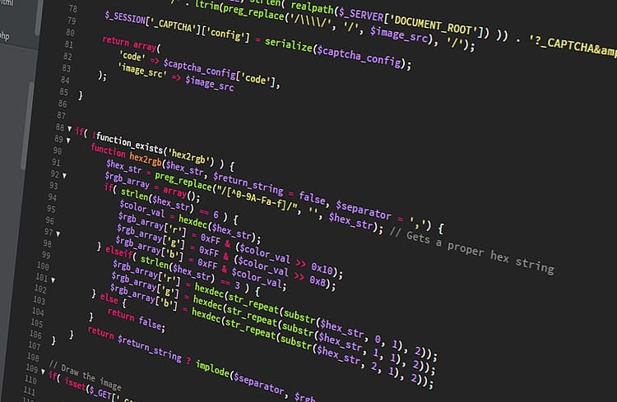
Technical Implementation
The CCI Canteen System is a web-based platform, optimized for both desktop and mobile use, that offers the following
ZIBEKE

Slide 7
Overview of System Architecture and Integration
This section outlines the technology stack, system flow, and security measures that power the platform. It highlights the frontend design for user accessibility, backend integration with CCI Connect for real-time authentication, and robust security protocols to ensure secure and compliant usage of employee allowances.
A. Frontend
Developed using HTML, Tailwind CSS, and JavaScript for responsiveness.
Accessible via mobile phones or work desktops.
Login system integrated with CCI Connect credentials (Employee Code + Password).
No manual account creation—authentication is automated via the internal database.
B. Backend
Secure Node.js + Express server (or equivalent) for managing user sessions, orders, and updates.
CCI Connect API integration for real-time employee status verification.
Admin dashboard for kitchen staff to view, update, and manage orders efficiently.
Transaction logs with secure encryption for tracking.
C. Security
Allowance usage is tied strictly to authenticated employees.
If an agent is terminated or resigned, their access is revoked immediately through live sync with CCI Connect.
No cash-out option is allowed for allowance of use; it is strictly for food purchases within the system.

Slide 8
Benefits to CCI employees
Operational Efficiency
Significant reduction in canteen queue times.
Better adherence to break schedules.
Improved productivity and supervisor oversight.
Employee Welfare
Agents are less likely to skip meals due to financial hardship.
The allowance system provides dignity and self-management without third-party loans or embarrassment.
Supports mental health by reducing food-related stress.
Financial Control for CCI
3-day allowance delay ensures financial stability and minimizes risk.
No open credit—only salary-backed usage.
System prevents unauthorized access automatically through HR status checks.

Slide 9
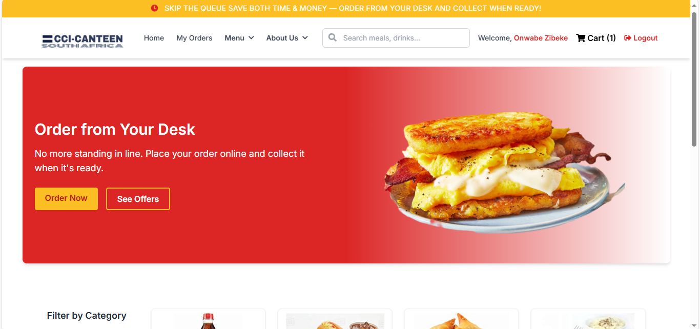
title
Full screen image of cci canteen system
ZIBEKE

Slide 10





Thank You
Onwabe Zibeke
+127 784 300 901
Zibekeonwabe@gmail.com
Esgela.onrender.com
ZIBEKE

