Slide 1

Agent Trainer Software
Presentation by:
ONWABE Zibeke
101
Notes:
1

Slide 2
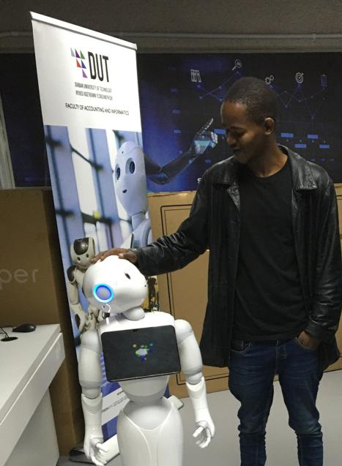
About Me: Software Developer
About Me
My name is Onwabe Zibeke, and I come from the Eastern Cape, South Africa — a place that shaped both my values and voice. In 2022, I completed my degree in Information and Communication Technology, majoring in Software Development and Machine Learning. Despite my qualifications, I struggled to find opportunities. For two years, I sent out applications with no callbacks — no internship, no junior position. But I didn’t give up. I used that time to continue learning and sharpening my skills. In 2024, CCI gave me my first real chance — and I’ll always be grateful for that.
The Struggles I Faced
When I joined the TalkTalk campaign, I started in Customer Service before moving into Collections. The training was informative, but when I got to the floor, I quickly saw the gap between theory and practice.
My empathy didn’t feel real — it sounded scripted. Customers could sense it. And because of my strong Xhosa accent, I often had to repeat myself. Some customers became frustrated. Complaints started to come in.
But instead of taking that as defeat, I took it as direction. I thought: “What if there was a way to train new agents using real-life call situations — something more human, more practical, more adaptive?”
That was the beginning of my idea — something I now call the Agent Trainer.

Slide 3

Challenges faced by new Agents
_{o1.}
System navigation
_{o2.}
Fear of Taking the first call
_{o3.}
Failure of Using guidance system when there is a customer
_{o4.}
Lack of Confidence
_{o5.}
Fear of the unknown
Agent trainer
3

Slide 4

Effects of new Agent challenges to the Company:
Unnecessary complaints
Image of The company
Loss of revenue and customers
What can we Do to Assist?

Slide 5

Introduction: Background of The Software
Agent Trainer is an innovative software designed to enhance customer service skills through interactive AI simulations. The platform enables trainees to engage in real-time call and chat scenarios with AI-powered customers who present a variety of queries. This dynamic environment allows trainees to practice their responses, improving their listening skills, communication, and response time in a controlled setting.
By using Agent Trainer, trainees gain hands-on experience handling customer inquiries with the appropriate tone and efficiency. The AI challenges them to ensure customer satisfaction and resolve issues while avoiding unnecessary complaints. This risk-free practice prepares trainees to confidently and effectively deliver high-quality service when engaging with real customers.
AGENT TRAINER
5

Slide 6

Benefits of (Why use) Agent Trainer
_{o1.}
Risk Free Environment
_{o2.}
Gaining hands-on experience
_{o3.}
Effective and Relevant Training
_{o4.}
Multi-tasking and listening skills
_{o5.}
Save and Reduce Unnecessary Complaints
AGENT TRAINER
6
ThePhoto by PhotoAuthor is licensed under CCYYSA.

Slide 7
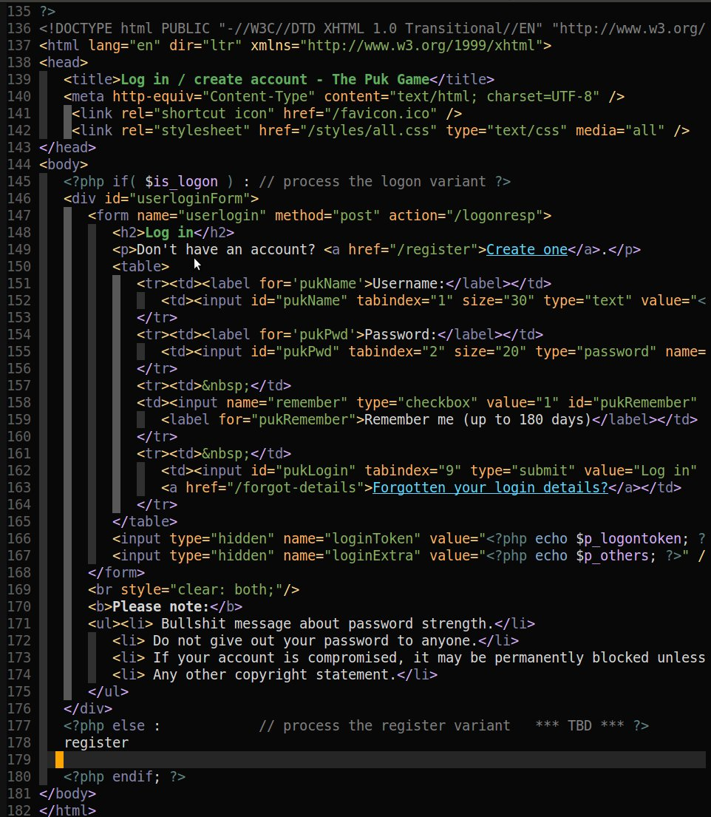
Technologies: Used to Develop Agent Trainer
Gemini AI (Open-source AI for simulating customer interactions)
Tailwind CSS (For streamlined and responsive design)
Node.js (Backend server for seamless real-time interactions)
HTML (Structure of the platform)
CSS (Styling and layout)
JavaScript (Frontend interactivity and functionality)
MongoDB (Database for storing user data and training scenarios)
AGENT TRAINER
7
ThePhoto by PhotoAuthor is licensed under CCYYSA.

Slide 8

Current Challenges
Budget
I’m working with a limited budget, which means I don’t have enough financial resources to invest in the best tools, research, and resources. This can impact the quality of my project and slow down my development process. I’m relying on free or low-cost alternatives, which may have limitations or trade-offs.
Experience and Skills
Despite having a strong educational background, I lack work experience, which can make it harder to navigate real-world development challenges. This means I spend more time researching and learning, and my code structure and quality may not be on par with more experienced developers.
Time
Developing this software project alongside my regular work requires a significant time commitment. With a demanding schedule from 8:00 AM to 9:30 PM, I have limited time and energy to focus on the project, making it challenging to maintain focus and make progress.

Slide 9
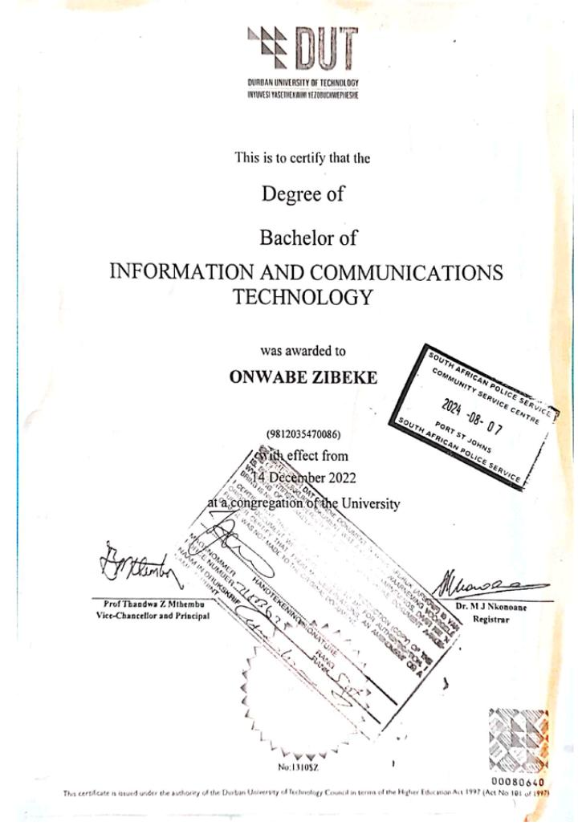
Agent Trainer Proposal
About Onwabe: I am a software development graduate from Durban University of Technology, with a strong educational background in software development. Through personal projects and ambitions, I have developed a range of skills and experience in software development, including programming languages, software development principles, and innovative solutions.
Collaboration I am fully committed to collaborating with experienced developers to ensure this idea is implemented effectively and efficiently, with my focus on the concept, user experience, and strategic impact.
Value to the Company This project will provide significant value by reducing errors, increasing customer satisfaction, and preparing agents for real-world customer interactions, all while saving time and resources in the training process.
Agent trainer

Slide 10

Thank you
Name:
Onwabe Zibeke
Contact detail:
Zibekeonwabe@gmail.com
0784300901

