Slide 1
Does Chronos-2 have a tunnel effect?
Layer-wise probing of a time-series foundation model
Notes:
"Today I'm asking a simple question about Chronos-2, a time-series foundation model: does it have a tunnel effect? I'll answer it by probing each layer.”
过渡 → "Let me start with what 'tunnel effect' means and what exactly I'm testing."
可能问题
Q: What's Chronos-2 again? → "Amazon's pretrained foundation model for time-series forecasting — encoder-only, ~120M params. I'm using it off-label, as a frozen feature extractor."
Q: Why this topic / who proposed it? → "It's the onboarding project Amartya set up — extending the tunnel-effect / Head2Toe line of work to time-series foundation models."
0. 数字速查 (BASICS BANK — 被问到立刻能答)
Model·
Chronos-2, amazon/chronos-2. ~120M parameters, encoder-only, T5-style.
12 encoder layers, d_model = 768, 12 heads, d_ff = 3072, patch size 16, context length 8192.
注:chronos-2-small(~28M)在 Hub 上不存在,所以用了 120M 这个。被问 "why not the small one" → "the small checkpoint isn't public on HuggingFace, so I used the 120M base."
Frozen — 整个实验从不训练/微调模型,只在它固定的表征上训一个小分类器。
全程在 MacBook Pro M5 本地跑,float32,MPS backend,没用集群。每次实验几分钟到十几分钟。
Probe (探针)
Linear logistic regression(sklearn),每层一个。max_iter=2000,默认正则,先做 StandardScaler(只在 train 上 fit)。
多通道处理:每个 channel 单独过 encoder → 拼接(c 个通道 → c×768 维/层)。
池化:对 content patches 取 mean pooling(也跑过 all-positions 和 REG-token 两种做对照)。
Datasets (UEA classification)
Dataset领域n_train / n_testclasseschancelate-drop (band) 95% CI备注Handwritinghandwriting150 / 85026.038+.050 [.025,.075]主图 (tunnel shape)SelfRegulationSCP1EEG268 / 2932.50+.063 [.027,.099]OOD 主数据集UWaveGestureLibrary手势/动作120 / 3208.125+.085 [.051,.123]最强效应EthanolConcentration化学光谱261 / 2634.25+.070 [.015,.121]LSST天文光变曲线2459 / 246614.07+.015 [.001,.030]效应小但显著(test 大)SelfRegulationSCP2EEG200 / 1802.50−.018 [−.090,.057]唯一不显著(probe≈chance)Epilepsy加速度计/动作137 / 1384.25(+.046)饱和,只当反例Cricket动作108 / 7212.08~0饱和,排除
⚠️ 要核对:上表 n_train/n_test / classes / chance 来自你的 run log(可信)。channel 数和序列长度是 UEA 标准值,建议你在 load_classification 输出里再确认一次再对外说精确数字。常见值:SCP1 6ch/len896,SCP2 7ch/len1152,Handwriting 3ch/len152,UWave 3ch/len315,Ethanol 3ch/len1751,LSST 6ch/len36,Epilepsy 3ch/len206。
关键统计口径
"middle" band = layers 3–8(事先定好的,a priori),"last" = layer 11。
late_drop_band = mean(acc, L3–L8) − acc(L11),配对 bootstrap 95% CI(B=2000)。
CI 都是 对 test set 重采样得到的;层间差异用配对 bootstrap(同一批样本)。
The must-knows you flagged, so they're top-of-mind:
Model — amazon/chronos-2, ~120M params, 12 layers, d_model 768, patch size 16, frozen, run locally on the M5. If asked why not the small one: the 28M chronos-2-small isn't public on HuggingFace, so you used the 120M base.
Probe — linear logistic regression per layer, StandardScaler on train only, no tuning. Per-channel through the encoder, then concatenate.
Data — the table has n_train/n_test, classes, chance, and the late-drop CI for all eight datasets. One honesty flag: the train/test/classes/chance numbers came straight from your run logs and are solid, but I reconstructed the channel counts and sequence lengths from the UEA spec — verify those against your load_classification output before quoting exact numbers, since those are the easy ones to misstate in front of Irina.
The three questions I'd most rehearse, because they're near-certain from a sharp lab:
"Why a linear probe and not an MLP?" → it measures directly decodable information, so layer differences reflect the representation, not the probe's capacity (and it's Head2Toe's setup).
"Did you cherry-pick the best layer?" → middle is a pre-declared band (L3–8), not chosen post-hoc; the argmax version is reported but labeled as selection-biased.
"Isn't the last-layer drop just because it's a forecasting model?" → that is the proposed mechanism, not a confound — and separating it from plain domain-mismatch is exactly your next experiment.
One strategic note that's in the sheet but worth saying plainly: with Irina in the room, the honest "I didn't test that, my expectation is X" beats improvising — the whole strength of this work is that you tested where it holds and where it doesn't. Don't defend the Part 2 null; own it.
Want me to fold this script into the deck's speaker notes so it's all in the presenter view, or keep it as a separate sheet you glance at?

Slide 2
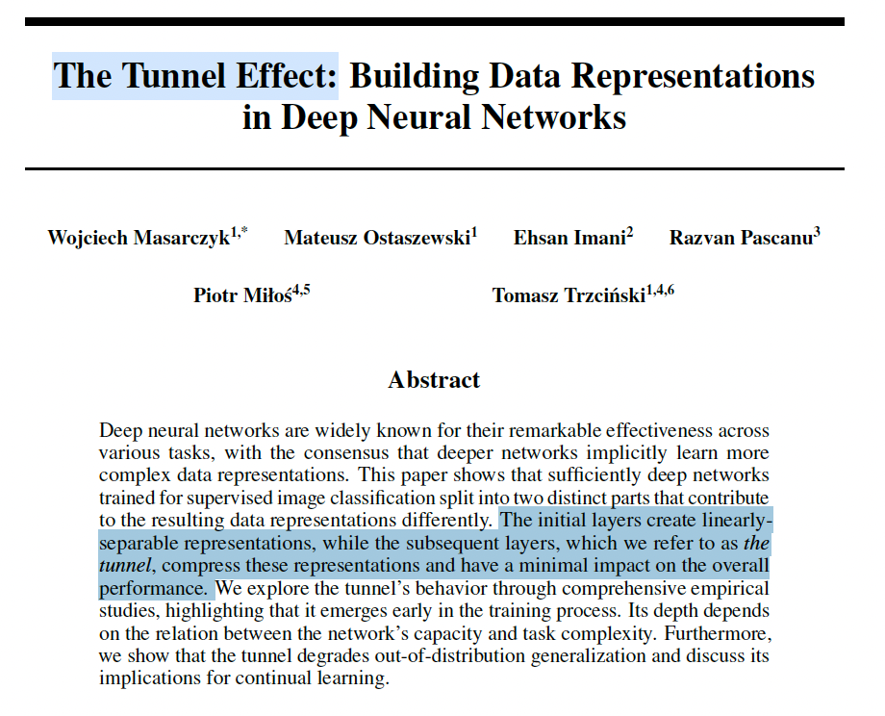
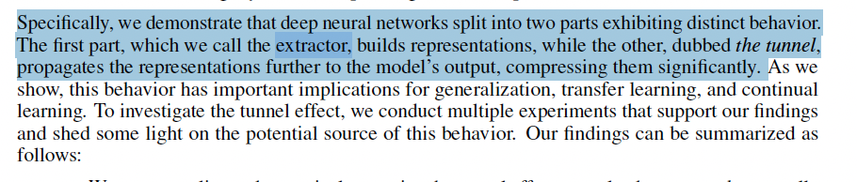


THE QUESTION
Is there a “tunnel effect” in time-series models?
1
Middle > last
2
…especially OOD
Middle layers hold more task-relevant information than the final layer.
And that advantage grows when the data is unlike what the model was trained on.
WHY A FORECASTING MODEL?
Chronos-2’s final layer is tuned to produce forecasts — so it may discard the general structure that middle layers still hold. If a tunnel effect exists, the last layer is where it should show.
Notes:
🗣️ The tunnel-effect idea, from the vision literature, says the middle layers carry the most transferable, task-relevant information, and the last layers specialize away from it. I split this into two parts. Part 1: middle layers should beat the last layer at decoding the task. Part 2: that middle-over-last advantage should grow when the data is out-of-distribution. And why a forecasting model? Chronos-2's final layer is tuned to produce forecasts — so it's exactly where we'd expect it to discard general class structure that the middle layers still hold. If a tunnel effect exists anywhere, it should show here.”
过渡 → "So how do I actually measure 'how much task information a layer holds’?”
可能问题
Q: What exactly is the "tunnel effect"? → "From Masarczyk et al. (NeurIPS 2023): a trained deep net splits into two parts — the early layers (the extractor) build linearly-separable representations, and the later layers (the tunnel) just compress them, with minimal impact on in-distribution performance — and the tunnel degrades OOD generalization / transfer.”
net splits → extractor (early, builds linearly-separable repr.) + tunnel (late, compresses, minimal impact on ID, hurts OOD).
"hurts OOD" 指的是 the tunnel degrades out-of-distribution generalization —— 隧道那部分(后段层)会让模型在"分布外数据"上的表现变差。
被问 "does your result match their definition?" → 别愣,直接接:
"Their tunnel is a plateau — later layers stop adding separability. Mine is stronger: an actual drop at the last layer, because Chronos-2's final layer is repurposed for forecasting, not idle."
Q: What's Head2Toe? → "Evci et al., ICML 2022 — a transfer method that selects features from all layers, not just the last, because intermediate features help transfer, especially under domain shift."
Q: Why would a forecasting objective hurt classification specifically? → "The decoder only needs whatever predicts the next values; class identity isn't part of that objective, so the final layer can compress it away while middle layers still carry it."
Q: Isn't 'transfer-relevant information' vague? → "I operationalize it concretely: how linearly decodable the class label is from that layer." (引到 Slide 3)

Slide 3
THE QUESTION
Is there a “tunnel effect” in time-series models?
1
Middle > last
2
…especially OOD
Middle layers hold more task-relevant information than the final layer.
And that advantage grows when the data is unlike what the model was trained on.
WHY A FORECASTING MODEL?
Chronos-2’s final layer is tuned to produce forecasts — so it may discard the general structure that middle layers still hold. If a tunnel effect exists, the last layer is where it should show.
Notes:
🗣️ The tunnel-effect idea, from the vision literature, says the middle layers carry the most transferable, task-relevant information, and the last layers specialize away from it. I split this into two parts. Part 1: middle layers should beat the last layer at decoding the task. Part 2: that middle-over-last advantage should grow when the data is out-of-distribution. And why a forecasting model? Chronos-2's final layer is tuned to produce forecasts — so it's exactly where we'd expect it to discard general class structure that the middle layers still hold. If a tunnel effect exists anywhere, it should show here.”
过渡 → "So how do I actually measure 'how much task information a layer holds’?”
可能问题
Q: What exactly is the "tunnel effect"? → "From Masarczyk et al. (NeurIPS 2023): a trained deep net splits into two parts — the early layers (the extractor) build linearly-separable representations, and the later layers (the tunnel) just compress them, with minimal impact on in-distribution performance — and the tunnel degrades OOD generalization / transfer.”
net splits → extractor (early, builds linearly-separable repr.) + tunnel (late, compresses, minimal impact on ID, hurts OOD).
"hurts OOD" 指的是 the tunnel degrades out-of-distribution generalization —— 隧道那部分(后段层)会让模型在"分布外数据"上的表现变差。
被问 "does your result match their definition?" → 别愣,直接接:
"Their tunnel is a plateau — later layers stop adding separability. Mine is stronger: an actual drop at the last layer, because Chronos-2's final layer is repurposed for forecasting, not idle."
Q: What's Head2Toe? → "Evci et al., ICML 2022 — a transfer method that selects features from all layers, not just the last, because intermediate features help transfer, especially under domain shift."
Q: Why would a forecasting objective hurt classification specifically? → "The decoder only needs whatever predicts the next values; class identity isn't part of that objective, so the final layer can compress it away while middle layers still carry it."
Q: Isn't 'transfer-relevant information' vague? → "I operationalize it concretely: how linearly decodable the class label is from that layer." (引到 Slide 3)

Slide 4
SETUP
Freeze the model, then read each layer
THE DATA — AND WHY
Time-series
task
Frozen
Chronos-2
Read label
from each layer
Standard time-series classification tasks (UEA).
First tries were too easy — every layer scored near-perfect, so layer differences were invisible.
Switched to harder tasks across domains far from forecasting:
EEG · handwriting · light-curves · chemical spectra
What we measure: how much task-relevant information each layer holds. The model is never changed.
Notes:
Slide 3 — 方法 + 数据 (~55s)
🗣️ "I freeze the model and use it purely as a feature extractor — I never touch the forecasting head. For each of the 12 encoder layers, I read the hidden representation, and fit a deliberately weak linear probe — logistic regression — to predict the class. The probe is weak on purpose: its accuracy reflects the representation, not the probe's own power. So I get one accuracy per layer. On data: these are standard UEA classification benchmarks. My first picks were too easy — every layer scored near-perfect, so I switched to harder tasks across very different domains: EEG, handwriting, light-curves, chemistry.
” 过渡 → "Here's what that looks like on a single dataset.”
可能问题(这页最容易被问技术细节)
Q: How do you extract each layer's representation? → "Forward hooks on each of the 12 encoder blocks — the public API only exposes the last layer, so I hook them directly. The model runs once and I capture all 12."
Q: How do you go from a layer's output to one vector? → "Mean-pool over the patch positions, giving one 768-d vector per layer; for multivariate series I run each channel through and concatenate."
Q: Why a LINEAR probe? Why not an MLP? → "On purpose. A weak, linear probe measures information that's directly available, so layer differences reflect the representation, not the probe's capacity. It's also Head2Toe's setup." (强答案 — 一定会被问)
Q: 为什么用 classification 不用 forecasting? → "Classification gives a clean label to probe and matches Head2Toe. Probing forecasting quality per layer is a natural follow-up."
Q: Why these specific datasets / how chosen? → "I needed headroom — tasks not near 100% — and domains far from Chronos's pretraining, where the effect should be strongest. Easy datasets like Epilepsy saturated and got dropped."
Q: How big are the datasets / how much compute? → 用上面的表;"all local on an M5, minutes per run, no cluster."
Q: Did you tune the probe (C, etc.)? → "No tuning — sklearn defaults, just standardization and enough iterations. Deliberately, to keep it a clean measurement."
Q: Train/test split? → "Canonical UEA splits; scaler and probe fit on train only."

Slide 5
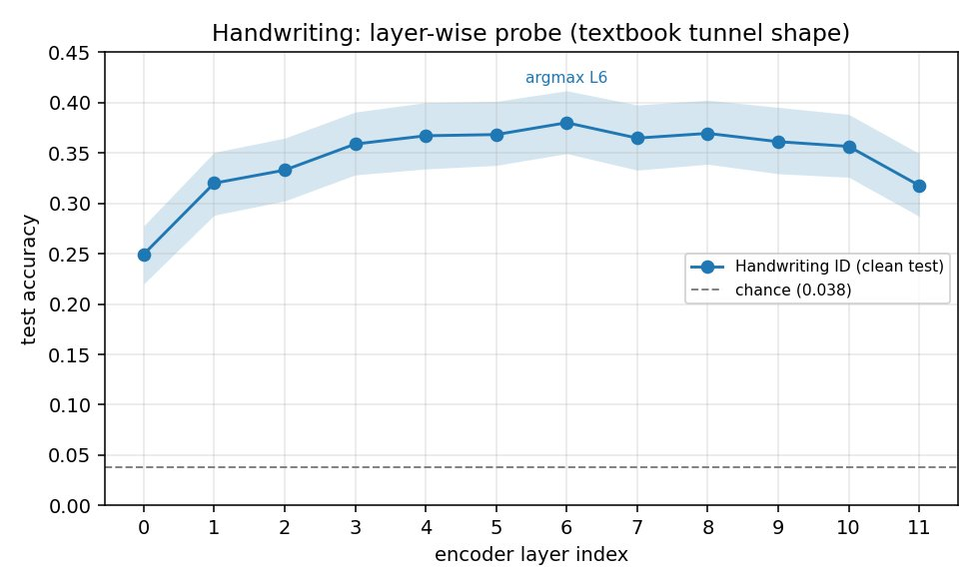
FINDING 1
Accuracy peaks in the middle, drops at the end
TAKEAWAY
The classic tunnel shape: rises as features build, plateaus, then falls at the last layer.
Far above chance — the model genuinely encodes the task.
Notes:
Slide 4 — Finding 1 形状 (~45s)
🗣️ "This is the core picture. Accuracy rises through the early layers as features build, plateaus in the middle, and drops at the last layer. The peak is in the middle band — well above chance, so the model genuinely encodes the task.That dip at the end is the tunnel effect: the final layer, specialized for forecasting, is a worse representation for classification than the middle.
过渡 → "So Part 1 holds. Now the more interesting question — does this gap amplify out-of-distribution?" 可能问题
Q: Why handwriting first? → "It has lots of headroom — 26 classes, so accuracy sits around 0.35–0.38, well below ceiling — which makes the layer-shape easy to see."
Q: 0.38 accuracy sounds low? → "Chance is 0.038 — that's ~10× chance on a 26-way task with a single linear layer on frozen features. The shape across layers is the point, not the absolute number."
Q: Is that dip at the end within noise? → "The shaded band is the 95% bootstrap CI; the last-layer drop is statistically resolved — quantified on the next slide across datasets."
Q: What's the shaded region? → "95% bootstrap confidence band over the test set."

Slide 6
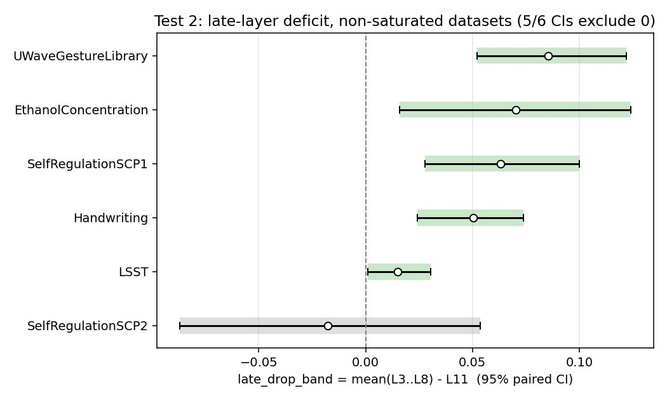
FINDING 1 — ROBUSTNESS
It holds across very different domains
TAKEAWAY
The last-layer drop is significant in 5 of 6 datasets.
Spans EEG, handwriting, light-curves, chemistry — not a one-dataset quirk.
(The 6th sits near chance, so it can’t show the effect.)
Notes:
Slide 5 — Finding 1 复现 (~50s)
🗣️ "Yes. This is the late-layer deficit — middle band minus last layer — across all six datasets with headroom. Five of six have a confidence interval that excludes zero: the last layer is significantly worse. And these span wildly different domains — EEG, handwriting, gesture, chemistry, light-curves. The one exception, SCP2, sits at chance everywhere, so it simply can't show the effect — it's underpowered, not a counterexample. I also checked this survives different feature-pooling choices and twenty re-shuffles of the data split. Part 1 is solid."
过渡 → "So Part 1 holds. Now the more interesting question — does this gap amplify out-of-distribution?"
可能问题
Q: 你怎么定义 "middle" 和 "last"?有没有 cherry-pick? → "Middle is a pre-declared band, layers 3–8; last is layer 11. I didn't pick the best layer post-hoc. I also report the argmax version but label it as selection-biased." (关键诚实答案)
Q: Multiple comparisons — you ran many tests? → "For Part 1 the evidence is consistent direction across independent datasets — replication, which is the opposite of cherry-picking a lone significant test."
Q: LSST 的效应只有 +.015,有意义吗? → "Small but significant — its test set is 2466, so even a small gap resolves. The bigger effects (UWave, Ethanol, SCP1) are ~.06–.09."
Q: Why is SCP2 not significant? → "Its probe sits at chance (~.49 on a binary task), so there's no signal to differentiate layers — underpowered, not contradictory."
Q: 这些是 paired CI 吗? → "Yes — paired bootstrap, same test samples for the middle band and the last layer, so the difference is far less noisy than either accuracy alone."

Slide 7
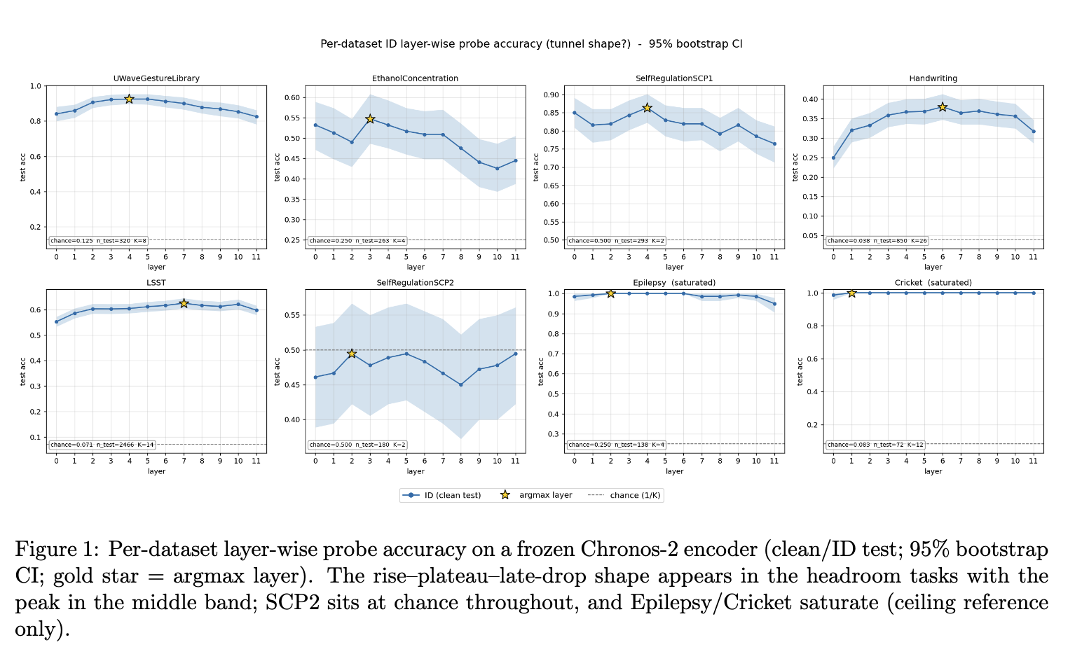

Slide 8
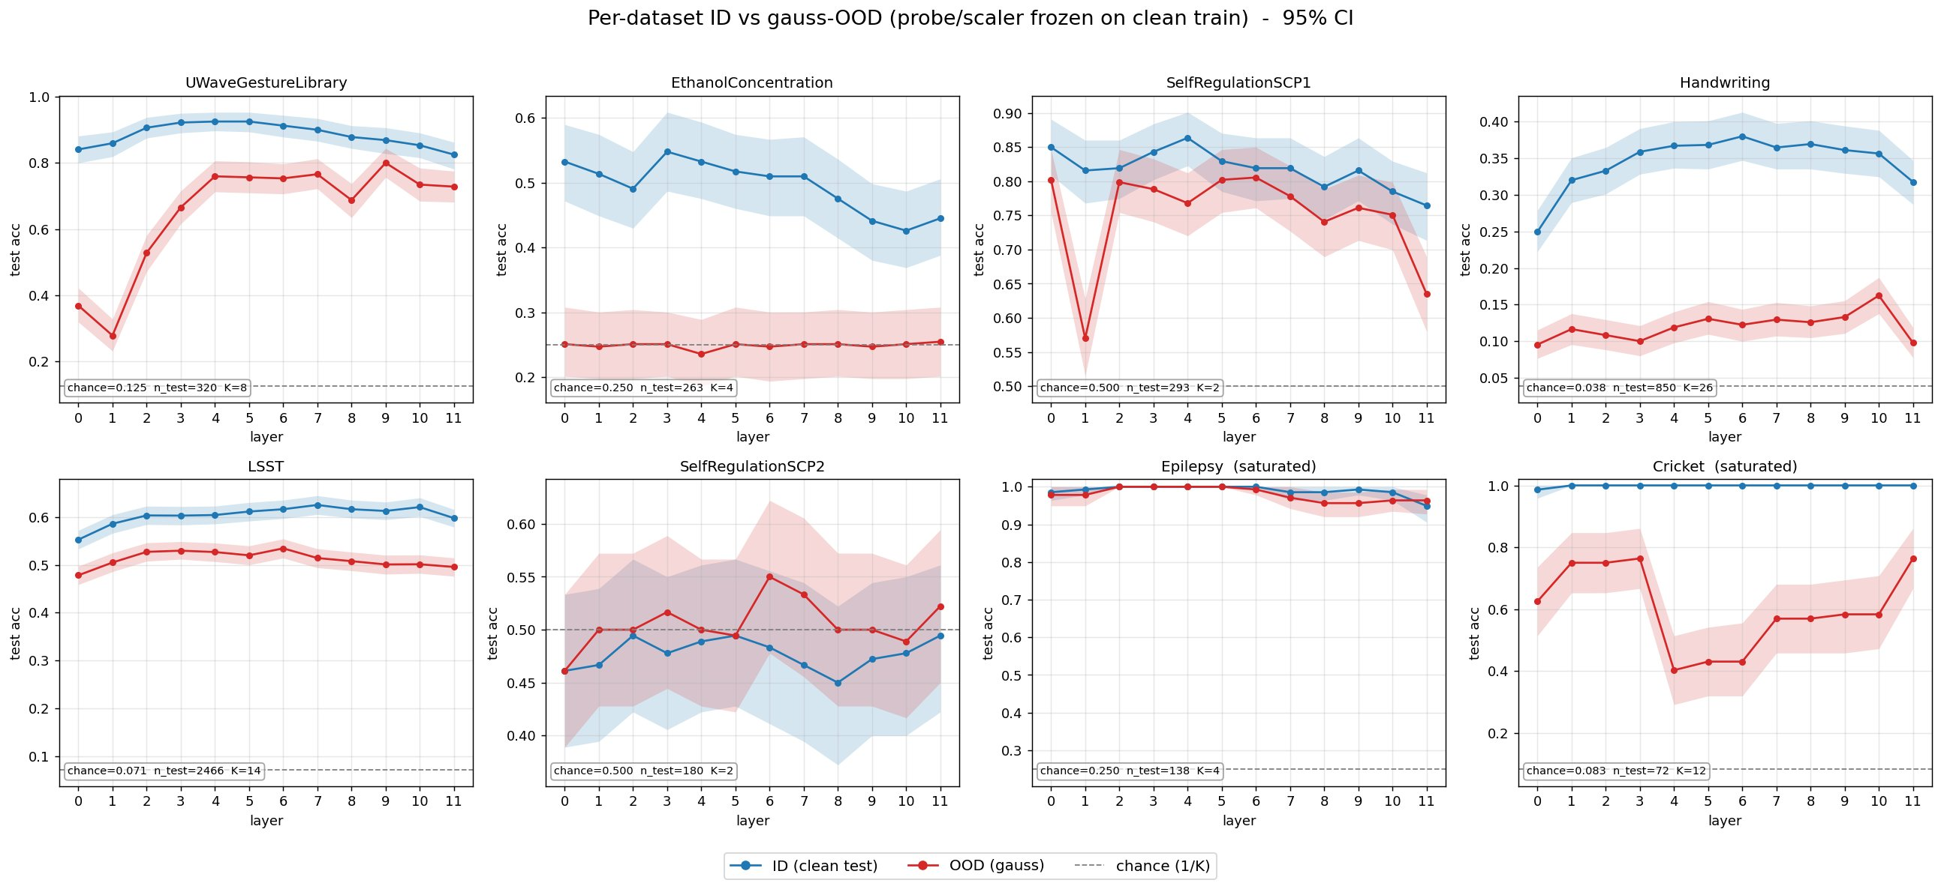
FINDING 2
The out-of-distribution prediction does not hold
TAKEAWAY
Prediction: the gap should widen under distribution shift.
Across 6 datasets × 3 shifts (18 cells): only 3 significant, and 2 go the wrong way.
Gaussian noise hits the early layers, not the last — the opposite of the prediction.
Notes:
Slide 6 — Finding 2 null (~45s) ⚠️ 别超时
🗣️ "Here Part 1's success meets an honest negative. I predicted the middle-over-last gap would widen under distribution shift. I applied three synthetic, label-preserving shifts — Gaussian noise, time-warp, drift — across six datasets, eighteen combinations. Only three showed significant amplification — and two went the opposite way, with the rest including zero. Scattered in both directions — that's noise, not amplification. So Part 2 does not hold. But the failure is informative. Look at the Gaussian panels: the damage hits the early layers — UWave and SCP1 crater at layers zero and one — not the last layer. That's the opposite of a tunnel prediction. It makes sense: the early layers sit closest to the raw input, so input noise hits them first. This echoes 'surgical fine-tuning' — input corruptions are best fixed at the early layers. So it's a real phenomenon, just a different one — input-coupling, not the tunnel effect.”
过渡 → "Let me put the two parts together."
可能问题
Q: What counts as "OOD" here? → "Synthetic, label-preserving input shifts — Gaussian noise, time-warp, baseline drift — applied to the test inputs only. The probe stays frozen from clean training." (同时承认局限 → 引到 Slide 8)
Q: Why did Gaussian noise work but the others didn't? → "Gaussian noise is input-coupled and hits some layers more than others; time-warp degrades every layer about equally, so there's no extra penalty at the last layer to amplify." (被追问翻 backup Slide 10)
Q: Could the one positive (SCP1/Gaussian) be a false positive? → "Honestly, yes — with six conditions, one significant cell is roughly what you'd expect by chance. That's exactly why I'm not claiming Part 2." (诚实,Irina 会喜欢)
Q: Maybe your shifts are too weak/strong? → "Possible — I checked the probe stays well above chance under each shift, so labels survive. But the deeper issue is synthetic ≠ real domain shift, which is my next experiment."

Slide 9
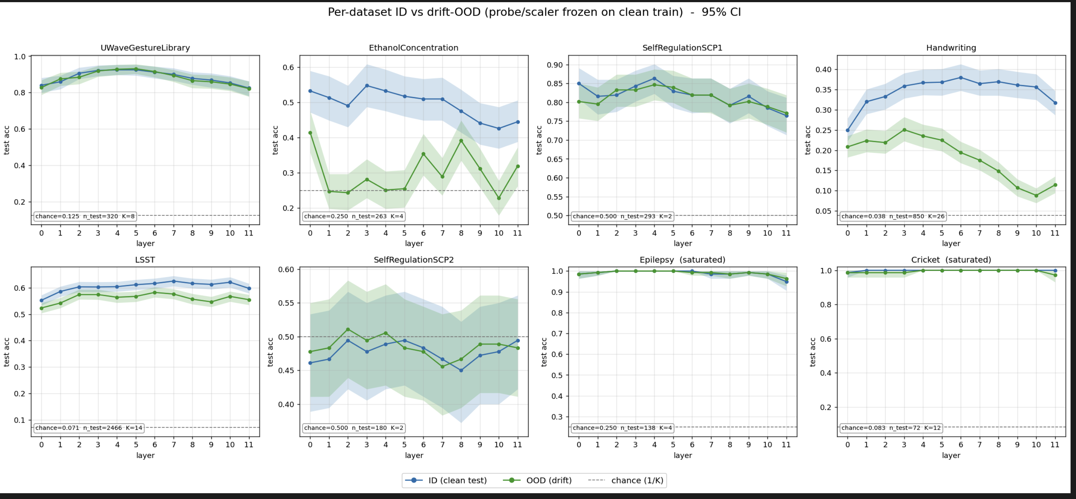

Slide 10
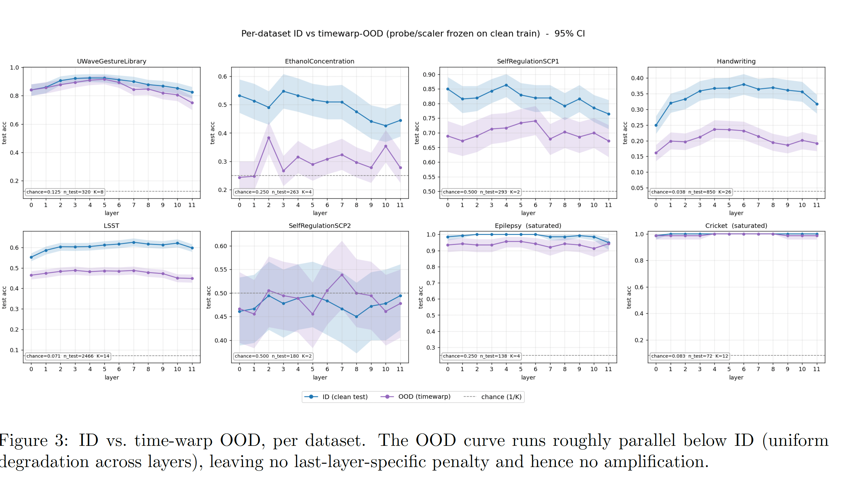

Slide 11
BACKUP
Per-shift amplification — all 18 cells
A = Δ_OOD − Δ_ID, where Δ = mean(layers 3–8) − layer 11
Dataset | Shift | Δ_ID | Δ_OOD | A | 95% CI
EthanolConcentration | drift | +0.070 | −0.016 | −0.086 | [−0.157, −0.026]
SelfRegulationSCP1 | gauss | +0.063 | +0.146 | +0.083 | [+0.019, +0.146]
UWaveGestureLibrary | gauss | +0.085 | +0.003 | −0.082 | [−0.138, −0.027]
EthanolConcentration | gauss | +0.070 | −0.007 | −0.077 | [−0.171, +0.018]
UWaveGestureLibrary | timewarp | +0.085 | +0.134 | +0.048 | [+0.006, +0.091]
EthanolConcentration | timewarp | +0.070 | +0.022 | −0.048 | [−0.110, +0.009]
Handwriting | drift | +0.050 | +0.091 | +0.040 | [+0.011, +0.071]
SelfRegulationSCP2 | timewarp | −0.018 | +0.019 | +0.037 | [−0.062, +0.136]
Handwriting | gauss | +0.050 | +0.024 | −0.027 | [−0.057, +0.003]
Handwriting | timewarp | +0.050 | +0.029 | −0.022 | [−0.055, +0.013]
SelfRegulationSCP1 | timewarp | +0.063 | +0.042 | −0.021 | [−0.077, +0.030]
LSST | timewarp | +0.015 | +0.036 | +0.020 | [−0.001, +0.040]
SelfRegulationSCP2 | drift | −0.018 | −0.003 | +0.015 | [−0.023, +0.054]
LSST | gauss | +0.015 | +0.027 | +0.012 | [−0.006, +0.029]
SelfRegulationSCP2 | gauss | −0.018 | −0.007 | +0.011 | [−0.083, +0.097]
SelfRegulationSCP1 | drift | +0.063 | +0.054 | −0.010 | [−0.035, +0.017]
UWaveGestureLibrary | drift | +0.085 | +0.087 | +0.002 | [−0.023, +0.028]
LSST | drift | +0.015 | +0.015 | +0.000 | [−0.014, +0.014]
blue = amplifies (CI > 0) · red = reverses (CI < 0) · plain = includes 0
3 positive · 2 negative · 13 include zero → scattered both directions = null (≈0.9 false positives expected by chance, α = 0.05).
Notes:
#11 全 18 格表 —— 被问具体数:"SCP1 under gauss amplifies +0.083, CI excludes zero;整体 3 正 2 负 13 含零,双向散开 = null。”
All CIs are paired bootstrap, B=2000, seed=0. For the forest plot I resample test samples with replacement and apply the same indices to the middle-band and last-layer correctness — paired, so it cancels shared sample-difficulty noise. For amplification it's a difference-in-differences with the same resample indices across all four vectors — ID and OOD are the same test samples, so it's doubly paired. CI excludes zero → significant."

Slide 12
Conclusions
✓
Part 1 — supported & robust
Middle layers carry more task information than the final layer — significant across diverse domains, and it survives every robustness check.
✕
Part 2 — not established
No general amplification under distribution shift — significant in just 3 of 18 conditions, and 2 of those reversed.
One clear positive and one honest null — both well-tested.
Notes:
Slide 7 — 结论 (~40s) ⭐ 放慢
🗣️ "Two clean takeaways. Part 1 — supported and robust: the middle layers carry more task information than the last, significant across diverse domains and every robustness check. Part 2 — not established: no general OOD amplification — significant in just three of eighteen conditions, two of them reversed. One clear positive result, and one honest null — both well-tested."
过渡 → "Which leaves one important open question."
可能问题
Q: So what's the practical takeaway? → "If you use frozen Chronos-2 as a feature extractor for downstream classification, don't default to the last layer — middle layers are better, and a Head2Toe-style multi-layer readout would likely help."
Q: Does this match the LLM/vision tunnel-effect findings? → "Yes — consistent direction with Masarczyk et al.; the contribution is showing it in a time-series foundation model, which hadn't been checked."

Slide 13
OPEN QUESTION & NEXT STEP
Tunnel effect — or just unfamiliar data?
The confound: is the late-layer drop the tunnel effect, or just the model being out of its depth on unfamiliar data? My current tasks can’t yet tell these apart.
PROPOSED TEST
In-distribution
task
Out-of-distribution
task
same probe — compare the drop
Prediction: if it’s really the tunnel effect, the drop should grow with distance from the training distribution.
Also planned: test the same late-layer drop on the model’s native forecasting objective — not just classification probes.
Notes:
Slide 8 — 下一步 (~45s) 收尾邀请讨论
🗣️
"There's a confound I can't yet resolve: is the late-layer drop really the tunnel effect, or just the model being out of its depth on unfamiliar data? My synthetic shifts can't separate those. The clean test: take a matched in-distribution task and an out-of-distribution task, same probe, and compare the drop. If it's genuinely the tunnel effect, the drop should grow with distance from the training distribution. And as a second next step — I want to test the same drop on the model's native forecasting objective, not just classification probes."
过渡(收尾)→ "That's the story: a robust Part 1, an honest null on Part 2, and a concrete path to pin down the mechanism. Happy to take questions — I've got the full per-shift numbers and robustness checks in backup."
可能问题
Q: How would you define "in-distribution" for Chronos-2? → "Tasks built from forecasting-style series with clear trend/seasonality, closer to its pretraining mix — versus the EEG/spectra/light-curve tasks, which are far from it." (承认这本身需要小心设计)
Q: 还有别的 next steps? → 见下方 General Bank 的 "future work"。

Slide 14
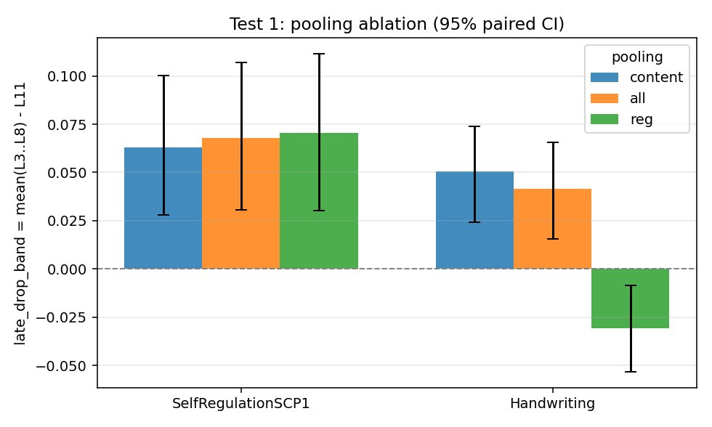
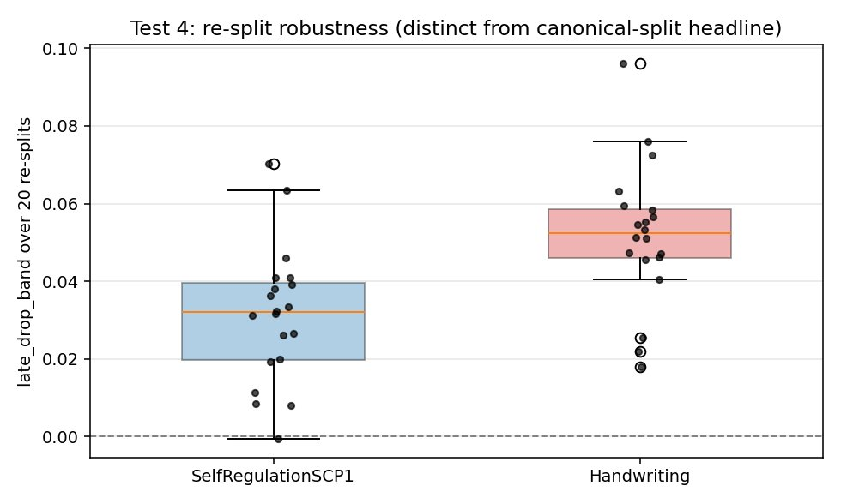
BACKUP
Robustness checks
Holds across feature choices (one variant on one dataset flips — a nuance, not a reversal).
Holds across 20 re-shuffles of the data split — not an artifact of one split.
Notes:
Slides 9–10 — Backup (不主动讲)
Slide 9 (robustness) — 被问稳健性时翻:"Holds across pooling choices and 20 re-splits.”
#9 robustness checks —— "pooling 和 20-split 都稳"(只在 SCP1+Handwriting 两个数据集,被问时如实说)。
方法学
Q: Overlapping CIs but you call it significant — how? → "Overlap of individual CIs doesn't imply a non-significant difference. The layers err on the same samples, so the paired difference is much tighter. I test the paired difference directly."
Q: 768×channels 维特征 + 几百样本,probe 会不会过拟合? → "Standardization plus L2, and I report test accuracy on a held-out split — and it replicates across datasets and 20 re-splits, so it's not a single-split overfit artifact."
Q: Bootstrap 只覆盖 test 采样方差? → "Correct — bootstrap is test-set sampling variance; the 20 re-splits capture split variance. I don't yet have multi-seed/model-init variance — fair limitation."
Q: Why pool over content patches and not the REG token? → "I tried all three (content / all / REG). Content and all give the same effect; the REG token behaves differently — it's CLS-like and can peak late. So the tunnel effect lives in the distributed patch representations."
Q: The SCP1 layer-1 fragility — what is that? → "Under noise, layer 1 collapses on SCP1. Early layers are close to the raw input, so input noise propagates almost undiminished — that's input-coupling, separate from the tunnel effect."

Slide 15
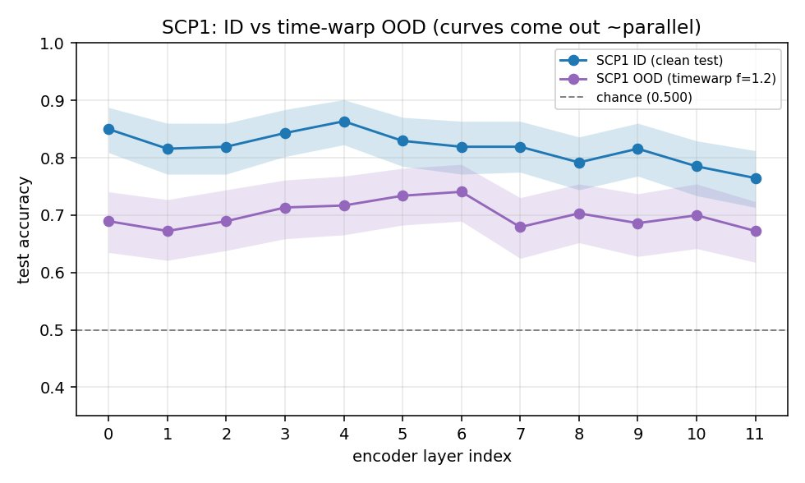
BACKUP
Why one shift type showed no amplification
The two curves stay roughly parallel: this shift hurts every layer about equally, so there’s no extra penalty concentrated at the last layer — hence no amplification.
Notes:
Slide 10 (timewarp) — 被问"为什么某 shift 没效果"时翻:平行曲线图。
"为什么 timewarp 没放大:两条曲线平行、每层均匀掉,最后一层没额外惩罚。"
设计/范围
Q: Only one model — does it generalize to other TSFMs? → "Open. Single model is a limitation; MOMENT, TimesFM, Moirai are the natural next comparisons."
Q: Layer-level only — what about within-block (attention vs MLP)? → "Right — this is block-level. Module-level probing (MHSA vs FFN), the Odonnat-style split, is the next resolution increase."
Q: 为什么不用 Chronos-2 自带的 multivariate (group-ID) 路径? → "I used per-channel-then-concatenate to reuse the validated univariate path. Probing the native multivariate representation is a clean follow-up — and it's the mechanism the model's actually built for."
Q: Forecasting-quality probing instead of classification? → "Natural extension — probe how well each layer supports the forecasting head, not just class labels."
解释/"so what"
Q: Isn't the last-layer drop just trivially because it's a forecasting model? → "That is the proposed mechanism, not a confound — the prediction was that a forecasting-specialized final layer sheds class structure, and that's what we see. The open question is whether it's that vs. plain domain-mismatch — my next experiment." (把"反驳"变成"正是我的论点")
Q: Relation to the lab's representation-collapse / manifold work (Seq-VCR, LLM-manifold)? → "Adjacent — same theme of where reusable, transferable structure lives across layers; this is the time-series-foundation-model angle."
诚实兜底脚本(不知道就这么说)
不知道精确数字:"I'd have to check the exact number, but it's on the order of ___ — I can follow up."
没做过的实验:"I didn't test that — good idea; my expectation is ___, and it'd be straightforward to add."
被指出可能的漏洞:"That's fair — it's a real limitation. Here's how I'd address it: ___."
中文提醒:不要硬撑。Irina 在场,诚实承认局限 > 编一个答案。你这套工作的最大卖点就是"诚实地测过、知道哪里成立哪里不成立"。

