Slide 1
Midterm Presentation
Predict the death rate by serval variables
Zibo Hong
STAT Deep learning

Slide 2
Data Set
Variables: Age , anaemia, creatinine phosphokinase
diabetes, ejection fraction
high blood pressure, platelets
serum creatinine, serum sodium
sex, smoking, time
Output: Death event
Source: https://www.kaggle.com/datasets/sagar029/heart-failure
Notes:
age: Age of the patient
anaemia: If the patient had the haemoglobin below the normal range
creatinine_phosphokinase: The level of the creatine phosphokinase in the blood in mcg/L
diabetes: If the patient was diabetic
ejection_fraction: Ejection fraction is a measurement of how much blood the left ventricle pumps out with each contraction
high_blood_pressure: If the patient had hypertension
platelets: Platelet count of blood in kiloplatelets/mL
serum_creatinine: The level of serum creatinine in the blood in mg/dL
serum_sodium: The level of serum sodium in the blood in mEq/L
sex: The sex of the patient
smoking: If the patient smokes actively or ever did in past
time: It is the time of the patient's follow-up visit for the disease in months
DEATH_EVENT: If the patient deceased during the follow-up period

Slide 3
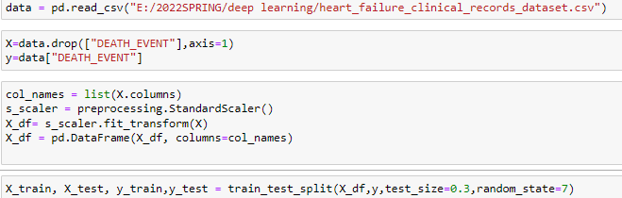
Scaling and Splitting

Slide 4
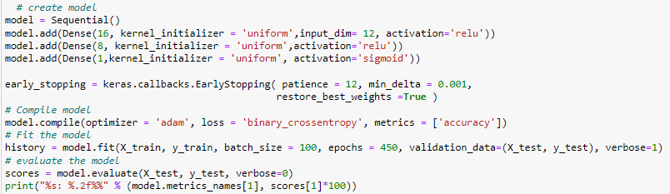
Model building
Notes:
For these page the code is to crate the model and find the accuracy
At first I create the epoch=300, and batch size =20.

Slide 5
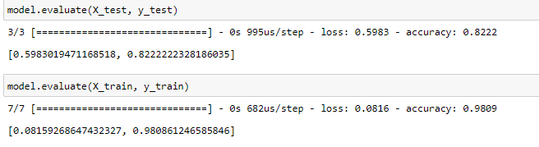
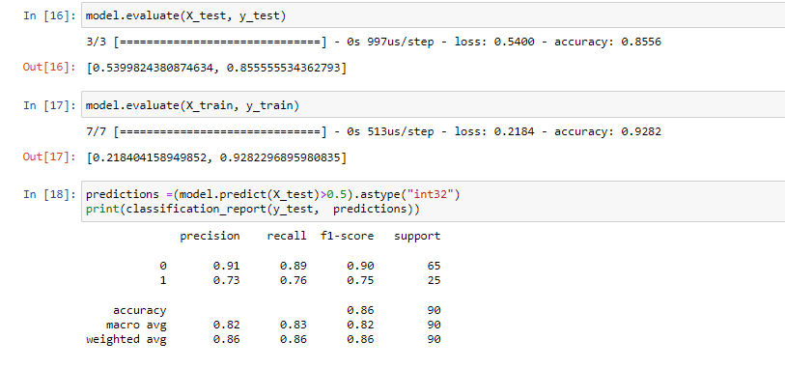
Compare with train and test
Size=20; epoch=300
Size=50; epoch=500
Notes:
Size=20; epoch=300
Change to Size=50; epoch=500

Slide 6
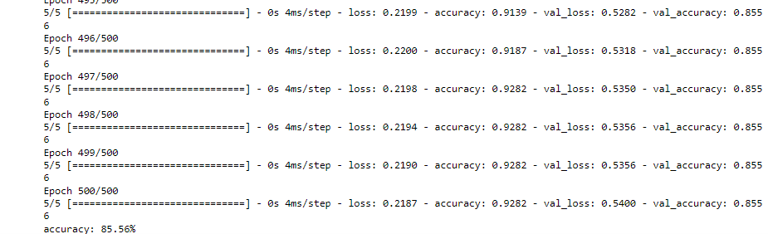
The result of accuracy
Notes:
It shows that after 500 epoch. The accuracy arrive 83.33% it is a number that has already accurate enough for this data set. The val_accuracy did not change for a while,

Slide 7
Thanks for your Listening

Slide 8
Reference Page
https://www.kaggle.com/code/sohommajumder21/neural-network-93-accuracy-no-complex-codes#Model-building
https://www.kaggle.com/datasets/sagar029/heart-failure
https://www.youtube.com/watch?v=PuZY9q-aKLw

