Slide 1
Cyber Operations
Mark Nelson
26 Sep

Slide 2
Notes:
Hacking’s done the same way

Slide 3
Methodology
Footprinting / Open Source Research
Enumeration
Analysis
Access
Privilege Escalation
Post Exploitation
Notes:
Source: https://c.ymcdn.com/sites/www.nibs.org/resource/resmgr/Conference2014/BI20140106_CS_Morris.pdf

Slide 4
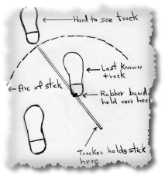
Footprinting & Open Source Research
Target identification
Social media, Google, Wikipedia, D&B, Yahoo Finance, etc.
Internet governance search (WhoIS, DNS, IP Address Searches, traceroute)
Social engineering, business cards, tradeshows, advertising, Careers/Jobs, etc.
Physical presence: Corporate office, datacenter, security posture, parking lot procedures, co-located businesses, etc.

Slide 5
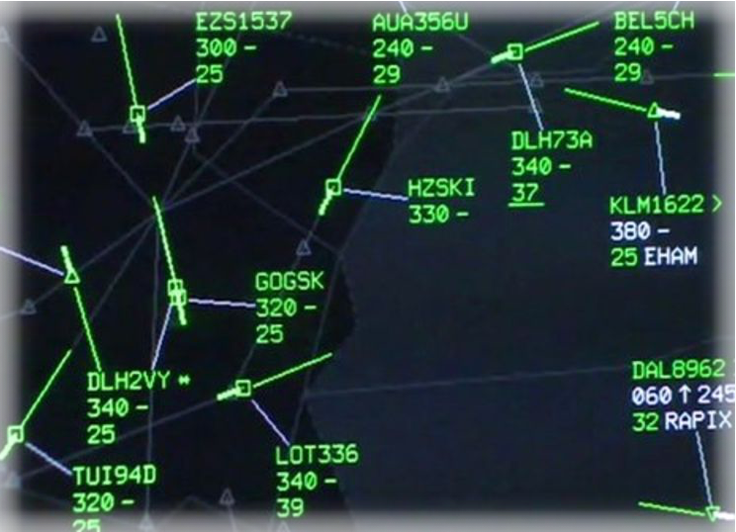
Enumeration
Nmap scans, account maintenance, etc.
Exercise their business processes: Purchase something. Return it.
…but mostly Nmap scans.
>>> The result, however, is a detailed list of assets and how they are interconnected

Slide 6

Analysis
Google
Software release notes
NVD / CVN
Nmap > Port Scan
OpenVAS
Fuzzing: Nessus

Slide 7

Access
Hacking…
Metasploit / downloaded code
“Licensed” code
Custom code
>>> Result: Sometimes it’s…
A memory dump
A shell prompt
Arbitrary code execution

Slide 8
Privilege Escalation
Optional step…
Sometimes you drop onto the box as a mortal user and you need to change your permissions in order to do your thing
More hacking… but a different kind of hacking

Slide 9

Post Exploitation
Ok, you’re there… so now what?
Most people don’t know what to do…
Retain access
Hide from…
IDS
AV Software
Administrators
Payload
Reverse shell, dropper, beacon, etc.

Slide 11
NSA
Summer Internship Programs
Mark Nelson
26 Sep 2016

Slide 12
Do you like…
Assembly Language
Write Kernel Modules
Write Kernel System Calls
Write a Root Kit
Software Reverse Engineering
Terrestrial & Cellular Telephone Systems
Vulnerability Discovery
Memory Analysis
Buffer Overflow & Code Injection
Exploitation Development
Cyber Operations

Slide 13
The Good & The Bad
~20 credit-hours worth of education & you get paid
No grades — freedom to learn deeply
Here on the island
4d/wk = Classroom
1d/wk = Project
Get a Top Secret security clearance
US citizens only
There is some bureaucratic overhead
The application process is time consuming
Polygraph
Psych screening
You have to keep out of trouble

Slide 14
Interested?
nsa.gov -> Careers
CAE in Cyber Operations Summer Intern Program - Hawaii (1076926)
2x Letters of Recommendation
Send Transcript to:
Attention Student Programs
National Security Agency
9800 Savage Rd.
Fort Meade, MD 20755
Suite 6779

