Slide 1
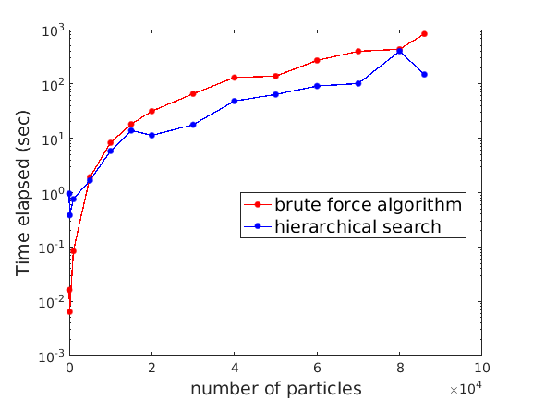
Hierarchical Calculation of Most Bound Particle
Scientific Achievement
Developed a hierarchical analysis scheme to find the particle with most-bound potential. Provides avenue for reducing the computational cost from O(n²) to O(nlog(n)).
Significance and Impact
Enables halo-center finding for cosmological simulations. The new scheme enables exploration of latent/intrinsic structure within the data and mitigates the curse of dimensionality for large-scale data analysis and data reduction tasks.
Research Details
Explore various clustering techniques to represent original individual particles by many fewer points.
Explore a local calculation that only considers neighboring particles instead of all particles.
Establish performance benchmarks (e.g., algorithmic scaling, memory use, etc.) based on speed, accuracy, and resource requirement tradeoffs.
Performance comparison of our initial (O(n²)) hierarchical scheme prototype and the currently-used brute force algorithm. This provides a bound on the performance of our O(nlog(n)) scheme.
Work was performed at Argonne National Lab
Notes:
Contacts for this slide: Zichao (Wendy) Di wendydi@anl.gov; Stefan Wild wild@anl.gov
The initial use cases were provided by the “Computing the Skies at Extreme Scales” ECP application.

