Slide 1

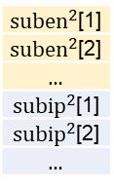

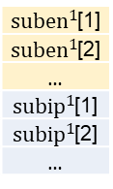

Assemble nodes
Assemble params
Input for lower-layer subcircuit
Input
$$x$$
en[1]
en[2]
en[3]
…
in[1]
in[2]
…
${suben}^{1}$[1]
${suben}^{1}$[2]
…
${subip}^{1}$[1]
${subip}^{1}$[2]
…
en[1]
en[2]
en[3]
…
$$f^{1},∇f^{1}$$
ip[1]
ip[2]
…
intrp[1]
intrp[2]
…
gv[1]
gv[2]
…
c[1]
…
$$x[nodes]$$
${suben}^{2}$[1]
${suben}^{2}$[2]
…
${subip}^{2}$[1]
${subip}^{2}$[2]
…
ip[1]
ip[2]
ip[3]
…
Intrinsic parameters
$$f^{2},∇f^{2}$$
SubModel
Gradient backpropagation
…

