Slide 1

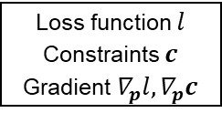



Simulator
$$p→x^{solution}$$
Design variables $p$
Simulation (iteration):
try $x$, to satisfy $f\left(x,p\right)=0$
$$(⇒sensitivity ∇_{p}x^{solution}=−∇_{x}F\backslash ∇_{p}F)$$
If not converge
OptSolver
(loop)
$$x^{solution}, ∇_{p}x^{solution}$$
If Converge
Loss function $l$
Constraints $c$
Gradient $∇_{p}l, ∇_{p}c$
Optimization model
Optimal solution and
constraint conflict analysis

