Slide 1
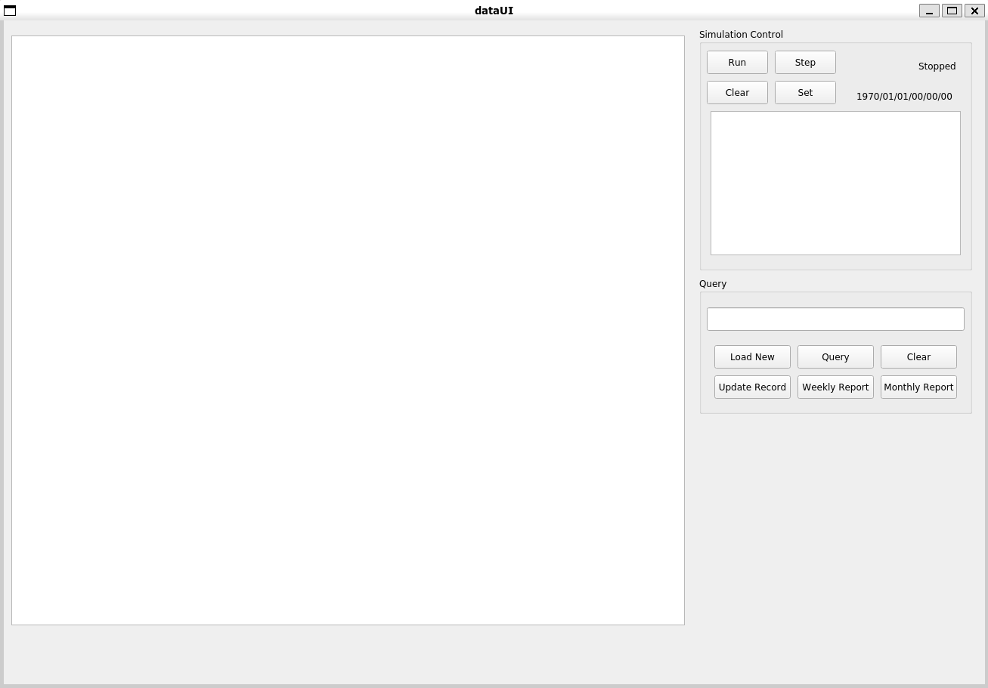
Start Simulation
Enter Query Here
Load New Record Set
Generate Reports
Update Existing Record

Slide 2
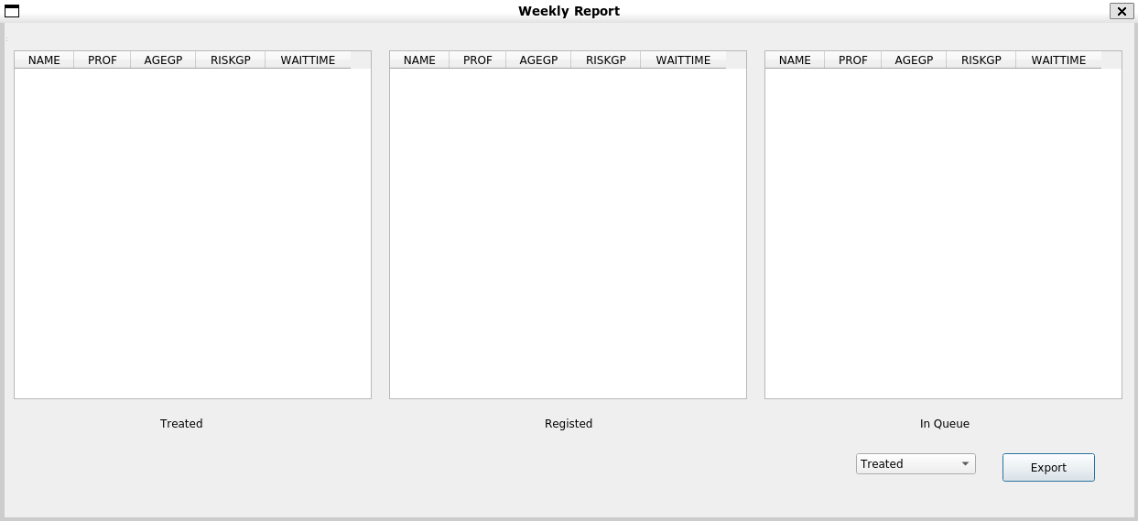
Sort Results by Clicking the Head
Report
Select Table To Export
Export Report

Slide 3
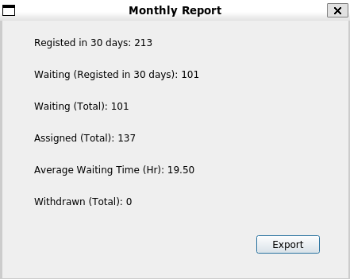
Report
Export Report

