Slide 1

Presentation
Adam
&
Zichuan

Slide 2
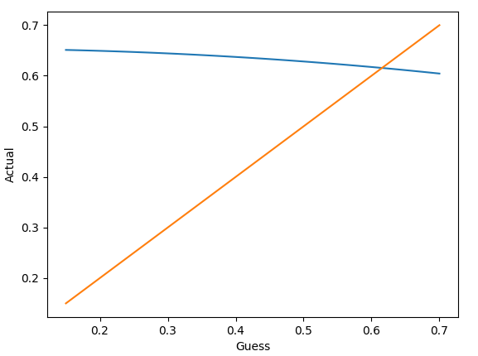
Hydraulic Design
Finding the mass flow rate from Fig 6.
1) Guess a mass flow rate
2) Run through the maths to get a given pressure loss
3) Use given flow characteristic to find the new mass
flow
4) Iterate over a range of guesses
5) Find intersection of guessed mass flow and returned
mass flow. This is the correct mass flow

Slide 3
Pressure Losses

Slide 4
Thermal Design

