Slide 1

Presentation
Adam
&
Zichuan

Slide 2
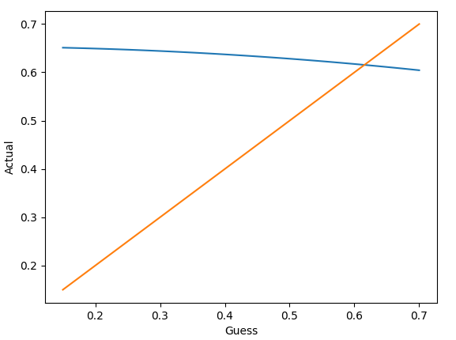
Hydraulic Design
Finding the mass flow rate from Fig 6.
1) Guess a mass flow rate
2) Run through the maths to get a given pressure loss
3) Use given flow characteristic to find the new mass
flow
4) Iterate over a range of guesses
5) Find intersection of guessed mass flow and returned
mass flow. This is the correct mass flow

Slide 3
Pressure Losses

Slide 4
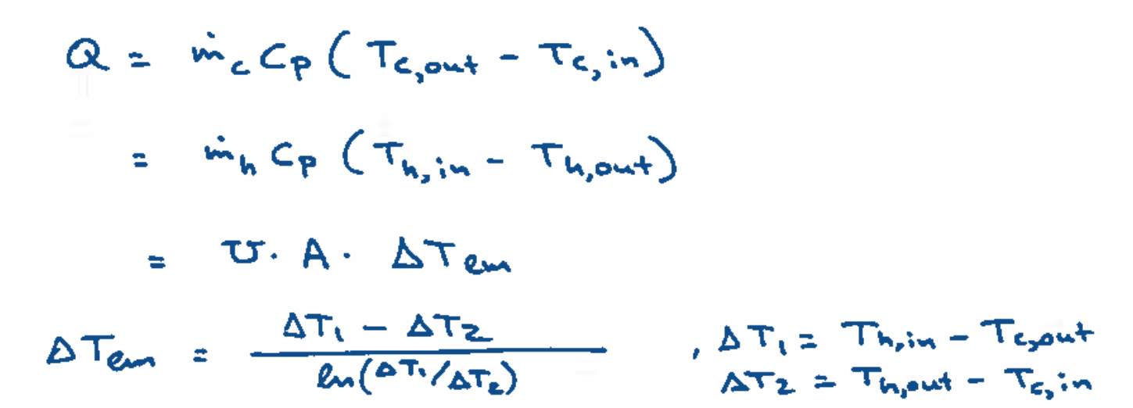
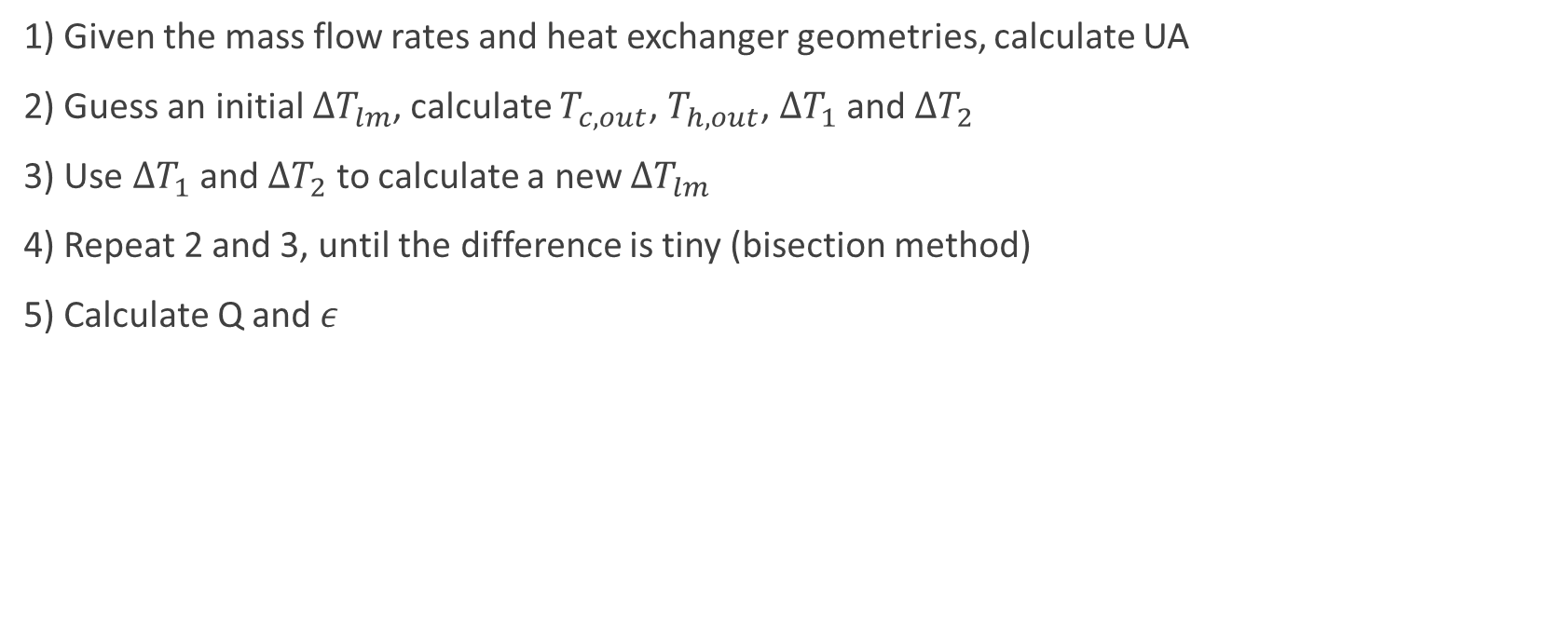
Thermal Design – LMTD Method
1) Given the mass flow rates and heat exchanger geometries, calculate UA
2) Guess an initial $ΔT_{lm}$, calculate $T_{c,out}$, $T_{h,out}$, $ΔT_{1}$ and $ΔT_{2}$
3) Use $ΔT_{1}$ and $ΔT_{2}$ to calculate a new $ΔT_{lm}$
4) Repeat 2 and 3, until the difference is tiny (bisection method)
5) Calculate Q and $ε$

Slide 5
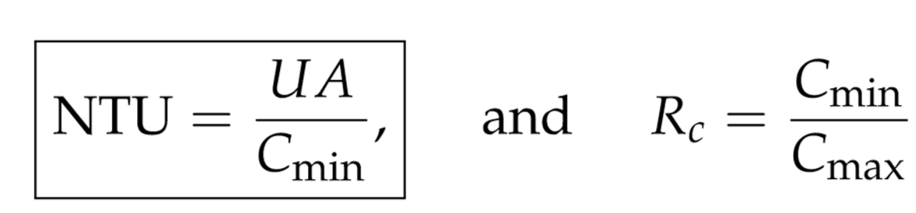
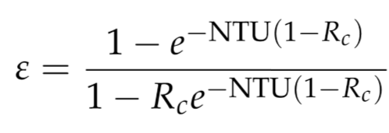
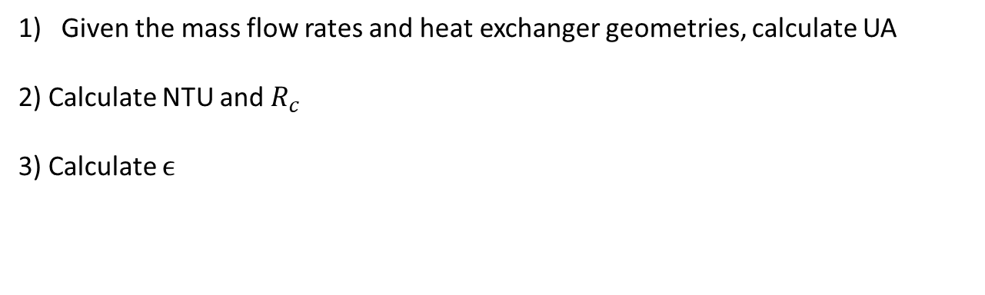
Thermal Design – NTU Method
Given the mass flow rates and heat exchanger geometries, calculate UA
2) Calculate NTU and $R_{c}$
3) Calculate $ϵ$

