Slide 1
CS 4604: Introduction to Database Management Systems
Team: ZELT
Team Members: Evan Dischinger, Zicong Lin, Tahmid Muttaki, Labiba Labanya
Project: TravelLover
Virginia Tech CS 4604 Spring 2021

Slide 2
Overview
Travel Lovers need a system that can help them plan their travel by providing them with a list of places they can visit along with approximate cost.
They also need a mechanism to mark the places they want to go, favorite and starred.
They also want to see restaurants near the places by cuisine and items they serve.
Travelers want to keep track of the places they have visited and searched for.
Lastly, they want to add a review for the places that they have visited.
Our database design addresses these specifications and allows Travel Lovers to plan, records, budget and review their travels.
Notes:
We have come up with an application that will provide travel guidance and assistance to travel lovers including list of tourist places with approximated cost, list of restaurants, adding their preference on the place etc.

Slide 3
Functionality
Users can search for scenic spots.
Users can edit/update the information of their profiles.
Users can see a list of scenic spots by a specific city.
Users can filter search results by state, address etc.
Users can see search history.
Users can see his/her travel history.
Users can "favorite", "want to go", "starred places", etc., places.
Users can search if he/she visited this scenic spot already.
Users can search for restaurants near a destination.
Users can search for restaurants for a certain type of cuisine.
Users can write reviews for the places they visited
Notes:
Need to be checked with the front-end??

Slide 4
Value added facilities
Can be used as a recommender system for top places to visit, or most popular restaurants to try.
Targeted advertisement can be done using the search history of the users.
Can be used as a travel log, where users can keep track of the places they’ve visited and the places they want to visit.
User can use this system as a travel budget calculator, where they can get an approximate cost based on the places they intend to visit.
Business owners can use this system to look up reviews on their businesses and take appropriate actions.

Slide 5
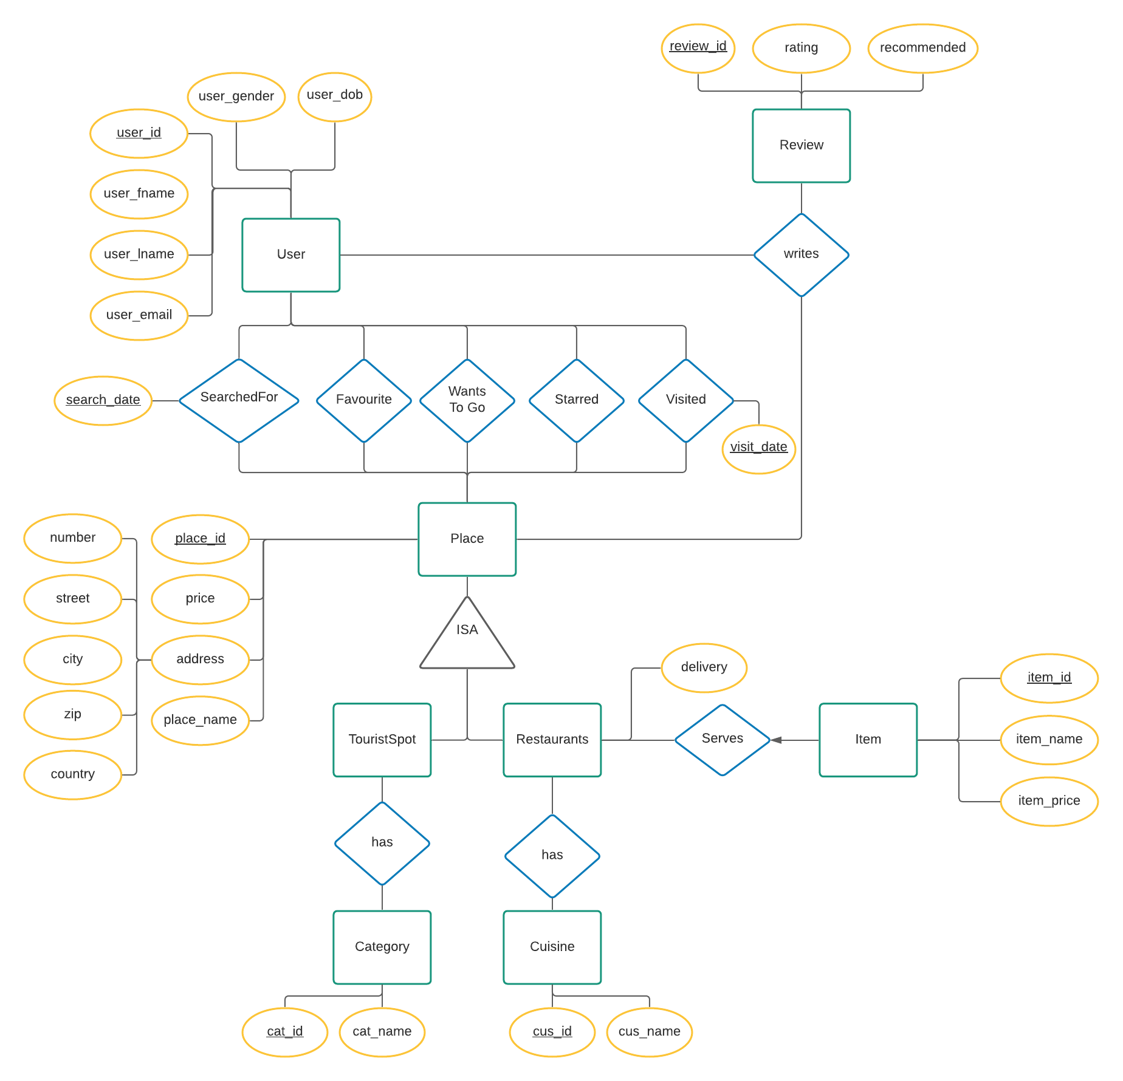
ER Diagram

Slide 6
Functional Dependencies
user_id -> user_fname, user_lname, user_email, user_gender, user_dob
review_id -> rating, recommended
place_id -> price, address, place_name
cat-id -> cat_name
cus_id -> cus_name
item_id -> item_name, item_price
visit_date -> place_id

Slide 7
BCNF Decomposition
BCNF form of the relation:
{ user_id, user_fname, user_lname, user_email, user_gender, user_dob},
{review_id, rating, recommended},
{place_id, price, address, place_name},
{cat_id, cat_name} , {cus_id, cus_name},
{item_id, item_name, item_price},
{user_id, review_id, place_id, cat_id, cus_id, item_id, visit_date}

Slide 8
3NF Decomposition
3NF form of the relation:
{ user_id, user_fname, user_lname, user_email, user_gender, user_dob},
{review_id, rating, recommended},
{place_id, price, address, place_name},
{cat_id, cat_name} , {cus_id, cus_name},
{item_id, item_name, item_price}, {visit_date, place_id}
Yes, it is in BCNF.

Slide 9
DEMO

