Slide 1
Neural Machine Translation II

Slide 2
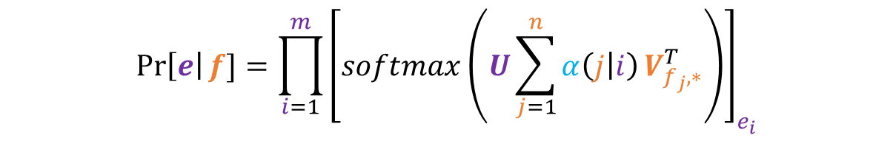
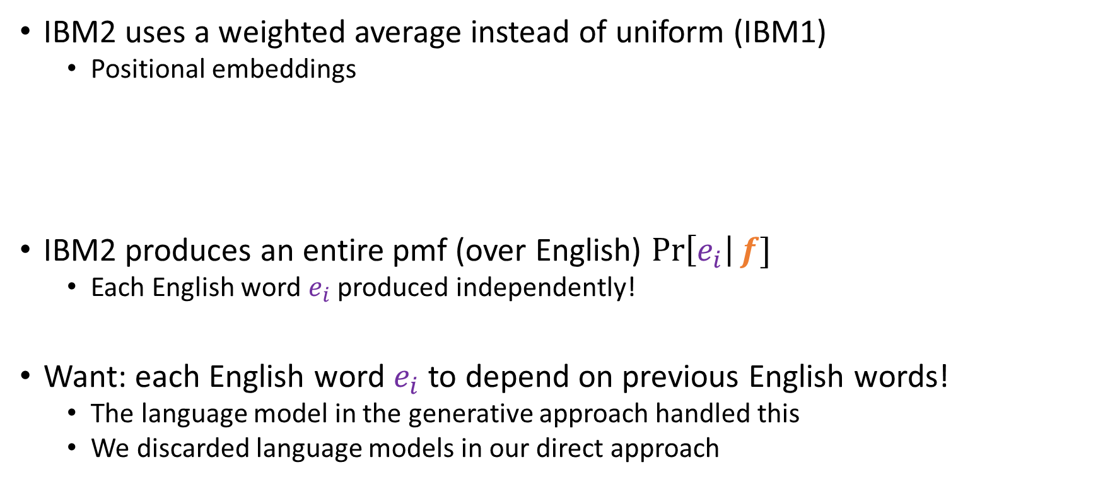
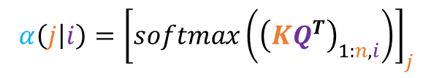


Getting More Context
$$\operatorname{Pr}\left[e\right|f]=\prod_{i=1}^{m}{{\left[softmax\left(U\sum_{j=1}^{n}{α\left(j | i\right)}V_{f_{j},∗}^{T}\right)\right]}_{e_{i}}}$$
IBM2 uses a weighted average instead of uniform (IBM1)
Positional embeddings
IBM2 produces an entire pmf (over English) $\operatorname{Pr}\left[e_{i}\right|f]$
Each English word $e_{i}$ produced independently!
Want: each English word $e_{i}$ to depend on previous English words!
The language model in the generative approach handled this
We discarded language models in our direct approach
$$Q∈ℝ^{M×d}$$
$$K∈ℝ^{N×d}$$
$$α\left(j | i\right)={\left[softmax\left({\left(KQ^{T}\right)}_{1:n,i}\right)\right]}_{j}$$

Slide 3

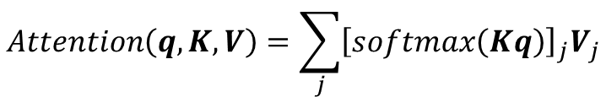

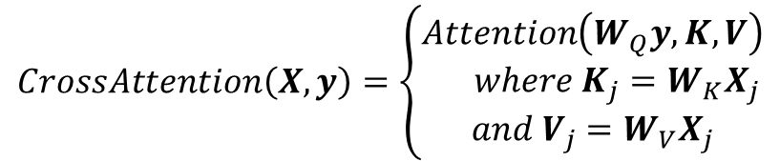







Common Operations
Common ops
$$Embedding\left(k\right)=E_{k}$$
$$Attention\left(q,K,V\right)=\sum_{j}{{\left[softmax\left(Kq\right)\right]}_{j}V_{j}}$$
$$Linear\left(x\right)=Wx+b$$
Neural networks are easy to make large
Compose together common operations
Ex: IBM2
$$CrossAttention\left(X,y\right)=\left\{\begin{aligned}Attention\left(W_{Q}y, K,V\right) \\ where K_{j}=W_{K}X_{j} \\ and V_{j}=W_{V}X_{j}\end{aligned}\right.$$
For $j=1…n$
$$V_{j}=Embedding_{1}\left(f_{j}\right)$$
$$K_{j}=Embedding_{2}\left(j\right)$$
For $i=1…m$
$$q^{(i)}=Embedding_{3}\left(i\right)$$
$$c^{(i)}=Attention\left(q^{(i)}, K, V\right)$$
$$Pr⁡[e_{i}|f]=softmax\left(Linear(c^{(i)})\right)$$

Slide 4

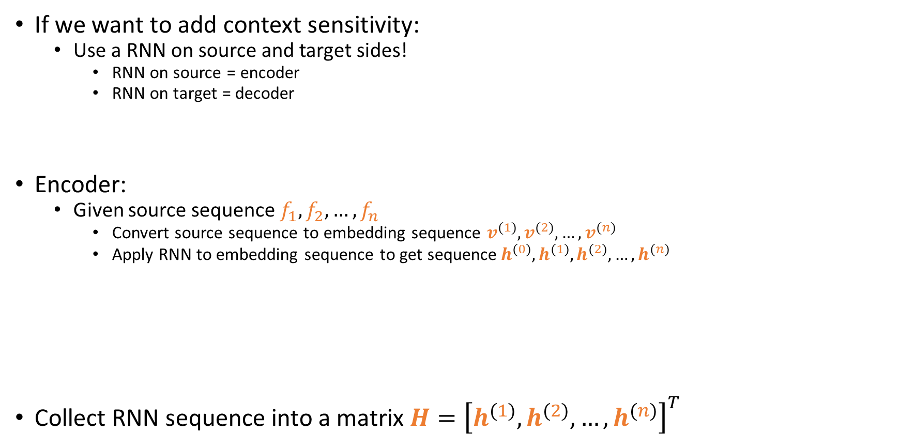
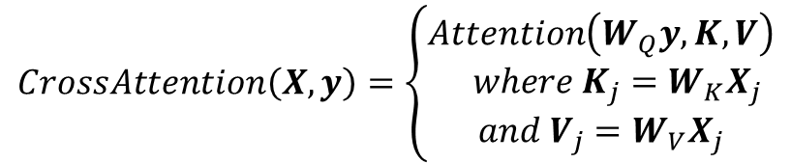



RNNs
Common ops
$$Embedding\left(k\right)=E_{k}$$
$$Attention\left(q,K,V\right)=\sum_{j}{{\left[softmax\left(Kq\right)\right]}_{j}V_{j}}$$
$$Linear\left(x\right)=Wx+b$$
If we want to add context sensitivity:
Use a RNN on source and target sides!
RNN on source = encoder
RNN on target = decoder
Encoder:
Given source sequence $f_{1},f_{2},…, f_{n}$
Convert source sequence to embedding sequence $v^{(1)},v^{(2)}, …,v^{(n)}$
Apply RNN to embedding sequence to get sequence$h^{(0)},h^{(1)},h^{(2)}, …,h^{(n)}$
Collect RNN sequence into a matrix $H={\left[h^{(1)},h^{(2)}, …,h^{(n)}\right]}^{T}$
$$CrossAttention\left(X,y\right)=\left\{\begin{aligned}Attention\left(W_{Q}y, K,V\right) \\ where K_{j}=W_{K}X_{j} \\ and V_{j}=W_{V}X_{j}\end{aligned}\right.$$
$$RNNCell\left(h, x\right)=tanh\left(Ah+Bx+c\right)$$
$$h^{(0)}=RNNCell_{1}\left(0, Embedding_{1}\left(<BOS>\right)\right)$$
$$v^{(j)}=Embedding_{1}\left(f_{j}\right)$$
For $j=1…n$
$$h^{(j)}=RNNCell_{1}\left(h^{(j −1)}, v^{(j)}\right)$$
For $j=1…n$

Slide 5













RNNs
RNN cell
$$z^{(1)}$$
RNN cell
$$z^{(2)}$$
$$z^{(n)}$$
RNN cell
$$z^{(n+1)}$$
$$z^{(0)}=0$$
RNN cell
$$h^{(1)}$$
RNN cell
$$h^{(2)}$$
$$h^{(n)}$$
RNN cell
$$h^{(n+1)}$$
Can swap RNNCell for fancier versions (GRUCell/LSTMCell)
Can even stack up multiple RNNs (quite common)
$$h^{(0)}=0$$
Embedding
Embedding
Embedding
$$<BOS>$$
$$f_{1}$$
$$f_{n}=<EOS>$$

Slide 6




























RNNs - Decoder
training
$$\operatorname{Pr}\left[e_{1} | f,e_{<1}\right]$$
$$\operatorname{Pr}\left[e_{2} | f,e_{<2}\right]$$
$$\operatorname{Pr}\left[e_{m+1} | f,e_{<m+1}\right]$$
$$g^{(1)}$$
$$g^{(2)}$$
$$g^{(m)}$$
$$g^{(m+1)}$$
Architecture varies from model to model
Before Attention was identified
Decoder was just another RNN
Teacher-forced during training
Self-generative during inference
$$<BOS>$$
$$e_{1}$$
$$e_{m}=<EOS>$$
argmax is <EOS>
$$\operatorname{Pr}\left[e_{1} | f,e_{<1}\right]$$
$$\operatorname{Pr}\left[e_{2} | f,e_{<2}\right]$$
$$\operatorname{Pr}\left[e_{k+1} | f,e_{<k+1}\right]$$
$$h^{(1)}$$
$$h^{(2)}$$
$$h^{(n)}$$
$$h^{(n+1)}$$
$$h^{(0)}=0$$
$$g^{(1)}$$
$$g^{(2)}$$
$$g^{(k)}$$
$$g^{(k+1)}$$
$$<BOS>$$
$$f_{1}$$
$$f_{n}=<EOS>$$
inference
$$<BOS>$$
$$e_{1}$$
$$e_{k}$$

Slide 7


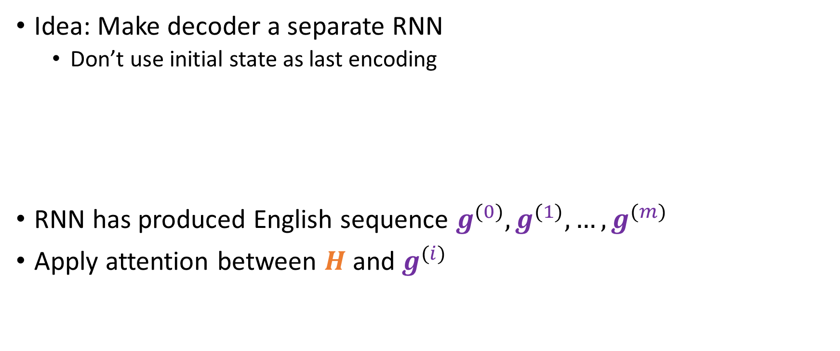





RNNs - Decoder
Idea: Make decoder a separate RNN
Don’t use initial state as last encoding
RNN has produced English sequence $g^{(0)},g^{(1)},…,g^{(m)}$
Apply attention between $H$ and $g^{(i)}$
$$g^{(0)}=RNNCell_{3}\left(0, Embedding_{1}\left(<BOS>\right)\right)$$
$$u^{(i)}=Embedding_{4}\left(e_{i}\right)$$
For $i=1…m$
$$g^{(i)}=RNNCell_{3}\left(g^{(i −1)}, u^{(i)}\right)$$
For $i=1…m$
$$c^{(i+1)}=CrossAttention\left(H,g^{(i)}\right)$$
$$o^{(i+1)}=c^{(i+1)}+g^{(i)}$$
$$Pr⁡[e_{i+1}|f,e_{≤i}]=softmax\left(Linear\left(o^{\left(i+1\right)}\right)\right)$$

Slide 8



















$$\operatorname{Pr}\left[e_{1} | f,e_{<1}\right]$$
$$\operatorname{Pr}\left[e_{2} | f,e_{<2}\right]$$
$$\operatorname{Pr}\left[e_{m+1} | f,e_{<m+1}\right]$$
Lin.Softmax
Lin.Softmax
Lin.Softmax
CrossAttn
CrossAttn
CrossAttn
$$g^{(0)}=0$$
$$g^{(1)}$$
$$g^{(2)}$$
$$g^{(m)}$$
$$g^{(m+1)}$$
$$h^{(1)}$$
$$h^{(2)}$$
$$h^{(n)}$$
$$h^{(n+1)}$$
$$h^{(0)}=0$$
$$<BOS>$$
$$e_{1}$$
$$e_{m}=<EOS>$$
$$<BOS>$$
$$f_{1}$$
$$f_{n}=<EOS>$$

Slide 9
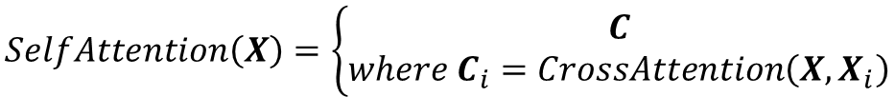
Self-Attention: Transformers
Idea:
Attention is not only useful for linking source and target sides
Attention can itself transform a sequence into another sequence
Output sequence has the same length as the input sequence
Drop in replacement for RNNs!
Turns out self-attention is better for long-distance dependencies
However, knows nothing about word order!
$$SelfAttention\left(X\right)=\left\{\begin{aligned}C \\ where C_{i}=CrossAttention\left(X, X_{i}\right)\end{aligned}\right.$$

Slide 10


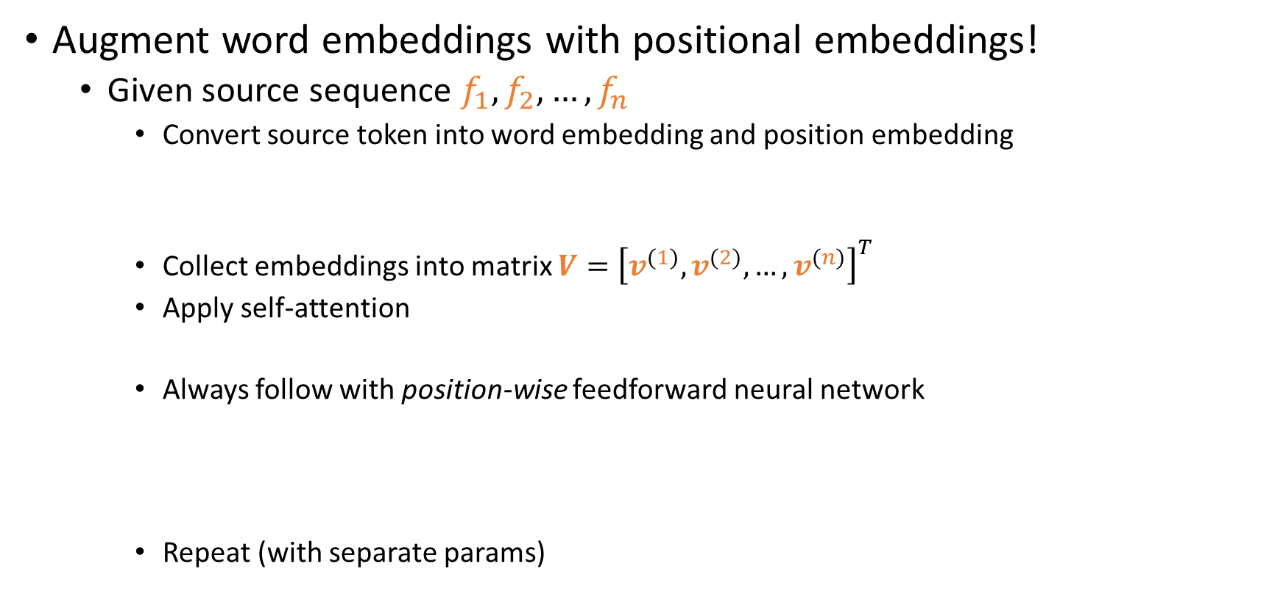



Giving Self-Attention Time
Augment word embeddings with positional embeddings!
Given source sequence $f_{1},f_{2},…, f_{n}$
Convert source token into word embedding and position embedding
Collect embeddings into matrix $V={\left[v^{(1)},v^{(2)}, …,v^{(n)}\right]}^{T}$
Apply self-attention
Always follow with position-wise feedforward neural network
Repeat (with separate params)
$$v^{(j)}=Embedding_{1}\left(f_{j}\right)+Embedding_{2}(j)$$
For $j=1…n$
$$H=SelfAttention\left(V\right)$$
One repetition
$$FFN(x)=Linear_{1}\left(ReLU\left(Linear_{2}\left(x\right)\right)\right)$$
$$H_{j}^{′}=FFN\left(H_{j}\right)+H_{j}$$
For $j=1…n$
Typically 4-6 times total
Called a residual connection

Slide 11


















Encoder
$${h^{′}}^{(0)}$$
$${h^{′}}^{(1)}$$
$${h^{′}}^{(n)}$$
FeedFwrd
FeedFwrd
FeedFwrd
$$h^{(1)}$$
$$h^{(n)}$$
$$h^{(0)}$$
SelfAttn
$${h^{′}}^{(0)}$$
$${h^{′}}^{(1)}$$
$${h^{′}}^{(n)}$$
Try to make input linearly separable
FeedFwrd
FeedFwrd
FeedFwrd
$$h^{(1)}$$
$$h^{(n)}$$
$$h^{(0)}$$
SelfAttn
$$v^{(0)}$$
$$v^{(n)}$$
$$v^{(1)}$$
$$<BOS>$$
$$f_{1}$$
$$f_{n}=<EOS>$$

Slide 12


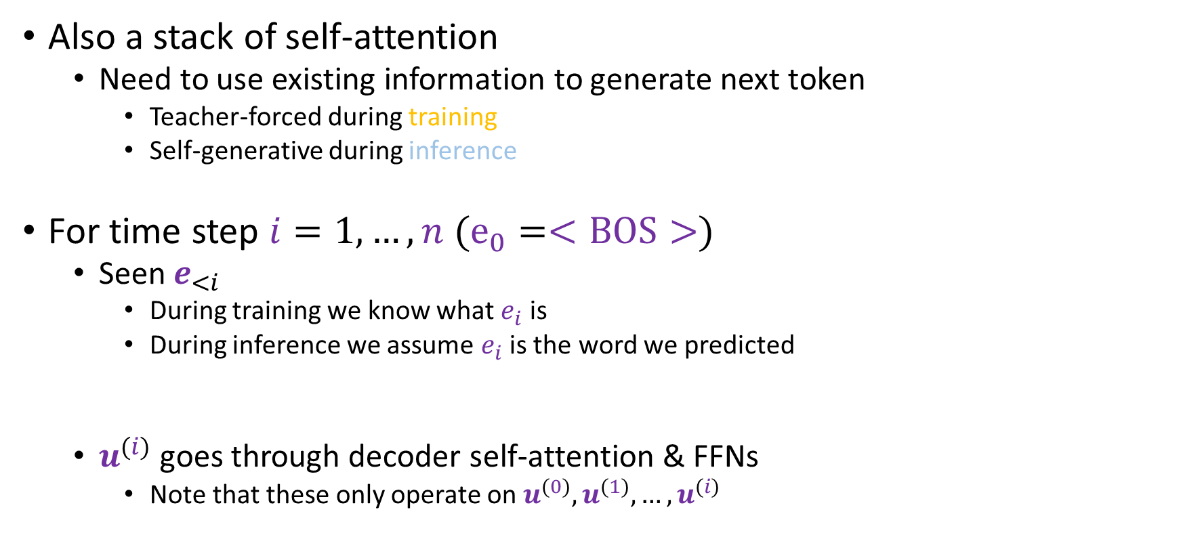
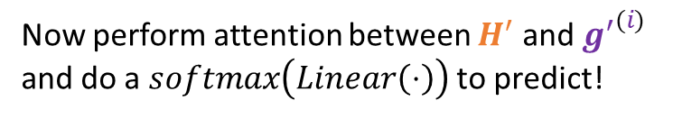



Decoder
$$g^{(i)}=SelfAttention\left({\left[u^{\left(0\right)},…,u^{\left(i\right)}\right]}^{T},u^{\left(i\right)}\right)$$
Repeat for same amount as encoder
$${g^{′}}^{(i)}=FFN\left(g^{(i)}\right)+g^{(i)}$$
Now perform attention between $H^{′}$ and ${g^{′}}^{(i)}$ and do a $softmax\left(Linear\left(⋅\right)\right)$ to predict!
Also a stack of self-attention
Need to use existing information to generate next token
Teacher-forced during training
Self-generative during inference
For time step $i=1,…,n (e_{0}=<BOS>)$
Seen $e_{<i}$
During training we know what $e_{i}$ is
During inference we assume $e_{i}$ is the word we predicted
$u^{(i)}$ goes through decoder self-attention & FFNs
Note that these only operate on $u^{(0)},u^{(1)},…,u^{(i)}$
$$c^{(i+1)}=CrossAttention\left(H^{′},{g^{′}}^{(i)}\right)$$
$$o^{(i+1)}=c^{(i+1)}+{g^{′}}^{(i)}$$
$$Pr⁡[e_{i+1}|f,e_{≤i}]=softmax\left(Linear\left(o^{\left(i+1\right)}\right)\right)$$
$$u^{(i)}=Embedding_{1}\left(e_{i}\right)+Embedding_{2}(i)$$

Slide 13






























Lin.Softmax
$$\operatorname{Pr}\left[e_{2} | f,e_{<2}\right]$$
CrossAttn
$${h^{′}}^{(0)}$$
$${h^{′}}^{(1)}$$
$${h^{′}}^{(n)}$$
$${g^{′}}^{(2)}$$
FeedFwrd
FeedFwrd
FeedFwrd
FeedFwrd
FeedFwrd
$$h^{(1)}$$
$$h^{(n)}$$
$$h^{(0)}$$
$$g^{(1)}$$
$$g^{(2)}$$
SelfAttn
SelfAttn
$${h^{′}}^{(0)}$$
$${h^{′}}^{(1)}$$
$${h^{′}}^{(n)}$$
$${g^{′}}^{(1)}$$
$${g^{′}}^{(2)}$$
FeedFwrd
FeedFwrd
FeedFwrd
FeedFwrd
FeedFwrd
$$h^{(1)}$$
$$h^{(n)}$$
$$h^{(0)}$$
$$g^{(1)}$$
$$g^{(2)}$$
SelfAttn
SelfAttn
$$v^{(0)}$$
$$v^{(n)}$$
$$u^{(0)}$$
$$u^{(1)}$$
$$v^{(1)}$$
$$<BOS>$$
$$f_{1}$$
$$f_{n}=<EOS>$$
$$<BOS>$$
$$e_{1}$$

