Slide 1
Morphology & Structure I

Slide 2
Parts of Speech
Categories of words
In principle substitutable for one another in a sentence
First level of syntactic structure
Although many words have unique POS tag
Some words are ambiguous
Ex: short
Can be an adjective
Can be a noun
Can be an adverb
Can be a verb
Need context to assign correct tag

Slide 3
POS tagging
Sequence labeling problem
Traditional model is a HMM
States are POS tags
Given a string, find the most probable sequence of states that accepts the string
State of the art?
Conditional Random Field (CRF)
Weighted finite automaton
Weights don’t have to be probabilities: only have to be nonnegative
Learned weights maximize weight of observed sequence while min other sequences
State of the art = RNN + CRF

Slide 4
Morphology
Study of how words are formed from more basic parts
A “sub-word” is called a morpheme
Morphemes often defined as the smallest “meaningful” part of a word
In English, some sounds are called phonesthemes
Tiny bit of meaning
Ex: many words related to “light” start with “gl” (gleam, glimmer, glisten, glitter, glow, …)
Generally considered distinct from morphemes
Wont deal with them much in this class

Slide 5
Morphology
Why bother?
We can develop NLP tools that ignore morphology
Treat each word as an atomic unit
Bad idea
Most languages have a richer morphology than English
Can form more complex/diverse words than English
With enough data this won’t matter….
But we need enough data for it not to matter
Want to share meaning across words
Learn meaning of morphemes = conquering words

Slide 6
Types of Morphemes
inflectional vs derivational morphemes
Inflectional (like -s)
Indicate features of a word
Singular vs plural
1st, 2nd, 3rd person
Gender
Etc.
Also can agree with features of other words
Derivational (like un-)
Change meaning of a word
Can also change part of speech of a word (like –en) changes adjectives to verbs

Slide 7
Syntactic Structure
I don’t like being made fun of
I don’t like being taken pictures of
I’d!
I would!
I saw a brown big spider
I saw a big brown spider
That movie was fan-freaking-tastic
That movie was fantas-freaking-tic
Grammar
More to sentences than a sequence of words
Help us to differentiate between meanings
“Two care were reported stolen by the Groveton police yesterday”
“Yoko Ono will talk about her husband John Lennon who was killed in an interview with Barbara Walters”
…
Sometimes we want to perform transformations on sequences
Program to turn statements in questions
Good fences make good neighbors
Make good fences good neighbors?
Do good fences make good neighbors?

Slide 8
Trees & Constituency
Naturally sentences are trees
The leaf nodes are the words
Subtree is called a constituent
Since we can’t observe the tree, linguists have developed tests
Can you move it around?
Can you replace it with something like a pronoun?
Can it participate in a cleft?
Can it be the answer to a question?

Slide 9
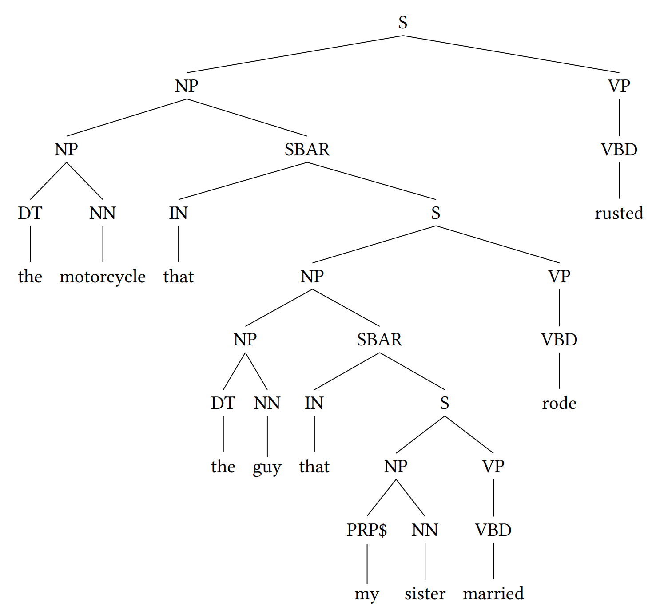
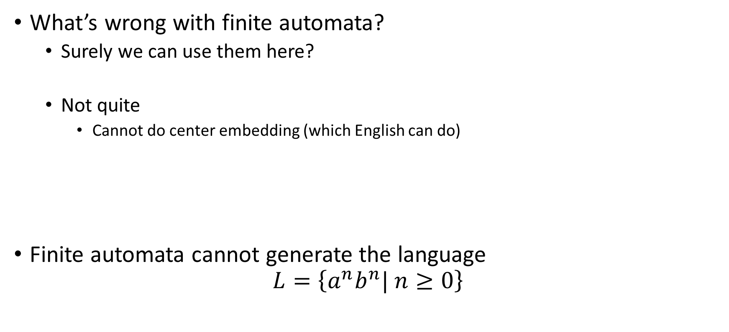
Modeling Structure
What’s wrong with finite automata?
Surely we can use them here?
Not quite
Cannot do center embedding (which English can do)
Finite automata cannot generate the language
$$L=\left\{a^{n}b^{n}| n≥0\right\}$$
The motorcycle rusted
The motorcycle that the guy rode rusted
The motorcycle that the guy that my sister married rode rusted

Slide 10



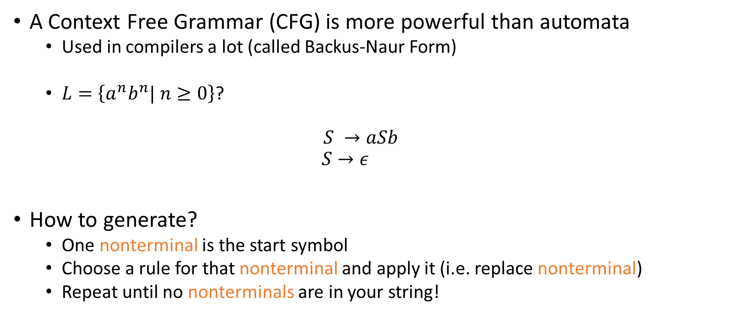



Context Free Grammars
How would this grammar generate $aaabbb$?
$$S$$
$$aSb$$
$$aaSbb$$
$$aaaSbbb$$
$$aaabbb$$
A Context Free Grammar (CFG) is more powerful than automata
Used in compilers a lot (called Backus-Naur Form)
$L=\left\{a^{n}b^{n}| n≥0\right\}$?
$$S →aSb$$
$$S→ε$$
How to generate?
One nonterminal is the start symbol
Choose a rule for that nonterminal and apply it (i.e. replace nonterminal)
Repeat until no nonterminals are in your string!
Terminal symbol
Nonterminal symbol

Slide 11
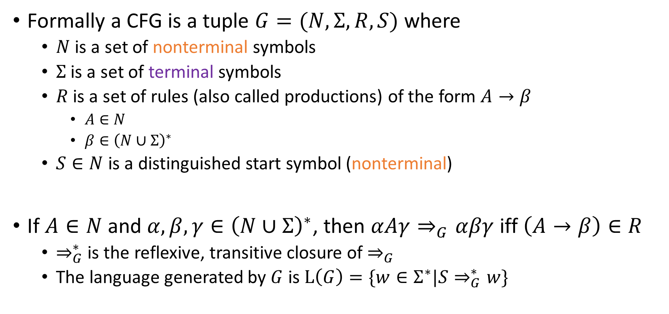
Context Free Grammars
Formally a CFG is a tuple $G=(N,Σ,R,S)$ where
$N$ is a set of nonterminal symbols
$Σ$ is a set of terminal symbols
$R$ is a set of rules (also called productions) of the form $A→β$
$A∈N$
$β∈{\left(N∪Σ\right)}^{∗}$
$S∈N$ is a distinguished start symbol (nonterminal)
If $A∈N$ and $α,β,γ∈{\left(N∪Σ\right)}^{∗}$, then $αAγ⇒_{G}αβγ$ iff $\left(A→β\right)∈R$
$⇒_{G}^{∗}$ is the reflexive, transitive closure of $⇒_{G}$
The language generated by $G$ is $L\left(G\right)=\{w∈Σ^{∗}|S⇒_{G}^{∗}w\}$

Slide 12
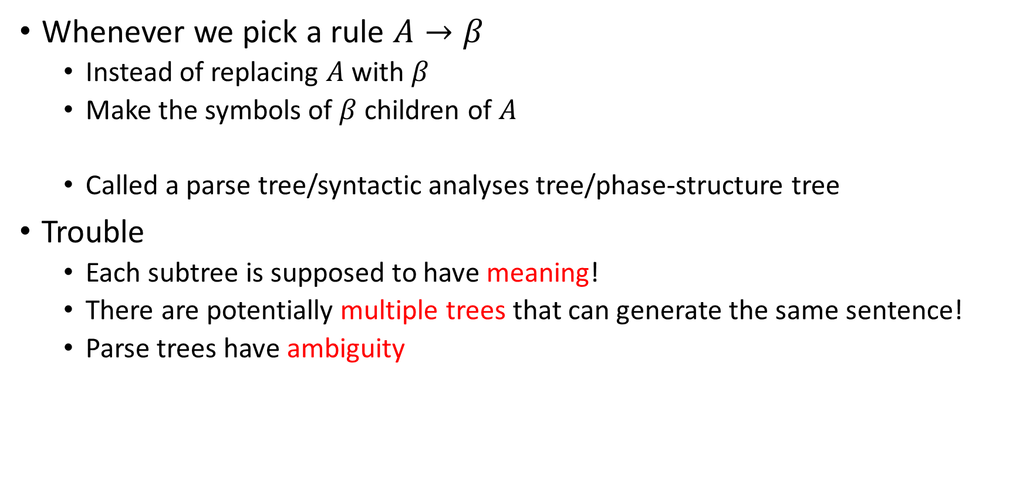
Making Trees with a CFG
Whenever we pick a rule $A→β$
Instead of replacing $A$ with $β$
Make the symbols of $β$ children of $A$
Called a parse tree/syntactic analyses tree/phase-structure tree
Trouble
Each subtree is supposed to have meaning!
There are potentially multiple trees that can generate the same sentence!
Parse trees have ambiguity

Slide 13
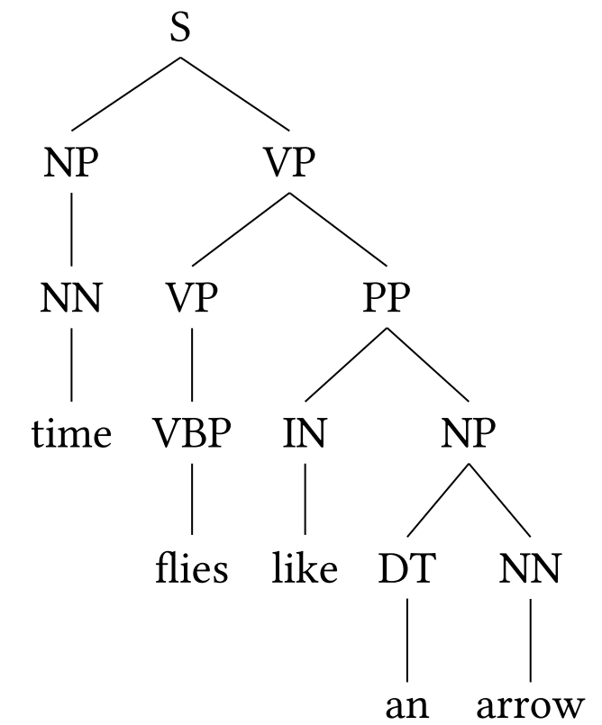
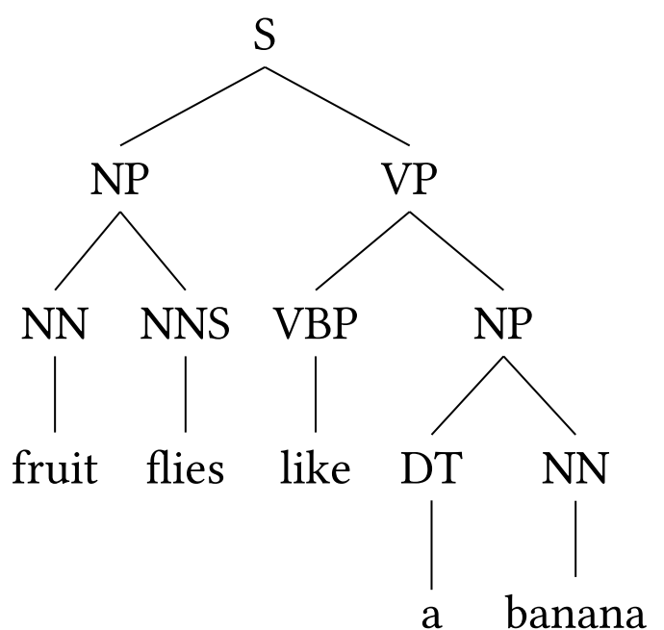
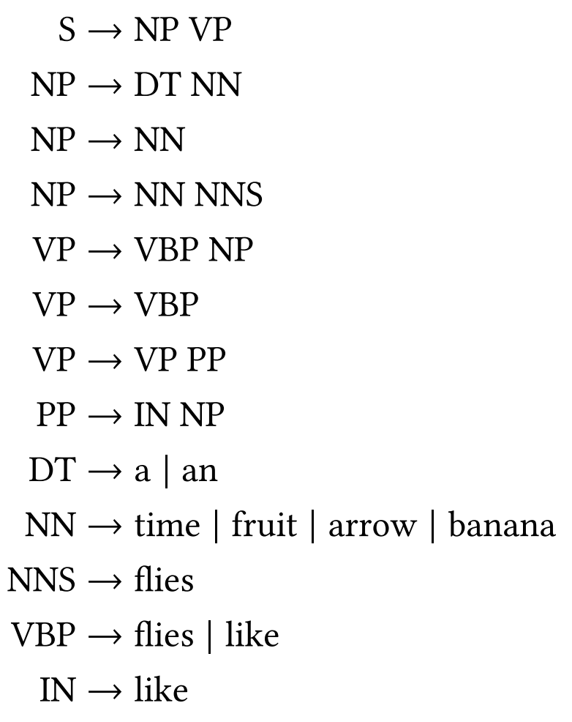
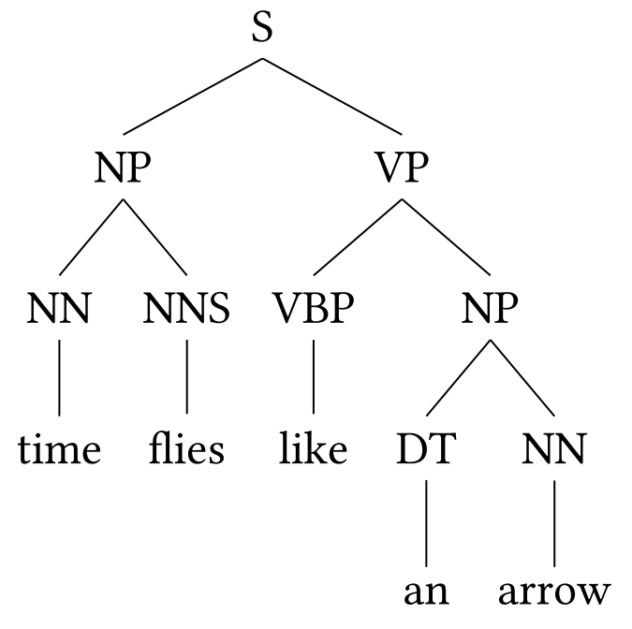
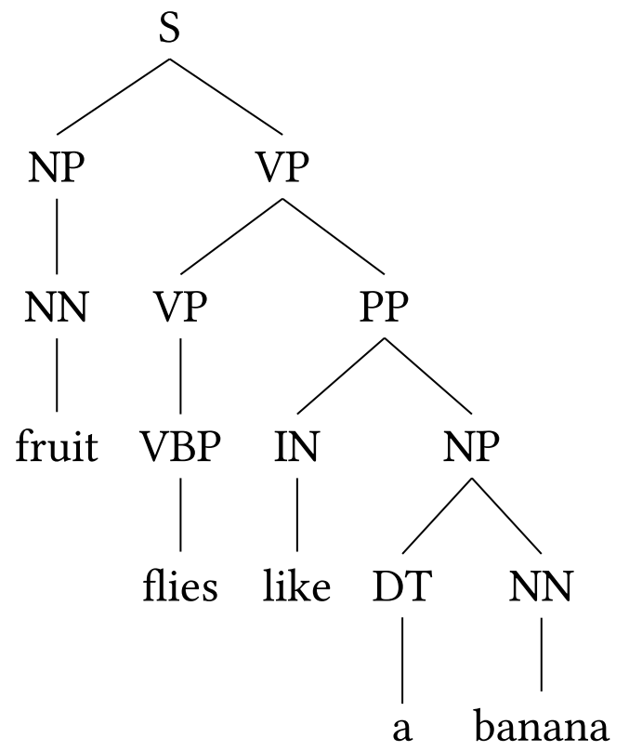
Ambiguity in CFGs
Time flies like an arrow
Fruit flies like a banana

Slide 14
How to Remove Ambiguity?
Assign probabilities to productions
Therefore parse trees have probability
Find the most probable parse tree
What if I don’t know the production probabilities?
Learn them from data!

Slide 15

Weighted CFGs
Every production has a weight attached to it
$$A\underset{→}{p}β$$
Weight of a tree is the product of the weights of the rules used

Slide 16
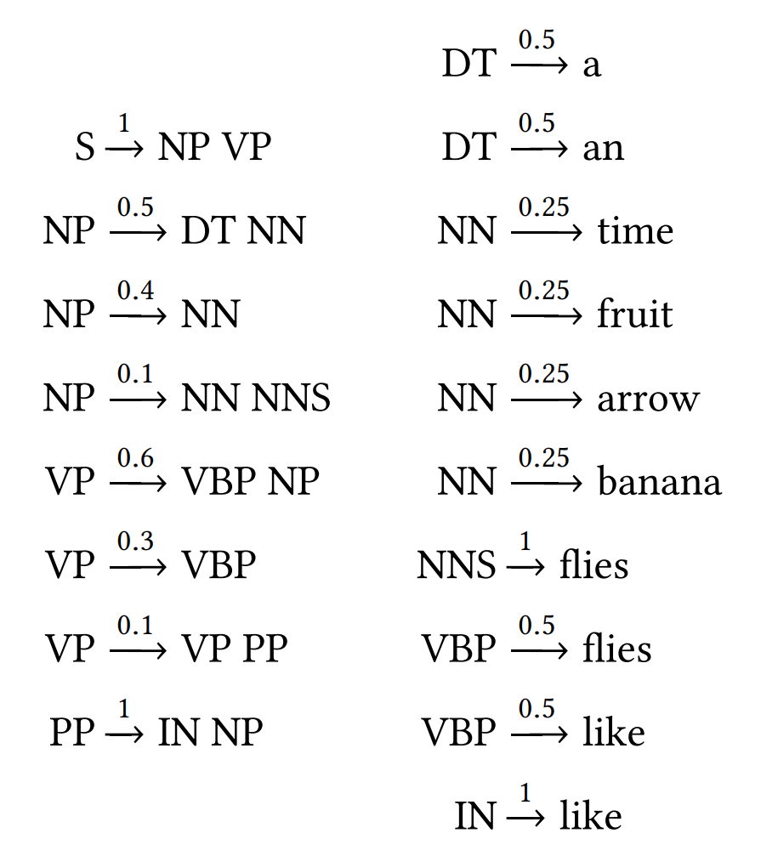
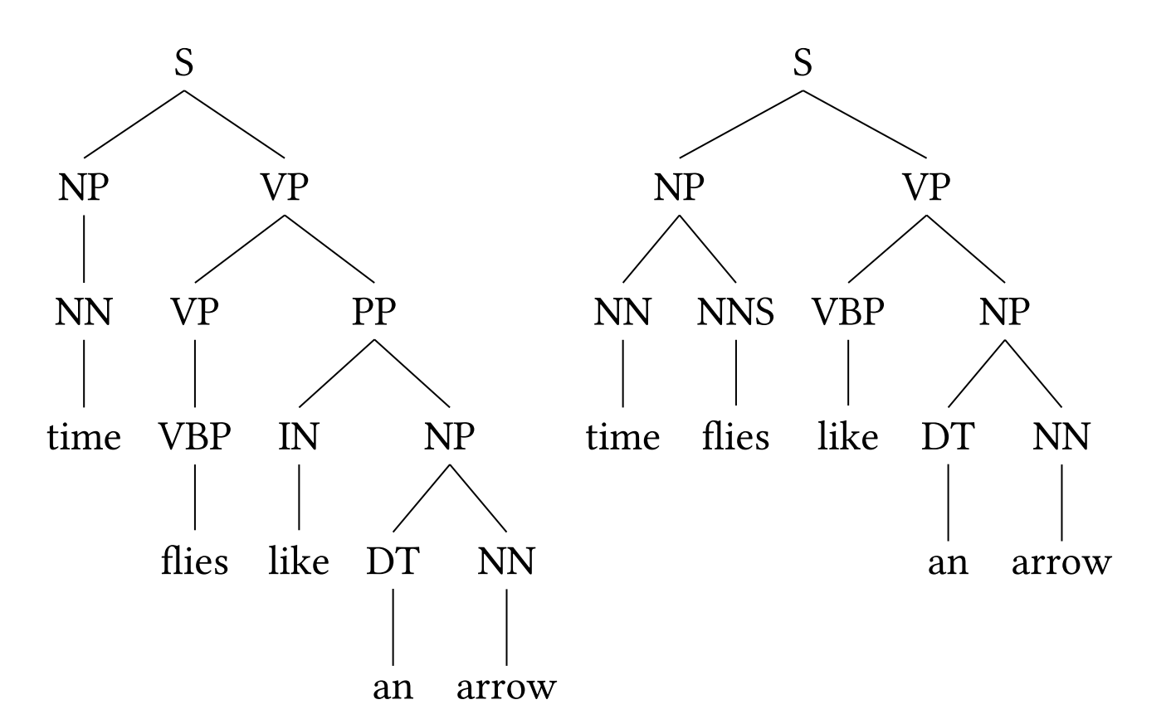
Weighted CFGs

Slide 17


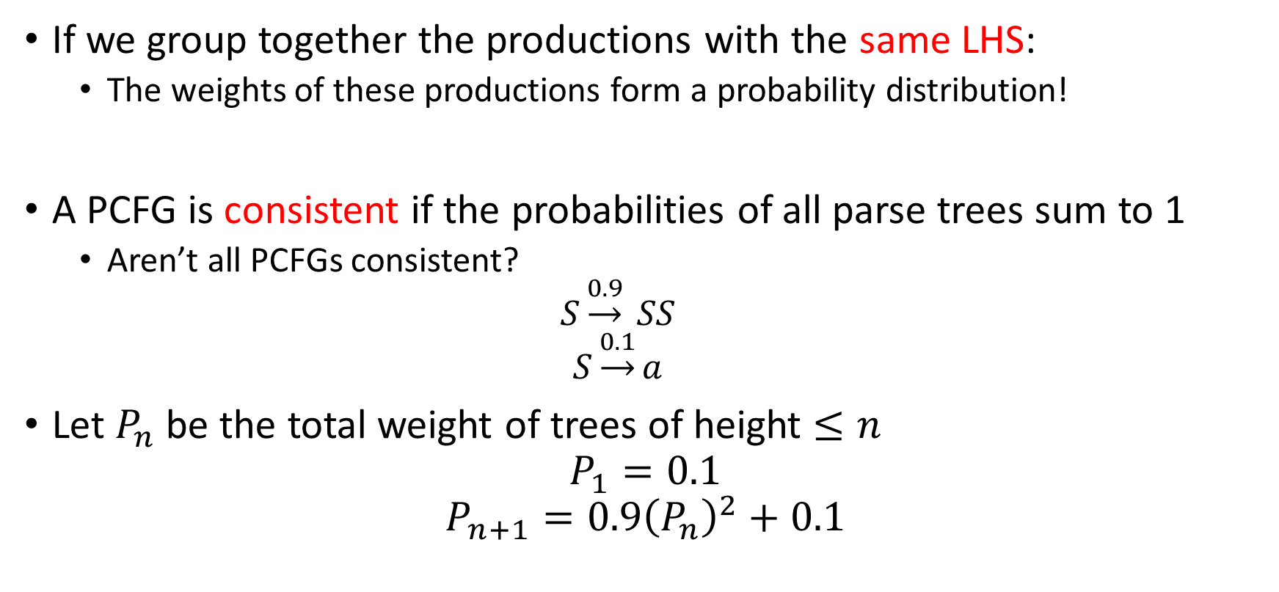


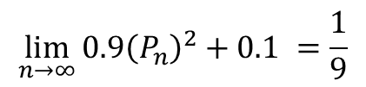
Probabilistic CFGs
$\lim_{n→∞}{P_{n}}$ must be a fixed point:
$$\lim_{n→∞}{0.9{\left(P_{n}\right)}^{2}+0.1 }=\frac{1}{9}$$
$$\lim_{n→∞}{0.9{\left(P_{n}\right)}^{2}+0.1 }=1$$
Since $P_{1}<\frac{1}{9}$ and $P_{i}<\frac{1}{9}⇒P_{i+1}<\frac{1}{9}$
Therefore limit is $\frac{1}{9}$
If we group together the productions with the same LHS:
The weights of these productions form a probability distribution!
A PCFG is consistent if the probabilities of all parse trees sum to 1
Aren’t all PCFGs consistent?
$$S\underset{→}{0.9} SS$$
$$S\underset{→}{0.1}a$$
Let $P_{n}$ be the total weight of trees of height $≤n$
$$P_{1}=0.1$$
$$P_{n+1}=0.9{\left(P_{n}\right)}^{2}+0.1$$

