Slide 1
Structure II

Slide 2
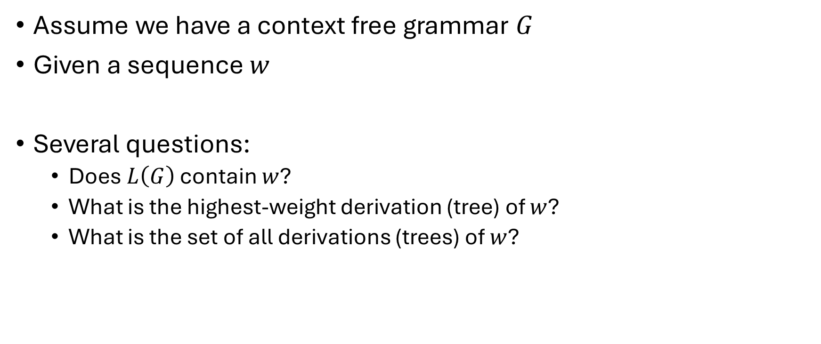
The Parsing Problem
Assume we have a context free grammar $G$
Given a sequence $w$
Several questions:
Does $L\left(G\right)$ contain $w$?
What is the highest-weight derivation (tree) of $w$?
What is the set of all derivations (trees) of $w$?

Slide 3

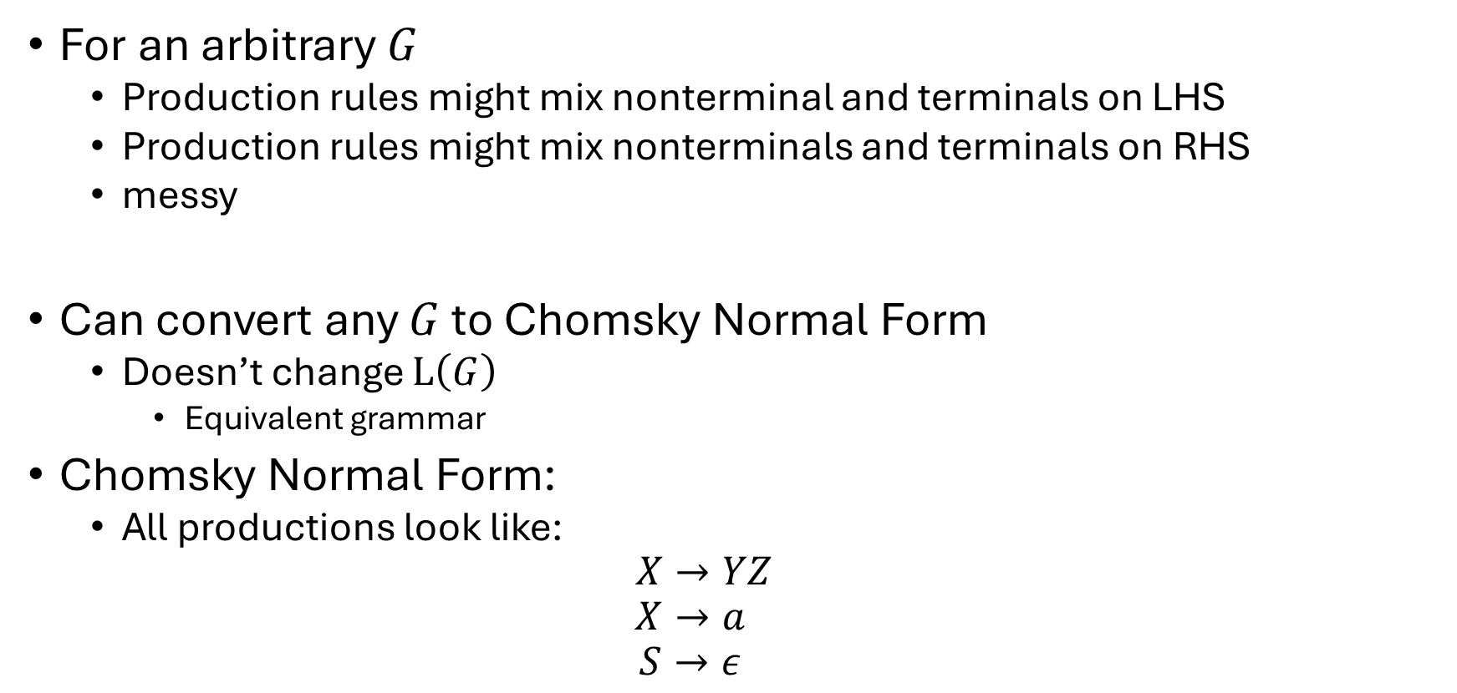
Chomsky Normal Form
For an arbitrary $G$
Production rules might mix nonterminal and terminals on LHS
Production rules might mix nonterminals and terminals on RHS
messy
Can convert any $G$ to Chomsky Normal Form
Doesn’t change $L\left(G\right)$
Equivalent grammar
Chomsky Normal Form:
All productions look like:
$$X→YZ$$
$$X→a$$
$$S→ε$$
Start symbol cannot appear in RHS
No terminals on LHS
A nonterminal can produce a pair of nonterminals
A nonterminal can produce a solo terminal
Only the start symbol is allowed to produce $ε$

Slide 4
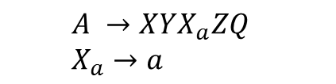
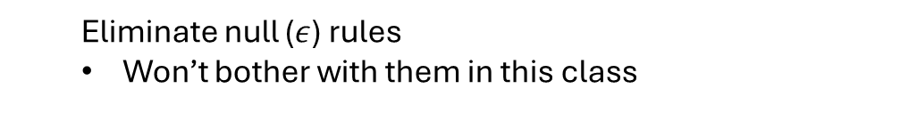

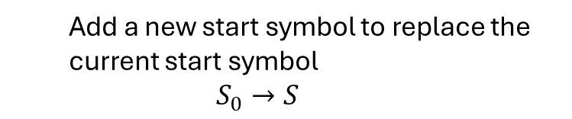


How to Convert to Chomksy Normal Form?
Apply a bunch of transformations
Eliminate null ($ε$) rules
Won’t bother with them in this class
Add a new start symbol to replace the current start symbol
$$S_{0}→S$$
Eliminate productions with a RHS with more than 2 nonterminals
Eliminate unary rules
While we could remove them from our grammar
In practice people don’t
Just modify their algorithms to handle them directly
$$A →XYaZQ$$
$$A →XYX_{a}ZQ$$
$$X_{a}→a$$
Eliminate productions that have non-solitary terminals
$$A →XA_{1}$$
$$A_{1}→YA_{2}$$
$${A_{2}→X}_{a}A_{3}$$
$$A_{3}→ZQ$$
$$A →XYX_{a}ZQ$$

Slide 5
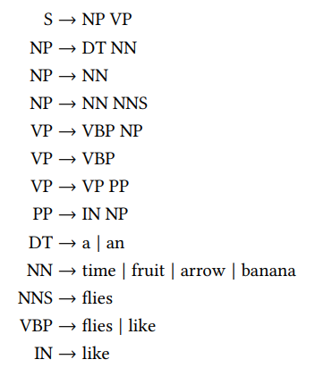
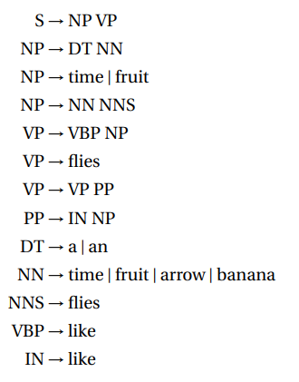
To Chomsky Normal Form

Slide 6
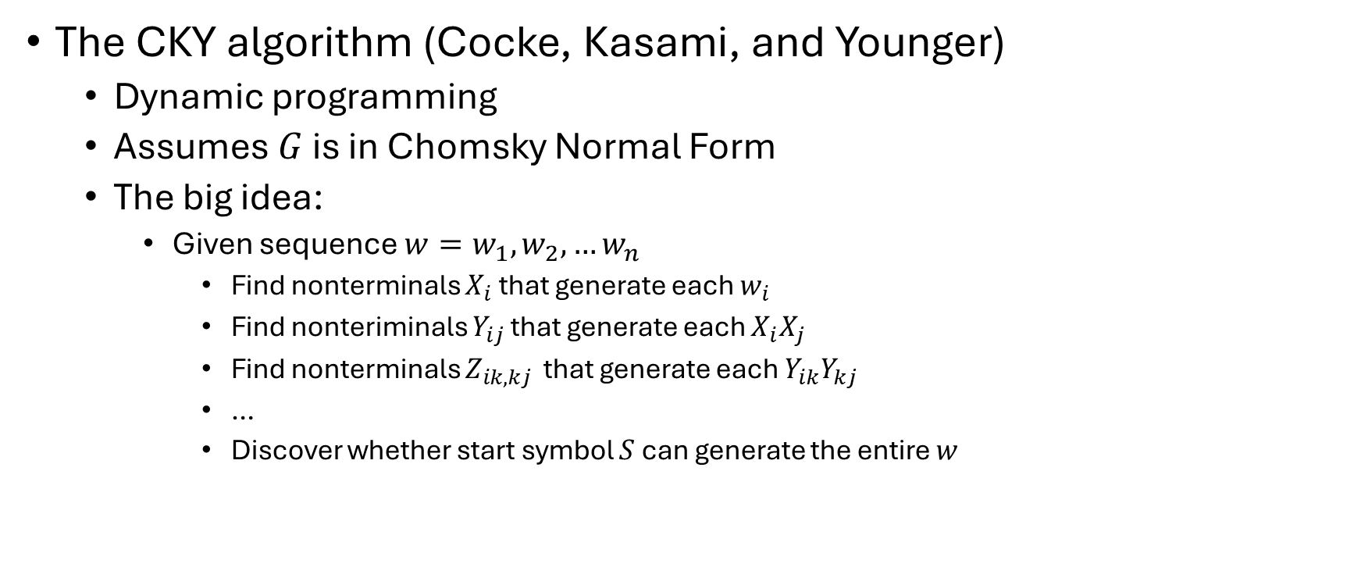

Is $w∈L(G)$?
The CKY algorithm (Cocke, Kasami, and Younger)
Dynamic programming
Assumes $G$ is in Chomsky Normal Form
The big idea:
Given sequence $w=w_{1},w_{2},…w_{n}$
Find nonterminals $X_{i}$ that generate each $w_{i}$
Find nonteriminals $Y_{ij}$ that generate each $X_{i}X_{j}$
Find nonterminals $Z_{ik,kj }$ that generate each $Y_{ik}Y_{kj}$
…
Discover whether start symbol $S$ can generate the entire $w$

Slide 7


















The CKY algorithm
The CYK Algorithm Visualization Tool • RAW
$$w_{5}$$
$$w_{1}$$
$$w_{2}$$
$$w_{3}$$
$$w_{4}$$
$$w_{5}$$
$$w_{1}$$
$$w_{2}$$
$$w_{3}$$
$$w_{4}$$
$$w_{6}$$
$$w_{8}$$
$$w_{9}$$
$$w_{6}$$
$$w_{7}$$
$$w_{8}$$
$$w_{9}$$
$$w_{7}$$

Slide 8


The CKY algorithm
Given $w=w_{1},w_{2},…,w_{n}$ and $G=(N,Σ, R,S)$
Build a $n×n$ table $T$(only populate one triangle-half of the table)
Each entry of the table will contain a set of nonterminals
$X∈T\left[i,j\right]$ implies $X$ can (eventually) generate $w_{i+1},…,w_{j}$
initialize $T\left[i,j\right]=∅$ for all $0≤i<j≤n$
for all $i=1,…n$ and $\left(X→w_{i}\right)∈R$ do
$T\left[i−1,i\right]=T\left[i−1,i\right]∪\{X\}$
for $l=2,…,n$ do
for $i=0,…,n−l$ do
$j=i+l$
for $k=i+1,…,j−1$ do
for all $\left(X→YZ\right)∈R$ do
if $Y∈T[i,k]$ and $Z∈T[k,j]$ then
$T\left[i,j\right]=T\left[i,j\right]∪\{X\}$
return $S∈T\left[0,n\right]$

