Slide 1
Machine Translation I

Slide 2
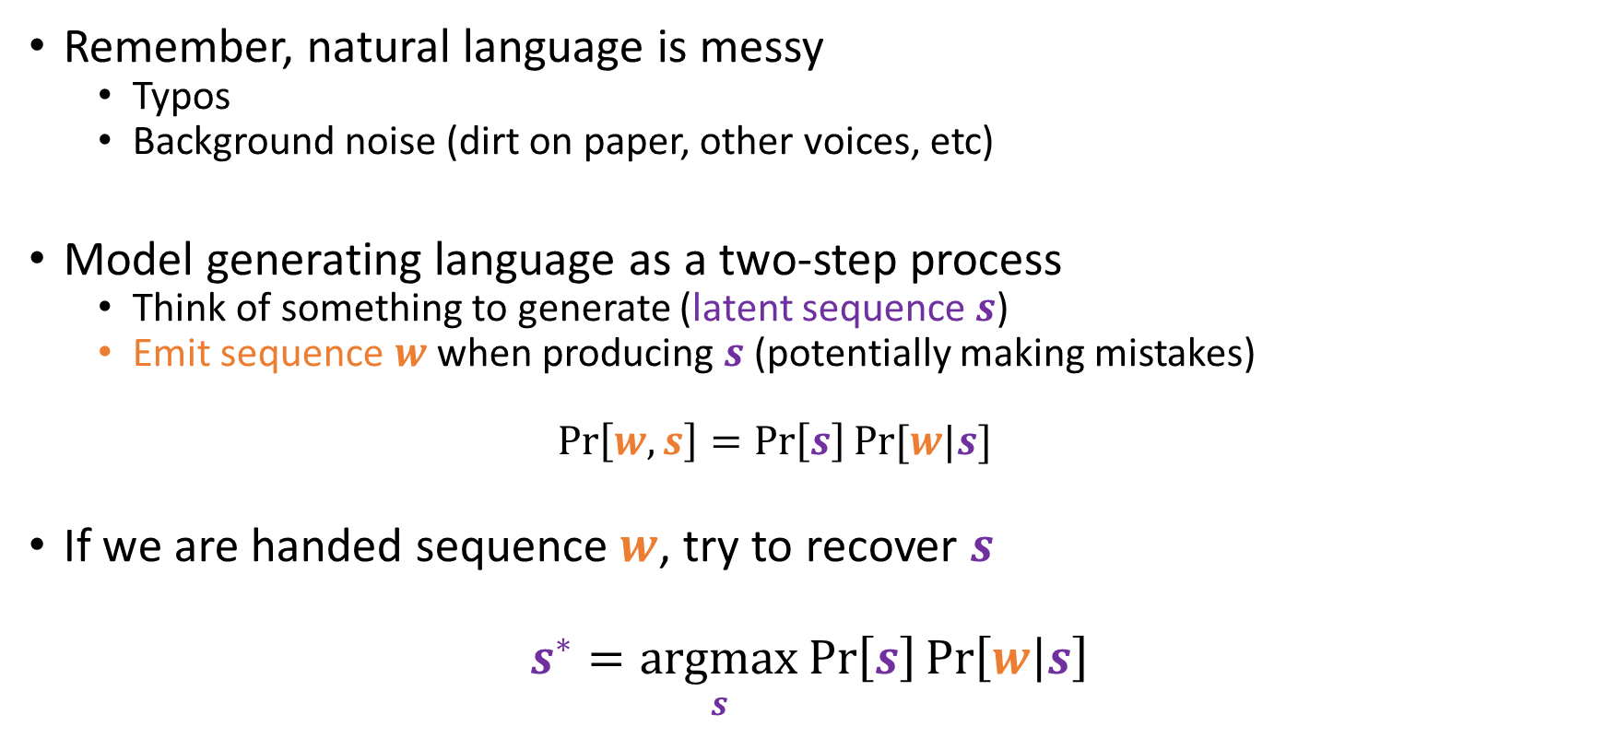
The noisy-channel model
Remember, natural language is messy
Typos
Background noise (dirt on paper, other voices, etc)
Model generating language as a two-step process
Think of something to generate (latent sequence $s$)
Emit sequence $w$ when producing $s$ (potentially making mistakes)
$$\operatorname{Pr}\left[w,s\right]=\operatorname{Pr}\left[s\right]Pr⁡[w|s]$$
If we are handed sequence $w$, try to recover $s$
$$s^{∗}=\underset{s}{argmax}{\operatorname{Pr}\left[s\right]\operatorname{Pr}\left[w | s\right]}$$
Language models!

Slide 3
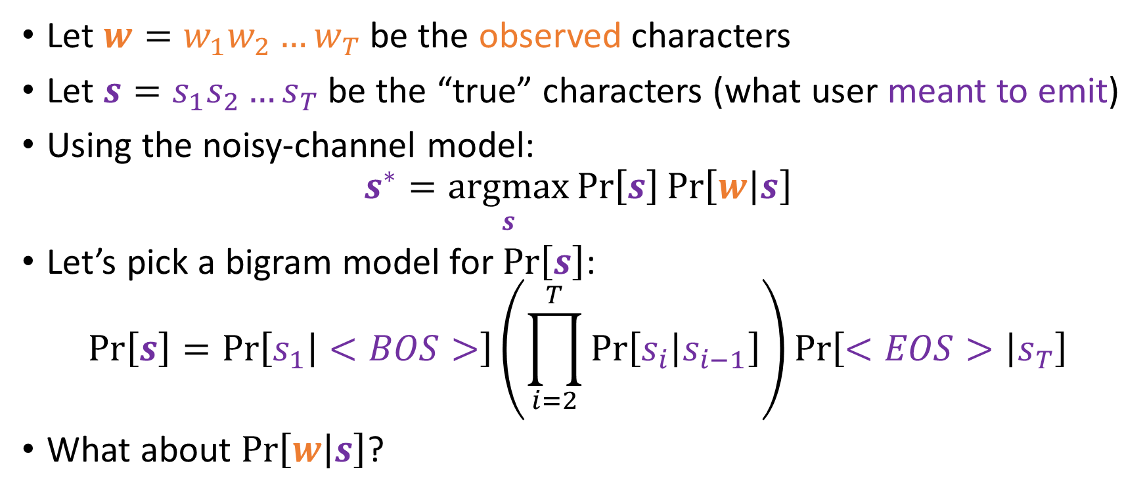
A simpler problem: typo correction
Let $w=w_{1}w_{2}…w_{T}$ be the observed characters
Let $s=s_{1}s_{2}…s_{T}$ be the “true” characters (what user meant to emit)
Using the noisy-channel model:
$$s^{∗}=\underset{s}{argmax}{\operatorname{Pr}\left[s\right]\operatorname{Pr}\left[w | s\right]}$$
Let’s pick a bigram model for $\operatorname{Pr}\left[s\right]$:
$$\operatorname{Pr}\left[s\right]=\operatorname{Pr}\left[s_{1} | <BOS>\right]\left(\prod_{i=2}^{T}{\operatorname{Pr}\left[s_{i} | s_{i−1}\right]}\right)\operatorname{Pr}\left[<EOS> | s_{T}\right]$$
What about $\operatorname{Pr}\left[w | s\right]$?

Slide 4
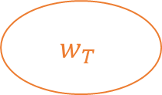
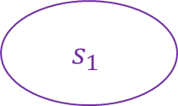
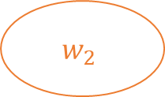
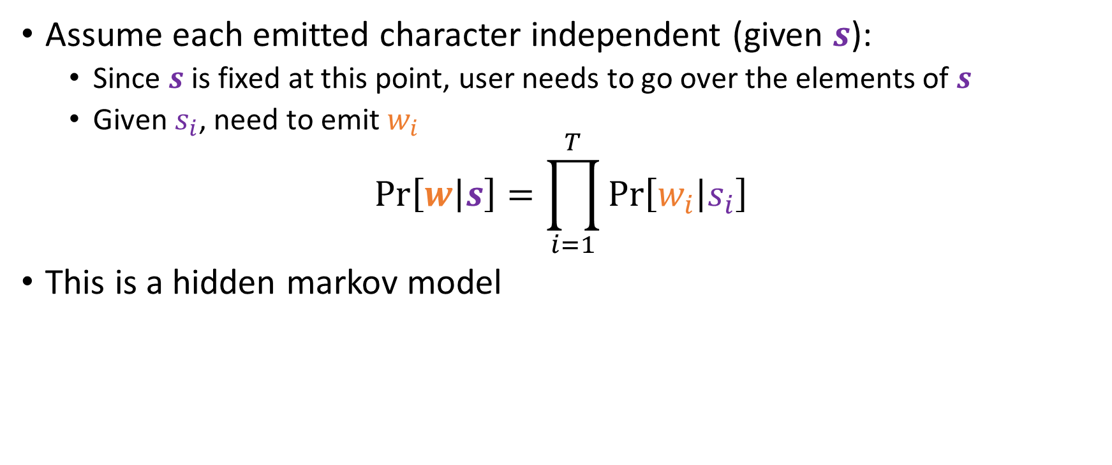
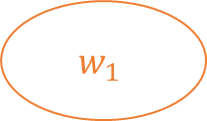


A simpler problem: typo correction
Assume each emitted character independent (given $s$):
Since $s$ is fixed at this point, user needs to go over the elements of $s$
Given $s_{i}$, need to emit $w_{i}$
$$\operatorname{Pr}\left[w | s\right]=\prod_{i=1}^{T}{\operatorname{Pr}\left[w_{i} | s_{i}\right]}$$
This is a hidden markov model
Latent (hidden)
<BOS>
$$s_{1}$$
$$s_{2}$$
$$s_{T}$$
<EOS>
Observable (seen)
$$w_{1}$$
$$w_{2}$$
$$w_{T}$$

Slide 5

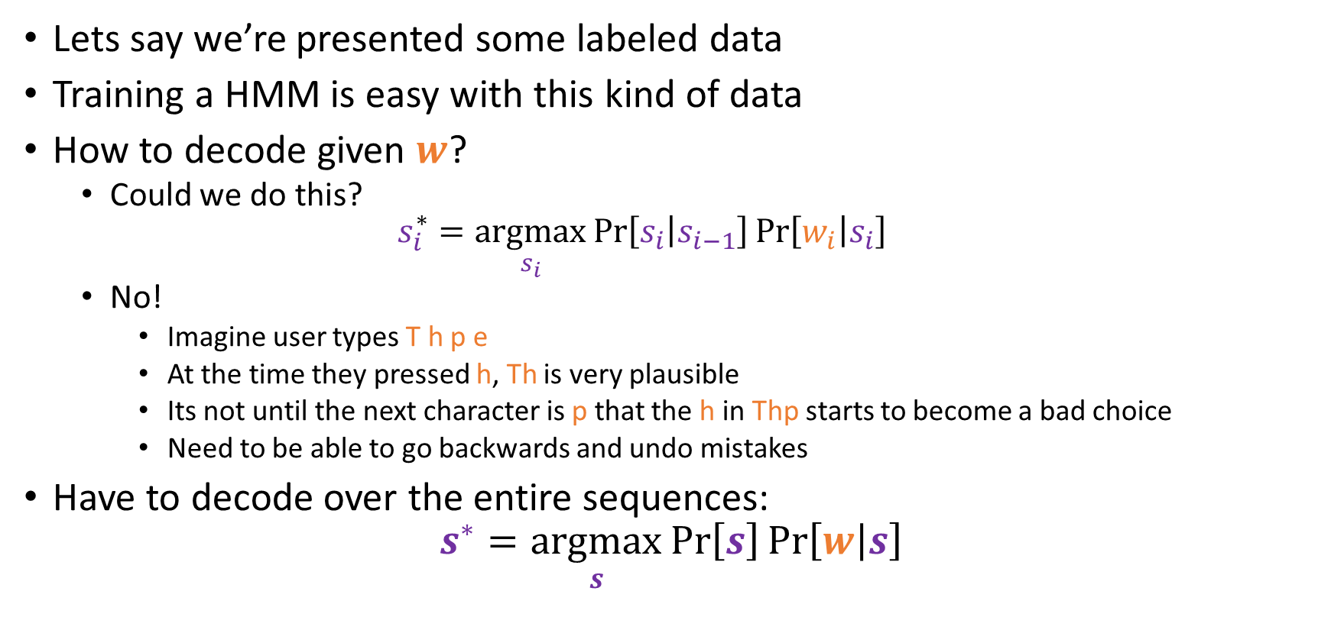

Hidden Markov Models
$$s$$
T y p e
$$w$$
T h p e
Lets say we’re presented some labeled data
Training a HMM is easy with this kind of data
How to decode given $w$?
Could we do this?
$$s_{i}^{∗}=\underset{s_{i}}{argmax}{\operatorname{Pr}\left[s_{i} | s_{i−1}\right]\operatorname{Pr}\left[w_{i} | s_{i}\right]}$$
No!
Imagine user types T h p e
At the time they pressed h, Th is very plausible
Its not until the next character is p that the h in Thp starts to become a bad choice
Need to be able to go backwards and undo mistakes
Have to decode over the entire sequences:
$$s^{∗}=\underset{s}{argmax}{\operatorname{Pr}\left[s\right]\operatorname{Pr}\left[w | s\right]}$$

Slide 6













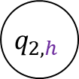
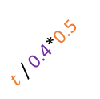












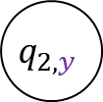



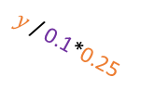
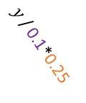














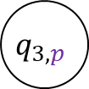

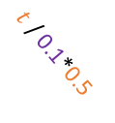













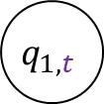
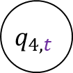

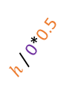








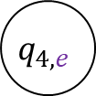

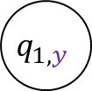








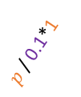
HMM Decoding
$$s$$
$$\operatorname{Pr}\left[w | s\right]$$
e
h
p
t
y
e
$$1$$
$$0$$
$$0$$
$$0.5$$
$$0$$
h
$$0$$
$$0.5$$
$$0$$
$$0$$
$$0.25$$
$$w$$
p
$$0$$
$$0$$
$$1$$
$$0$$
$$0$$
t
Lets say our HMM has the following params:
Given $w=$Thpe:
Build a FSA that generates all possible $s$ for $w$
State $q_{i,s}$ for every $0≤i≤T$ and $s∈Σ_{S}$
Edge $q_{i,s}→q_{i+1,s^{′}}$ on $w$ w/ weight $\operatorname{Pr}\left[s^{′} | s\right]\operatorname{Pr}\left[w | s^{′}\right]$
$$0.25$$
$$0$$
$$0$$
$$0$$
$$0.5$$
y
$$0$$
$$0.5$$
$$0$$
$$0$$
$$0.5$$
$$s$$
$$\operatorname{Pr}\left[s^{′} | s\right]$$
<BOS>
e
h
p
t
y
e
$$0.2$$
$$0.2$$
$$0.5$$
$$0.2$$
$$0.1$$
$$0.4$$
h
$$0.2$$
$$0.1$$
$$0$$
$$0.1$$
$$0.6$$
$$0$$
$$s^{′}$$
p
$$0.1$$
$$0.1$$
$$0$$
$$0.2$$
$$0$$
$$0.1$$
$$q_{1,t}$$
$h$ / 0.6*0.5
$$q_{2,h}$$
$p$ / 0*1
$$q_{3,p}$$
$e$ / 0.2*1
$$q_{4,e}$$
t
$$0.4$$
$$0.2$$
$$0.1$$
$$0.1$$
$$0.1$$
$$0.1$$
y
$$0.1$$
$$0.1$$
$$0$$
$$0.2$$
$$0.1$$
$$0$$
$t$ / 0.4*0.5
<EOS>/ 0.3
<EOS>
$$0$$
$0.$3
$$0.4$$
$$0.2$$
$$0.1$$
$$0.4$$
$$q_{0,<BOS>}$$
$y$ / 0.1*0.25
$$q_{5,<EOS>}$$
$p$ / 0.1*1
$t$ / 0.1*0.5
$h$ / 0*0.5
<EOS>/ 0.1
$y$ / 0.1*0.25
$$q_{1,y}$$
$$q_{2,y}$$
$$q_{4,t}$$
$y$ / 0*0.25

Slide 7

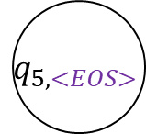
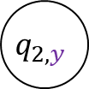


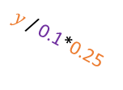
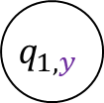






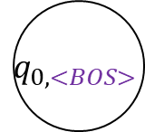

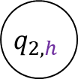
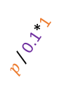




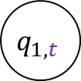

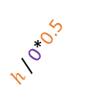
HMM Decoding
viterbi[$q_{0,<BOS>}$] = 1
viterbi[$q$] = 0 for each state $q≠q_{0,<BOS>}$
for each state $q^{′}$ in topological order do
for each incoming transition $q→q^{′}$ w/ weight $p$ do
if viterbi[$q$]*$p$ > viterbi[$q^{′}$] then
viterbi[$q^{′}$] = viterbi[$q$]*$p$
parents[$q^{′}$] = $q$
What do we do with the (acyclic) FSA?
Find the highest-weighted path through the FSA (from $q_{0,<BOS>}$ to $q_{T,<EOS>}$)
Use the Viterbi algorithm:
Dynamic programming
Visit states in topological order
Sub-problem: when at state $q_{i,s}$, want to find largest-weighted path from $q_{0,<BOS>}$ to $q_{i,s}$
return viterbi[$q_{0,<EOS>}$]
$$q_{1,t}$$
$h$ / 0.6*0.5
$$q_{2,h}$$
$p$ / 0*1
$$q_{3,p}$$
$e$ / 0.2*1
$$q_{4,e}$$
$t$ / 0.4*0.5
<EOS>/ 0.3
$$q_{0,<BOS>}$$
$y$ / 0.1*0.25
$$q_{5,<EOS>}$$
$p$ / 0.1*1
$t$ / 0.1*0.5
$h$ / 0*0.5
<EOS>/ 0.1
$y$ / 0.1*0.25
$$q_{1,y}$$
$$q_{2,y}$$
$$q_{4,t}$$
$y$ / 0*0.25

Slide 8
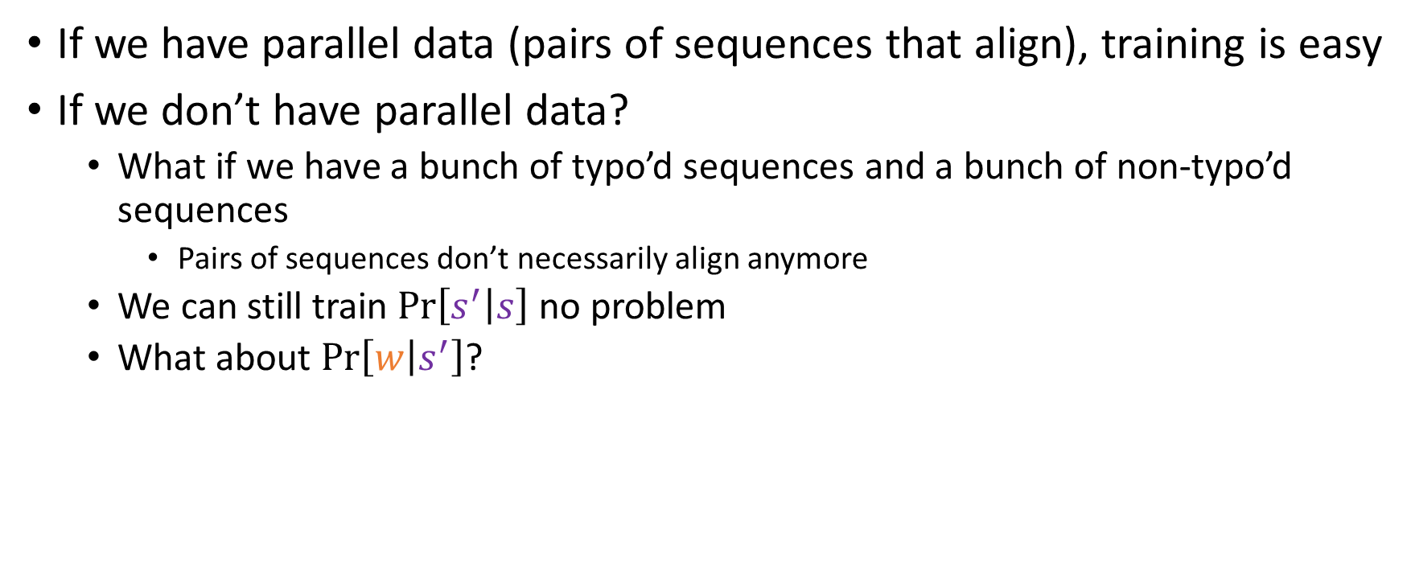
Parallel vs Incomplete data
If we have parallel data (pairs of sequences that align), training is easy
If we don’t have parallel data?
What if we have a bunch of typo’d sequences and a bunch of non-typo’d sequences
Pairs of sequences don’t necessarily align anymore
We can still train $\operatorname{Pr}\left[s^{′} | s\right]$ no problem
What about $\operatorname{Pr}\left[w | s^{′}\right]$?

Slide 9

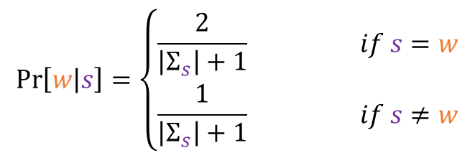





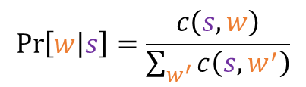


“Hard” Expectation Maximization
$$\operatorname{Pr}\left[w | s\right]=\left\{\begin{aligned}\frac{2}{\left|Σ_{s}\right|+1} if s=w \\ \frac{1}{\left|Σ_{s}\right|+1} if s≠w\end{aligned}\right.$$
A method of bootstrapping:
Start with some initialization of $\operatorname{Pr}\left[w | s^{′}\right]$ (doesn’t have to be a good one):
Lets say we have observed sequences $w^{(1)}, w^{(2)},…,w^{(N)}$
Initialize the model $\operatorname{Pr}\left[w | s^{′}\right]$
repeat
Viterbi decoding
for each observed sequence $w^{(i)}$ do
compute the best correction $s^{∗}=\underset{s}{argmax}{\operatorname{Pr}\left[s | w^{\left(i\right)}\right]}$
for each position $j$ do
Expectation (or E) step
$$c\left(s_{j}^{∗},w_{j}^{\left(i\right)}\right)+=1$$
Record that $w_{j}^{\left(i\right)}$ was used to generate $s_{j}^{∗}$
for all $w∈Σ_{W},s∈Σ_{S}$ do
$$\operatorname{Pr}\left[w | s\right]=\frac{c\left(s,w\right)}{\sum_{w^{′}}{c\left(s,w^{′}\right)}}$$
Recompute probs from counts
Maximization (or M) step
until converged

Slide 10



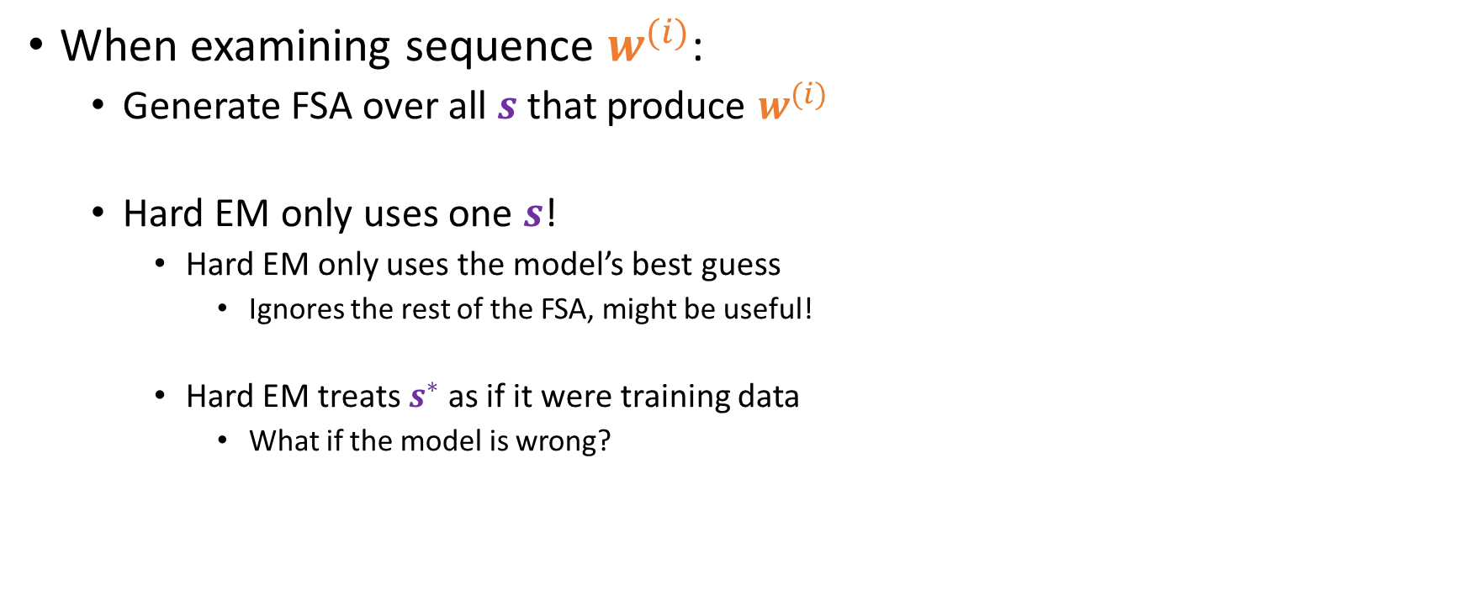




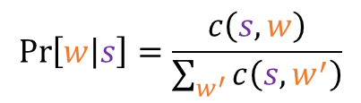
Problems with “Hard” EM
Initialize the model $\operatorname{Pr}\left[w | s^{′}\right]$
repeat
for each observed sequence $w^{(i)}$ do
compute the best correction $s^{∗}=\underset{s}{argmax}{\operatorname{Pr}\left[s | w^{\left(i\right)}\right]}$
for each position $j$ do
$$c\left(s_{j}^{∗},w_{j}^{\left(i\right)}\right)+=1$$
Record that $w_{j}^{\left(i\right)}$ was used to generate $s_{j}^{∗}$
When examining sequence $w^{(i)}$:
Generate FSA over all $s$ that produce $w^{(i)}$
Hard EM only uses one $s$!
Hard EM only uses the model’s best guess
Ignores the rest of the FSA, might be useful!
Hard EM treats $s^{∗}$ as if it were training data
What if the model is wrong?
for all $w∈Σ_{W},s∈Σ_{S}$ do
$$\operatorname{Pr}\left[w | s\right]=\frac{c\left(s,w\right)}{\sum_{w^{′}}{c\left(s,w^{′}\right)}}$$
Recompute probs from counts
until converged

Slide 11
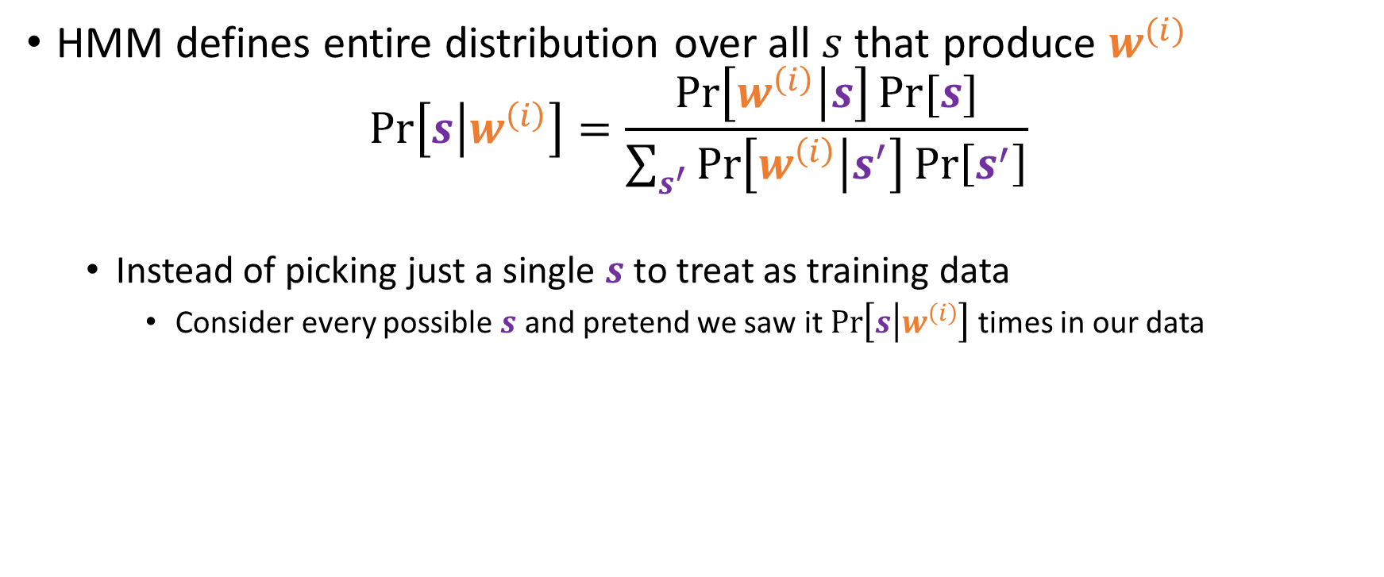
Improving “Hard” EM
HMM defines entire distribution over all $s$ that produce $w^{(i)}$
$$\operatorname{Pr}\left[s | w^{\left(i\right)}\right]=\frac{\operatorname{Pr}\left[w^{\left(i\right)} | s\right]Pr⁡[s]}{\sum_{s^{′}}{\operatorname{Pr}\left[w^{\left(i\right)} | s^{′}\right]\operatorname{Pr}\left[s^{′}\right]}}$$
Instead of picking just a single $s$ to treat as training data
Consider every possible $s$ and pretend we saw it $\operatorname{Pr}\left[s | w^{\left(i\right)}\right]$ times in our data

Slide 12














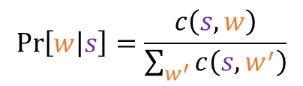

“Soft” Expectation Maximization
Here’s a straightforward yet infeasible way to do this:
Infeasible b/c we need to generate every possible correction $s$
We actually have it worse: $\operatorname{Pr}\left[s | w^{\left(i\right)}\right]$ means we divide by $\operatorname{Pr}\left[w^{\left(i\right)}\right]$ (so consider all $s^{′}$)
Initialize the model $\operatorname{Pr}\left[w | s^{′}\right]$
Initialize the model $\operatorname{Pr}\left[w | s^{′}\right]$
repeat
repeat
for each observed sequence $w^{(i)}$ do
for each observed sequence $w^{(i)}$ do
compute the best correction $s^{∗}=\underset{s}{argmax}{\operatorname{Pr}\left[s | w^{\left(i\right)}\right]}$
for every possible correction $s$ do
for each position $j$ do
E-step
compute $\operatorname{Pr}\left[s | w^{\left(i\right)}\right]$
$$c\left(s_{j}^{∗},w_{j}^{\left(i\right)}\right)+=1$$
for each position $j$ do
$$c\left(s_{j},w_{j}^{\left(i\right)}\right)+=Pr\left[s | w^{\left(i\right)}\right]$$
for all $w∈Σ_{W},s∈Σ_{S}$ do
$$\operatorname{Pr}\left[w | s\right]=\frac{c\left(s,w\right)}{\sum_{w^{′}}{c\left(s,w^{′}\right)}}$$
for all $w∈Σ_{W},s∈Σ_{S}$ do
M-step
$$\operatorname{Pr}\left[w | s\right]=\frac{c\left(s,w\right)}{\sum_{w^{′}}{c\left(s,w^{′}\right)}}$$
until converged
until converged

Slide 13

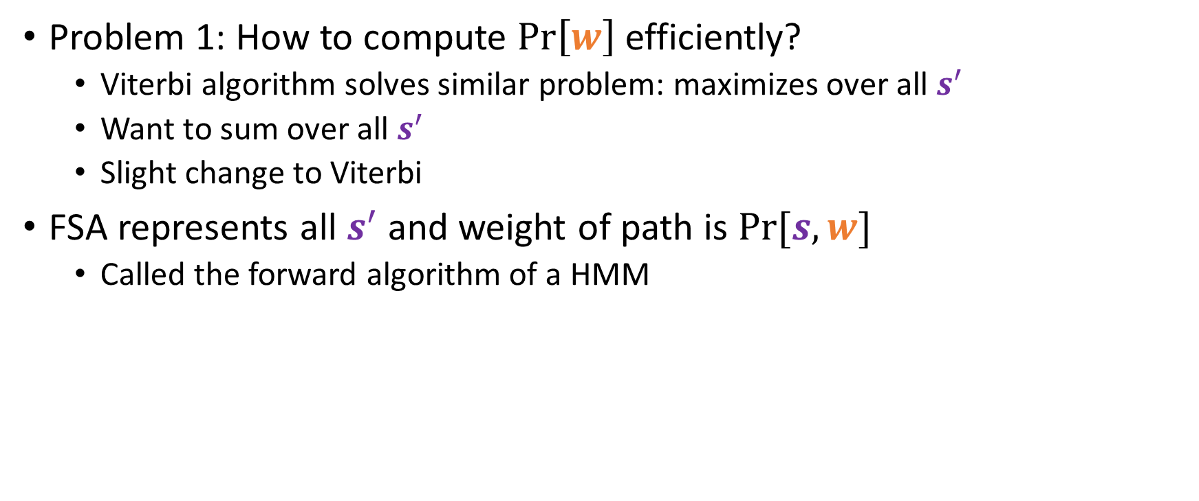





Computing $\operatorname{Pr}\left[w\right]$
Problem 1: How to compute $\operatorname{Pr}\left[w\right]$ efficiently?
Viterbi algorithm solves similar problem: maximizes over all $s^{′}$
Want to sum over all $s^{′}$
Slight change to Viterbi
FSA represents all $s^{′}$ and weight of path is $\operatorname{Pr}{[s,w]}$
Called the forward algorithm of a HMM
forward[$q_{0,<BOS>}$] = 1
forward[$q$] = 0 for each state $q≠q_{0,<BOS>}$
for each state $q^{′}$ in topological order do
for each incoming transition $q→q^{′}$ w/ weight $p$ do
forward[$q^{′}$] += forward[$q$]*$p$
return forward[$q_{T,<EOS>}$]

Slide 14
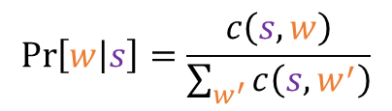



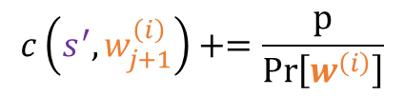
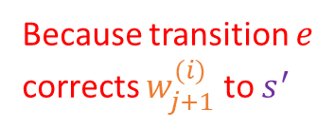



“Soft” Expectation Maximization
Initialize the model $\operatorname{Pr}\left[w | s^{′}\right]$
repeat
forward algorithm
for each observed sequence $w^{(i)}$ do
form FSA that generates all possible $s$ with weight $\operatorname{Pr}\left[s,w^{\left(i\right)}\right]$
compute $\operatorname{Pr}\left[w^{\left(i\right)}\right]$
Because transition $e$ corrects $w_{j+1}^{(i)}$ to $s^{′}$
for every transition $e=\left(q_{j,s}→q_{j+1,s^{′}}\right)$ do
E-step
compute weight $p$ of all paths using transition $e$
$$c\left(s^{′},w_{j+1}^{\left(i\right)}\right)+=\frac{p}{\operatorname{Pr}\left[w^{\left(i\right)}\right]}$$
for all $w∈Σ_{W},s∈Σ_{S}$ do
$$\operatorname{Pr}\left[w | s\right]=\frac{c\left(s,w\right)}{\sum_{w^{′}}{c\left(s,w^{′}\right)}}$$
M-step
until converged
How do we compute this?

Slide 15

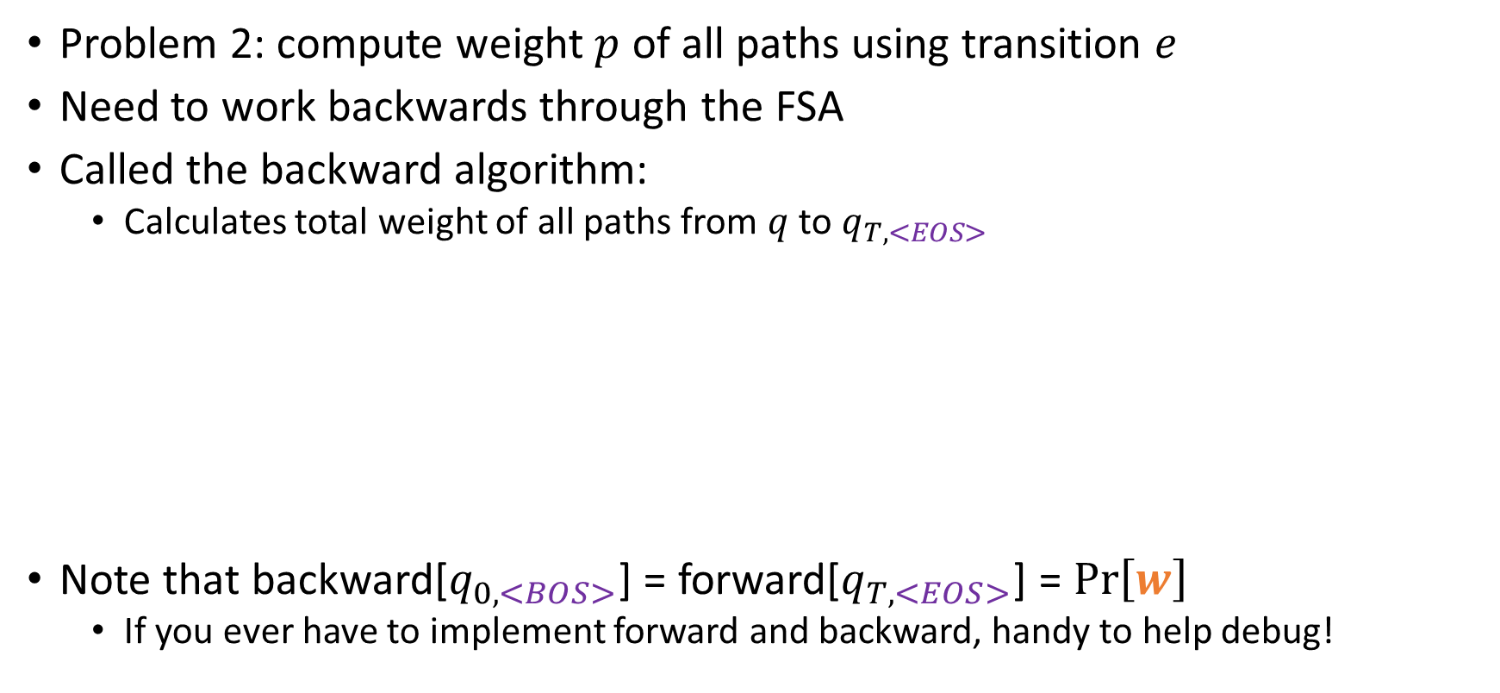





Computing the weight $p$ of transition $e$
Problem 2: compute weight $p$ of all paths using transition $e$
Need to work backwards through the FSA
Called the backward algorithm:
Calculates total weight of all paths from $q$ to $q_{T,<EOS>}$
Note that backward[$q_{0,<BOS>}$] = forward[$q_{T,<EOS>}$] = $\operatorname{Pr}\left[w\right]$
If you ever have to implement forward and backward, handy to help debug!
backward[$q_{T,<EOS>}$] = 1
backward[$q$] = 0 for each state $q≠q_{T,<EOS>}$
for each state $q^{′}$ in reverse topological order do
for each outgoing transition $q→q^{′}$ w/ weight $p$ do
backward[$q$] += backward[$q^{′}$]*$p$
return backward[$q_{0,<BOS>}$]

Slide 16











One last thing
$$q_{0,<BOS>}$$
forward[$q$]
$$p$$
backward[$r$]
$$q_{T,<EOS>}$$
$$q$$
$$r$$
$$p$$
Consider transition
Need to compute total weight of all paths using $e$
Total weight of all paths going into $q$ is forward[$q$]
Weight of $e$ itself is $p$
Total weight of all paths going out of $r$ is backward[$r$]
Total weight of all paths using $e=$ forward[$q$]*$p$*backward[$r$]
Implement counts as
$$e=(q→r)$$
$$c\left(s^{′},w_{j+1}^{\left(i\right)}\right)+=\frac{forward\left[q\right]×p×backward\left[r\right]}{forward\left[q_{T,<EOS>}\right]}$$

Slide 17








“Soft” EM
Initialize the model $\operatorname{Pr}\left[w | s^{′}\right]$
repeat
forward algorithm
for each observed sequence $w^{(i)}$ do
form FSA that generates all possible $s$ with weight $\operatorname{Pr}\left[s,w^{\left(i\right)}\right]$
backward algorithm
compute $\operatorname{Pr}\left[w^{\left(i\right)}\right]$
re-compute $\operatorname{Pr}\left[w^{\left(i\right)}\right]$
for every transition $e=\left(q_{j,s}→q_{j+1,s^{′}}\right)$ w/ weight $p$ do
Our complete EM algorithm
For every $w^{(i)}$
Calls forward and backward
Uses results to increment “soft” counts
Normalizes pmfs from “soft” counts
The beauty:
Each iteration of EM is guaranteed to either improve the model or keep it the same
Measured by log-likelihood of data:
$$𝓛𝓛\left(w^{\left(1\right)},w^{\left(2\right)}, …,w^{\left(N\right)}\right)=\sum_{w^{(i)}}{\log\left(\operatorname{Pr}\left[w^{(i)}\right]\right)}$$
No guarantee to find global max of $𝓛𝓛$
Often run EM multiple times from different starting points (i.e. different initializations)
$$c\left(s^{′},w_{j+1}^{\left(i\right)}\right)+=\frac{forward\left[q_{j,s}\right]×p×backward\left[q_{j+1,s^{′}}\right]}{forward\left[q_{T,<EOS>}\right]}$$
for all $w∈Σ_{W},s∈Σ_{S}$ do
$$\operatorname{Pr}\left[w | s\right]=\frac{c\left(s,w\right)}{\sum_{w^{′}}{c\left(s,w^{′}\right)}}$$
until converged

Slide 18
HMMs in Machine Translation
HMMs are popular
Trouble: assume specific kind of dependency relationship
In particular: bigram language model
Need to be able to add/delete from sequences
HMMs (FSA specifically) are good for assigning probability to sequences
Not good for transforming sequences into other sequences
Need something more flexible
Finite State Transducers (FSTs)

Slide 19









Finite State Transducers
A FST is like a FSA, but it has two vocabularies:
Input vocabulary $Σ$
Output vocabulary $Π$
Transitions look slightly different
FSA defines a set of sequences
FST defines a relation on sequences
Pair $<s,w>$ belongs to this relation if there’s a sequence of states $q_{0},…,q_{n}$ s.t.
$∀i ∃$
FST may not be deterministic
Given an input sequence, might be more than one way for FST to accept it
Weighted FST is just like a weighted FSA
Probabilistic weighted FST is different
For each state $q$ and input symbol $a∈Σ$, the weights of all transitions leaving $q$ with input symbol $a$ OR the empty symbol $ε$ form a pmf
Defines $\operatorname{Pr}\left[w | s\right]$
$$∈Σ$$
$$∈Π$$
$$a:b/ p$$
$$q$$
$$r$$
$$s_{i}:w_{i}$$
$$q_{i−1}$$
$$q_{i}$$

Slide 20





















FST for Typo Correction
r:r / 0.4
r:e / 0.2
e:r / 0.2
e:e / 0.4
$ε$:e / 0.1
$ε$:r / 0.1
Restrict $Σ=Π=\{r,e,<EOS>\}$
Vocabs will be bigger in practice
Which transitions form pmf?
Consider state $q$
Consider input symbol $a$
All transitions leaving $q$ w/ input symbol $a$ OR $ε$ form pmf!
Consider $q_{0}$ and $e$
Insertion!
$$q_{0}$$
<EOS>:<EOS> / 0.8
r:r / 0.6
r:e / 0.4
e:r / 0.4
e:e / 0.6
e:$ε$ / 0.2
r:$ε$ / 0.2
$$q_{2}$$
Deletion!
$$e:r$$
$$ε:r$$
<EOS>:<EOS> / 1
$$q_{0}$$
$$q_{0}$$
$$q_{0}$$
$$q_{0}$$
$$q_{1}$$
$$e:e$$
$$ε:ε$$
$$q_{0}$$
$$q_{0}$$
$$q_{0}$$
$$q_{1}$$
$$ε:e$$
$$q_{0}$$
$$q_{0}$$

Slide 21







FST Composition
r:r / 0.4
r:e / 0.2
e:r / 0.2
e:e / 0.4
$ε$:e / 0.1
$ε$:r / 0.1
$$M_{2}$$
Lets say we have FSA $M_{1}$
generates sequences of true characters
Bigram model!
Have our typo FST $M_{2}$
Want to combine them into one machine that does both at the same time
Process for combining is called composition
$$q_{0}$$
<EOS>:<EOS> / 0.8
r:r / 0.6
r:e / 0.4
e:r / 0.4
e:e / 0.6
e:$ε$ / 0.2
r:$ε$ / 0.2
$$q_{2}$$
<EOS>:<EOS> / 1
$$q_{1}$$

Slide 22









FST Composition
Step 1: Convert all machines into FSTs
FSA -> FST is straightforward
Converted FST copies input to output
Replace every transition with
$$a/ p$$
$$a:a/ p$$
$$q$$
$$r$$
$$q$$
$$r$$
r:r
e:e
e:e
<BOS>:<BOS>
$$q_{0}$$
$$q_{1}$$
$$q_{2}$$
r:r
<BOS>:<BOS>

Slide 23






FST Composition
$$M_{2}$$
r:r / 0.4
r:e / 0.2
e:r / 0.2
e:e / 0.4
$ε$:e / 0.1
$ε$:r / 0.1
Now we need to feed the output of $M_{1}$ into $M_{2}$
In general, we can take any two FSTs $M_{1}$ and $M_{2}$
Create a new FST $M_{3}$ that is equivalent to feeding output of $M_{1}$ into $M_{2}$
This is done by taking the intersection of the two machines
$$q_{0}$$
$$M_{1}$$
r:r
e:e
e:e
<EOS>:<EOS> / 0.8
<BOS>:<BOS>
$$q_{0}$$
$$q_{1}$$
$$q_{2}$$
r:r / 0.6
r:e / 0.4
e:r / 0.4
e:e / 0.6
r:r
e:$ε$ / 0.2
r:$ε$ / 0.2
$$q_{2}$$
<BOS>:<BOS>
<EOS>:<EOS> / 1
$$q_{1}$$

Slide 24










FST Composition
How to take the intersection of two FSTs?
States of $M_{3}$ are pairs of states from $M_{1}$ and $M_{2}$
Will write $q_{1}q_{2}$ for brevity of $\left(q_{1},q_{2}\right)$
Start state of $M_{3}$ is $s_{M_{1}}s_{M_{2}}$ where $s_{M_{i}}$ is the start state of $M_{i}$
Final states of $M_{3}$ are $F_{M_{1}}×F_{M_{2}}$
For each transition in $M_{1}$ and in $M_{2}$
Add transition to $M_{3}$.
If the transitions had weights, new transition gets weight equal to the product
Can either leave duplicate transitions or merge them by summing their weights
$$a:b$$
$$b:c$$
$$q_{1}$$
$$r_{1}$$
$$q_{2}$$
$$r_{2}$$
$$q_{1}q_{2}$$
$$a:c$$
$$r_{1}r_{2}$$

Slide 25













FST Composition for Typos
$$M_{2}$$
r:r / 0.4
r:e / 0.2
e:r / 0.2
e:e / 0.4
$ε$:e / 0.1
$ε$:r / 0.1
$$M_{1}$$
r:r
e:e
e:e
$$q_{0}$$
$$q_{1}$$
<BOS>:<BOS>
$$q_{2}$$
$$q_{0}$$
$$∩$$
$$=$$
r:r
<EOS>:<EOS> / 0.8
r:r / 0.6
r:e / 0.4
e:r / 0.4
e:e / 0.6
<BOS>:<BOS>
e:$ε$ / 0.2
r:$ε$ / 0.2
$$q_{2}$$
<EOS>:<EOS> / 1
$$q_{1}$$

Slide 26

Using composed FSTs
How do we use this?
Given observed sequence $w$
Build a FST $M_{w}$ that accept only $w$ and outputs $w$
Compose $M_{w}$ with our model to produce $M_{4}$
Composition of three FSTs
$M_{4}$ accepts as input only possible true sequences $s$
$M_{4}$ only produces $w$ as output
Run viterbi on this FST!
$s^{∗}=\underset{s}{argmax}{\operatorname{Pr}\left[s\right]\operatorname{Pr}\left[w | s\right]}$
Can perform EM on this FST (forward/backward/viterbi)
Just like a HMM!

