Slide 1
CS 505: What is Natural Language Processing?

Slide 2
The big question
What is “natural language”?
Human languages!
More specifically, languages that humans use to communicate (to other humans)
This does not include programming languages, formal languages, etc.
So, what is NLP?
Making computers do various things with natural language
Why?
Language translation
Human-machine interfaces
Knowledge digestion/analysis (specifically at scale)
Etc.

Slide 3
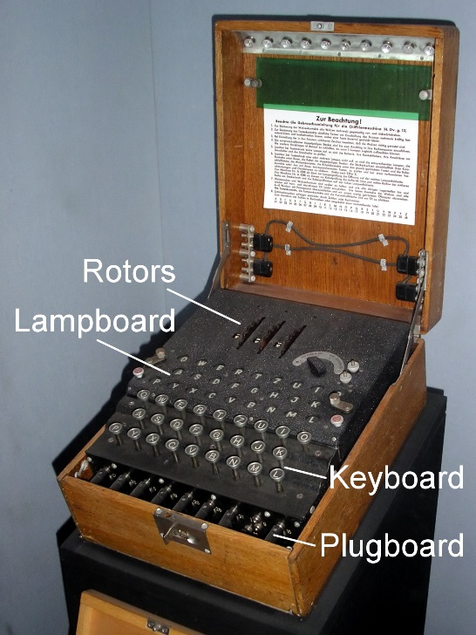
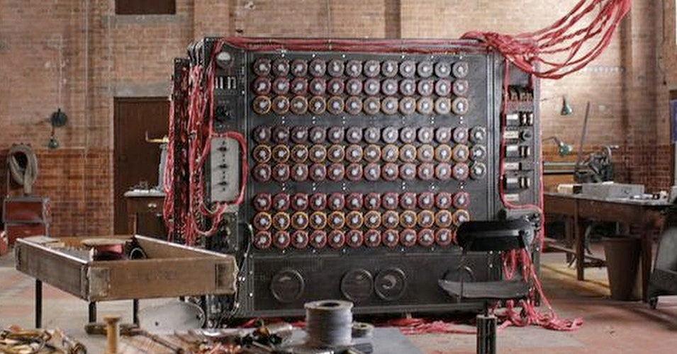
NLP & Computing are tightly coupled
NLP is actually the oldest task in computing
WWII
Alan Turing broke enigma: German -> English
Cold War
US govt funded lots of Russian -> English research
NLP is typically at the forefront of computing
Turing test
ChatGPT & LLMs
Dali
Imagegen
Automatic img captioning
Etc.

Slide 4
How does NLP work?
Andrew asked when who arrived?
Who did Andrew ask when arrived?
Two main historical phases of NLP
Early NLP (1950s -> 1990s) was dominated by linguistics
Scientific study of language
Computational linguistics = using computational methods to study language
The big idea:
If we can understand the theory of language, we can programs to imitate it!
Natural languages are hard
Much more difficult than formal/computer languages
Rules in natural language exist, but mostly unobserved
Theory of language (linguistics) should differentiate
Computational linguistics -> algorithm for differentiation

Slide 5
Modern NLP
Modern NLP is dominated by “learning” algorithms
Rather than simulate human use of language
Simulate learning language (from data)
Let the computer learn the rules directly rather than program them by hand
Linguistics is interested in mental structures/representations
Structures/representations not directly observable
Statistics interested in observed quantities

Slide 6
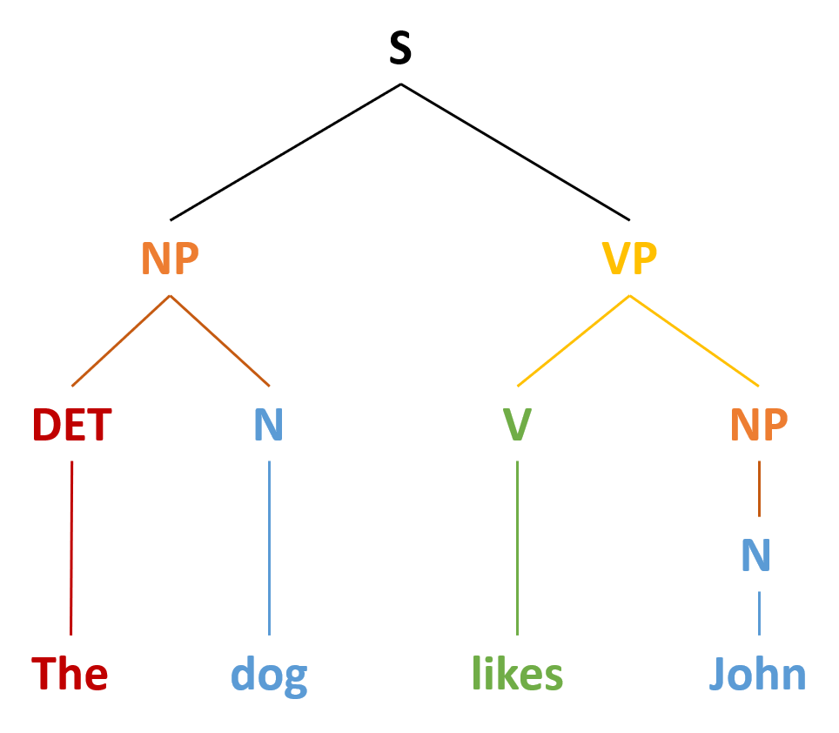
Learning
Several attempts to fuse linguistics and statistics (learning)
Build datasets annotated with linguistic structures
Make the unobservable observable!
Build models that can learn unobserved things
Informed by linguistics even though model not directly tied to linguistic theory
Ex: if syntactic structure is recursive, shouldn’t the model be recursive?
State-of-the-art
Generic, powerful models (almost no influence from linguistics)
Big tradeoff
What are the models doing?
Linguistics now helps analyze what the model learned/behavior

Slide 7
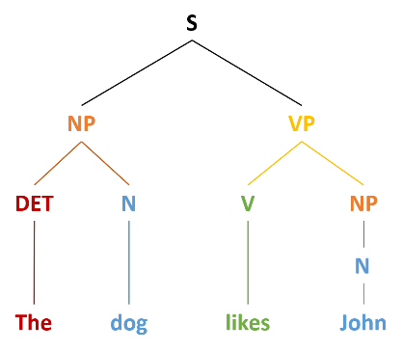
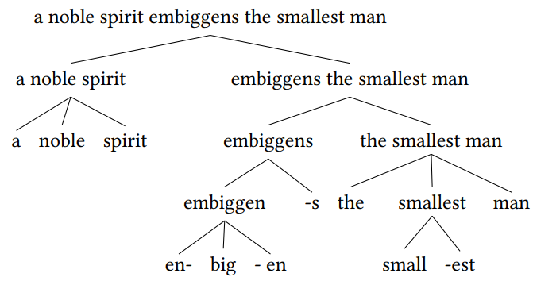
The NLP pipeline
Raw language comes in many forms:
Text
Speech
Sign language
Etc.
Each system has an ingestion point
(typically converted to text)
Natural language has structure
Morphemes form words
Words form phrases
Phrases form sentences
Etc.
Structure is believed to be key to understanding
Languages are thought to be compositional
Meaning is recursive
Sentence depends on phrases
Phrases depend on words
Words depend on morphemes
Computing “meaning” is thought to be a bottom-up process
text
structure
Reverse direction:
Generate text from internal representation/structure
Producing natural language in the desired form like speech (if necessary)
meaning
emission
generation

Slide 8
Our Class
4) Meaning
Semantics
Vectors
Graphs
Named Entity Recognition
Abstract Meaning Representations
Logic
5) Generation
Language Models
Sampling Methods
Exact search & beam search
RL w/ human feedback
6) Special Topics (if we have time)
Speech & Writing
Automatic transcription
Optical character recognition
Music processing
1) Text
Tokenization
Language Models
N-gram
RNNs
Embeddings
Bag of Words
Word2Vec
Embedding Layers
Translation
Statistical Machine Translation (IBM-1 IBM-2)
Neural Machine Translation (RNNs)
Transformers
3) Structure
Morphology
Syntax
Context Free Grammars
Parsing

