Slide 1
Tokenization

Slide 2
The Data
Traditionally, a dataset in natural language is called a corpus
A corpus consists of many documents
Each document is a sequence of paragraphs
Each paragraph is a sequence of sentences
Each sentence is a sequence of words
Our first step is to normalize the data

Slide 3
Normalizing data - granularity
Natural language is messy
Need to divide up language into a sequence of atomic symbols
What should those symbols be?
Need to decide granularity
Are characters atomic symbols?
Are sub-words atomic symbols?
Are words atomic symbols?
Are Dialogue Acts atomic symbols?
Token = abstract term for atomic symbol

Slide 4
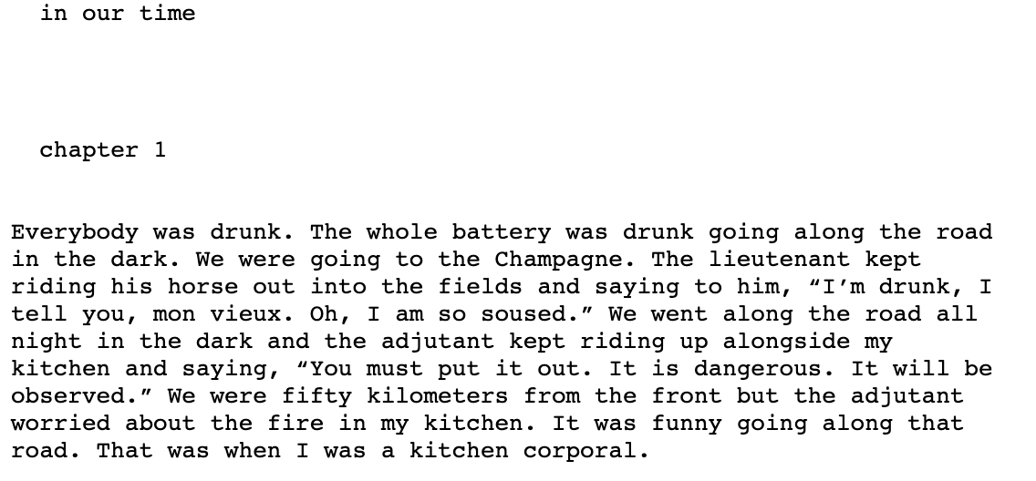
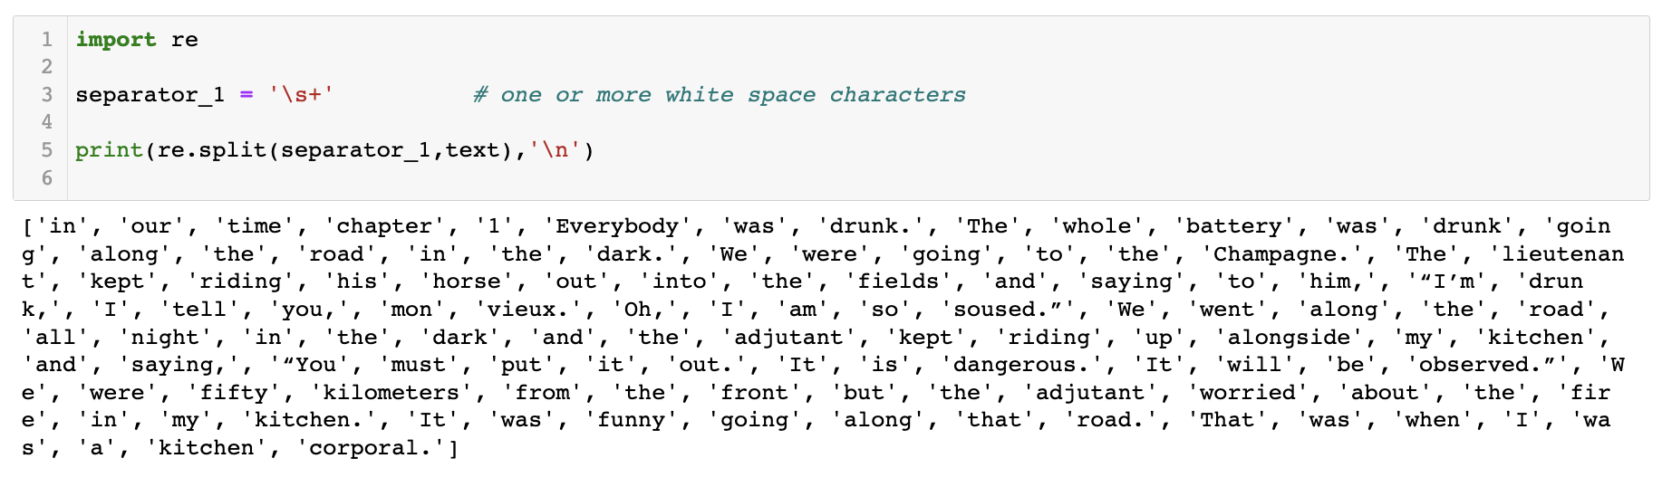
Normalizing data - tokenization
Once we decide token granularity
Text is one big string
Document -> sequence of tokens!
Split on whitespace?
What about punctuation?

Slide 5
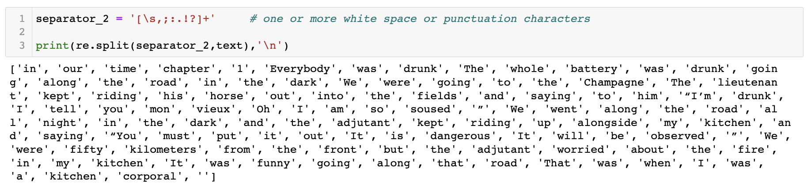
Normalizing data - tokenization
Split on whitespace and punctuation?
What about contractions?

Slide 6
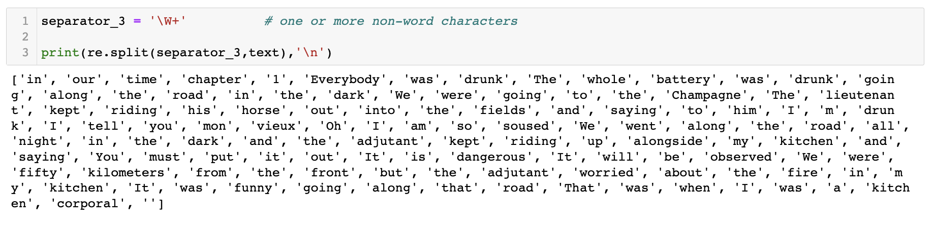
Normalizing data - tokenization
Split on anything other than a “word”?
Split up contractions?

Slide 7
Normalizing data - tokenization
Tons of edge cases
For instance, can’t blindly remove punctuation or non-words:
Ph.D, AT&T, cap’n all need the punctuation!
Prices ($50.12)
Dates (6/15/2021)
Urls (https://github.com)
Hashtags (#gme)
Email addresses (aewood@bu.edu)
What about words that don’t stand on their own (clitic words)?
“are” in “we’re”, “a”, etc.

Slide 8
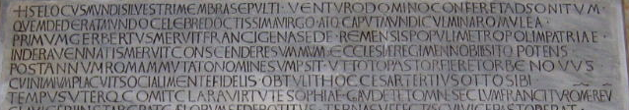
Normalizing data - tokenization
Some languages don’t have consistent spacing or punctuation!
莎拉波娃现在居住在美国东南部的佛罗里达。
莎拉波娃 现在 居住 在 美国 东南部 的 佛罗里达
Sharapova now lives in US southeastern Florida

Slide 9
Normalizing data - tokenization
Most western languages have a few solutions (so far):
Rule-based methods (nltk)
Sequence to sequence methods
Hmms
Neural networks

Slide 10
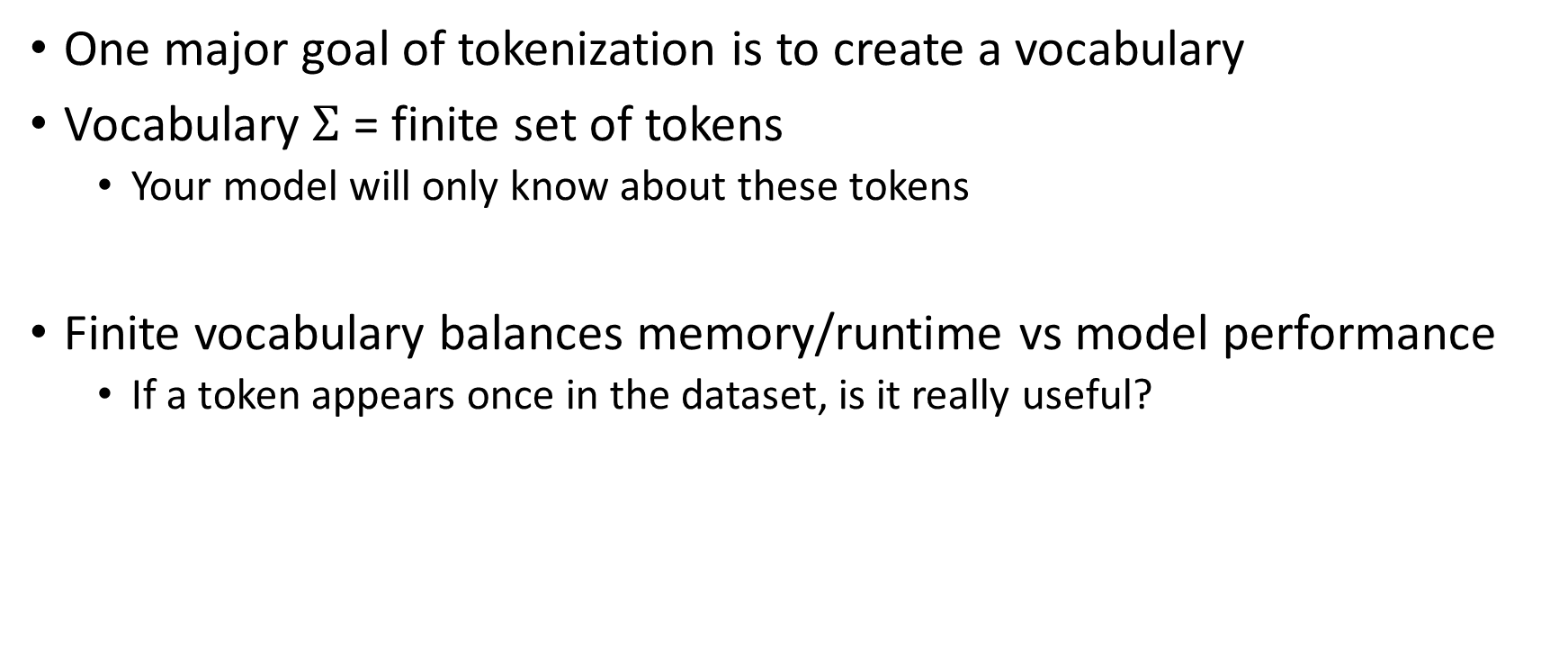
Normalizing data - vocabularies
One major goal of tokenization is to create a vocabulary
Vocabulary $Σ$ = finite set of tokens
Your model will only know about these tokens
Finite vocabulary balances memory/runtime vs model performance
If a token appears once in the dataset, is it really useful?

Slide 11
Normalizing data – stemming
Trouble (particularly in English):
Lots of different words with the same “stem” (likes, liked, likely, liking, likable)
Do we want to allocate separate vocabulary entries for similar words?
The process of reducing words to their “stem” is called “stemming”
Often implemented as rules (nltk)

Slide 12
Normalizing data - lemmatization
Can go further:
Most words are various forms of another word (shared word root)
Am, are, is -> be
Car, cars, car’s, cars’ -> car
This is called lemmatization
Goal A is to preserve vocabulary space
Goal B is to avoid confusing the model

Slide 13
Normalizing data – how?
Typically done recursively.
In English, split document into sentences
Be careful, punctuation is a good rule but has exceptions!
Then split each sentence into words
Then split each word …

Slide 14
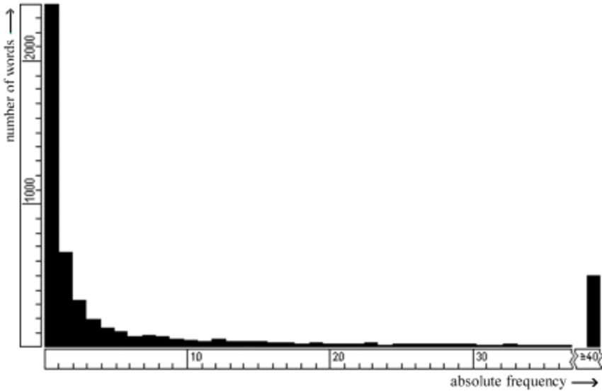
Normalizing data – building a vocabulary
Once tokenized, stemmed, and lemmatized
Make a histogram of your tokens
X axis: count/frequency
Y axis: number of tokens with that count/frequency
Will have a long tail
Tokens with high count -> appear often
Long tail = rare tokens
Question to answer:
When is a token “too rare” to be useful
Common approaches:
Top k most frequent tokens kept (ex: keep most frequent 100k tokens)
Top x% tokens kept (ex: keep top 90% of the tokens)

Slide 15
Normalizing data – special tokens
Whatever your decision, you have three tokens to add to your vocab
<BOS> (also appears as <s> in literature)
<EOS> (also appears as </s> in literature)
<UNK>
Now, reprocess your data (i.e. adapt it to the vocabulary)
Every sequence in your dataset must begin with <BOS>
Every sequence in your dataset must end with <EOS>
Any “out of vocabulary” tokens replaced with <UNK>

