Slide 1
Background Knowledge

Slide 2
Prob & Stats Refresher
Random experiment:
Process where we observe something uncertain
Outcome: result of the experiment
Sample space: set of all possible outcomes
Event: any subset of the sample space
Exercises!
Experiment 1: roll a die & observe the number 3
Experiment 2: # of times you toss a (fair) coin until H appears
Experiment 3: throw dart at dart board & observe location
Prob of events?

Slide 3
Probability Definitions
Let $S$ be a sample space. A probability function $\operatorname{Pr}\left[⋅\right]$:
$$Pr: 𝓟\left(S\right)→[0,1]$$
$\operatorname{Pr}\left[⋅\right]$ obeys three axioms:
For any event $E⊆𝓟\left(S\right)$, $Pr\left[E\right]≥0$
$Pr\left[S\right]=1$
For two event $A, B$, if $A∩B=∅$, then $Pr\left[A∪B\right]=\operatorname{Pr}\left[A\right]+\operatorname{Pr}\left[B\right]$

Slide 4
Conditional Probability
Consider two events $A$, and $B$
If we know $A$ has already occurred, what can we say about $Pr\left[B\right]$?
Exercise. Roll two dice. Let $X_{1}$ = value of die 1, $X_{2}$ = value on die 2:
$\operatorname{Pr}\left[X_{1}+X_{2}≤5\right]?$
$\operatorname{Pr}\left[X_{1}+X_{2}≤5 | X_{1}=2\right]?$

Slide 5
Conditional Probability
Conditional prob for event $B$ given $A$: $\operatorname{Pr}\left[B | A\right]$
Formally (if $\operatorname{Pr}\left[A\right]≠0$):
$$\operatorname{Pr}\left[B | A\right]=\frac{\operatorname{Pr}\left[B∩A\right]}{\operatorname{Pr}\left[A\right]}$$
Exercise:
show $\operatorname{Pr}\left[A | B\right]\operatorname{Pr}\left[B\right]=\operatorname{Pr}\left[B | A\right]\operatorname{Pr}\left[A\right]$
show $Pr⁡[⋅|B]$ satisfies the three axioms

Slide 6
Conditional Probability Chain Rule
$$\operatorname{Pr}\left[A∩B∩C\right]$$
$$=\operatorname{Pr}\left[A∩\left(B∩C\right)\right]$$
$$=\operatorname{Pr}\left[A\right]\operatorname{Pr}\left[B∩C | A\right]$$
$$=\operatorname{Pr}\left[A\right]\operatorname{Pr}\left[B | A\right]\operatorname{Pr}\left[C \right|A∩B]$$
Can extend this to $n$ many events:
$$\operatorname{Pr}\left[E_{1}∩E_{2}∩…∩E_{n}\right]$$
$$=\operatorname{Pr}\left[E_{1}\right]$$
$$\operatorname{Pr}\left[A∩B\right]=\operatorname{Pr}\left[A\right]\operatorname{Pr}\left[B | A\right]$$
$$\operatorname{Pr}\left[B∩C | A\right]=\operatorname{Pr}\left[B | A\right]\operatorname{Pr}\left[C | A∩B\right]$$
$$\operatorname{Pr}\left[E_{2} | E_{1}\right]$$
$$\operatorname{Pr}\left[E_{3} | E_{2}∩E_{1}\right]$$
$$…\operatorname{Pr}\left[E_{n}\right|E_{1}∩E_{2}∩…∩E_{n−1}]$$

Slide 7
Independence
Two events $A$ and $B$ if $\operatorname{Pr}\left[A | B\right]=Pr⁡[A]$ (and vice versa)
Therefore $\operatorname{Pr}\left[A∩B\right]=\operatorname{Pr}\left[A\right]Pr⁡[B]$
Exercise:
Roll die and toss coin. $A$ = roll even number, $B$ = Heads. $\operatorname{Pr}\left[A∩B\right]?$

Slide 8
Law of Total Prob & Total Conditional Prob
Let $E_{1}$, $E_{2}$, … $E_{n}$ partition the sample space (i.e. no overlap)
For any event $A$:
$$\operatorname{Pr}\left[A\right]=\sum_{i}{\operatorname{Pr}\left[A∩B_{i}\right]}=\sum_{i}{\operatorname{Pr}\left[A|B_{i}\right]\operatorname{Pr}\left[B_{i}\right]}$$
Special case is when $B$ is Boolean
$$\operatorname{Pr}\left[A\right]=\operatorname{Pr}\left[A∩B\right]+Pr⁡[A∩\overline{B}]$$

Slide 9


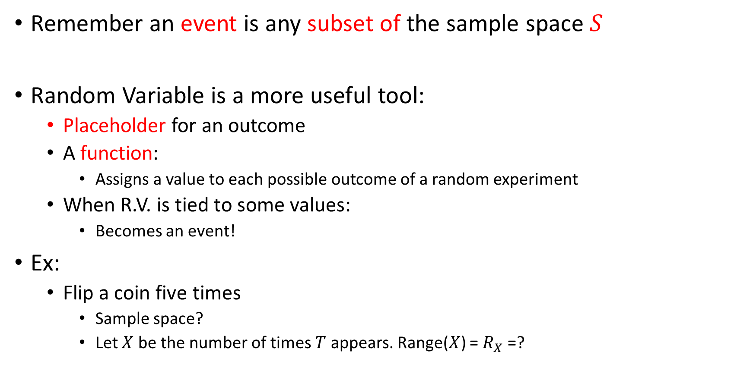




Events & Random Variables
Remember an event is any subset of the sample space $S$
Random Variable is a more useful tool:
Placeholder for an outcome
A function:
Assigns a value to each possible outcome of a random experiment
When R.V. is tied to some values:
Becomes an event!
Ex:
Flip a coin five times
Sample space?
Let $X$ be the number of times $T$ appears. Range($X$) = $R_{X}$ =?
Description
Event or R.V.
Let $X$ be the number of times where you have 2 $H$
$X$is an Event
Let $X$ be the number of $H$
$X$is a R.V.
Let $X$ be the number of $H$. Let $Y=X>3$
$Y$is an Event
$$S=\{HHHHH, HHHHT, HHHTH, HHTHH, …, TTTTT\}$$

Slide 10

Events vs. R.V.s
Sanity check
Let $X$ be an event
Does $Pr⁡[X]$ make sense?
Let $X$ be a R.V.
Does $\operatorname{Pr}\left[X\right]$ make sense?
Does $\operatorname{Pr}\left[X<c\right]$ make sense?
Yes. Probs are chances of (observing) outcomes
Probs support the event datatype (since events are from sample space)
Wrong datatype
No. R.V.s are functions! Doesn’t tell us anything about outcomes
Yes. Once we “bind” a R.V. it becomes an event!
This is an event, not a R.V.

Slide 11
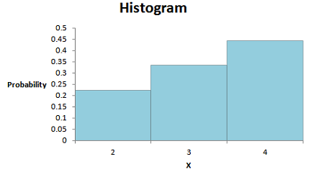
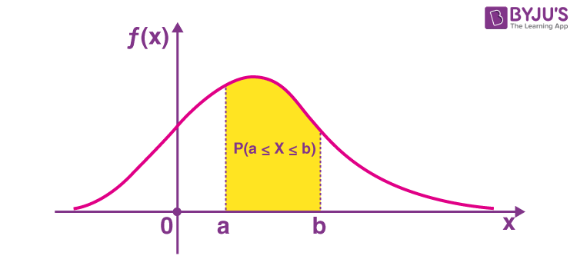





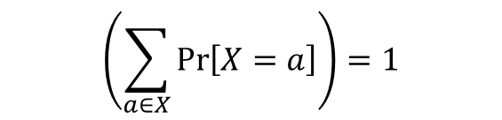

Why are R.V.s more useful?
“Binding” a R.V. creates an event
Notationally very elegant to use (in equations)
Prob Mass Functions (PMFs) and Prob. Density Functions (PDFs)
Assigns prob to every element in range of R.V.
Assigns prob to every interval within range of R.V.
$$p_{X}:R_{X}→[0,1]$$
$$p_{X}:{(a∈R}_{X}, b∈R_{X})→[0,1]$$
$p_{X}$ obeys axioms of probability
$p_{X}$ obeys axioms of probability
$$p_{X}\left(X=a\right)=p_{X}\left(a\right)=Pr⁡[X=a]≥0 ∀a∈R_{X}$$
$$p_{X}\left(a≤X≤b\right)=\int_{a}^{b}{f\left(x\right)dx}$$
$$\left(\sum_{a∈X}{\operatorname{Pr}\left[X=a\right]}\right)=1$$
$$\int_{−∞}^{+∞}{f\left(x\right)dx}=1$$

Slide 12
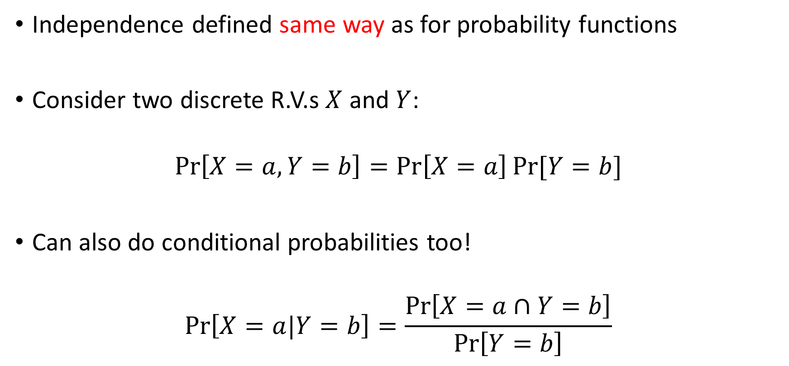
R.V.s and Independence/Conditionals
Independence defined same way as for probability functions
Consider two discrete R.V.s $X$ and $Y$:
$$\operatorname{Pr}\left[X=a, Y=b\right]=\operatorname{Pr}\left[X=a\right]Pr⁡[Y=b]$$
Can also do conditional probabilities too!
$$\operatorname{Pr}\left[X=a|Y=b\right]=\frac{\operatorname{Pr}\left[X=a∩Y=b\right]}{\operatorname{Pr}\left[Y=b\right]}$$

Slide 13
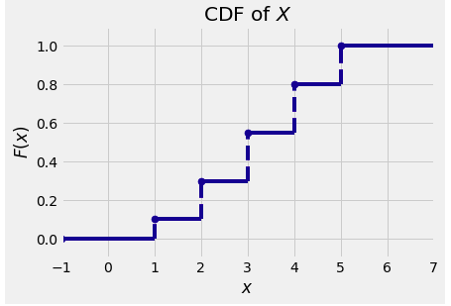
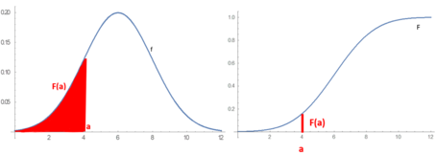
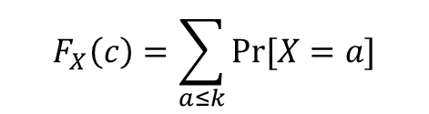


Cumulative Distribution Functions (CDFs)
Measures $F_{X}\left(c\right)=Pr⁡[X≤c]$
Discrete R.V.s
Continuous R.V.s
$$F_{X}\left(c\right)=\sum_{a≤k}{Pr⁡[X=a]}$$
$$F_{X}(c)\int_{−∞}^{c}{f\left(x\right)dx}$$

Slide 14


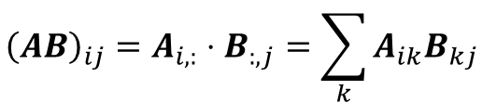
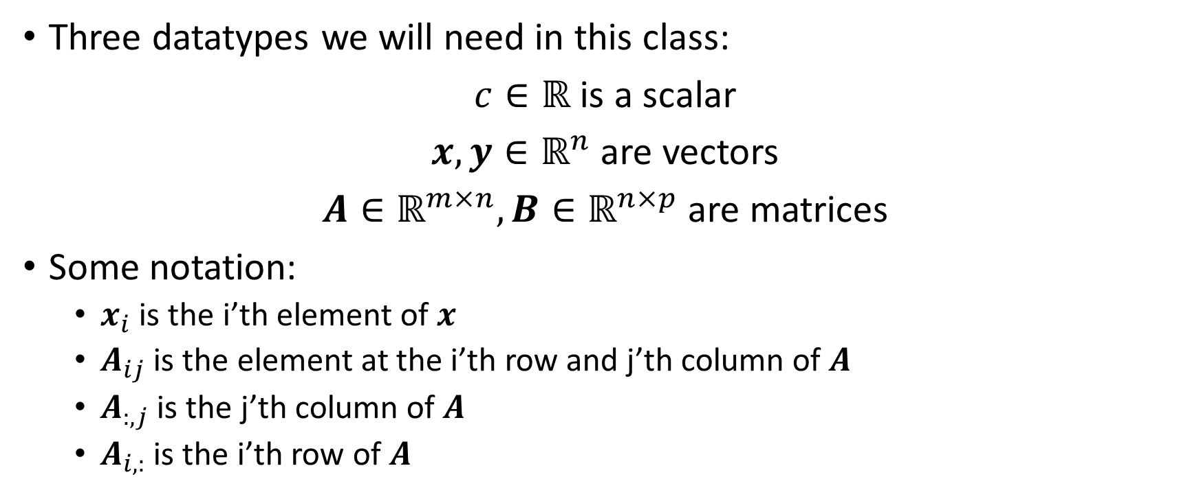
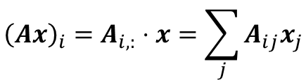



Vectors and Matrices
$${\left(A^{T}\right)}_{ij}=A_{ji}$$
$${\left(cx\right)}_{i}=cx_{i}$$
$${\left(cA\right)}_{ij}=cA_{ij}$$
$${\left(Ax\right)}_{i}=A_{i,:}⋅x=\sum_{j}{A_{ij}x_{j}}$$
Three datatypes we will need in this class:
$c∈ℝ$ is a scalar
$x,y∈ℝ^{n}$ are vectors
$A∈ℝ^{m×n}, B∈ℝ^{n×p}$ are matrices
Some notation:
$x_{i}$ is the i’th element of $x$
$A_{ij}$ is the element at the i’th row and j’th column of $A$
$A_{:,j}$ is the j’th column of $A$
$A_{i,:}$ is the i’th row of $A$
$${\left(AB\right)}_{ij}=A_{i,:}⋅B_{:,j}=\sum_{k}{A_{ik}B_{kj}}$$
$$y⋅x=\sum_{j}{y_{j}x_{j}}$$
$${\left(e^{x}\right)}_{i}=e^{x_{i}}$$

Slide 15

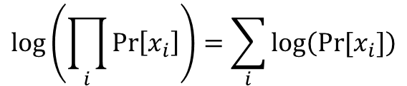
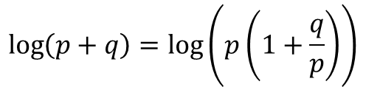


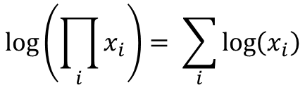










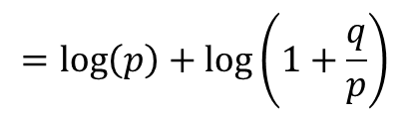


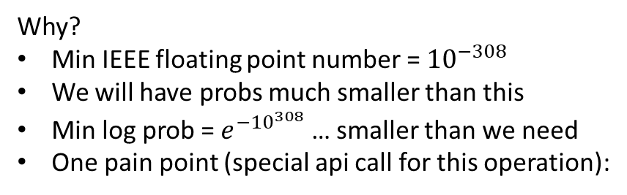
Logarithms
In this class, we will use log-probabilities a lot
$$\log\left(\prod_{i}{\operatorname{Pr}\left[x_{i}\right]}\right)=\sum_{i}{\log\left(Pr⁡[x_{i}]\right)}$$
Why?
Min IEEE floating point number = ${10}^{−308}$
We will have probs much smaller than this
Min log prob = $e^{{−10}^{308}}$ … smaller than we need
One pain point (special api call for this operation):
Logs are incredibly useful in NLP
They make theory easier (i.e. math)
They make computation more stable (harder to over/under flow)
In this class, $log\left(⋅\right)$ will mean $\ln\left(⋅\right)$
Could underflow!
$$\log{(p+q)}$$
$$\log\left(e^{x}\right)=x$$
$$e^{log\left(x\right)}=x{ }$$
$$=\log\left(e^{\log\left(p\right)}+e^{\log\left(q\right)}\right)$$
$$\log\left(xy\right)=\log\left(x\right)+log⁡(y)$$
$$e^{x+y}=e^{x}e^{y}{ }$$
Assume $p>q$ (if not, swap the values)
$$\log\left(p+q\right)=\log\left(p\left(1+\frac{q}{p}\right)\right)$$
$$\log\left(\prod_{i}{x_{i}}\right)= \sum_{i}{\log\left(x_{i}\right)}$$
$$e^{\sum_{i}{x_{i}}}=\prod_{i}{e^{x_{i}}}$$
$$=\log\left(p\right)+\log\left(1+\frac{q}{p}\right)$$
$$\log\left(x^{n}\right)=n\log\left(x\right)$$
$$e^{nx}={\left(e^{x}\right)}^{n}$$
$$=\log\left(p\right)+\log\left(1+e^{\log\left(\frac{q}{p}\right)}\right)$$
$$\log\left(1\right)=0$$
$$e^{0}=1{ }$$
Exp underflow is now harmless!
$$=\log\left(p\right)+\log\left(1+e^{\log\left(p\right)−\log\left(q\right)}\right)$$

Slide 16

Softmax
Lets say we have a pmf of log-probabilities
Their exps should sum to 1
Or lets have unconstrained values (call logits)
we want to force their exps to sum to 1
Can be used to convert logits into a pmf
This function happens often
Need to familiarize ourselves with it
$$softmax\left(x\right)=\frac{e^{x}}{\sum_{i}{e^{x_{i}}}}$$

