Slide 1
Embeddings

Slide 2





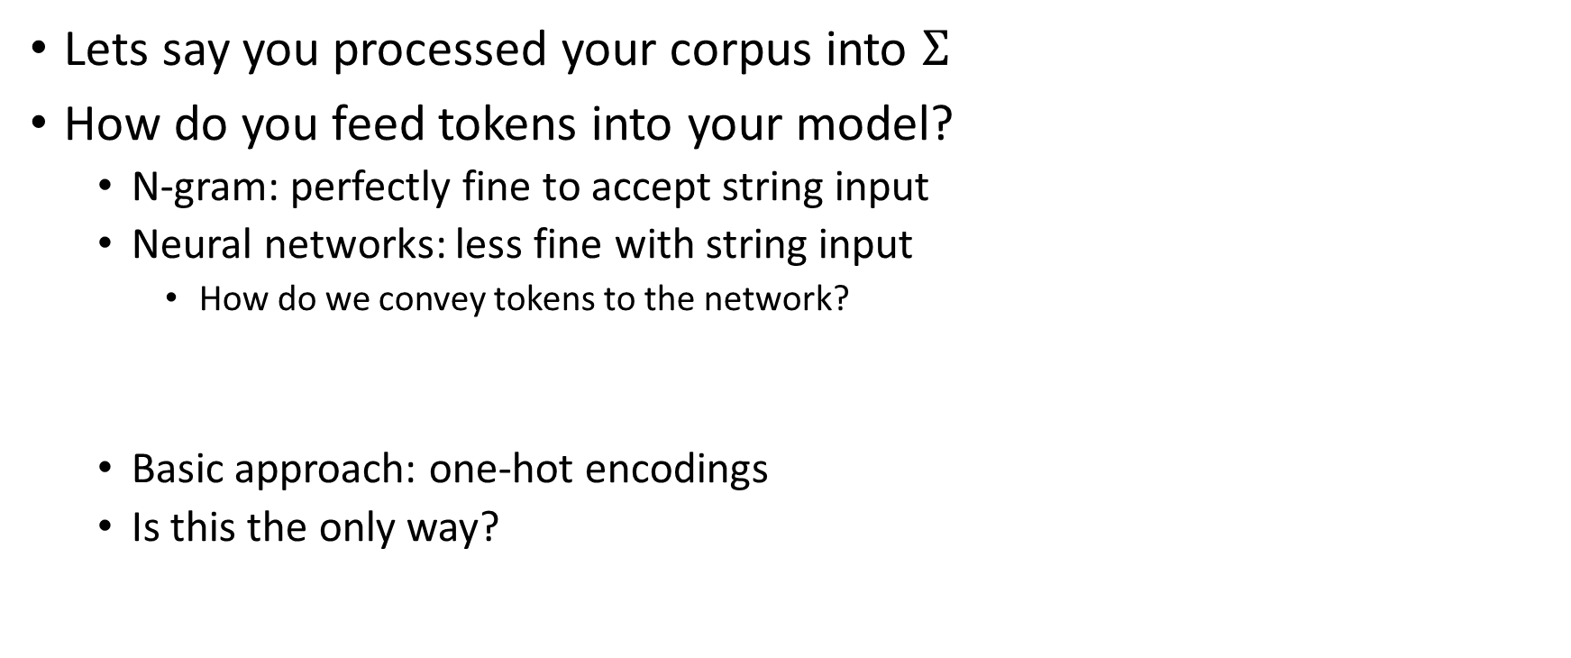









The basic approach
$$Σ=\{<BOS>,a,b,<EOS>\}$$
<BOS>
a
b
a
<EOS>
$$\left[\begin{matrix}1 \\ 0 \\ \begin{aligned}0 \\ 0\end{aligned}\end{matrix}\right]$$
$$\left[\begin{matrix}1 \\ 0 \\ \begin{aligned}0 \\ 0\end{aligned}\end{matrix}\right]$$
$$\left[\begin{matrix}0 \\ 1 \\ \begin{aligned}0 \\ 0\end{aligned}\end{matrix}\right]$$
$$\left[\begin{matrix}0 \\ 1 \\ \begin{aligned}0 \\ 0\end{aligned}\end{matrix}\right]$$
$$\left[\begin{matrix}0 \\ 0 \\ \begin{aligned}0 \\ 1\end{aligned}\end{matrix}\right]$$
$$\left[\begin{matrix}0 \\ 1 \\ \begin{aligned}0 \\ 0\end{aligned}\end{matrix}\right]$$
$$\left[\begin{matrix}0 \\ 0 \\ \begin{aligned}1 \\ 0\end{aligned}\end{matrix}\right]$$
Lets say you processed your corpus into $Σ$
How do you feed tokens into your model?
N-gram: perfectly fine to accept string input
Neural networks: less fine with string input
How do we convey tokens to the network?
Basic approach: one-hot encodings
Is this the only way?
$$x^{(0)}$$
$$x^{(0)}$$
$$x^{(1)}$$
$$x^{(2)}$$
$$x^{(3)}$$
$$x^{(4)}$$

Slide 3
















What are we trying to do?
Vectors are a particular kind of “embedding”
Short for “embedding (placing) tokens into some feature space”
Each axis has “meaning”
Stands for a particular feature
The set of axes = set of features
This should not be new: happens often in ML
Trying to engineer “meaning”
Simplest way to process an example:
Combine individual token embeddings
$$Σ=\{<BOS>,a,b,<EOS>\}$$
<BOS>
<BOS>
a
a
b
b
a
a
<EOS>
$$\left[\begin{matrix}1 \\ 0 \\ \begin{aligned}0 \\ 0\end{aligned}\end{matrix}\right]$$
$$\left[\begin{matrix}0 \\ 1 \\ \begin{aligned}0 \\ 0\end{aligned}\end{matrix}\right]$$
$$\left[\begin{matrix}0 \\ 0 \\ \begin{aligned}1 \\ 0\end{aligned}\end{matrix}\right]$$
$$\left[\begin{matrix}0 \\ 1 \\ \begin{aligned}0 \\ 0\end{aligned}\end{matrix}\right]$$
$$\left[\begin{matrix}0 \\ 0 \\ \begin{aligned}0 \\ 1\end{aligned}\end{matrix}\right]$$
$$+$$
$$+$$
$$+$$
$$+$$
$$x^{(0)}$$
$$x^{(1)}$$
$$x^{(2)}$$
$$x^{(3)}$$
$$x^{(4)}$$
$$\left[\begin{matrix}1 \\ 2 \\ \begin{aligned}1 \\ 1\end{aligned}\end{matrix}\right]$$

Slide 4
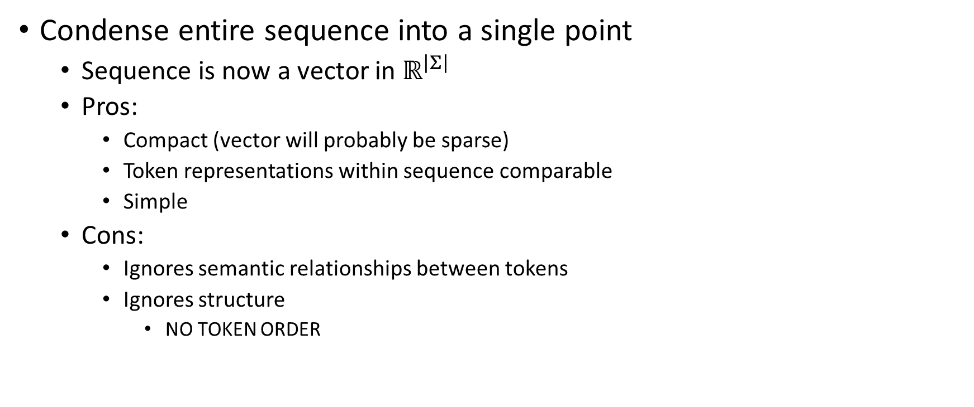
Bag of Words Embeddings
Condense entire sequence into a single point
Sequence is now a vector in $ℝ^{\left|Σ\right|}$
Pros:
Compact (vector will probably be sparse)
Token representations within sequence comparable
Simple
Cons:
Ignores semantic relationships between tokens
Ignores structure
NO TOKEN ORDER

Slide 5
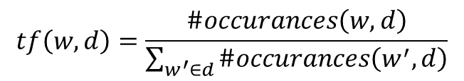
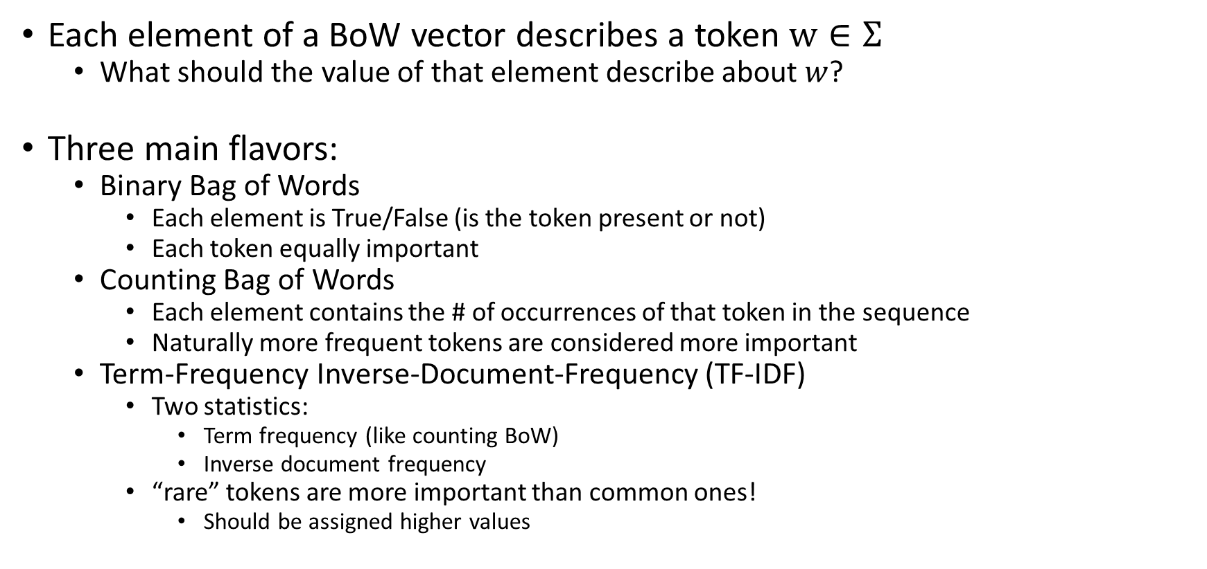
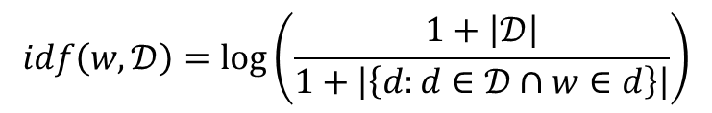
Flavors of Bag of Words
$$tf\left(w,d\right)=\frac{\#occurances\left(w, d\right)}{\sum_{w^{′}∈d}{\#occurances\left(w^{′},d\right)}}$$
$$idf\left(w,𝒟\right)=\log\left(\frac{1+\left|𝒟\right|}{1+\left|\left\{d:d∈𝒟∩w∈d\right\}\right|}\right)$$
Each element of a BoW vector describes a token $w∈Σ$
What should the value of that element describe about $w$?
Three main flavors:
Binary Bag of Words
Each element is True/False (is the token present or not)
Each token equally important
Counting Bag of Words
Each element contains the # of occurrences of that token in the sequence
Naturally more frequent tokens are considered more important
Term-Frequency Inverse-Document-Frequency (TF-IDF)
Two statistics:
Term frequency (like counting BoW)
Inverse document frequency
“rare” tokens are more important than common ones!
Should be assigned higher values

Slide 6
BoW are common
Used in a lot of applications:
Mostly text classification
Email/text filters
Author predictions
Product reviews (# of stars, etc.)
Diagnosis from speech
Etc.
BoW are typically horrible for most NLP tasks
Getting rid of structure (most importantly word order) is bad

Slide 7
More advanced Embeddings
What is “meaning”?
Some words have “shared” meaning
“throw” and “toss” (different granularity of the same action)
“running” and “sleeping” (both verbs)
“fade” and “grow” (opposite direction but both gradual processes)
Some words have “opposite” meaning
“live” and “die” (opposite state of being)
“light” and “dark” (opposite descriptive attributes)
How do we measure shared/opposite meaning?
Can approximate from usage!
Humans use “similar” words in “similar” contexts

Slide 8

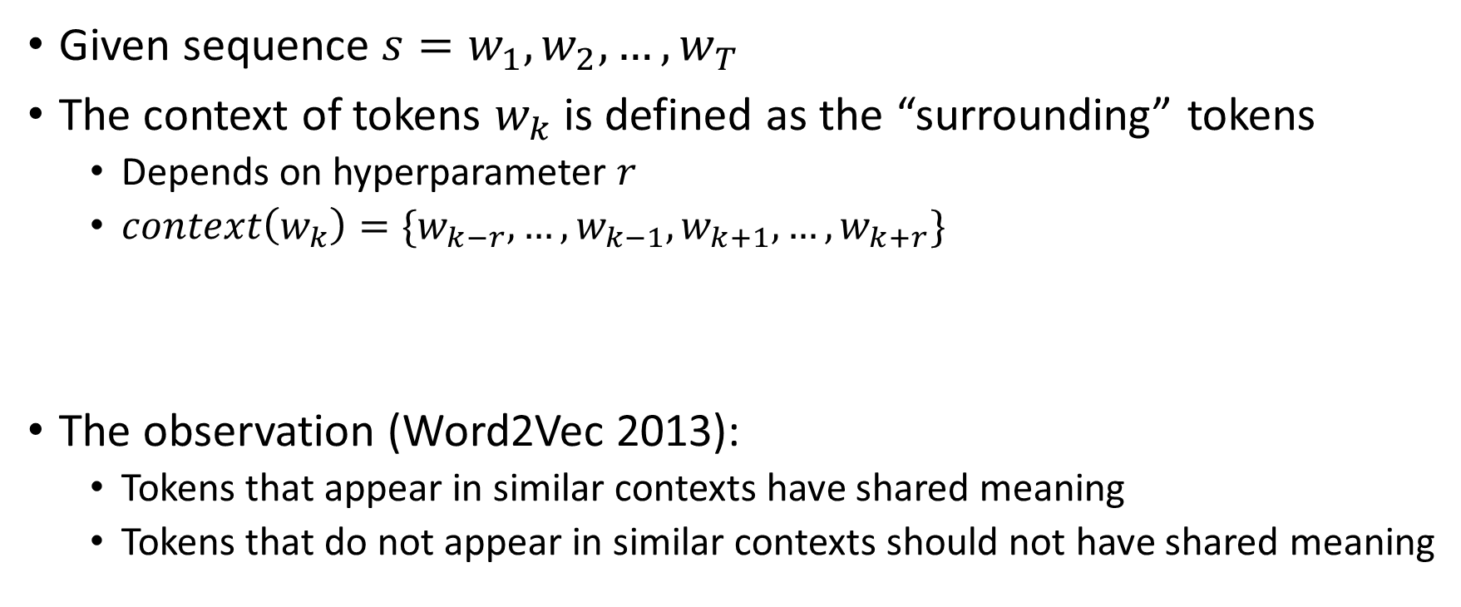

Token contexts
Given sequence $s=w_{1},w_{2},…, w_{T}$
The context of tokens $w_{k}$ is defined as the “surrounding” tokens
Depends on hyperparameter $r$
$context\left(w_{k}\right)=\{w_{k−r}, …,w_{k−1}, w_{k+1},…,w_{k+r}\}$
The observation (Word2Vec 2013):
Tokens that appear in similar contexts have shared meaning
Tokens that do not appear in similar contexts should not have shared meaning
$r$ tokens before $w_{k}$ in $s$
$r$ tokens after $w_{k}$ in $s$

Slide 9
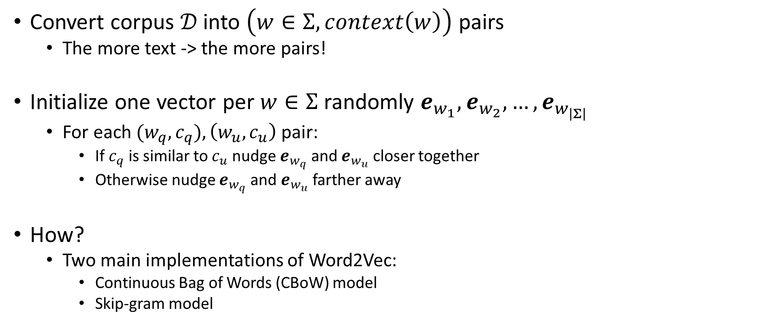
Word2Vec
Convert corpus $𝒟$ into $\left(w∈Σ, context\left(w\right)\right)$ pairs
The more text -> the more pairs!
Initialize one vector per $w∈Σ$ randomly $e_{w_{1}},e_{w_{2}},…,e_{w_{\left|Σ\right|}}$
For each ${(w}_{q}, c_{q}),\left(w_{u},c_{u}\right)$ pair:
If $c_{q}$ is similar to $c_{u}$ nudge $e_{w_{q}}$ and $e_{w_{u}}$ closer together
Otherwise nudge $e_{w_{q}}$ and $e_{w_{u}}$ farther away
How?
Two main implementations of Word2Vec:
Continuous Bag of Words (CBoW) model
Skip-gram model

Slide 10

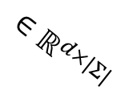


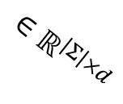


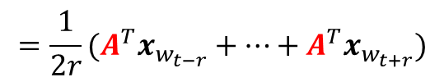




Word2Vec implementation: CBoW
Feed-forward neural network (1 hidden layer)
Given context of a word: predict the word the context belongs to
Input: flattened one-hot encodings of each word in the context
Output: pmf over $Σ$
Params of model: $A,B$
$$\left[\begin{matrix}0 \\ 0 \\ \begin{aligned}… \\ 1\end{aligned}\end{matrix}\right]$$
$$x_{w_{t−r}}$$
$$y_{c}=softmax\left(B^{T}h_{c}\right)$$
$$\left[\begin{matrix}−0.7781 \\ \begin{aligned}0.423 \\ 0.00051\end{aligned} \\ \begin{aligned}… \\ −9.1124\end{aligned}\end{matrix}\right]$$
$$\left[\begin{matrix}{10}^{−6} \\ 0.91 \\ \begin{aligned}… \\ 0.004\end{aligned}\end{matrix}\right]$$
The actual word embeddings!
$$\left[\begin{matrix}0 \\ 1 \\ \begin{aligned}… \\ 0\end{aligned}\end{matrix}\right]$$
$$x_{w_{t+r}}$$
$$h_{c}=\underset{x_{w}\sim context\left(w_{t}\right)}{𝔼}\left[A^{T}x_{w}\right]$$
$$=\frac{1}{2r}(A^{T}x_{w_{t−r}}+…+A^{T}x_{w_{t+r}})$$
$$∈ℝ^{\left|Σ\right|×d}$$
$$∈ℝ^{d×|Σ|}$$

Slide 11








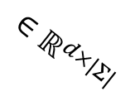

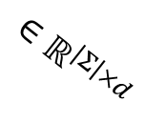
Word2Vec implementation: Skip-gram
Feed-forward neural network (1 hidden layer)
Given target word: predict words most likely to appear in context
Target word = one-hot encoding
Output layer = pmf over $Σ$
Params of model: $A,B$
$$\left[\begin{matrix}{10}^{−6} \\ 0.91 \\ \begin{aligned}… \\ 0.004\end{aligned}\end{matrix}\right]$$
$$y_{w_{t−r}}=softmax\left(B^{T}h_{c}\right)$$
The actual word embeddings!
$$\left[\begin{matrix}−0.7781 \\ \begin{aligned}0.423 \\ 0.00051\end{aligned} \\ \begin{aligned}… \\ −9.1124\end{aligned}\end{matrix}\right]$$
$$\left[\begin{matrix}0 \\ 1 \\ \begin{aligned}… \\ 0\end{aligned}\end{matrix}\right]$$
$$x_{w_{t}}$$
$$h_{w_{t}}=A^{T}x_{w_{t}}$$
$$\left[\begin{matrix}{10}^{−6} \\ 0.91 \\ \begin{aligned}… \\ 0.004\end{aligned}\end{matrix}\right]$$
$$y_{w_{t+r}}=softmax\left(B^{T}h_{c}\right)$$
$$∈ℝ^{\left|Σ\right|×d}$$
$$∈ℝ^{d×|Σ|}$$

Slide 12
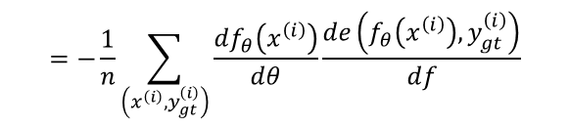
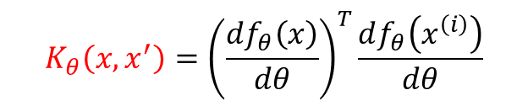
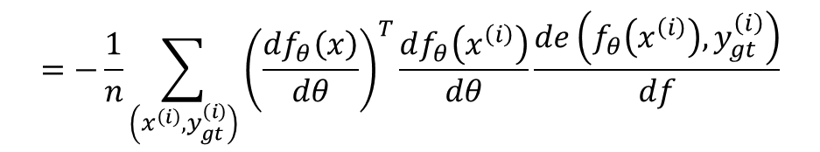
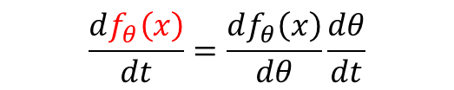
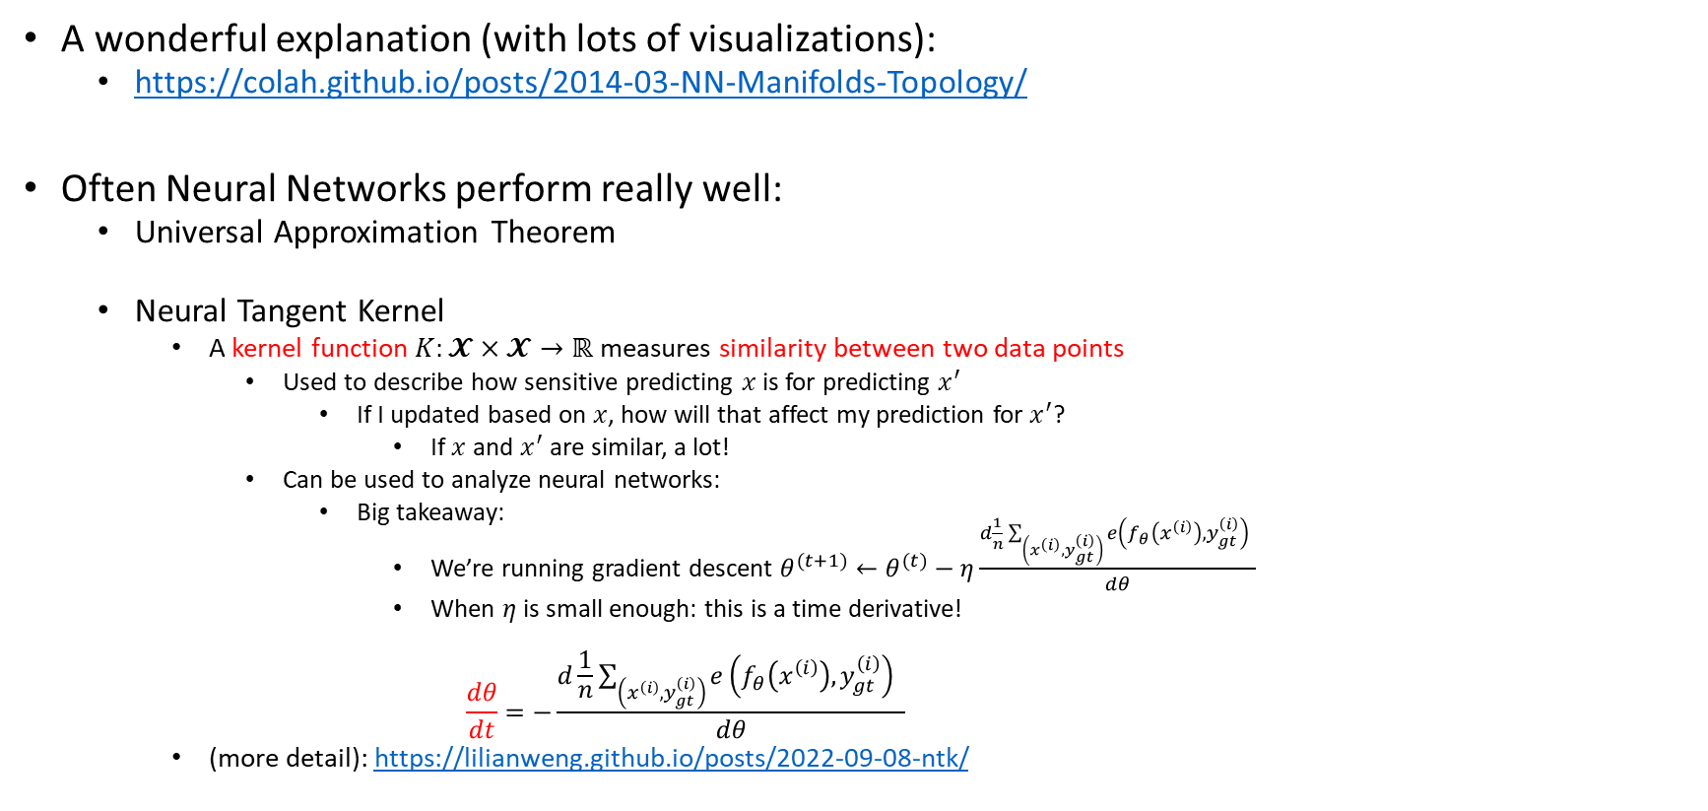
What’s Going On?
$$\frac{df_{θ}\left(x\right)}{dt}=\frac{df_{θ}\left(x\right)}{dθ}\frac{dθ}{dt}$$
$$=−\frac{1}{n}\sum_{\left(x^{\left(i\right)},y_{gt}^{\left(i\right)}\right)}{{\left(\frac{df_{θ}\left(x\right)}{dθ}\right)}^{T}\frac{df_{θ}\left(x^{\left(i\right)}\right)}{dθ}}\frac{de\left(f_{θ}\left(x^{\left(i\right)}\right),y_{gt}^{\left(i\right)}\right)}{df}$$
A wonderful explanation (with lots of visualizations):
https://colah.github.io/posts/2014-03-NN-Manifolds-Topology/
Often Neural Networks perform really well:
Universal Approximation Theorem
Neural Tangent Kernel
A kernel function $K:𝓧×𝓧→ℝ$ measures similarity between two data points
Used to describe how sensitive predicting $x$ is for predicting $x^{′}$
If I updated based on $x$, how will that affect my prediction for $x^{′}$?
If $x$ and $x^{′}$ are similar, a lot!
Can be used to analyze neural networks:
Big takeaway:
We’re running gradient descent $θ^{(t+1)}←θ^{(t)}−η\frac{d\frac{1}{n}\sum_{\left(x^{\left(i\right)},y_{gt}^{\left(i\right)}\right)}{e\left(f_{θ}\left(x^{\left(i\right)}\right),y_{gt}^{\left(i\right)}\right) } }{dθ}$
When $η$ is small enough: this is a time derivative!
$$\frac{dθ}{dt}=−\frac{d\frac{1}{n}\sum_{\left(x^{\left(i\right)},y_{gt}^{\left(i\right)}\right)}{e\left(f_{θ}\left(x^{\left(i\right)}\right),y_{gt}^{\left(i\right)}\right) } }{dθ}$$
(more detail): https://lilianweng.github.io/posts/2022-09-08-ntk/
$$K_{θ}\left(x, x^{′}\right)={\left(\frac{df_{θ}\left(x\right)}{dθ}\right)}^{T}\frac{df_{θ}\left(x^{\left(i\right)}\right)}{dθ}$$
$$=−\frac{1}{n}\sum_{\left(x^{\left(i\right)},y_{gt}^{\left(i\right)}\right)}{\frac{df_{θ}\left(x^{\left(i\right)}\right)}{dθ}\frac{de\left(f_{θ}\left(x^{\left(i\right)}\right),y_{gt}^{\left(i\right)}\right)}{df}}$$

Slide 13
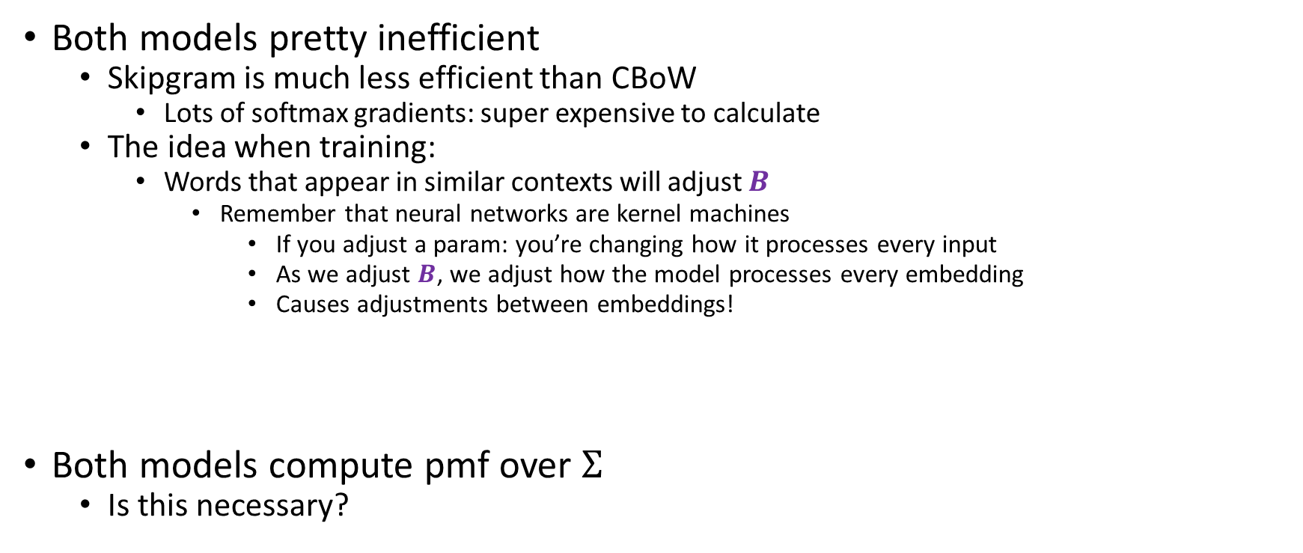
CBoW vs Skipgram
Both models pretty inefficient
Skipgram is much less efficient than CBoW
Lots of softmax gradients: super expensive to calculate
The idea when training:
Words that appear in similar contexts will adjust $B$
Remember that neural networks are kernel machines
If you adjust a param: you’re changing how it processes every input
As we adjust $B$, we adjust how the model processes every embedding
Causes adjustments between embeddings!
Both models compute pmf over $Σ$
Is this necessary?

Slide 14
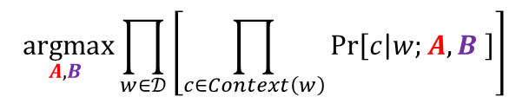

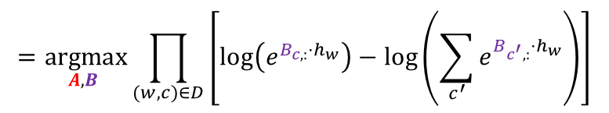
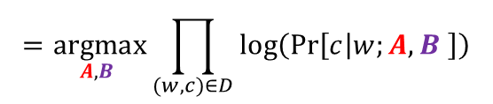
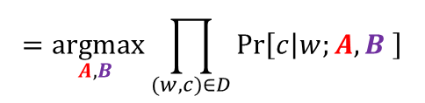
Skipgram improvement
Lets take a closer look at Skipgram
As mentioned, this gradient is expensive to calculate
Why are we predicting the exact position of the context words?
CBoW averages over the context words
Equivalent choice here is to predict whether or not a word does appear in context w/ $w_{t}$
$$\underset{A,B }{argmax}{\prod_{w∈𝒟}{\left[\prod_{c∈Context\left(w\right)}{\operatorname{Pr}\left[c | w;A,B \right]}\right]}}$$
$$=\underset{A,B }{argmax}{\prod_{(w,c)∈D}{\operatorname{Pr}\left[c | w;A,B \right]}}$$
$$=\underset{A,B }{argmax}{\prod_{(w,c)∈D}{\log\left(\operatorname{Pr}\left[c | w;A,B \right]\right)}}$$
$$=\underset{A,B }{argmax}{\prod_{(w,c)∈D}{\left[\log\left(e^{B_{c,:}⋅h_{w}}\right)−\log\left(\sum_{c^{′}}{e^{B_{c^{′},:}⋅h_{w}}}\right)\right]}}$$

Slide 15









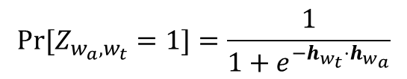









Skipgram improvement
How would we do that?
Let $Z_{w_{a},w_{t}}$ be an I.R.V for $w_{a}∈Context\left(w_{t}\right)$
$$y_{w_{t−r}}=softmax\left(B^{T}h_{c}\right)$$
$$h_{w_{t}}=A^{T}x_{w_{t}}$$
$$\left[\begin{matrix}{10}^{−6} \\ 0.91 \\ \begin{aligned}… \\ 0.004\end{aligned}\end{matrix}\right]$$
$$\left[\begin{matrix}−0.7781 \\ \begin{aligned}0.423 \\ 0.00051\end{aligned} \\ \begin{aligned}… \\ −9.1124\end{aligned}\end{matrix}\right]$$
$$\left[\begin{matrix}0 \\ 1 \\ \begin{aligned}… \\ 0\end{aligned}\end{matrix}\right]$$
$$Pr⁡[Z_{w_{a},w_{t}}=1]=\frac{1}{1+e^{−h_{w_{t}}⋅h_{w_{a}}}}$$
$$x_{w_{t}}$$
$$\left[\begin{matrix}−0.7781 \\ \begin{aligned}0.423 \\ 0.00051\end{aligned} \\ \begin{aligned}… \\ −9.1124\end{aligned}\end{matrix}\right]$$
$$\left[\begin{matrix}0 \\ 1 \\ \begin{aligned}… \\ 0\end{aligned}\end{matrix}\right]$$
$$\left[0.23\right]$$
$$x_{w_{t}}$$
$$\left[\begin{matrix}1 \\ 0 \\ \begin{aligned}… \\ 0\end{aligned}\end{matrix}\right]$$
$$\left[\begin{matrix}0.021 \\ \begin{aligned}16.2 \\ −4.124\end{aligned} \\ \begin{aligned}… \\ 0.119\end{aligned}\end{matrix}\right]$$
$$h_{w_{t}}=A^{T}x_{w_{t}}$$
$$\left[\begin{matrix}{10}^{−6} \\ 0.91 \\ \begin{aligned}… \\ 0.004\end{aligned}\end{matrix}\right]$$
$$x_{w_{a}}$$
$$h_{w_{a}}=A^{T}x_{w_{a}}$$
$$y_{w_{t+r}}=softmax\left(B^{T}h_{c}\right)$$

Slide 16
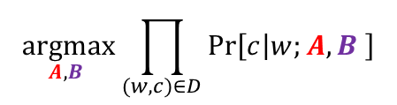
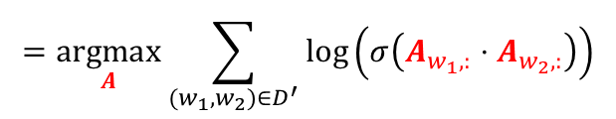
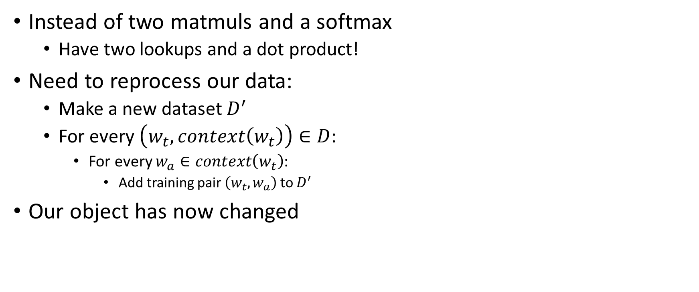
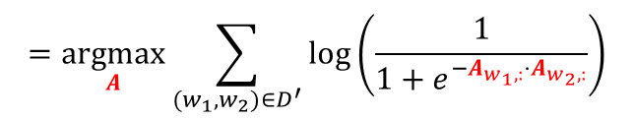
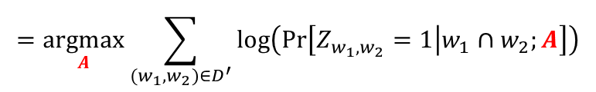
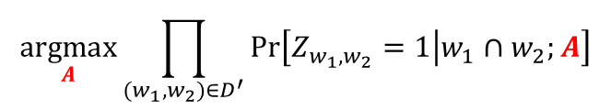
Skipgram improvement
$$\underset{A,B }{argmax}{\prod_{(w,c)∈D}{\operatorname{Pr}\left[c | w;A,B \right]}}$$
Instead of two matmuls and a softmax
Have two lookups and a dot product!
Need to reprocess our data:
Make a new dataset $D^{′}$
For every $\left(w_{t}, context\left(w_{t}\right)\right)∈D$:
For every $w_{a}∈context\left(w_{t}\right)$:
Add training pair $\left(w_{t},w_{a}\right)$ to $D^{′}$
Our object has now changed
$$\underset{A}{argmax}{\prod_{(w_{1},w_{2})∈D^{′}}{\operatorname{Pr}\left[Z_{w_{1},w_{2}}=1 | w_{1}∩w_{2};A\right]}}$$
$$=\underset{A}{argmax}{\sum_{(w_{1},w_{2})∈D^{′}}{\log\left(\operatorname{Pr}\left[Z_{w_{1},w_{2}}=1 | w_{1}∩w_{2};A\right]\right)}}$$
$$=\underset{A}{argmax}{\sum_{(w_{1},w_{2})∈D^{′}}{\log\left(\frac{1}{1+e^{−A_{w_{1},:}⋅A_{w_{2},:}}}\right)}}$$
$$=\underset{A}{argmax}{\sum_{(w_{1},w_{2})∈D^{′}}{\log\left(σ\left(A_{w_{1},:}⋅A_{w_{2},:}\right)\right)}}$$

Slide 17
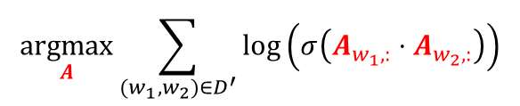
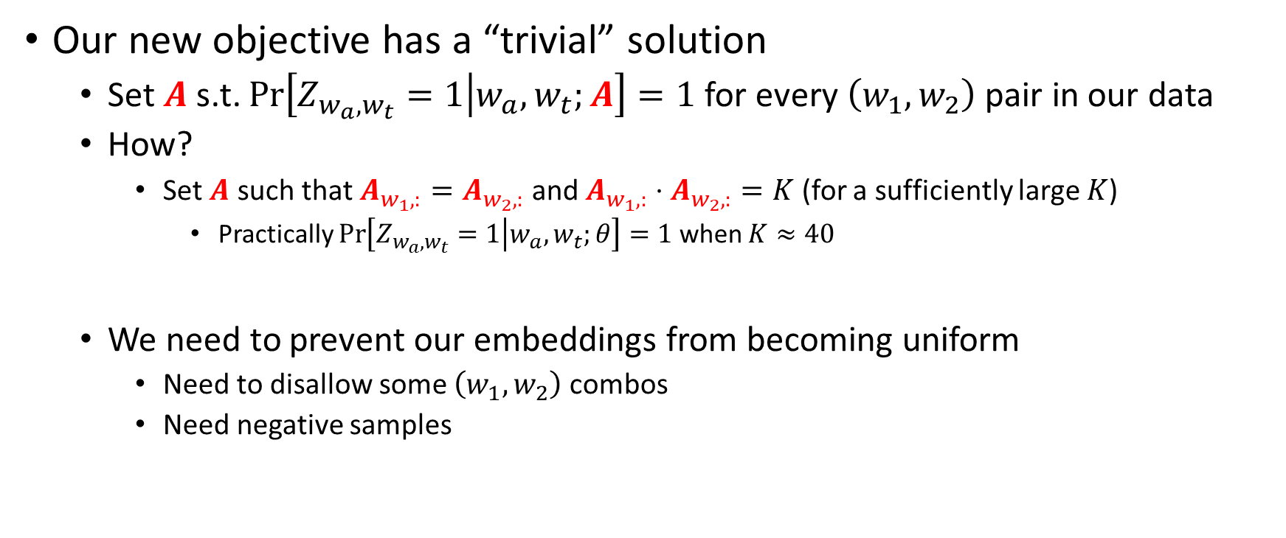
Trouble with our improvement
$$\underset{A}{argmax}{\sum_{(w_{1},w_{2})∈D^{′}}{\log\left(σ\left(A_{w_{1},:}⋅A_{w_{2},:}\right)\right)}}$$
Our new objective has a “trivial” solution
Set $A$ s.t. $\operatorname{Pr}\left[Z_{w_{a},w_{t}}=1 | w_{a},w_{t};A\right]=1$ for every $\left(w_{1},w_{2}\right)$ pair in our data
How?
Set $A$ such that $A_{w_{1},:}=A_{w_{2},:}$ and $A_{w_{1},:}⋅A_{w_{2},:}=K$ (for a sufficiently large $K$)
Practically $\operatorname{Pr}\left[Z_{w_{a},w_{t}}=1 | w_{a},w_{t};θ\right]=1$ when $K≈40$
We need to prevent our embeddings from becoming uniform
Need to disallow some $\left(w_{1},w_{2}\right)$ combos
Need negative samples

Slide 18
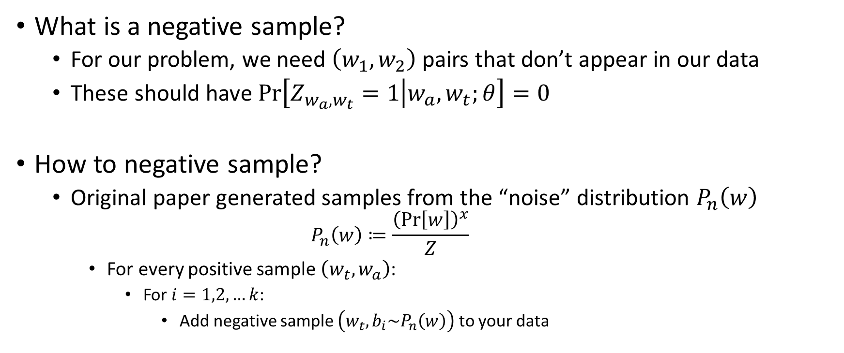
Negative Sampling
What is a negative sample?
For our problem, we need $\left(w_{1},w_{2}\right)$ pairs that don’t appear in our data
These should have $\operatorname{Pr}\left[Z_{w_{a},w_{t}}=1 | w_{a},w_{t};θ\right]=0$
How to negative sample?
Original paper generated samples from the “noise” distribution $P_{n}\left(w\right)$
$$P_{n}\left(w\right)≔\frac{{\left(\operatorname{Pr}\left[w\right]\right)}^{x}}{Z}$$
For every positive sample $\left(w_{t},w_{a}\right)$:
For $i=1,2,…k$:
Add negative sample $\left(w_{t}, b_{i}\sim P_{n}\left(w\right)\right)$ to your data

Slide 19
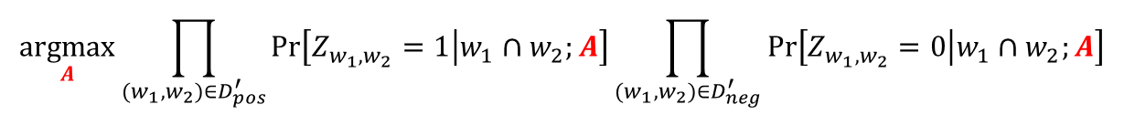
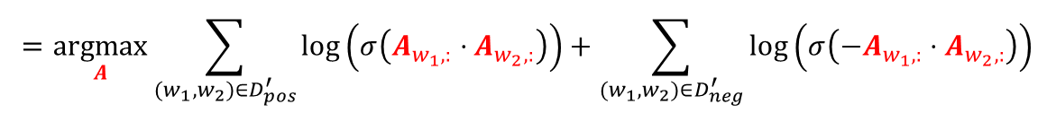
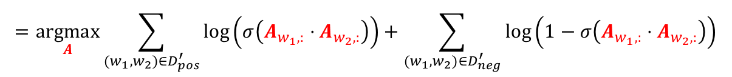
Skipgram w/ negative samples
Our objective has changed once again
$$\underset{A}{argmax}{\prod_{(w_{1},w_{2})∈D_{pos}^{′}}{\operatorname{Pr}\left[Z_{w_{1},w_{2}}=1 | w_{1}∩w_{2};A\right]}\prod_{(w_{1},w_{2})∈D_{neg}^{′}}{\operatorname{Pr}\left[Z_{w_{1},w_{2}}=0 | w_{1}∩w_{2};A\right]}}$$
$$=\underset{A}{argmax}{\prod_{(w_{1},w_{2})∈D_{pos}^{′}}{\operatorname{Pr}\left[Z_{w_{1},w_{2}}=1 | w_{1}∩w_{2};A\right]}\prod_{(w_{1},w_{2})∈D_{neg}^{′}}{\left(1−\operatorname{Pr}\left[Z_{w_{1},w_{2}}=1 | w_{1}∩w_{2};A\right]\right)}}$$
$$=\underset{A}{argmax}{\sum_{(w_{1},w_{2})∈D_{pos}^{′}}{\log\left(σ\left(A_{w_{1},:}⋅A_{w_{2},:}\right)\right)}+\sum_{(w_{1},w_{2})∈D_{neg}^{′}}{\log\left(1−σ\left(A_{w_{1},:}⋅A_{w_{2},:}\right)\right)}}$$
$$=\underset{A}{argmax}{\sum_{(w_{1},w_{2})∈D_{pos}^{′}}{\log\left(σ\left(A_{w_{1},:}⋅A_{w_{2},:}\right)\right)}+\sum_{(w_{1},w_{2})∈D_{neg}^{′}}{\log\left(σ\left(−A_{w_{1},:}⋅A_{w_{2},:}\right)\right)}}$$
make embedding pairs similar
make embedding different

Slide 20

















General Embedding Layers
$$y_{w_{t−r}}=softmax\left(B^{T}h_{c}\right)$$
$$\left[\begin{matrix}{10}^{−6} \\ 0.91 \\ \begin{aligned}… \\ 0.004\end{aligned}\end{matrix}\right]$$
Lookup
further processing
$$\left[\begin{matrix}−0.7781 \\ \begin{aligned}0.423 \\ 0.00051\end{aligned} \\ \begin{aligned}… \\ −9.1124\end{aligned}\end{matrix}\right]$$
$$\left[\begin{matrix}0 \\ 1 \\ \begin{aligned}… \\ 0\end{aligned}\end{matrix}\right]$$
All three models have same paradigm:
Allocate one vector per $w∈Σ$
When presented with $w$:
Lookup its vector
Use the vectors for further processing
Additional layers do other things!
We can do this in an arbitrary NN!
$$h_{w_{t}}=A^{T}x_{w_{t}}$$
$$\left[\begin{matrix}{10}^{−6} \\ 0.91 \\ \begin{aligned}… \\ 0.004\end{aligned}\end{matrix}\right]$$
$$\left[\begin{matrix}0 \\ 0 \\ \begin{aligned}… \\ 1\end{aligned}\end{matrix}\right]$$
$$x_{w_{t−r}}$$
$$y_{w_{t+r}}=softmax\left(B^{T}h_{c}\right)$$
$$y_{c}=softmax\left(B^{T}h_{c}\right)$$
$$\left[\begin{matrix}−0.7781 \\ \begin{aligned}0.423 \\ 0.00051\end{aligned} \\ \begin{aligned}… \\ −9.1124\end{aligned}\end{matrix}\right]$$
$$\left[\begin{matrix}{10}^{−6} \\ 0.91 \\ \begin{aligned}… \\ 0.004\end{aligned}\end{matrix}\right]$$
$$\left[\begin{matrix}0 \\ 1 \\ \begin{aligned}… \\ 0\end{aligned}\end{matrix}\right]$$
$$x_{w_{t+r}}$$
$$h_{c}=\underset{x_{w}\sim context\left(w_{t}\right)}{𝔼}\left[A^{T}x_{w}\right]$$
$$=\frac{1}{2r}(A^{T}x_{w_{t−r}}+…+A^{T}x_{w_{t+r}})$$

Slide 21
















General Embedding Layers
$$Σ=\{<BOS>,a,b,<EOS>\}$$
Consider a RNN-language model
Does the RNN have to operate on the one-hot encodings?
$$y^{(1)}$$
$$y^{(2)}$$
$$y^{(3)}$$
$$y^{(4)}$$
$$y^{(5)}$$
RNN cell
$$h^{(1)}$$
RNN cell
$$h^{(2)}$$
RNN cell
$$h^{(3)}$$
RNN cell
$$h^{(4)}$$
RNN cell
$$h^{(0)}=0$$
$$\left[\begin{matrix}1 \\ 0 \\ \begin{aligned}0 \\ 0\end{aligned}\end{matrix}\right]$$
$$\left[\begin{matrix}0 \\ 1 \\ \begin{aligned}0 \\ 0\end{aligned}\end{matrix}\right]$$
$$\left[\begin{matrix}0 \\ 0 \\ \begin{aligned}1 \\ 0\end{aligned}\end{matrix}\right]$$
$$\left[\begin{matrix}0 \\ 1 \\ \begin{aligned}0 \\ 0\end{aligned}\end{matrix}\right]$$
$$\left[\begin{matrix}0 \\ 0 \\ \begin{aligned}0 \\ 1\end{aligned}\end{matrix}\right]$$
<BOS>
a
b
a
<EOS>

Slide 22











General Embedding Layers
$$Σ=\{<BOS>,a,b,<EOS>\}$$
Is this an embedding?
Yes!
Sequence embedding!
Swap the one-hot encodings for dense embeddings!
Let backprop adjust the embeddings for you!
$$y^{(1)}$$
$$y^{(2)}$$
$$y^{(3)}$$
$$y^{(4)}$$
$$y^{(5)}$$
RNN cell
$$h^{(1)}$$
RNN cell
$$h^{(2)}$$
RNN cell
$$h^{(3)}$$
RNN cell
$$h^{(4)}$$
RNN cell
$$h^{(5)}$$
$$h^{(0)}=0$$
$$e_{<BOS>}$$
$$e_{a}$$
$$e_{b}$$
$$e_{a}$$
$$e_{<EOS>}$$
Emb. layer
Emb. layer
Emb. layer
Emb. layer
Emb. layer
$$\left[\begin{matrix}1 \\ 0 \\ \begin{aligned}0 \\ 0\end{aligned}\end{matrix}\right]$$
$$\left[\begin{matrix}0 \\ 1 \\ \begin{aligned}0 \\ 0\end{aligned}\end{matrix}\right]$$
$$\left[\begin{matrix}0 \\ 0 \\ \begin{aligned}1 \\ 0\end{aligned}\end{matrix}\right]$$
$$\left[\begin{matrix}0 \\ 1 \\ \begin{aligned}0 \\ 0\end{aligned}\end{matrix}\right]$$
$$\left[\begin{matrix}0 \\ 0 \\ \begin{aligned}0 \\ 1\end{aligned}\end{matrix}\right]$$
<BOS>
a
b
a
<EOS>

