Slide 1
Machine Translation II

Slide 2
Parallel Data
In machine translation, we have two (different) languages
The source language (what language we’re given as input)
The target language (what language we want to produce as output)
Translation is supposed to preserve meaning between the two sequences
Our data is given as a parallel corpus
Typically sentence aligned
Convention is to call the source language French and target language English
Even though other languages are possible!

Slide 3
Word Alignment
Something we need to figure out when translating
Which words align to which words?
Consider the following sentence pairs (English and Spanish)
Which words correspond to each other?
Do all words have to correspond?
garcia and associates
his associates are not strong
the groups do not sell zenzanine
garcia y asociados
sus asociados no son fuertes
los grupos no venden zanzanina

Slide 4

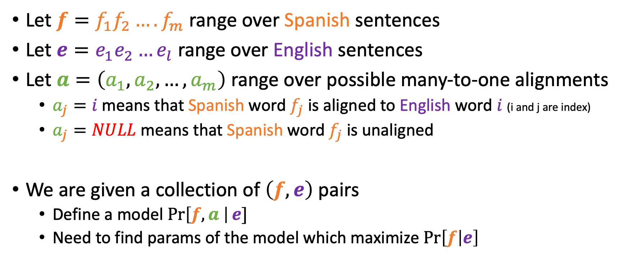
Word Alignment
his associates are not strong
sus asociados no son fuertes
$$a=(1,2,4,3,5,6)$$
Let $f=f_{1}f_{2}…. f_{m}$ range over Spanish sentences
Let $e=e_{1}e_{2}…e_{l}$ range over English sentences
Let $a=\left(a_{1},a_{2},…,a_{m}\right)$ range over possible many-to-one alignments
$a_{j}=i$ means that Spanish word $f_{j}$ is aligned to English word $i$ (i and j are index)
$a_{j}=NULL$ means that Spanish word $f_{j}$ is unaligned
We are given a collection of $\left(f, e\right)$ pairs
Define a model $\operatorname{Pr}\left[f,a \right|e]$
Need to find params of the model which maximize $\operatorname{Pr}\left[f | e\right]$

Slide 5
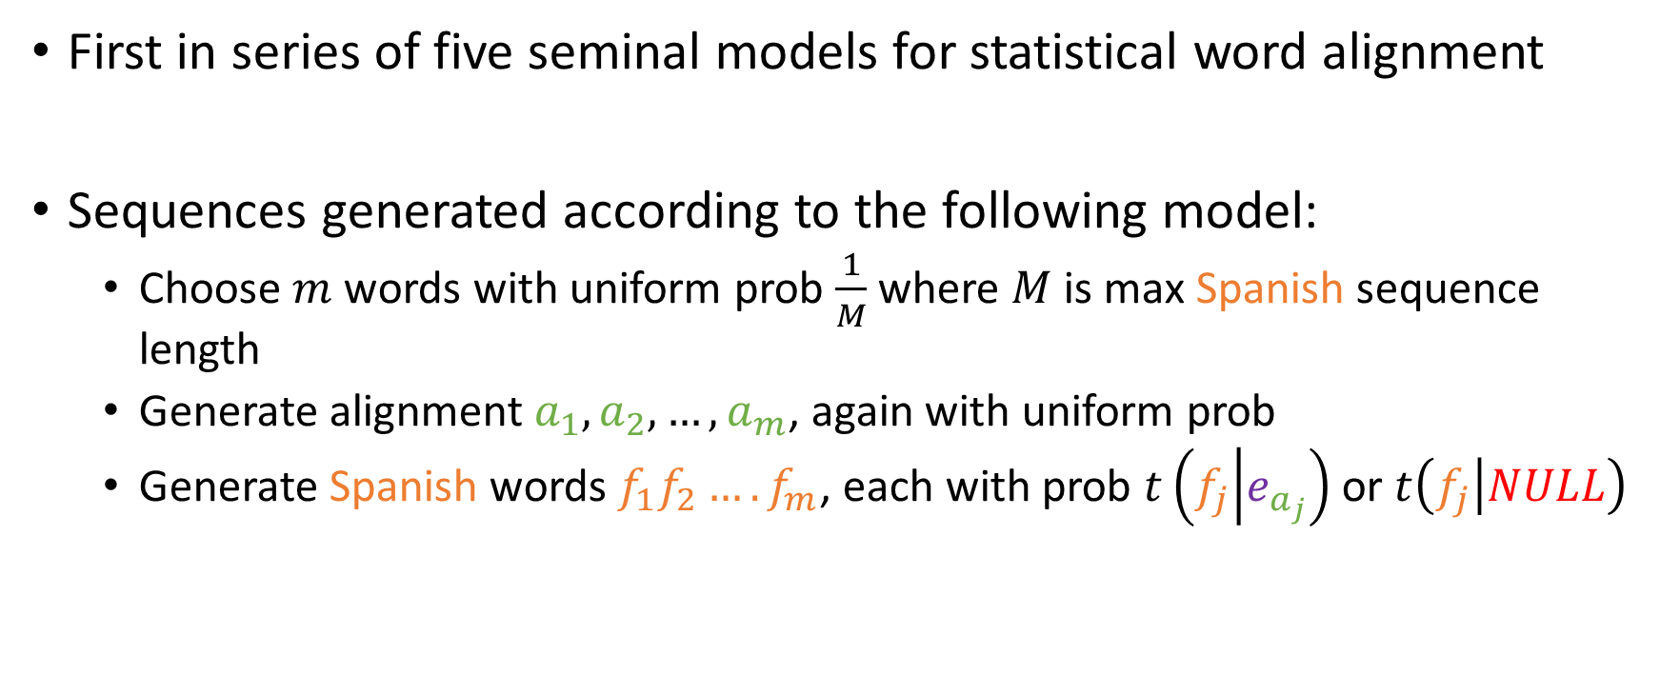
IBM Model 1
First in series of five seminal models for statistical word alignment
Sequences generated according to the following model:
Choose $m$ words with uniform prob $\frac{1}{M}$ where $M$ is max Spanish sequence length
Generate alignment $a_{1},a_{2},…,a_{m}$, again with uniform prob
Generate Spanish words $f_{1}f_{2}…. f_{m}$, each with prob $t\left(f_{j} | e_{a_{j}}\right)$ or $t\left(f_{j} | NULL\right)$

Slide 6
w_1 w_2 w_3 (Null)
Step 1): how my words
(1/4 -> 1, ¼ ->2 ,…) -> length = 4
_, _, _, _
Step 2) which position correspond
_1 -> w_2, _2 -> w_3, _3 -> _3, _4 -> (Null)
Step 3) generate words

Slide 7



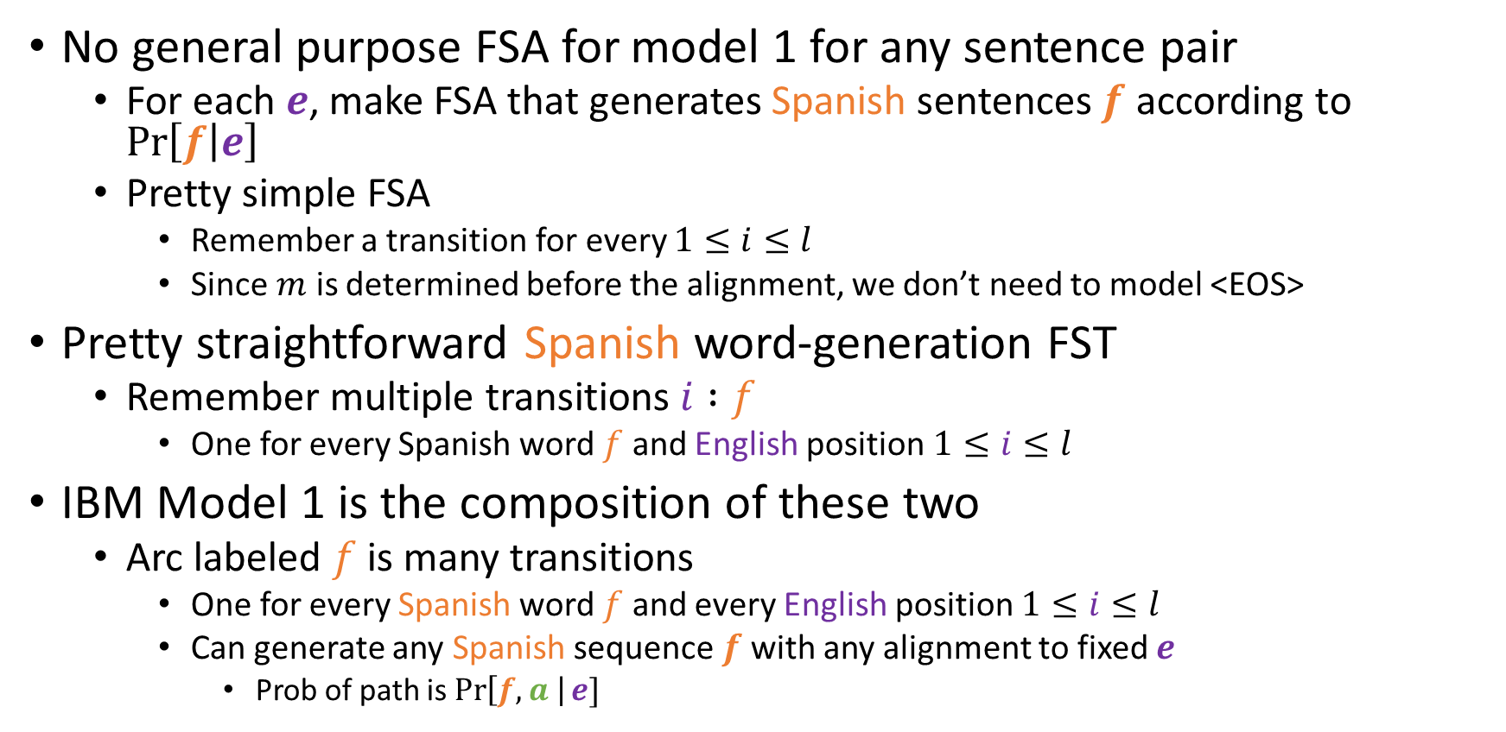



IBM Model 1
$$i :f / t\left(f | e_{i}\right)$$
$$i/\frac{1}{l+1}$$
$$NULL :f / t(f|NULL)$$
$$NULL/\frac{1}{l+1}$$
No general purpose FSA for model 1 for any sentence pair
For each $e$, make FSA that generates Spanish sentences $f$ according to $\operatorname{Pr}\left[f | e\right]$
Pretty simple FSA
Remember a transition for every $1≤i≤l$
Since $m$ is determined before the alignment, we don’t need to model <EOS>
Pretty straightforward Spanish word-generation FST
Remember multiple transitions $i :f$
One for every Spanish word $f$ and English position $1≤i≤l$
IBM Model 1 is the composition of these two
Arc labeled $f$ is many transitions
One for every Spanish word $f$ and every English position $1≤i≤l$
Can generate any Spanish sequence $f$ with any alignment to fixed $e$
Prob of path is $\operatorname{Pr}\left[f,a \right|e]$
$$f / \frac{1}{l+1}t\left(f | e_{i}\right)$$
$$NULL / \frac{1}{l+1}t(f|NULL)$$

Slide 8













IBM Model 1
garcia and associates
garcia y asociados
If we intersect IBM1 with a FST for $f$ we get something like:
$$garcia / \frac{1}{l+1}t(garcia|garcia)$$
$$y / \frac{1}{l+1}t(y|garcia)$$
$$asociados / \frac{1}{l+1}t(asociados|garcia)$$
$$garcia / \frac{1}{l+1}t(garcia|and)$$
$$y / \frac{1}{l+1}t(y|and)$$
$$asociados / \frac{1}{l+1}t(asociados|and)$$
$$garcia / \frac{1}{l+1}t(garcia|associates)$$
$$y / \frac{1}{l+1}t(y|associates)$$
$$asociados / \frac{1}{l+1}t(asociados|associates)$$
$$garcia / \frac{1}{l+1}t(garcia|NULL)$$
$$y / \frac{1}{l+1}t(y|NULL)$$
$$asociados / \frac{1}{l+1}t(asociados|NULL)$$

Slide 9
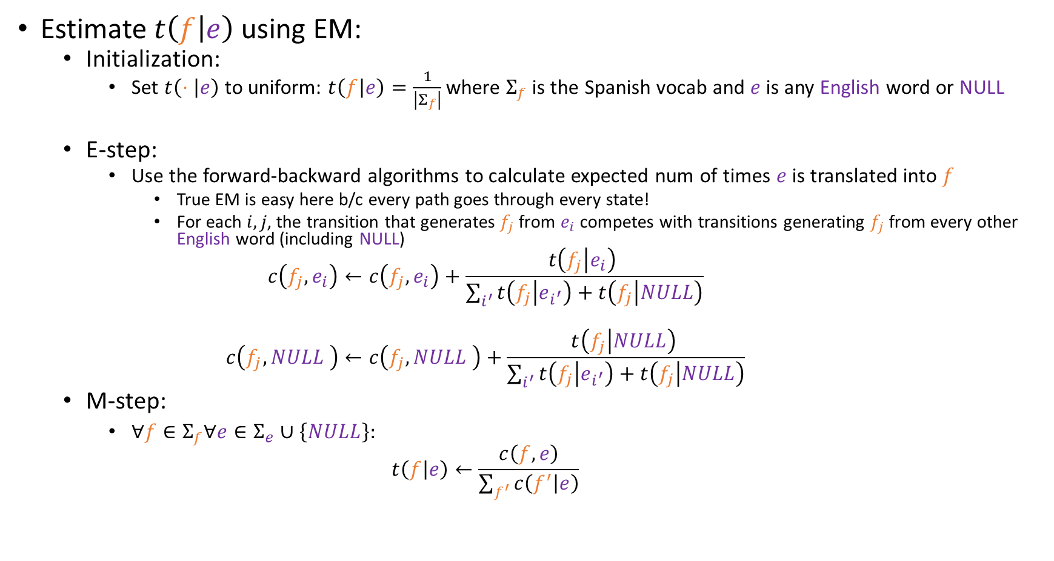
Training IBM1
Estimate $t\left(f | e\right)$ using EM:
Initialization:
Set $t\left(⋅ | e\right)$ to uniform: $t\left(f | e\right)=\frac{1}{\left|Σ_{f}\right|}$ where $Σ_{f}$ is the Spanish vocab and $e$ is any English word or NULL
E-step:
Use the forward-backward algorithms to calculate expected num of times $e$ is translated into $f$
True EM is easy here b/c every path goes through every state!
For each $i,j$, the transition that generates $f_{j}$ from $e_{i}$ competes with transitions generating $f_{j}$ from every other English word (including NULL)
$$c\left(f_{j},e_{i}\right)←c\left(f_{j},e_{i}\right)+\frac{t\left(f_{j} | e_{i}\right) }{\sum_{i^{′}}{t\left(f_{j} | e_{i^{′}}\right)+t\left(f_{j} | NULL\right)}}$$
$$c\left(f_{j},NULL \right)←c\left(f_{j},NULL \right)+\frac{t\left(f_{j} | NULL\right) }{\sum_{i^{′}}{t\left(f_{j} | e_{i^{′}}\right)+t\left(f_{j} | NULL\right)}}$$
M-step:
$∀f∈Σ_{f}∀e∈Σ_{e}∪\left\{NULL\right\}:$
$$t\left(f | e\right)←\frac{c\left(f,e\right)}{\sum_{f^{′}}{c\left(f^{′} | e\right)}}$$

Slide 10
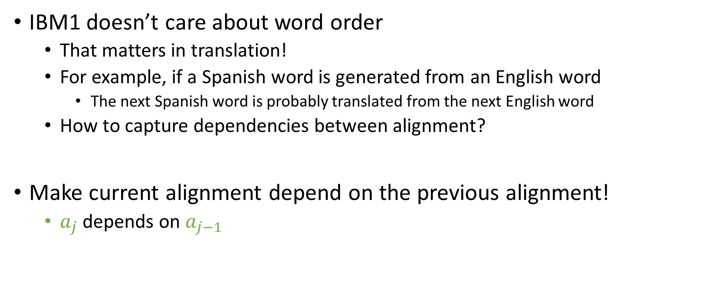
Word Order
IBM1 doesn’t care about word order
That matters in translation!
For example, if a Spanish word is generated from an English word
The next Spanish word is probably translated from the next English word
How to capture dependencies between alignment?
Make current alignment depend on the previous alignment!
$a_{j}$ depends on $a_{j−1}$

Slide 11

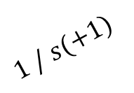

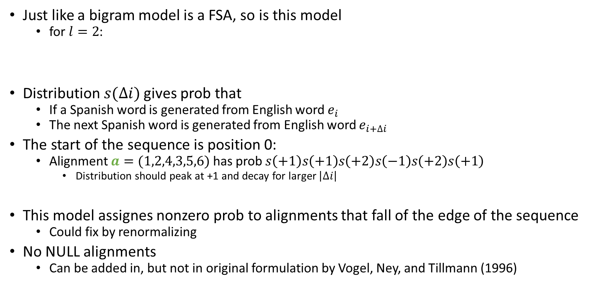
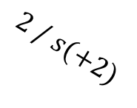


Word Order
$$1 / s(0)$$
$$1 / s(+1)$$
Just like a bigram model is a FSA, so is this model
for $l=2$:
Distribution $s(∆i)$ gives prob that
If a Spanish word is generated from English word $e_{i}$
The next Spanish word is generated from English word $e_{i+∆i}$
The start of the sequence is position 0:
Alignment $a=(1,2,4,3,5,6)$ has prob $s\left(+1\right)s\left(+1\right)s\left(+2\right)s\left(−1\right)s\left(+2\right)s\left(+1\right)$
Distribution should peak at +1 and decay for larger $\left|∆i\right|$
This model assignes nonzero prob to alignments that fall of the edge of the sequence
Could fix by renormalizing
No NULL alignments
Can be added in, but not in original formulation by Vogel, Ney, and Tillmann (1996)
$$1 / s(−1)$$
$$2 / s(+1)$$
$$2 / s(+2)$$
$$2 / s(0)$$

Slide 12

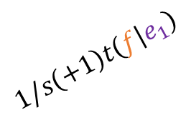

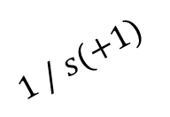




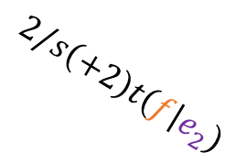
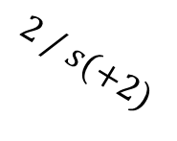







Word Order and Alignment
Take Spanish-word generation model from before
Compose it with FSA of word order (again assuming $l=2$)
$$1 / s(0)$$
$$1/s\left(0\right)t\left(f | e_{1}\right)$$
$$i :f / t\left(f | e_{i}\right)$$
$$1 / s(+1)$$
$$1/s\left(+1\right)t\left(f | e_{1}\right)$$
$$∩$$
$$1 / s(−1)$$
$$2 / s(+1)$$
$$=$$
$$1/s\left(−1\right)t(f|e_{1})$$
$$2/s\left(+1\right)t\left(f | e_{2}\right)$$
$$NULL :f / t(f|NULL)$$
$$2 / s(+2)$$
$$2/s\left(+2\right)t\left(f | e_{2}\right)$$
$$2 / s(0)$$
$$2/s\left(0\right)t\left(f | e_{2}\right)$$

Slide 13
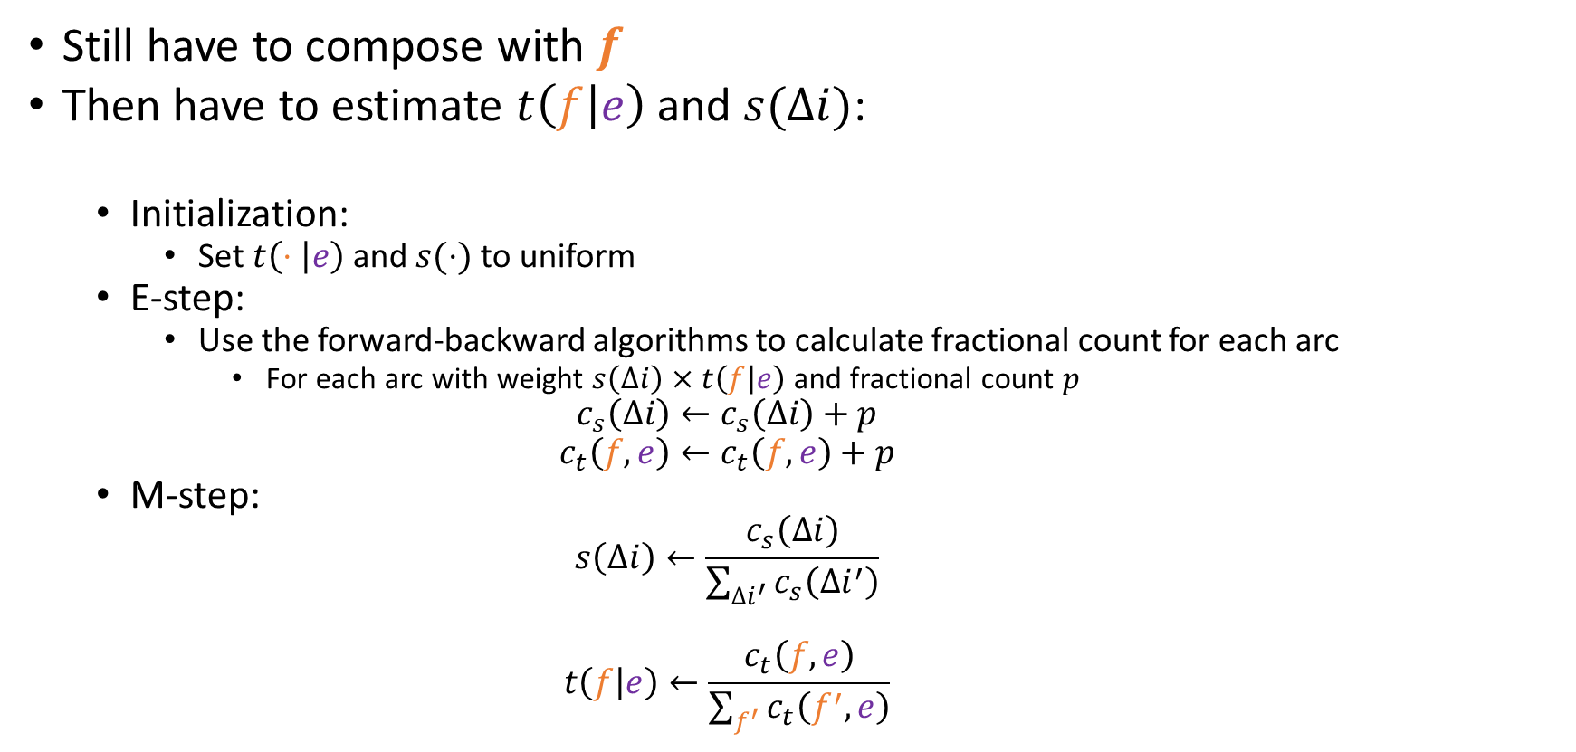
Word Order and Alignment
Still have to compose with $f$
Then have to estimate $t\left(f | e\right)$ and $s(∆i)$:
Initialization:
Set $t\left(⋅ | e\right)$ and $s(⋅)$ to uniform
E-step:
Use the forward-backward algorithms to calculate fractional count for each arc
For each arc with weight $s\left(∆i\right)×t\left(f | e\right)$ and fractional count $p$
$$c_{s}\left(∆i\right)←c_{s}\left(∆i\right)+p$$
$$c_{t}\left(f,e\right)←c_{t}\left(f,e\right)+p$$
M-step:
$$s\left(∆i\right)←\frac{c_{s}\left(∆i\right)}{\sum_{∆i^{′}}{c_{s}\left(∆i^{′}\right)}}$$
$$t\left(f | e\right)←\frac{c_{t}\left(f,e\right)}{\sum_{f^{′}}{c_{t}\left(f^{′},e\right)}}$$

