Slide 1
Semantics II

Slide 2
Topic Modeling
Lots of effort goes into modeling the “vector” for an example
Example could be a document
Example could be an image
…
We know that a chunk of language has (at least one) topic
Let say we break down the language into chunks containing a single topic
Want to include topic in the vector

Slide 3
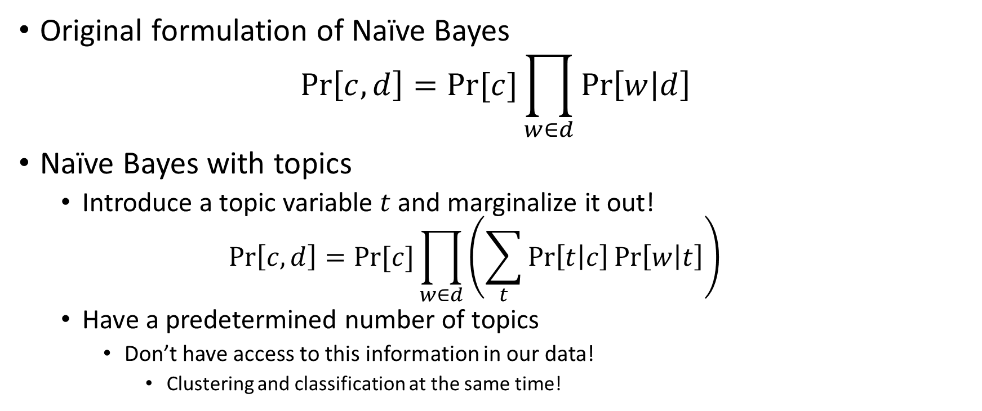
Modifying Naïve Bayes
Original formulation of Naïve Bayes
$$\operatorname{Pr}\left[c,d\right]=Pr⁡[c]\prod_{w∈d}{\operatorname{Pr}\left[w | d\right]}$$
Naïve Bayes with topics
Introduce a topic variable $t$ and marginalize it out!
$$\operatorname{Pr}\left[c,d\right]=Pr⁡[c]\prod_{w∈d}{\left(\sum_{t}{\operatorname{Pr}\left[t | c\right]\operatorname{Pr}\left[w | t\right]}\right)}$$
Have a predetermined number of topics
Don’t have access to this information in our data!
Clustering and classification at the same time!

Slide 4
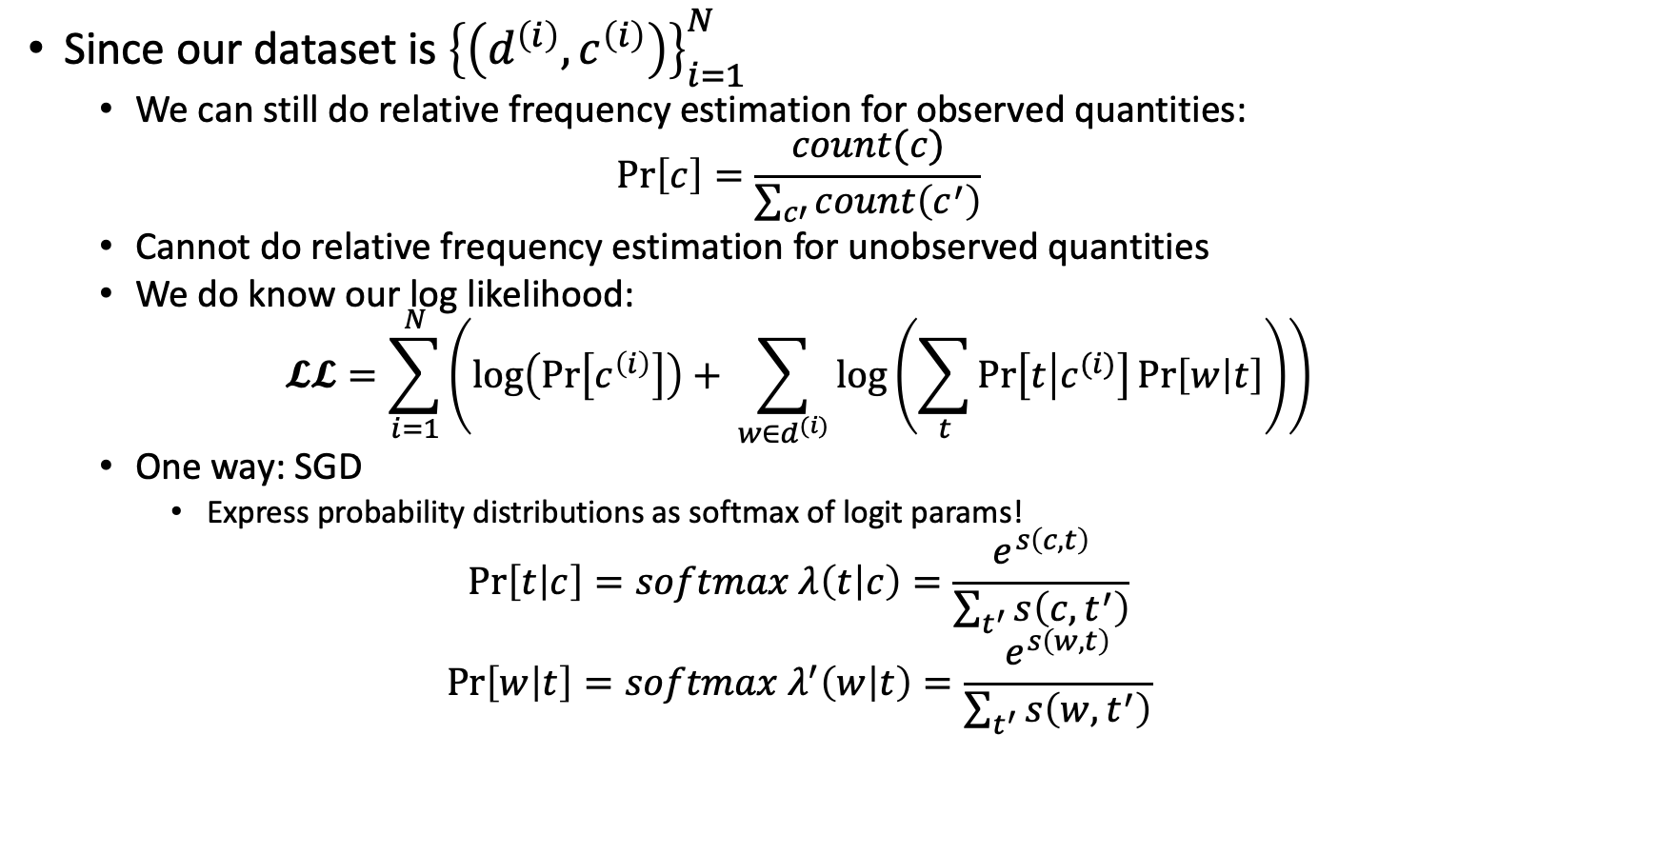
Training Topic-Naïve Bayes
Since our dataset is ${\left\{\left(d^{\left(i\right)},c^{\left(i\right)}\right)\right\}}_{i=1}^{N}$
We can still do relative frequency estimation for observed quantities:
$$\operatorname{Pr}\left[c\right]=\frac{count(c)}{\sum_{c′}{count\left(c^{′}\right)}}$$
Cannot do relative frequency estimation for unobserved quantities
We do know our log likelihood:
$$𝓛𝓛=\sum_{i=1}^{N}{\left(\log\left(\operatorname{Pr}\left[c^{\left(i\right)}\right]\right)+ \sum_{w∈d^{(i)}}{\log\left(\sum_{t}{\operatorname{Pr}\left[t | c^{(i)}\right]\operatorname{Pr}\left[w | t\right]}\right)}\right)}$$
One way: SGD
Express probability distributions as softmax of logit params!
$$\operatorname{Pr}\left[t | c\right]=softmax λ\left(t | c\right)=\frac{e^{s\left(c,t\right)}}{\sum_{t^{′}}{s\left(c,t^{′}\right)}}$$
$$\operatorname{Pr}\left[w | t\right]=softmax λ^{′}\left(w | t\right)=\frac{e^{s\left(w,t\right)}}{\sum_{t^{′}}{s\left(w,t^{′}\right)}}$$

Slide 5
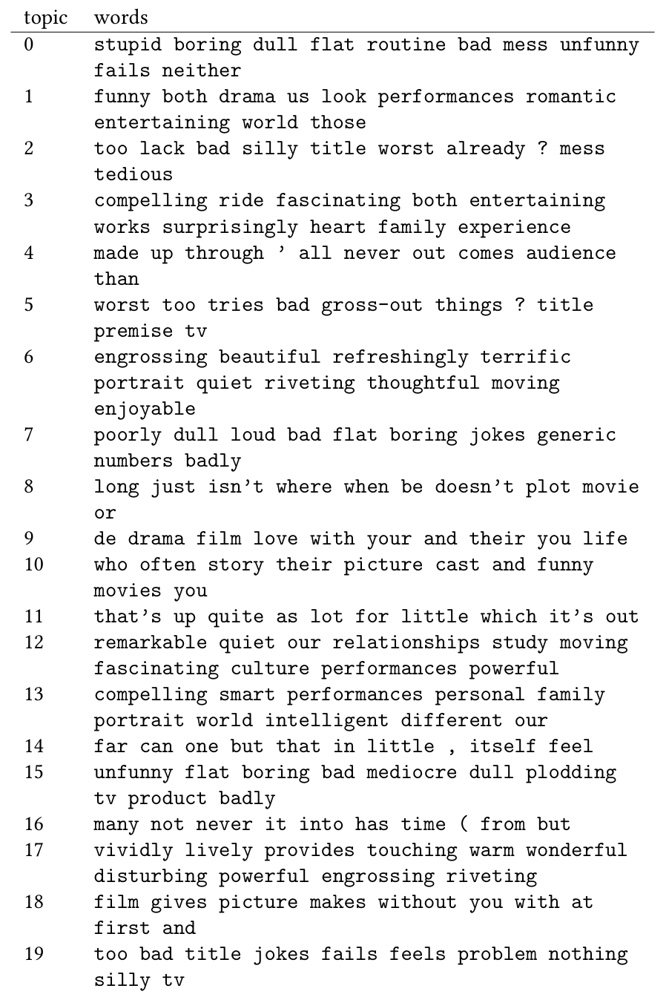
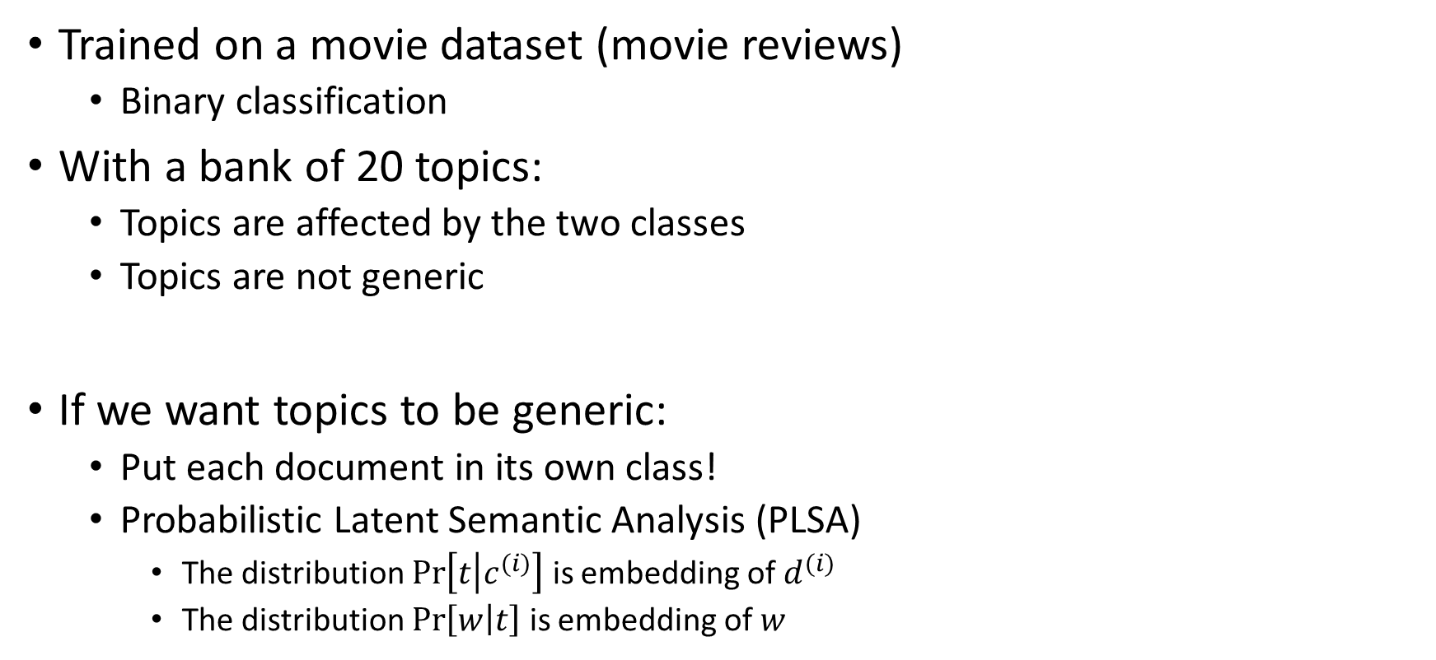
What Kind of Topics Does It Learn?
Trained on a movie dataset (movie reviews)
Binary classification
With a bank of 20 topics:
Topics are affected by the two classes
Topics are not generic
If we want topics to be generic:
Put each document in its own class!
Probabilistic Latent Semantic Analysis (PLSA)
The distribution $\operatorname{Pr}\left[t | c^{(i)}\right]$ is embedding of $d^{(i)}$
The distribution $\operatorname{Pr}\left[w | t\right]$ is embedding of $w$
More advanced: LDA

Slide 6
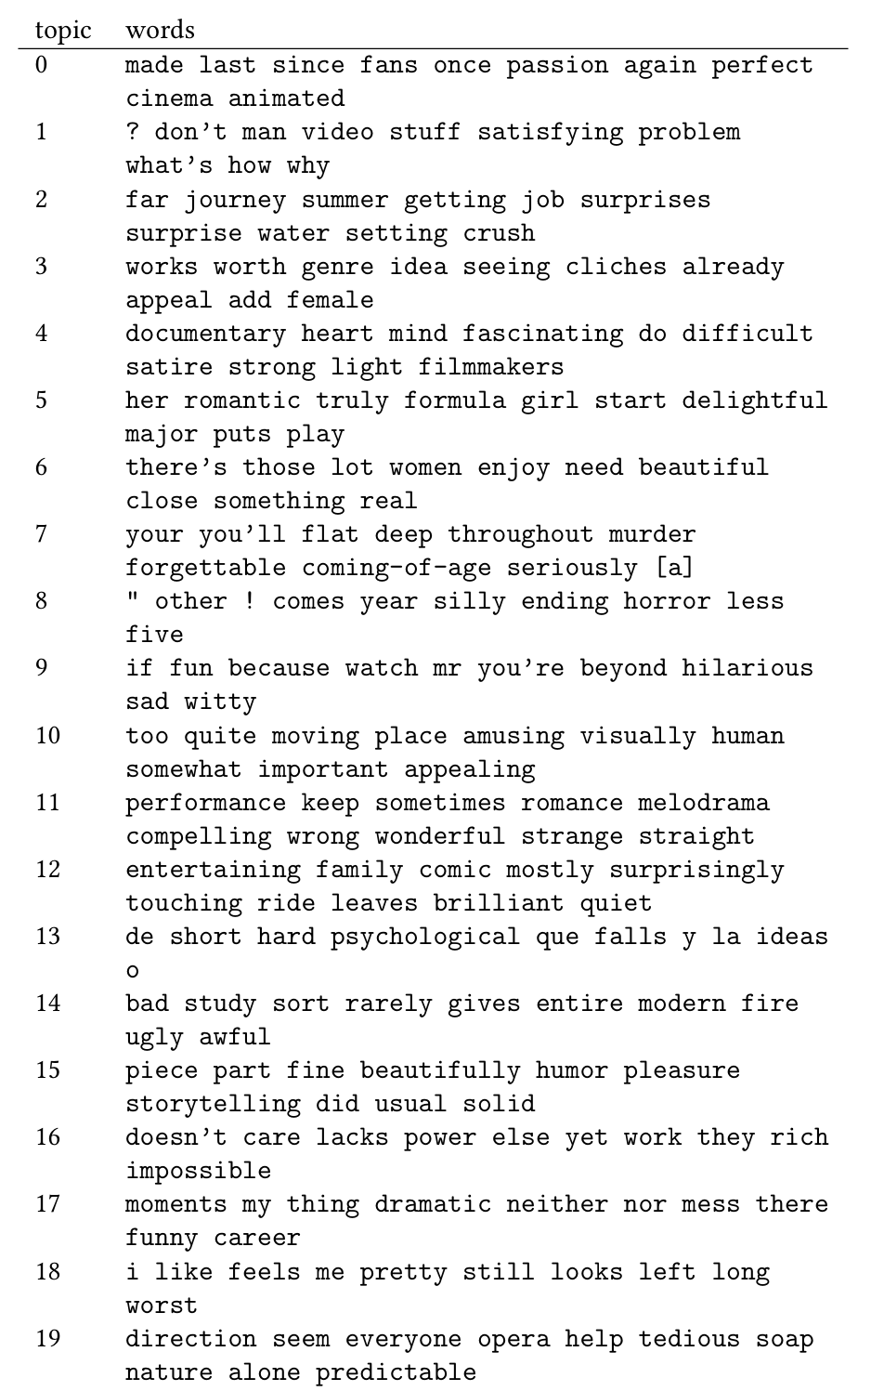
What Kind of Topics Does It Learn?
Now topics are more generic
No topics strongly positive/negative
Class information not influencing topics!
Still not very coherent topics though

Slide 7
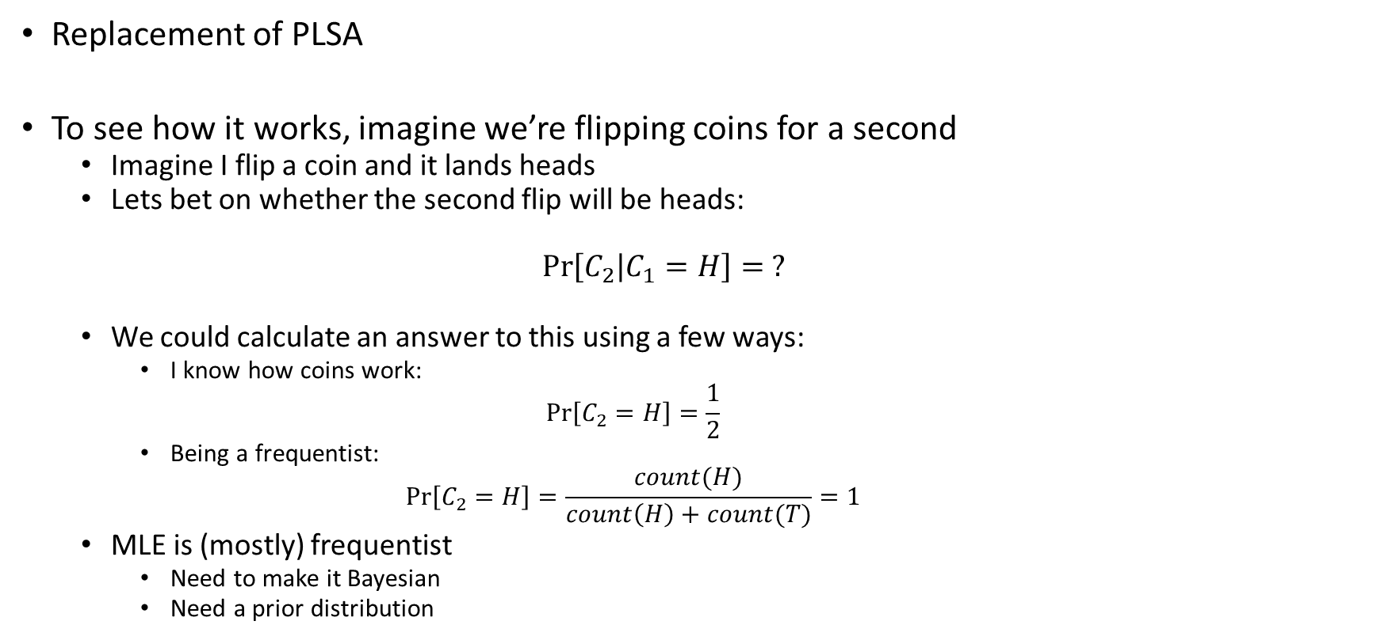
Latent Dirichlet Allocation (LDA)
Replacement of PLSA
To see how it works, imagine we’re flipping coins for a second
Imagine I flip a coin and it lands heads
Lets bet on whether the second flip will be heads:
$$\operatorname{Pr}\left[C_{2} | C_{1}=H\right]= ?$$
We could calculate an answer to this using a few ways:
I know how coins work:
$$\operatorname{Pr}\left[C_{2}=H\right]=\frac{1}{2}$$
Being a frequentist:
$$\operatorname{Pr}\left[C_{2}=H\right]=\frac{count(H)}{count\left(H\right)+count(T)}=1$$
MLE is (mostly) frequentist
Need to make it Bayesian
Need a prior distribution

Slide 8






The Prior Distribution
Suppose that (for some reason) we only have 3 hypotheses:
HT (fair coin)
HH (both sides are heads)
TT (both sides are tails)
Using the prior:
$$\operatorname{Pr}\left[C_{2}=H | HT\right]=\frac{1}{2}$$
$$\operatorname{Pr}\left[C_{2}=T | HT\right]=\frac{1}{2}$$
$$\operatorname{Pr}\left[C_{2}=H | HH\right]=1$$
$$\operatorname{Pr}\left[C_{2}=T | HH\right]=0$$
$$\operatorname{Pr}\left[C_{2}=H | TT\right]=0$$
$$\operatorname{Pr}\left[C_{2}=T | TT\right]=1$$

Slide 9
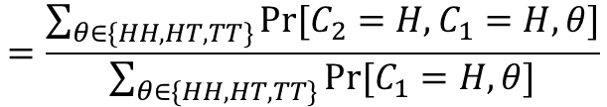
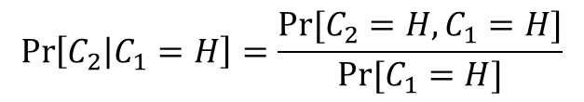


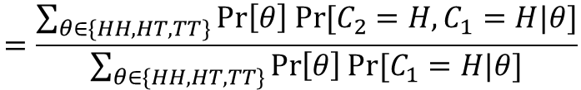
The Prior Distribution
After seeing the first coin flip:
$$\operatorname{Pr}\left[C_{2} | C_{1}=H\right]=\frac{Pr⁡[C_{2}=H,C_{1}=H]}{Pr⁡[C_{1}=H]}$$
Each hypothesis is equally likely
$$=\frac{\sum_{θ∈\{HH, HT,TT\}}{Pr⁡[C_{2}=H,C_{1}=H,θ]}}{\sum_{θ∈\{HH, HT,TT\}}{Pr⁡[C_{1}=H,θ]}}$$
$$=\frac{\sum_{θ∈\{HH, HT,TT\}}{Pr\left[θ\right] Pr⁡[C_{2}=H,C_{1}=H|θ]}}{\sum_{θ∈\{HH, HT,TT\}}{\operatorname{Pr}\left[θ\right]Pr⁡[C_{1}=H|θ]}}$$
$$=\frac{\frac{1}{3}∗\frac{1}{4}+\frac{1}{3}∗1+\frac{1}{3}∗0}{\frac{1}{3}∗\frac{1}{2}+\frac{1}{3}∗1+\frac{1}{3}∗0}$$
$$=\frac{5}{6}$$

Slide 10
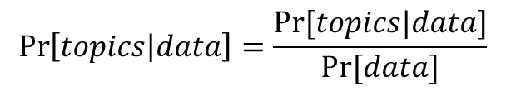
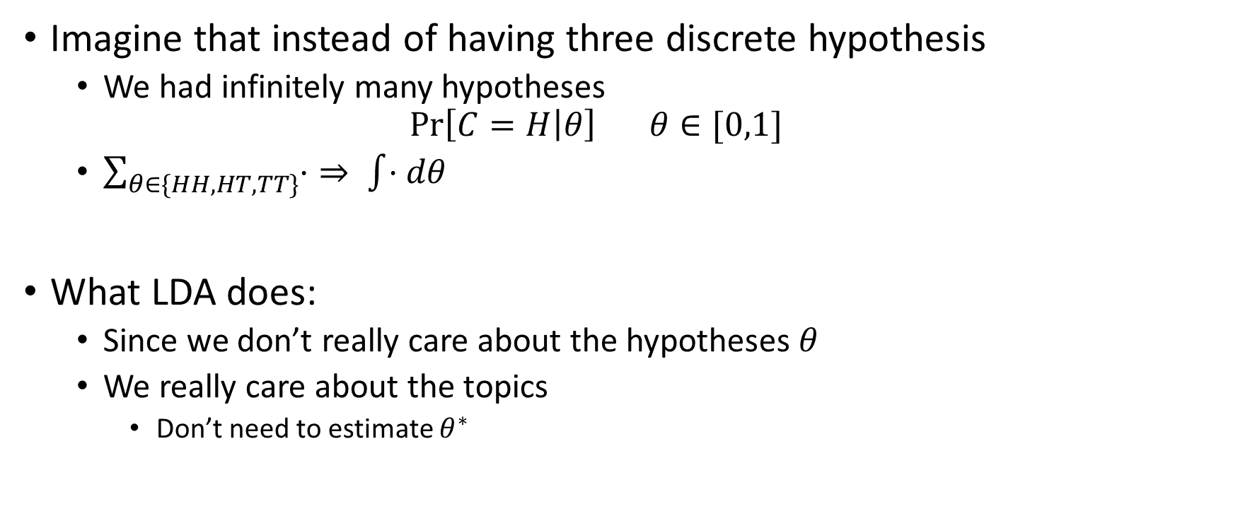
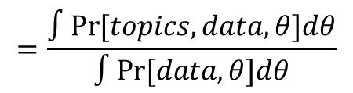
LDA
Imagine that instead of having three discrete hypothesis
We had infinitely many hypotheses
$$\operatorname{Pr}\left[C=H | θ\right] θ∈[0,1]$$
$\sum_{θ∈\{HH, HT,TT\}}{⋅}⇒ \int{⋅dθ}$
What LDA does:
Since we don’t really care about the hypotheses $θ$
We really care about the topics
Don’t need to estimate $θ^{∗}$
$$\operatorname{Pr}\left[topics | data\right]=\frac{Pr⁡[topics|data]}{Pr⁡[data]}$$
$$=\frac{∫Pr[topics,data,θ]dθ}{∫Pr[data,θ]dθ}$$

Slide 11

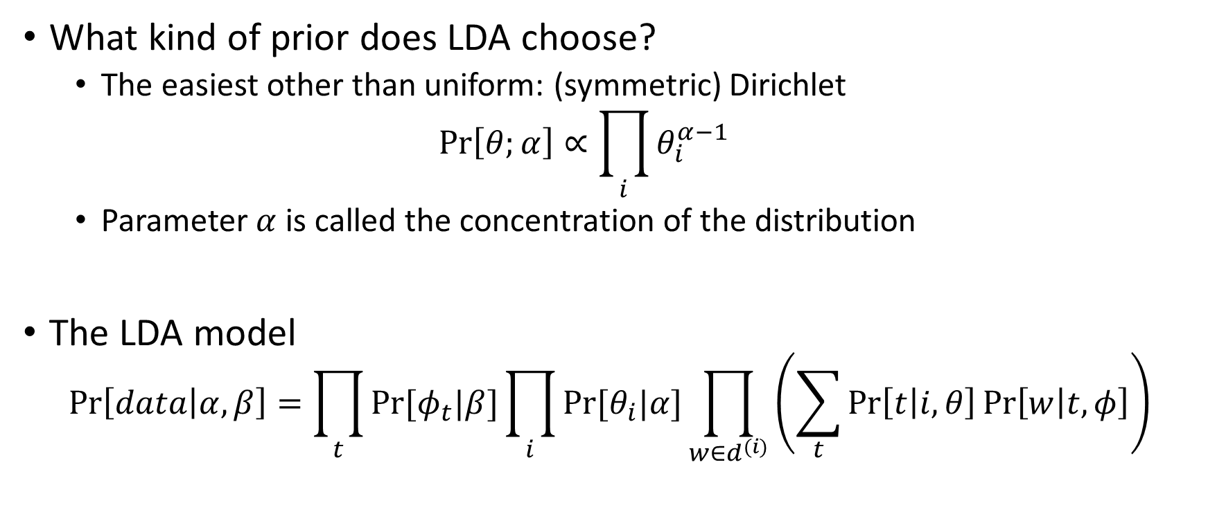

LDA
What kind of prior does LDA choose?
The easiest other than uniform: (symmetric) Dirichlet
$$\operatorname{Pr}\left[θ;α\right]∝\prod_{i}{θ_{i}^{α−1}}$$
Parameter $α$ is called the concentration of the distribution
The LDA model
$$\operatorname{Pr}\left[data | α,β\right]=\prod_{t}{Pr⁡[φ_{t}|β]}\prod_{i}{Pr⁡[θ_{i}|α]}\prod_{w∈d^{(i)}}{\left(\sum_{t}{\operatorname{Pr}\left[t | i,θ\right]\operatorname{Pr}\left[w | t,φ\right]}\right)}$$
Dirichlet prior on words $Pr⁡[w|t]$
What PLSA was doing
Dirichlet prior on topics $Pr⁡[t|i]$
prior
likelihood

Slide 12
Semantic Graphs
A bunch of (famous) tasks nestled under this type of semantics:
Named Entity Recognition
Which noun phrases are names of people, places, etc., and what entity do they refer to?
Coreference Resolution
Which noun phrases (including pronouns) refer to the same thing?
Word Sense Disambiguation
If a word has more than one sense, which one is being uses in this context?
Semantic Role Labeling
For each action in the sentence
Who is the agent (the one doing the action)
Who is the patient (the one upon whom the action is done)
Etc.
Relation Extraction
High level relationships like “x is the president of y”

Slide 13
Named Entity Recognition
Given a sequence, which elements are named entities and what kind?
Person
Organization
Location (also called GPE or GeoPolitical Entity)
Misc.
Etc.
Natural next step is entity linking
Which person, org, location, etc. in the real world is the element(s) referring
Often the url to the Wikipedia entry is used as proxy for “the real world”

Slide 14
Named Entity Recognition
People typically reduce NER into a sequence labeling problem
Assign a label to every word in a sequence
Sequence labeling is a well studied problem:
Part of Speech tagging
Slot filling (scheduling something to happen in each slot of time)
For airports: scheduling departure/arrival airport/date/time
To reduce NER (and slot filling) to sequence labeling, we use BIO-tagging
B stands for “begin” and begins the entity being recognized
I stands for “inside” and spans the rest of the entity being recognized
O stands for “outside” and is used for any word not belonging to an entity
B-ORG
I-ORG
O
B-PER
I-PER
O
O
B-LOC
O
United
Nations
official
Rolf
Ekeus
heads
for
Baghdad
.

Slide 15
Named Entity Recognition
You know what else was a sequence labeling problem?
Typos!
We can solve this problem with a Hidden Markov Model
Bigram model over tags
Emission model to convert a tag into a word
Find the most likely tag sequence that can generate the observed words!
This requires building a layered graph and then viterbi on the graph!
We can solve this problem with FSTs!
Arbitrary n-gram model over tags
Emission model to convert a tag into a word
Find the most likely tag sequence that can generate the observed words!
This requires FST composition and then viterbi on the composed FST

Slide 16
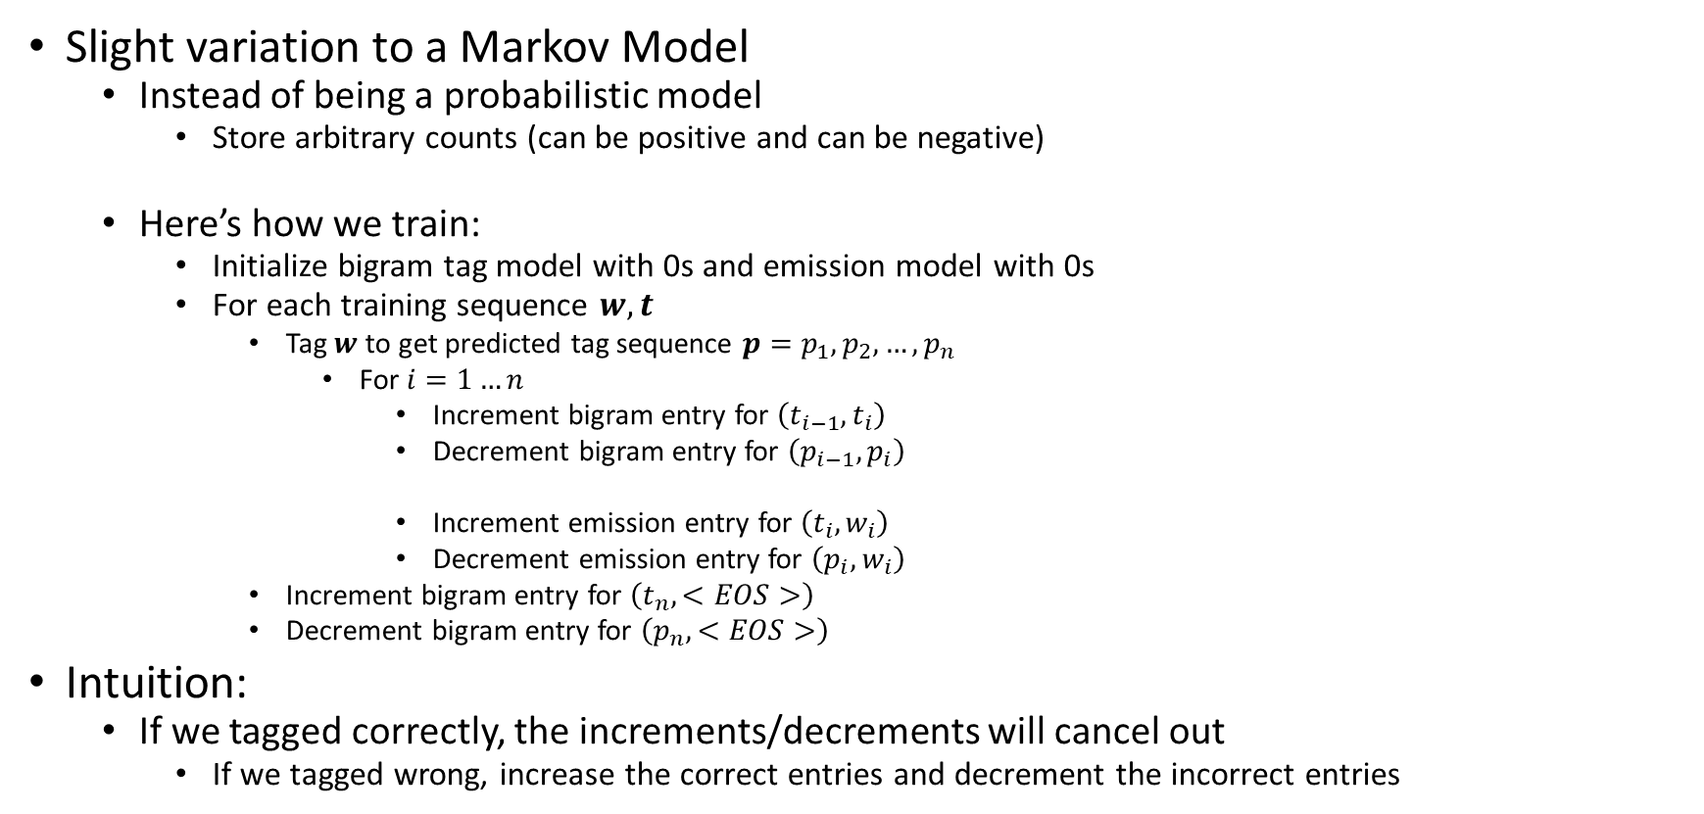
Structured Perceptrons
Slight variation to a Markov Model
Instead of being a probabilistic model
Store arbitrary counts (can be positive and can be negative)
Here’s how we train:
Initialize bigram tag model with 0s and emission model with 0s
For each training sequence $w, t$
Tag $w$ to get predicted tag sequence $p=p_{1},p_{2}, …, p_{n}$
For $i=1…n$
Increment bigram entry for $\left(t_{i−1},t_{i}\right)$
Decrement bigram entry for $\left(p_{i−1},p_{i}\right)$
Increment emission entry for $\left(t_{i},w_{i}\right)$
Decrement emission entry for $\left(p_{i},w_{i}\right)$
Increment bigram entry for $\left(t_{n},<EOS>\right)$
Decrement bigram entry for $\left(p_{n},<EOS>\right)$
Intuition:
If we tagged correctly, the increments/decrements will cancel out
If we tagged wrong, increase the correct entries and decrement the incorrect entries

Slide 17

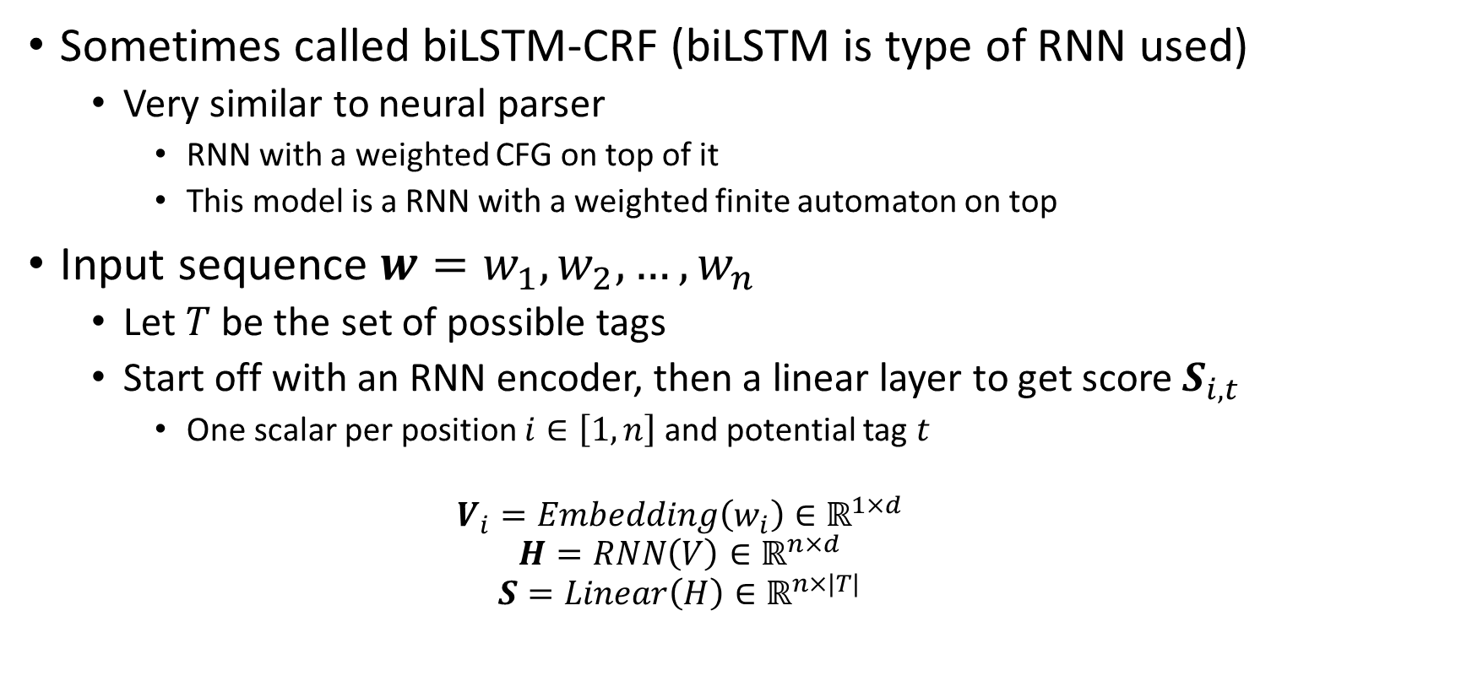
RNN-CRFs
Crf: weighted automaton
Sometimes called biLSTM-CRF (biLSTM is type of RNN used)
Very similar to neural parser
RNN with a weighted CFG on top of it
This model is a RNN with a weighted finite automaton on top
Input sequence $w=w_{1},w_{2},…,w_{n}$
Let $T$ be the set of possible tags
Start off with an RNN encoder, then a linear layer to get score $S_{i,t}$
One scalar per position $i∈\left[1,n\right]$ and potential tag $t$
$$V_{i}=Embedding\left(w_{i}\right)∈ℝ^{1×d}$$
$$H=RNN\left(V\right)∈ℝ^{n×d}$$
$$S=Linear\left(H\right)∈ℝ^{n×|T|}$$
$$i=1…n$$

Slide 18
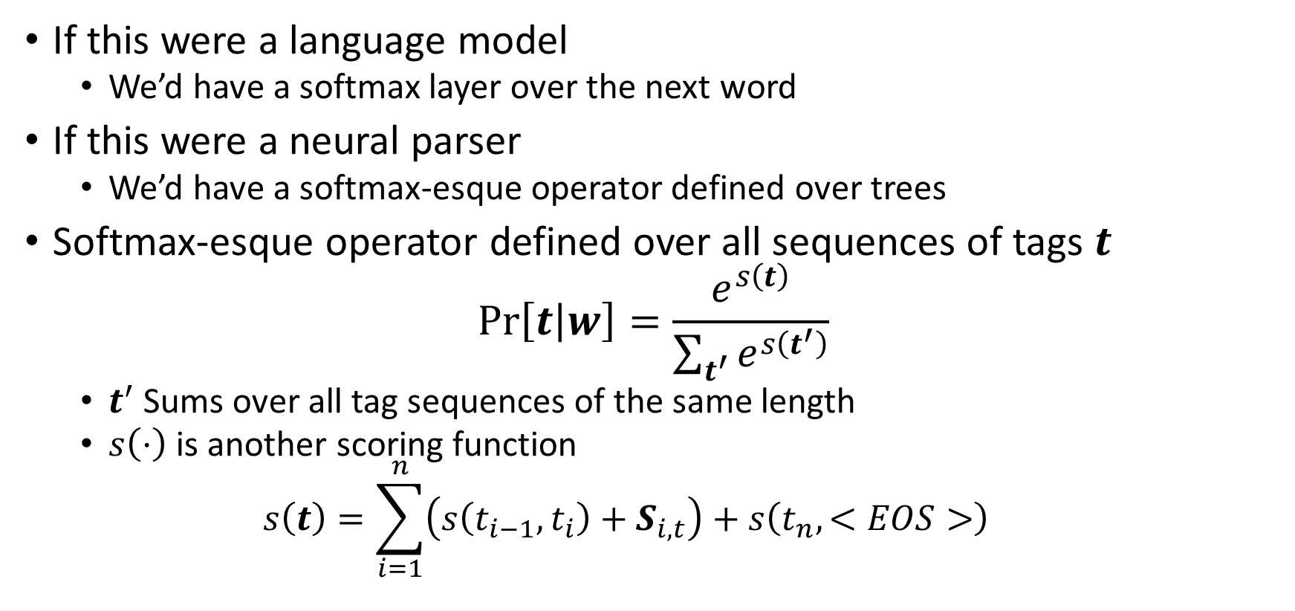
RNN-CRFs
If this were a language model
We’d have a softmax layer over the next word
If this were a neural parser
We’d have a softmax-esque operator defined over trees
Softmax-esque operator defined over all sequences of tags $t$
$$\operatorname{Pr}\left[t | w\right]=\frac{e^{s\left(t\right)}}{\sum_{t^{′}}{e^{s\left(t^{′}\right)}}}$$
$t^{′}$ Sums over all tag sequences of the same length
$s\left(⋅\right)$ is another scoring function
$$s\left(t\right)=\sum_{i=1}^{n}{\left(s\left(t_{i−1},t_{i}\right)+S_{i,t}\right)}+s\left(t_{n},<EOS>\right)$$
Neural tag, position embedding score
Bigram scoring function

Slide 19
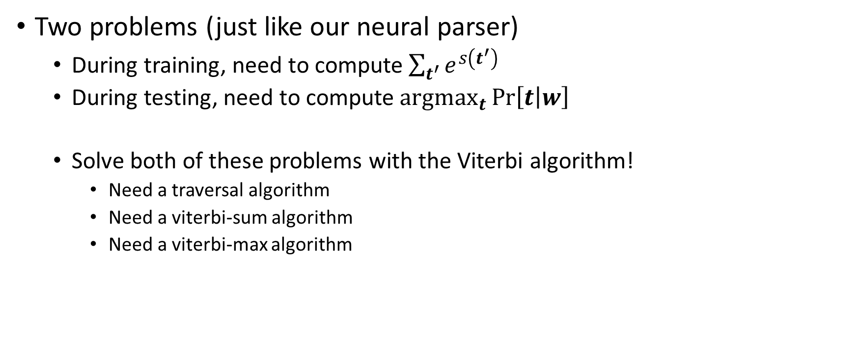
RNN-CRFs
Two problems (just like our neural parser)
During training, need to compute $\sum_{t^{′}}{e^{s\left(t^{′}\right)}}$
During testing, need to compute $\underset{t}{argmax}{\operatorname{Pr}\left[t | w\right]}$
Solve both of these problems with the Viterbi algorithm!
Need a traversal algorithm
Need a viterbi-sum algorithm
Need a viterbi-max algorithm

Slide 20
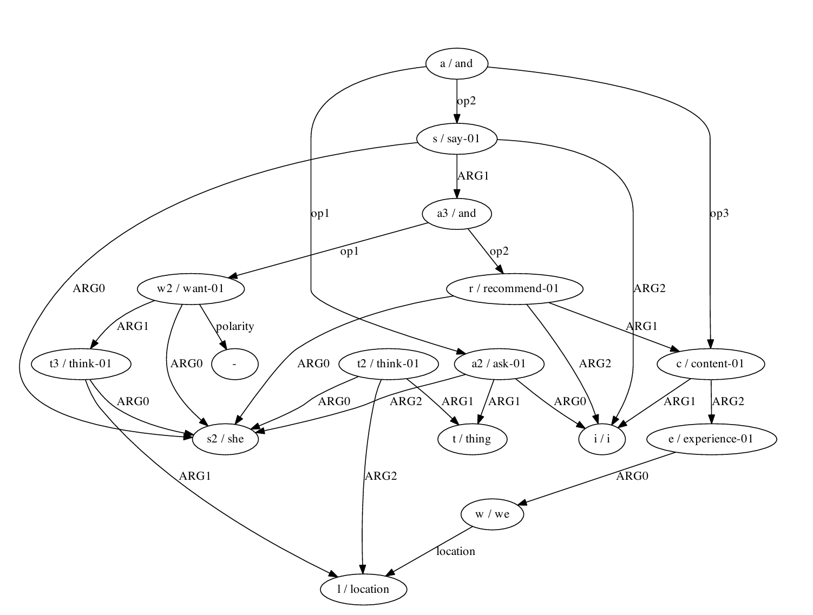
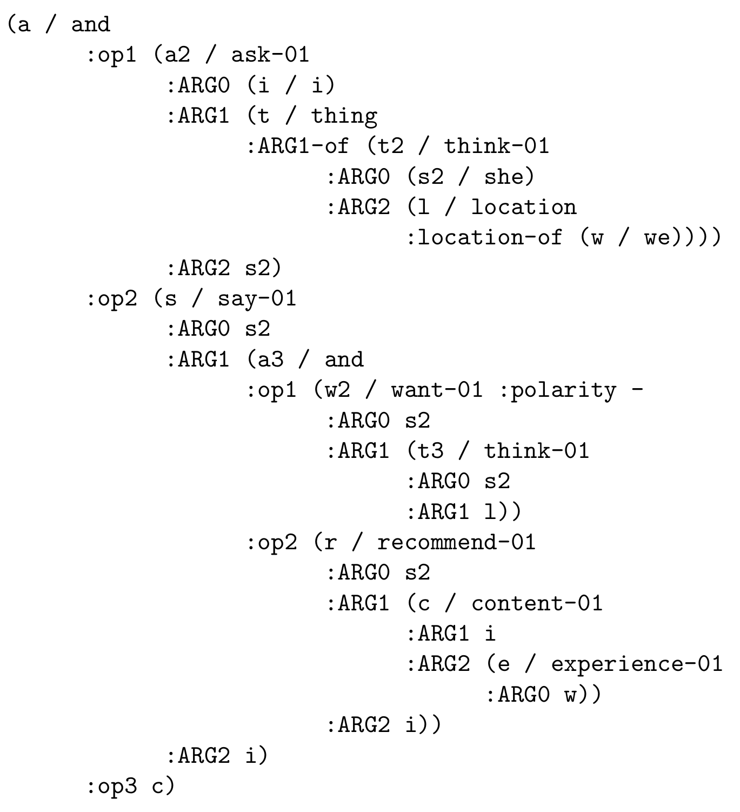
Abstract Meaning Representations
Store vertices as entities
Edges as relationships between entities
AMR Bank (database)
Vertices are labeled with lexical information
Edges label to convey semantic roles
Labels at each edge don’t need to be unique
No edge ordering either
“I asked her what she thought about where we’d be and she said she doesn’t want to think about that, and that I should be happy about the experiences we’ve had (which I am)”
Numbered labels convey different senses:
ask-01 = for asking questions
ask-02 = for asking for favors
ask-03 = for asking a price
…
Each sense comes with numbered list of arguments
For ask-01:
arg0 = asker
arg1 = question
arg2 = answerer (hearer of the question)

Slide 21
AMR Parsing
Semantic parsing is taking natural language sequence and mapping it to a representation of its meaning
If semantic representation is AMR, called AMR parsing
NMT systems are good at this
“translate from natural language to AMR”
Train on parallel corpus (natural language/AMR aligned pairs)
Unlike language-to-language translation
Typical for AMR to have shared words with the natural language
NMT can do a good job of copying for frequent words
Hard for rare words
Unable to deal with <UNK>
Need to add a copy mechanism

Slide 22
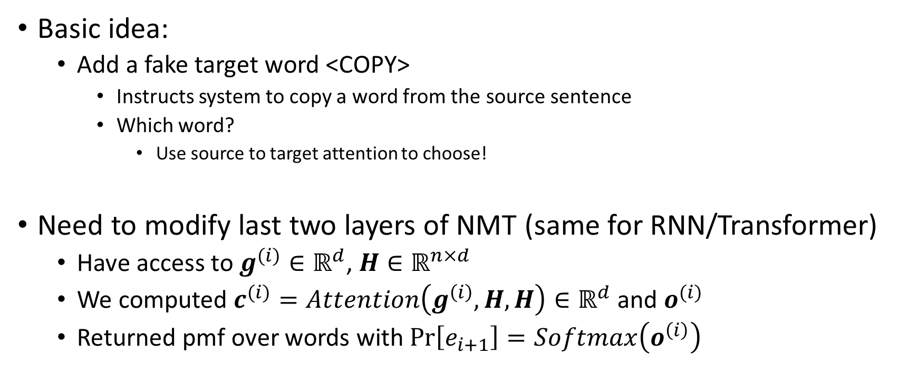
NMT with <COPY>
Basic idea:
Add a fake target word <COPY>
Instructs system to copy a word from the source sentence
Which word?
Use source to target attention to choose!
Need to modify last two layers of NMT (same for RNN/Transformer)
Have access to $g^{(i)}∈ℝ^{d}$, $H∈ℝ^{n×d}$
We computed $c^{(i)}=Attention\left(g^{\left(i\right)}, H, H\right)∈ℝ^{d}$ and $o^{(i)}$
Returned pmf over words with $Pr\left[e_{i+1}\right]=Softmax\left(o^{\left(i\right)}\right)$

Slide 23
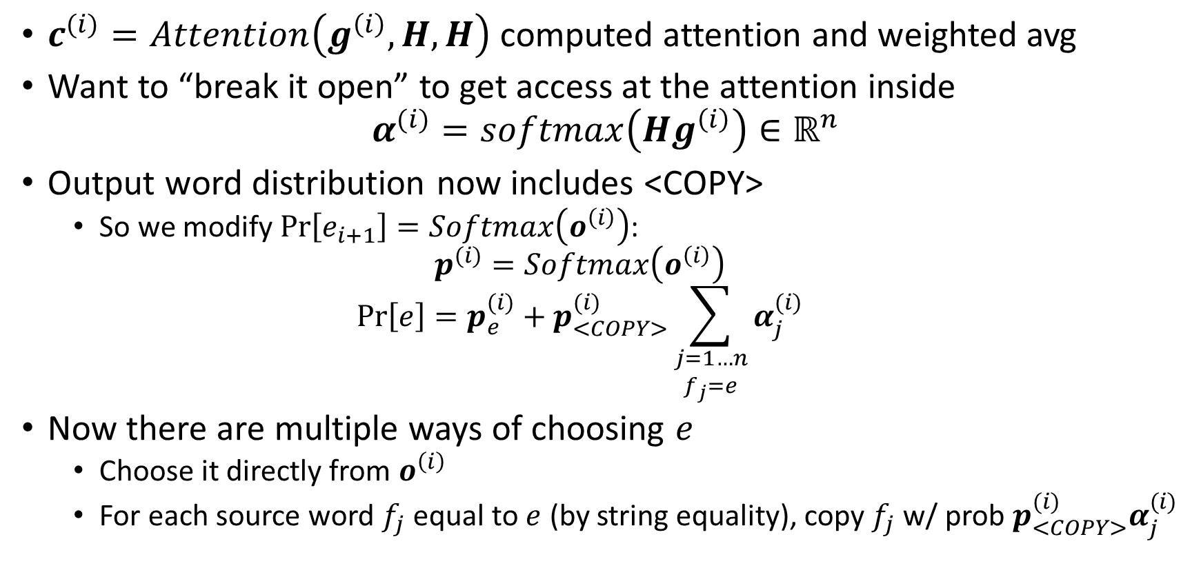
NMT with <COPY>
$c^{(i)}=Attention\left(g^{\left(i\right)}, H, H\right)$ computed attention and weighted avg
Want to “break it open” to get access at the attention inside
$$α^{(i)}=softmax\left(Hg^{\left(i\right)}\right)∈ℝ^{n}$$
Output word distribution now includes <COPY>
So we modify $Pr\left[e_{i+1}\right]=Softmax\left(o^{\left(i\right)}\right)$:
$$p^{(i)}=Softmax\left(o^{\left(i\right)}\right)$$
$$Pr\left[e\right]=p_{e}^{(i)}+p_{<COPY>}^{(i)}\sum_{\begin{aligned}j=1…n \\ f_{j}=e\end{aligned}}{α_{j}^{(i)}}$$
Now there are multiple ways of choosing $e$
Choose it directly from $o^{\left(i\right)}$
For each source word $f_{j}$ equal to $e$ (by string equality), copy $f_{j}$ w/ prob $p_{<COPY>}^{(i)}α_{j}^{(i)}$

Slide 24
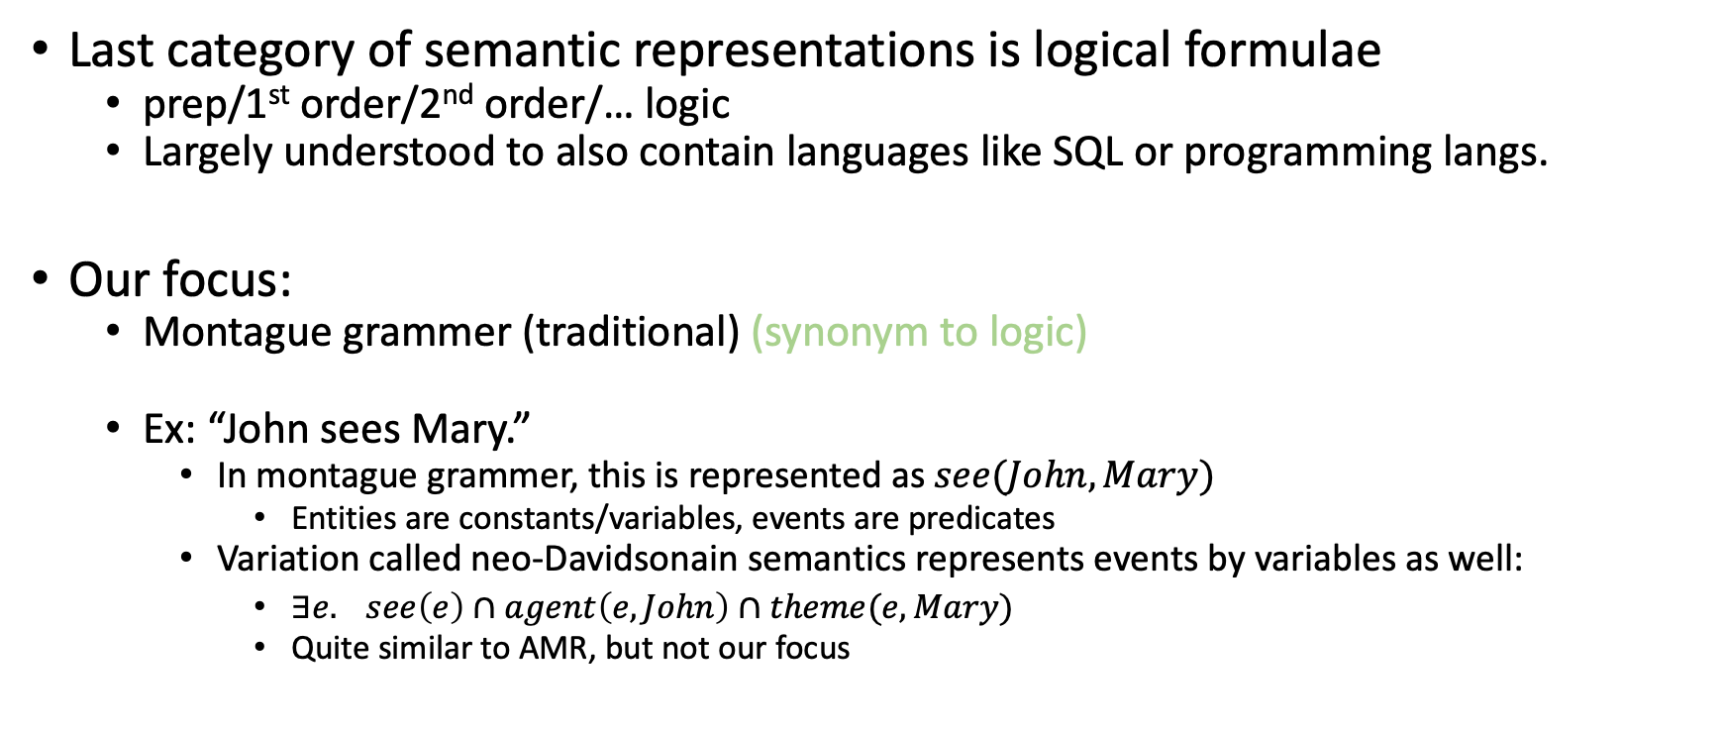
Logic
Last category of semantic representations is logical formulae
prep/1st order/2nd order/… logic
Largely understood to also contain languages like SQL or programming langs.
Our focus:
Montague grammer (traditional) (synonym to logic)
Ex: “John sees Mary.”
In montague grammer, this is represented as $see(John, Mary)$
Entities are constants/variables, events are predicates
Variation called neo-Davidsonain semantics represents events by variables as well:
$∃e. see\left(e\right)∩agent\left(e, John\right)∩theme(e, Mary)$
Quite similar to AMR, but not our focus

Slide 25
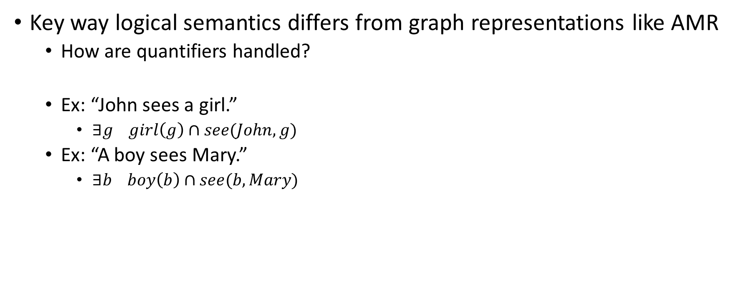
Logic
Key way logical semantics differs from graph representations like AMR
How are quantifiers handled?
Ex: “John sees a girl.”
$∃g girl\left(g\right)∩see(John, g)$
Ex: “A boy sees Mary.”
$∃b boy\left(b\right)∩see(b, Mary)$

Slide 26
How to Compute?
Compositionality:
The meaning of expression is computed from meaning of sub-expressions
Want to write a recursive function that processes a syntax tree bottom-up
function semantics(root)
if root = S and root.children = (NP, VP) then
s1 = semantics(root.children[1])
s2 = semantics(root.children[2])
build s from s1 and s2
return s
else…
Want to associate each rule in a CFG with a little function
This little function computes the semantics of rule from semantics of RHS

Slide 27
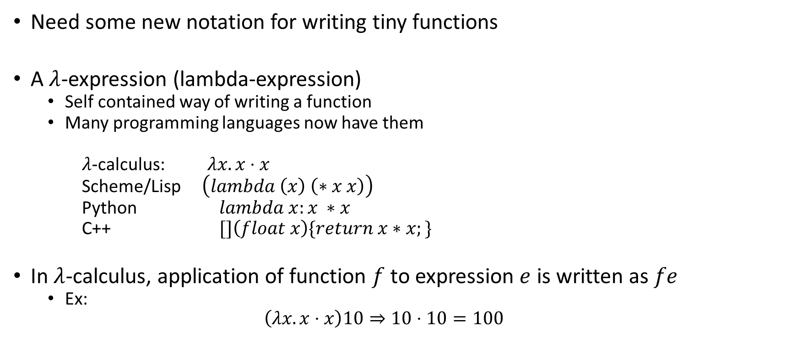
Lambda Calculus
Need some new notation for writing tiny functions
A $λ$-expression (lambda-expression)
Self contained way of writing a function
Many programming languages now have them
$λ$-calculus: $λx.x⋅x$
Scheme/Lisp $\left(lambda \left(x\right) \left(∗x x\right)\right)$
Python $lambda x:x ∗x$
C++ $[]\left(float x\right)\{return x∗x;\}$
In $λ$-calculus, application of function $f$ to expression $e$ is written as $fe$
Ex:
$$\left(λx.x⋅x\right)10⇒10⋅10=100$$

Slide 28
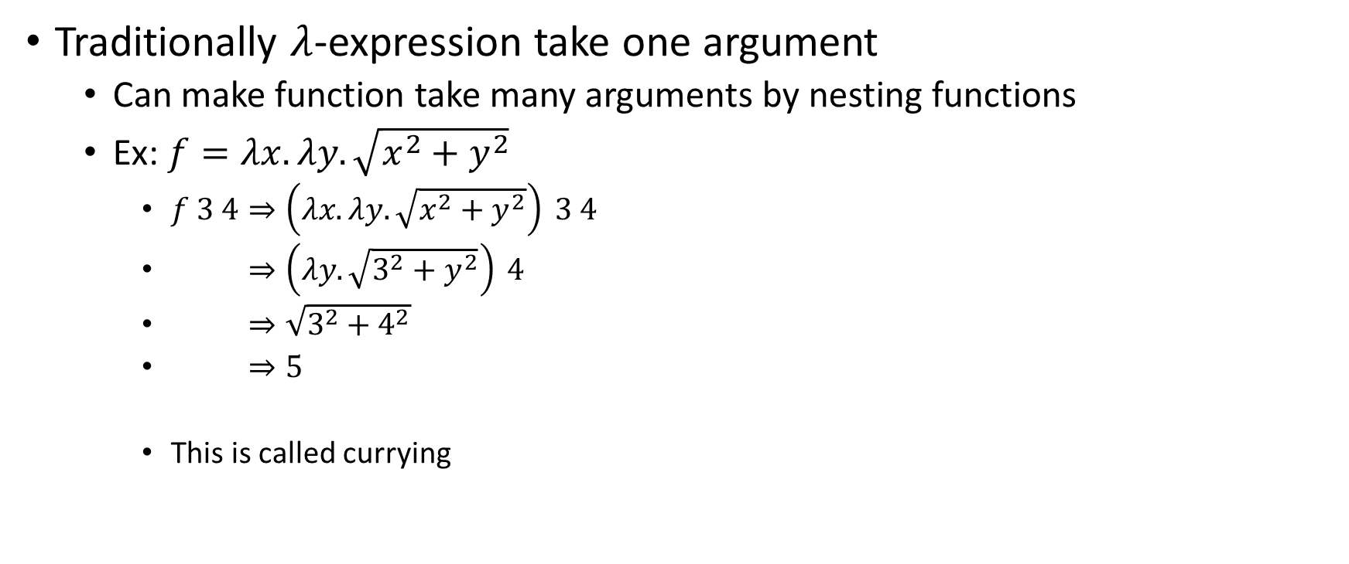
Lambda Calculus
Traditionally $λ$-expression take one argument
Can make function take many arguments by nesting functions
Ex: $f=λx. λy. \sqrt{x^{2}+y^{2}}$
$f 3 4⇒\left(λx. λy. \sqrt{x^{2}+y^{2}}\right) 3 4$
$⇒\left(λy. \sqrt{3^{2}+y^{2}}\right) 4$
$⇒\sqrt{3^{2}+4^{2}}$
$⇒5$
This is called currying

Slide 29
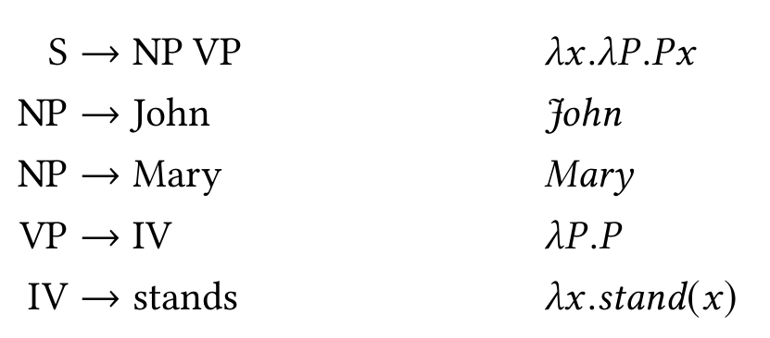
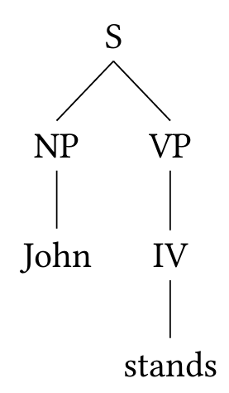
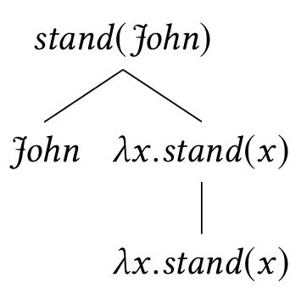
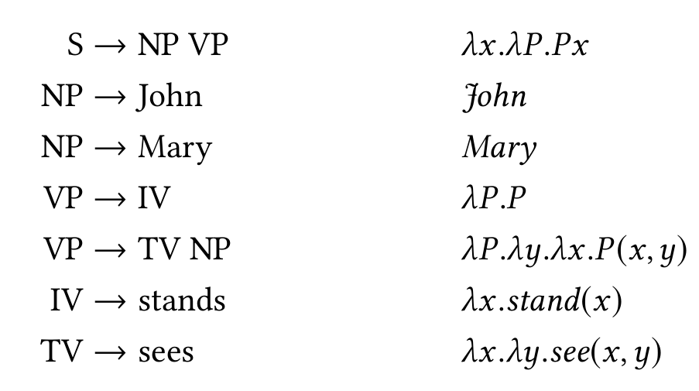
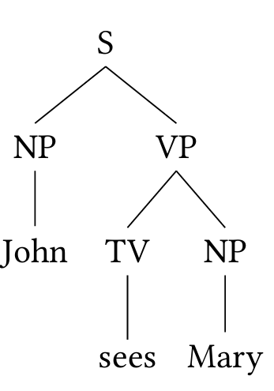
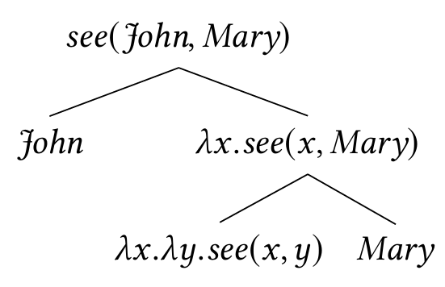

CFG & Lambda Calculus
Associate each rule in a CFG with a $λ$-expression
Ex:
$λ$-expression computes semantics of the LHS of a rule in terms of semantics of RHS
From this parse tree:
With a more rich grammar, richer semantics
Ex:

Slide 30
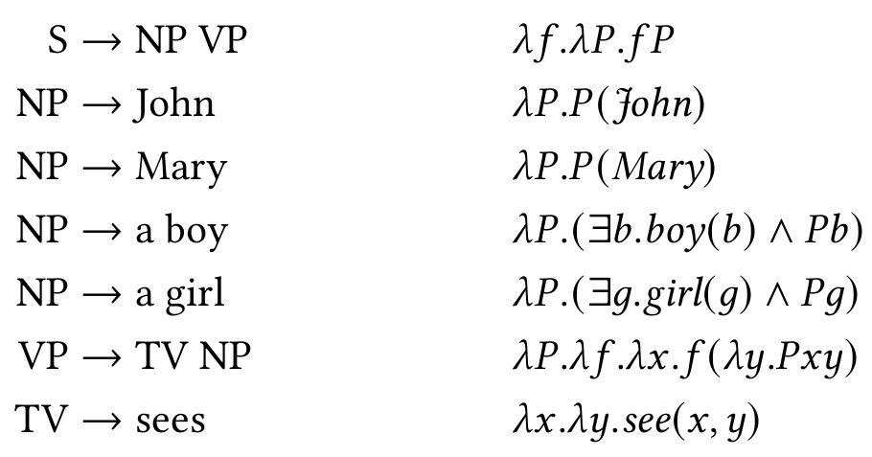
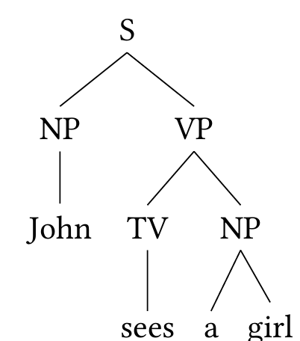
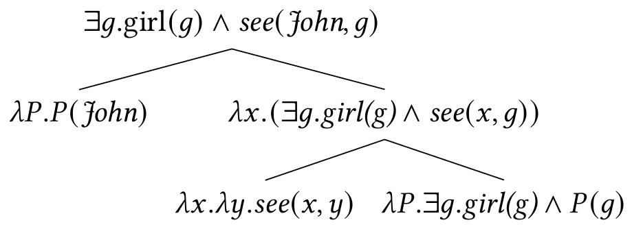


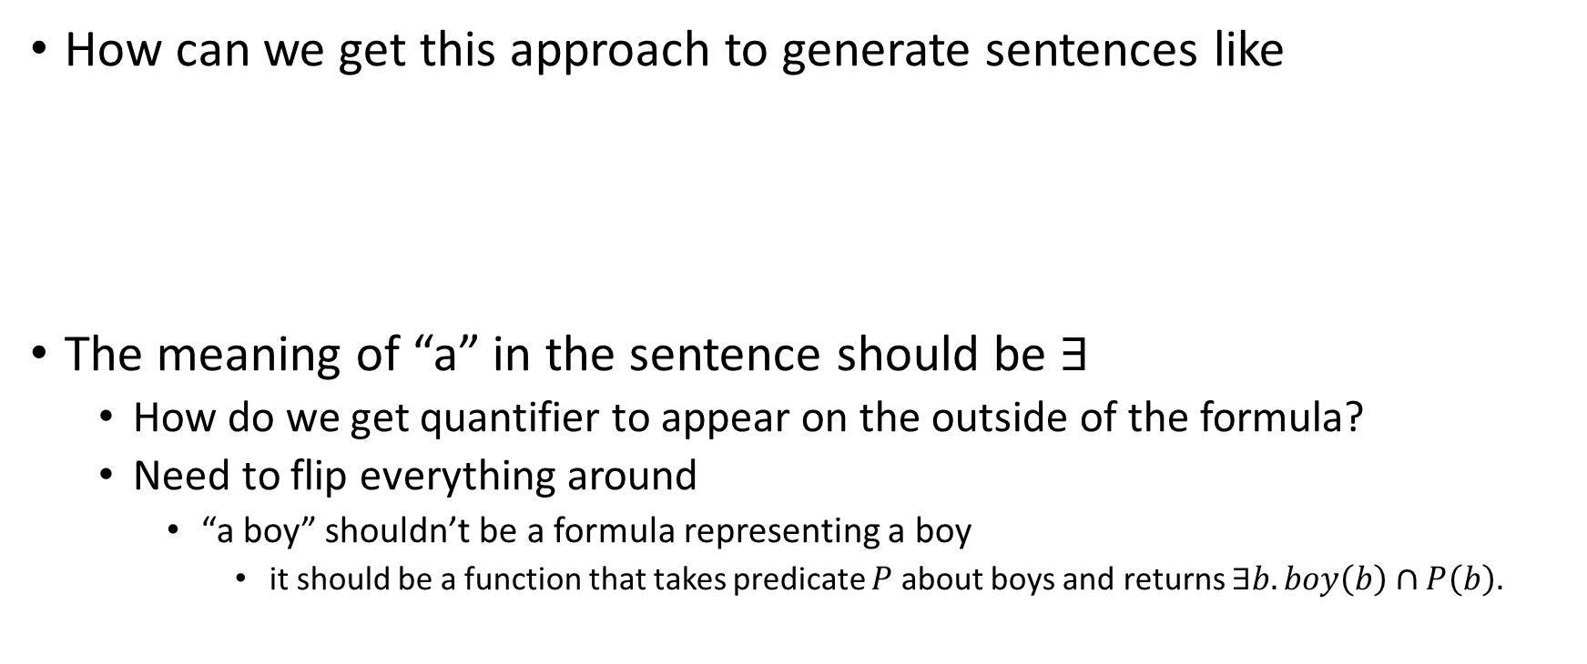
CFG & Lambda Calculus
How can we get this approach to generate sentences like
The meaning of “a” in the sentence should be $∃$
How do we get quantifier to appear on the outside of the formula?
Need to flip everything around
“a boy” shouldn’t be a formula representing a boy
it should be a function that takes predicate $P$ about boys and returns $∃b.boy\left(b\right)∩P\left(b\right).$
“John sees a girl.”
“A boy sees Mary.”

Slide 31


VP Currying
The currying of VP is particularly difficulty
$$\left(λP. λf. λx. f\left(λy. Pxy\right)\right)\left(λx. λy. see\left(x,y\right)\right)\left(λP.\left(∃g.girl\left(g\right)∩P g\right)\right)$$
$$\left(λf. λx. f\left(λy. \left(λx. λy. see\left(x,y\right)\right) x y\right)\right)\left(λP.\left(∃g.girl\left(g\right)∩P g\right)\right)$$
$$\left(λf. λx. f\left(λy. \left(λy. see\left(x,y\right)\right) y\right)\right)\left(λP.\left(∃g.girl\left(g\right)∩P g\right)\right)$$
$$\left(λf. λx. f\left(λy. see\left(x,y\right)\right)\right)\left(λP.\left(∃g.girl\left(g\right)∩P g\right)\right)$$
$$λx.\left(λP.\left(∃g.girl\left(g\right)∩P g\right)\right)\left(λy.see\left(x,y\right)\right)$$
$$λx.\left(∃g.girl\left(g\right)∩\left(λy.see\left(x,y\right)\right)g\right)$$
$$λx.\left(∃g.girl\left(g\right)∩see\left(x,g\right)\right)$$

Slide 32
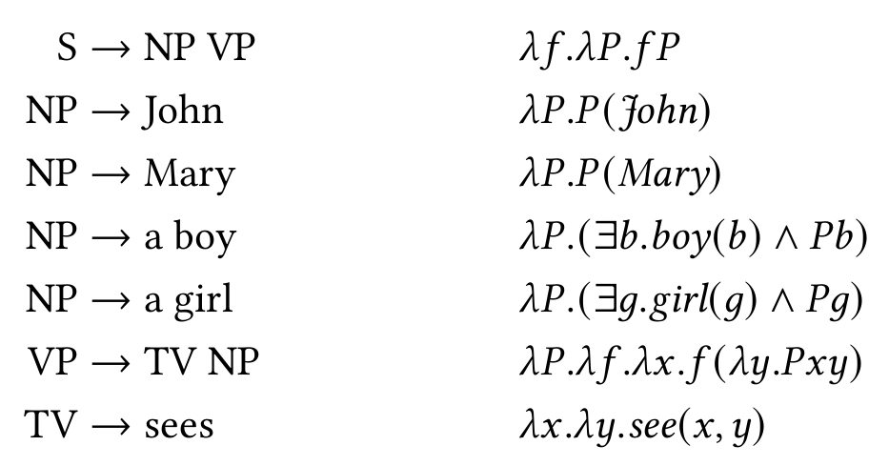
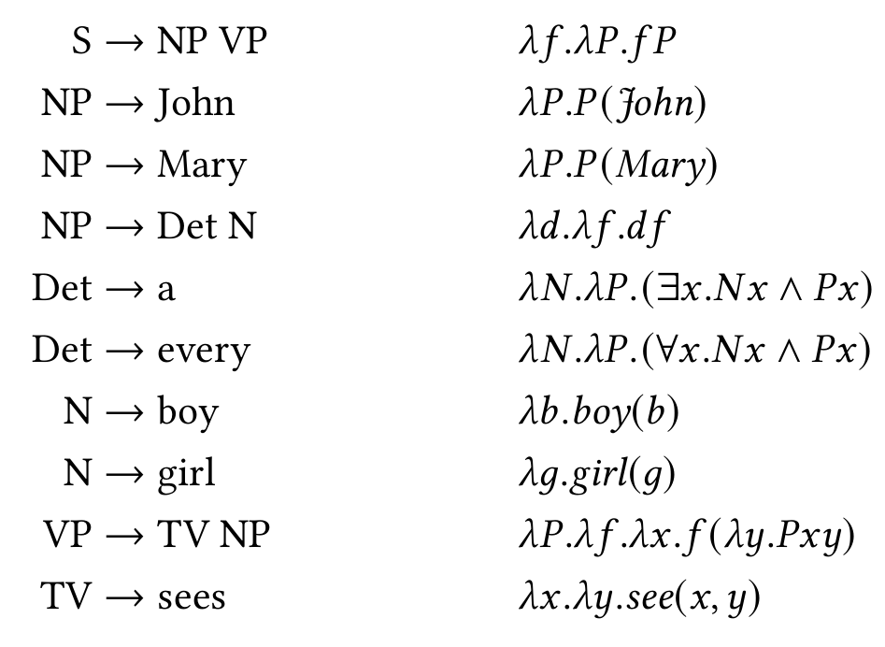
Giving “a”/“every” its own Semantics

