Slide 1
Generation II

Slide 2
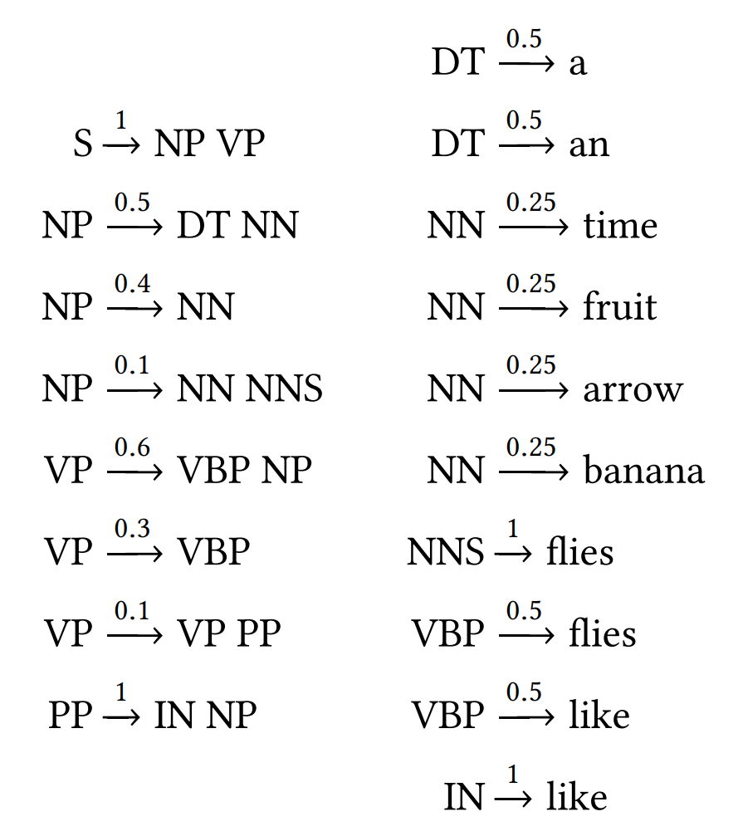
Context Free Grammars
Remember productions are in CNF
If the RHS has 1 symbol it’s a terminal
If the RHS has > 1 symbol they’re both nonterminals
Use grammars to build weighted Trees
When we’re given a sequence
What’s the highest weighted parse?
Does a parse exist?

Slide 3
Sequence Completion
Godzilla
Redacted
the town
V
VP
Let’s say you’re presented with a sequence
For now, let’s say only one element in the sequence is “masked” away
You know something goes there, but you don’t have access to what
Is this missing element a terminal?
Is this missing element itself a sequence?
For now, let’s make the problem easier:
You’re supplied with the nonterminal that goes there (like POS tag)
Need to fill in (“complete”) the sequence with terminals?
How?

Slide 4
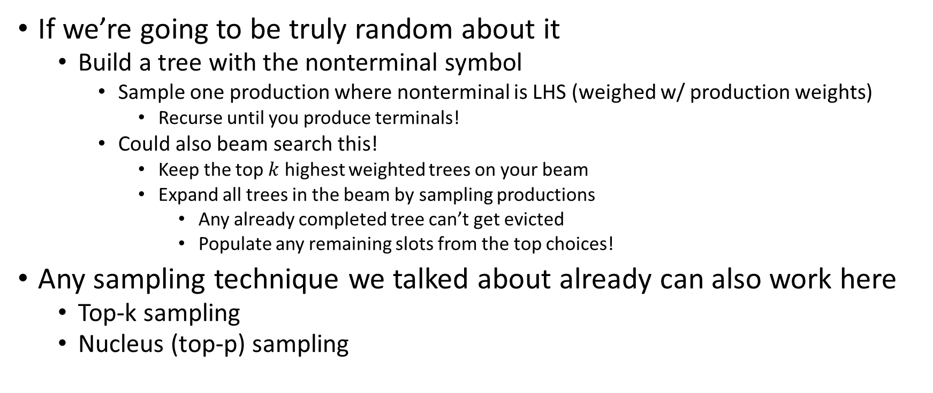
Tree Sampling
Godzilla
Redacted
the town
V
VP
If we’re going to be truly random about it
Build a tree with the nonterminal symbol
Sample one production where nonterminal is LHS (weighed w/ production weights)
Recurse until you produce terminals!
Could also beam search this!
Keep the top $k$ highest weighted trees on your beam
Expand all trees in the beam by sampling productions
Any already completed tree can’t get evicted
Populate any remaining slots from the top choices!
Any sampling technique we talked about already can also work here
Top-k sampling
Nucleus (top-p) sampling

Slide 5
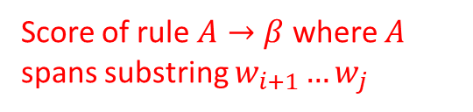
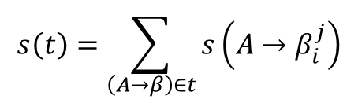
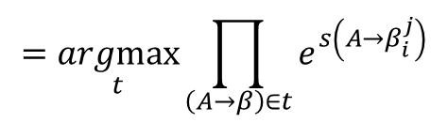

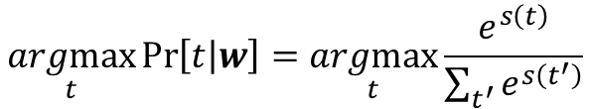
Tree Sampling
$$s\left(t\right)=\sum_{\left(A→β\right)∈t}{s\left(A→β_{i}^{j}\right)}$$
Score of rule $A→β$ where $A$ spans substring $w_{i+1}…w_{j}$
Do the weights need to be probabilities?
No!
Remember neural parsing
The weights were just scores
So when sampling and need to choose stochastically:
Softmax scores -> pmf!
If we throw out probabilities, can we add other “features” to generation?
If we can score them, we can include them!
$$\underset{t}{argmax}{\operatorname{Pr}\left[t | w\right]}=\underset{t}{argmax}{\frac{e^{s\left(t\right)}}{\sum_{t^{′}}{e^{s\left(t^{′}\right)}}}}$$
$$=\underset{t}{argmax}{e^{s\left(t\right)}}$$
$$=\underset{t}{argmax}{\prod_{\left(A→β\right)∈t}{e^{s\left(A→β_{i}^{j}\right)}}}$$

Slide 6
Q/A
Sequence completion not very good for generating answers
Typically sentence completion doesn’t work well
Complete the sentence where the first half is the question?
Q/A needs conditional information
Question depends on the answer
What do we mean?
Neural networks capture this (somehow)
Since we have a grammar, we need to do it outselves

Slide 7
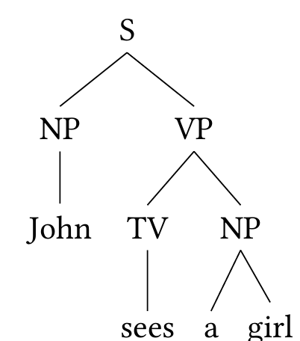
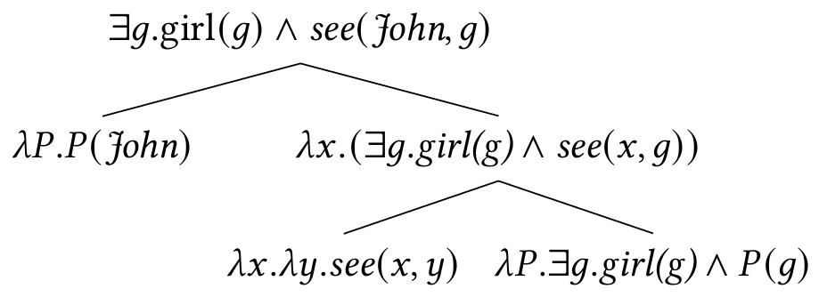

Topic Modeling
We already talked about topic modeling
One important application is sentiment analysis
Most common:
What “emotion” is being conveyed?
Answers typically depend on
The subject of the question
The action of the question
The direct object of the question
The sentiment of the question
We can do most of these with first order logic
In English, subject comes before direct object
First order logic removes ambiguity
“A boy sees Mary.”

Slide 8
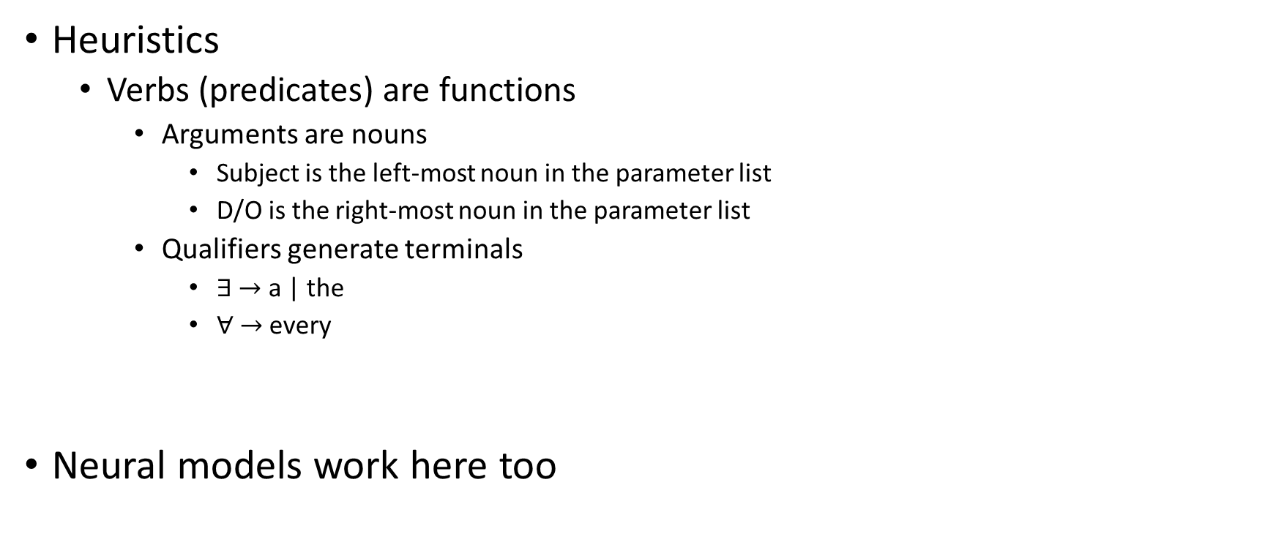
Natural Language from FOL
Heuristics
Verbs (predicates) are functions
Arguments are nouns
Subject is the left-most noun in the parameter list
D/O is the right-most noun in the parameter list
Qualifiers generate terminals
$∃ →$ a | the
$∀ →$ every
Neural models work here too

Slide 9
Q/A
If we build a “language model” for sentiments in Q/A
What sentiments come after what sentiments
What dialogue acts come after what dialogue acts
A dialogue act is the indivisible “topic” of a chunk of text
Suggest
Offer
Ellicit-Inform
Stall
Be-Positive
Be-Negative
We need a way to convert FOL sentences into other FOL sentences

Slide 10
FOL -> FOL
Most people solve this with a Knowledge Base
Not the same thing as AMR
If we have a ton of FOL sentences stored about our world
This is called a knowledge base
Goal: When we observe a new FOL sentence
Try to infer other sentences from our KB

Slide 11
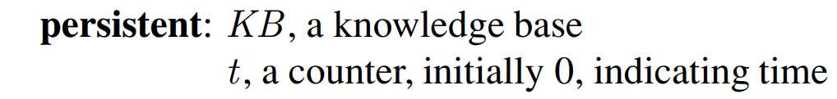
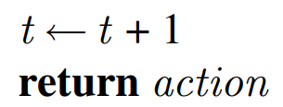
Logical Agents
Two primary operations:
TELL
Add new sentences to KB
ASK
Query what is known
Need:
Internal representation of “the stuff”
Ways to manipulate “the stuff”
Internal Mechanism:
Knowledge Base
A set of sentences
Each sentence written in a “knowledge representation language”
Manipulating Sentences:
Derive new sentences from existing ones
Base case: axioms = sentences assumed to be true without derivation

Slide 12
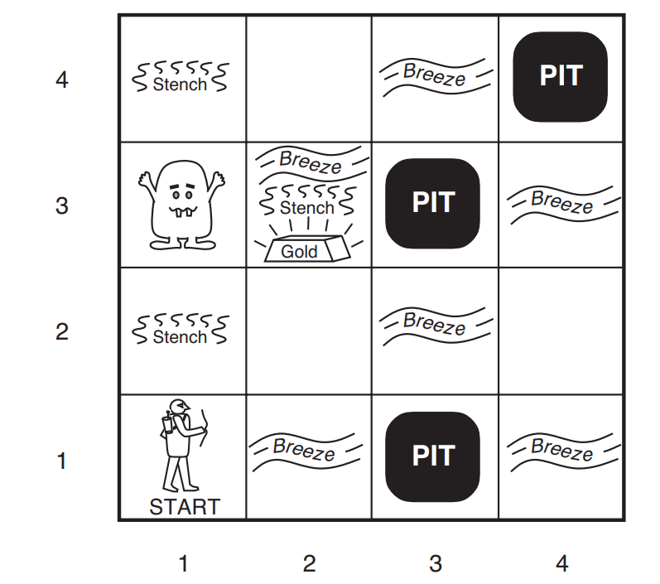
Example World
y
Performance Measure:
+1000 when escaping w/ gold
-1000 for dying (falling into pit / eaten)
-1 for each action taken
-10 using your only arrow
Environment:
4x4 grid
Agent always starts in (1,1)
Gold + Wumpus chosen randomly (uniformly) from squares not (1,1)
Pit appears in each square with prob 0.2
Actions:
Go forward 1 square
Turn left/right by 90 degrees
Sensing:
Squares adjacent to Wumpus have stenches
Squared adjacent to pits have breezes
Square with gold in it is glittery
Bump when agent walks into a wall
Wumpus emits a scream when killed (heard anywhere)
x
Percept(t) = [Stench, Breeze, Glitter, Bump, Scream]

Slide 13
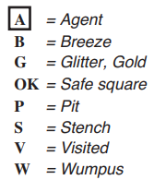
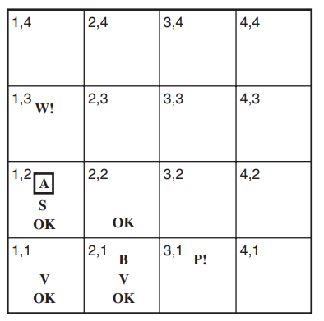
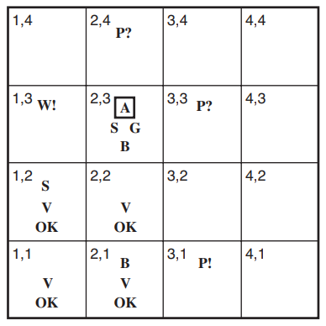
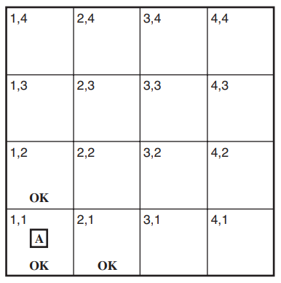
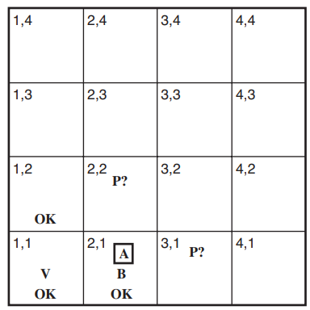
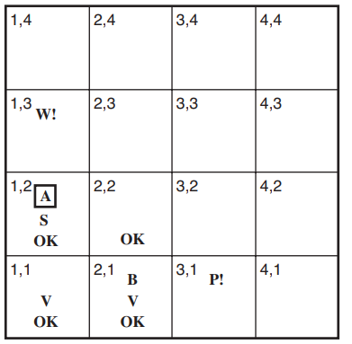
Inference in The Wumpus World
Legend
Stench
Breeze
Glitter
Bump
Scream
Percept(0) = [None, None, None, None, None]
Percept(1) = [None, Breeze, None, None, None]
Percept(3) = [Stench, None, None, None, None]

Slide 14
Logic Representation
# pros
# amateurs
Consider sentence $x+y=4$
Sentence is true when there are 4 people
All possible models:
All possible # pros & # amateurs
Sentence is only true for some of them
Model fixes truth of this sentence
Knowledge is a collection of sentences
Each sentence must have syntax
Grammer
Is a sentence well formed?
Each sentence must have semantics
Apply a sentence to a world
Determine if that sentence is true (holds) or not given a world
Could be a hypothetical world!
A model in Logic
A hypothetical world
If sentence $α$ is true in model $m$:
$m$ satisfies $α$
$M(α)$ = (set of) all models that satisfy $α$

Slide 15
Reasoning
All possible Models
$M\left(β\right)$
$M\left(α\right)$
Now we have a notion of “truth”
Want to relate two sentences to each other
If sentence $α$ logically follows from sentence $β$:
$$α \left|=\right. β$$
Every model in which $α$ is true, $β$ is also true
$$α \left|=\right. β iff M\left(α\right)⊆M\left(β\right)$$

Slide 16
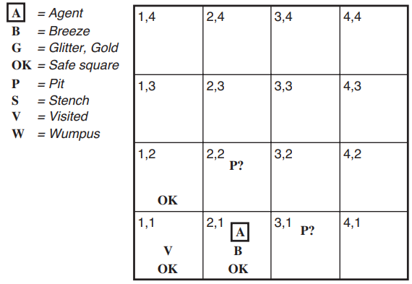
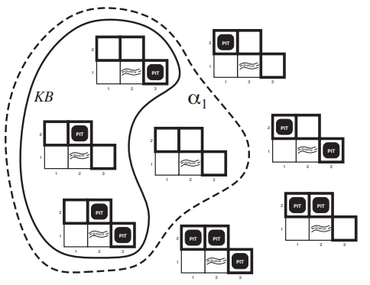
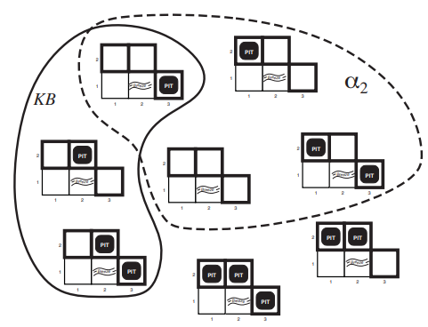
Models & The Wumpus World
KB (so far):
Precepts
Rules (axioms) of Wumpus World
Consider two possible conclusions:
$α_{1}$= “There is no pit in (1,2)”
$α_{2}$= “There is no pit in (2,2)”
$$KB\left|=\right. α_{1}$$
$α_{1}$ is true (and should be added to KB)
$$!(KB\left|=\right. α_{2})$$
$α_{2}$ is not known to be true

Slide 17
Entailment & Inference
Properties of Inference algorithms:
Soundness
Only derive entailed sentences
Completeness
Can derive every entailed sentences
Goal:
Find sentences that are entailed by our KB
Add them to our KB
How?
Algorithm from past slide is called model checking
Enumerate every possible model & check!
Calculate if $M\left(KB\right)⊆M\left(α\right)$ by brute force
Inference algorithm tries to derive sentences that are entailed by KB
Lets differentiate entailment from derivation
If inference algorithm $A$ can derive $α$ from $KB$:
$$KB \left|−_{A}\right. α$$

Slide 18
Sentence Structure: Prepositional Logic
Two kinds of prepositional logic sentences:
Atomic sentences:
A single prepositional symbol
True/False
Variable
Complex sentences:
Atomic sentences connected via operators (and paranthases):
Not $¬$
And $∩$
Or $∪$
Implies $⟹$
Iff $⟺$

Slide 19
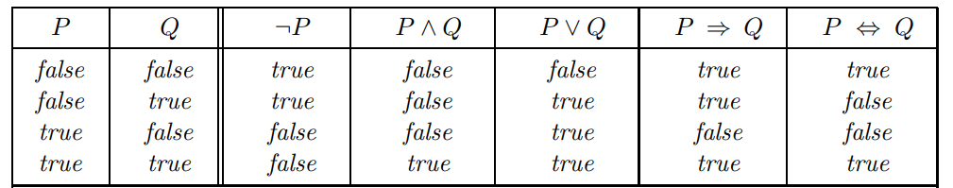
Prepositional Logic
Semantics
Each model fixed truth value (True/False) for every variable
Can evaluate truth value of sentences for a model

Slide 20
Prepositional Sentences + Wumpus World
Need lots of variables:
Variables for percepts:
$S_{1,1}, S_{1,2}, …, S_{4,4}$
$B_{1,1}, B_{1,2}, …, B_{4,4}$
${Glitter}_{1,1}, {Glitter}_{1,2}, …, {Glitter}_{4,4}$
…
Variables for Unknowns
$W_{1,1}, W_{1,2}, …, W_{4,4}$
$P_{1,1}, P_{1,2}, …, P_{4,4}$
${Gold}_{1,1}, {Gold}_{1,2}, …, {Gold}_{4,4}$
Complex sentences:
Axioms:
$B_{1,1}⟺\left(P_{1,2}∪P_{2,1}\right), …$
$S_{1,1}⟺\left(W_{1,2}∪W_{2,1}\right), …$
$…$
y
x

Slide 21
KB + Wumpus World
KB starts off with axioms inside it
Also know $¬P_{1,1}$ and $¬W_{1,1}$!
y
KB
$$R_{1}:¬P_{1,1}$$
$$R_{2}:B_{1,1}⟺\left(P_{1,2}∪P_{2,1}\right)$$
$$R_{3}:B_{2,1}⟺\left(P_{1,1}∪P_{2,2}∪P_{3,1}\right)$$
Stench
Breeze
x
Scream
$$…$$
Glitter
Bump
Percept(0) = [None, None, None, None, None]
Constructed sentences:
$¬S_{1,1}$
$¬B_{1,1}$
…
Add to KB

Slide 22
Inference
The goal is to derive some new sentences $α$ to add to our KB
Want to derive $α$s that are entailed from our KB!
How?
Model checking = truth table enumeration
Tree search?
Exponential for prepositional logic (co-NP-complete)
Theorem proving!
Math on logic sentences
Two sentences $α,β$ are logically equivalent iff true in the same models:
$$α\overline{=}β⟺α \left|=\right. β∩β \left|=\right. α$$
A sentence is valid iff it is true in all models (i.e. tautology)
A sentence $α$ is satisfiable iff $∃ m∈\left|M\left(α\right)\right|>0$

Slide 23
Theorem Proving
For any $α,β$:
$$α \left|=\right. β⟺\left(a⟹β\right) is valid$$
We can check if $α \left|=\right. β$ by checking that $\left(a⟹β\right)$is true in every model!
For any $α,β$:
$$α \left|=\right. β⟺\left(a∩¬β\right) is unsatisfiable$$
We can check if $α \left|=\right. β$ by checking that there is no model that satisfies $\left(a∩¬β\right)$
Proof by contradiction

Slide 24


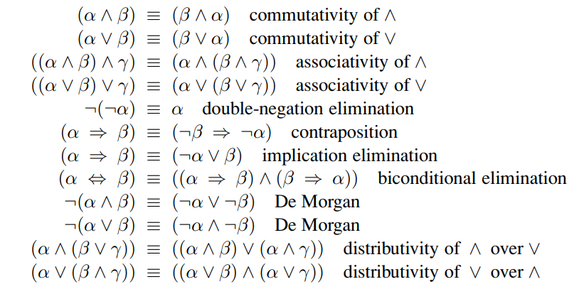
Inference Rules
Know this to be true
Also know this to be true
Modus Ponens:
And-Elimination
These two rules are Sound!
Avoid enumerating models!
Infer this!
Logical equivalence

Slide 25
Using Inference Rules
KB
$$R_{1}:¬P_{1,1}$$
$$R_{2}:B_{1,1}⟺\left(P_{1,2}∪P_{2,1}\right)$$
$$R_{3}:B_{2,1}⟺\left(P_{1,1}∪P_{2,2}∪P_{3,1}\right)$$
y
$$R_{4}:¬B_{1,1}$$
Is there a pit in (1,2)?
$$…$$
$$R_{2}:B_{1,1}⟺\left(P_{1,2}∪P_{2,1}\right)$$
$$\left(B_{1,1}⟹\left(P_{1,2}∪P_{2,1}\right)\right)∩\left(\left(P_{1,2}∪P_{2,1}\right)⟹B_{1,1}\right)$$
x
$$\left(P_{1,2}∪P_{2,1}\right)⟹B_{1,1}$$
$$¬B_{1,1}⟹¬\left(P_{1,2}∪P_{2,1}\right)$$
$$¬\left(P_{1,2}∪P_{2,1}\right)$$
$$¬P_{1,2}$$
$$¬P_{1,2}∩¬P_{2,1}$$

Slide 26
Inference Algorithms
Use any search algorithm
Proof problem:
Initial state = initial KB
Actions = all inference rules applied to all sentences that match the top half of inference rule
Result of applying an action = add the sentence in the bottom half of the inference rule to the KB
Goal = state that contains the sentence we are trying to prove!
Searching for proof = enumerating all possible models!
More efficient
Ignoring irrelevant variables

Slide 27




Completeness?
Also know this
Lets say we know this
So far we have a sound inference procedure
Is it complete?
No
Cannot “resolve” disjunctions (ors)
Resolution inference rule
Resulting clause should only have one copy per literal (variable)
Now our inferences are complete
Can infer this!

Slide 28

Conjunctive Normal Form
Resolution only applies to disjunctions
Good news!
Every sentence can be converted into a conjunction of clauses!
Might look ugly to us, but search algorithm doesn’t care!

Slide 29
Proving via Resolution
Turns out all we need is resolution (to prove if $KB\left|=\right. α$)
Convert $KB∩¬α$ into CNF
Apply resolution to resulting clauses
Each pair of clauses that contains complimentary literals produces new clauses
Repeat until one of two outcomes occurs:
No new clauses → KB does not entail $α$
Two clauses resolve to the empty clause → KB entails $α$

Slide 30
















Example
KB =
$α$ =
$KB∩¬α$:
CNF of $KB∩¬α$:
{}

Slide 31



Prepositional Logic Resolution Algorithm

Slide 32

All We Need is Resolution
All we need is Resolution
Convert $KB∩¬α$ to CNF
Resolution on CNF form

Slide 33

Further Optimization
In many KBs
All sentences have the same template
Definite clause(s) appear all the time
Disjunction where only one literal is positive
Horn clause(s) appear all the time
Disjunction where at most one literal is positive
Definite clauses are Horn clauses
Clauses with no positives = goal clauses
If you resolve two Horn clauses, the result is a Horn clause!

Slide 34



Horn Clauses
Why are these so popular?
Remember logical equivalency!
Horn clauses are implication sentences!
Axioms are typically implications!
Sentence that is just a literal?
Perceptions typically written this way
Called a “fact”
Can also be written as a Horn clause!
Horn clause!
To CNF
premise
head

Slide 35
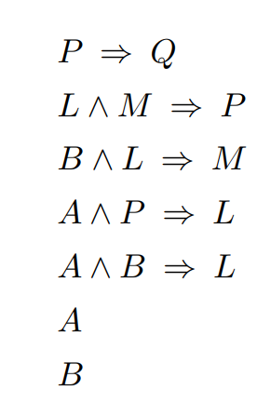
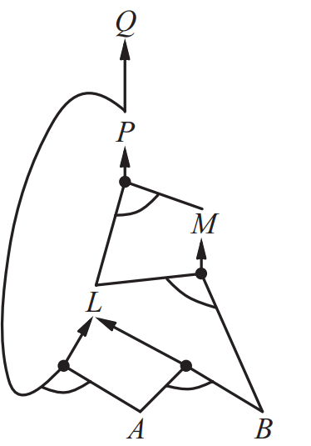
Inference w/ Horn Clauses
KB
Can be crazy efficient
Forward-chaining & backward-chaining algorithms
If everything is a Horn clause (implies)
Don’t need to do resolution at all!
Forward chaining (try to derive query sentence $q$)
Begin with known facts
For every implication where the premise is met:
Add conclusion (head) of implication as a fact to the KB
Repeat until $q$ is added to KB or no further implications!
Runs in linear time!
Data-driver Reasoning
Start with what you know: infer what you don’t
Work your way up!
“or”
“and”
Start here!
AND-OR graph

Slide 36



Forward-Chaining
Sound & Complete!
Rules can by cyclic!
Don’t add variables back to the Queue if we’ve processed them!

Slide 37
Forward-Chaining in the Wumpus World
Whenever we get some new perceptions:
Engineer the KB to write axioms as implications
Add variables for the location of the agent!
Add the facts to the KB
Run Forward-Chaining to derive all new facts!
Humans do Forward-Chaining
Keep it under control though
Don’t need to try to derive every new fact

Slide 38
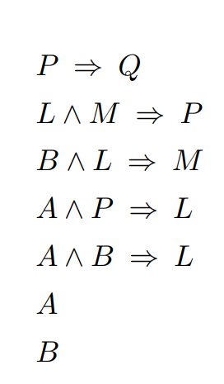
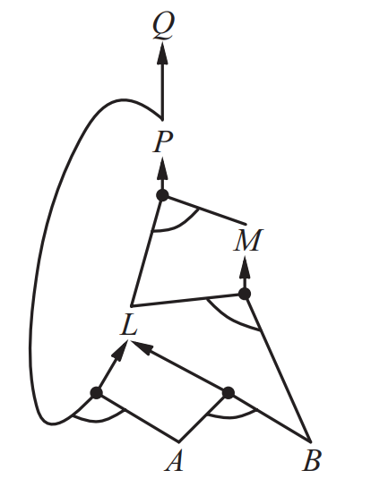
Backward-Chaining
Start here!
(try to derive query sentence $q$)
Work backwards (instead of forwards)
Find implications in KB whose conclusion is $q$
Try to prove premises are true (via backward chaining)
If one premise is true, then $q$ is true!
Also runs in linear time!
Goal-directed reasoning:
Start with what you want: derive what you know
Often sublinear: only touches relevant facts
Work your way down!

Slide 39
Prepositional Logic & The Wumpus World
Chapter 7.7
Lots of details on how to build axioms & notion of time
TLDR: it takes quite a bit of engineering
Generally sucks
We’re going to move on to a more expressive language
Easier for us to write (more powerful) sentences

Slide 40
First Order Logic
Prepositional logic has some nice properties
Declarative
Knowledge and inference are separate things
Knowledge (i.e. sentences) declare things to be true/false
Inference is domain independent!
Compositionality
Sentence meaning is a function of its parts
Prepositional logic is not concise
Lots
And lots
And lots of sentences

Slide 41
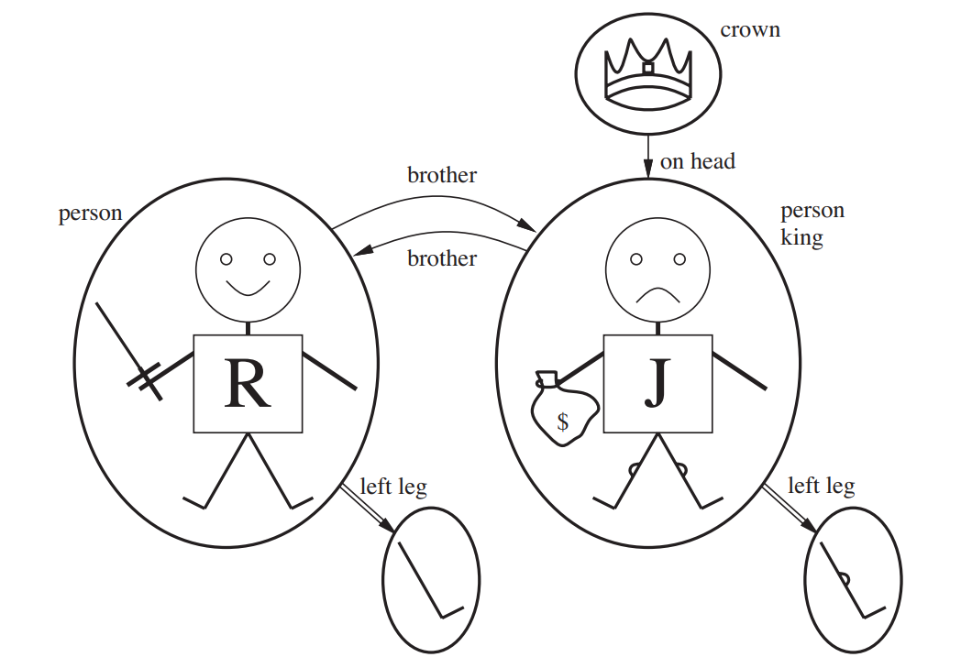
FOL Models
Logical languages have models:
Hypothetical worlds
Links the vocabulary to elements
Determine the truth of sentence(s)
Models in FOL:
Have objects in them
Domain of a model = set of objects (domain elements) it contains
Objects can be related:
Relation is the set of tuples of objects that are related
Brotherhood = {(Richard, John), (John, Richard)}
OnHead = {(crown, John)}

Slide 42
FOL Models
Some Relations are Functions
An object is related to exactly one other object in a certain way
People only have one left leg
LeftLeg:
(Richard) -> Richard’s left leg
(John) -> John’s left leg
Functions in FOL must be total
Must be a value for every input tuple
Must be a left leg for the crown!
Each left leg has a left leg!
Add an “invisible” object for base case
Left leg for everything that doesn’t have one
Left leg of it is itself

Slide 43
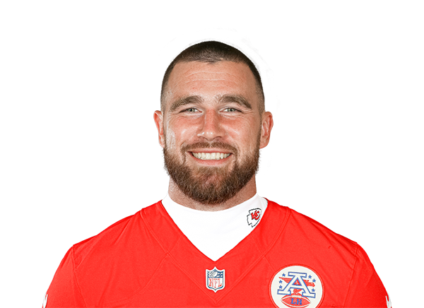
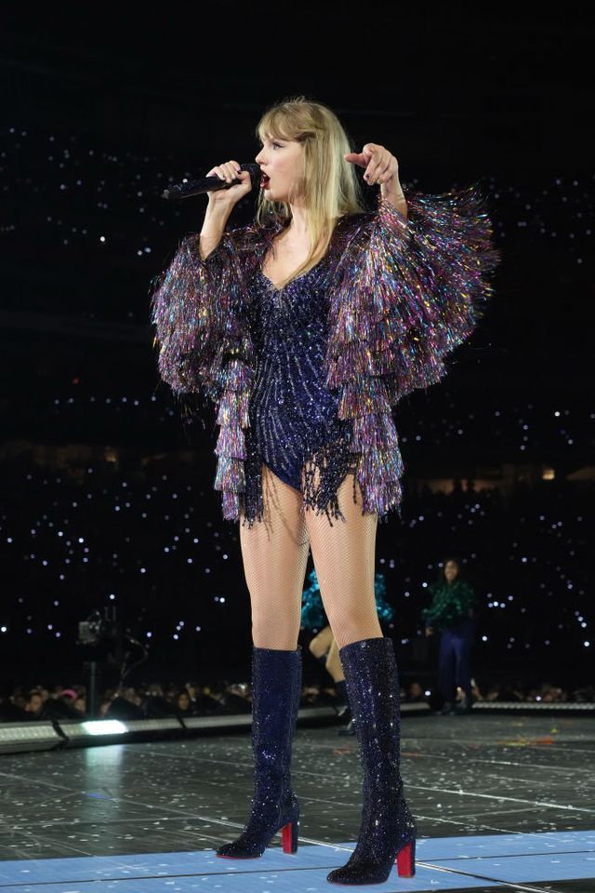
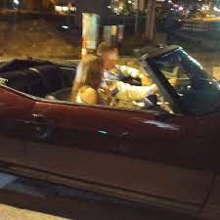
FOL Models
Logical languages have models:
Hypothetical worlds
Links the vocabulary to elements
Determine the truth of sentence(s)
Models in FOL:
Have objects in them
Domain of a model = set of objects (domain elements) it contains
Objects can be related:
Relation is the set of tuples of objects that are related
Driving = {(Travis, Getaway Car)}
Dating = {(Taylor, Travis), (Travis, Taylor)}
Holding = {(Microphone, Taylor)}

Slide 44
FOL Models
Some Relations are Functions
An object is related to exactly one other object
Driving is a function!
Only drive one thing (at a time)
Functions in FOL must be total
Must be a value for every input tuple
Taylor must be driving something!
The thing that Taylor is driving must be driving something!
Add an “invisible” object for base case
Stands for “nothing”
Taylor is driving nothing
Nothing is driving nothing

Slide 45
FOL Syntax
Types of symbols in the language:
Constants (objects)
Predicates (relations)
Functions
Convention in FOL is to start symbols with capital letters
Predicate/Function symbols have arity
Number of arguments

Slide 46
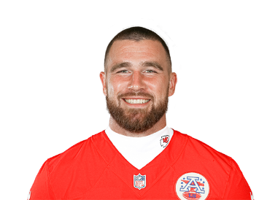

FOL Syntax & Models
Every model must map symbols to objects (in the model)
Called an “interpretation” of the symbols
Don’t need to name all objects in the model
Can assign multiple symbols to the same object
Remember, it’s the KBs job to rule out inconsistent models!
Lots of models are garbage
Logic Symbols
$$m_{1}$$
$$m_{2}$$
Travis
Taylor
Getaway Car
Travis
Taylor
Getaway Car
Model Objects
…

Slide 47
Good News
Can bring lots over from prepositional logic
Entailment
Validity
Etc.
Term
Logical expression that refers to an object
Constant symbols are terms
$$John$$
$$LeftLeg(John)$$
This is not a function call, it’s a name!
Can reason about left legs without defining $LeftLeg$

Slide 48



FOL Syntax
Atomic sentences (atom)
State facts
Predicate symbol (optionally w arguments)
Can be true/false in a given model
If relation referred by predicate holds among the objects referred by the arguments
Is $\left(Taylor, Travis\right)∈Dating$?
Complex sentences
Logical operators
Same as prepositional logic!
Quantifiers
Express properties of collections (rather than enumerating)
$∀$ (forall)
$∃$ (exists)
$$Dating\left(Taylor, Travis\right)$$
variable
$$∃x Microphone\left(x\right)∩Holding\left(x, Taylor\right)$$

Slide 49
FOL Equality
Another kind of atomic sentence
Declare two terms refer to the same object
$$WonGrammy\left(Taylor, 2016\right)=1989 Album$$
$$Championship\left(Travis, 2023\right)=Superbowl LVII Trophy$$
Can rule our models (interpretations) by checking these!
States facts about functions
Want to say:
Andrew has two siblings (I do):
$$∃x,y Sibling\left(x, Andrew\right)∩Sibling\left(y,Andrew\right)$$
$$∃x,y Sibling\left(x, Andrew\right)∩Sibling\left(y,Andrew\right)∩x≠y$$

Slide 50
FOL Sentences can be Tricky
Want to say:
“Andrew has two siblings: Nathaniel and Elizabeth”
Does this work?
$$Sibling\left(Nathaniel, Andrew\right)∩Sibling\left(Elizabeth,Andrew\right)$$
No! Sentence is true for models where I have only one sibling
(Nathaniel & Elizabeth can be mapped to the same object)
Doesn’t rule out models where I am assigned more than two siblings
Correct sentence:
$$Sibling\left(Nathaniel, Andrew\right)∩Sibling\left(Elizabeth,Andrew\right)∩Nathaniel≠Elizabeth∩∀x Sibling\left(x, Andrew\right)⇒(x=Nathaniel∪x=Elizabeth)$$
Easy to make mistakes
Insist that every constant symbol refer to a distinct object (unique-names assumption)
Atomic sentences not known to be true are false (closed-world assumption)
model cannot have more objects than constant symbols (domain closure)
works now!
Database
semantics

Slide 51
FOL Semantics
There is no single correct semantics for FOL
Standard FOL semantics:
Infinite many models
Don’t need to know all symbols beforehand
Database Semantics:
Finite number of models
Need definite knowledge of what the world contains

Slide 52
Using FOL in Agents
Add sentences to KB with TELL routine (just like prep logic)
Sentences called assertions
$TELL\left(KB, Holding\left(Microphone, Taylor\right)\right)$
$TELL\left(KB, Dating\left(Travis, Taylor\right)\right)$
$TELL\left(KB, ∀x Driving\left(x, Getaway Car\right)⇒Person\left(x\right)\right)$
Query the KB with ASK routine
Questions asked are called queries / goals
$ASK\left(KB, Holding\left(Microphone, Taylor\right)\right)$
$ASK\left(KB, ∃x Driving\left(x, Getaway Car\right)\right)$
Sometimes want to know variable values where query is true
ASKVARS routine
$ASK\left(KB, Driving\left(x, Getaway Car\right)\right)$
$ASK\left(KB, ∃y Dating\left(x, y\right)\right)$
Returns true
Returns true
Called “substitution” or “binding list”
Returns [{x/Travis}]
Returns [{x/Travis}, {x/Taylor}]

Slide 53
The Kinship Domain
Lets work through this example:
Add axioms about family tree:
$$∀m, c Mother\left(c\right)⇔Female\left(m\right)∩Parent\left(m,c\right)$$
$$∀w, h Husband\left(h,w\right)⇔Male\left(h\right)∩Spouse\left(h,w\right)$$
$$∀x Male\left(x\right)⇔¬Female\left(x\right)$$
$$∀p,c Parent\left(p,c\right)⇔Child\left(c,p\right)$$
$$∀g, c Grandparent\left(g,c\right)⇔∃p Parent\left(g,p\right)∩Parent(p,c)$$
$$∀x, y Sibling\left(x,y\right)⇔x≠y∩∃p Parent\left(p, x\right)∩Parent(p, y)$$
Theorem (not an axiom):
$$∀x,y Sibling\left(x,y\right)⇔Sibling(y, x)$$
Not all axioms are definitions:
$$∀x Person\left(x\right)⇔…?$$
Good news!
We don’t need a complete definition of $Person$ in order to use it!
We can write partial specifications of properties that every person has
$$∀x Person(x)⇒…$$
We can write partial specifications of properties that make something a person
$$∀x …⇒Person(x)$$

Slide 54
Numbers, Sets, and Lists
We can build large KBs from a tiny amount of axioms
Let’s talk about natural numbers (non-negative ints)
$Natnum$ predicate (i.e. relation)
One constant symbol $0$
One function symbol $S$ (“successor” function)
$$Natnum\left(0\right)$$
$$∀n Natnum\left(n\right)⇒NatNum\left(S\left(n\right)\right)$$
Need some other axioms to constrain $S$
$$∀n 0≠S\left(n\right)$$
$$∀m,n m≠n⇒S\left(m\right)≠S\left(n\right)$$
Naming 0 to be a natural number
If $n$ is a natural number, then so is $S\left(n\right)$, etc.
0 cannot be a successor
Successors of two distinct numbers are distinct

Slide 55
Natural Numbers
$$Natnum\left(0\right)$$
$$∀n Natnum\left(n\right)⇒NatNum\left(S\left(n\right)\right)$$
$$∀n 0≠S\left(n\right)$$
$$∀m,n m≠n⇒S\left(m\right)≠S\left(n\right)$$
With these axioms:
We can define operators!
$$∀m Natnum\left(m\right)⇒+\left(0,m\right)=m$$
$$∀m,n Natnum\left(m\right)∩Natnum\left(n\right)⇒+\left(S\left(m\right),n\right)=S\left(+\left(m,n\right)\right)$$
Once we have addition:
Can do subtraction (addition in negative direction)
Can do multiplication (repeated addition)
Can do division (repeated subtraction)
All of number theory & cryptography are built from these!
Addition!
Adding 0 does nothing!
$$\left(m+1\right)+n=\left(m+n\right)+1$$

Slide 56


Inference in FOL
Universal Instantiation
Existential Instantiation
Inference rules for Quantifiers
Take the following sentence
$$∀x King\left(x\right)∩Greedy\left(x\right)⇒Evil(x)$$
We could now infer:
$$King\left(John\right)∩Greedy\left(John\right)⇒Evil(John)$$
$$King\left(Father\left(John\right)\right)∩Greedy\left(Father\left(John\right)\right)⇒Evil\left(Father\left(John\right)\right)$$
Universal Instantiation (UI):
Infer any sentence obtained for substituting a ground term for a variable
Existential Instantiation (EI)
Infer any sentence obtained for substituting a single new constant symbol
New constant symbol unused anywhere else in the KB
$$∃x Crown\left(x\right)∩OnHead\left(x, John\right)$$
Skolem constant
$$Crown\left(C_{1}\right)∩OnHead\left(C_{1}, John\right)$$
As long as $C_{1}$ does not appear elsewhere in KB!

Slide 57
Inference in FOL
Once we can convert qualified sentences to non-qualified sentences
Prepositional inference applies!
Ex:
$$∀x King\left(x\right)∩Greedy\left(x\right)⇒Evil(x)$$
$$King\left(John\right)$$
$$Greedy\left(John\right)$$
$$Brother\left(Richard, John\right)$$
Apply UI with substitutions $\{x/John\}$ and $\{x/Richard\}$
$$King\left(John\right)∩Greedy\left(John\right)⇒Evil(John)$$
$$King\left(Richard\right)∩Greedy\left(Richard\right)⇒Evil(Richard)$$
KB is now (essentially) prepositional logic
Can infer $Evil(John)$

Slide 58
Inference in FOL
This process is called propositionalization
Big problem:
what happens if we have a function symbol (like $Father$)
This can nest infinitely!
$Father(John)$
$Father\left(Father(John)\right)$
$Father\left(Father\left(Father\left(John\right)\right)\right)$
…
Idea:
Generate all instances with constant symbols (i.e. $John$, etc.)
Generate all instances with depth 1 functional symbols (i.e. $Father(John)$)
Generate all instances with depth 2 functional symbols (i.e. $Father\left(Father(John)\right)$)
…
Stop when you construct a propositional proof of an entailed sentence
Trouble
How do we know if a sentence is not entailed?
Semidecidable: we can’t!

Slide 59
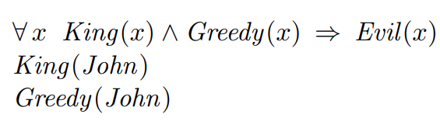

Inference in FOL
Propositionalization isn’t great
Can we do better?
This is obvious to a human
Can we make it obvious to the machine?
Find a substitution $θ$ that makes each conjunct in premise identical to sentences in KB
Then we can assert conclusion!
Suppose our KB was slightly different:
Find substitution for variables in implication sentence and sentences in KB
$\{x/John, y/John\}$ satisfies this!

Slide 60
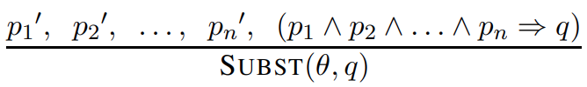
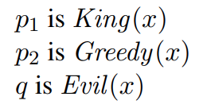
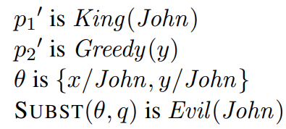
Generalized Modus Ponens
Given atomic sentences $p_{i}, p_{i}^{′}, q$
If there is a substitution $θ$ such that SUBST$(θ,p_{i}^{′})$ = SUBST$(θ,p_{i})$ for all $i$
Generalized Modus Ponens lifts Modus Ponens:
Raises modus ponens from prep logic to FOL
Can lift forward/backward chaining & resolution

Slide 61
Lifting & Unification
$x$ cannot take on two values at the same time
Problem! What if the rule is $∀x Knows\left(x, Elizabeth\right)$?
two rules just happen to use the same variable
Lifted inference rules
Find substitutions that make different sentences look identical
Called unification
How should this algorithm behave?
ASKVARS$\left(Knows\left(John, x\right)\right)$
Find all sentences in KB that unify with $Knows\left(John, x\right)$:
Standardize apart sentences

Slide 62

Most General Unifier
Could return $\{y/John, x/z\}$ or $\{y/John, x/John, z/John\}$
2nd result can be obtained from the first (with additional substitution)
1st result (unifier) is more general than 2nd
Places fewer restrictions on variables
There is always a single most general unifier for very unifiable pair of sentences
$S\left(x\right)$ cant unify with $S\left(S\left(x\right)\right)$

Slide 63
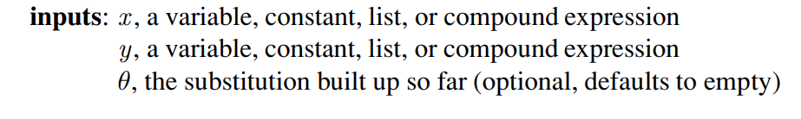



Unify

