Slide 1
Neural Machine Translation I

Slide 2
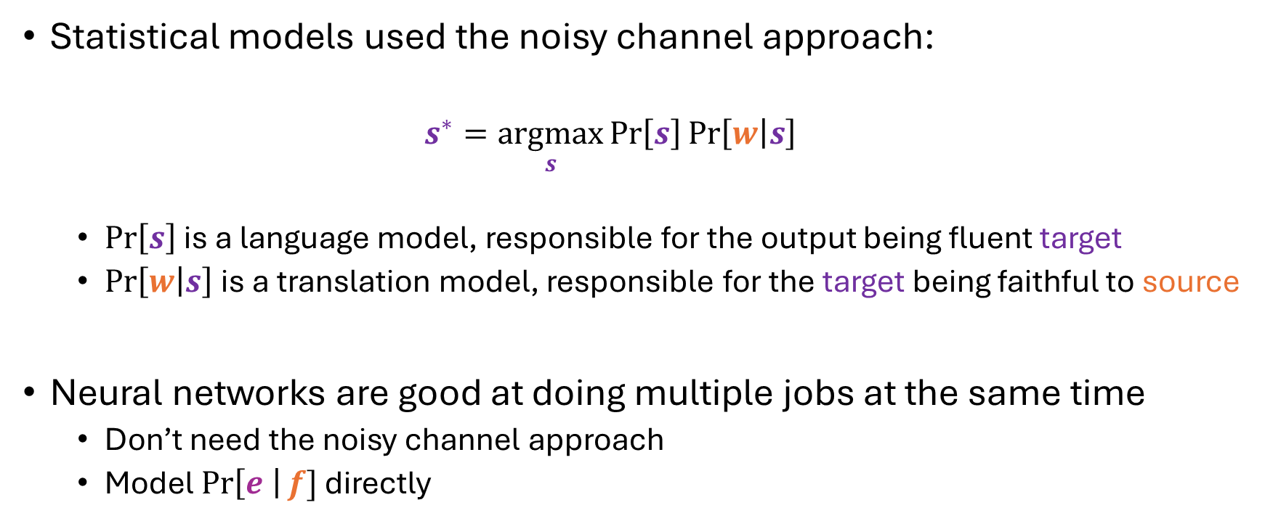
From Statistical to Neural Models
Statistical models used the noisy channel approach:
$$s^{∗}=\underset{s}{argmax}{\operatorname{Pr}\left[s\right]\operatorname{Pr}\left[w | s\right]}$$
$\operatorname{Pr}\left[s\right]$ is a language model, responsible for the output being fluent target
$\operatorname{Pr}\left[w | s\right]$ is a translation model, responsible for the target being faithful to source
Neural networks are good at doing multiple jobs at the same time
Don’t need the noisy channel approach
Model $\operatorname{Pr}\left[e \right|f]$ directly

Slide 3
Can we do this with FSTs?
Not quite
FSTs do have input and output alphabets
Trouble:
FSTs limit token re-ordering
No FST that, when input a sequence, produces the reverse sequence

Slide 4




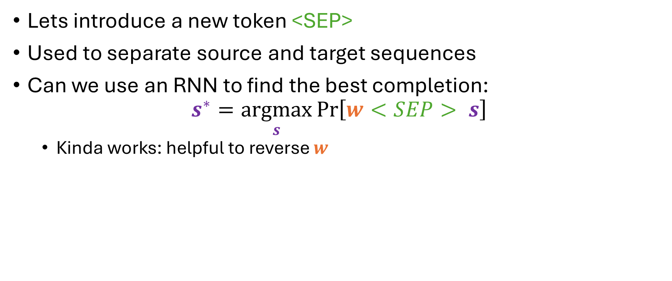






Can we do this with RNNs?
Lets introduce a new token <SEP>
Used to separate source and target sequences
Can we use an RNN to find the best completion:
$$s^{∗}=\underset{s}{argmax}{\operatorname{Pr}\left[w<SEP> s\right]}$$
Kinda works: helpful to reverse $w$
$$y^{(4)}$$
$$y^{(5)}$$
RNN cell
$$h^{(1)}$$
RNN cell
$$h^{(2)}$$
RNN cell
$$h^{(3)}$$
RNN cell
$$h^{(4)}$$
RNN cell
$$h^{(0)}=0$$
$$f_{1}$$
$$f_{2}$$
$$<SEP>$$

Slide 5

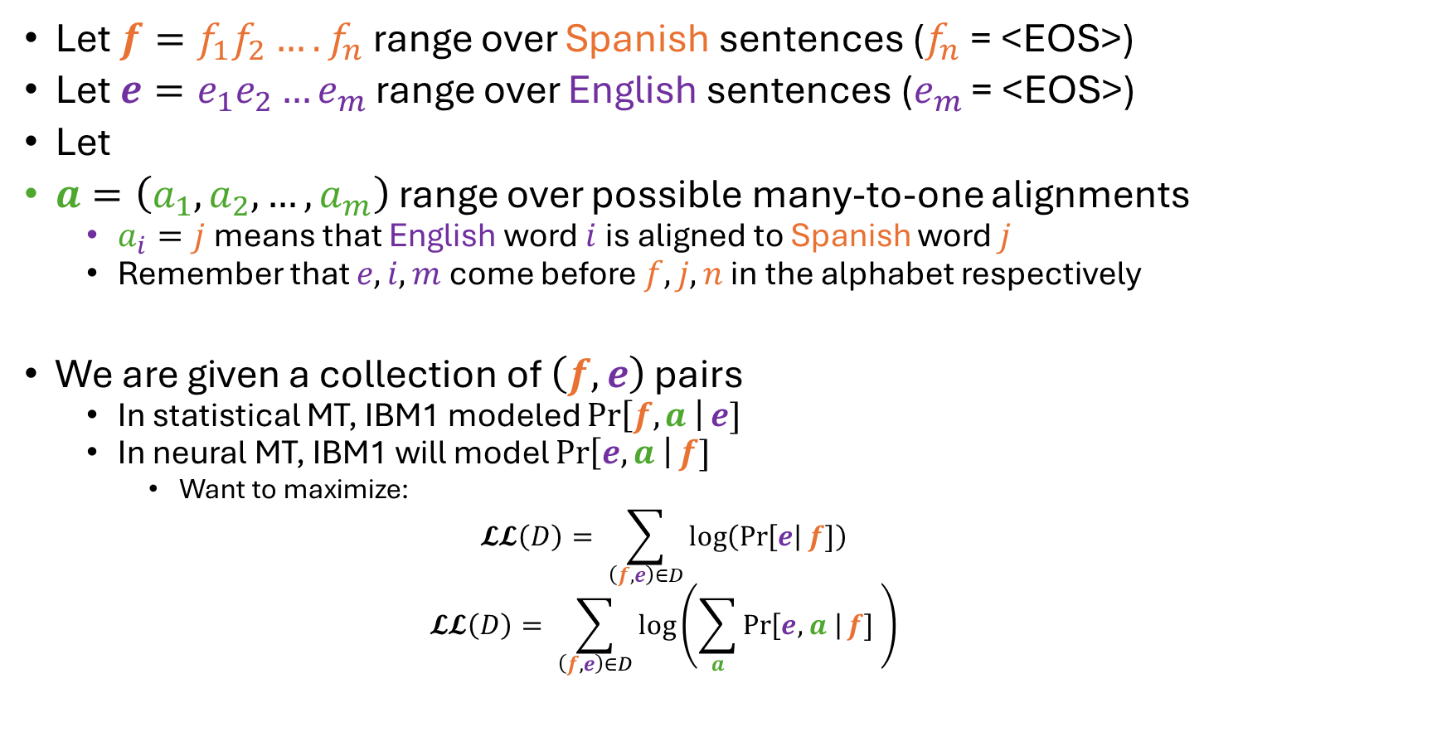


IBM1
$$a=(1,2,4,3,5,6)$$
his associates are not strong <EOS>
$$m=6$$
sus asociados no son Fuertes <EOS>
$$n=6$$
Let $f=f_{1}f_{2}…. f_{n}$ range over Spanish sentences ($f_{n}$ = <EOS>)
Let $e=e_{1}e_{2}…e_{m}$ range over English sentences ($e_{m}$ = <EOS>)
Let
$a=\left(a_{1},a_{2},…,a_{m}\right)$ range over possible many-to-one alignments
$a_{i}=j$ means that English word $i$ is aligned to Spanish word $j$
Remember that $e,i,m$ come before $f,j,n$ in the alphabet respectively
We are given a collection of $\left(f, e\right)$ pairs
In statistical MT, IBM1 modeled $\operatorname{Pr}\left[f,a \right|e]$
In neural MT, IBM1 will model $\operatorname{Pr}\left[e,a \right|f]$
Want to maximize:
$$𝓛𝓛\left(D\right)= \sum_{\left(f, e\right)∈D}{\log\left(\operatorname{Pr}\left[e\right|f]\right)}$$
$$𝓛𝓛\left(D\right)= \sum_{\left(f, e\right)∈D}{\log\left(\sum_{a}{\operatorname{Pr}\left[e,a \right|f] }\right)}$$

Slide 6
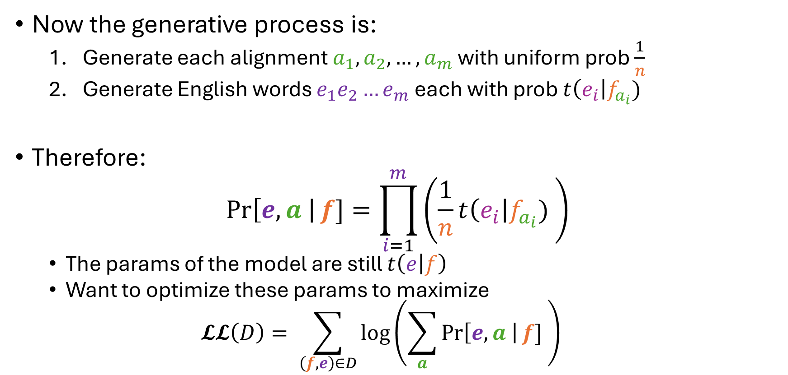
IBM1
Now the generative process is:
Generate each alignment $a_{1},a_{2},…,a_{m}$ with uniform prob $\frac{1}{n}$
Generate English words $e_{1}e_{2}…e_{m}$ each with prob $t\left(e_{i}\right|f_{a_{i}})$
Therefore:
$$\operatorname{Pr}\left[e,a \right|f]=\prod_{i=1}^{m}{\left(\frac{1}{n}t\left(e_{i}\right|f_{a_{i}}) \right)}$$
The params of the model are still $t\left(e | f\right)$
Want to optimize these params to maximize
$$𝓛𝓛\left(D\right)= \sum_{\left(f, e\right)∈D}{\log\left(\sum_{a}{\operatorname{Pr}\left[e,a \right|f] }\right)}$$

Slide 7
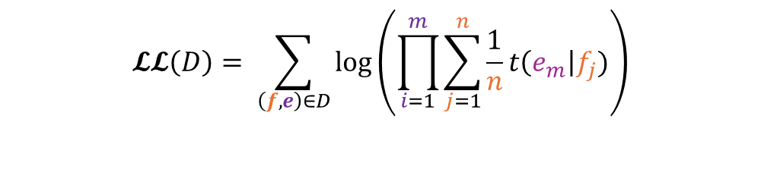


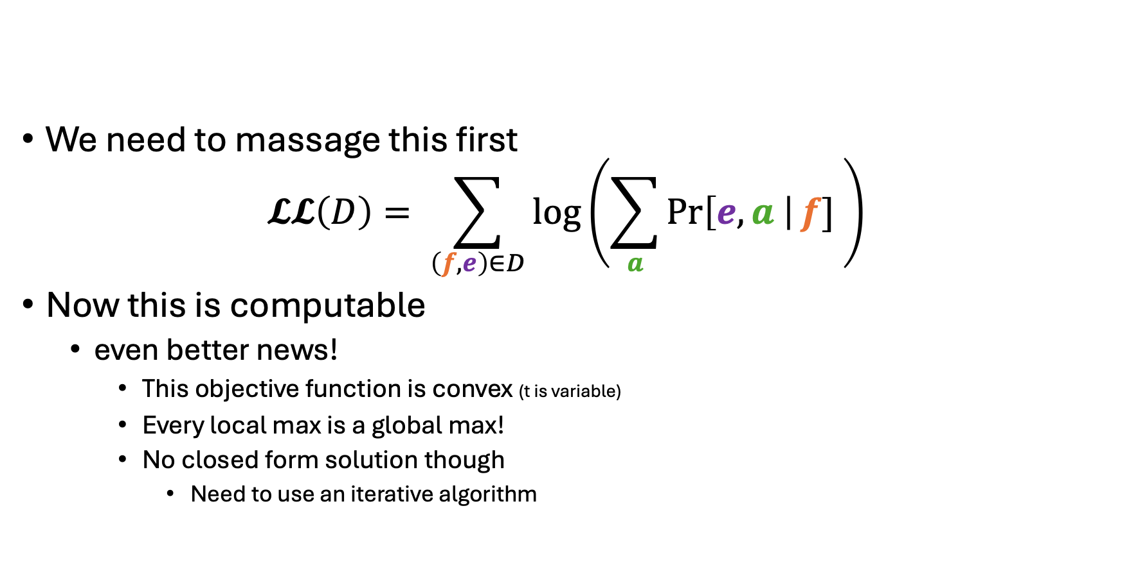

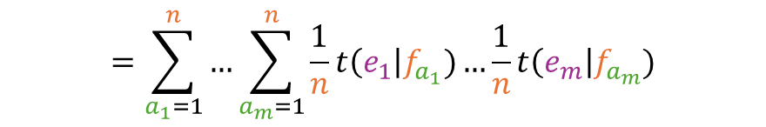
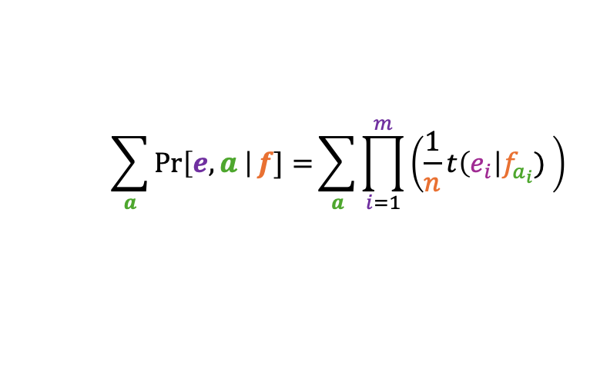
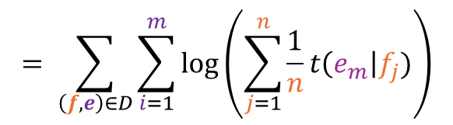
IBM1
$n^{m}$ different alignments $a$
We need to massage this first
$$𝓛𝓛\left(D\right)= \sum_{\left(f, e\right)∈D}{\log\left(\sum_{a}{\operatorname{Pr}\left[e,a \right|f] }\right)}$$
Now this is computable
even better news!
This objective function is convex (t is variable)
Every local max is a global max!
No closed form solution though
Need to use an iterative algorithm
$$\sum_{a}{\operatorname{Pr}\left[e,a \right|f]=}\sum_{a}{\prod_{i=1}^{m}{\left(\frac{1}{n}t\left(e_{i}\right|f_{a_{i}}) \right)}}$$
$$=\sum_{a_{1}=1}^{n}{…\sum_{a_{m}=1}^{n}{\frac{1}{n}t\left(e_{1}\right|f_{a_{1}})…\frac{1}{n}t\left(e_{m}\right|f_{a_{m}})}}$$
$$=\sum_{a_{1}=1}^{n}{\frac{1}{n}t\left(e_{1}\right|f_{a_{1}})…\sum_{a_{m}=1}^{n}{\frac{1}{n}t\left(e_{m}\right|f_{a_{m}})}}$$
$$𝓛𝓛\left(D\right)= \sum_{\left(f, e\right)∈D}{\log\left(\prod_{i=1}^{m}{\sum_{j=1}^{n}{\frac{1}{n}t\left(e_{m}\right|f_{j})}}\right)}$$
$$= \sum_{\left(f, e\right)∈D}{\sum_{i=1}^{m}{\log\left(\sum_{j=1}^{n}{\frac{1}{n}t\left(e_{m}\right|f_{j})}\right)}}$$
$$=\prod_{i=1}^{m}{\sum_{j=1}^{n}{\frac{1}{n}t\left(e_{m}\right|f_{j})}}$$

Slide 8

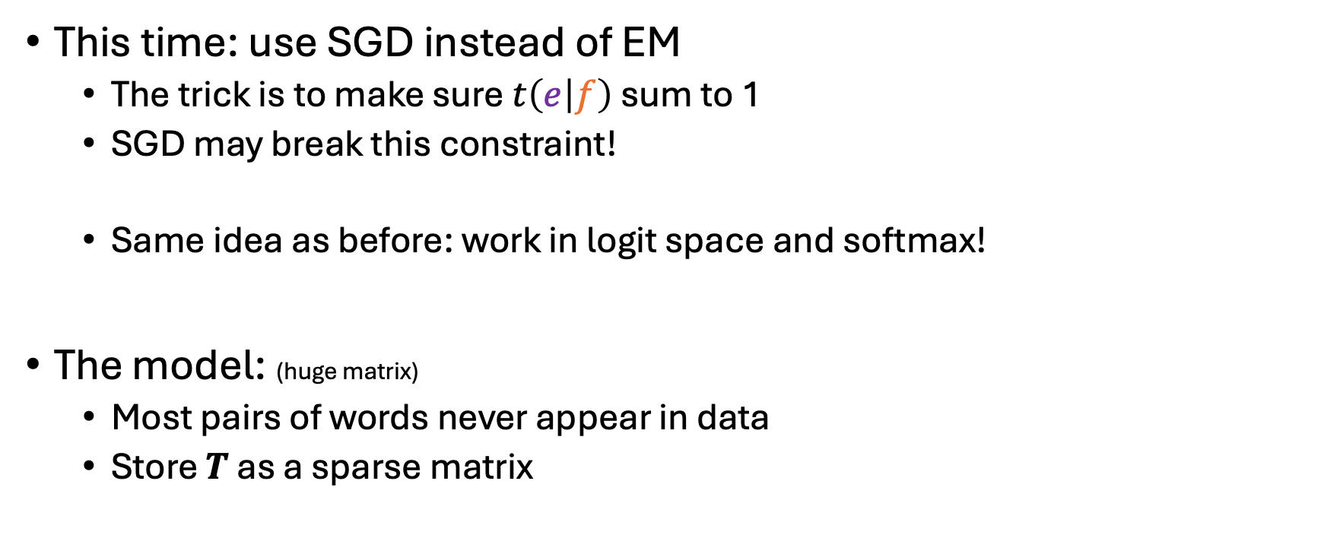

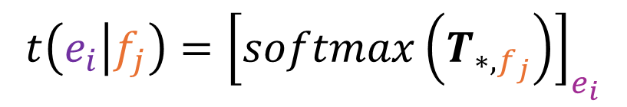
IBM1
This time: use SGD instead of EM
The trick is to make sure $t\left(e | f\right)$ sum to 1
SGD may break this constraint!
Same idea as before: work in logit space and softmax!
The model: (huge matrix)
Most pairs of words never appear in data
Store $T$ as a sparse matrix
$$T∈ℝ^{\left|Σ_{e}\right|×\left|Σ_{f}\right|}$$
$$t\left(e_{i} | f_{j}\right)={\left[softmax\left(T_{∗,f_{j}}\right)\right]}_{e_{i}}$$
$$=\frac{e^{T_{e_{i},f_{j}}}}{\sum_{e^{′}∈Σ_{e}}{e^{T_{e^{′},f_{j}}}}}$$

Slide 9
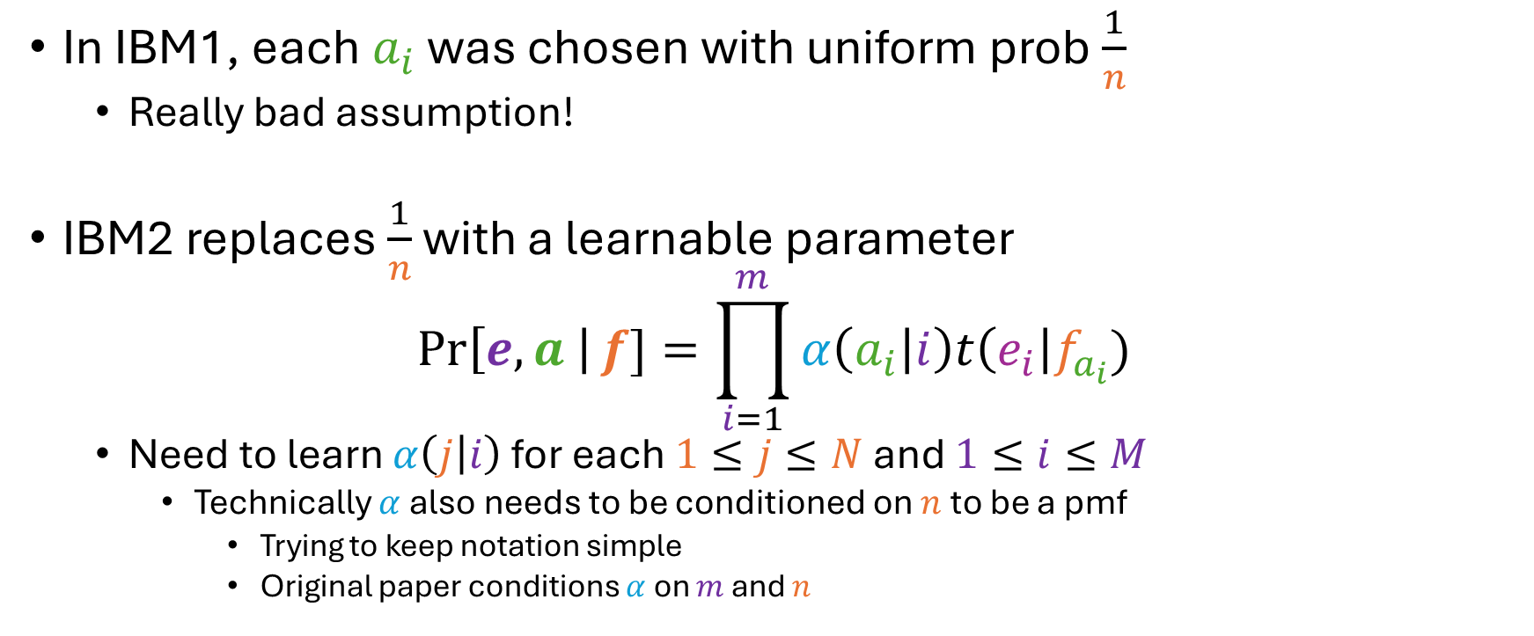
IBM Model 2
In IBM1, each $a_{i}$ was chosen with uniform prob $\frac{1}{n}$
Really bad assumption!
IBM2 replaces $\frac{1}{n}$ with a learnable parameter
$$\operatorname{Pr}\left[e,a \right|f]=\prod_{i=1}^{m}{α\left(a_{i} | i\right)t\left(e_{i}\right|f_{a_{i}})}$$
Need to learn $α\left(j | i\right)$ for each $1≤j≤N$ and $1≤i≤M$
Technically $α$ also needs to be conditioned on $n$ to be a pmf
Trying to keep notation simple
Original paper conditions $α$ on $m$ and $n$

Slide 10
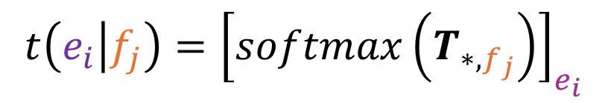


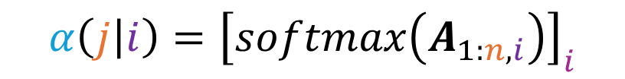


IBM2
The model now has two parameter matrices:
$$A∈ℝ^{N×M}$$
$$T∈ℝ^{\left|Σ_{e}\right|×\left|Σ_{f}\right|}$$
$$α\left(j | i\right)={\left[softmax\left(A_{1:n,i}\right)\right]}_{i}$$
$$t\left(e_{i} | f_{j}\right)={\left[softmax\left(T_{∗,f_{j}}\right)\right]}_{e_{i}}$$
$$=\frac{e^{A_{j,i}}}{\sum_{j^{′}=1}^{n}{e^{A_{j^{′},i}}}}$$
$$=\frac{e^{T_{e_{i},f_{j}}}}{\sum_{e^{′}∈Σ_{e}}{e^{T_{e^{′},f_{j}}}}}$$

Slide 11
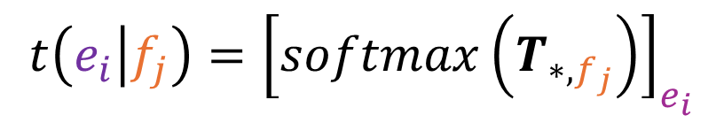




From Alignment to Attention
$$\operatorname{Pr}\left[e_{i}\right]$$
mean
Here is what IBM1 looks like as a neural network
$$T∈ℝ^{\left|Σ_{e}\right|×\left|Σ_{f}\right|}$$
softmax
$$t\left(e_{i} | f_{j}\right)={\left[softmax\left(T_{∗,f_{j}}\right)\right]}_{e_{i}}$$
$$=\frac{e^{T_{e_{i},f_{j}}}}{\sum_{e^{′}∈Σ_{e}}{e^{T_{e^{′},f_{j}}}}}$$
$$T$$
garcia
y
asociados

Slide 12
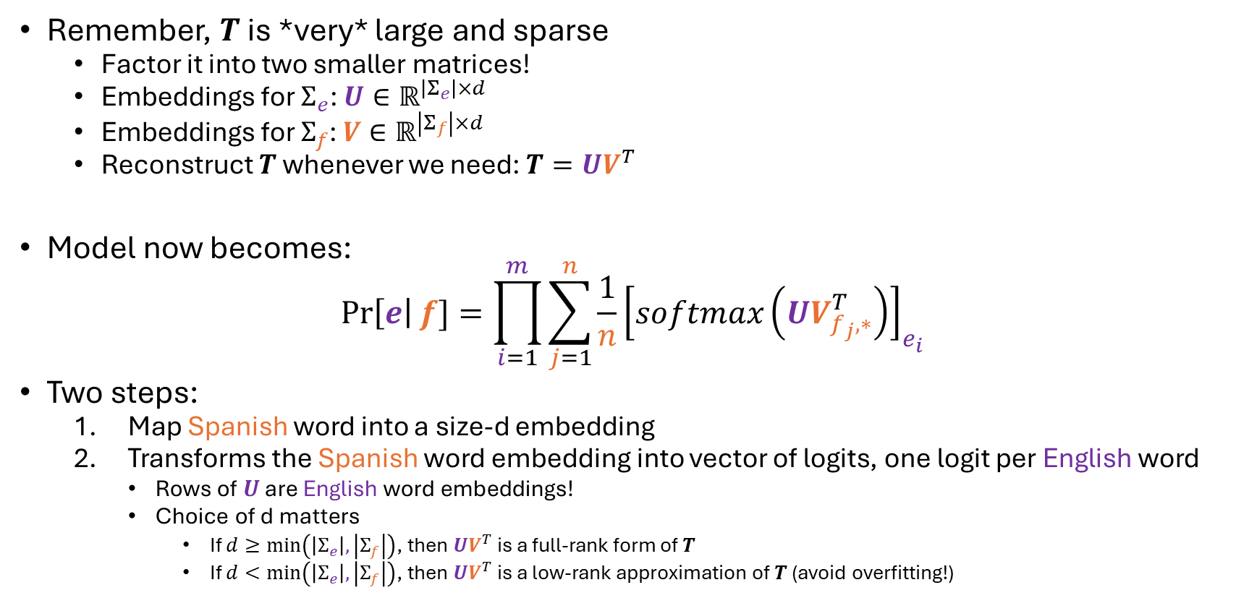
Use Embeddings!
Remember, $T$ is *very* large and sparse
Factor it into two smaller matrices!
Embeddings for $Σ_{e}$: $U∈ℝ^{\left|Σ_{e}\right|×d}$
Embeddings for $Σ_{f}$: $V∈ℝ^{\left|Σ_{f}\right|×d}$
Reconstruct $T$ whenever we need: $T=UV^{T}$
Model now becomes:
$$\operatorname{Pr}\left[e\right|f]=\prod_{i=1}^{m}{\sum_{j=1}^{n}{\frac{1}{n}{\left[softmax\left(UV_{f_{j},∗}^{T}\right)\right]}_{e_{i}}}}$$
Two steps:
Map Spanish word into a size-d embedding
Transforms the Spanish word embedding into vector of logits, one logit per English word
Rows of $U$ are English word embeddings!
Choice of d matters
If $d≥\min\left(\left|Σ_{e}\right|,\left|Σ_{f}\right|\right)$, then $UV^{T}$ is a full-rank form of $T$
If $d<\min\left(\left|Σ_{e}\right|,\left|Σ_{f}\right|\right)$, then $UV^{T}$ is a low-rank approximation of $T$ (avoid overfitting!)

Slide 13
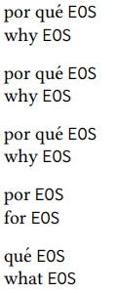
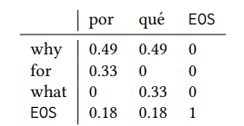
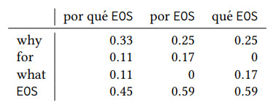
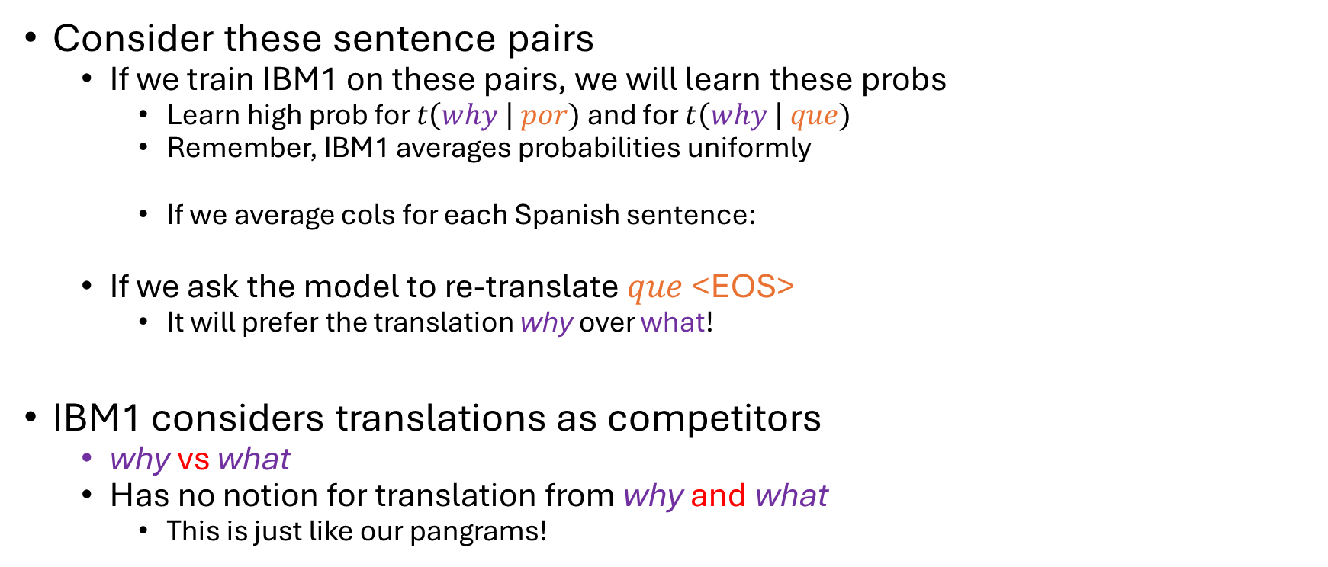
Factored IBM1 Problems
Consider these sentence pairs
If we train IBM1 on these pairs, we will learn these probs
Learn high prob for $t\left(why \right| por)$ and for $t\left(why \right| que)$
Remember, IBM1 averages probabilities uniformly
If we average cols for each Spanish sentence:
If we ask the model to re-translate $que$ <EOS>
It will prefer the translation why over what!
IBM1 considers translations as competitors
why vs what
Has no notion for translation from why and what
This is just like our pangrams!

Slide 14
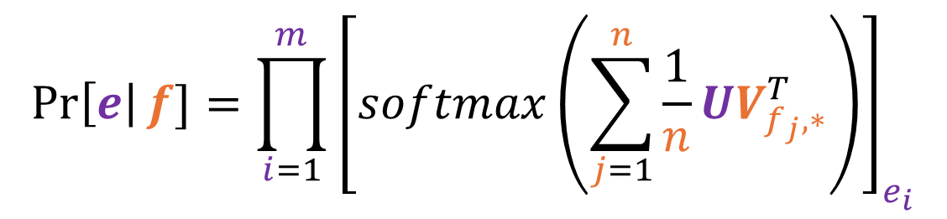
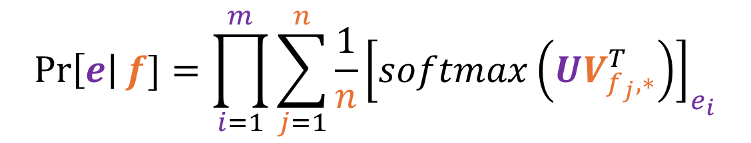
Factored IBM1 Problems
We can solve this by moving the average inside the softmax
Since we’re averaging logits, not probs
Lots more room for words to influence each others translations!
$$\operatorname{Pr}\left[e\right|f]=\prod_{i=1}^{m}{\sum_{j=1}^{n}{\frac{1}{n}{\left[softmax\left(UV_{f_{j},∗}^{T}\right)\right]}_{e_{i}}}}$$
$$\operatorname{Pr}\left[e\right|f]=\prod_{i=1}^{m}{{\left[softmax\left(\sum_{j=1}^{n}{\frac{1}{n}}UV_{f_{j},∗}^{T}\right)\right]}_{e_{i}}}$$

Slide 15
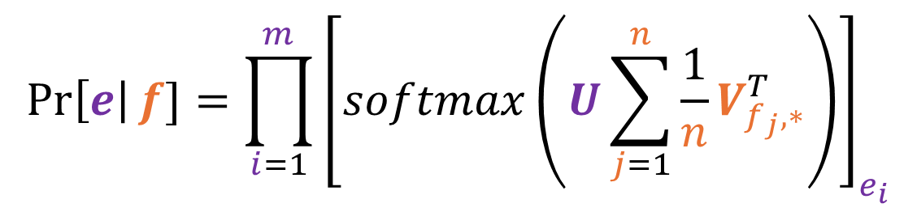

Factored IBM1 with Attention
Since everything inside the softmax is linear
We can put the average wherever we want!
Averaging Spanish word embeddings is an example of attention
Each English word is said to “attend” to the Spanish words
$$\operatorname{Pr}\left[e\right|f]=\prod_{i=1}^{m}{{\left[softmax\left(\sum_{j=1}^{n}{\frac{1}{n}}UV_{f_{j},∗}^{T}\right)\right]}_{e_{i}}}$$
$$\operatorname{Pr}\left[e\right|f]=\prod_{i=1}^{m}{{\left[softmax\left(U\sum_{j=1}^{n}{\frac{1}{n}}V_{f_{j},∗}^{T}\right)\right]}_{e_{i}}}$$

Slide 16
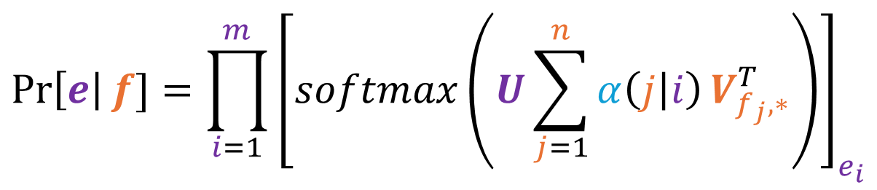

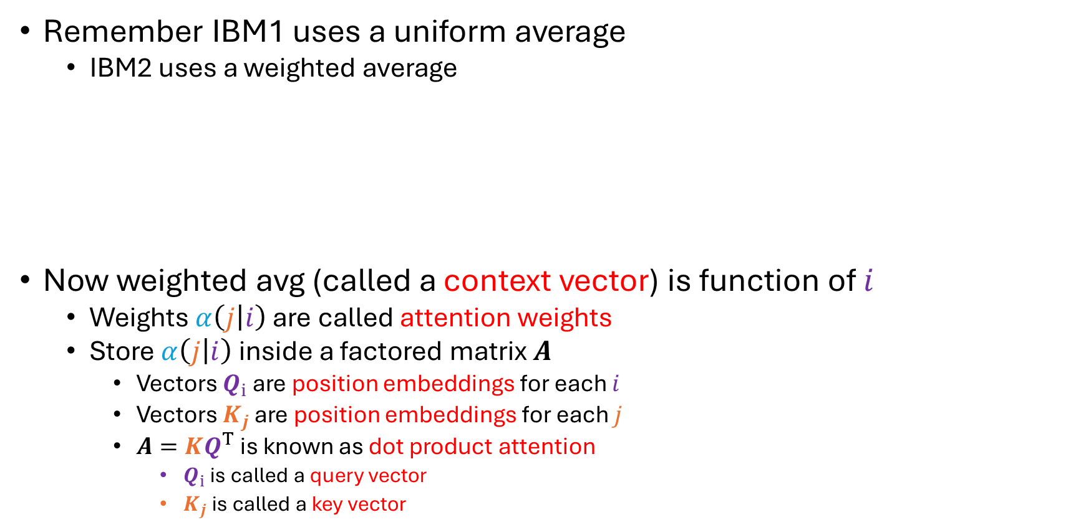



Factoring IBM2
$$Q∈ℝ^{M×d}$$
$$K∈ℝ^{N×d}$$
$$α\left(j | i\right)={\left[softmax\left(A_{1:n,i}\right)\right]}_{j}$$
where $A=KQ^{T}$
Remember IBM1 uses a uniform average
IBM2 uses a weighted average
Now weighted avg (called a context vector) is function of $i$
Weights $α\left(j | i\right)$ are called attention weights
Store $α\left(j | i\right)$ inside a factored matrix $A$
Vectors $Q_{i}$ are position embeddings for each $i$
Vectors $K_{j}$ are position embeddings for each $j$
$A=KQ^{T}$ is known as dot product attention
$Q_{i}$ is called a query vector
$K_{j}$ is called a key vector
$$\operatorname{Pr}\left[e\right|f]=\prod_{i=1}^{m}{{\left[softmax\left(U\sum_{j=1}^{n}{α\left(j | i\right)}V_{f_{j},∗}^{T}\right)\right]}_{e_{i}}}$$

