Slide 1
Statistical Parsing

Slide 2




























Last Time
8
7
6
5
4
3
2
1
0
function cky:
inputs: $w=w_{1}w_{2}…w_{n}$
$G=\left(N,Σ,R,S\right)$
returns: true iff $w∈L\left(G\right)$
initialize $chart\left[row, col\right]=∅$ for all $0≤row<col<n$
// populate terminal production
for all $col=0…n−1$ and $\left(X→w_{col}\right)∈R$ do
$chart\left[0,col\right]=char\left[0,col\right]∪\left\{X\right\}$
// populate nonterminal production
for $row=1…n$ do
for $col=0…n−row$ do
// update cell at coordinates $\left(row, col\right)$
for $leftRow=0…row−1$ do
// left cell is at coords $(leftRow, col)$
// right cell is at coords $(row−leftRow−1, col+leftRow+1)$
for all $\left(X→YZ\right)∈R$ do
if $Y∈chart[leftRow, col]$ and $Z∈chart[row−leftRow−1, col+leftRow+1]$ then
$chart\left[row,col\right]=chart\left[row,col\right]∪\left\{X\right\}$
return $S∈chart[n−1,0]$
row
$$w_{5}$$
$$w_{5}$$
$$w_{5}$$
$$w_{1}$$
$$w_{2}$$
$$w_{3}$$
$$w_{4}$$
$$w_{5}$$
$$w_{1}$$
$$w_{2}$$
$$w_{3}$$
$$w_{4}$$
$$w_{5}$$
$$w_{1}$$
$$w_{1}$$
$$w_{2}$$
$$w_{2}$$
$$w_{3}$$
$$w_{3}$$
$$w_{4}$$
$$w_{1}$$
$$w_{2}$$
$$w_{3}$$
$$w_{4}$$
$$w_{4}$$
$$w_{6}$$
$$w_{8}$$
$$w_{9}$$
$$w_{6}$$
$$w_{8}$$
$$w_{9}$$
$$w_{6}$$
$$w_{6}$$
$$w_{8}$$
$$w_{8}$$
$$w_{9}$$
$$w_{6}$$
$$w_{8}$$
$$w_{9}$$
$$w_{7}$$
$$w_{9}$$
$$w_{7}$$
$$w_{7}$$
$$w_{7}$$
$$w_{7}$$
0 1 2 3 4 5 6 7 8
col

Slide 3
Using CKY
We have a probabilistic Context Free Grammar
Want to find the parse tree with the largest weight
Combine CKY with Viterbi!
Viterbi for a graph: find the highest-weight path from the source to a node
Viterbi for cky: find the highest-weight parse from the leaves of the tree to a nonterminal
How to find the highest-weight parse?
Instead of remembering all of the nonterminals in a cell
Remember the nonterminals in a cell along with the max logprob for that nonterminal!

Slide 4
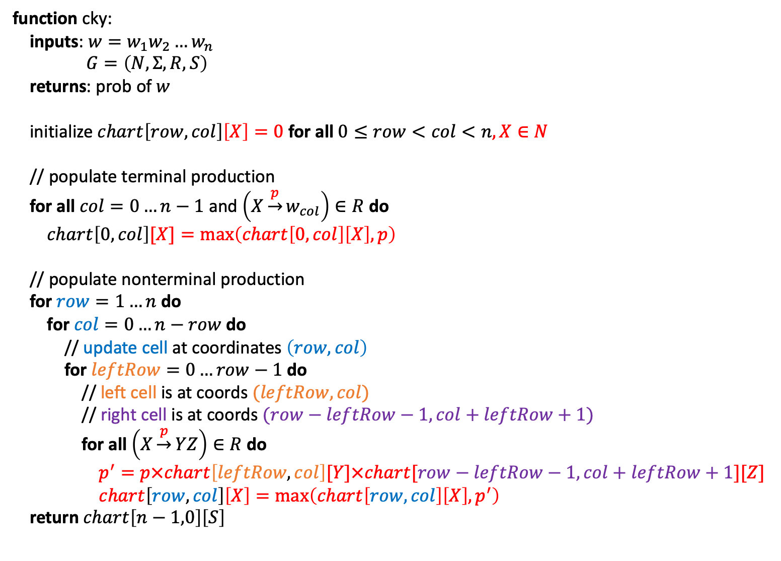
CKY-Viterbi
function cky:
inputs: $w=w_{1}w_{2}…w_{n}$
$G=\left(N,Σ,R,S\right)$
returns: prob of $w$
initialize $chart\left[row, col\right]\left[X\right]=0$ for all $0≤row<col<n,X∈N$
// populate terminal production
for all $col=0…n−1$ and $\left(X\underset{→}{p}w_{col}\right)∈R$ do
$chart\left[0,col\right][X]=\max\left(chart\left[0,col\right]\left[X\right], p\right)$
// populate nonterminal production
for $row=1…n$ do
for $col=0…n−row$ do
// update cell at coordinates $\left(row, col\right)$
for $leftRow=0…row−1$ do
// left cell is at coords $(leftRow, col)$
// right cell is at coords $(row−leftRow−1, col+leftRow+1)$
for all $\left(X\underset{→}{p}YZ\right)∈R$ do
$p^{′}=p×chart\left[leftRow, col\right][Y]×chart[row−leftRow−1, col+leftRow+1][Z]$
$chart\left[row,col\right]\left[X\right]=\max\left(chart\left[row,col\right]\left[X\right],p^{′}\right)$
return $chart\left[n−1,0\right]\left[S\right]$

Slide 5


CKY-Viterbi
The cell traversal was still the same between the two versions
The only difference is *what we did to update a cell*
// cky-viterbi
// populate terminal production
for all $col=0…n−1$ and $\left(X\underset{→}{p}w_{col}\right)∈R$ do
…
// populate nonterminal production
for $row=1…n$ do
for $col=0…n−row$ do
// update cell at coordinates $\left(row, col\right)$
for $leftRow=0…row−1$ do
// left cell is at coords $(leftRow, col)$
// right cell is at coords $(row−leftRow−1, col+leftRow+1)$
// vanilla cky
// populate terminal production
for all $col=0…n−1$ and $\left(X→w_{col}\right)∈R$ do
$…$
// populate nonterminal production
for $row=1…n$ do
for $col=0…n−row$ do
// update cell at coordinates $\left(row, col\right)$
for $leftRow=0…row−1$ do
// left cell is at coords $(leftRow, col)$
// right cell is at coords $(row−leftRow−1, col+leftRow+1)$

Slide 6

CKY-Traversal
I think its much easier to separate the traversal from the update
Vanilla cky calls it
Cky-viterbi calls it
…
Provide a function ptr!
Updates already init structure(s)
function cky-traversal:
inputs: $w=w_{1}w_{2}…w_{n}$
update-function-ptr
returns: Nothing
// populate nonterminal production
for $row=1…n$ do
for $col=0…n−row$ do
// update cell at coordinates $\left(row, col\right)$
for $leftRow=0…row−1$ do
// left cell is at coords $(leftRow, col)$
// right cell is at coords $(row−leftRow−1, col+leftRow+1)$
update-function-ptr($\left(row, col\right)$,
$(leftRow, col)$
$(row−leftRow−1, col+leftRow+1)$)

Slide 7
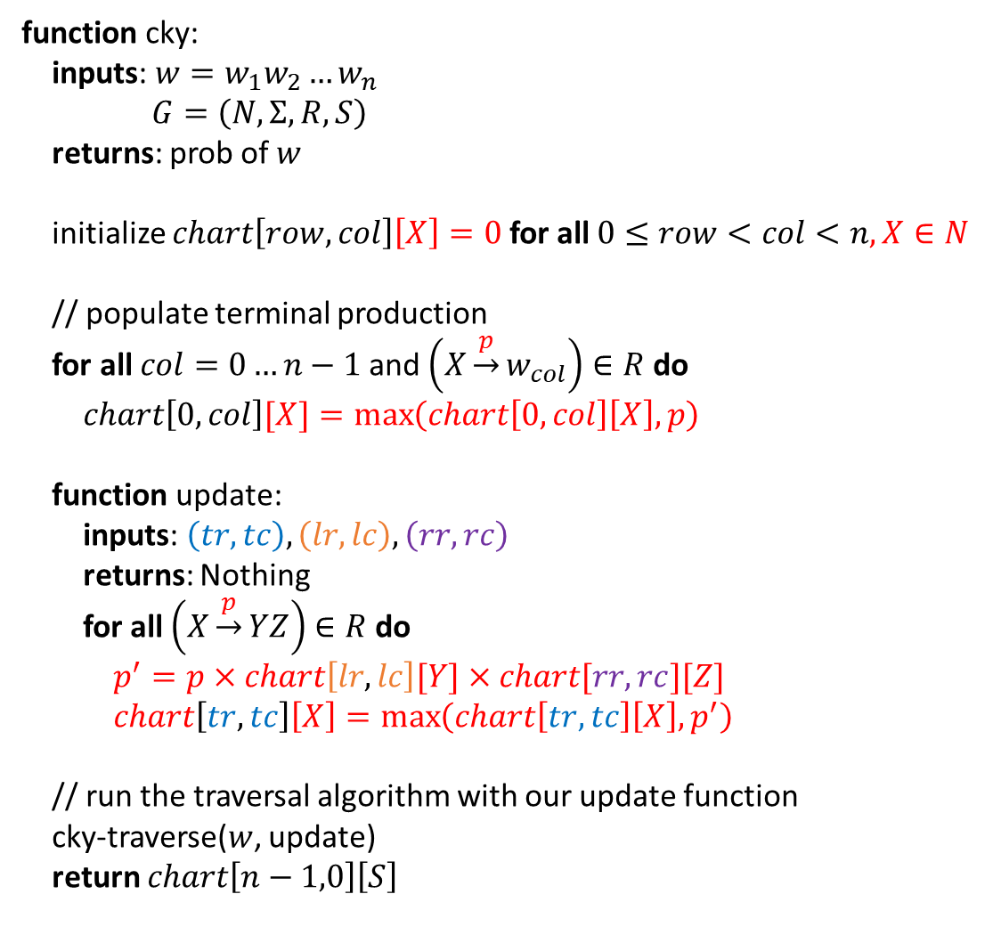
CKY-Viterbi
function cky:
inputs: $w=w_{1}w_{2}…w_{n}$
$G=\left(N,Σ,R,S\right)$
returns: prob of $w$
initialize $chart\left[row, col\right]\left[X\right]=0$ for all $0≤row<col<n,X∈N$
// populate terminal production
for all $col=0…n−1$ and $\left(X\underset{→}{p}w_{col}\right)∈R$ do
$chart\left[0,col\right][X]=\max\left(chart\left[0,col\right]\left[X\right], p\right)$
function update:
inputs: $\left(tr, tc\right), \left(lr, lc\right), \left(rr, rc\right)$
returns: Nothing
for all $\left(X\underset{→}{p}YZ\right)∈R$ do
$p^{′}=p×chart\left[lr, lc\right][Y]×chart[rr, rc][Z]$
$chart\left[tr,tc\right]\left[X\right]=\max\left(chart\left[tr,tc\right]\left[X\right],p^{′}\right)$
// run the traversal algorithm with our update function
cky-traverse($w$, update)
return $chart\left[n−1,0\right]\left[S\right]$

Slide 8
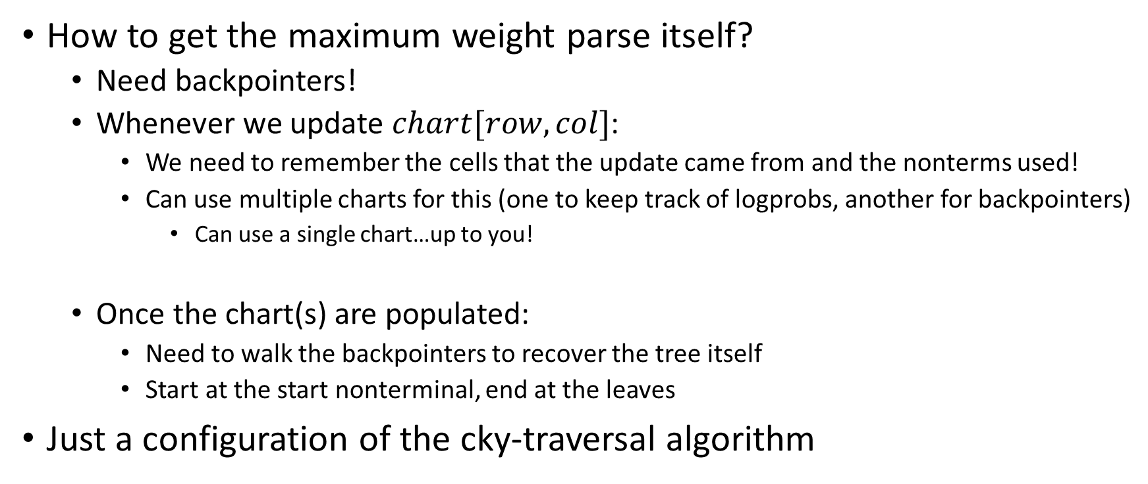
CKY-Viterbi
How to get the maximum weight parse itself?
Need backpointers!
Whenever we update $chart[row,col]$:
We need to remember the cells that the update came from and the nonterms used!
Can use multiple charts for this (one to keep track of logprobs, another for backpointers)
Can use a single chart…up to you!
Once the chart(s) are populated:
Need to walk the backpointers to recover the tree itself
Start at the start nonterminal, end at the leaves
Just a configuration of the cky-traversal algorithm

Slide 9
Parsing with Unary Rules
Earlier I said that even though unary rules aren’t allowed in CNF
People often don’t get rid of them
Instead modify the algorithms to deal with unary rules specifically
How?
Once we’ve checked for any binary rules
Check for unary ones!
If we find a unary one that works
Need to re-check unary rules again (b/c nonterminal added may be RHS of a unary rule)!

Slide 10


Vanilla CKY w/ Unary Rules
function cky:
// skip char initialization and terminal row population
// populate nonterminal production
for $row=1…n$ do
for $col=0…n−row$ do
// update cell at coordinates $\left(row, col\right)$
// check combos for binary rules like normal
// check for unary rules
again = true
while again do
again = false
for all $\left(X→Y\right)∈R$ do
if $X∉chart[row,col]$ and $Y∈chart[row,col]$ then
$chart\left[row,col\right]=chart\left[row,col\right]∪\left\{X\right\}$
again = true
return $S∈chart[n−1,0]$
Can also modify cky-viterbi
Cky-traversal has two update fncs!
One for binary rule update
One for unary rule update
If $G$ has unary rules in it
Possible to derive $X⇒…⇒^{∗}X$
Infinite derivations!
If weight of a cycle > 1…viterbi breaks
Common to add “hacks” to stop cycle
Explore cycles at most 5 times?
…

Slide 11

Statistical Parsing
If we have a corpus of trees
Don’t need EM
Perform relative frequency estimation (aka count and divide)
$$\operatorname{Pr}\left[A→β | A\right]=\frac{count(A→β)}{\sum_{β^{′}}{count\left(A→β^{′}\right)}}$$

Slide 12

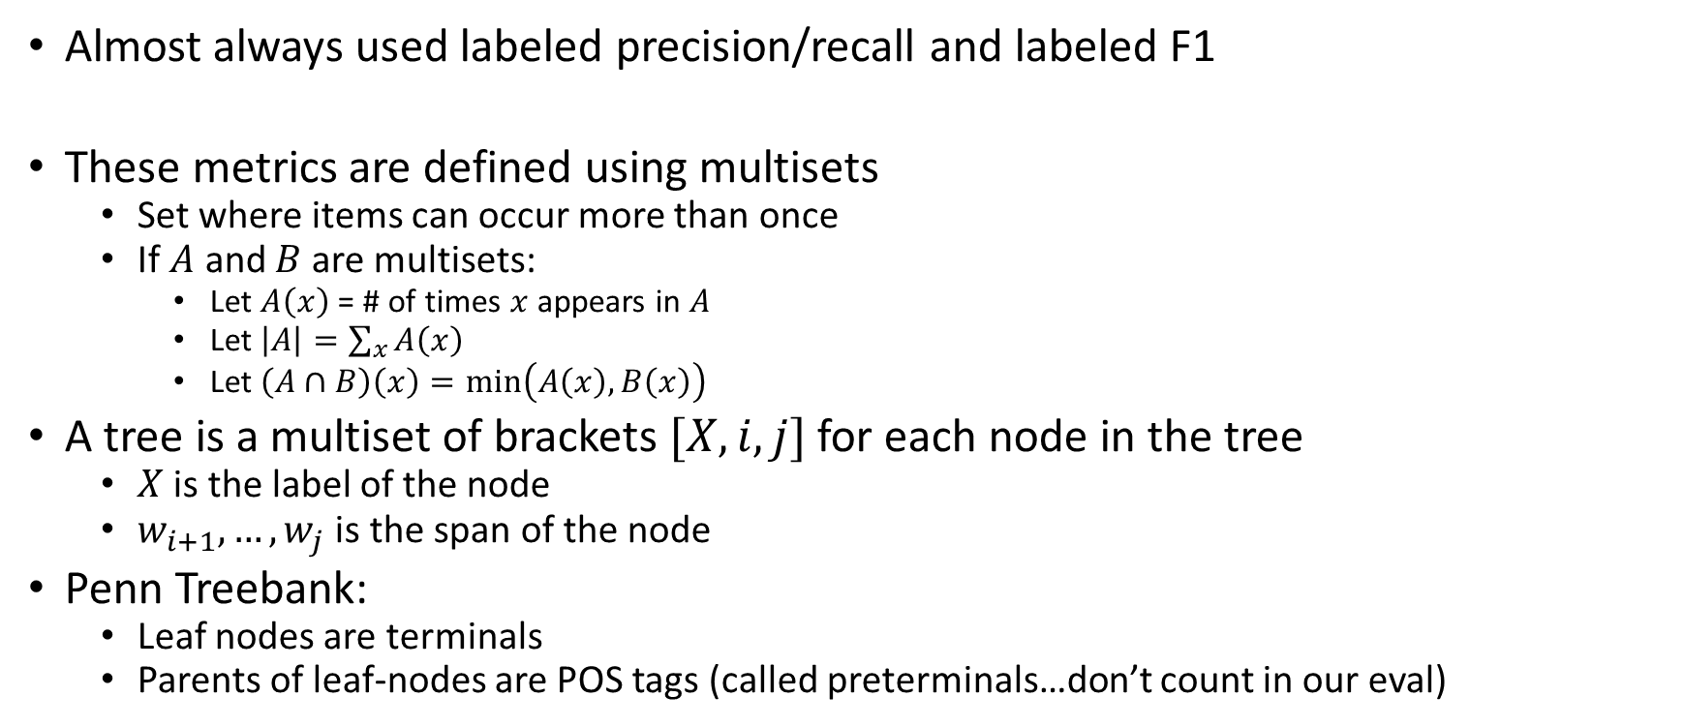

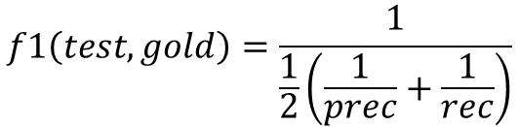

How to Evaluate a Parser?
$$prec\left(test, gold\right)=\frac{|test∩gold|}{|test|}$$
$$rec\left(test, gold\right)=\frac{|test∩gold|}{|gold|}$$
$$f1\left(test, gold\right)=\frac{1}{\frac{1}{2}\left(\frac{1}{prec}+\frac{1}{rec}\right)}$$
$$=\frac{2\left|t∩g\right|}{\left|t\right|+|g|}$$
Almost always used labeled precision/recall and labeled F1
These metrics are defined using multisets
Set where items can occur more than once
If $A$ and $B$ are multisets:
Let $A\left(x\right)$ = # of times $x$ appears in $A$
Let $\left|A\right|=\sum_{x}{A\left(x\right)}$
Let $\left(A∩B\right)\left(x\right)=\min\left(A\left(x\right), B\left(x\right)\right)$
A tree is a multiset of brackets $[X, i,j]$ for each node in the tree
$X$ is the label of the node
$w_{i+1},…,w_{j}$ is the span of the node
Penn Treebank:
Leaf nodes are terminals
Parents of leaf-nodes are POS tags (called preterminals…don’t count in our eval)

Slide 13
Grammar Quality
Since we’re doing relative frequency estimation:
Same problems as Ngram models
Are our counts accurate?
PCFG captures dependencies between parent node and all children
On Penn Treeback this can lead to 10k or more rules
Each rule has its own probability
This can be too little information and also too much info

Slide 14
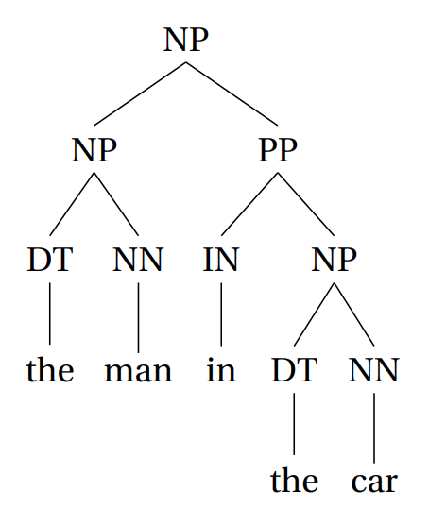
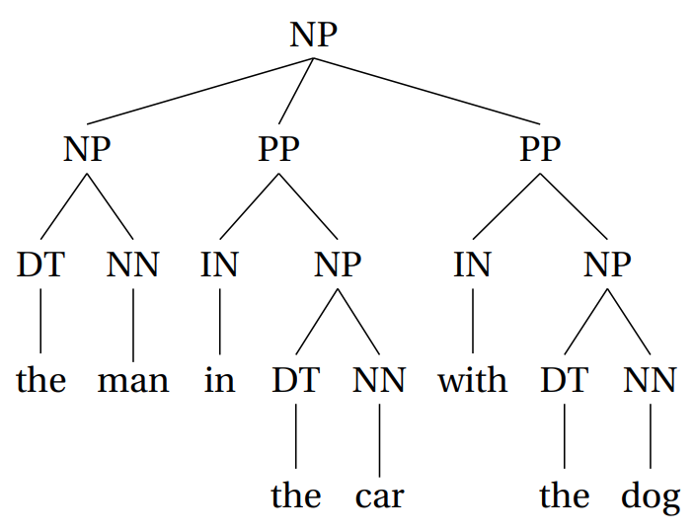
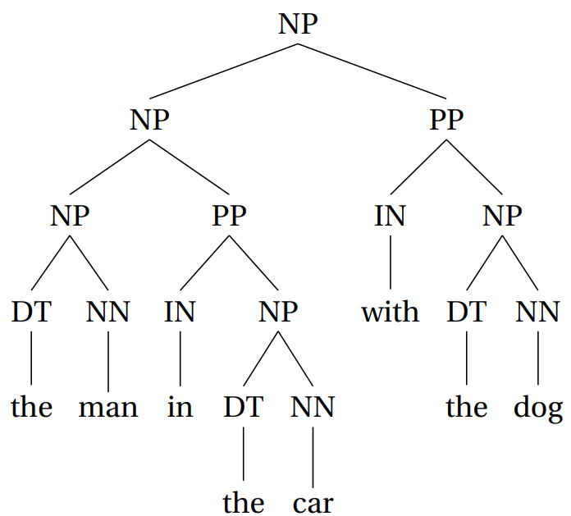
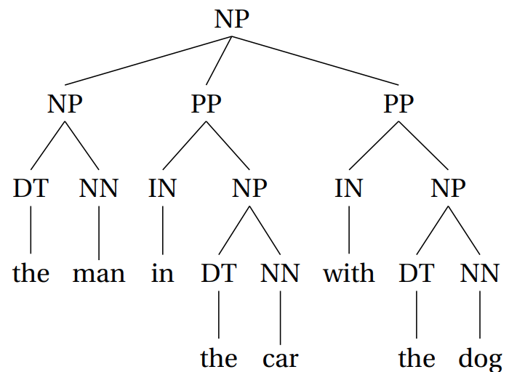
Too Little Information
This appears 90 times
Suppose our Treebank looked like this
When its test time, imagine we have to choose between:
This tree was never seen in our training data!
This appears 10 times
Winner!

Slide 15
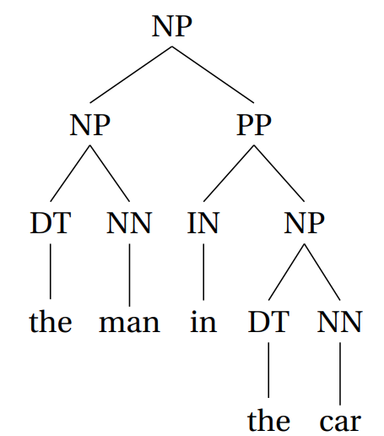
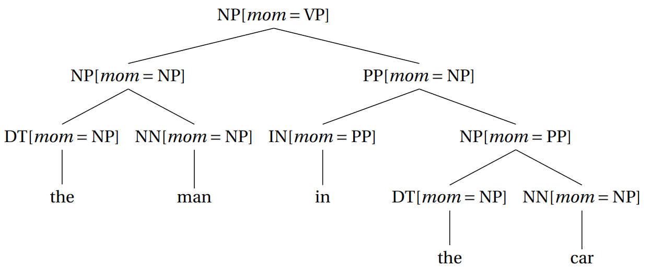

Vertical Markovization
Just like we can increase the sensitivity of an Ngram model
Annotate each node with its parent’s label
For this example assume the top NP has a parent of VP
Now the parser won’t be tempted to build a 3-layer N
Really rare to have a $NP[mom=NP]$ child of a $NP[mom=NP]$ node!

Slide 16
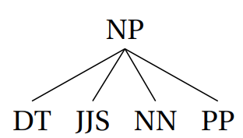
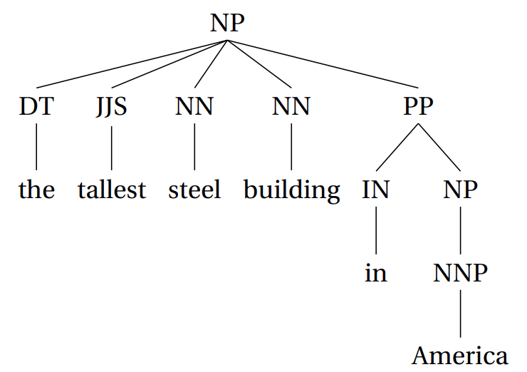
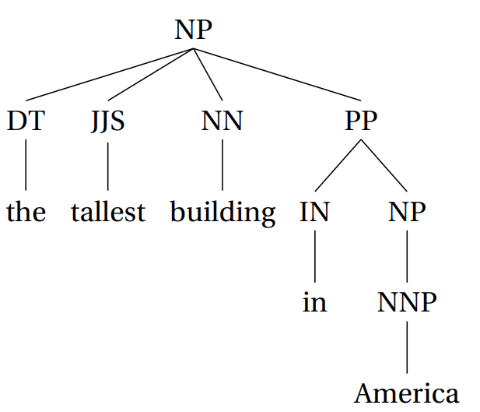
Too Much Information
Suppose our Treebank contains the tree fragment
However it never contains
Our parser will fail when trying to parse
If we allow long rules
There are many long rules
Model considers them to be independent
Is this true?

Slide 17
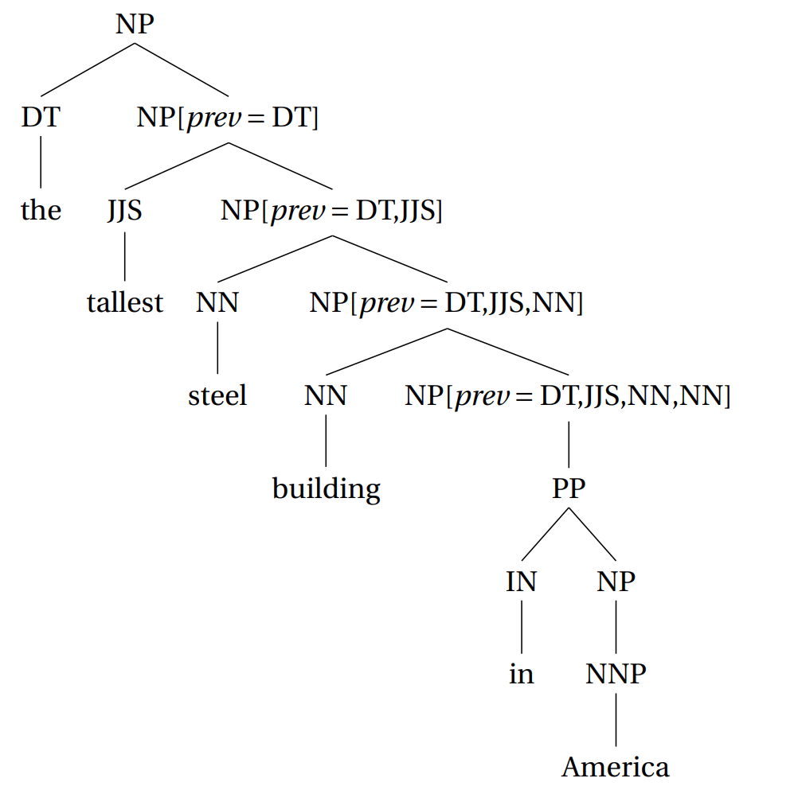
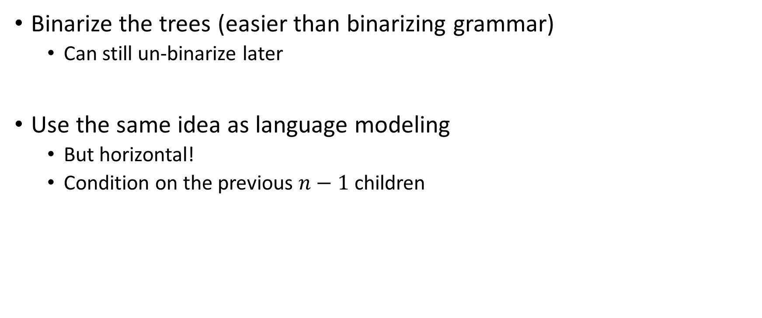
Binarizing Trees
Binarize the trees (easier than binarizing grammar)
Can still un-binarize later
Use the same idea as language modeling
But horizontal!
Condition on the previous $n−1$ children

Slide 18
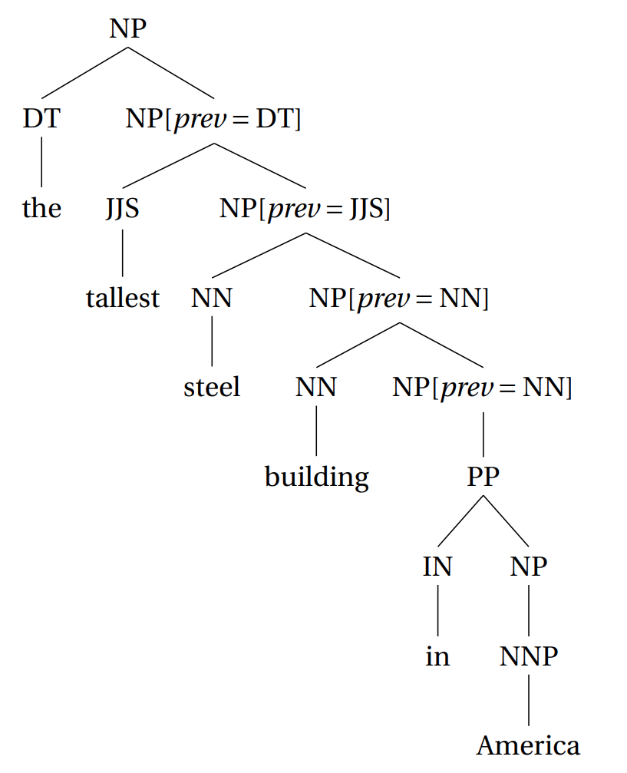

Horizontal Markovization
With $n=2$
With either vertical/horizontal markovization
Train/test on annotated trees
Un-annotate for eval

Slide 19
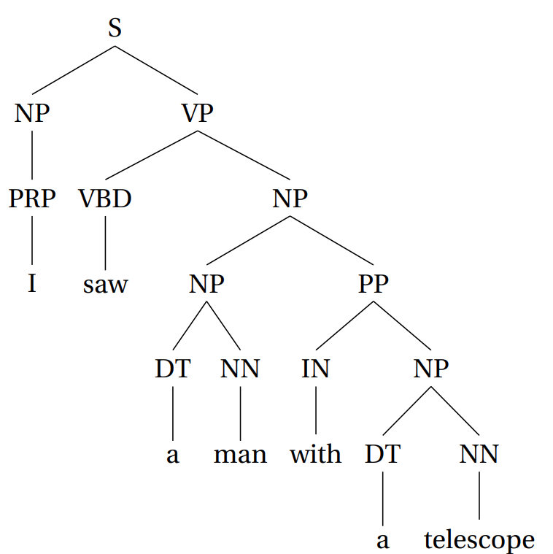
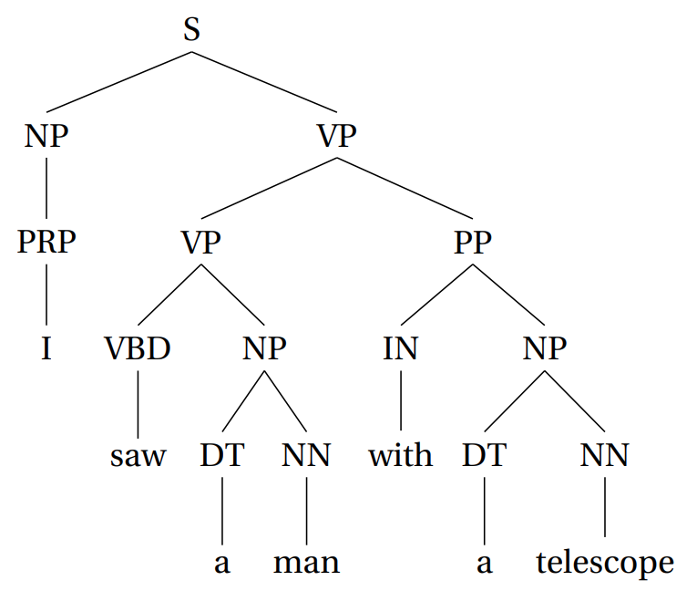
Using Linguistic Knowledge
Use linguistics to make context dependencies more intelligent
In the vertical direction, common approach is called lexicalization
Sometimes called head-lexicalization
For instance, PP attachment (prepositional phrases) are really difficult

Slide 20
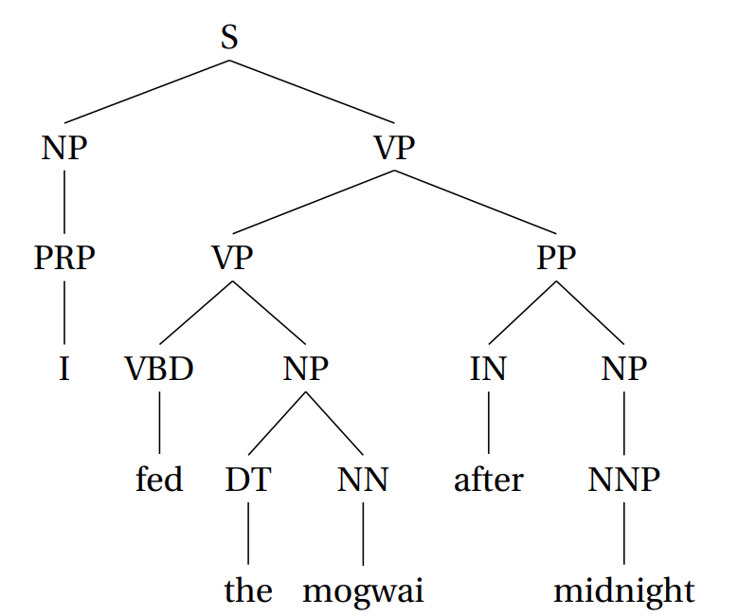
Head-lexicalization
Although we generally prefer simpler parses
Therefore lower attachment
The words involved may change this preference!
For instance, the word after would prefer attaching to a VP
Rather than annotate each node with a parent
Annotate each node with one of its leaves
Which one? The “most important” word (called the head word)
Solve this problem with heuristics
Head of VP is the verb
Head of NP is the final noun
Etc.

Slide 21
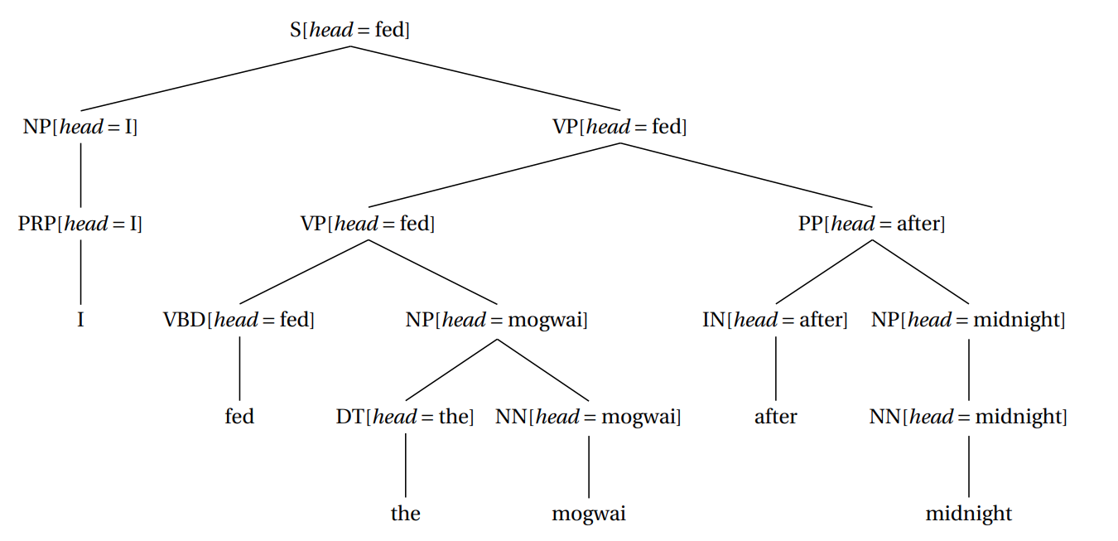
Head-lexicalization

Slide 22
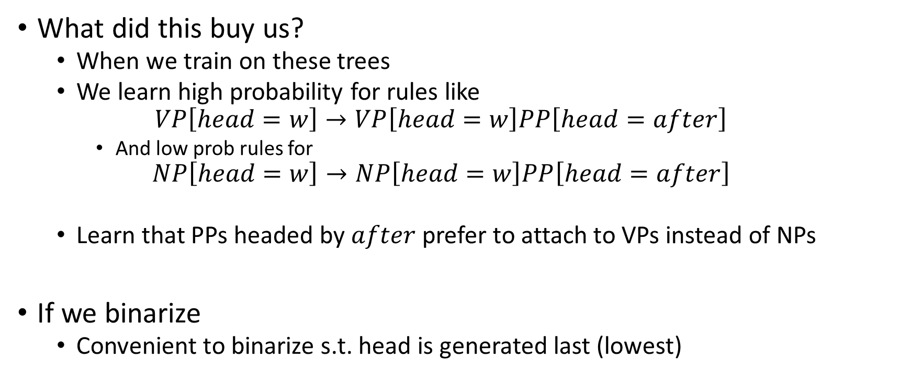
Head-lexicalization
What did this buy us?
When we train on these trees
We learn high probability for rules like
$$VP\left[head=w\right]→VP\left[head=w\right]PP\left[head=after\right]$$
And low prob rules for
$$NP\left[head=w\right]→NP\left[head=w\right]PP\left[head=after\right]$$
Learn that PPs headed by $after$ prefer to attach to VPs instead of NPs
If we binarize
Convenient to binarize s.t. head is generated last (lowest)

Slide 23
Subcategorization
Godzilla obliterated the city
Godzilla obliterated the city today
Godzilla obliterated
Godzilla exists
Godzilla exists today
Godzilla exists the monster
Horizontal direction
Basic idea:
Some phrases are required (called arguments)
Some phrases are optional (called adjuncts)
The verb obliterated normally takes a direct object
The verb exists never takes a direct object
Adjuncts can occur much more freely
Saw can take either an NP or an S as an argument
Obliterated is ambiguous for machines
Needs to learn obliterated must take an NP argument, not an S argument
I saw her duck
I obliterated her duck

Slide 24
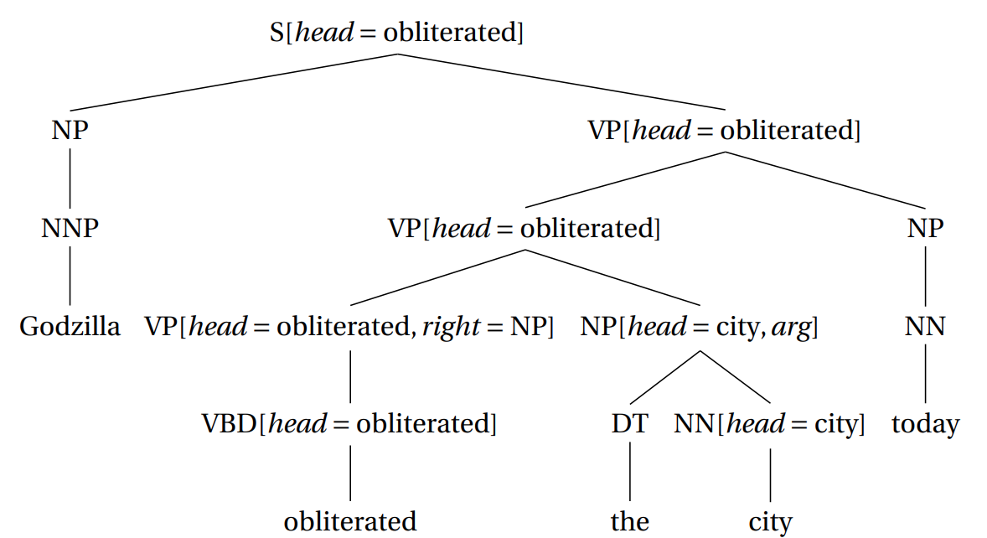
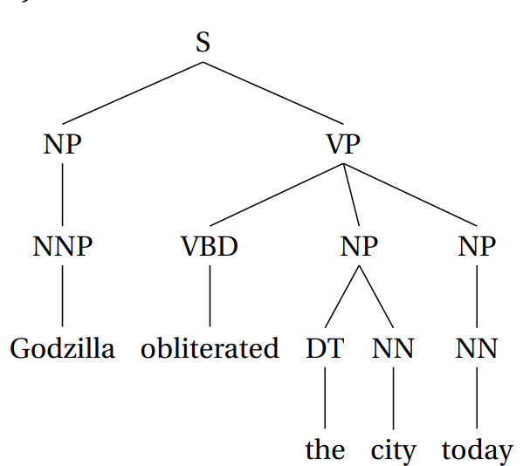
Subcategorization
Made child node depend on another (previous) child node
Same idea, but control the number of arguments depending on the verb
Make child depend on all of the previous arguments
Depend on none of the previous adjuncts
Marked arg!
Only keeps track of previous args

Slide 25
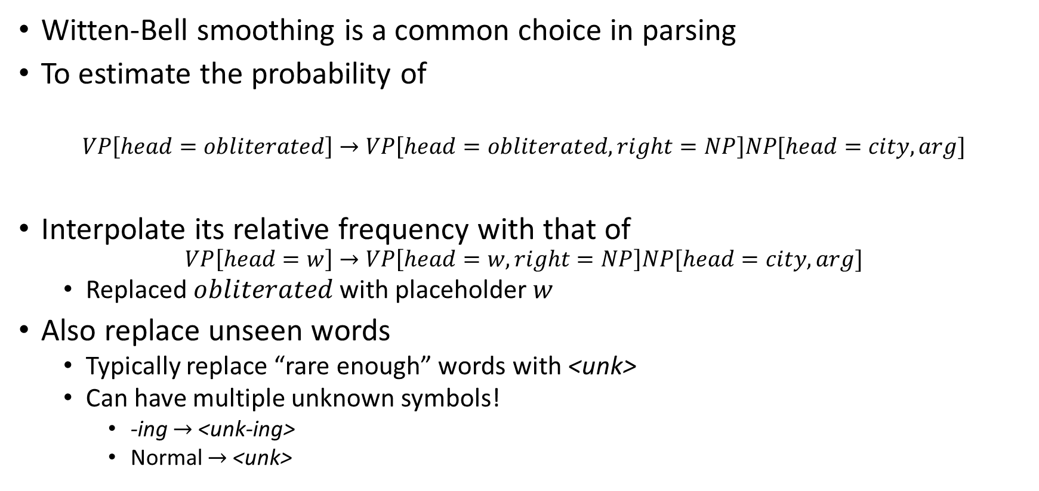
Smoothing
Witten-Bell smoothing is a common choice in parsing
To estimate the probability of
$$VP\left[head=obliterated\right]→VP\left[head=obliterated,right=NP\right]NP[head=city,arg]$$
Interpolate its relative frequency with that of
$$VP\left[head=w\right]→VP\left[head=w,right=NP\right]NP[head=city,arg]$$
Replaced $obliterated$ with placeholder $w$
Also replace unseen words
Typically replace “rare enough” words with <unk>
Can have multiple unknown symbols!
-ing $→$ <unk-ing>
Normal $→$ <unk>

