Slide 1
Neural Parsing

Slide 2
Two (Major) Approaches
Dependency parsing
More widespread
Constituency parsing
What we’re focused on (neural version of our statistical parsing)
Two categories:
Models loosly based on pushdown automata (PDAs)
Models based on Context Free Grammars

Slide 3
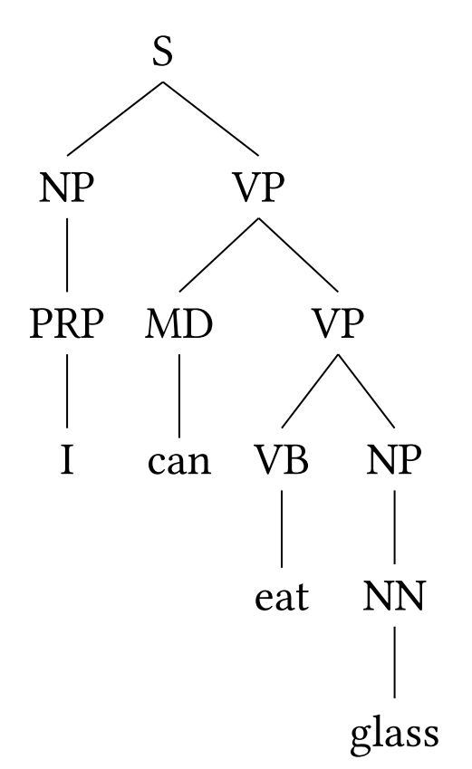
Stack-based approaches
Treat a tree as a sequence of symbols
Use some kind of stack to ensure the sequence is well formed
(kind of like how parentheses matching tools work)
This tree turns into
Search amongst flattened tree for the one with highest prob
Use a neural language model (mostly RNNs)

Slide 4
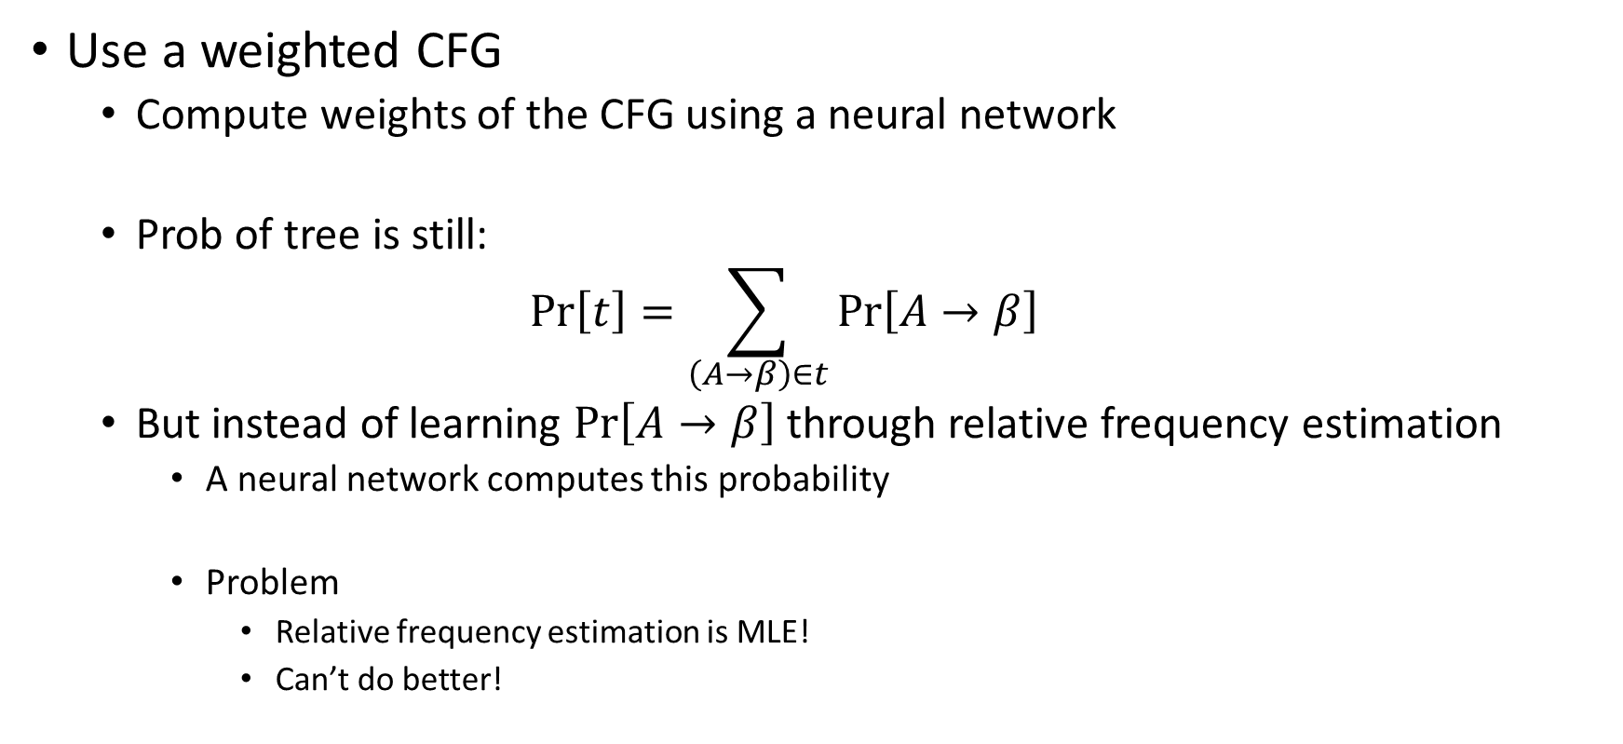
Grammar-based approaches
Use a weighted CFG
Compute weights of the CFG using a neural network
Prob of tree is still:
$$\operatorname{Pr}\left[t\right]=\sum_{\left(A→β\right)∈t}{\operatorname{Pr}\left[A→β\right]}$$
But instead of learning $\operatorname{Pr}\left[A→β\right]$ through relative frequency estimation
A neural network computes this probability
Problem
Relative frequency estimation is MLE!
Can’t do better!

Slide 5
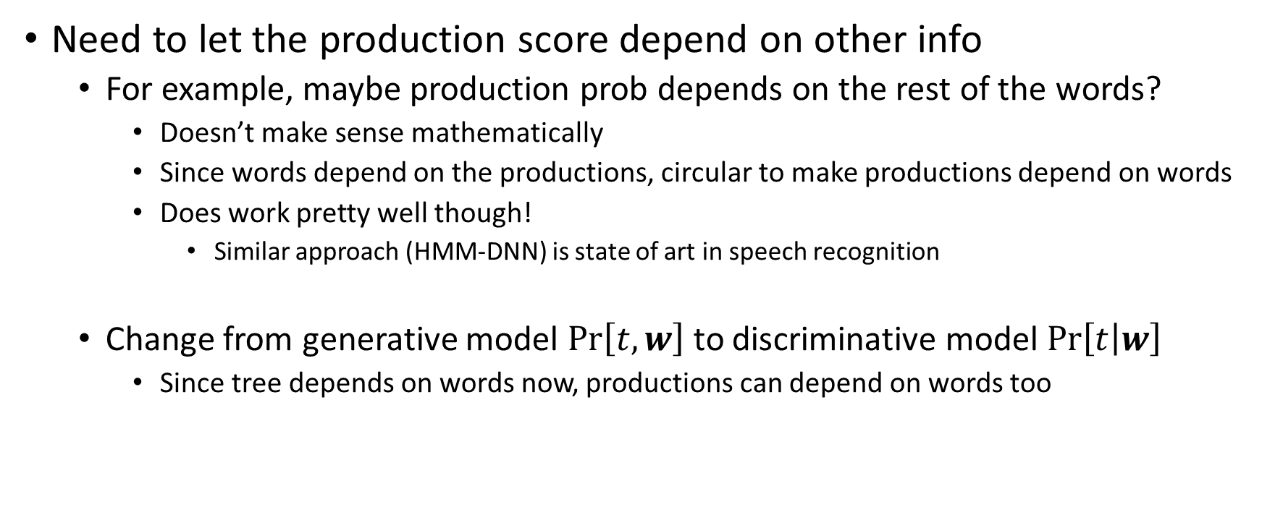
Grammar-based approaches
Need to let the production score depend on other info
For example, maybe production prob depends on the rest of the words?
Doesn’t make sense mathematically
Since words depend on the productions, circular to make productions depend on words
Does work pretty well though!
Similar approach (HMM-DNN) is state of art in speech recognition
Change from generative model $\operatorname{Pr}\left[t,w\right]$ to discriminative model $\operatorname{Pr}\left[t | w\right]$
Since tree depends on words now, productions can depend on words too

Slide 6

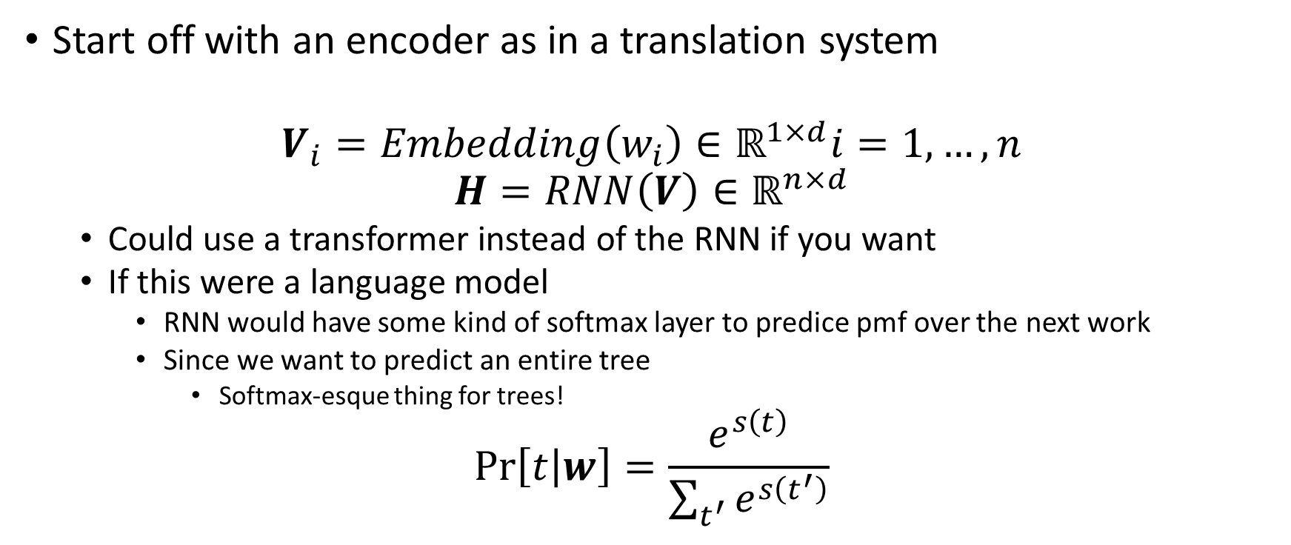
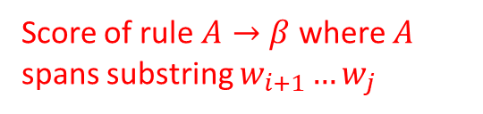
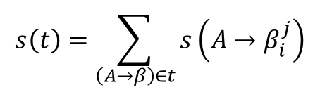
Grammar-based approaches
$$s\left(t\right)=\sum_{\left(A→β\right)∈t}{s\left(A→β_{i}^{j}\right)}$$
Score of rule $A→β$ where $A$ spans substring $w_{i+1}…w_{j}$
Start off with an encoder as in a translation system
$$V_{i}=Embedding\left(w_{i}\right)∈ℝ^{1×d}i=1,…,n$$
$$H=RNN\left(V\right)∈ℝ^{n×d}$$
Could use a transformer instead of the RNN if you want
If this were a language model
RNN would have some kind of softmax layer to predice pmf over the next work
Since we want to predict an entire tree
Softmax-esque thing for trees!
$$\operatorname{Pr}\left[t | w\right]=\frac{e^{s\left(t\right)}}{\sum_{t^{′}}{e^{s\left(t^{′}\right)}}}$$
All trees $t^{′}$ must have $w$ as the leaf nodes

Slide 7
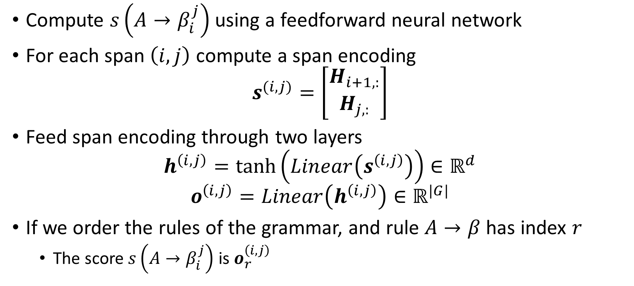
Grammar-based approaches
Compute $s\left(A→β_{i}^{j}\right)$ using a feedforward neural network
For each span $\left(i, j\right)$ compute a span encoding
$$s^{(i,j)}=\left[\begin{matrix}H_{i+1,:} \\ H_{j,:}\end{matrix}\right]$$
Feed span encoding through two layers
$$h^{\left(i,j\right)}=\tanh\left(Linear\left(s^{\left(i,j\right)}\right)\right)∈ℝ^{d}$$
$$o^{\left(i,j\right)}=Linear\left(h^{\left(i,j\right)}\right)∈ℝ^{|G|}$$
If we order the rules of the grammar, and rule $A→β$ has index $r$
The score $s\left(A→β_{i}^{j}\right)$ is $o_{r}^{\left(i,j\right)}$

Slide 8
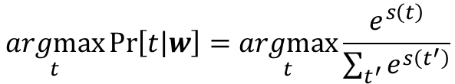
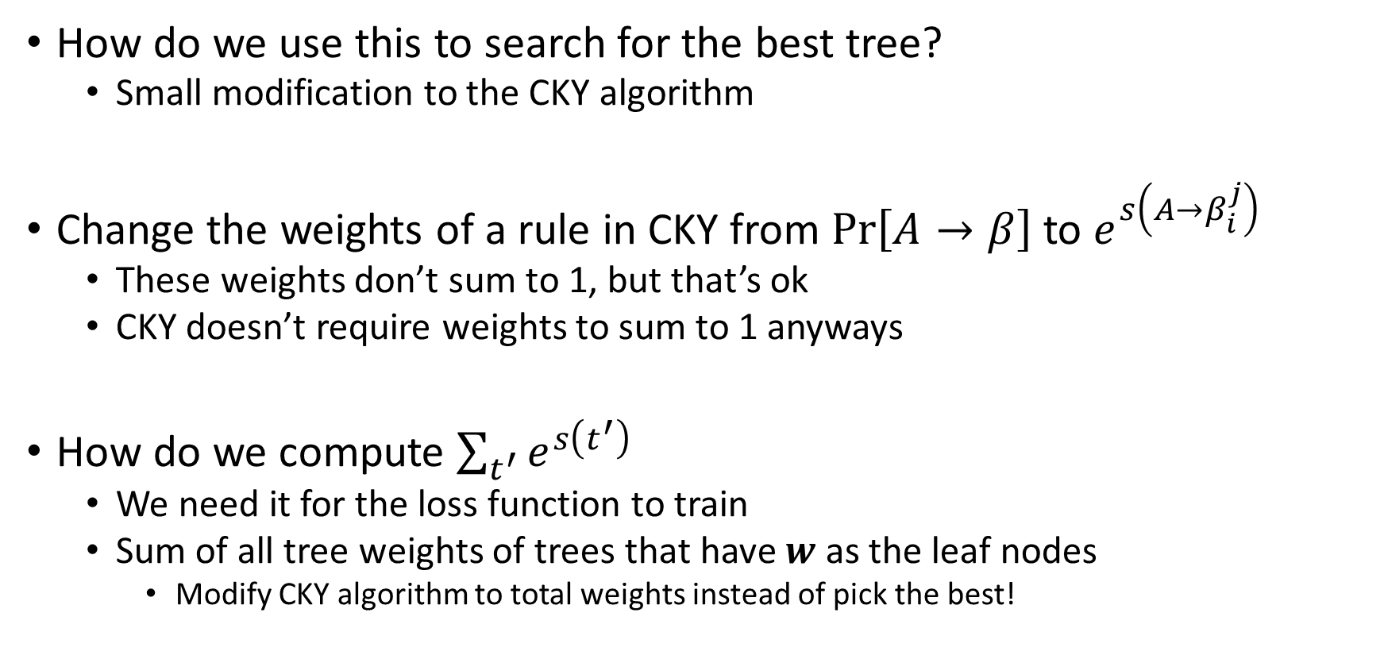
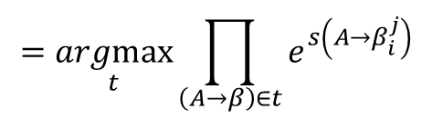

Grammar-based approach
$$\underset{t}{argmax}{\operatorname{Pr}\left[t | w\right]}=\underset{t}{argmax}{\frac{e^{s\left(t\right)}}{\sum_{t^{′}}{e^{s\left(t^{′}\right)}}}}$$
$$=\underset{t}{argmax}{e^{s\left(t\right)}}$$
$$=\underset{t}{argmax}{\prod_{\left(A→β\right)∈t}{e^{s\left(A→β_{i}^{j}\right)}}}$$
How do we use this to search for the best tree?
Small modification to the CKY algorithm
Change the weights of a rule in CKY from $\operatorname{Pr}\left[A→β\right]$ to $e^{s\left(A→β_{i}^{j}\right)}$
These weights don’t sum to 1, but that’s ok
CKY doesn’t require weights to sum to 1 anyways
How do we compute $\sum_{t^{′}}{e^{s\left(t^{′}\right)}}$
We need it for the loss function to train
Sum of all tree weights of trees that have $w$ as the leaf nodes
Modify CKY algorithm to total weights instead of pick the best!

Slide 9
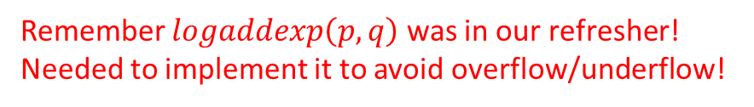
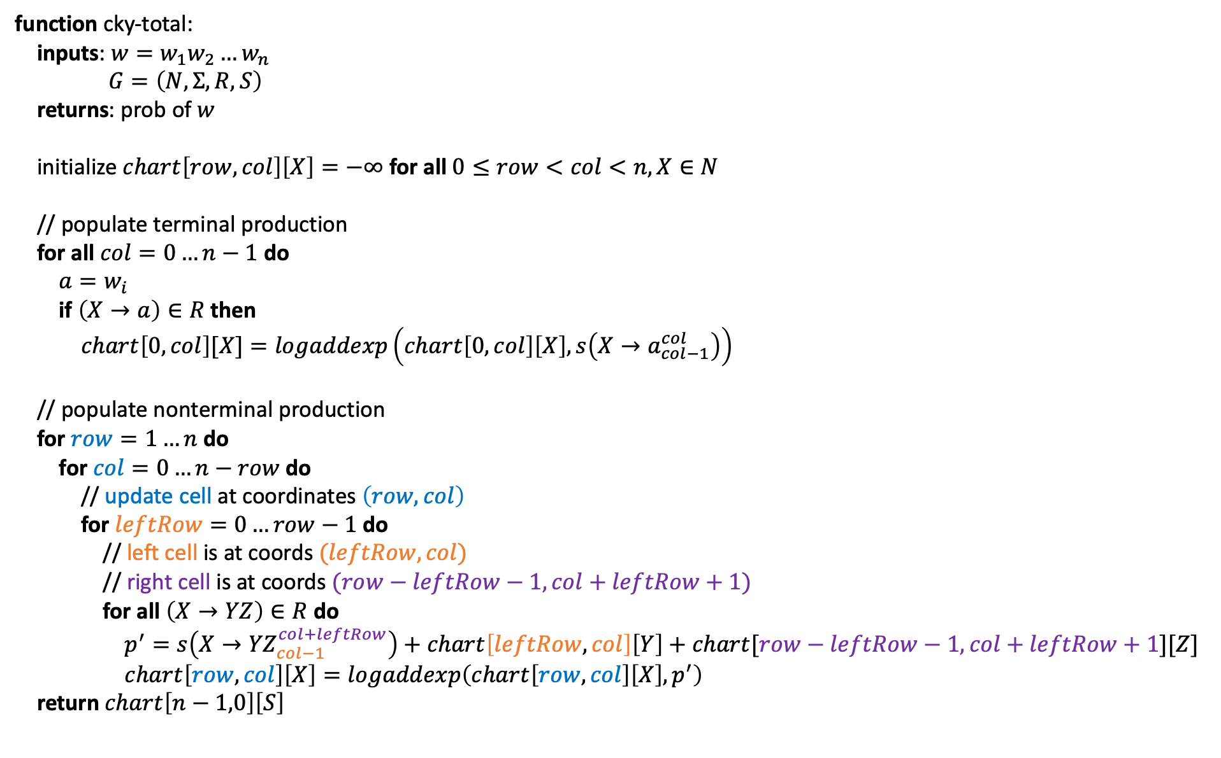
function cky-total:
inputs: $w=w_{1}w_{2}…w_{n}$
$G=\left(N,Σ,R,S\right)$
returns: prob of $w$
initialize $chart\left[row, col\right]\left[X\right]=−∞$ for all $0≤row<col<n,X∈N$
// populate terminal production
for all $col=0…n−1$ do
$a=w_{i}$
if $\left(X→a\right)∈R$ then
$chart\left[0,col\right][X]=logaddexp\left(chart\left[0,col\right]\left[X\right], s\left(X→a_{col−1}^{col}\right)\right)$
// populate nonterminal production
for $row=1…n$ do
for $col=0…n−row$ do
// update cell at coordinates $\left(row, col\right)$
for $leftRow=0…row−1$ do
// left cell is at coords $(leftRow, col)$
// right cell is at coords $(row−leftRow−1, col+leftRow+1)$
for all $\left(X→YZ\right)∈R$ do
$p^{′}=s\left(X→{YZ}_{col−1}^{col+leftRow}\right)+chart\left[leftRow, col\right]\left[Y\right]+chart[row−leftRow−1, col+leftRow+1][Z]$
$chart\left[row,col\right]\left[X\right]=logaddexp\left(chart\left[row,col\right]\left[X\right], p^{′}\right)$
return $chart\left[n−1,0\right]\left[S\right]$
Remember $logaddexp\left(p,q\right)$ was in our refresher!
Needed to implement it to avoid overflow/underflow!

