Slide 1
Semantics I

Slide 2
What is meaning?
Really abstract
Different kinds of meaning
The meaning of words = lexical semantics
The meaning of sentences/paragraphs/etc. = semantics
How to represent “meaning”
Vectors
Elements designed by humans (BoW) or learned automatically (word2vec, etc.)
Graphs
Vertices are entities and edges are relationships among them
Logic
Logical sentences = formulae of various kinds
First order logic?

Slide 3
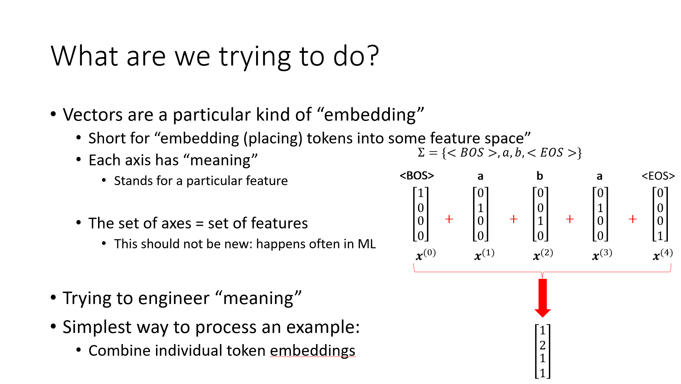
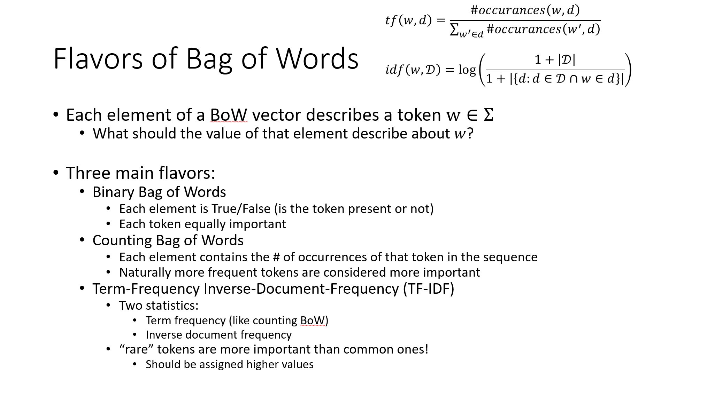
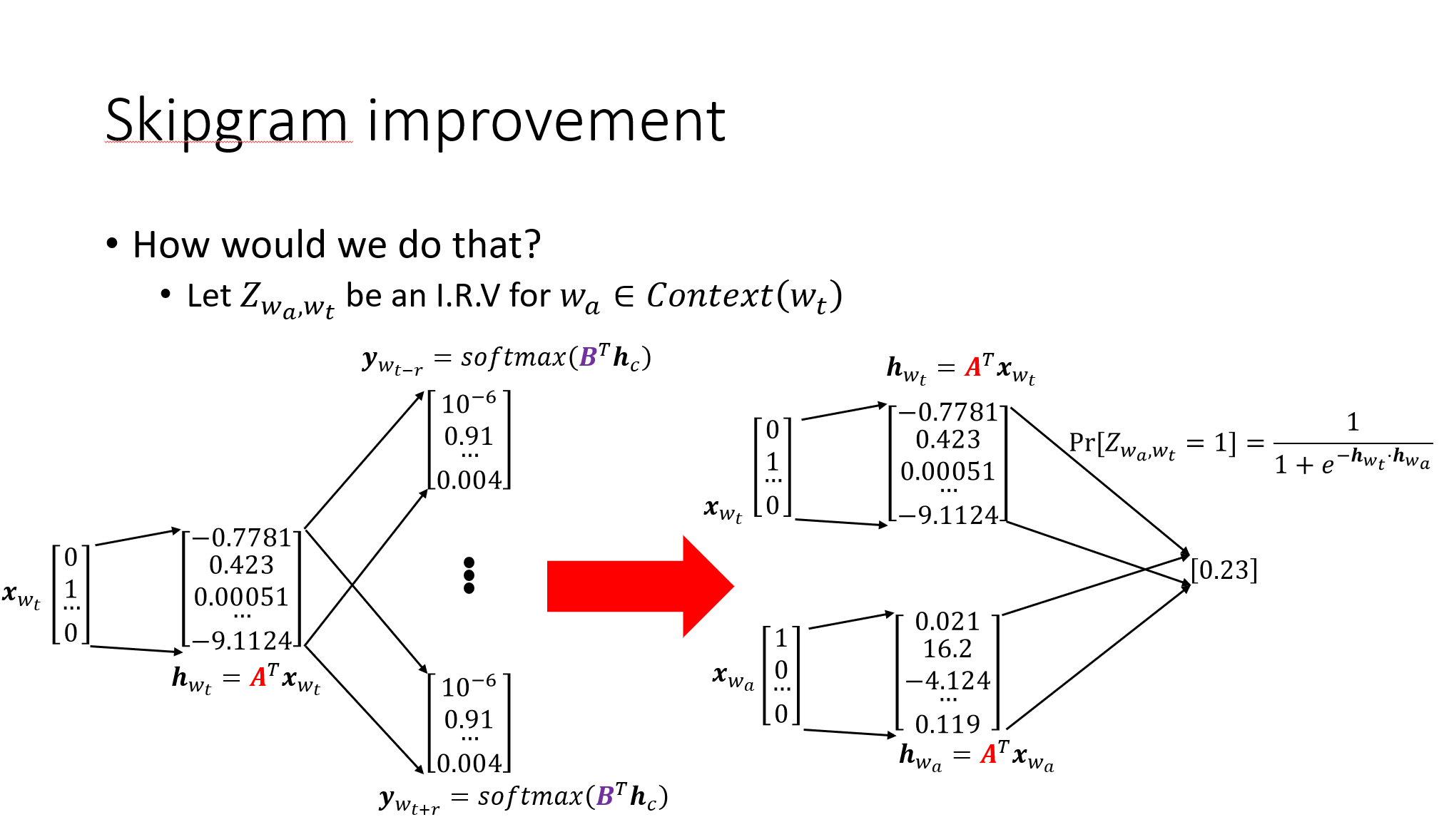
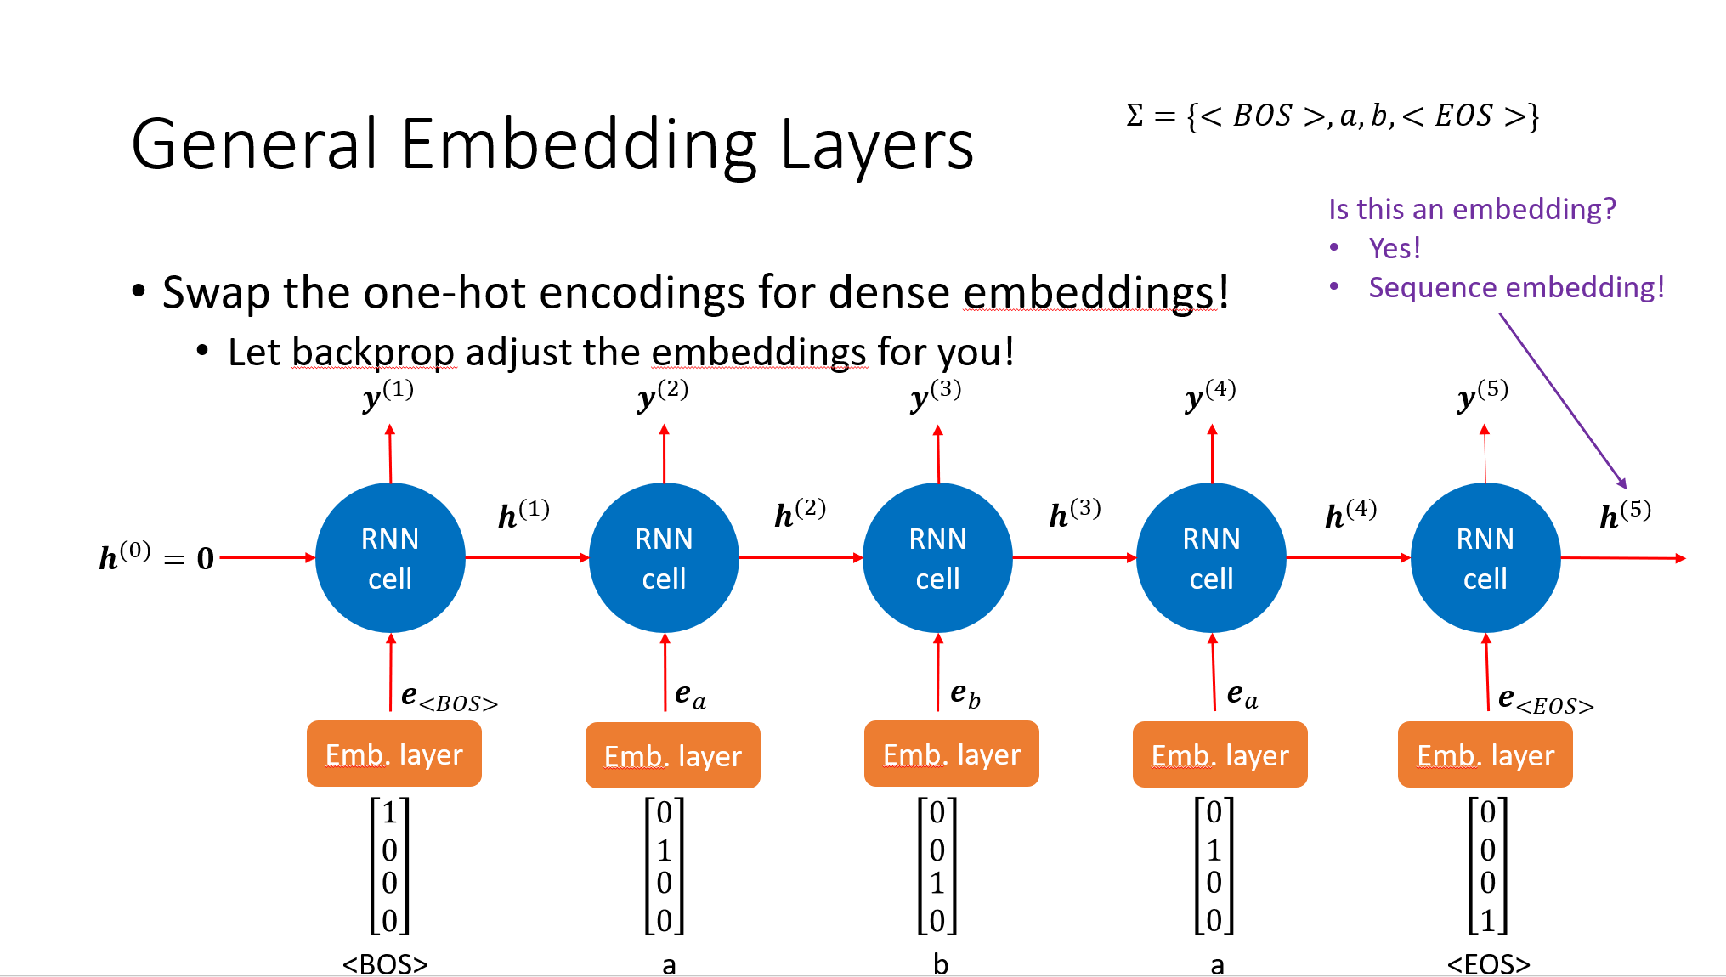
Some approaches we’ve seen already
Tried to design vectors ourselves
BoW
Ignores structure
Ignores semantic relationships
Let machine learn them
Approx meaning w/ context
Fixed size context
General embedding layers
IBM1/IBM2

Slide 4
Text Classification
Vector representations of text used naturally here
Represent text as a vector
Use an off-the-shelf classifier to predict the “type” of text
Simplest kind of model is the Naïve Bayes classifier

Slide 5
Our Example Data
Labels (aka “ground truth”)
Outlook | Temperature | Humidity | Windy? | Play Outside?
Sunny | Hot | High | False | No
Sunny | Hot | High | True | No
Overcast | Hot | High | False | Yes
Rainy | Mild | High | False | Yes
Rainy | Cool | Normal | False | Yes
Rainy | Cool | Normal | True | No
Overcast | Cool | Normal | True | Yes
Sunny | Mild | High | False | No
Sunny | Cool | Normal | False | Yes
Rainy | Mild | Normal | False | Yes
Sunny | Mild | Normal | True | Yes
Overcast | Mild | High | True | Yes
Overcast | Hot | Normal | False | Yes
Rainy | Mild | High | True | No

Slide 6
First Convert into Numeric Representation
Outlook | Temperature | Humidity | Windy? | Play Outside?
0 | 2 | 1 | 0 | 0
0 | 2 | 1 | 1 | 0
1 | 2 | 1 | 0 | 1
2 | 1 | 1 | 0 | 1
2 | 0 | 0 | 0 | 1
2 | 0 | 0 | 1 | 0
1 | 0 | 0 | 1 | 1
0 | 1 | 1 | 0 | 0
0 | 0 | 0 | 0 | 1
2 | 1 | 0 | 0 | 1
0 | 1 | 0 | 1 | 1
1 | 1 | 1 | 1 | 1
1 | 2 | 0 | 0 | 1
2 | 1 | 1 | 1 | 0

Slide 7
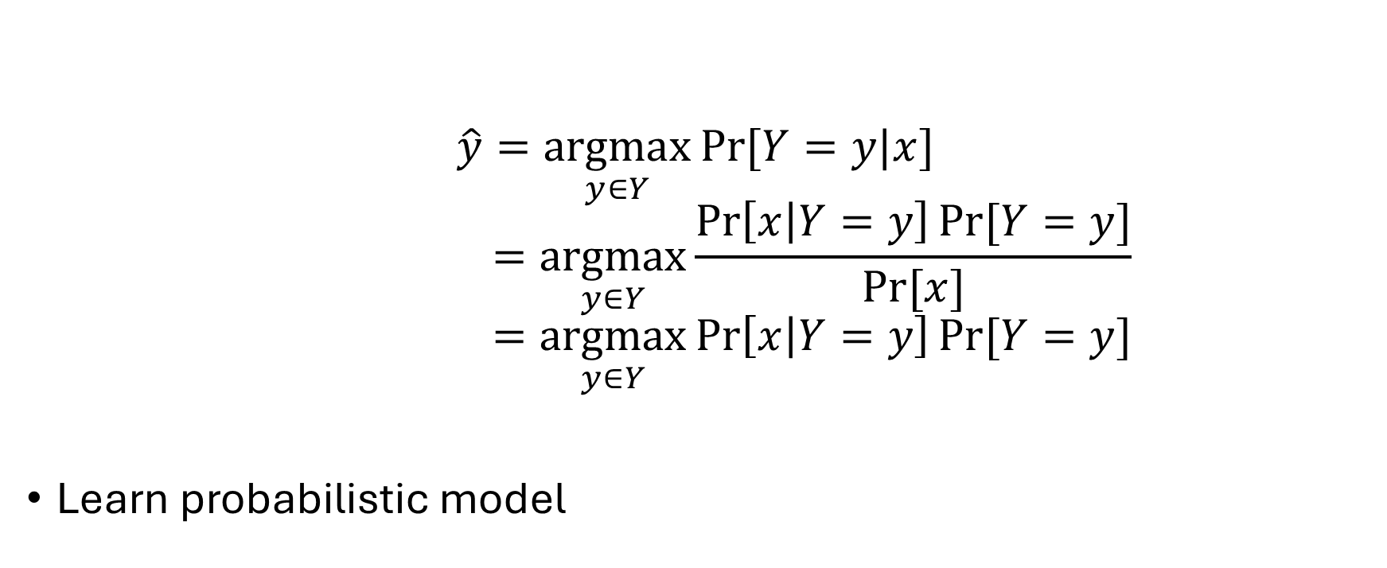
Modeling the Data
$$\hat{y}=\underset{y∈Y}{argmax}{Pr⁡[Y=y|x] }$$
$$=\underset{y∈Y}{argmax}{\frac{\operatorname{Pr}\left[x | Y=y\right]Pr⁡[Y=y]}{Pr⁡[x]}}$$
$$=\underset{y∈Y}{argmax}{\operatorname{Pr}\left[x | Y=y\right]Pr⁡[Y=y]}$$
Learn probabilistic model

Slide 8
The Hard Part
Outlook | Temperature | Humidity | Windy? | Play Outside?
0 | 2 | 1 | 0 | 0
0 | 2 | 1 | 1 | 0
1 | 2 | 1 | 0 | 1
2 | 1 | 1 | 0 | 1
2 | 0 | 0 | 0 | 1
2 | 0 | 0 | 1 | 0
1 | 0 | 0 | 1 | 1
0 | 1 | 1 | 0 | 0
0 | 0 | 0 | 0 | 1
2 | 1 | 0 | 0 | 1
0 | 1 | 0 | 1 | 1
1 | 1 | 1 | 1 | 1
1 | 2 | 0 | 0 | 1
Need to learn two things:
$\operatorname{Pr}{[Y]}$
Easy: just count!
$Pr⁡[x|Y]$
Hard, need to learn a joint distribution:
$Pr⁡[x_{Outlook},x_{Temp},x_{Humidity},x_{Windy}|Y]$
In general:
$\operatorname{Pr}\left[x | y\right]=Pr⁡[f_{1},f_{2},f_{3},…, f_{m}|Y]$
What should we do?
Naïve Bayes part:
Assume features are conditionally independent
$\operatorname{Pr}\left[f_{1},f_{2},f_{3},…, f_{m} | Y\right]=Pr⁡[f_{1}|Y]$ $Pr⁡[f_{2}|Y]$ $\operatorname{Pr}\left[f_{3} | Y\right]…Pr⁡[f_{m}|Y]$
2 | 1 | 1 | 1 | 0
Play Outside? = y | Pr[Y=y]
0 | 5/14
1 | 9/14
There may be a relation between temp and humidity, but
when Y tell me play or not, I can infer the humidity, and
nothing new will temp tell me
Conditionally independent vs independent

Slide 9
Naïve Bayes
Outlook | Temperature | Humidity | Windy? | Play Outside?
0 | 2 | 1 | 0 | 0
0 | 2 | 1 | 1 | 0
1 | 2 | 1 | 0 | 1
2 | 1 | 1 | 0 | 1
2 | 0 | 0 | 0 | 1
2 | 0 | 0 | 1 | 0
1 | 0 | 0 | 1 | 1
0 | 1 | 1 | 0 | 0
0 | 0 | 0 | 0 | 1
2 | 1 | 0 | 0 | 1
0 | 1 | 0 | 1 | 1
1 | 1 | 1 | 1 | 1
1 | 2 | 0 | 0 | 1
Since we assumed conditional independence:
Only need to focus on one feature at a time!
Much easier!
$\operatorname{Pr}\left[x_{Outlook} | Y\right]$
$Pr⁡[x_{Humidity}|Y]$
$Pr⁡[x_{Temp}|Y]$
$Pr⁡[x_{Windy}|Y]$
Be careful!
Don’t want 0 probs!
Smooth the distribution
2 | 1 | 1 | 1 | 0
Outlook | Pr[Outlook = x | Y = 0] | Pr[Outlook = x | Y = 1]
0 | 3/5 | 2/9
1 | 0/5 | 4/9
2 | 2/5 | 3/9
Humidity | Pr[Humidity = x | Y = 0] | Pr[Humidity = x | Y = 1]
0 | 2/5 | 6/9
1 | 3/5 | 3/9

Slide 10
Naïve Bayes Visually
$$\operatorname{Pr}\left[Outlook \right|Y]$$
$$\operatorname{Pr}\left[Temp \right|Y]$$
Outlook | Temperature | Humidity | Windy? | Play Outside?
0 | 2 | 1 | 0 | 0
0 | 2 | 1 | 1 | 0
1 | 2 | 1 | 0 | 1
2 | 1 | 1 | 0 | 1
2 | 0 | 0 | 0 | 1
2 | 0 | 0 | 1 | 0
1 | 0 | 0 | 1 | 1
$$Pr⁡[Y]$$
0 | 1 | 1 | 0 | 0
0 | 0 | 0 | 0 | 1
2 | 1 | 0 | 0 | 1
0 | 1 | 0 | 1 | 1
1 | 1 | 1 | 1 | 1
1 | 2 | 0 | 0 | 1
$$\operatorname{Pr}\left[Humidity \right|Y]$$
2 | 1 | 1 | 1 | 0
An instance of a Bayesian network
$$\operatorname{Pr}\left[Windy \right|Y]$$
NP hard but useful

Slide 11
How to Make Predictions
function predict(x) returns int // class label
best_prob = -inf
best_class = -1
for y $∈$ Y do
$\operatorname{Pr}\left[Y=y | x\right]=Pr[Y=y]\prod_{f∈F}{Pr⁡[f=x_{f}|Y=y]}$
if $\operatorname{Pr}\left[Y=y | x\right]$ > best_prob then
best_prob = $\operatorname{Pr}\left[Y=y | x\right]$
best_class = y
end if
end for
return best_class
Super tiny prob -> log_prob

Slide 12
Continuous Features
The node no longer contains a pmf
That’s ok!
Parameterize with a pdf
For instance, assume a Gaussian (or another pdf)
Learn the parameters of the pdf from the feature data!
When making predictions:
You have the feature value: how likely is it to be drawn from the pdf!

Slide 13

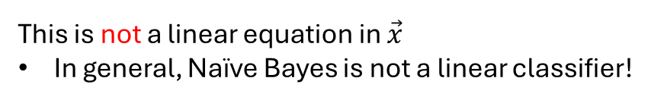
Decision Boundary?
Shape for classification
$$σ\left(z\right)=\frac{1}{1+e^{−z}}$$
$$=σ\left(\log\left(\frac{\operatorname{Pr}\left[\vec{x} | c=1\right]}{\operatorname{Pr}\left[\vec{x} | c=0\right]}\right)+\log\left(\frac{\operatorname{Pr}\left[c=1\right]}{\operatorname{Pr}\left[c=0\right]}\right)\right)$$
Consider binary classification
Argument extends to higher dims
$$=σ\left(\log\left(\frac{\operatorname{Pr}\left[c=1\right]}{\operatorname{Pr}\left[c=0\right]}\right)+\sum_{x_{i}}{\log\left(\frac{\operatorname{Pr}\left[x_{i} | c=1\right]}{\operatorname{Pr}\left[x_{i} | c=0\right]}\right)}\right)$$
$$\operatorname{Pr}\left[c=1 | \vec{x}\right]=\frac{\operatorname{Pr}\left[\vec{x} | c=1\right]\operatorname{Pr}\left[c=1\right]}{\operatorname{Pr}\left[\vec{x} | c=1\right]\operatorname{Pr}\left[c=1\right]+\operatorname{Pr}\left[\vec{x} | c=0\right]\operatorname{Pr}\left[c=0\right]}$$
$$=\frac{1}{1+\frac{\operatorname{Pr}\left[\vec{x} | c=0\right]\operatorname{Pr}\left[c=0\right]}{\operatorname{Pr}\left[\vec{x} | c=1\right]\operatorname{Pr}\left[c=1\right]}}$$
Hmmm….are we stuck?
This is not a linear equation in $\vec{x}$
In general, Naïve Bayes is not a linear classifier!
$$=\frac{1}{1+e^{−\log\left(\frac{\operatorname{Pr}\left[\vec{x} | c=1\right]\operatorname{Pr}\left[c=1\right]}{\operatorname{Pr}\left[\vec{x} | c=0\right]\operatorname{Pr}\left[c=0\right] }\right)}}$$
What if $\operatorname{Pr}\left[x_{i}\right|c]$ is from the exponential family?
Gaussian
Exponential
Bernoulli
Dirichlet
Poisson
…
$$=\frac{1}{1+e^{−\log\left(\frac{\operatorname{Pr}\left[\vec{x} | c=1\right]}{\operatorname{Pr}\left[\vec{x} | c=0\right]}\right) −\log\left(\frac{\operatorname{Pr}\left[c=1\right]}{\operatorname{Pr}\left[c=0\right]}\right)}}$$

Slide 14
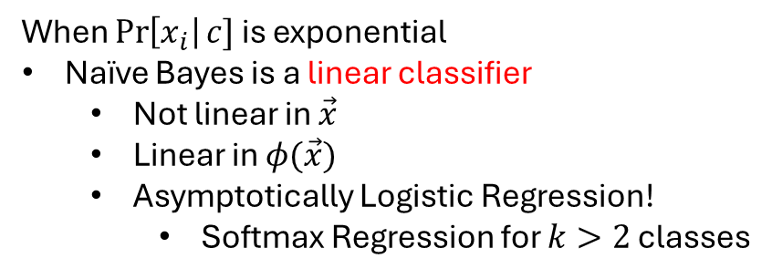
When $\operatorname{Pr}\left[x_{i}\right|c]$ is from the exponential family
General formula for distribution in exponential family
$$=σ\left(b+\sum_{x_{i}}{{\vec{w}}^{T}φ_{i}\left(x_{i}\right)}\right)$$
$\operatorname{Pr}\left[x_{i}\right|c]=h_{i}\left(x_{i}\right)e^{{{\vec{w}}_{i}^{c}}^{T}φ_{i}\left(x_{i}\right)−f\left({\vec{w}}_{i}^{c}\right)}$
offset
amplitude
Linear comb. of features
When $\operatorname{Pr}\left[x_{i}\right|c]$ is exponential
Naïve Bayes is a linear classifier
Not linear in $\vec{x}$
Linear in $φ(\vec{x})$
Asymptotically Logistic Regression!
Softmax Regression for $k>2$ classes
$$\operatorname{Pr}\left[c=1 | \vec{x}\right]=σ\left(\log\left(\frac{\operatorname{Pr}\left[c=1\right]}{\operatorname{Pr}\left[c=0\right]}\right)+\sum_{x_{i}}{\log\left(\frac{\operatorname{Pr}\left[x_{i} | c=1\right]}{\operatorname{Pr}\left[x_{i} | c=0\right]}\right)}\right)$$
$$=σ\left(\log\left(\frac{\operatorname{Pr}\left[c=1\right]}{\operatorname{Pr}\left[c=0\right]}\right)+\sum_{x_{i}}{\log\left(\frac{h_{i}\left(x_{i}\right)e^{{{\vec{w}}_{i}^{1}}^{T}φ_{i}\left(x_{i}\right)−f\left({\vec{w}}_{i}^{1}\right)}}{h_{i}\left(x_{i}\right)e^{{{\vec{w}}_{i}^{0}}^{T}φ_{i}\left(x_{i}\right)−f\left({\vec{w}}_{i}^{0}\right)}}\right)}\right)$$
$$=σ\left(\log\left(\frac{\operatorname{Pr}\left[c=1\right]}{\operatorname{Pr}\left[c=0\right]}\right)+\sum_{x_{i}}{\left[\log\left(\frac{h_{i}\left(x_{i}\right)}{h_{i}\left(x_{i}\right)}\right)+\log\left(e^{{{\vec{w}}_{i}^{1}}^{T}φ_{i}\left(x_{i}\right)−f\left({\vec{w}}_{i}^{1}\right)−\left({{\vec{w}}_{i}^{0}}^{T}φ_{i}\left(x_{i}\right)−f\left({\vec{w}}_{i}^{0}\right)\right)}\right)\right]}\right)$$
$$=σ\left(\log\left(\frac{\operatorname{Pr}\left[c=1\right]}{\operatorname{Pr}\left[c=0\right]}\right)+\sum_{x_{i}}{\left[−f\left({\vec{w}}_{i}^{1}\right)+f\left({\vec{w}}_{i}^{0}\right)\right]}+\sum_{x_{i}}{\left({{\vec{w}}_{i}^{1}}^{T}−{{\vec{w}}_{i}^{0}}^{T}\right)φ_{i}\left(x_{i}\right)}\right)$$
Constant offset $b$
Weights $\vec{w}$

Slide 15
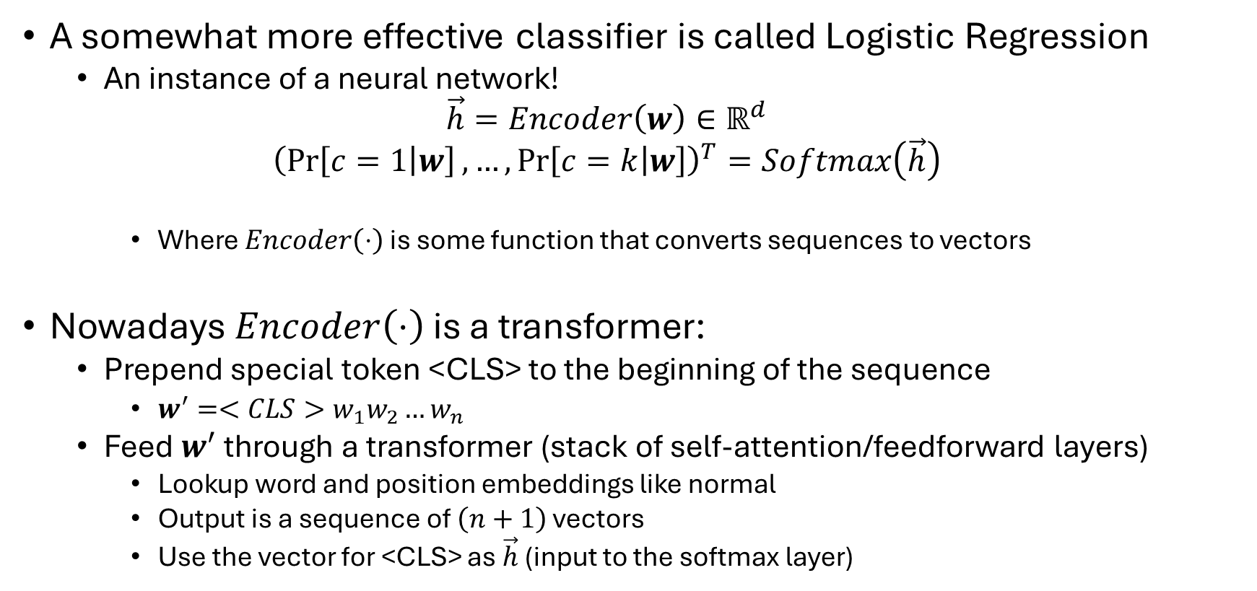
Text Classification
A somewhat more effective classifier is called Logistic Regression
An instance of a neural network!
$$\vec{h}=Encoder\left(w\right)∈ℝ^{d}$$
$${\left(\operatorname{Pr}\left[c=1 | w\right], …,\operatorname{Pr}\left[c=k | w\right]\right)}^{T}=Softmax\left(\vec{h}\right)$$
Where $Encoder\left(⋅\right)$ is some function that converts sequences to vectors
Nowadays $Encoder\left(⋅\right)$ is a transformer:
Prepend special token <CLS> to the beginning of the sequence
$w^{′}=<CLS>w_{1}w_{2}…w_{n}$
Feed $w^{′}$ through a transformer (stack of self-attention/feedforward layers)
Lookup word and position embeddings like normal
Output is a sequence of $\left(n+1\right)$ vectors
Use the vector for <CLS> as $\vec{h}$ (input to the softmax layer)

Slide 16

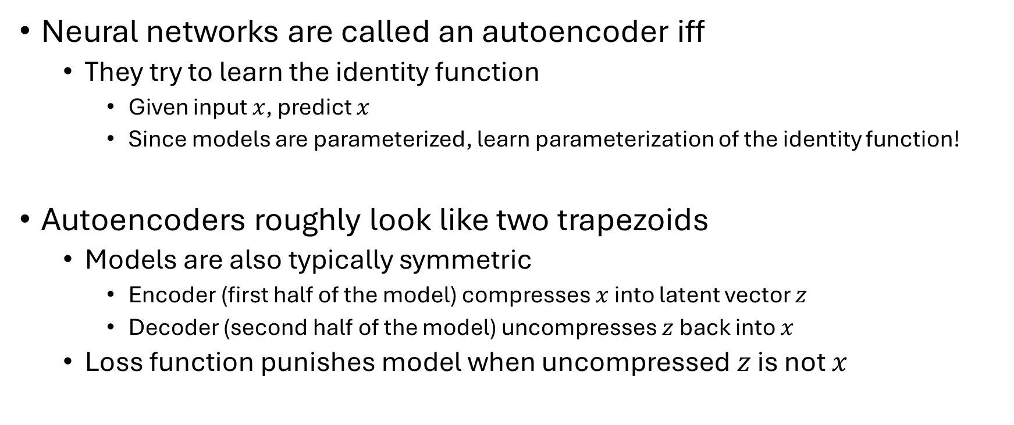


Autoencoders
$$x$$
$$z$$
$$x$$
Neural networks are called an autoencoder iff
They try to learn the identity function
Given input $x$, predict $x$
Since models are parameterized, learn parameterization of the identity function!
Autoencoders roughly look like two trapezoids
Models are also typically symmetric
Encoder (first half of the model) compresses $x$ into latent vector $z$
Decoder (second half of the model) uncompresses $z$ back into $x$
Loss function punishes model when uncompressed $z$ is not $x$

Slide 17



















Autoencoders
Neural networks can have more than a single output
Often an autoencoder is used as one “branch” of the model
$$\operatorname{Pr}\left[c | w\right]$$
$$\operatorname{Pr}\left[w_{1} | w_{<1}\right]$$
$$\operatorname{Pr}\left[w_{2} | w_{<2}\right]$$
$$\operatorname{Pr}\left[w_{n+1} | w_{<n+1}\right]$$
Softmax
$$g^{(1)}$$
$$g^{(2)}$$
$$g^{(m)}$$
$$g^{(m+1)}$$
$$h^{(1)}$$
$$h^{(2)}$$
$$h^{(n+1)}$$
$$h^{(n+2)}$$
$$h^{(0)}=0$$
$$<BOS>$$
$$w_{1}$$
$$w_{n}=<EOS>$$
$$<BOS>$$
$$w_{1}$$
$$w_{n+1}=<EOS>$$

Slide 18

Sparse Autoencoders
How many dimensions should my latent vector be?
Idea: what if I let the model figure it out?
How?
Invert the trapezoids
Give the model lots of dims to use
Punish the model for using them
Make latent vector $z$ sparse!
“Only use what it needs”

Slide 19
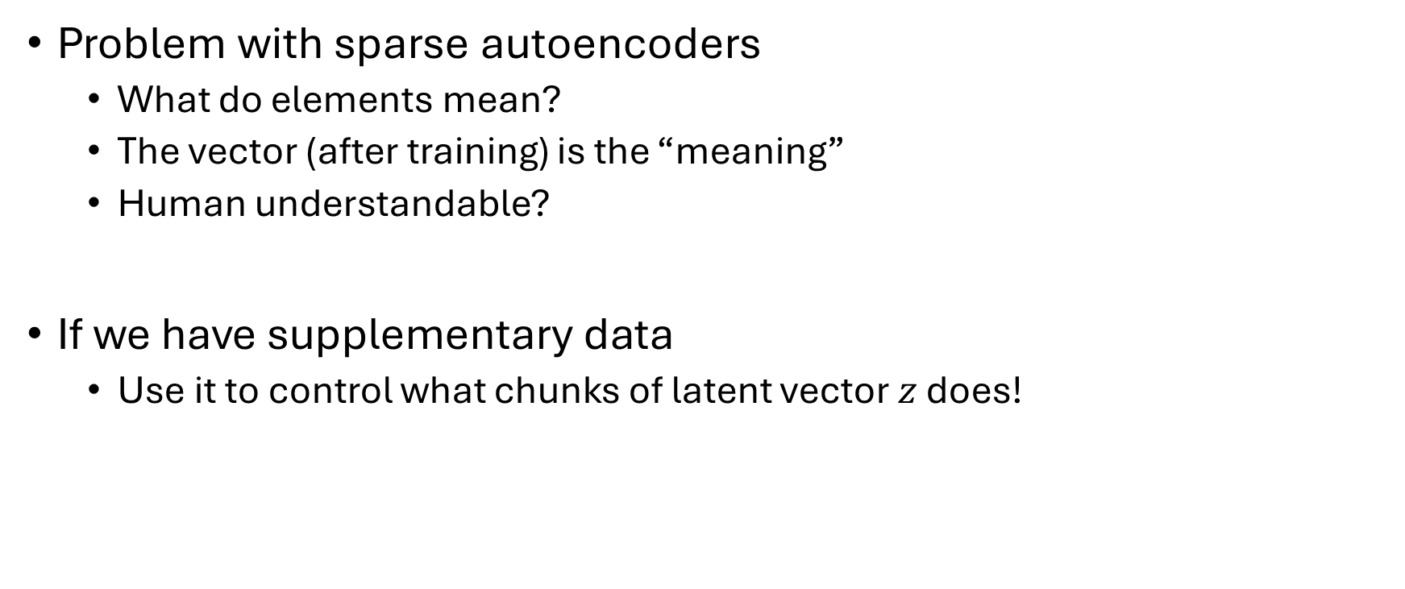
Structured Sparse Autoencoders
Problem with sparse autoencoders
What do elements mean?
The vector (after training) is the “meaning”
Human understandable?
If we have supplementary data
Use it to control what chunks of latent vector $z$ does!

Slide 20




















Structured Sparse Autoencoders
Dataset
Encode something about $q^{(i)}$
Supplementary data
$$x^{(1)}$$
$$q^{(1)}$$
$$g^{(1)}$$
$$x^{(2)}$$
$$q^{(2)}$$
$$g^{(2)}$$
$$x^{(3)}$$
$$q^{(3)}$$
$$g^{(3)}$$
$$x^{(4)}$$
$$q^{(4)}$$
$$g^{(4)}$$
Encode something about $g^{(i)}$
$$x^{(N)}$$
$$q^{(N)}$$
$$g^{(N)}$$
$$x^{(i)}$$
$$z^{(i)}$$
$$x^{(i)}$$

