Slide 1
Language Models I

Slide 2
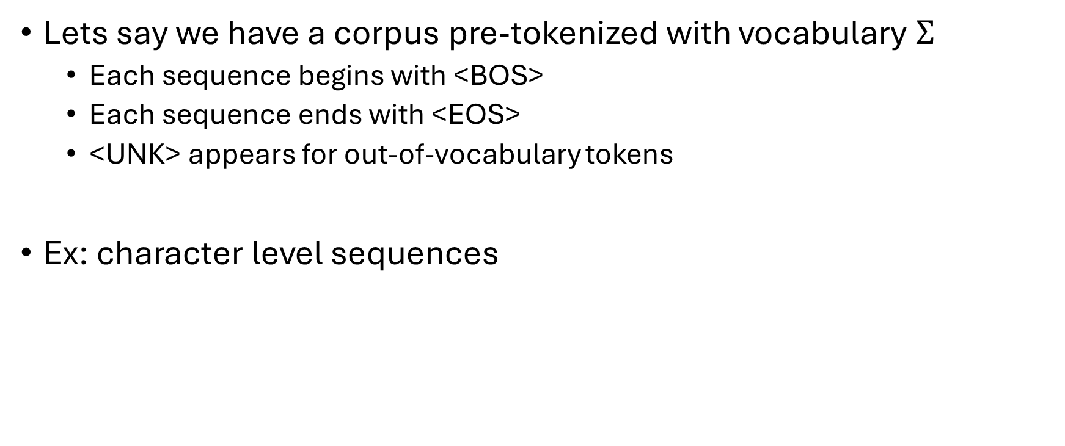
The Data
Lets say we have a corpus pre-tokenized with vocabulary $Σ$
Each sequence begins with <BOS>
Each sequence ends with <EOS>
<UNK> appears for out-of-vocabulary tokens
Ex: character level sequences
Raw text
Tokenized text (kept all characters in vocab)
ok 1 sec
bekks, was, he said he is not running that kernel
Mulder911 type ps -e|less <-- which has number 88 ?
[“<BOS>”, “o”, “k”, “ “, “1”, “ “, “s”, “e”, “c”, “<EOS>”]
[“<BOS>”, “b”, “e”, “k”, “k”, “s”, “,”, “ “, …, “l”, “<EOS>”]
[“<BOS>”, “M”, “u”, “l”, “d”, “e”, …, “8”, “8”, “?”, “<EOS>”]

Slide 3
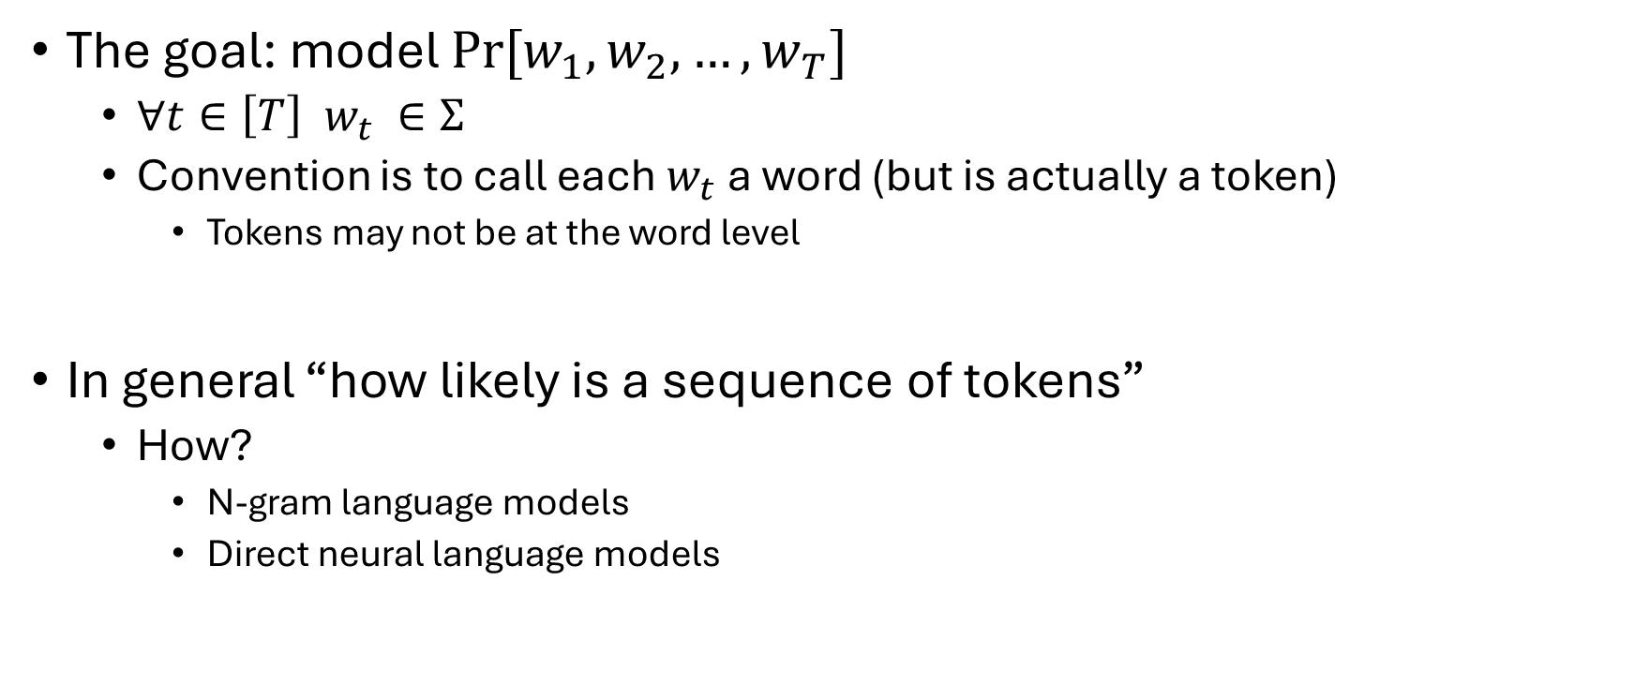
Language models: the goal
The goal: model $Pr⁡[w_{1},w_{2},…, w_{T}]$
$∀t∈\left[T\right] w_{t} ∈Σ$
Convention is to call each $w_{t}$ a word (but is actually a token)
Tokens may not be at the word level
In general “how likely is a sequence of tokens”
How?
N-gram language models
Direct neural language models

Slide 4
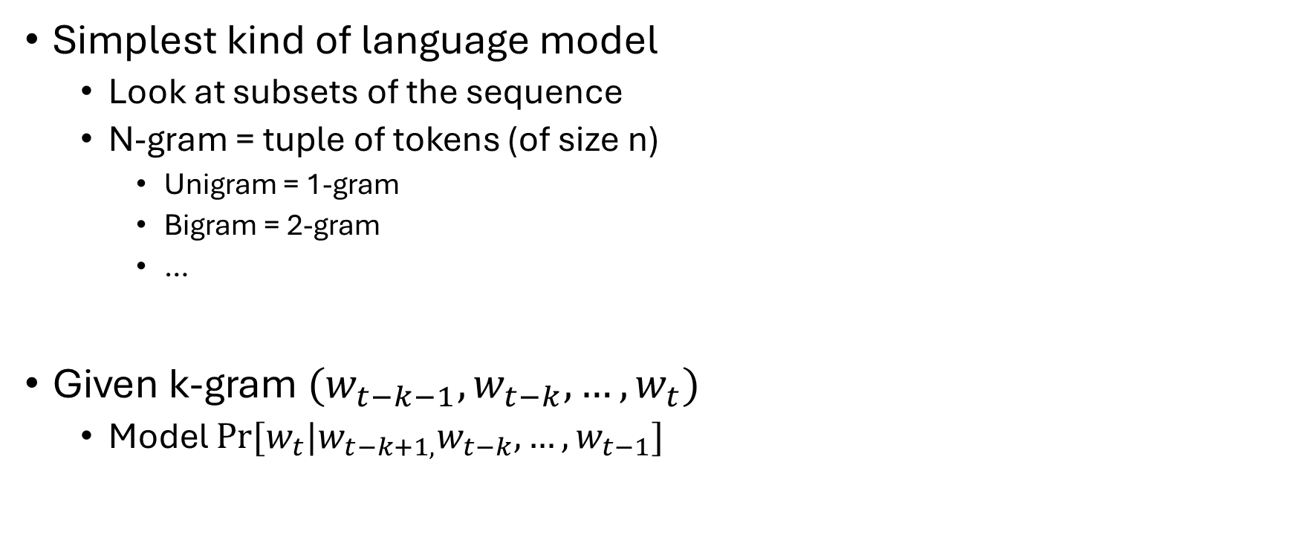
N-gram language models
Simplest kind of language model
Look at subsets of the sequence
N-gram = tuple of tokens (of size n)
Unigram = 1-gram
Bigram = 2-gram
…
Given k-gram $(w_{t−k−1}, w_{t−k}, …,w_{t})$
Model $Pr⁡[w_{t}|w_{t−k+1,}w_{t−k}, …, w_{t−1}]$

Slide 5

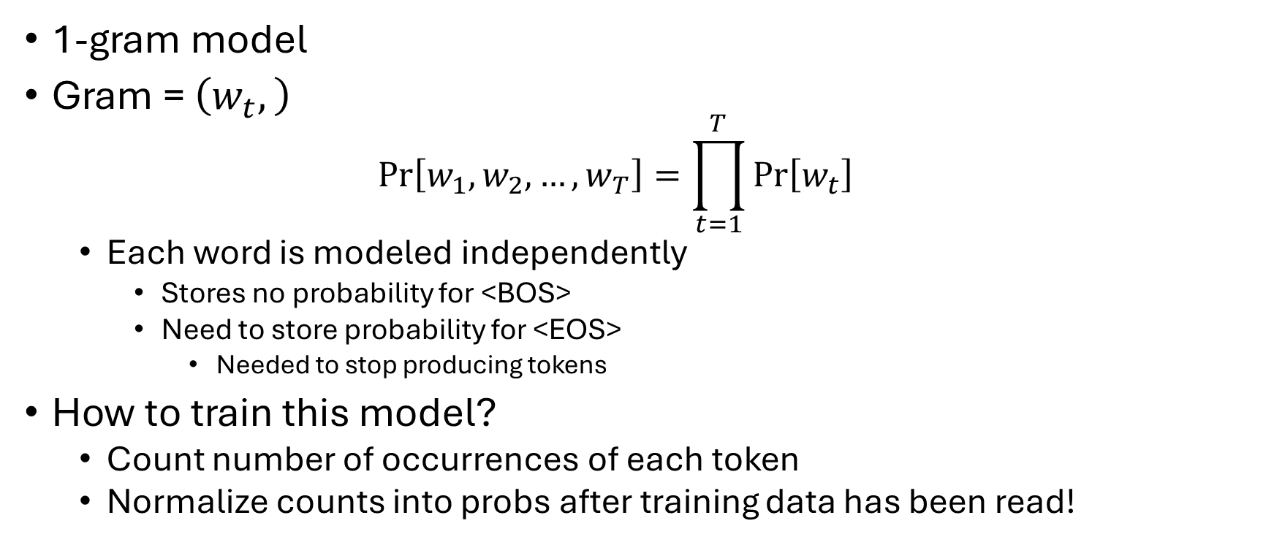



Unigram model
the cat sat on the mat
$Σ$ = {'sat', 'cat', 'mat', 'on', 'the', '<EOS>'}
$$w∈Σ$$
$$c\left(w\right)$$
$$\operatorname{Pr}\left[w\right]$$
sat
cat
mat
on
the
<EOS>
1
1
1
1
2
1
1/7
1/7
1/7
1/7
2/7
1/7
1-gram model
Gram = $\left(w_{t},\right)$
$$\operatorname{Pr}\left[w_{1},w_{2},…,w_{T}\right]=\prod_{t=1}^{T}{\operatorname{Pr}\left[w_{t}\right]}$$
Each word is modeled independently
Stores no probability for <BOS>
Need to store probability for <EOS>
Needed to stop producing tokens
How to train this model?
Count number of occurrences of each token
Normalize counts into probs after training data has been read!

Slide 6
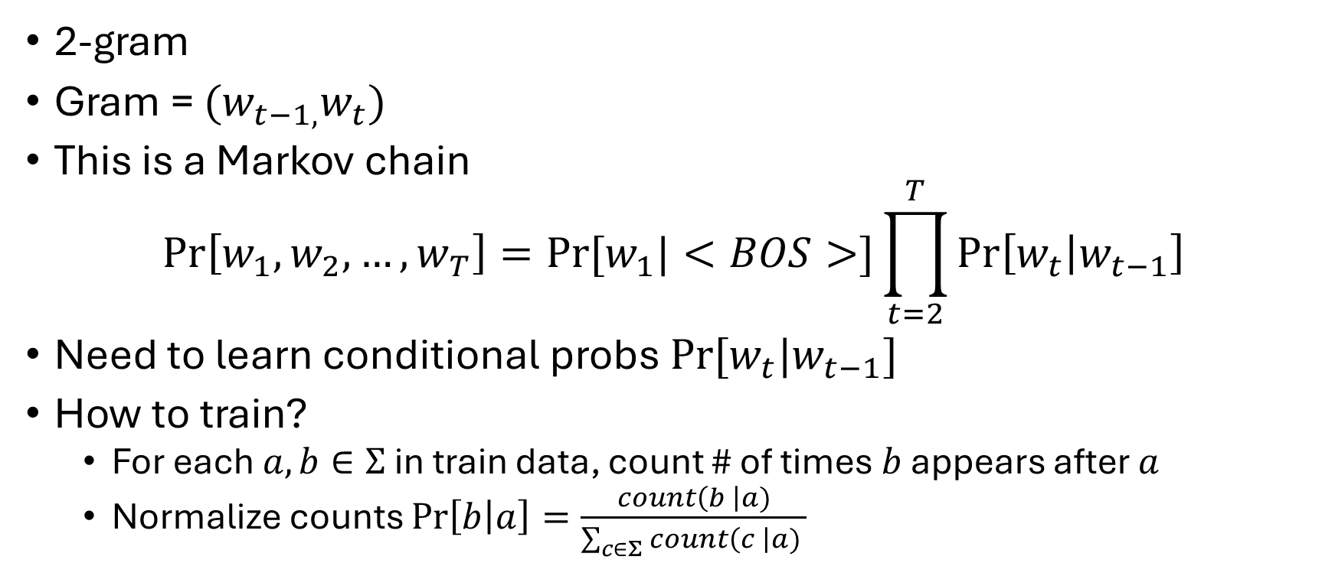



Bigram model
the cat sat on the mat
$Σ$ = {'sat', 'cat', 'mat', 'on', 'the', '<EOS>'}
$$(w_{t}, w_{t−1})$$
$$c\left(w_{t}|w_{t−1}\right)$$
$$\operatorname{Pr}\left[w_{t}|w_{t−1}\right]$$
(the, <BOS>)
(cat, the)
(sat, cat)
(on, sat)
(the, on)
(mat, the)
(<EOS>, mat)
1
1
1
1
1
1
1
1/1
1/2
1/1
1/1
1/1
1/2
1/1
2-gram
Gram = $(w_{t−1,}w_{t})$
This is a Markov chain
$$\operatorname{Pr}\left[w_{1},w_{2},…, w_{T}\right]=Pr⁡[w_{1}|<BOS>]\prod_{t=2}^{T}{\operatorname{Pr}\left[w_{t} | w_{t−1}\right]}$$
Need to learn conditional probs $Pr⁡[w_{t}|w_{t−1}]$
How to train?
For each $a,b∈Σ$ in train data, count # of times $b$ appears after $a$
Normalize counts $\operatorname{Pr}\left[b | a\right]=\frac{count\left(b \right|a)}{\sum_{c∈Σ}{count\left(c \right|a) }}$
After “the”, two choices (with 50% each)!

Slide 7
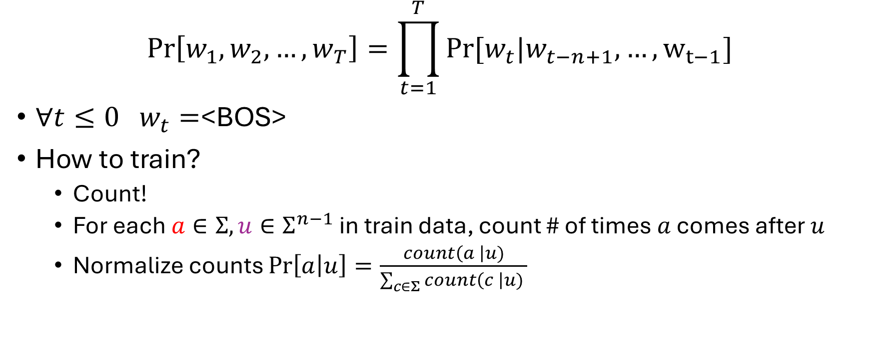
General n-gram
$$\operatorname{Pr}\left[w_{1},w_{2},…, w_{T}\right]=\prod_{t=1}^{T}{Pr⁡[w_{t}|w_{t−n+1}, …,w_{t−1}]}$$
$∀t≤0 w_{t}=$<BOS>
How to train?
Count!
For each $a∈Σ, u∈Σ^{n−1}$ in train data, count # of times $a$ comes after $u$
Normalize counts $\operatorname{Pr}\left[a | u\right]=\frac{count\left(a \right|u)}{\sum_{c∈Σ}{count\left(c \right|u) }}$
word
(n-1)-gram

Slide 8
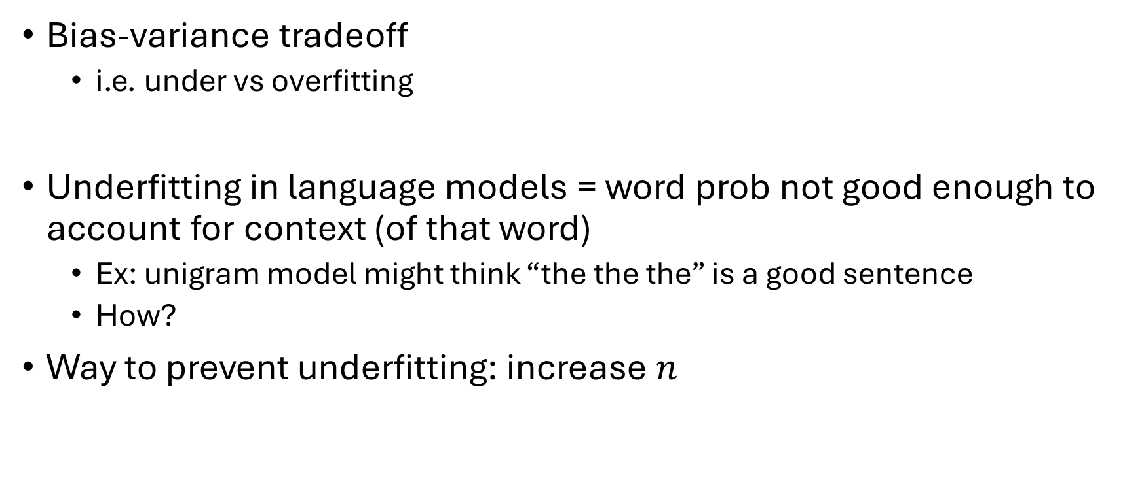
N-gram trouble
Bias-variance tradeoff
i.e. under vs overfitting
Underfitting in language models = word prob not good enough to account for context (of that word)
Ex: unigram model might think “the the the” is a good sentence
How?
Way to prevent underfitting: increase $n$

Slide 9



N-gram trouble
If underfitting is probs don’t account for word context
What do you think overfitting is in n-gram models?
Overestimates prob of words seen in data
Underestimates those not seen in data
For instance:
We need a way to redistribute prob mass
Are these good estimates?
$$\operatorname{Pr}\left[w | \text{the}\right]$$
$$\operatorname{Pr}\left[w | \text{the}\right]$$
$$count⁡(w|\text{the})$$
cat
dog
human
model
cat
dog
human
model
cat
dog
human
model

Slide 10

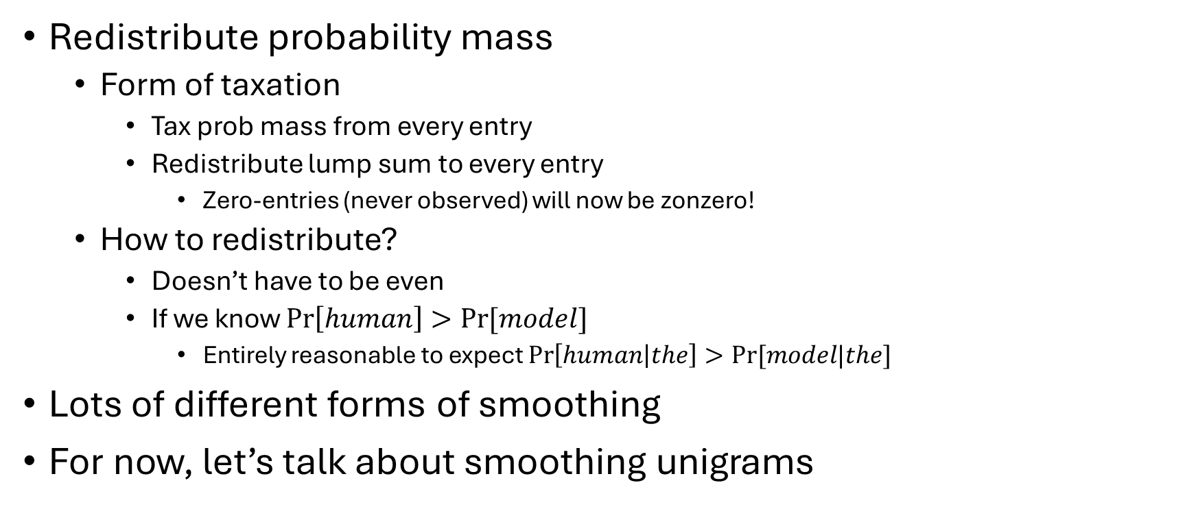

N-gram smoothing
Redistribute probability mass
Form of taxation
Tax prob mass from every entry
Redistribute lump sum to every entry
Zero-entries (never observed) will now be zonzero!
How to redistribute?
Doesn’t have to be even
If we know $\operatorname{Pr}\left[human\right]>Pr⁡[model]$
Entirely reasonable to expect $\operatorname{Pr}\left[human | the\right]>Pr⁡[model|the]$
Lots of different forms of smoothing
For now, let’s talk about smoothing unigrams
$$count⁡(w|\text{the})$$
cat
dog
human
model
$$\operatorname{Pr}\left[w\right]$$
cat
dog
human
model

Slide 11
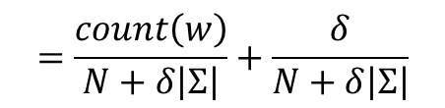

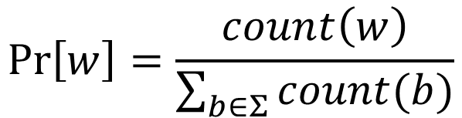
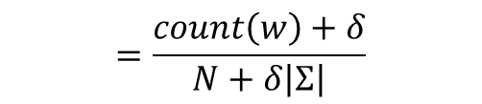


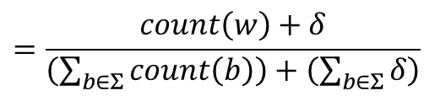

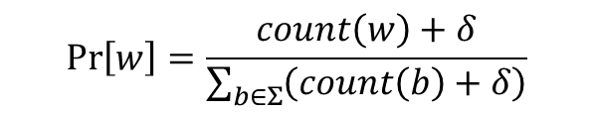

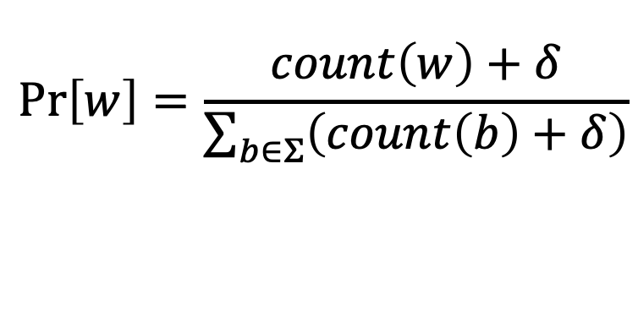
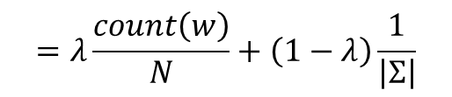
Additive smoothing
You probably have seen this before
Lets write it another way to make it more clear
$$\operatorname{Pr}\left[w\right]=\frac{count\left(w\right)+δ}{\sum_{b∈Σ}{\left(count\left(b\right)+δ\right)}}$$
$$=\frac{count\left(w\right)}{N+δ\left|Σ\right|}+\frac{δ}{N+δ\left|Σ\right|}$$
$$=\frac{count\left(w\right)+δ}{\left(\sum_{b∈Σ}{count\left(b\right)}\right)+\left(\sum_{b∈Σ}{δ}\right)}$$
$$=λ\frac{count\left(w\right)}{N}+\left(1−λ\right)\frac{1}{\left|Σ\right|}$$
Easiest form of smoothing
Add $δ>0$ to every count
When $δ$=1, this is called Laplace or add-one smoothing
In general, add- $δ$ smoothing is easy but hard to tune
Small $δ$, “trusting” counts
High $δ$, everything becomes more uniform
$$=\frac{count\left(w\right)+δ}{N+δ\left|Σ\right|}$$
$$λ=\frac{N}{N+δ|Σ|}$$
where
This is the pagerank transform!
Convex comb. of MLE & uniform!
$$\operatorname{Pr}\left[w\right]=\frac{count\left(w\right)}{\sum_{b∈Σ}{count(b)}}$$
$$\operatorname{Pr}\left[w\right]=\frac{count\left(w\right)+δ}{\sum_{b∈Σ}{\left(count\left(b\right)+δ\right)}}$$
Tune on held out data (dev/validation set)
Another popular option:
Good to start with
$$δ=\frac{n_{1+}}{N}$$
$$λ=\frac{N}{N+n_{1+}}$$
Witten-Bell smoothing
$n_{r+}=$ # of vocab elements seen at least $r$ times

Slide 12
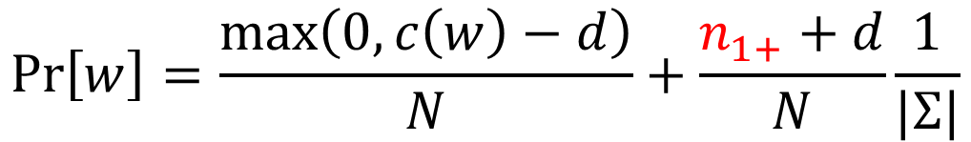
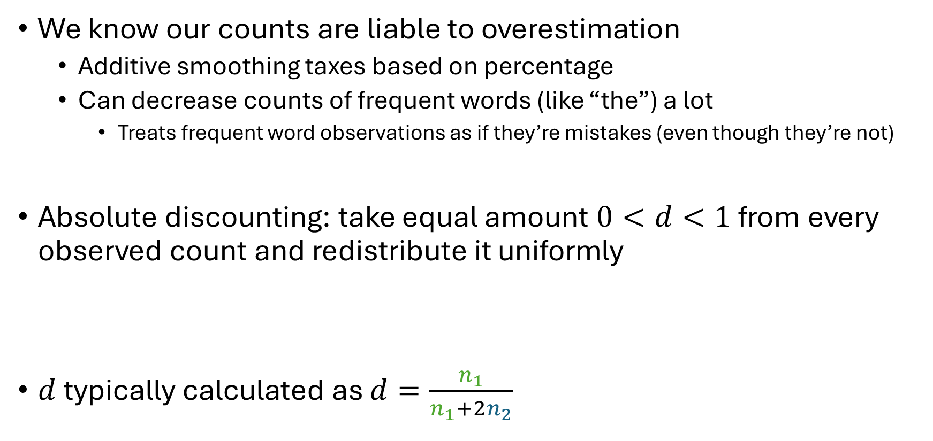



Absolute discounting
We know our counts are liable to overestimation
Additive smoothing taxes based on percentage
Can decrease counts of frequent words (like “the”) a lot
Treats frequent word observations as if they’re mistakes (even though they’re not)
Absolute discounting: take equal amount $0<d<1$ from every observed count and redistribute it uniformly
$d$ typically calculated as $d=\frac{n_{1}}{n_{1}+2n_{2}}$
$$\operatorname{Pr}\left[w\right]=\frac{\max\left(0, c\left(w\right)−d\right)}{N}+\frac{n_{1+}+d}{N}\frac{1}{|Σ|}$$
$n_{r+}=$ # of vocab elements seen at least $r$ times
$n_{1}=$# of vocab elements seen exactly once
$n_{2}=$# of vocab elements seen exactly twice

Slide 13
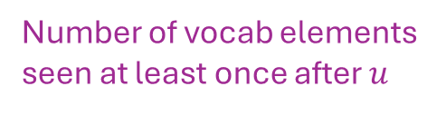
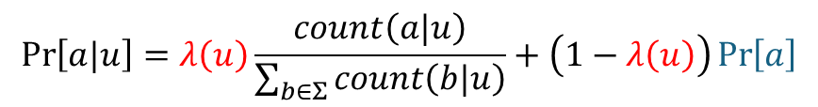

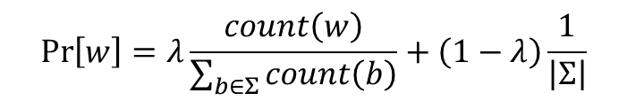





Smoothing Bigrams (smooth by unigram)
Additive smoothing & absolute discounting still work
Need slightly different formulations
Absolute discounting:
$λ$ now depends on $u$
Unigram prob (which can also be smoothed)
$$\operatorname{Pr}\left[w\right]=λ\frac{count\left(w\right)}{\sum_{b∈Σ}{count\left(b\right)}}+\left(1−λ\right)\frac{1}{\left|Σ\right|}$$
$$\operatorname{Pr}\left[a|u\right]=λ\left(u\right)\frac{count\left(a|u\right)}{\sum_{b∈Σ}{count\left(b|u\right)}}+\left(1−λ\left(u\right)\right)\operatorname{Pr}\left[a\right]$$
$$λ=\frac{\sum_{b∈Σ}{count\left(b\right)}}{\sum_{b∈Σ}{count\left(b\right)}+δ|Σ|}$$
Number of vocab elements seen at least once after $u$
$$λ=\frac{\sum_{b∈Σ}{count\left(b\right)}}{\sum_{b∈Σ}{count\left(b\right)}+n_{1+}}$$
Witten-Bell smoothing
$$λ=\frac{\sum_{b∈Σ}{count\left(b|u\right)}}{\sum_{b∈Σ}{count\left(b|u\right)}+n_{1+}(u)}$$
$$\operatorname{Pr}\left[w\right]=\frac{\max\left(0, c\left(w\right)−d\right)}{\sum_{b∈Σ}{count\left(b\right)}}+\frac{n_{1+}+d}{\sum_{b∈Σ}{count\left(b\right)}}\frac{1}{|Σ|}$$
$$\operatorname{Pr}\left[a|u\right]=\frac{\max\left(0, c\left(a|u\right)−d\right)}{\sum_{b∈Σ}{count\left(b|u\right)}}+\frac{n_{1+}(u)+d}{\sum_{b∈Σ}{count\left(b|u\right)}}\operatorname{Pr}\left[a\right]$$

Slide 14
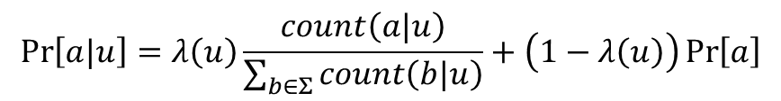


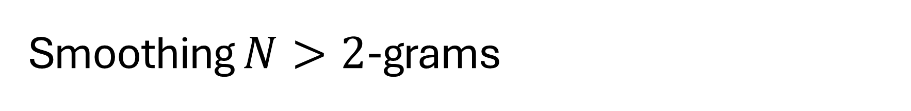


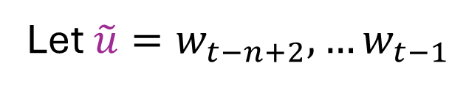


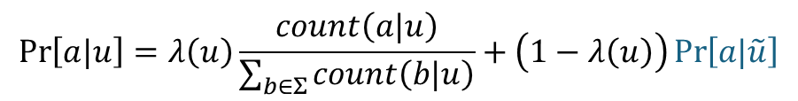
Smoothing $N>2$-grams
Example: $u$ = (the, cat, sat)
$\tilde{u}$ = (cat, sat)
If we have an n-gram model
Need to store $\operatorname{Pr}\left[w_{t} | w_{t−n+1},…w_{t−1}\right]$
Additive smoothing
Absolute discounting
$$u$$
Let $\tilde{u}=w_{t−n+2},…w_{t−1}$
(n-1)-gram estimate (can also be smoothed)
$$\operatorname{Pr}\left[a|u\right]=λ\left(u\right)\frac{count\left(a|u\right)}{\sum_{b∈Σ}{count\left(b|u\right)}}+\left(1−λ\left(u\right)\right)\operatorname{Pr}\left[a\right]$$
$$\operatorname{Pr}\left[a|u\right]=λ\left(u\right)\frac{count\left(a|u\right)}{\sum_{b∈Σ}{count\left(b|u\right)}}+\left(1−λ\left(u\right)\right)\operatorname{Pr}\left[a|\tilde{u}\right]$$
$$\operatorname{Pr}\left[a|u\right]=\frac{\max\left(0, c\left(a|u\right)−d\right)}{\sum_{b∈Σ}{count\left(b|u\right)}}+\frac{n_{1+}(u)+d}{\sum_{b∈Σ}{count\left(b|u\right)}}\operatorname{Pr}\left[a\right]$$
$$\operatorname{Pr}\left[a|u\right]=\frac{\max\left(0, c\left(a|u\right)−d\right)}{\sum_{b∈Σ}{count\left(b|u\right)}}+\frac{n_{1+}(u)+d}{\sum_{b∈Σ}{count\left(b|u\right)}}\operatorname{Pr}\left[a|\tilde{u}\right]$$

Slide 15
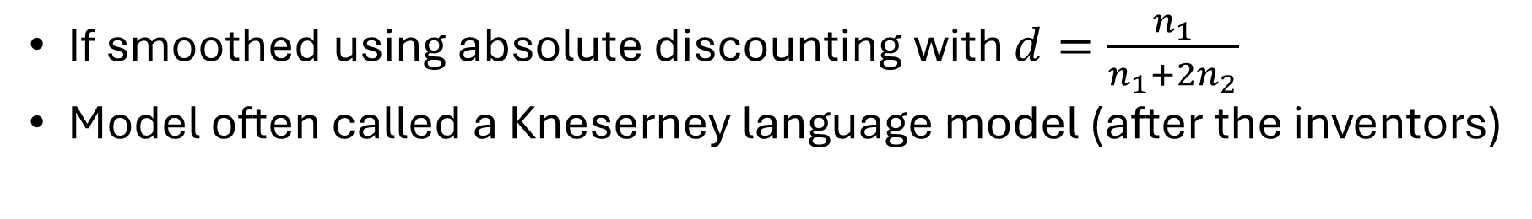
Smoothing $N>2$-grams
If smoothed using absolute discounting with $d=\frac{n_{1}}{n_{1}+2n_{2}}$
Model often called a Kneserney language model (after the inventors)
Smoothed by
Smoothed by
N-gram model
(N-1)-gram model
(N-2)-gram model
Unigram model

