Slide 1
Language Models II

Slide 2
How to eval language models?
Three main approaches:
Use it to generate sequences
Does it produce good sequences?
Big flaw:
What if it memorizes?
Extrinsic eval
Use it in concert with another model for some task
Eval it on that task!
Intrinsic eval
Eval on held out data

Slide 3
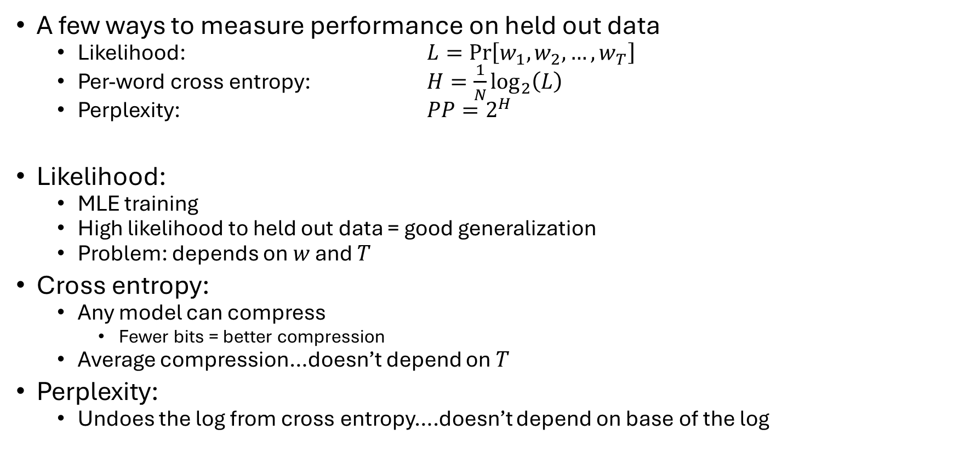
Intrinsic eval
A few ways to measure performance on held out data
Likelihood: $L=\operatorname{Pr}\left[w_{1},w_{2},…,w_{T}\right]$
Per-word cross entropy: $H=\frac{1}{N}\log_{2}\left(L\right)$
Perplexity: $PP=2^{H}$
Likelihood:
MLE training
High likelihood to held out data = good generalization
Problem: depends on $w$ and $T$
Cross entropy:
Any model can compress
Fewer bits = better compression
Average compression…doesn’t depend on $T$
Perplexity:
Undoes the log from cross entropy….doesn’t depend on base of the log

Slide 4



Finite Automata
Many models in NLP can be thought of as FA (or variants)
Makes it easier to combine models (intersection, union, etc.)
Every FA has:
A initial/start state
State names
State transitions
Final/accept state
For NLP: every string ends with <EOS>
Transitions for <EOS> lead to accept state
$$a$$
$$q$$
$$r$$

Slide 5













Deterministic vs Nondeterministic FA
Deterministic FA
Every state has, for each label, exactly 1 outgoing transition w/ that label
“Always knows which state to go to when reading a label”
Nondeterministic FA
Can be more than 1 outgoing transition w/ the same label from a state
Accepts string if any path accepts
duck
dog
her
$$q_{3}$$
$$q_{5}$$
$$q_{7}$$
<EOS>
saw
chased
<EOS>
cats
dogs
that
I
$$q_{9}$$
$$q_{1}$$
$$q_{2}$$
$$q_{3}$$
$$q_{4}$$
$$q_{1}$$
$$q_{2}$$
saw
heard
<EOS>
see
chase
$$q_{4}$$
$$q_{6}$$
$$q_{8}$$
her
duck
jump

Slide 6





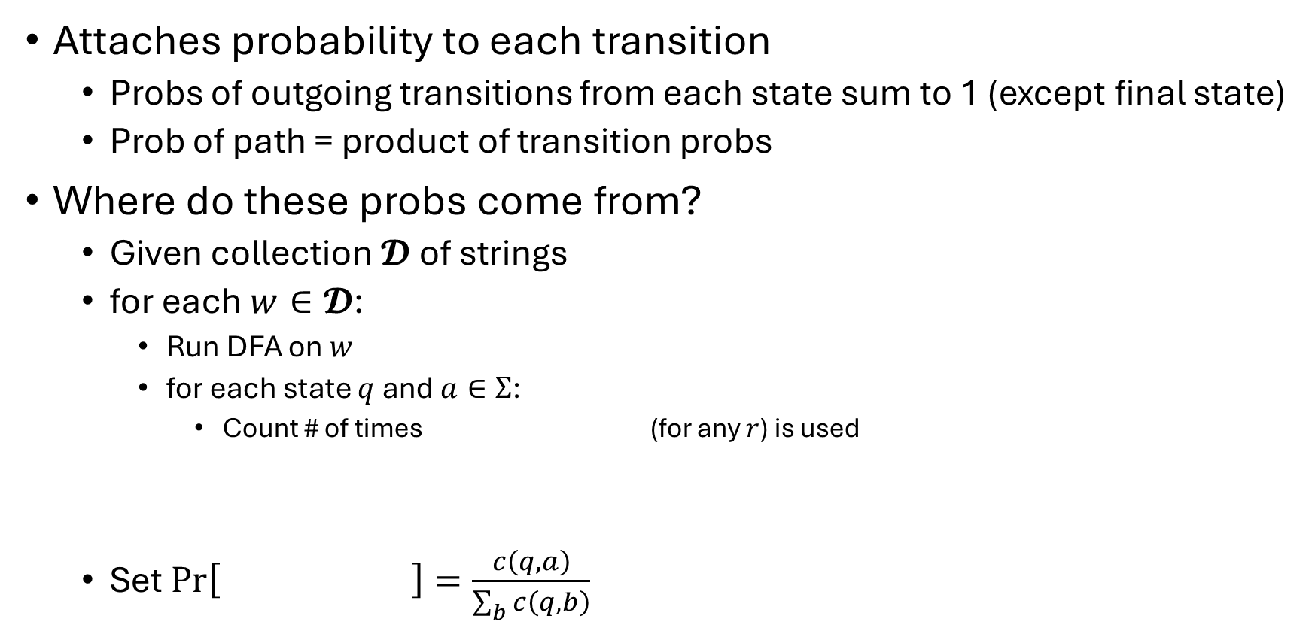








Probabilistic DFAs
Pr[cats that chase dogs that see cast <EOS>]
$$a/p$$
$$q$$
$$r$$
Attaches probability to each transition
Probs of outgoing transitions from each state sum to 1 (except final state)
Prob of path = product of transition probs
Where do these probs come from?
Given collection 𝓓 of strings
for each $w∈𝓓$:
Run DFA on $w$
for each state $q$ and $a∈Σ$:
Count # of times (for any $r$) is used
Set $\operatorname{Pr}\left[ \right]=\frac{c\left(q,a\right)}{\sum_{b}{c\left(q,b\right)}}$
<EOS>/0.8
cats / 0.1
dogs / 0.9
that/0.2
$$q_{1}$$
$$q_{2}$$
$$q_{3}$$
$$q_{4}$$
$$a$$
see/0.3
chase/0.7
$$q$$
$$r$$
$$a$$
$$q$$
$$r$$

Slide 7










Bigrams as Probabilistic DFAs
Every $w∈Σ$ gets a state $q_{w}$
Add a transition between $a,b∈Σ$
Add transition for every $a∈Σ$
Add transition for every $a∈Σ$
$$b/\operatorname{Pr}\left[b | a\right]$$
$$q_{a}$$
$$q_{b}$$
<EOS>$/\operatorname{Pr}\left[<EOS> | a\right]$
$$q_{<EOS>}$$
$$q_{a}$$
$$q_{<BOS>}$$
a$/\operatorname{Pr}\left[a | <BOS>\right]$
$$q_{a}$$

Slide 8



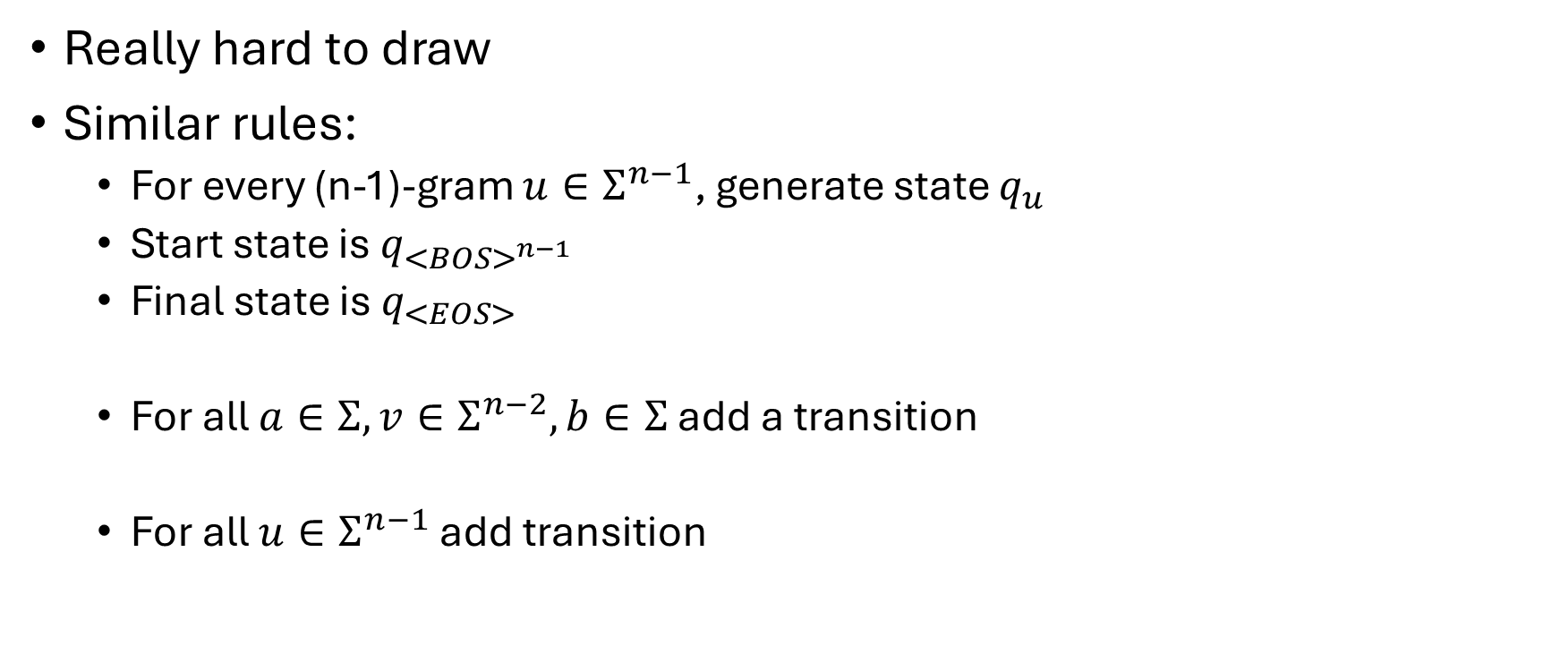



N-grams as Probabilistic DFAs
Really hard to draw
Similar rules:
For every (n-1)-gram $u∈Σ^{n−1}$, generate state $q_{u}$
Start state is $q_{{<BOS>}^{n−1}}$
Final state is $q_{<EOS>}$
For all $a∈Σ, v∈Σ^{n−2}, b∈Σ$add a transition
For all $u∈Σ^{n−1}$ add transition
$$b/\operatorname{Pr}\left[b | av\right]$$
$$q_{av}$$
$$q_{bv}$$
<EOS>$/\operatorname{Pr}\left[<EOS> | u\right]$
$$q_{<EOS>}$$
$$q_{u}$$

Slide 9








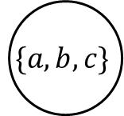

Recurrent Neural Networks
$O\left(2^{|Σ|}\right)$ states!
Cousins of FA
Consider a pangram:
Multiple simultaneous constraints
Same for language modeling
Pangram DFA for $Σ=\{a,b,c\}$
a
b,c
$$\{a\}$$
$$\{b,c\}$$
c
b
a
a,b,c
a
b
a,c
c
$$\{\}$$
b
$$\{b\}$$
$$\{a,c\}$$
b
$$\{a,b,c\}$$
<EOS>
a
c
a,b
c
b
c
$$\{c\}$$
$$\{a,b\}$$
a

Slide 10








Convert to NFA?
b,c
a,b,c
$$−a$$
a
$$+a$$
a
Every NFA = DFA
$O\left(\left|Σ\right|\right)$ states
Trouble, doesn’t work
Accepts if a or b or c read
Need and conditions
Need to modify our NFA
Can either add more states
Or we can do something else
b,c
a,b,c
<EOS>
a,c
a,c
$$−b$$
b
$$+b$$
<EOS>
$$q_{f}$$
b
a,b
c
<EOS>
a,b
a,b,c
$$−c$$
$$+c$$
c

Slide 11

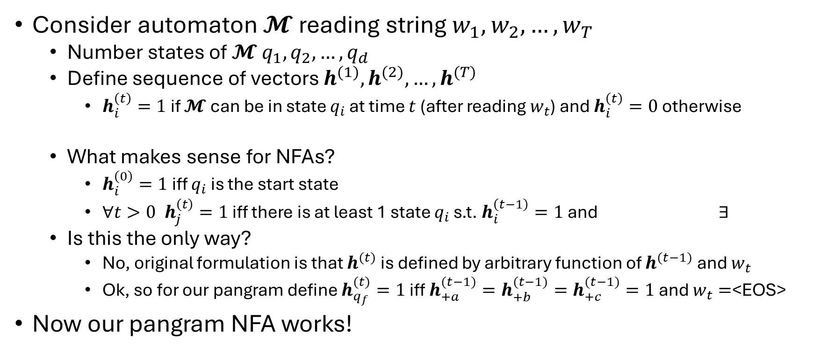


Something else
Consider automaton 𝓜 reading string $w_{1},w_{2},…, w_{T}$
Number states of 𝓜 $q_{1},q_{2},…, q_{d}$
Define sequence of vectors $h^{(1)}, h^{(2)},…, h^{(T)}$
$h_{i}^{\left(t\right)}=1$ if 𝓜 can be in state $q_{i}$ at time $t$ (after reading $w_{t}$) and $h_{i}^{\left(t\right)}=0$ otherwise
What makes sense for NFAs?
$h_{i}^{\left(0\right)}=1$ iff $q_{i}$ is the start state
$∀t>0 h_{j}^{\left(t\right)}=1$ iff there is at least 1 state $q_{i}$ s.t. $h_{i}^{\left(t−1\right)}=1$ and $∃$
Is this the only way?
No, original formulation is that $h^{(t)}$ is defined by arbitrary function of $h^{(t−1)}$ and $w_{t}$
Ok, so for our pangram define $h_{q_{f}}^{(t)}=1$ iff $h_{+a}^{(t−1)}=h_{+b}^{(t−1)}=h_{+c}^{(t−1)}=1$ and $w_{t}=$<EOS>
Now our pangram NFA works!
$$w_{t}$$
$$q_{i}$$
$$q_{j}$$

Slide 12







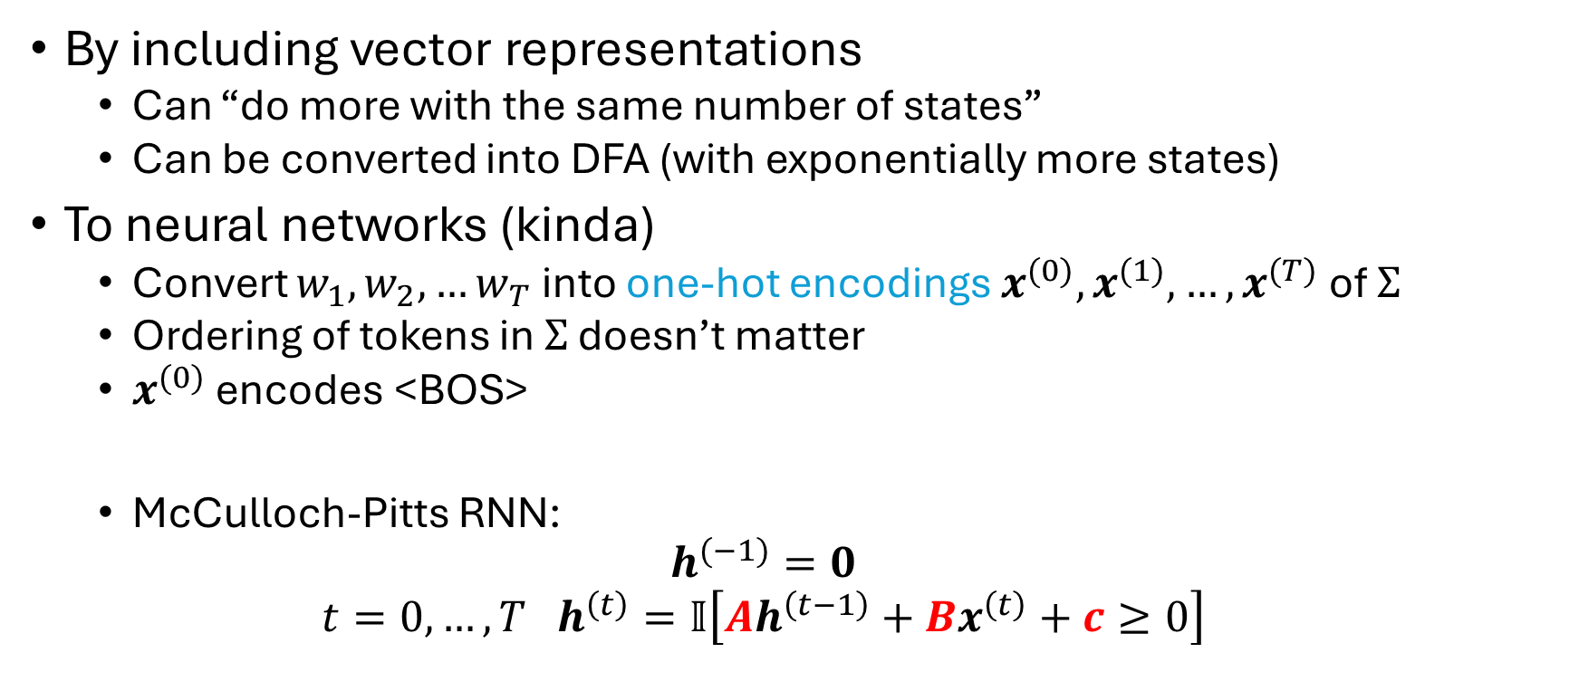




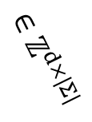




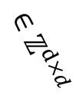
The big idea
$$Σ=\{<BOS>,a,b,<EOS>\}$$
<BOS>
a
b
a
<EOS>
$$\left[\begin{matrix}1 \\ 0 \\ \begin{aligned}0 \\ 0\end{aligned}\end{matrix}\right]$$
$$\left[\begin{matrix}0 \\ 1 \\ \begin{aligned}0 \\ 0\end{aligned}\end{matrix}\right]$$
$$\left[\begin{matrix}0 \\ 0 \\ \begin{aligned}1 \\ 0\end{aligned}\end{matrix}\right]$$
$$\left[\begin{matrix}0 \\ 1 \\ \begin{aligned}0 \\ 0\end{aligned}\end{matrix}\right]$$
$$\left[\begin{matrix}0 \\ 0 \\ \begin{aligned}0 \\ 1\end{aligned}\end{matrix}\right]$$
By including vector representations
Can “do more with the same number of states”
Can be converted into DFA (with exponentially more states)
To neural networks (kinda)
Convert $w_{1},w_{2},…w_{T}$ into one-hot encodings $x^{(0)},x^{(1)},…, x^{(T)}$ of $Σ$
Ordering of tokens in $Σ$ doesn’t matter
$x^{(0)}$ encodes <BOS>
McCulloch-Pitts RNN:
$$h^{(−1)}=0$$
$$t=0,…,T h^{\left(t\right)}=𝕀\left[Ah^{\left(t−1\right)}+Bx^{\left(t\right)}+c≥0\right]$$
$$x^{(0)}$$
$$x^{(1)}$$
$$x^{(2)}$$
$$x^{(3)}$$
$$x^{(4)}$$
Pangram model?
$$\begin{matrix}A_{q_{f},+a}=1 \\ A_{q_{f},+b}=1 \\ A_{q_{f},+c}=1\end{matrix}$$
$$B_{q_{f},<EOS>}=1$$
$$c=−4$$
$$∈ℤ^{d}$$
$$∈ℤ^{d×d}$$
$$∈ℤ^{d×|Σ|}$$

Slide 13
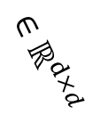
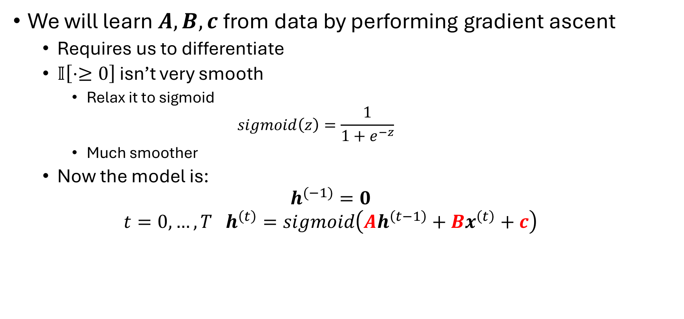

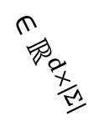
Step functions
We will learn $A,B,c$ from data by performing gradient ascent
Requires us to differentiate
$𝕀\left[⋅≥0\right]$ isn’t very smooth
Relax it to sigmoid
$$sigmoid\left(z\right)=\frac{1}{1+e^{−z}}$$
Much smoother
Now the model is:
$$h^{(−1)}=0$$
$$t=0,…,T h^{\left(t\right)}=sigmoid\left(Ah^{\left(t−1\right)}+Bx^{\left(t\right)}+c\right)$$
$$∈ℝ^{d×d}$$
$$∈ℝ^{d×|Σ|}$$
$$∈ℝ^{d}$$

Slide 14
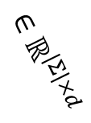
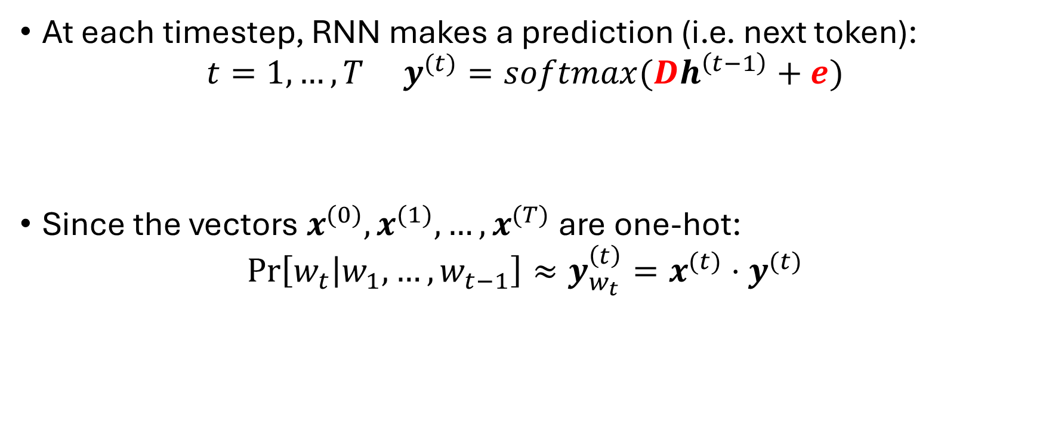
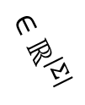
Making Predictions
At each timestep, RNN makes a prediction (i.e. next token):
$$t=1,…,T y^{(t)}=softmax(Dh^{\left(t−1\right)}+e)$$
Since the vectors $x^{(0)},x^{(1)},…, x^{(T)}$ are one-hot:
$$\operatorname{Pr}\left[w_{t} | w_{1},…,w_{t−1}\right]≈y_{w_{t}}^{\left(t\right)}=x^{(t)}⋅y^{(t)}$$
$$∈ℝ^{|Σ|×d}$$
$$∈ℝ^{|Σ|}$$

Slide 15
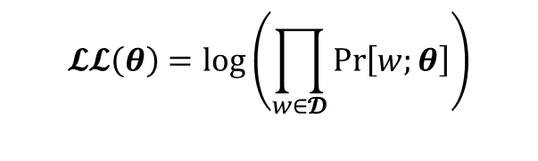
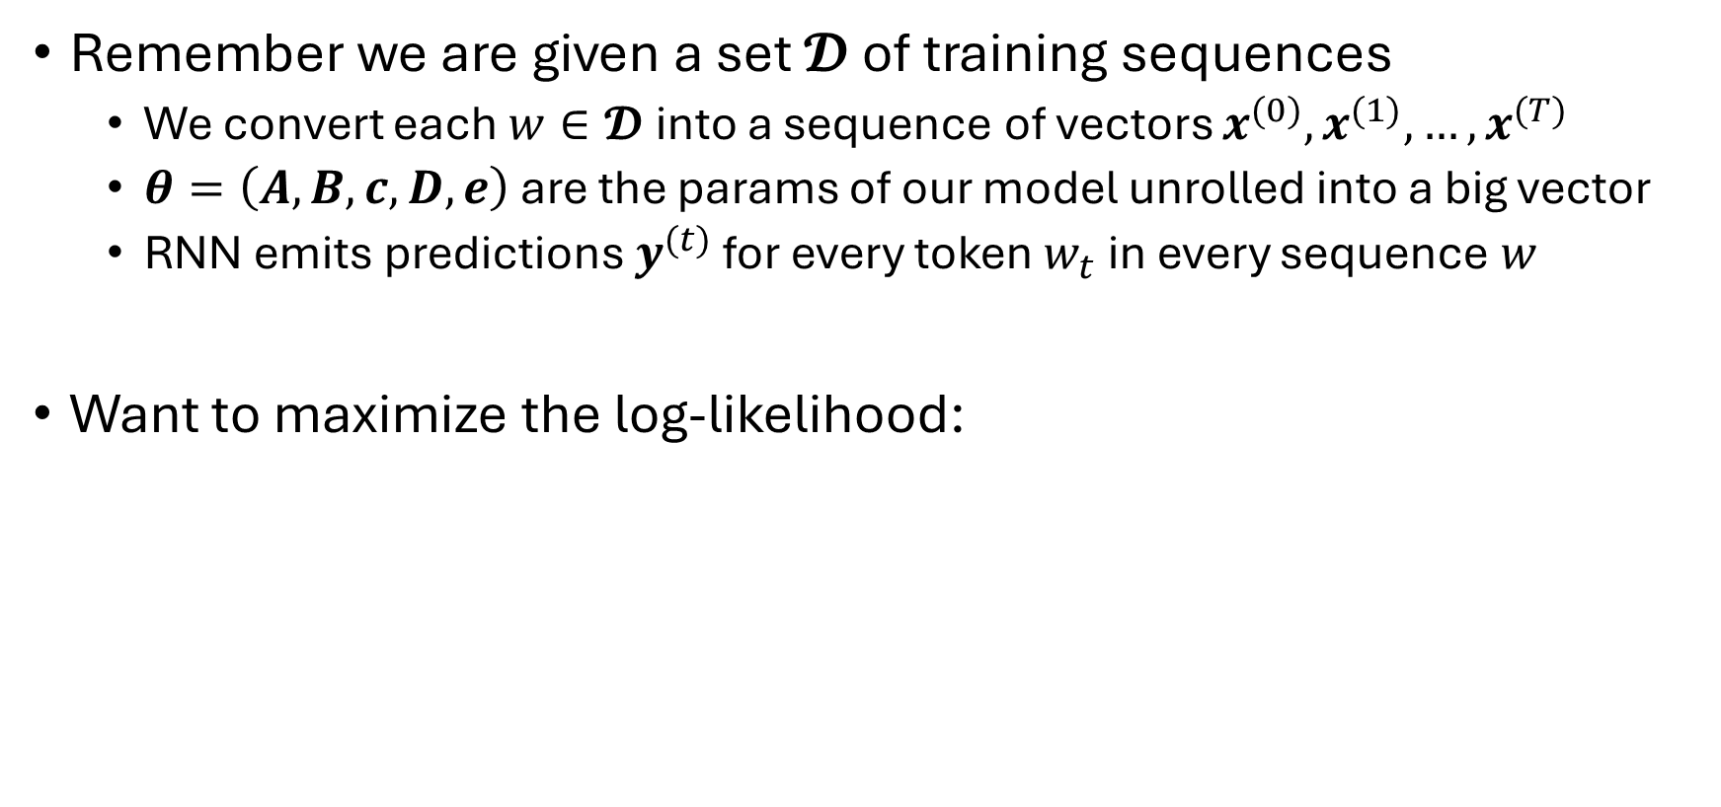
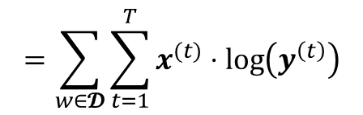
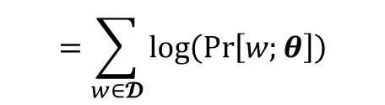
How to train?
Remember we are given a set $𝓓$ of training sequences
We convert each $w∈𝓓$ into a sequence of vectors $x^{(0)},x^{(1)},…, x^{(T)}$
$θ=\left(A,B,c,D,e\right)$ are the params of our model unrolled into a big vector
RNN emits predictions $y^{(t)}$ for every token $w_{t}$ in every sequence $w$
Want to maximize the log-likelihood:
$$𝓛𝓛\left(θ\right)=log\left(\prod_{w∈𝓓}{\operatorname{Pr}\left[w;θ\right]}\right)$$
$$=\sum_{w∈𝓓}{\log\left(\operatorname{Pr}\left[w;θ\right]\right)}$$
$$=\sum_{w∈𝓓}{\sum_{t=1}^{T}{x^{(t)}⋅\log\left(y^{\left(t\right)}\right)}}$$

Slide 16

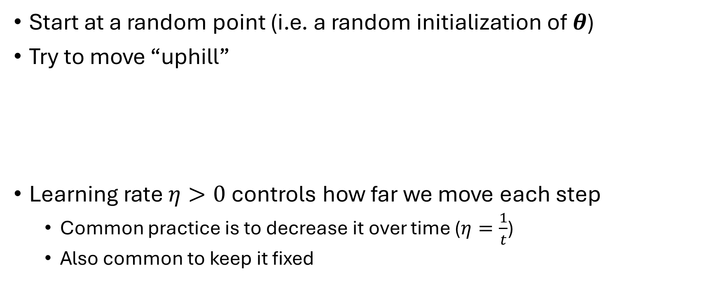
Gradient ascent
Start at a random point (i.e. a random initialization of $θ$)
Try to move “uphill”
Learning rate $η>0$ controls how far we move each step
Common practice is to decrease it over time ($η=\frac{1}{t}$)
Also common to keep it fixed
repeat
$$θ=θ+η∇𝓛𝓛\left(θ\right)$$
until done

Slide 17




Stochastic gradient ascent
Instead of computing $∇𝓛𝓛\left(θ\right)$ of the entire dataset
Work on a since sequence at a time
The main algorithm now goes
$$𝓛𝓛_{w}\left(θ\right)=log\left(\operatorname{Pr}\left[w;θ\right]\right)$$
$$=\sum_{t=1}^{T}{x^{(t)}⋅\log\left(y^{\left(t\right)}\right)}$$
repeat
for each sequence $w$ do
$$θ=θ+η∇𝓛𝓛_{w}\left(θ\right)$$
A complete pass through the data is called an epoch
end for
until done

