Slide 1

GoMyCode
football pitch rental
Ben Rejeb Zied

Slide 2
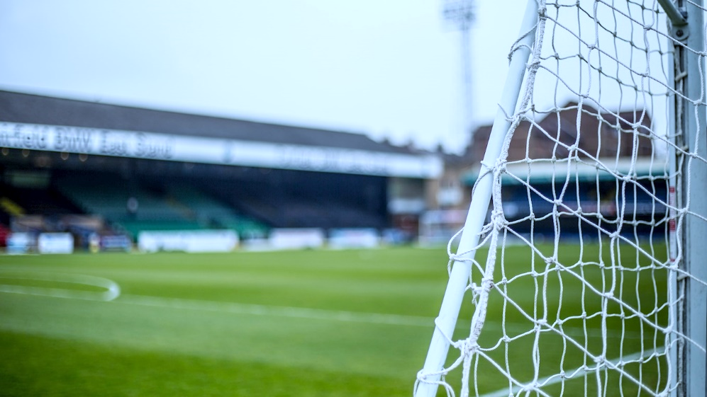
Project Description
Football Field Rentals is an application that allows you to reserve land near your home, to organize with friends and colleagues or to find partners if you are alone (or simply not enough).
Football stadium is equipped with lights, scoreboard, home and visitor grandstands, restaurant.
the rental of football pitches has now become lucrative. All age groups gather on these green meadows for moments of pleasure and relaxation, for a financial consideration. Focus on this business which has become very flourishing.

Slide 3
Actors
Admin :
Admin account management
Users accounts management
Consult letter boxes
Consult subscriptions list
Controlling Posts
User:
Inscription and Login
User account management
Consult schedule
Contact Admin (Feedback)
Posts Management
Field reservation

Slide 4
Goals
Time saving
Quickness
Being UpToDate
Simplicity
Advertising
Facilitates the reservation
Avoid double booking problems

