Slide 1
Predator and Prey
COMP 4720 Project Report
Alex Ziegenhorn

Slide 2
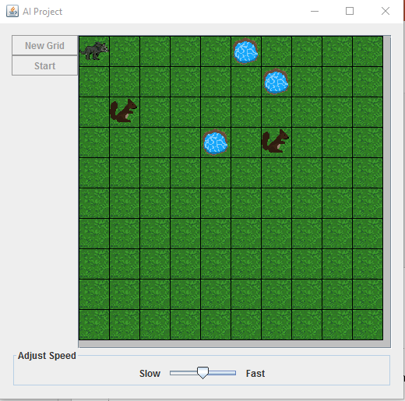
The Problem
Initial State
The predator spawns in the upper-leftmost corner of the grid, the prey spawn randomly throughout the grid.

Slide 3
The Problem (Cont.)
Actions and Transition Models
The predator has a set of actions that it can carry out every tick:
Move: Moves one tile adjacent of current position of the predator.
Formal Action: Position(GridTile), {Move(NeighboringGridTile)}
Formal Result: Position (GridTile), Move(NeighboringGridTile) = Position(NeighboringGridTile)
Drink: Only usable on water tiles; predator drinks to relieve thirst value.
Formal Action: Position(GridTileNeighboringWaterTile), {Drink()}
Formal Result: Position(GridTile), Drink() = (self.thirst = 100.0)
Attack: If at least one prey exists in an adjacent tile, predator attacks prey, prey disappears, and predator moves to prey’s previous location. This also relieves the predator’s hunger value.
Formal Action: Position(GridTileNeighboringPrey), {Attack()}
Formal Result: Position(GridTileNeighboringPrey), Attack() = (prey.removed , Move(prey.position)

Slide 4
The Problem (Cont.)
Actions and Transition Models (Cont.)
The prey have one action they can carry out every tick:
Move: Moves one tile adjacent of current position of the predator.
Formal Action: Position(GridTile), {Move(NeighboringGridTile)}
Formal Result: Position (GridTile), Move(NeighboringGridTile) = Position(NeighboringGridTile)

Slide 5
The Problem (Cont.)
Goal Test:
Has the predator kept his hunger and thirst bars above 0% for the duration of the program?
Path Cost:
The number of ticks (or moves) taken for each action the predator takes.

Slide 6
Implementation of Genetic Algorithm
I use the genetic algorithm when the predator must decide which path to take to get to a water tile in the grid. Using the genetic algorithm in this way returns an entire path, which the predator can then use to travel efficiently to the closest water source. Each individual vector is a direction (left, right, up, down) and represents a move for the predator.

Slide 7
Implementation of Simulated Annealing
I use simulated annealing when the predator must decide which path to take to get to a prey object in the grid. Since the prey are constantly changing location, I have the simulated annealing algorithm simply return the best possible move towards the prey, so that the path is updated after every move by the predator.

Slide 8
Mathematic Definition of Fitness Function(GA)
In code, it is represented as:
- SimulatedAnnealing.distanceFormula(finalLoc, this.goal)-(this.maxDistance/100);
Now to break it down:
First, we take the distance between the final location of the path and the goal location as a negative value (distance)
Then, we take the maximum number of moves allowed for a population and divide that by 100, so that we can have a more precise fitness value for use in comparisons (maxDistance/100)
Mathematical Representation:
-distance – (maxDistance/100)

Slide 9
Mathematical Definition of Objective Function (SA)
In code, it is represented as:
Math.exp( (currentEnergy - newEnergy) / temperature );
Now to break it down:
First, the current energy of the best solution (distance)
Then, we take the maximum number of moves allowed for a population and divide that by 100, so that we can have a more precise fitness value for use in comparisons (maxDistance/100)
Mathematical Representation:
-distance – (maxDistance/100)

Slide 10
Comparison of Accuracy

Slide 11
Comparison of Time Taken

