Slide 1

CUSTOMER’S SENTIMENT ANALYTIC SYSTEM
(SentiSys)

Slide 2
INTRODUCTION
1

Slide 3
INTRODUCTION
Sentiment analysis is a natural language process (NLP) method for detecting hidden emotion in human speech or text.
It is a method of classifying text to infer whether a section of text is positive or negative, or perhaps neutral.
SentiSys is a system to give an overall rating for a certain product based on their score in the sentiment analysis method.

Slide 4
PROBLEM STATEMENT
2

Slide 5
PROBLEM STATEMENT
The goal of sentiment categorization is to figure out what is written text's general objective is, whether it's praise or criticism.
Argumentation is one of the fastest-growing and most difficult areas of future sentiment analysis approaches on social media.
Opinion search, recommendation, summarization, and mining of the growing
amount of web-based opinionated information require such a tool.

Slide 6
OBJECTIVES
2

Slide 7
OBJECTIVES
1
Find the sentiment of the customer’s reviews, whether it is Positive, Negative or Neutral
2
Find the frequency of the ratings for all models
3
Find the mean and standard deviation for the score and rating for all models

Slide 8
METHODOLOGY
3

Slide 9
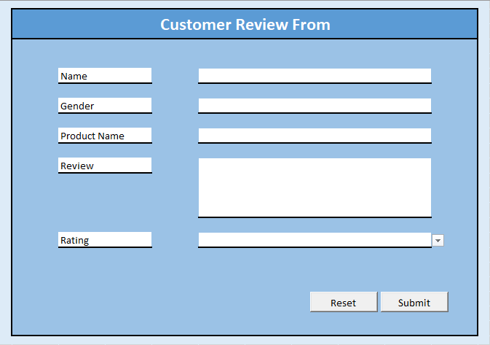
Data Entry

Slide 10
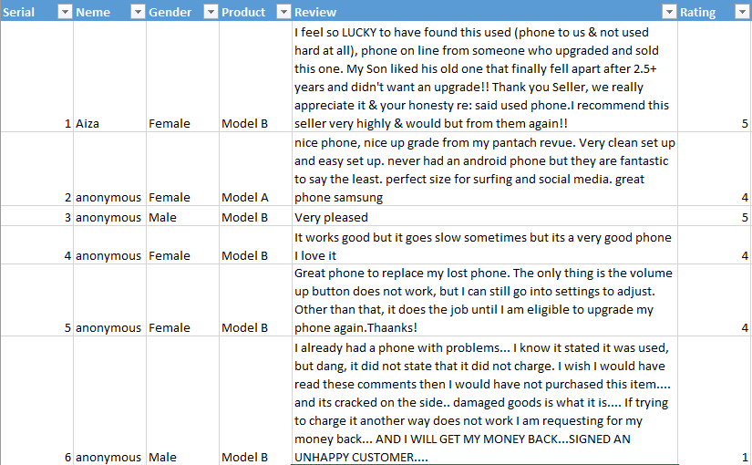
Database

Slide 11
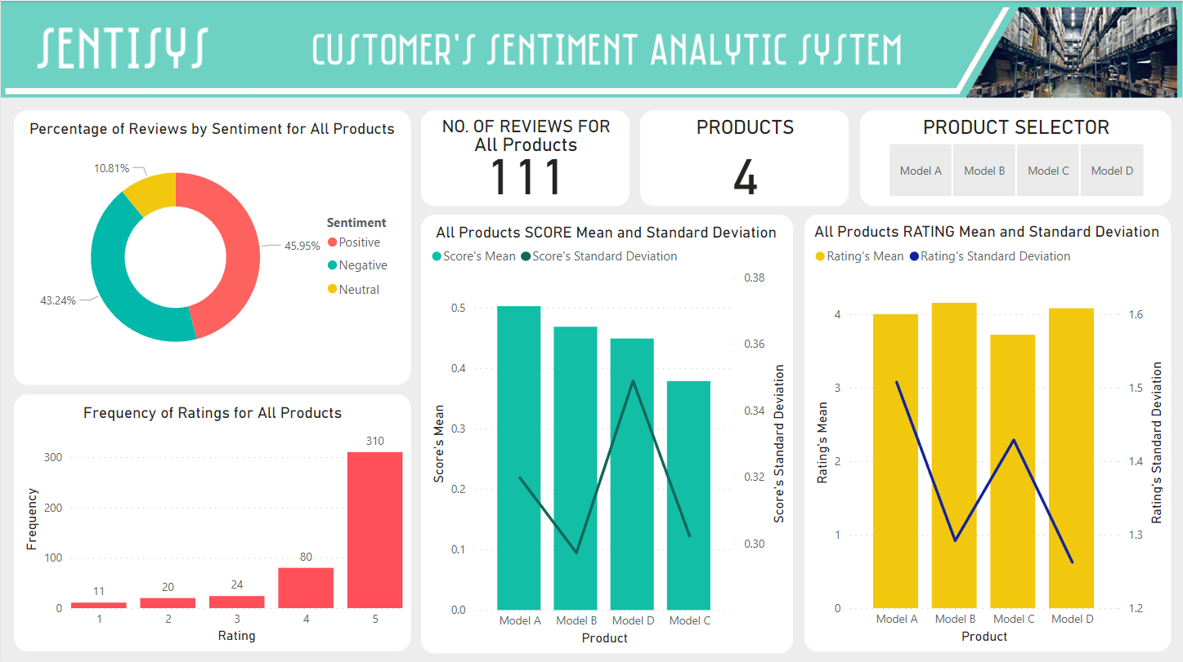
Data Exploration

Slide 12
RESULTS AND DISCUSSIONS
4

Slide 13
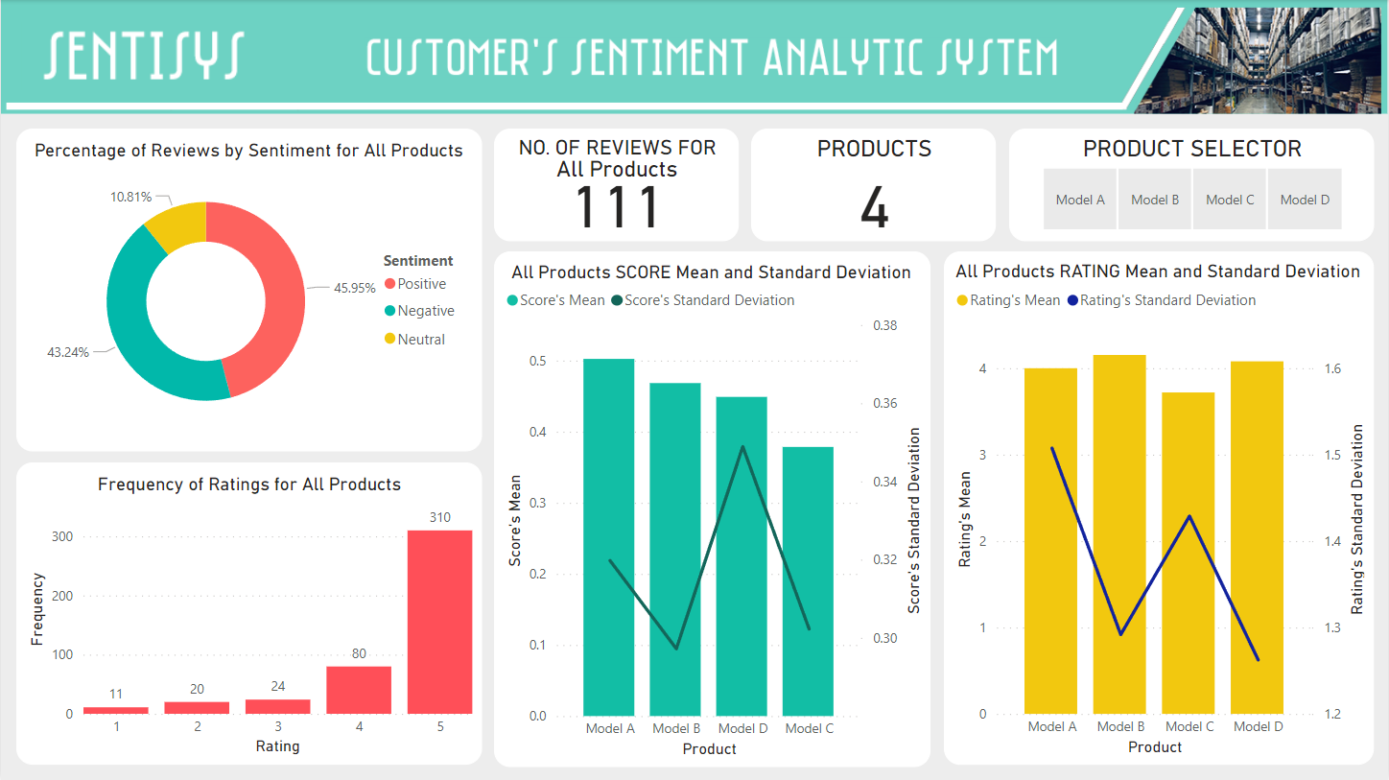

Slide 14

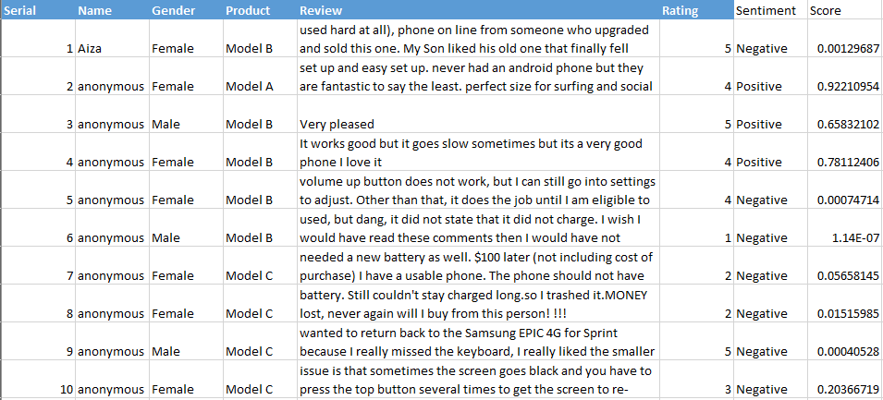

Slide 15


Slide 16
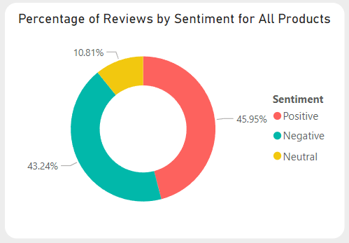

Slide 17
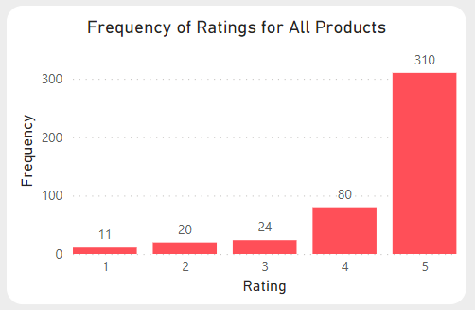

Slide 18
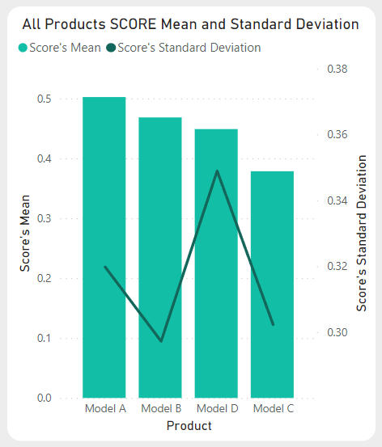

Slide 19
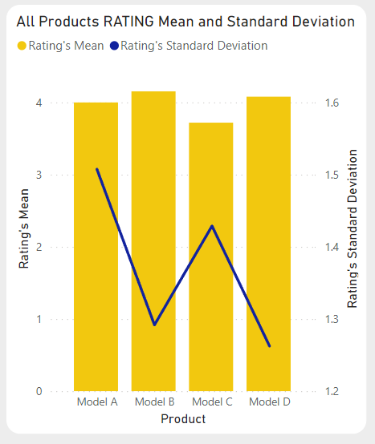

Slide 20
NOVELTY OF THE STUDY
5

Slide 21
NOVELTY OF THE STUDY
A new system for sentiment analysis
An effective, efficient, & ethical device
Ease the burden of users
Helps in producing better decision making

Slide 22
CONCLUSION
6

Slide 23
CONCLUSION
SentiSys helps business to understand and get an idea of what the general
public opinions concerning their product and services.
SentiSys aids business to improve their existing line of products and services,
and generate ideas for future products and services
to fulfill customer needs and expectations.
SentiSys assist business in producing better decision making
to maximize the customer satisfaction and gain more profits.

