Slide 1
Introduction · Framework & data · Architecture · Descriptive analysis · Predictive analysis · Privacy · Admin · Findings · Future work
A R A H
Built for students who have to
choose, with no way to compare.
System and technical overview — framework, data, descriptive and predictive analysis
Next.js 16 · React 19 · Python 3.13 · scikit-learn · Supabase Postgres · Vercel
arah-sand.vercel.app

Slide 2

Introduction · Framework & data · Architecture · Descriptive analysis · Predictive analysis · Privacy · Admin · Findings · Future work
INTRODUCTION
What it is, and what it is for.
The problem
A Malaysian student leaving SPM picks a field with almost nothing to compare against — a prospectus, a family opinion, and whatever their friends are doing. Nobody tells them what students like them actually went on to do, or whether they were glad of it.
What ARAH is
A pathway finder. Ten questions, matched against 207 real SPM leavers who already made the choice — returning the fields students with similar answers entered, the sample behind each, and how satisfied those students were.
Objectives
1. Turn real outcomes into a comparison a student can act on.
2. Rank fields by evidence, and show the sample behind each.
3. Publish the uncertainty, and nothing where the data is thin.
4. Protect the 207 teenagers whose answers make it work.
arah-sand.vercel.app
About three minutes end to end. Browsing needs no account; saving a result does.

Slide 3

Introduction · Framework & data · Architecture · Descriptive analysis · Predictive analysis · Privacy · Admin · Findings · Future work
HOW A STUDENT USES IT
Four steps, about three minutes.
01
02
Answer
Match
Ten questions about results, subjects, interests, and how they like to work.
Compared against 207 real Malaysian SPM leavers who already made the choice.
03
04
Rank
Explore
Fields ordered by fit, each with a confidence level and the sample it rests on.
What those students chose, how satisfied they were, and the advice they left.
A stored result — /results/<id>, never recomputed
The result is written once and read back. A student returning to the same link sees the same three fields, not a fresh roll of the model.

Slide 4
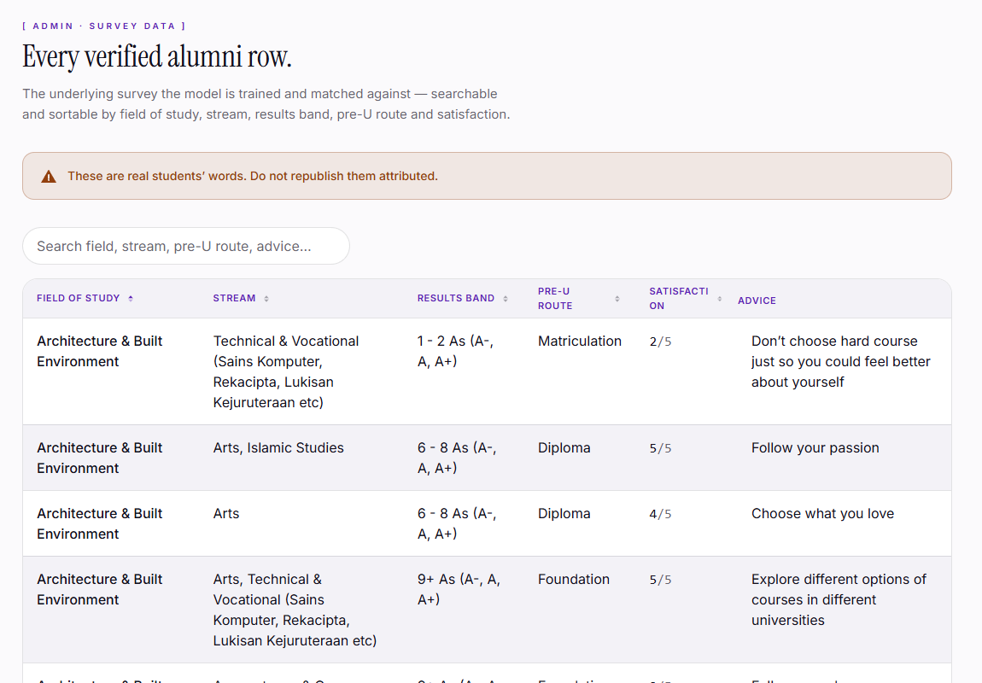
Introduction · Framework & data · Architecture · Descriptive analysis · Predictive analysis · Privacy · Admin · Findings · Future work
CRISP-DM FRAMEWORK AND DATA OVERVIEW
A standard method, applied to one survey.
1
Business understanding
What a student actually needs at the point of choosing — a comparison, not advice.
The data
207 responses · 10 fields of study · 5 pre-U routes · satisfaction 1–5 · free-text advice. One Google Forms export, no third-party dataset. National MoHE enrolment figures are cited as context and never used as training rows.
2
Data understanding
One survey of 207 SPM leavers: ten answers each, the field they entered, and how satisfied they are.
3
Data preparation
Cleaning, then a 55-slot one-hot encoding. One encoder in Python, a mirror in JavaScript, pinned by fixture tests.
4
Modelling
Four scikit-learn classifiers — KNN, logistic regression, random forest, Bernoulli naive Bayes — combined by soft voting.
5
Evaluation
Top-3 accuracy under repeated stratified cross-validation: five folds, five repeats. Never a single split.
6
Deployment
Shipped as a Python service on Vercel behind the Next.js app, with the artefacts committed alongside the code.
/admin/survey-data — the corpus the model reads
ml/train.py reads ml/data/survey.csv and nothing else. Every descriptive figure in the next three slides comes from decks/describe_corpus.py, reading that same file.

Slide 5
Introduction · Framework & data · Architecture · Descriptive analysis · Predictive analysis · Privacy · Admin · Findings · Future work
TOOLS AND TECHNIQUES USED
What it is built from.
Language
JavaScript (JSX) · Python 3.13 · SQL
No TypeScript, by request — JSX throughout.
Framework
Next.js 16.2 App Router · React 19.2
Server Components by default; client code only where the browser is needed.
Styling
Tailwind CSS v4 · shadcn/ui · Radix · PrimeReact
CSS-first @theme configuration — v4 has no tailwind.config.js.
Motion
GSAP · Motion · Lenis · custom canvas
Every animation gated on prefers-reduced-motion.
Machine learning
scikit-learn · NumPy · pandas · Joblib
pandas is training-only and deliberately absent from the deployed service.
Data
Supabase Postgres · Row Level Security
Access rules live in the database, not only in application code.
Charts
Recharts
The same component set on public pages and in the admin console.
Quality
Vitest · pytest · ESLint · Playwright
382 JavaScript tests and 36 Python tests; 12 of them need production credentials.
Techniques
Descriptive statistics over the corpus · one-hot encoding into 55 features · four-classifier soft-voting ensemble · repeated stratified cross-validation, five folds and five repeats · marginalisation over the unknown pre-U route · k-anonymity suppression, count banding and refresh gating on everything published.

Slide 6
Introduction · Framework & data · Architecture · Descriptive analysis · Predictive analysis · Privacy · Admin · Findings · Future work
ARCHITECTURE
Two runtimes, one deployment.
Browser
Why two services?
React 19 interface, client-side
validation, animated canvas
Next.js cannot run scikit-learn, and rewriting the model in JavaScript would mean two implementations to keep in step. Vercel Services runs both from one repository and one deploy.
Web service
ML service
Database
Next.js 16 App Router
Server Components, Server
Actions, route handlers
Python 3.13 ASGI app
scikit-learn ensemble loaded
from model.joblib
Supabase Postgres
Row Level Security
11 migrations
vercel.json routes /api/ml/* to the Python runtime; every other path goes to Next.js.

Slide 7
Introduction · Framework & data · Architecture · Descriptive analysis · Predictive analysis · Privacy · Admin · Findings · Future work
SYSTEM FLOW
One request, end to end.
1
Browser
A student answers ten questions. Answers are validated in the browser against the same feature spec the model uses.
2
POST /api/questions
The Next.js route handler authenticates the session and writes the raw answers to quiz_responses.
3
Encode
Answers become a 55-feature vector. One encoder in Python, a mirror in JavaScript, held in step by fixture tests.
4
POST /api/ml/predict
Rewritten to the Python service. The ensemble votes and returns a ranked probability for every field.
5
Annotate
Each field is joined to its published statistics — sample size, satisfaction, confidence tier.
6
Store and redirect
The finished result is written to predictions; the student lands on /results/<id>. It is never recomputed.

Slide 8
Introduction · Framework & data · Architecture · Descriptive analysis · Predictive analysis · Privacy · Admin · Findings · Future work
DESCRIPTIVE ANALYSIS · PART 1
What 207 students actually chose.
The classes are not balanced
Business & Management carries 44 students; Humanities carries 7. A model trained on this has far more to say about some fields than others, which is why the ensemble carries a naive Bayes term and the interface always prints the sample size.
Two fields publish nothing
Creative Art (9) and Humanities (7) fall below the k = 10 threshold. Their pages say so in plain words rather than showing a statistic drawn from single figures — the grey bars on the left.
WHO ANSWERED
109 public school · 51 boarding · 29 private · 18 religious
PRE-U ROUTES
Diploma 73 · Foundation 52 · A-Levels 42 · Matriculation 31 · STPM 9
SPM RESULTS
64 at 6–8 As · 59 at 3–5 As · 58 at 9+ As · 25 at 1–2 As
n = 207 · generated by decks/describe_corpus.py from ml/data/survey.csv — the same file ml/train.py reads.

Slide 9
Introduction · Framework & data · Architecture · Descriptive analysis · Predictive analysis · Privacy · Admin · Findings · Future work
DESCRIPTIVE ANALYSIS · PART 2
Where students ended up glad of it.
The spread is wide
Media & Communication averages 4.61 of 5, with 100% rating themselves 4 or 5. Engineering averages 2.83, with 39%. A ranked shortlist that left satisfaction out would treat those two as the same result.
So the product publishes it
Every match carries average satisfaction and the share who ended up dissatisfied, next to the percentage — so a high match with an unhappy cohort reads as exactly that.
The grey bars are not published
Creative Art (9) and Humanities (7) are shown here for completeness. In the product both pages publish no statistics at all — the same k = 10 rule that governs every figure on the site.
Mean of the 1–5 self-rating, computed by decks/describe_corpus.py over all 207 rows.

Slide 10
Introduction · Framework & data · Architecture · Descriptive analysis · Predictive analysis · Privacy · Admin · Findings · Future work
DESCRIPTIVE ANALYSIS · PART 3
Does staying in your SPM stream make you happier?
Satisfaction spread by pre-U route
Box is the middle half, line is the median, whisker is the full range.
Diploma
n=73
Foundation
n=52
A-Levels
n=42
Matriculation
n=31
STPM
n=9
1
2
3
4
5
Self-rated satisfaction, 1 to 5 — share of each group
The stream is not the answer
Matriculation is the outlier on the right — median 2 against 4 for every other route, on 31 students. Reported as an observation, not a claim: at that sample it is not separable from noise.
Students whose field matched their SPM stream average 3.45 of 5 (n=122); those who switched average 3.80 (n=85). Following the stream is not what makes people glad of the choice — which is why the model matches on the whole answer set, not the stream alone.

Slide 11
Introduction · Framework & data · Architecture · Descriptive analysis · Predictive analysis · Privacy · Admin · Findings · Future work
PREDICTIVE ANALYSIS · PART 1
From ten answers to a ranked list.
1. Encode
The ten answers become a 55-number vector
Each option a student can pick becomes one slot, set to 1 if they picked it. "Science stream" is one slot, "enjoys maths" another. The 1-5 comfort scale is scaled into the same range so no single answer dominates by virtue of being a bigger number.
2. Compare
Against all 207 encoded alumni
The same encoding was applied to every alumnus, so a student and an alumnus are directly comparable — 55 numbers against 55 numbers. This is what makes "students like you" a measurement rather than a figure of speech.
3. Vote
Four models each score every field
Nearest-neighbours asks who answered most like you. Regression asks which answers historically pointed where. The forest looks for combinations. Naive Bayes steadies thin classes. Each returns a probability per field; the four are averaged.
4. Marginalise
Unknown pre-U route is averaged, not guessed
A student who has not chosen a pre-U route yet is predicted once for every route, and the results are averaged weighted by how common each route is. Nothing is invented on their behalf — the uncertainty is carried through instead of hidden.
5. Rank
Sorted, with the sample behind each
Fields are ordered by probability. Each carries the number of alumni it rests on, so a 20% match built on 44 students is visibly different from one built on 11.
Nothing here is a rule someone wrote down. Every relationship in the model was learned from what 207 real students actually did.

Slide 12
Introduction · Framework & data · Architecture · Descriptive analysis · Predictive analysis · Privacy · Admin · Findings · Future work
PREDICTIVE ANALYSIS · PART 2
Four algorithms vote. None decides alone.
K-Nearest
Neighbours
Logistic
Regression
Random
Forest
Bernoulli
Naive Bayes
k = 15, cosine
balanced classes
600 trees
alpha = 0.5
Finds the students who answered most like you.
Learns which single answers push toward which field.
Catches combinations — results and subject and temperament.
Steadies the vote where a field has few examples.
weight 2
weight 2
weight 1
weight 1
Soft voting
Each model returns a probability per field, and the four are averaged with equal weight. A model that is confidently wrong gets outvoted — which is the point. Scored with repeated stratified cross-validation: five folds, five repeats, never a single split.

Slide 13
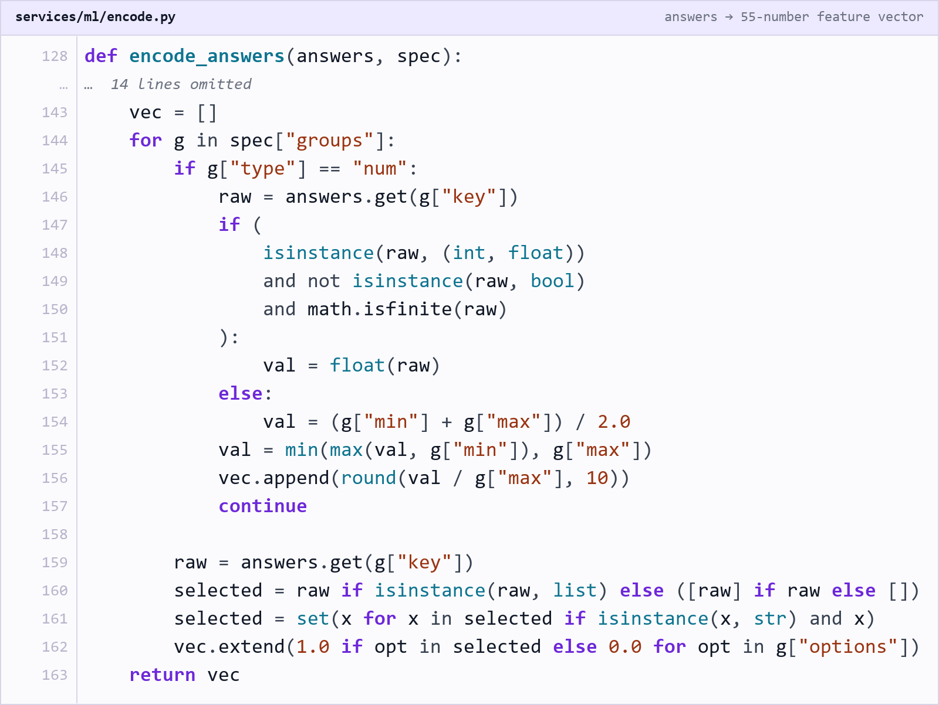
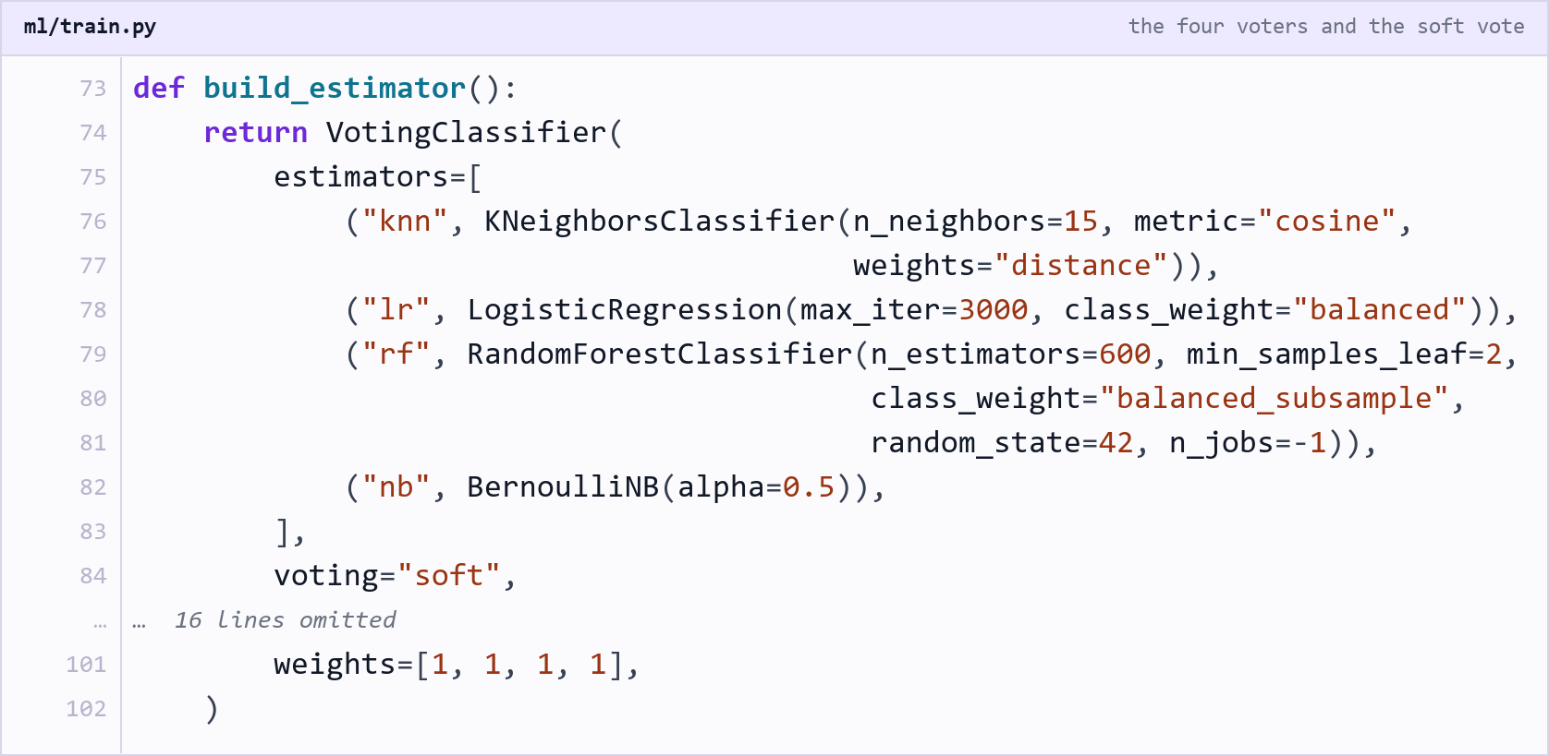
Introduction · Framework & data · Architecture · Descriptive analysis · Predictive analysis · Privacy · Admin · Findings · Future work
PREDICTIVE ANALYSIS · IN CODE
Steps 1 and 3, as they are actually written.
Step 1 — encode
Step 3 — vote
services/ml/encode.py One block of the vector per question. A categorical answer sets one position to 1; the 1–5 comfort rating is scaled into the same range. An unseen option contributes zeros rather than raising, so the rest of the answers still predict.
ml/train.py The four models are declared with their tuned parameters and combined under soft voting with equal weights, so the ranking is an average of four probability distributions rather than a majority vote on four separate answers.
Both extracts are rendered from the repository at build time, so a slide cannot show code the project no longer contains.

Slide 14
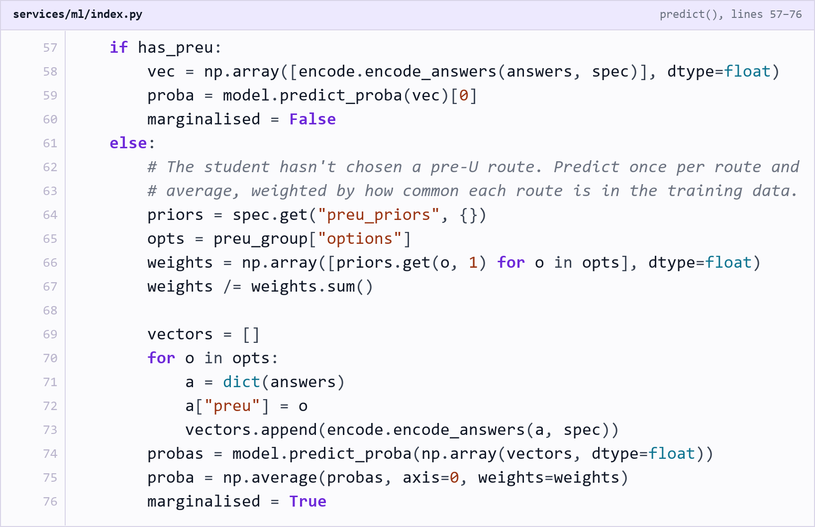
Introduction · Framework & data · Architecture · Descriptive analysis · Predictive analysis · Privacy · Admin · Findings · Future work
PREDICTIVE ANALYSIS · IN CODE
Step 4, where the two prediction paths split.
Step 4 — marginalise
One function, two paths
Line 57 is the whole branch. A student who has named a pre-U route is encoded once and passed straight through the ensemble — the 71.5% path.
Marginalised, not guessed
The else-branch predicts once for every route in the spec and averages the distributions, weighted by how common each route is in the corpus. Nothing is imputed — the uncertainty is carried through the arithmetic.
The flag the interface reads
The response carries marginalised: true, which is what the results page turns into a visible notice. A student is told which of the two paths produced their shortlist.
services/ml/index.py — the model service, called over HTTP. The application never imports the model.

Slide 15
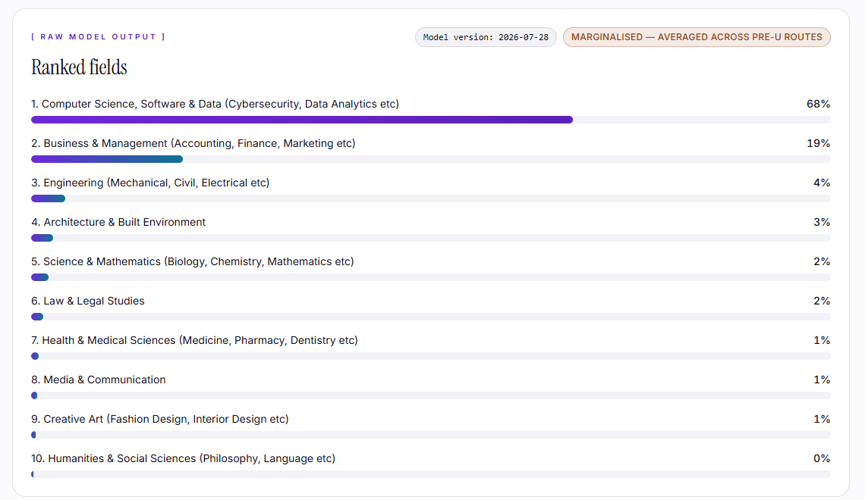
Introduction · Framework & data · Architecture · Descriptive analysis · Predictive analysis · Privacy · Admin · Findings · Future work
PREDICTIVE ANALYSIS · PART 3
The same model, run by hand.
Not a mock-up
The tester posts to the same /api/ml/predict endpoint the questions page uses, and prints the raw ranked probabilities before the interface rounds or annotates anything.
The shape of a real answer
A technical-stream preset returns Computer Science at 68%, Business at 19%, then a long tail under 5%. The top three carry the mass; the rest is reported as near-zero rather than padded.
Marginalised, and it says so
The badge on the output records that no pre-U route was given, so the prediction is an average across all five routes, weighted by how common each is, rather than a guess at which one the student will take.
/admin/algorithm-tester — posted to the live ML service, nothing stored
Model version is stamped on every run. A prediction made against an older artefact can be told apart from one made after a retrain.

Slide 16
Introduction · Framework & data · Architecture · Descriptive analysis · Predictive analysis · Privacy · Admin · Findings · Future work
PREDICTIVE ANALYSIS · SCOPE
What it is, in plain terms.
It is a comparison, not a verdict
Not a personality test
The output is “students who answered like you most often chose this”. The model has no opinion about what anyone should do, and the interface never phrases it as advice.
Nothing is inferred about character. The questions ask what someone did and what they enjoy, and the answers are matched to outcomes.
It is classification, not a score
Not a prediction of success
There is no aptitude number and no ranking of students. The model picks among ten fields; it never rates the person.
The model says where similar students went, not how well anyone will do there. It has no data on outcomes beyond satisfaction.
Top-3, because that is the honest unit
Not a substitute for a counsellor
A single answer would overstate the certainty available from 207 people. Three keeps the shortlist useful and truthful.
It is a starting shortlist backed by evidence, meant to inform a conversation rather than replace one.
Every one of these boundaries is enforced in the product copy, not just stated here — the results page never uses the word “should”.

Slide 17
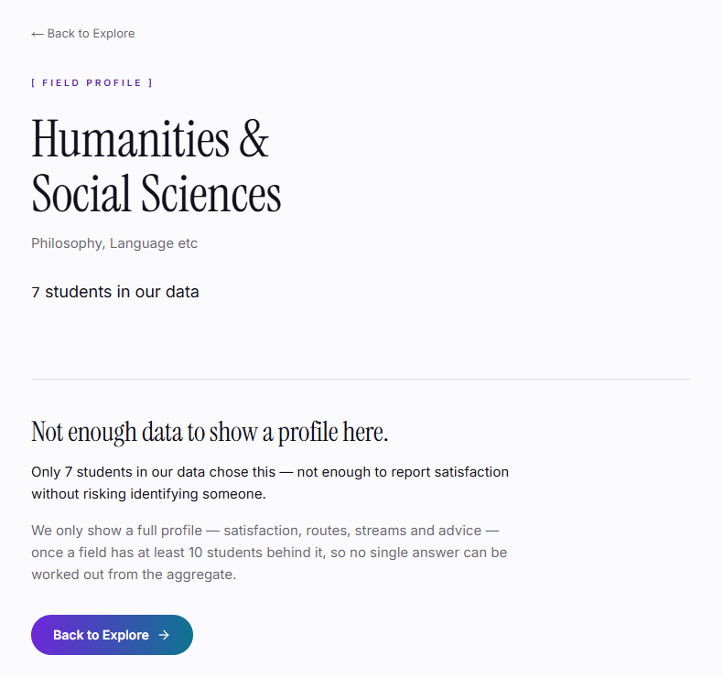
Introduction · Framework & data · Architecture · Descriptive analysis · Predictive analysis · Privacy · Admin · Findings · Future work
PRIVACY ENGINEERING
The data is 207 teenagers. It is treated that way.
k-anonymity
A field with fewer than 10 students publishes no statistics at all. It says so plainly rather than showing a number.
Count banding
Sample sizes appear as ranges — 10 to 19, 20 to 49 — never exact counts, so two pages cannot be subtracted.
Refresh gating
Published aggregates only move once at least three rows have changed, closing the temporal-differencing attack.
Row Level Security
A student can read only their own responses, enforced in Postgres — so an application bug cannot leak the rest.
Locked at the grant layer
Admin routes are guarded in the app and the tables are locked by database privilege. One is convenience; the other is the control.
The account is theirs
Name, email and password are the student’s to change, and deleting the account removes the responses and predictions.
/explore/humanities-social-sciences — 7 students, so nothing is published
Suppression, banding and the refresh gate each have a test that fails if a published number becomes more precise than it should be.

Slide 18
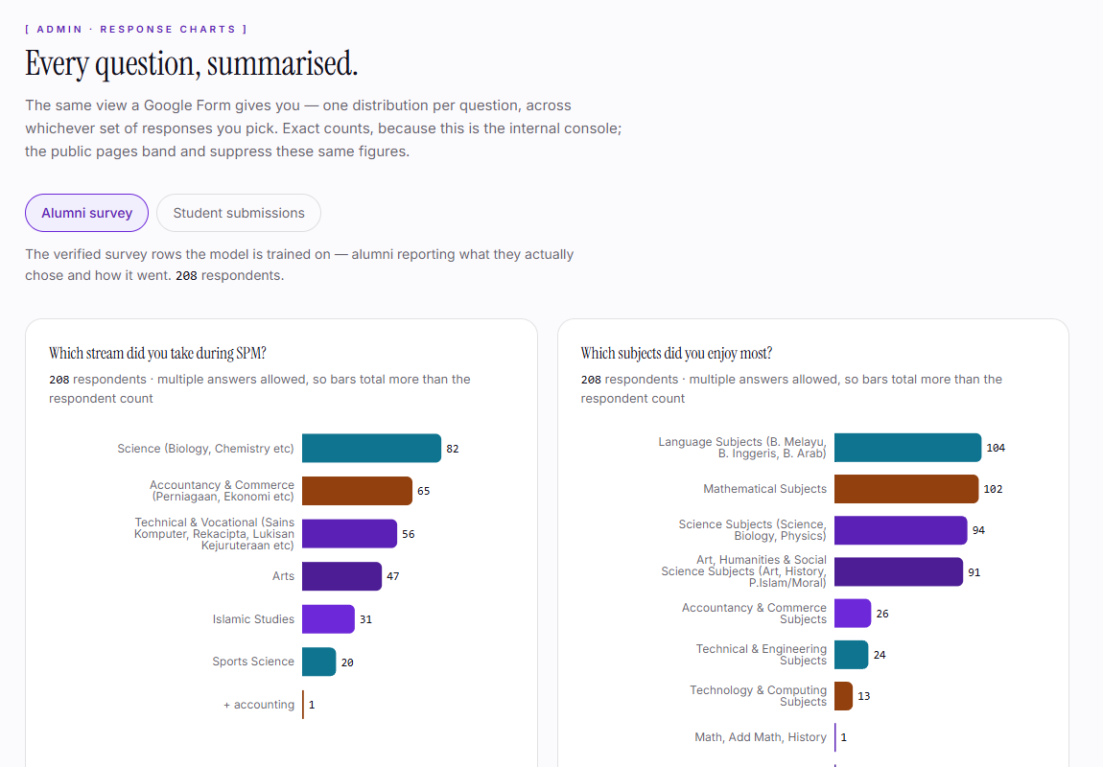
Introduction · Framework & data · Architecture · Descriptive analysis · Predictive analysis · Privacy · Admin · Findings · Future work
ADMIN CONSOLE
Six sections, behind a role flag.
Overview
Live counts, recent activity, and where students drop off.
Response Charts
Every question summarised as a distribution, Google-Forms style.
Survey Data
The corpus the model learns from, searchable and sortable.
Student Responses
Every submission with the prediction it produced, opened row by row.
People
Accounts, display names and who has admin access.
/admin/response-charts
Access control
Algorithm Tester
Enter answers by hand and watch the model rank them live.
Entry is a discreet Admin button in the site footer — present for an admin, absent from the page entirely for everyone else, not merely hidden with CSS. Verified against production: the demo student account is redirected away from every admin route.

Slide 19
Introduction · Framework & data · Architecture · Descriptive analysis · Predictive analysis · Privacy · Admin · Findings · Future work
QUALITY AND VERIFICATION
What has actually been proven.
370
36
106
11
JavaScript tests passing
Python tests passing
commits
database migrations
Encoder parity
Privacy boundaries
Fixture tests pin the JavaScript encoder to the Python one, so the browser and the model can never disagree about what a student said.
Suppression, banding, and the refresh gate each have tests that fail if a published number becomes more precise than it should be.
Role separation
Full journey
A further 13 tests drive the real production site. They are skipped, not silently passed, when no production credentials are present.
Login through to a stored result, driven in a real browser.
Re-derive rather than trust: npm test · python -m pytest · ls supabase/migrations/*.sql. 382 JavaScript tests are defined; 370 run without production credentials.

Slide 20
Introduction · Framework & data · Architecture · Descriptive analysis · Predictive analysis · Privacy · Admin · Findings · Future work
FINDINGS
What the data and the model actually showed.
The corpus is uneven, and the product admits it
Satisfaction is not uniform, so it is published
Staying in your SPM stream does not predict happiness
Field counts run from 44 down to 7. Two fields sit below the k = 10 threshold and publish nothing at all rather than a statistic drawn from single figures.
Media & Communication averages 4.61 of 5 (100% rating 4 or 5); Engineering averages 2.83 (39%). Every match carries its own satisfaction figure next to the percentage.
Related 3.45 of 5 against unrelated 3.80. The stream alone is a poor guide, which is why the model matches on all ten answers rather than routing by stream.
Accuracy is measured, not advertised
The honest unit is three fields, not one
Every published number is traceable
Top-3 accuracy is 71.5% with a stated pre-U route and 63.7% without, by repeated stratified cross-validation. Both are re-runnable from ml/measure_paths.py; neither is published in the product.
At n = 207 the confidence interval is about six points. A single named field would claim a precision the sample cannot support.
Descriptive figures come from decks/describe_corpus.py, accuracy from ml/measure_paths.py, counts from the test runners — all committed, all re-runnable.
The descriptive findings above are what justify the design decisions on the previous slides — they were not written to fit them.

Slide 21
Introduction · Framework & data · Architecture · Descriptive analysis · Predictive analysis · Privacy · Admin · Findings · Future work
FUTURE WORK
What 207 students cannot yet tell us.
Grow the corpus
Automate the retrain
Outcomes beyond satisfaction
The sample is the binding constraint on everything else. At roughly a thousand rows the two suppressed fields become publishable and the confidence interval narrows from about six points.
The manual gate exists because a small batch can move accuracy by more than the noise floor. Once the corpus is large enough that it cannot, the export-refit-redeploy chain can run unattended.
The survey knows whether a student is glad of the choice, and nothing about employment, earnings or time to graduate. Those are the questions students ask next.
Widen the questions
Follow the same students
Independent evaluation
Cost and location are the two reasons students give for a choice that the current ten questions do not capture at all.
Satisfaction was captured once. Re-asking a year on would show whether it holds, and would turn a snapshot into a trend.
Cross-validation measures the model against its own corpus. A held-out cohort from a different intake year would measure it against the world.
Nothing on this list is blocked by the architecture. Every one of them is waiting on more students answering the same ten questions.

Slide 22
WHAT MAKES IT DEFENSIBLE
It says “students like you chose this.”
It does not say “you should study this.”
Nothing in the model is a rule someone wrote down — every relationship was learned from what 207 real students did.
Fields with too few students show an honest message, never an invented statistic.
Every number on screen can be traced back to the students it came from.
arah-sand.vercel.app

