Slide 1

REVIVING LE MINITEL
Notes:
Hi !
I’m Frédéric BISSON, a french engineer. I work for the city of Rouen (Normandy).
My interest for the Minitel started when my employer decided to give away its old french little boxes.
Before that I had nearly never touched a Minitel.
Collecting for collecting would be meaningless if I did nothing with them.

Slide 2
Summary
How France conquered the world
How it worked
HTML5 and ES6 to the rescue
Creating a VideoTex page [live demo]
Surfing on Minitel [live demo]
Notes:
We’ll start with a brief history of Le Minitel and how France conquered the world.
Next, you will have a glimpse of how it worked and how it can be emulated in a standard web browser.
I'll end this presentation with two demos : how to create a Minitel page and how to surf on Minitel services nowadays

Slide 3
How France conquered the World
Notes:
Yes France nearly conquered the World!

Slide 4
France was REALLY late (late 1960s)
Household equipment
  USA = 90,5 %
  France = 15,2 %
Installation time
  USA = 3 days
  France = 3 years
QoS
  less than 60 % of calls succeeded
Notes:
Late 1960s, France was really, really late on telephony.
At this time, only 15% of french households were equipped while 90% of their American counterpart where.
You needed 3 years, no joke, to get a phone line at home.
And quality of service was so low that more than 40% of calls did not succeed.

Slide 5
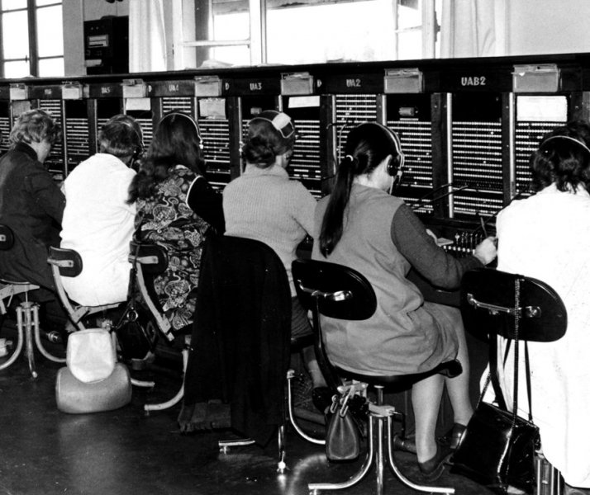
So what?
Manual switching until the late 1970s!
  First automatic switch was tested in 1912
  France is completely automated in 1978
Up to 30000 operators
  ~100 subscribers / operator
  < 400 calls / hour / operator
But France has a super plan!
Notes:
The last operator worked until 1978 thought the first automatic switch was tested in 1912, 66 years before!
Up to 30000 operators were employed, making each call much more expensive than everywhere else.
But, fear not my friends, France had a super plan!

Slide 6
Catch up and take the lead!
Late 1960s, a decision is made
1972, DGT becomes the first investor in France
Direction Générale des Télécommunications / General Direction of Telecommunications
1978, PSTN is complete
Réseau Téléphonique Commuté RTC / Public Switched Telephone Network
1978, Transpac is born
French packet switched network based on X.25
Notes:
We took over the world with the best technology of all time : French technology.
And that needed a lot of money. Telecommunications became the first investor in France.
In less than 10 years, the public switch telephone network was completely automated and Transpac was born.
Transpac is the french packet switched public network based on X.25, a technology so much better than TCP/IP.

Slide 7
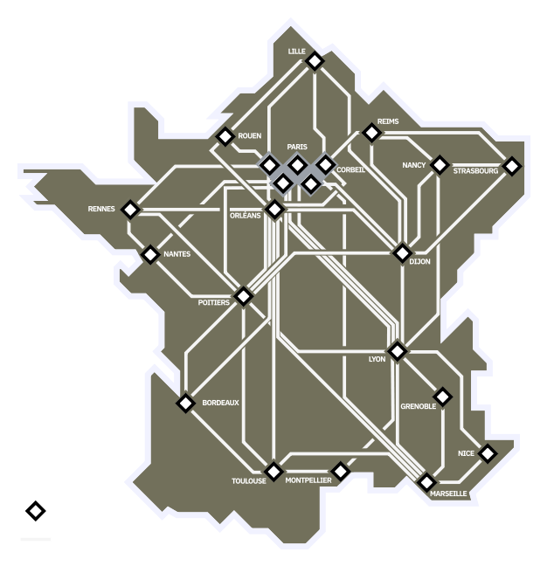
Transpac
A public network: RCP
packed switched network, virtual circuit, X.25
Variable rate
50 bits/s to 64000 bits/s
Heterogeneous
direct access, modem, Telex…
New pricing
depends on rate and connection time, does not
depend on distance
Notes:
Transpac allowed from 50 bits/s (because of Telex) to 64000 bits/s.
It was heterogeneous, meaning you could access it directly, via a modem or with Telex.
Its pricing was really innovative at the time : it did not depend on the distance, only on rate and connection time.

Slide 8
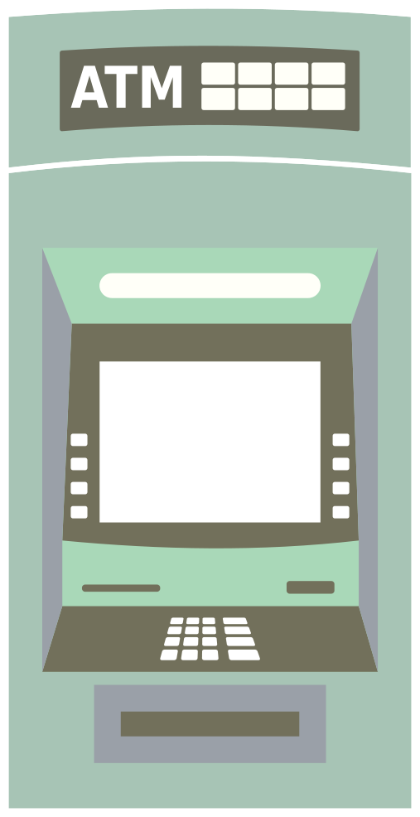
What could you do with Transpac?
B2B applications
  Links between agencies (banks, insurance…)
  ATM machine
  Payment terminal
B2C applications
  Minitel
Notes:
For B2B applications, you could link agencies across France, connect ATM machine, payment terminal for example.
For B2C applications, it was Le Minitel realm.

Slide 9
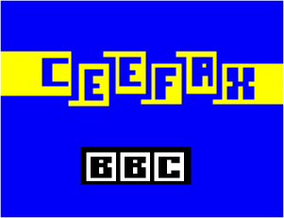
Here comes the Minitel!
Minitel = television + network + computing
  1974, BBC’s Ceefax
  1979, CCETT’s Antiope
Getting it adopted by the French is not an easy task
  Micro-computing is hard to grasp
  Micro-computing is expensive
  Nobody dreams of network
Notes:
Le Minitel was a Videotex screen with a keyboard connected to the network with an internal modem.
The main task was to get it adopted by the French. Back then, very few households had a micro-computer : it was expensive and difficult to use.
And nobody dreamed of network.

Slide 10
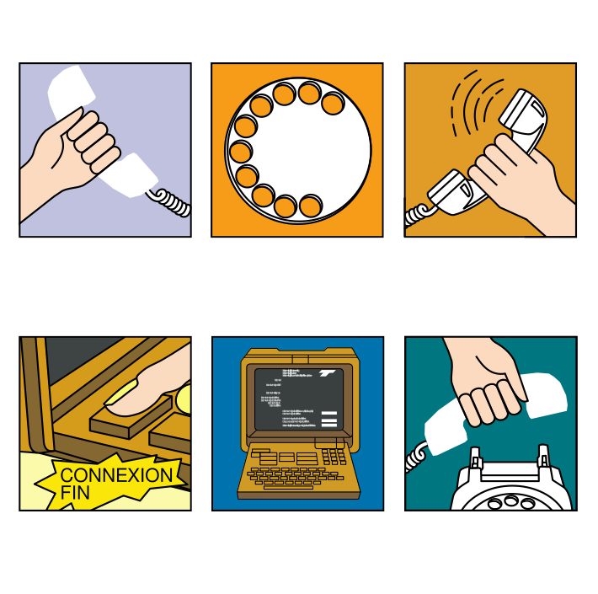
Make it easy to use
A simple terminal
  zero maintenance, zero config
  easy to install and use
One killer app
electronic telephone directory
Ad campaign
A FREE terminal
free as in free beer!
Notes:
But don't forget the great French mind! We knew how to make Le Minitel a success.
First, Le Minitel was a plug and play terminal. Zero configuration, zero maintenance.
Second, it needed a killer app : the electronic telephone directory which gave access to the phone numbers of all France while the standard telephone directory gave you only the phone number in your region.
Third, Le Minitel was handed free! You read right, free as in free beer.

Slide 11
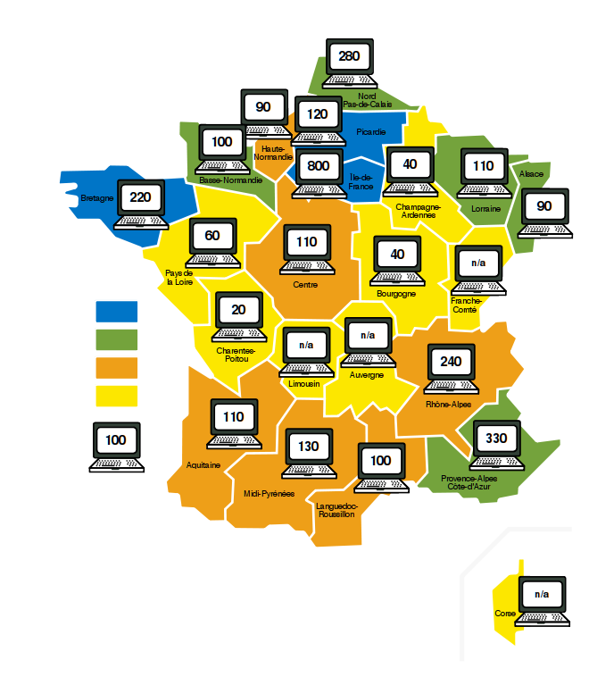
Minitel everywhere
1 Minitel = 260 €
750 M€ on the map
In 1993
  6.5 millions of Minitel
  500000 internal cards
Paid by the French state
Need to get the money back
Notes:
1 Minitel cost 260€, entirely paid by the French state.
In 1993, 6.5 millions of them were installed in households.
And the French needed to get the money back.
It did so by introducing the Kiosk, a catalog of services paid by time spent.

Slide 12
How it worked

Slide 13
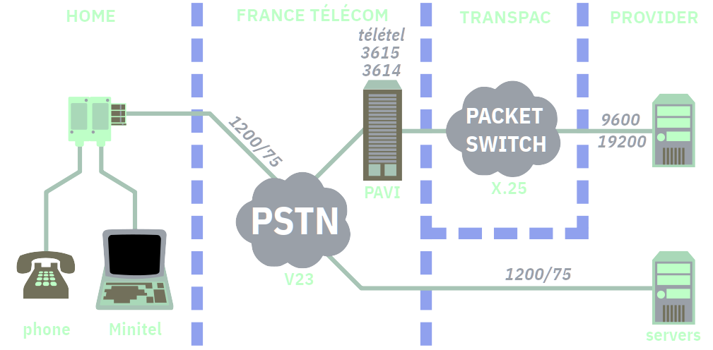
The Minitel network
Notes:
This is a schema of the Minitel network.
On the left, at home, there was the Minitel and a telephone. The telephone was used to dial the number.
The phone line was then used to go through the Videotex access point or PAVI in French. The PAVI connects the PSTN to the packet switched network.
It housed the electronic telephone directory and, most importantly, it handled all the billing.
Servers directly connected to the PSTN avoided the Transpac network but were very limited in the number of lines they could handle.

Slide 14
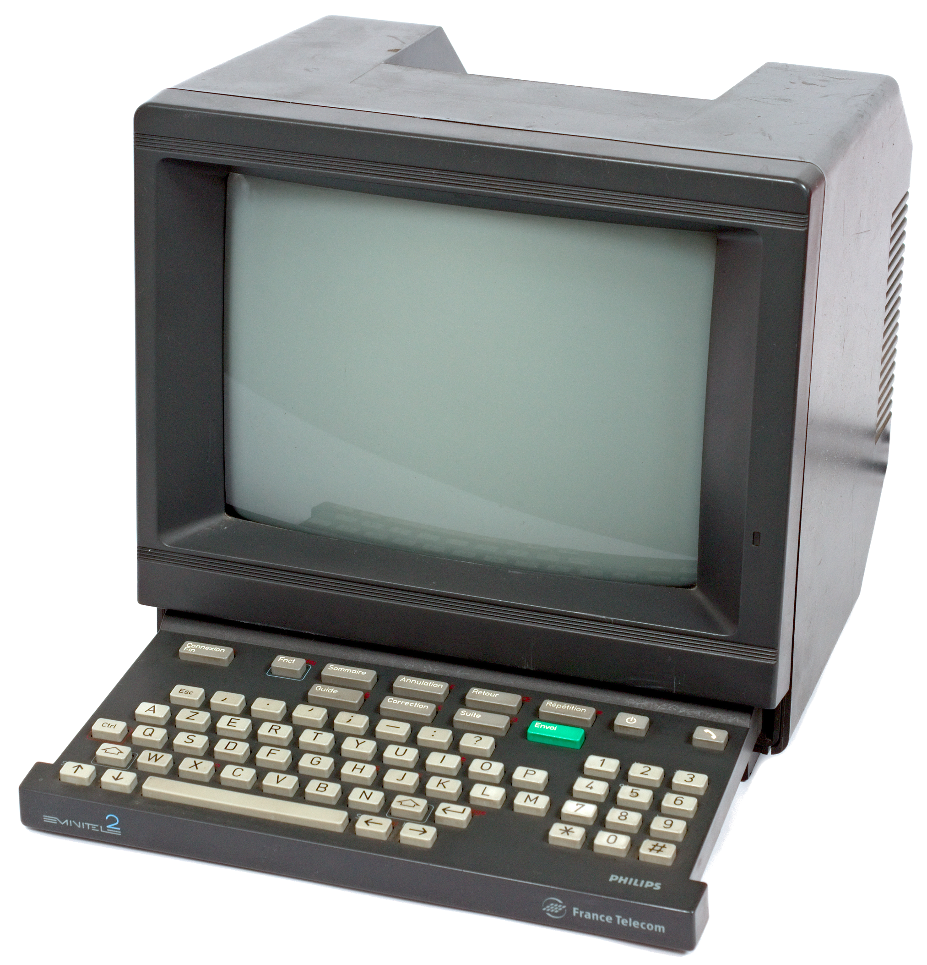
Le Minitel
A b&w passive terminal
7 bits, uses Videotex
40 columns for 25 rows
320 × 250 pixels, semi-graphic
8 colors
though displayed as 8 shades of gray
Rate
↓ 1200 bits/s, ↑ 75 bits/s
Notes:
Le Minitel itself is a black and white passive terminal which communicates in 7 bits Videotex.
Screens are composed of 40 columns for 25 rows. This gives an actual resolution of 320×250 pixels.
It can display 8 colors : black, red, green, blue, yellow, cyan, purple and white.
It can download at 1200 bits/s and upload at 75 bits/s. 75 bits is approximately 7 characters per second which was considered enough for the keyboard.

Slide 15
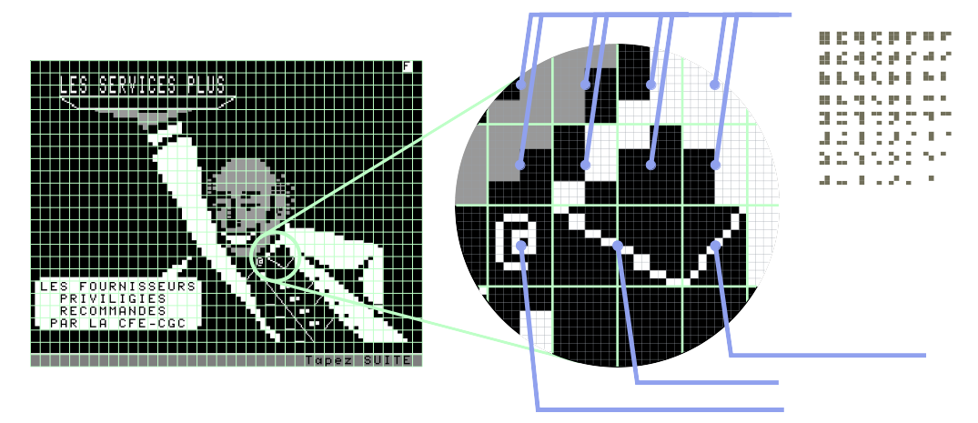
Semi-graphic
Notes:
To overcome the limitation of text screens, Videotex has 64 special characters. They are the 64 combinations of a character divided into 2×3 blocks.
In order to get the best out of Videotex, you had to combine mosaic characters with ASCII characters.
In this example, the button is an at sign.

Slide 16
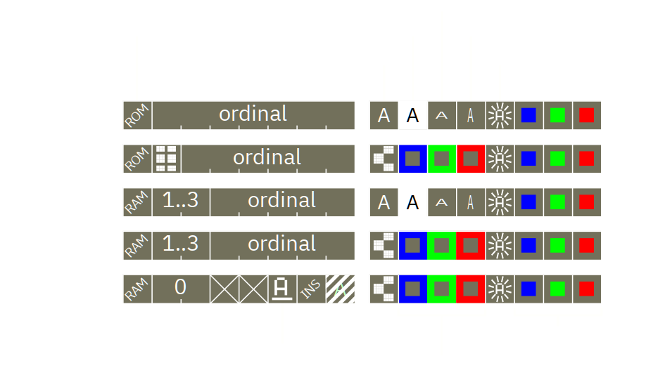
A complex set of attributes
Notes:
Videotex uses a complex set of attributes. They are coded internally on 16 bits.
The engineers played with constraints to be able to display up to 449 characters on a screen while having 8 colors, mosaic characters, blinking, underlining, double width, double height, video inversion.

Slide 17
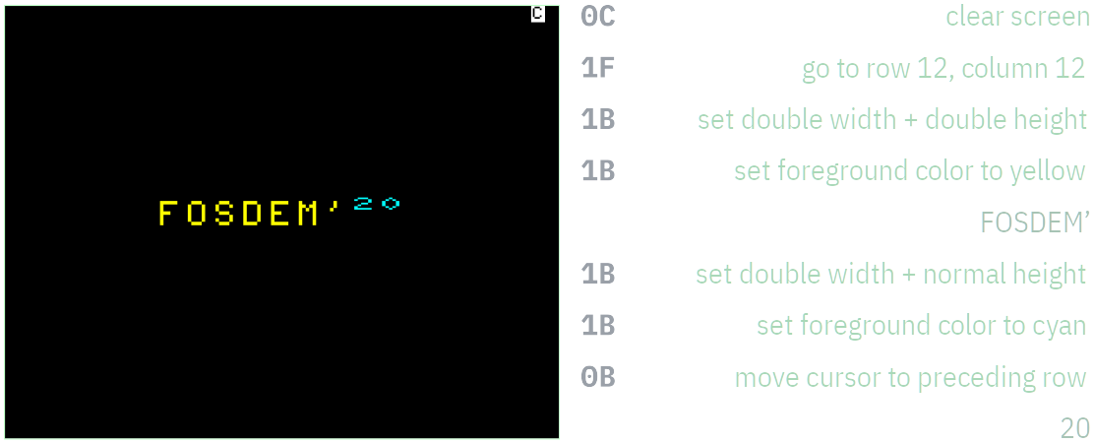
What Videotex stream looks like
Notes:
This slide shows what Videotex stream looks like. For those familiar with ANSI console, this is the same principle but with different capabilities.
Characters before the space are control characters which are not visible but change the terminal behaviour.

Slide 18
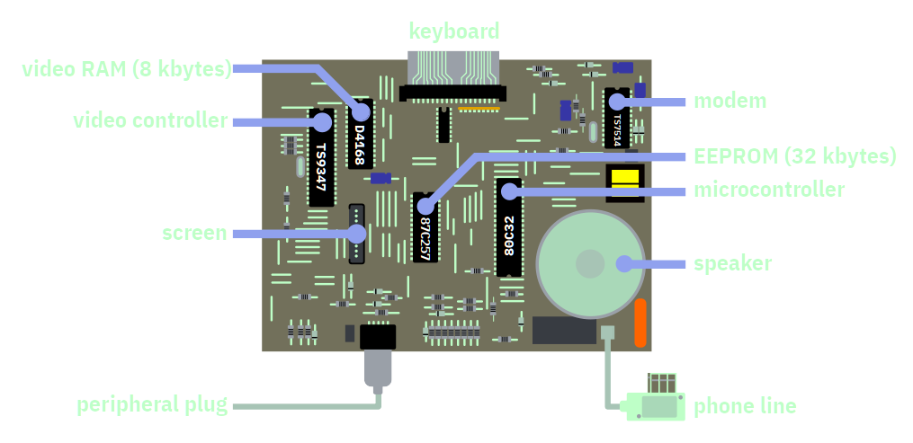
Minitel 2 hardware
Notes:
At the hardware level, Le Minitel is close to a computer, a computer your cannot reprogram.
The processor is a micro-controller to which the modem, the speaker, the keyboard and the video chipset are connected.

Slide 19
The enemy brothers
Web (<HTML5) | Minitel
client initiates request | full duplex
no state | continuous
separation of content and presentation | graphics and text are the same
hyperlink | no hyperlink
hardware agnostic | tied to hardware
HTML, CSS, JS | Videotex
Notes:
Web and Videotex are very different.
On the web, the browser initiates the request. On Minitel, communications are full duplex : the server may send data whenever it wants.
The web has no state while the Minitel uses a continuous stream.
The web separates content and presentation. Not the Minitel.
The greatest advantage of the web is its hyperlink system which the Minitel sadly lacks of.
It is also hardware agnostics contrary to the Minitel.

Slide 20
What’s needed to emulate a Minitel
A widely available platform
Specific capabilities
  asynchronous communication
  graphic primitives
Identifying essential parts
  Videotex interpreter
  video controller
  a Minitel service to connect to
Notes:
To emulate the Minitel, we need to satisfy some points.
The platform should be widely available, otherwise the World won’t be able to enjoy the greatness of Le Minitel.
It should be capable of asynchronous communication, of graphic primitives to look as closely as possible like Le Minitel.
The best is to work on three parts : the Videotex interpreter, the video controller and a Minitel service to connect to.

Slide 21
HTML5 and ES6 to the rescue
Notes:
Happily, we now have HTML5 and ES6!

Slide 22


HTML5 and ES6
HTML5 brings essential elements
  Minitel screen → canvas
  keyboard click → audio
  phone line → WebSocket
ES6 brings lots of programming facilities
  promises
  functional approach
  etc.
Notes:
With HTML5 we now have canvas to draw the Minitel screen, audio to have the keyboard click of the Minitel and WebSocket to emulate the phone line.
ES6 bringes lots of programming facilities like arrow functions, promises, a more functional approach etc.

Slide 23
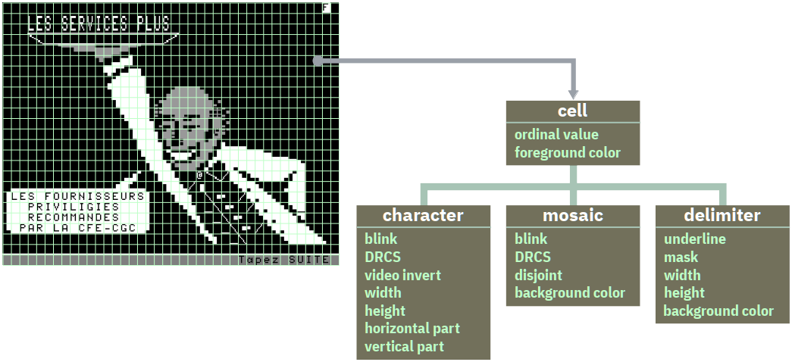
The video memory
Notes:
The video memory uses the object model of ES6. Each cell may be a standard character, a mosaic character or a delimiter character (the space character).
Each of theses children has specific attributes.

Slide 24

Video Display Unit (VDU)
Refreshes 50 times/second
  draws modified rows
  draws blinking characters
Draws characters given their…
  fore/back color + video inversion
  underline
  size
  mask
Notes:
The video display unit looks into the video memory 50 times per second. It draws modified rows and rows containing blinking characters.

Slide 25
Creating a Minitel page
(demo)
Notes:
Let's see it in action by creating a Minitel page.
The MiEdit Minitel editor URL is https://zigazou.github.io/miedit

Slide 26
Surfing on Minitel
(demo)
Notes:
Let’s go surfing on the good old Minitel

Slide 27
Resources
MiEdit and emulator
  sources → https://github.com/Zigazou/miedit
  online → https://zigazou.github.io/miedit/
Minitel font
  sources → https://github.com/Zigazou/Minitel-Canvas
PyMinitel
  sources → https://github.com/Zigazou/PyMinitel

Slide 28
THANKS FOR WATCHING!
Many thanks to Christian Quest for his invaluable help
Thanks also go to Julien Mailland
Contact me
  Twitter → @zigazou
  Mail → zigazou@free.fr

Slide 29
Minitel services… alive!
Name | Web | Phone
Electronic telephone directory | http://3611.re/ | +339 7227 3671
3615 code | http://3615co.de/
3614 Hacker | http://www.3614hacker.fr/ | +339 7252 7252
3614 Teaser | http://www.3614teaser.fr:8080/
3615 SM | http://sm.3615.live/
Eureka | http://eureka.rxl1.com/emul/
Jelora |  | +339 7262 9267
Computel (runs on a vintage Apple //e) |  | +331 8421 8116
JCA |  | +331 8421 8115
Cosmos 6502 |  | +331 8421 8124

