Slide 1
Tip / Head
☑ Ball
Dia □□
□ Ball
Pentration
Height
□□□□
Dia
□□
Min Angle
Height
□□□□
Dia
□□
Min Angle
Dia
□□
Dia
□□

Slide 2
Centre / Stem
Dia
□□

Slide 3
Base
Height
□□□□
Dia
□□

Slide 4
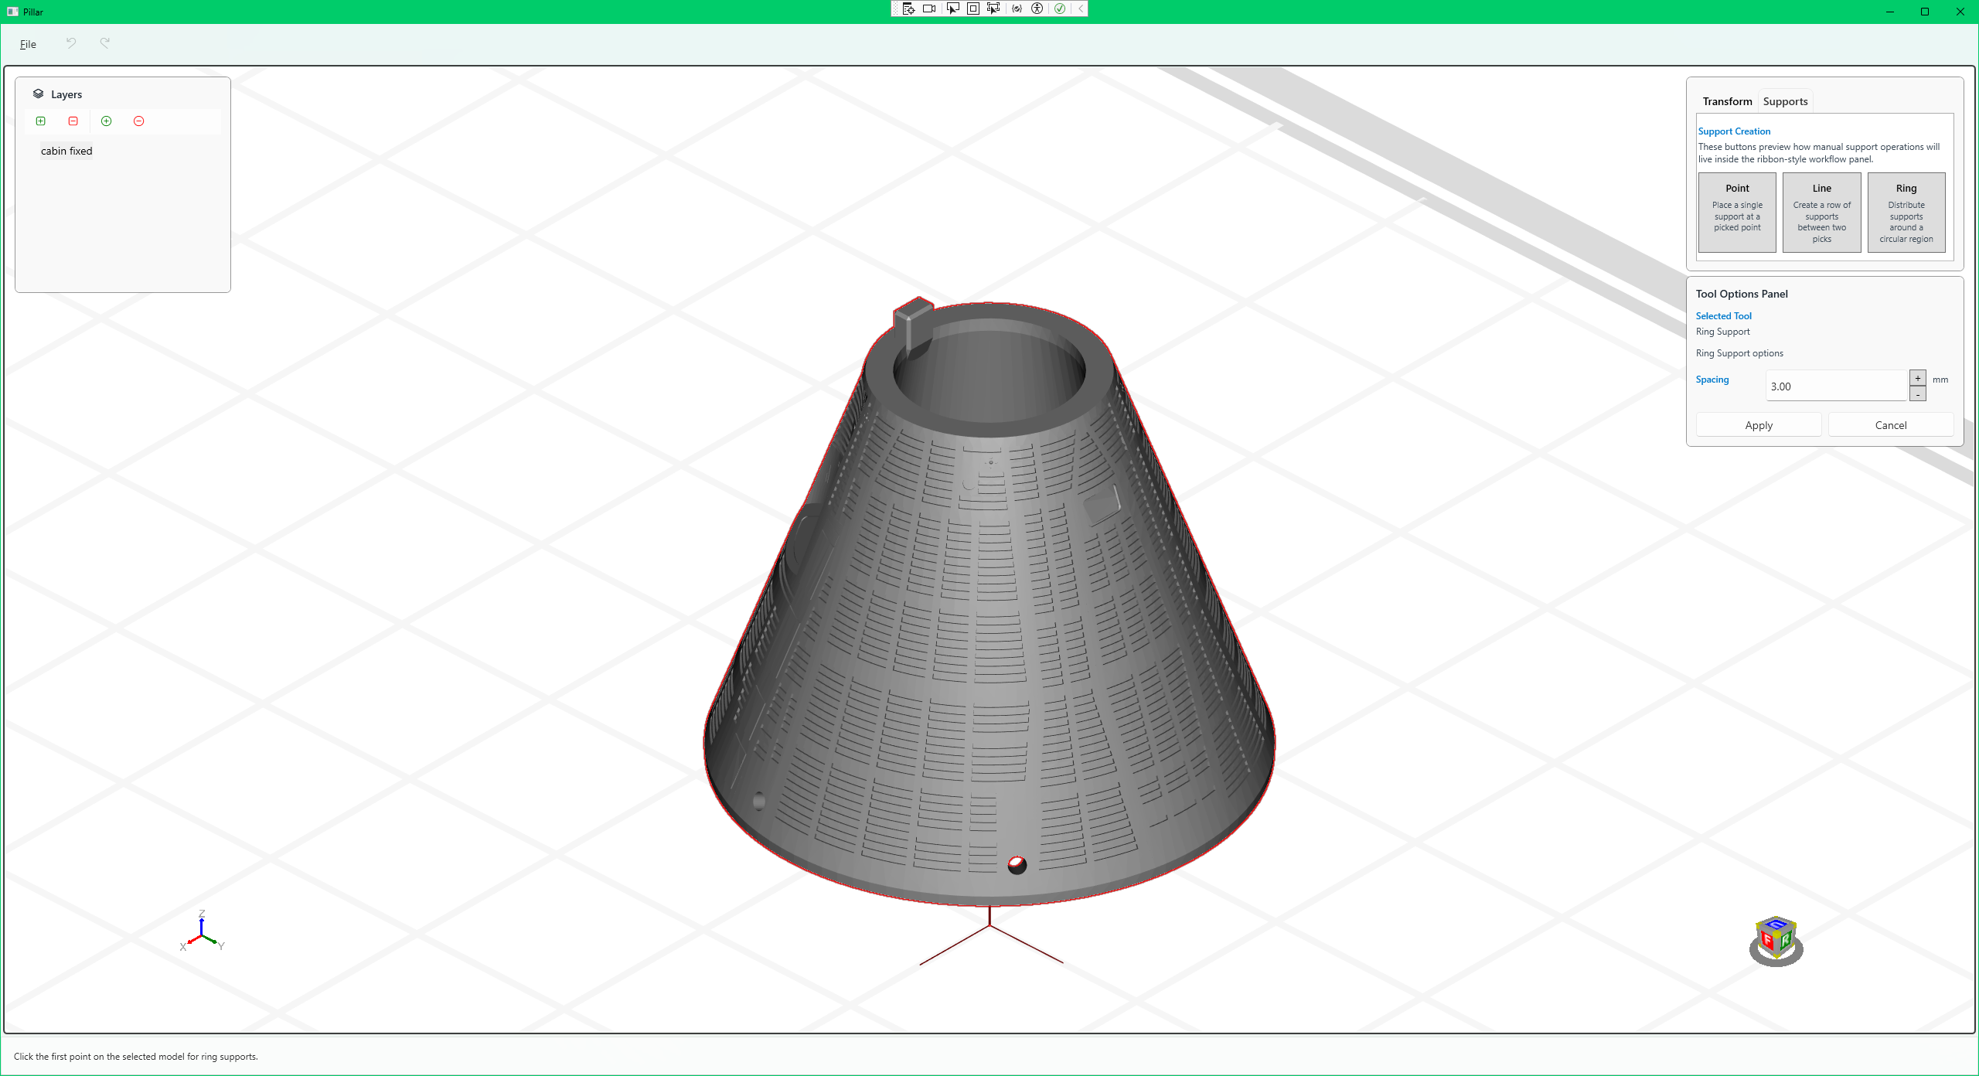
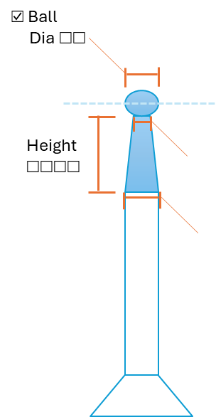
Support Preset
Medium
Advanced…

