Slide 1
What is a
Just culture?
Samuel Sidzyik
CSD-380

Slide 2
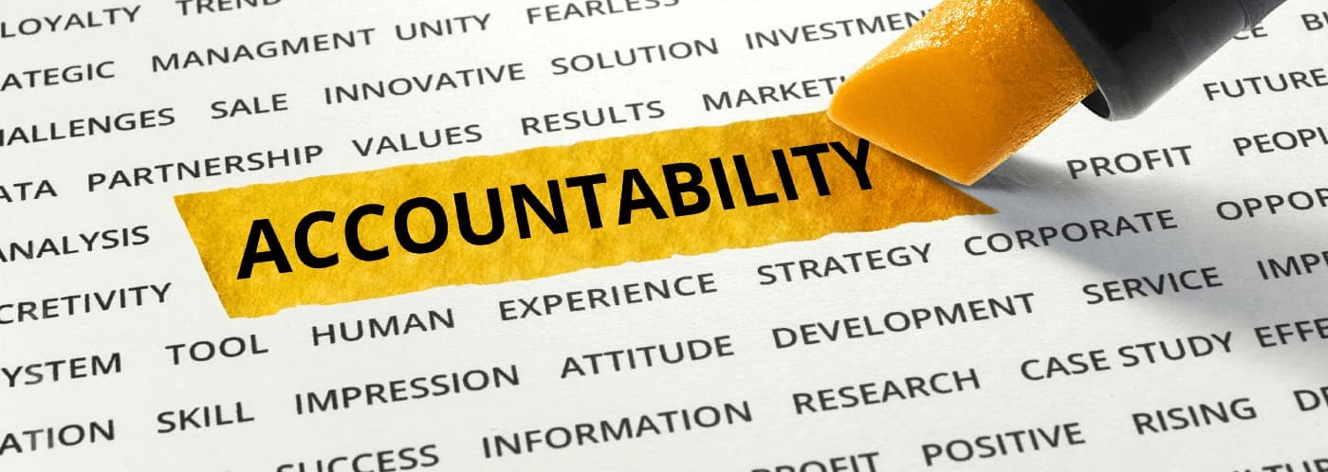
A Just Culture Is:
A just culture balances accountability with learning, ensuring individuals are not punished for honest mistakes while still addressing reckless behavior.
Purpose: Encourages reporting, transparency, and continuous improvement.
Core Idea: Shift from “Who is at fault?” to “What went wrong in the system?”
Why It Matters: Reduces fear, increases reporting, improves safety outcomes.

Slide 3
Why this won’t work at my company
Blame Culture: Long-standing habits of punishing errors discourage reporting.
  We JUST implemented a Reason/Resolution field for any defect that includes “Developer misunderstood Business requirements” and “Business did not accurately define requirements” So we can track WHO to blame.
Fear of Reprisal: Employees may worry about job loss, disciplinary action, or reputational damage.
Low Psychological Safety: Staff don’t feel safe speaking up.
Resistance to Change: “We’ve always done it this way” mentality.
(AKA) Cultural Barriers

Slide 4

Leadership & Management Barriers
-The Issues-
-What it feels like-
Inconsistent Leadership Messaging: Leaders say “report issues” but react punitively.
Lack of Training: Leaders may not understand just culture principles or how to apply them.
Accountability Confusion: Leaders struggle to differentiate human error, at‑risk behavior, and reckless behavior.
Competing Priorities: Pressure for productivity or compliance overrides learning-focused responses.
Office Space Clip - 8 Different Bosses

Slide 5
Legal & Regulatory Barriers
I work in insurance (Life, MedSup, Dental) so we are working with business teams that don’t walk on the cracks on concrete in case that breaks a law in a state we are trying to get approval in. (Only barely kidding)
Fear of Litigation: Organizations worry that admitting mistakes increases legal exposure.
Regulatory Pressure: Compliance requirements may push leaders toward punitive responses.

Slide 6
What We Need
Overcoming Barriers & Building a Just Culture would be a multi-year project that would require constant commitment and push from above. So many initiatives are canceled after 5 months if there aren’t instant results, so employees have become hesitant to jump 10 toes into new initiatives.
Leadership Modeling: Leaders must demonstrate non-punitive responses.
Clear Frameworks: Use structured decision tools (e.g., Just Culture Algorithm).
Training & Communication: Educate staff on expectations and protections.
Transparent Follow‑Through: Show how reports lead to improvements.
Continuous Reinforcement: Culture change requires repetition and consistency.

Slide 7
References
Examples of just culture are, and how to analyze them. (In Healthcare, but still applies)
https://oxford-review.com/the-oxford-review-dei-diversity-equity-and-inclusion-dictionary/just-culture-definition-and-explanation/
Where I looked for references. Just a good example of a simple breakdown.
https://en.wikipedia.org/wiki/Just_culture
What is needed to transform culture
https://www.prosci.com/blog/culture-transformation

